Slide 1
PIP-II Overview
Marc Kaducak
Risk Workshop
12-13 July 2018

Slide 2
Outline
Workshop Purpose and Objectives
Project Scope Overview
PIP-II Organization
Risk Categories of Current High Risks
Summary

Slide 3
Workshop Purpose and Objectives
Goal is to advance completeness, accuracy, and quality of the risk register
  Quantitative risk analysis required for CD-2
Objective is to generate a concise and actionable list of risks.
  Which risks are likely to have greatest impact?
  Where should we focus our efforts?
  Does our plan require adjustments?
Your expertise, experience, and candor are required to inform our risk assessment and mitigation plans.

Slide 4
Scope Overview

Slide 5

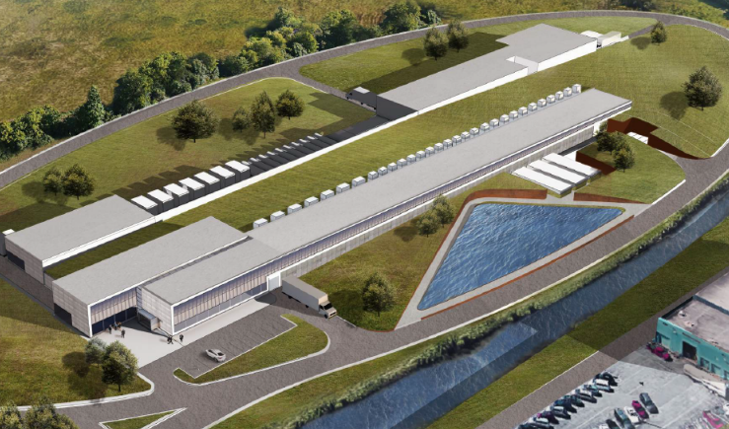
The PIP-II Project
Mission
PIP-II will deliver the world’s most intense beam of neutrinos to the international LBNF/DUNE project, and enable a broad physics research program, powering new discoveries for decades to come.
Goals
  Deliver 1.2 MW of proton beam power from the Main Injector over the energy range 60 – 120 GeV, at the start of LBNF ops
    Establish a platform for future upgrades to multi-MW capability
  Provide a flexible platform for extension of capability to high duty factor/higher beam power, multiple users and reliable operations
    Support the ongoing 8 GeV program, including an upgrade path for Mu2e
Building the world’s most powerful neutrino beam

Slide 6
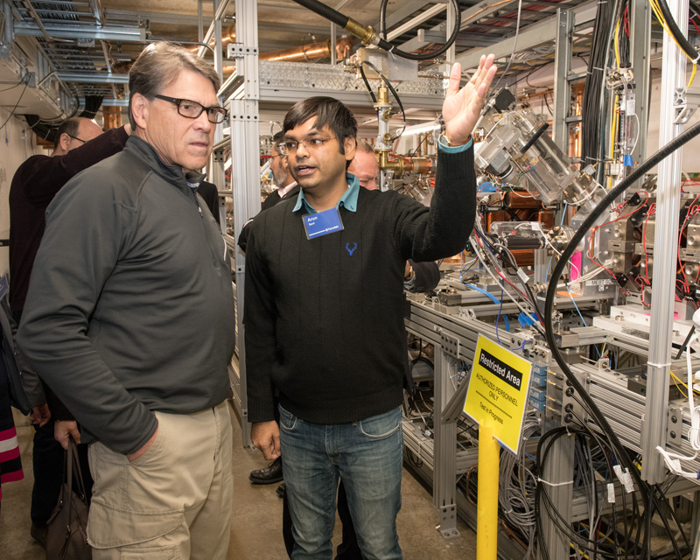
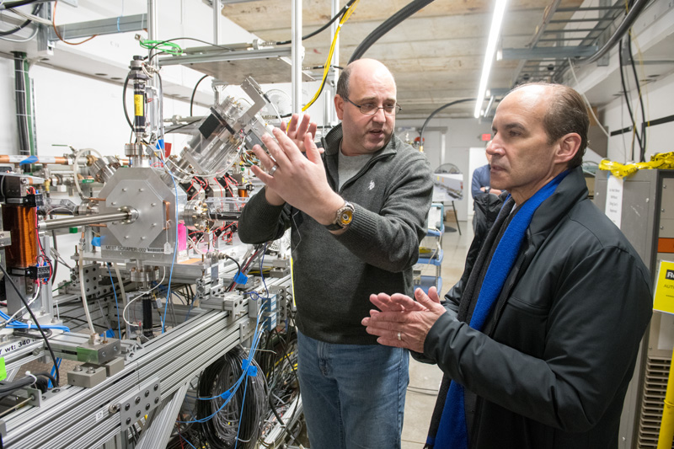
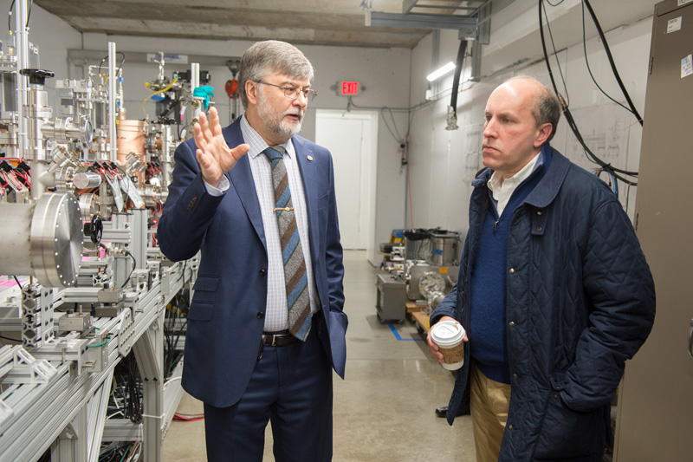
PIP-II is Building Momentum
FY18 funding for PIP-II:
$24M
Line item was created
Construction start
Enthusiasm and strong support from FNAL, OHEP, Office of Science, DOE, Congress
Successfully completed DOE ICR and IPR reviews – Dec 2017
Project is ready for CD-1 – ESAAB review in July 23
Launched CD-2/3a process: Goal is CD-2/3a in spring 2019
New organization and team members with focus on execution
DOE Secretary of Energy Rick Perry
DOE Under Secretary of Energy Mark Menezes
DOE Under Secretary for Science Paul Dabbar
Notes:
Energy Systems Acquisition Advisory Board
PIP-II is gaining momentum not only on the international front, but also on the domestic front:

Slide 7
Key Performance Parameters
# | Description of Scope | Threshold KPP | Objective KPP
1 | SRF linac | 700 MeV beam delivered to the Booster Injection Region | 800 MeV beam delivered to Booster Injection Region
2 | Booster/RR/MI upgrades | L11 Booster injection region, Recycler RF upgrades, and MI RF upgrades, hardware installed in respective machines. Linac beam injected and circulated in the Booster. | 8 GeV beam transmitted through Recycler and Main Injector, delivered to MI dump.
3 | Cryogenic Infrastructure | Cryogenic plant and distribution lines ready to support pulsed RF operation, and operated to 2 K. | Cryogenic plant and distribution lines ready to support CW RF operation, and operated to 2 K.
4 | Civil Construction | Tunnel enclosures and service buildings ready to support 700 MeV SRF linac and transfer line to the Booster | Tunnel enclosures to support 1 GeV SRF linac and transfer line to the Booster. Service buildings to support 800 MeV SRF linac and transfer line to Booster.
TPC Estimate based on Objective KPPs

Slide 8
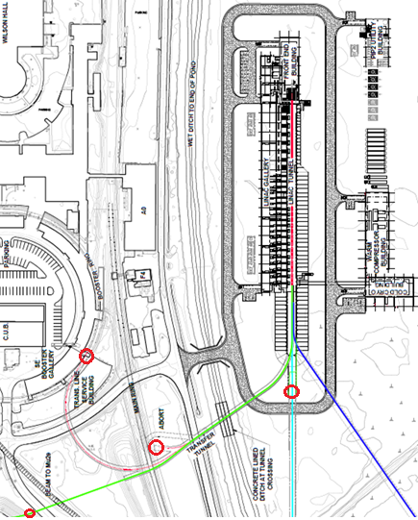
PIP-II Components
800 MeV linac
  Warm Front End
  SRF section
Linac-to-Booster transfer line
  3-way beam split to: (1) Beam
  dump, (2) Booster & (3) Mu2e-II
Upgraded Booster
  20 Hz, 800 MeV injection
    New injection area
    Resonant Magnet Upgrade
Upgraded Recycler & MI
  RF in both rings
Conventional Facilities
  Includes 2 empty slots at the
  linac end (L≈23 m)
  Up to 1 GeV
Cryogenic Plant

Slide 9
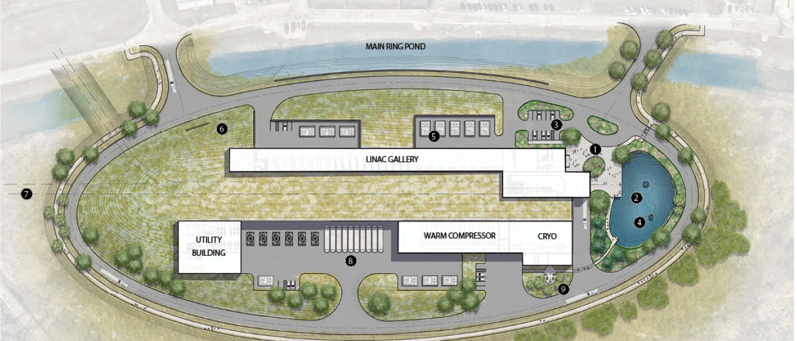
Site Plan

Slide 10

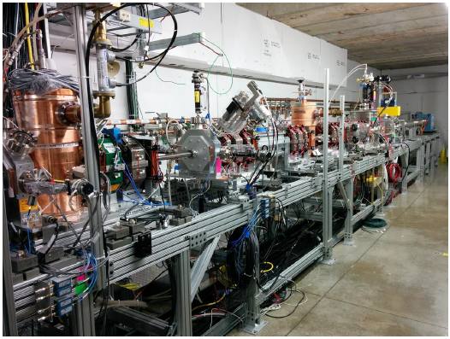
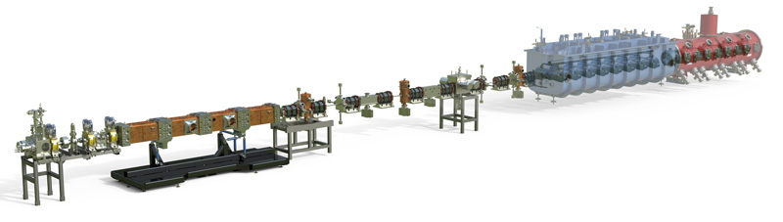
PIP-II has a mature, validated technical design
PIP2IT
PIP2IT is a complete systems-integration of the PIP-II Front End - coming to completion in FY21
Notes:
Working on vacuum bursts in RFQ, Alex.
Installing CDS
Getting ready for:
HWR cryomodule in fabrication
at ANL
SSR1 cryomodule being
prepared for string assembly at
Fermilab; will include ≥ 1 DAE cavities
PIP2IT will be reconfigured to test SRF CMs following tests of HWR and SSR1 with beam.

Slide 11
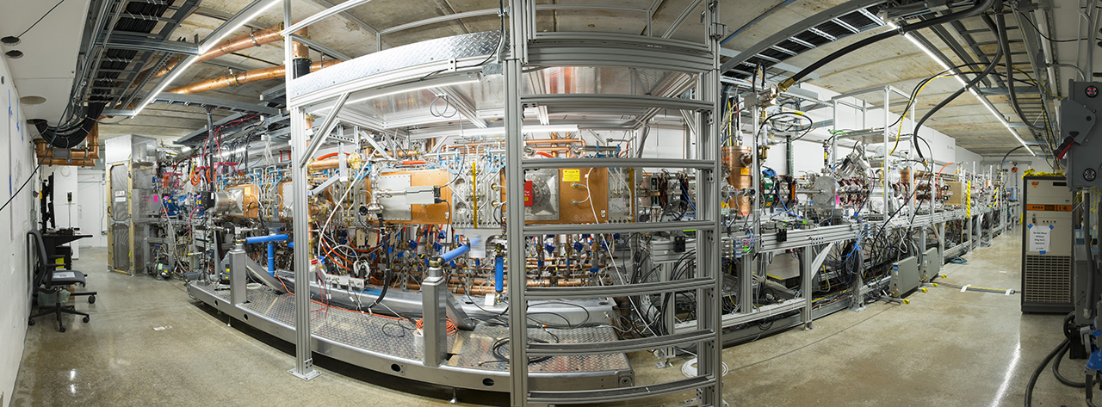
PIP-II Front End (Injector) Test
A collaboration of Fermilab, LBNL, ANL, SNS and Indian partners

Slide 12

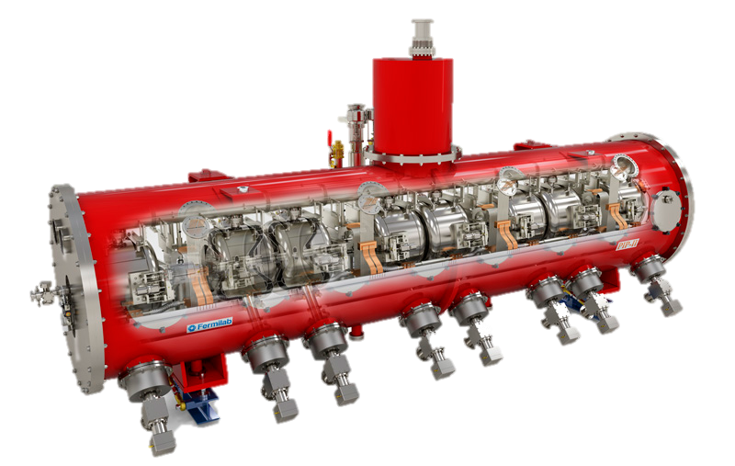
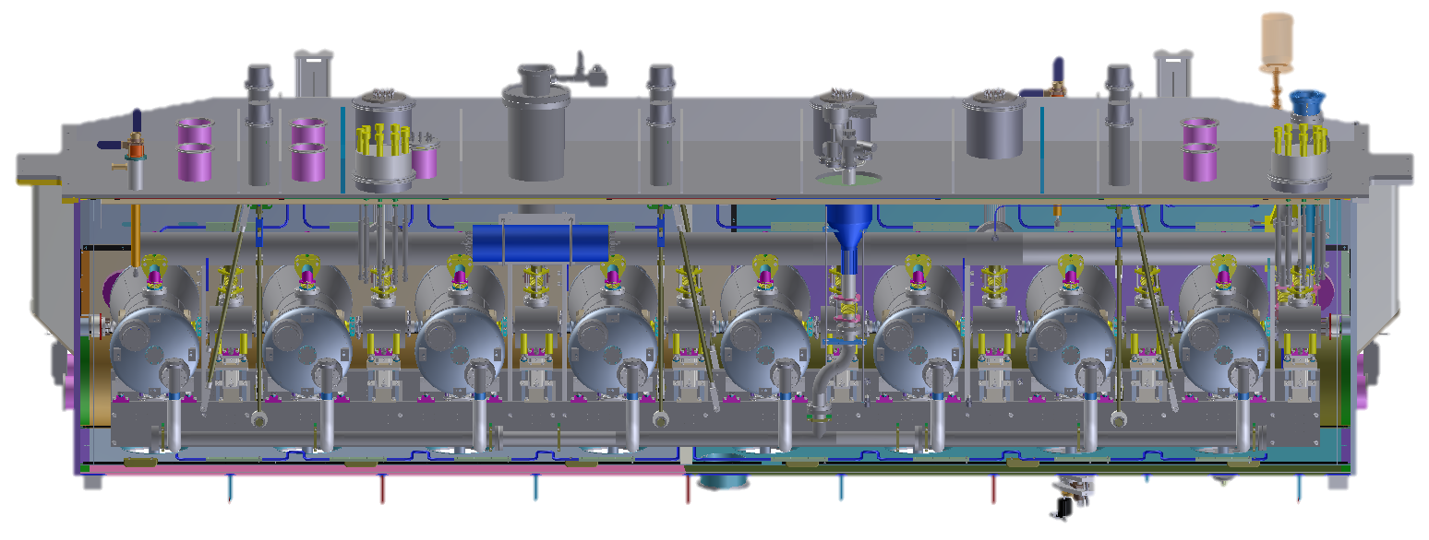
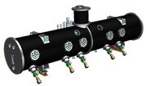

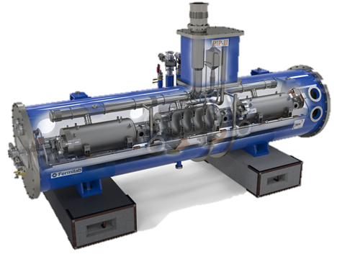


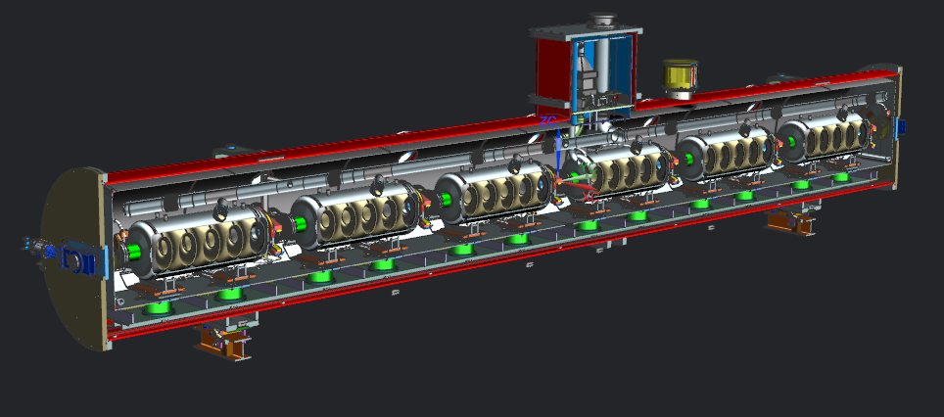

PIP-II SRF Linac & Areas of International Interest
HWR X 1
SSR1 X 2
SSR2 X 7
LB650 X 11
HB650 X 4
PIP-II is the first Accelerator Project in the U.S. with substantial International Contributions

Slide 13
Partner Deliverables: Assumptions / Strategy
HWR x1: CM from ANL. Full RF testing at Fermilab
SSR1 x2: 1 cavity in-kind, rest of cavities from US; 2 CMs from US.
SSR2 x7: All cavities in-kind; All CMs from US.
LB650 x 11: All cavities in-kind; All CMs in kind.
HB650 x 4: 3 CMs (including cavities) in-kind; 1 CM US
All amplifiers in-kind, except for HWR.
Cryoplant in-kind.
Our Strategy:
For all SRF systems, we will include effort by FNAL staff for design (in parallel or jointly with partners), participation in fabrication (at partners’ site, vendor…), assembly, testing at the partner site, and testing at our site.
  Redundancy, ownership, readiness to maintain/operate/repair, risk mitigation

Slide 14
Organization

Slide 15
PIP-II Project Management and Level 2 Systems/Managers
ADVISORY COMMITTEES
PIP-II Machine Advisory Committee R. Garoby
PIP-II Project Management Group R. Tschirhart
PIP-II Project
Lia Merminga
PROJECT DIRECTOR
US TECHNICAL COORDINATOR
TECHNICAL DIRECTOR Arkadiy Klebaner
PROJECT MANAGER Marc Kaducak
SPECIAL ADVISOR Steve Holmes
ANL SENIOR TEAM LEAD TBD
LBNL SENIOR TEAM LEAD TBD
ENVIRONMENTAL, SAFETY & HEALTH John Anderson Jr.
DOCUMENT SYSTEM MANAGER Traci Langford
EXECUTIVE ADMINISTRATION Traci Langford
ADMINISTRATION SUPPORT Tatiana Hamilton
FNAL SUPPORT
ACCELERATOR DIV M. Lindgren
TECHNICAL DIV S. Belomestnykh
CFO OFFICE V. Peoples
WDRS K. Van Vreede
CSO OFFICE M. Michels
COO OFFICE K. Gregory
CPO OFFICE R. Tschirhart
TECHNICAL INTEGRATION
Technical Director - A. Klebaner
PROJECT ENGINEER Allan Rowe
DEPUTY PROJ ENGINEER Jim Steimel
PROJECT SCIENTIST Paul Derwent
INTEGRATION COORDINATOR Alex Martinez
SRF COORDINATOR Jeremiah Holzbauer
PROJECT OFFICE
Project Manager - M. Kaducak
Deputy Project Manager – L. Lari
PROJECT CONTROLS MANAGER TBD
Project Controls Specialists J. Randall, M. Bossert
OPSS Consultant D. Hoffer
FINANCIAL MANAGER C. Jacobsen
PROCUREMENT MANAGER T. Powers (acting)
RISK MANAGER L. Lari (acting)
QUALITY ASSURANCE MGR J. Adetunji (acting)
INTERNATIONAL COORDINATION
IIFC TECHNICAL COORDINATORS S. Krishnagopal
S.C. Joshi
UK/STFC TECH. COORD’R P. McIntosh
ITALY/INFN TECH. COORD’R C. Pagani
FRANCE/CEA TECH. COORD’R O. Napoly
FRANCE/IN2P3 TECH. COORD’R D. Longuevergne
PROJECT MANAGEMENT
M. Kaducak
System Manager
SRF & CRYO SYSTEMS
G. Wu
System Manager
ACCELERATOR SYSTEMS
P. Derwent
System Manager
LINAC INSTALLATION & COMMISSIONING
F.G. Garcia
System Manager
ACCELERATOR COMPLEX UPGRADES
I. Kourbanis
System Manager
CONVENTIONAL FACILITIES
S. Dixon
System Manager
Yellow highlighted names belong administratively to PIP-II Division, rest are matrixed
PIP-II is building a strong, experienced, highly motivated team

Slide 16
Level 3 Systems & Managers
PROJECT MANAGEMENT
M. Kaducak
System Manager
SRF & CRYO SYSTEMS
G. Wu
System Manager
ACCELERATOR SYSTEMS
P. Derwent
System Manager
LINAC INSTALLATION & COMMISSIONING
F. G. Garcia
System Manager
ACCELERATOR COMPLEX UPGRADES
I. Kourbanis
System Manager
CONVENTIONAL FACILITIES
S. Dixon
System Manager
Project Management
M. Kaducak
HPRF, RF distribution
J. Steimel
Site Preparation
S. Dixon
Half-wave Cryomodule
Z. Conway (ANL)
WFE
L. Prost
Booster
W. Pellico
LLRF
B. Chase
Cryoplant Building
TBD
Technical Oversight & Integration
A. Klebaner
SSR Cryomodules
D. Passarelli
Test Infrastructure
J. Leibfritz
MI/RR
J. Dey
Magnets/PS
B. Hanna
Utility Plant Building
TBD
ESH&Q
J. Anderson Jr.
650 MHz Cryomodules
S. Chandrasekaran
Linac Commissioning
F.G. Garcia
Transfer Line/Beam absorber
M. Xiao
Vacuum
TBD
Linac Complex
TBD
Cryogenic Plant
Ben Hansen
Linac Installation
C. Baffes
Rings Installation
D. Morris
Controls
TBD
Booster Connection
TBD
Cryogenic Distribution
TBD
Safety Systems
R. Zifko
Building Infrastructure
J. Hunt
Instrumentation
V. Scarpine
Accelerator Physics
P. Derwent (act.)
Notes:
Point out Jim Steimel

Slide 17
Risk

Slide 18
PIP-II Project Challenges
Critical technologies
  Five (5) cryomodule types
  RF Amplifiers
  Resonance Control
  Limited resources, facilities availability
Complex construction
  Tunneling
  Multiple buildings
  Multiple utilities
  Interfaces with existing site and operations
International Partnerships
  Systems Engineering, QA
  Administrative, governance issues
  All partnerships involve critical technologies

Slide 19
Lessons Learned from ESS
Need strong In-kind management, installation coordination, and project engineering functions. Roles/responsibilities clear at host and partners.
Administrative delays, e.g. procurements, cash flow, VAT were significant
Communication:
  Collaboration meetings
  Build trust
  Lessons learned across entire project/collaboration
  Transparent status updates
Safety risks with interleaved equipment installation
Host needs to have continuous physical presence at partner sites
Avoid overly optimistic schedules, assumptions. Include adequate prototyping, testing.
Bringing foreign workers/trades to work at host site is not trivial.
Defining ownership of risk between host and partners is challenging.

Slide 20
Categories of High Risks in PIP-II Risk Register
Cryomodule system test failures
  Any of types (SSR1, SSR2, LB650, HB650) don’t meet performance requirements
  Resonance control and field regulation
  Pulsed and CW cryomodule operating modes cause cryogenic or mechanical instabilities
Individual components or subsystems fail tests
  Couplers, LLRF/RFPI, Power Amps, Circulators
  MI RF station power tubes
  Vacuum between MEBT absorber and SRF
Design decisions, systems engineering
  Technical Issues with International Deliverables
  Choice of laser profiling technology
  Incompatibility in high performance electronic systems
  Integration of instrumentation into MPS
  Subproject changes impact Conventional Facilities

Slide 21
Categories of High Risks in Risk Register cont’d
Production Schedules
  Insufficient cryogenic system vendor capacity and/or priority
  Insufficient cavity production delivery rate
  Insufficient cryomodule production rate
Interfaces within Fermilab
  Delay in access to SRF testing and fabrication infrastructure
  Insufficient Scientific, engineering, and technical human resources
  Failure of 650 MHz IOT Amplifiers @ MDB test stand
  Assumptions Document terms change
  Accelerator shutdown changes
Cost, Schedule, Management
  Increase in overhead rate
  Funding delays
  NEPA approval delay
  Currency fluctuation
  Delay in formalizing international in-kind contributions

Slide 22
Risks related to In-kind Deliverables
RT-121-01-01-002: Delay in formalizing international in-kind contributions
RT-121-02-01-002: Technical issues with in-kind deliverables
RT-121-02-01-006 Delay in in-kind deliverables
RT-121-02-03-002: Insufficient documentation for in-kind deliverables

Slide 23
Comments on International Risk Mitigation Plan
Mitigation Strategy | Actions, Status, Comments
Jointly agreed upon requirements and specifications for international deliverables | Recent strengthening of technical integration and systems engineering function.
Demonstration of international partners’ capabilities through the project development phase | Ongoing.
Validation of designs through formalized review processes | Ongoing development of systems engineering plan including well defined design review process.
Integration of international partners within the Project Quality Assurance Program | Project Quality Assurance under development.
Active coordination by technical managers | Revised list of US POCs for IIFC. Developing governance and coordination model across all partners.
Maximum possible advanced warning on delivery delays during the construction phase | Including progress milestones into schedule. Note: also applies to domestic procurements.
Multiple contributors and/or maintenance of redundant capabilities on critical systems | Under development. Also can create new challenges for QC across multiple suppliers.
Backup plans in the event of receipt of non-conforming equipment at Fermilab | Reaction time will not be instantaneous in most cases.

Slide 24
Summary
PIP-II is the first accelerator project in the US built with substantial international contributions
PIP-II is the “heart and soul” of Fermilab, and critical to the success of the U.S. neutrino program
PIP-II has many challenges that are new to us
Risk Management
  We have a mature risk management system, but it is only as good as the inputs
  We have identified many relevant risks, but we may be missing some important ones.
  Often the best input comes from outside the project team
Thank you for your participation

