Slide 1
PIP-II WB 121.06 Risk Overview
S. Dixon
Risk Workshop
12,13-Jul-2018

Slide 2
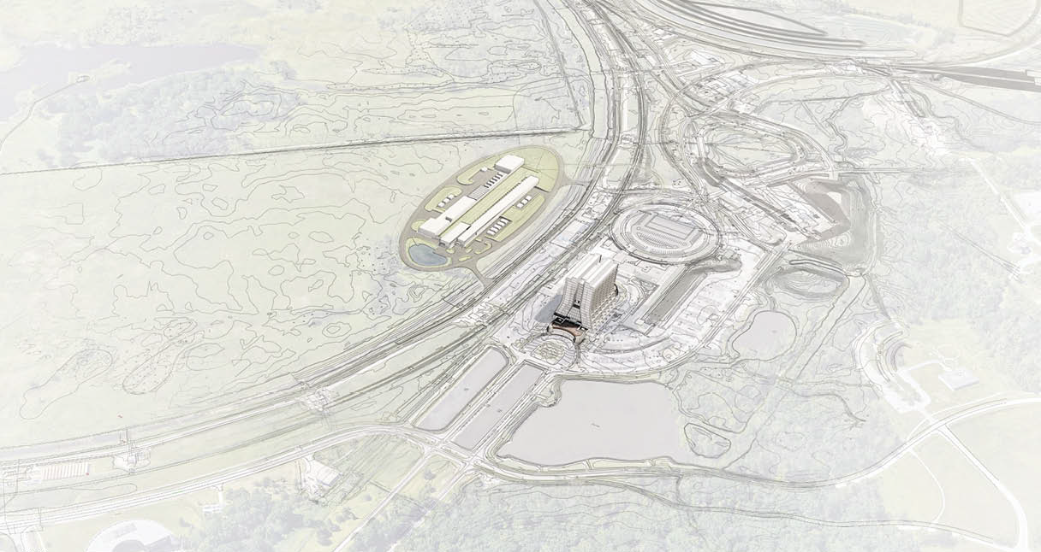
Agenda
Scope Overview
Critical Technology Elements
Key System Interfaces
Key Assumptions
Cost and Schedule
Risk Categories

Slide 3
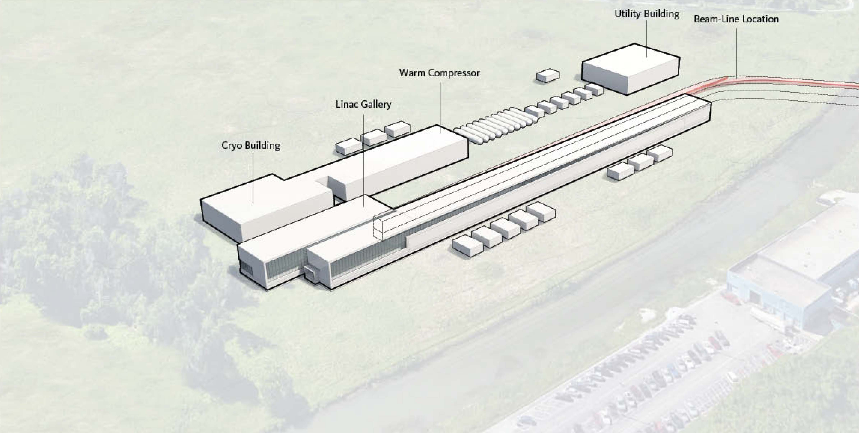
121.06 - Scope Overview – Above Grade
Utility Plant Building
LCW Equipment
Control Room
Exterior Space
Cryo Plant Building
Cold Box Station
Warm Compressor Station
Control Room
Exterior Space
Linac Gallery
General Space
Half Wave Resonator
SSR1
SSR2
LB650
HB650
Beam Transfer Line PS
Exterior Space
High Bay Building
Control Room
Computer Room/Conference Room
Tech Support Space
Upper High Bay
Lower High Bay
Mechanical/Electrical Space
Exterior Space
Space descriptions based on Room Data Sheets

Slide 4
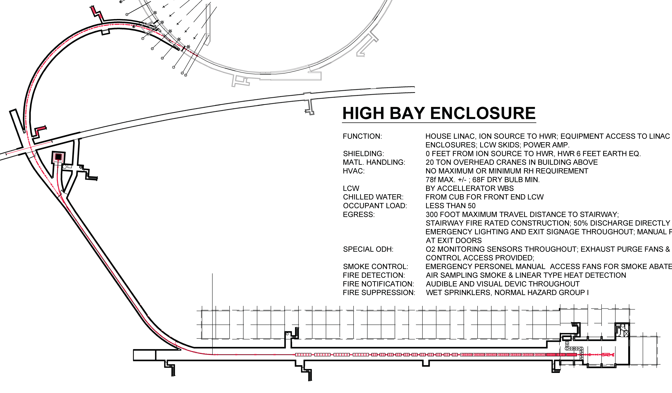
121.06 - Scope Overview – Below Grade
Booster Connection
Beamline
Beam Transfer Line
Beamline
Beam Absorber Space
Linac Tunnel
Half Wave Resonator
SSR1
SSR2
LB650
HB650
Space descriptions based on Room Data Sheets

Slide 5
121.06 - Critical Technology Elements
Conventional Facilities does not contain critical technology elements

Slide 6
121.06 - Key System Interfaces

Slide 7
121.06 - Key Assumptions - Scope
Conventional Facilities provides the space and related infrastructure to the building;
Building infrastructure extensions and installation of technical components is by others;
Continuous Wave operation will be required as part of the base scope;

Slide 8
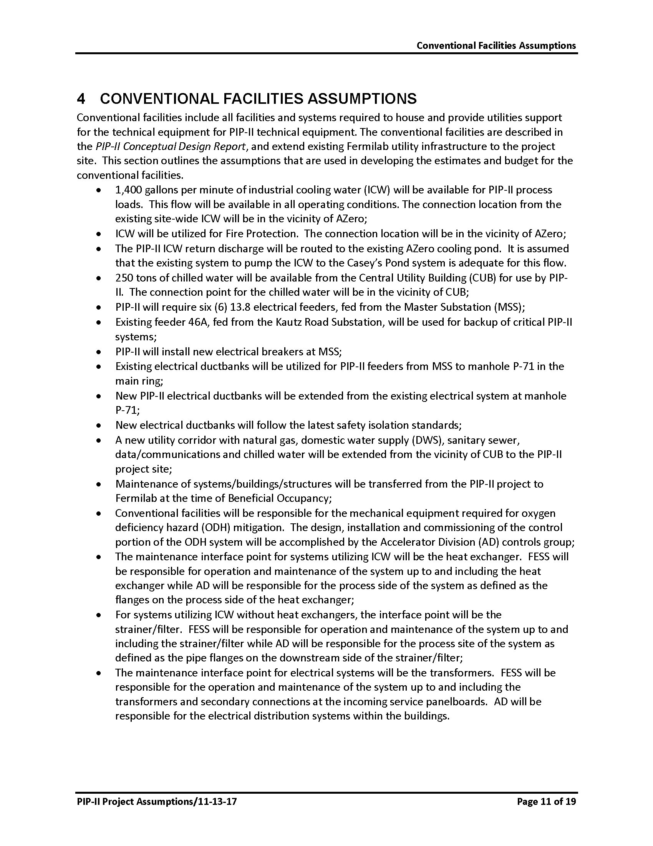
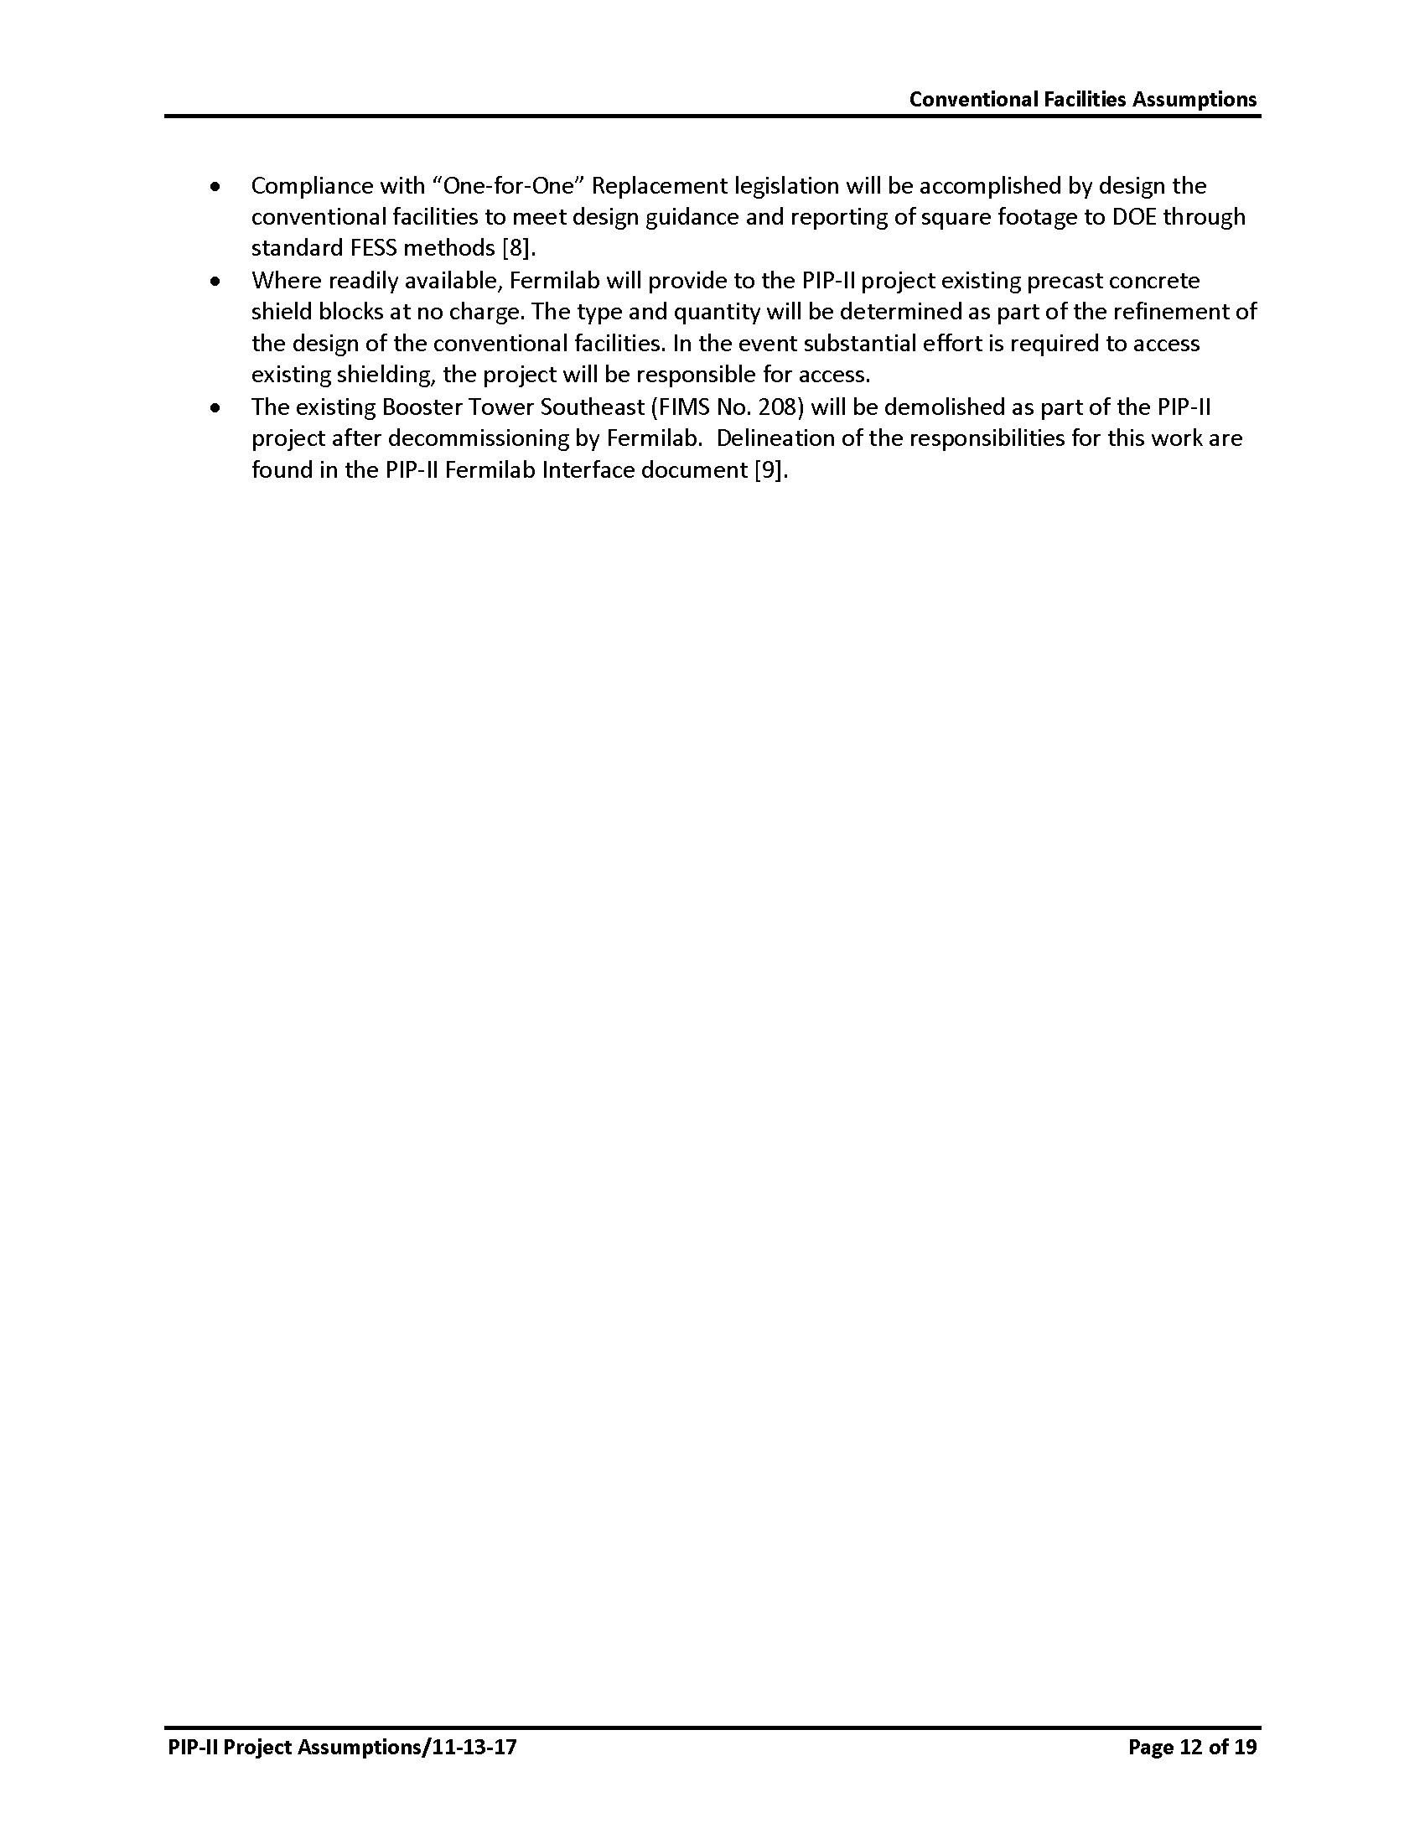
121.06 - Key Assumptions - Scope
From PIP-II Project Assumptions Document (PIP-II-doc-144)

Slide 9
121.06 - Key Assumptions - Design
Conventional Facilities will be built using normal construction techniques;
Building infrastructure extensions and installation of technical components is by others;

Slide 10
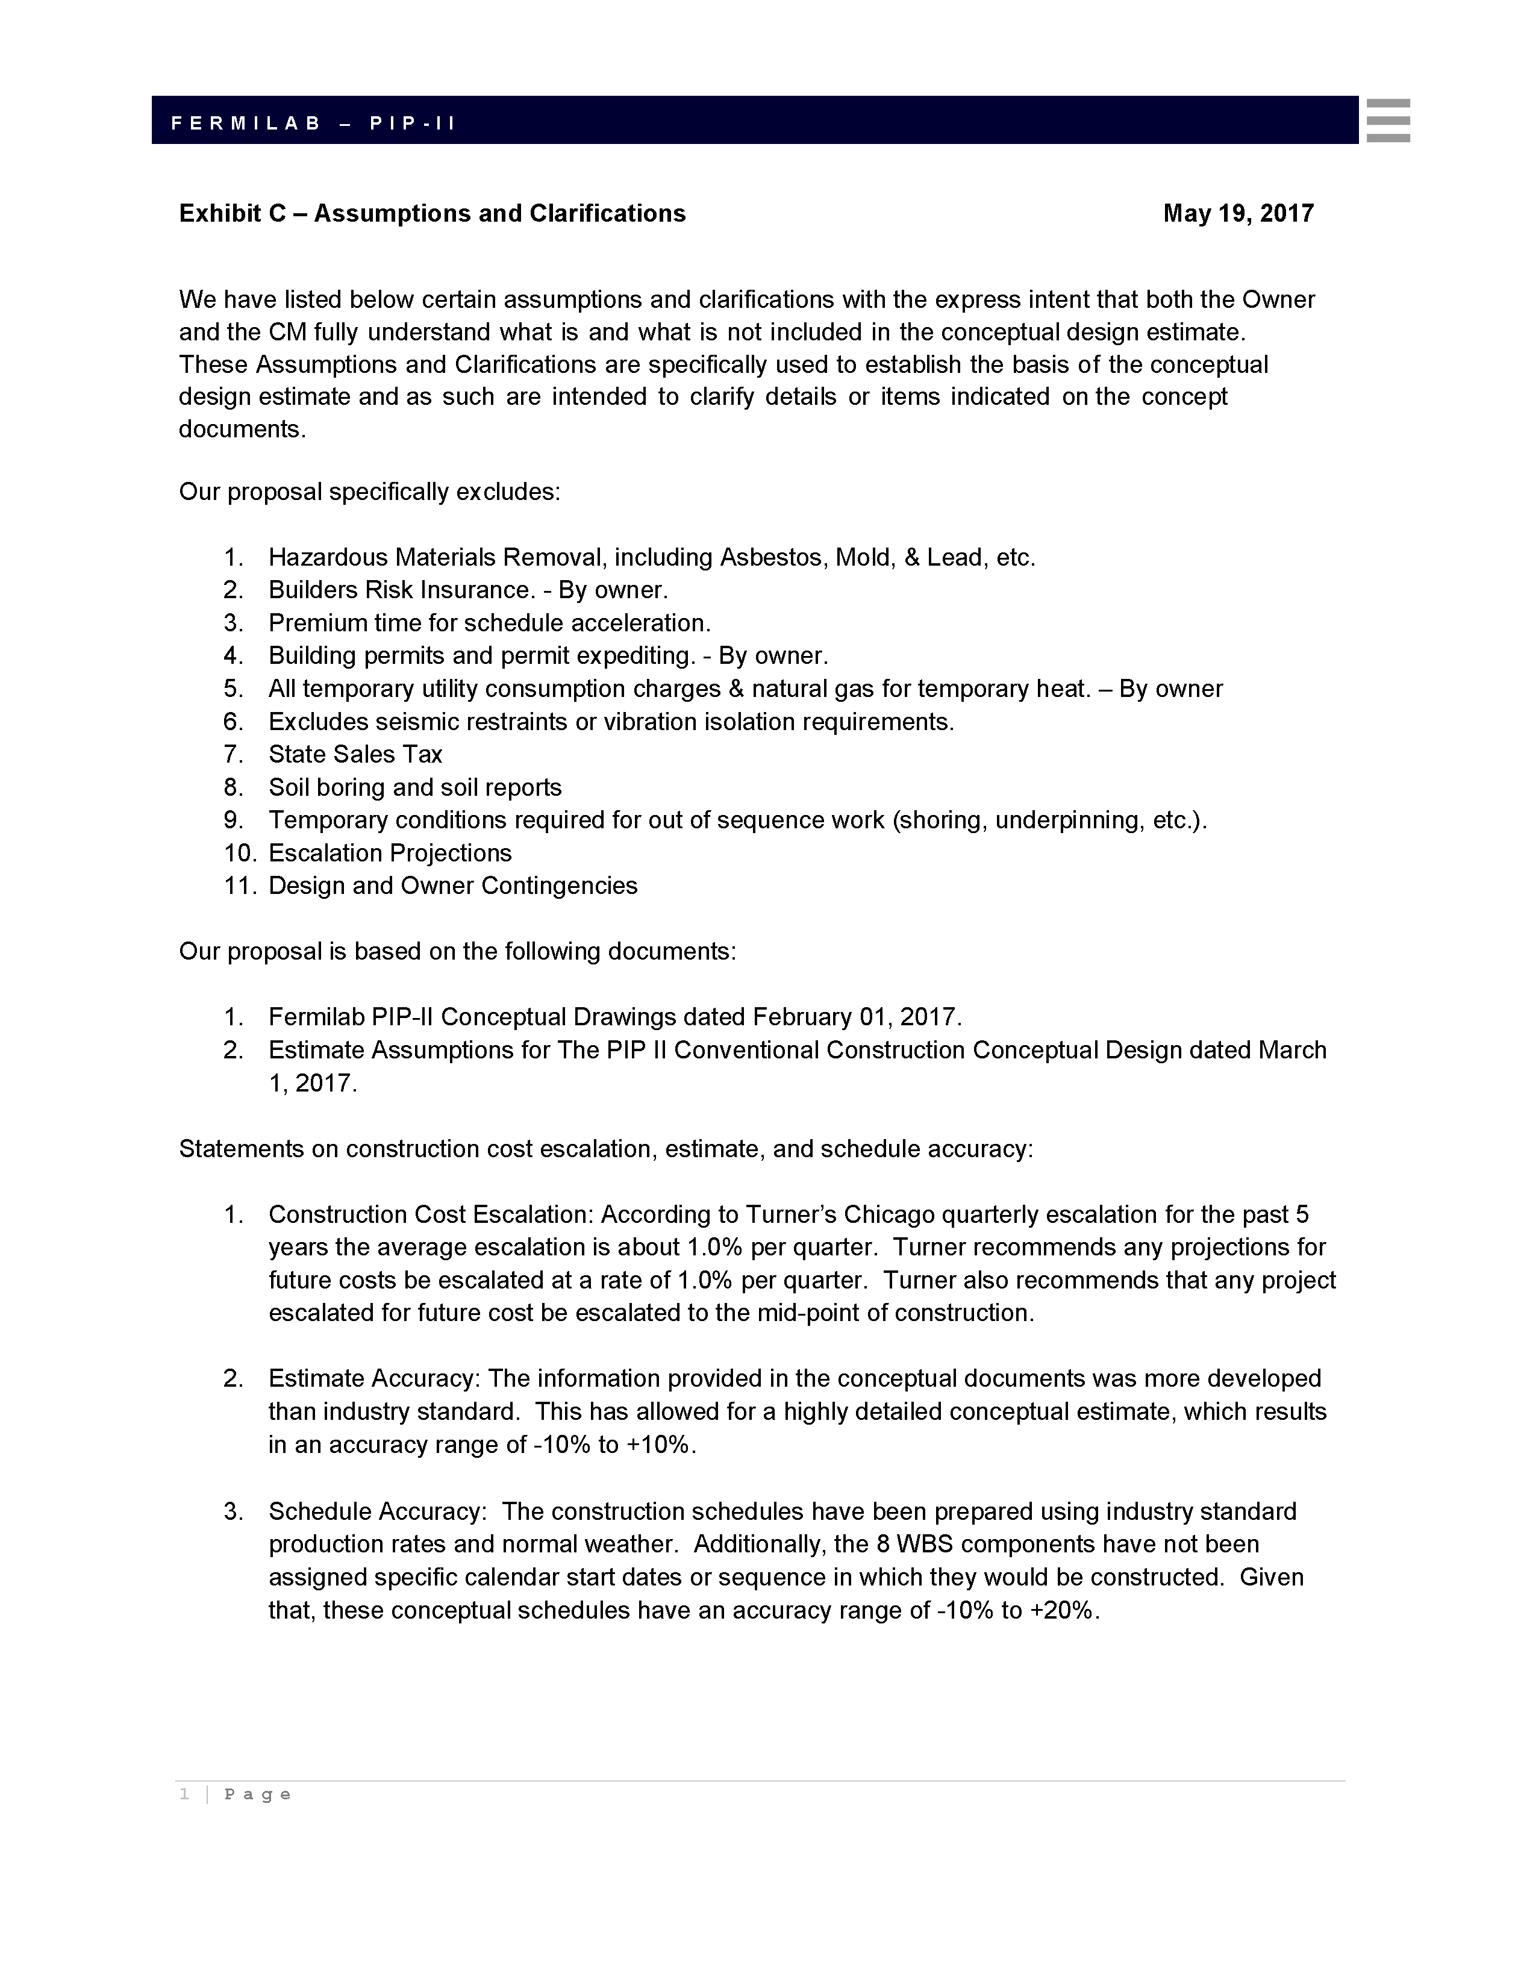
121.06 - Key Assumptions - Estimate
Conventional Facilities will be built using normal construction techniques;
Construction sequence is generally serial (see schedule slide)
Estimate assumptions are taken from PIP-II-doc-333
From Construction Package Cost Estimate (PIP-II-doc-333)

Slide 11
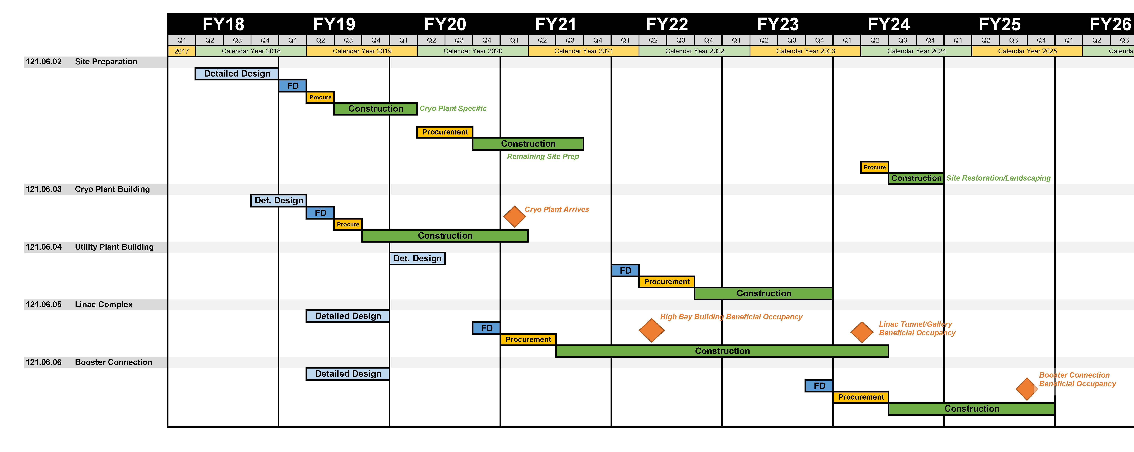
121.06 - Schedule

Slide 12
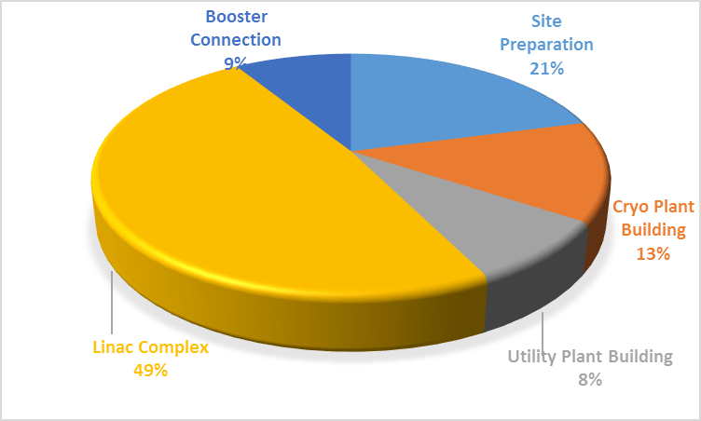
121.06 - Cost
$26.7M
$17.1M
$10.7M
$62.1M
$11.3M
Cost shown are Base Cost + Estimate Uncertainty only in FY18 dollars
(no escalation, EDIA, Indirects or Risk Based Contingency)

Slide 13
121.06 - Risk Categories
Unclear/Changing Technical Requirements
Interface with Laboratory
Conventional Facilities Design/Construction

Slide 14
END

