Slide 1
Risk Process and PIP-II Risk Register
Lucas Taylor
Fermilab Risk Manager
Associate Project Manager, CMS HL-LHC Upgrades
Deputy Project Manager, CMS Phase 1 Upgrades
PIP-II Risk Workshop, 12-13th July 2018

Slide 2
Overview
Fermilab risk management process
PIP-II risk register – guidance for the workshop
A few subjective comments

Slide 3
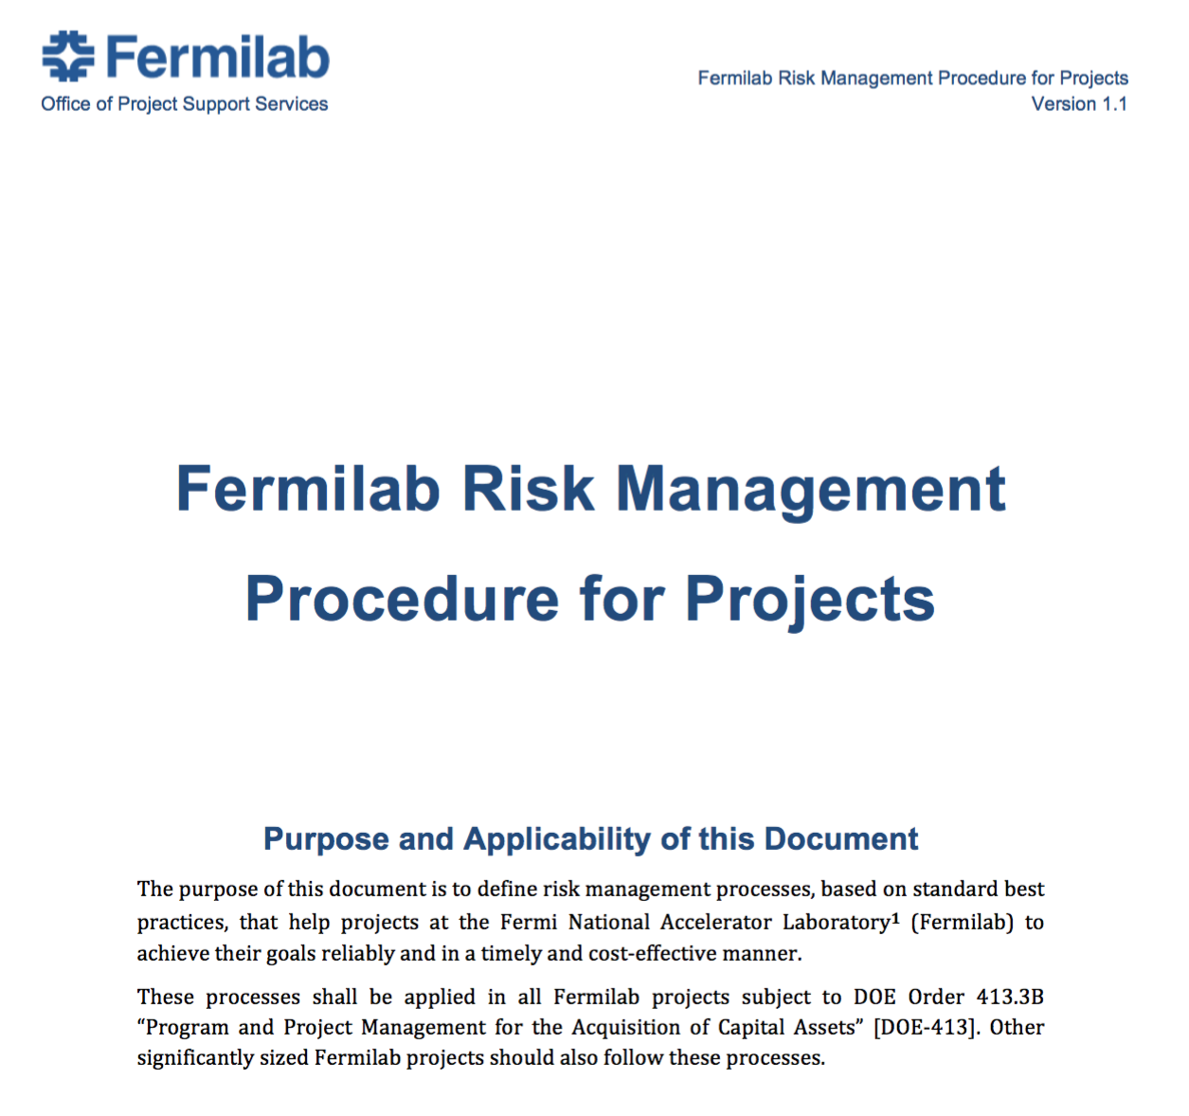
Fermilab Risk Management Procedure
https://go.usa.gov/xUTJS
Plan Risk
Management
Identify
Risks
Communicate and Improve
Analyze
Risks
Develop mitigation
and response plans
Monitor and
Control risks

Slide 4
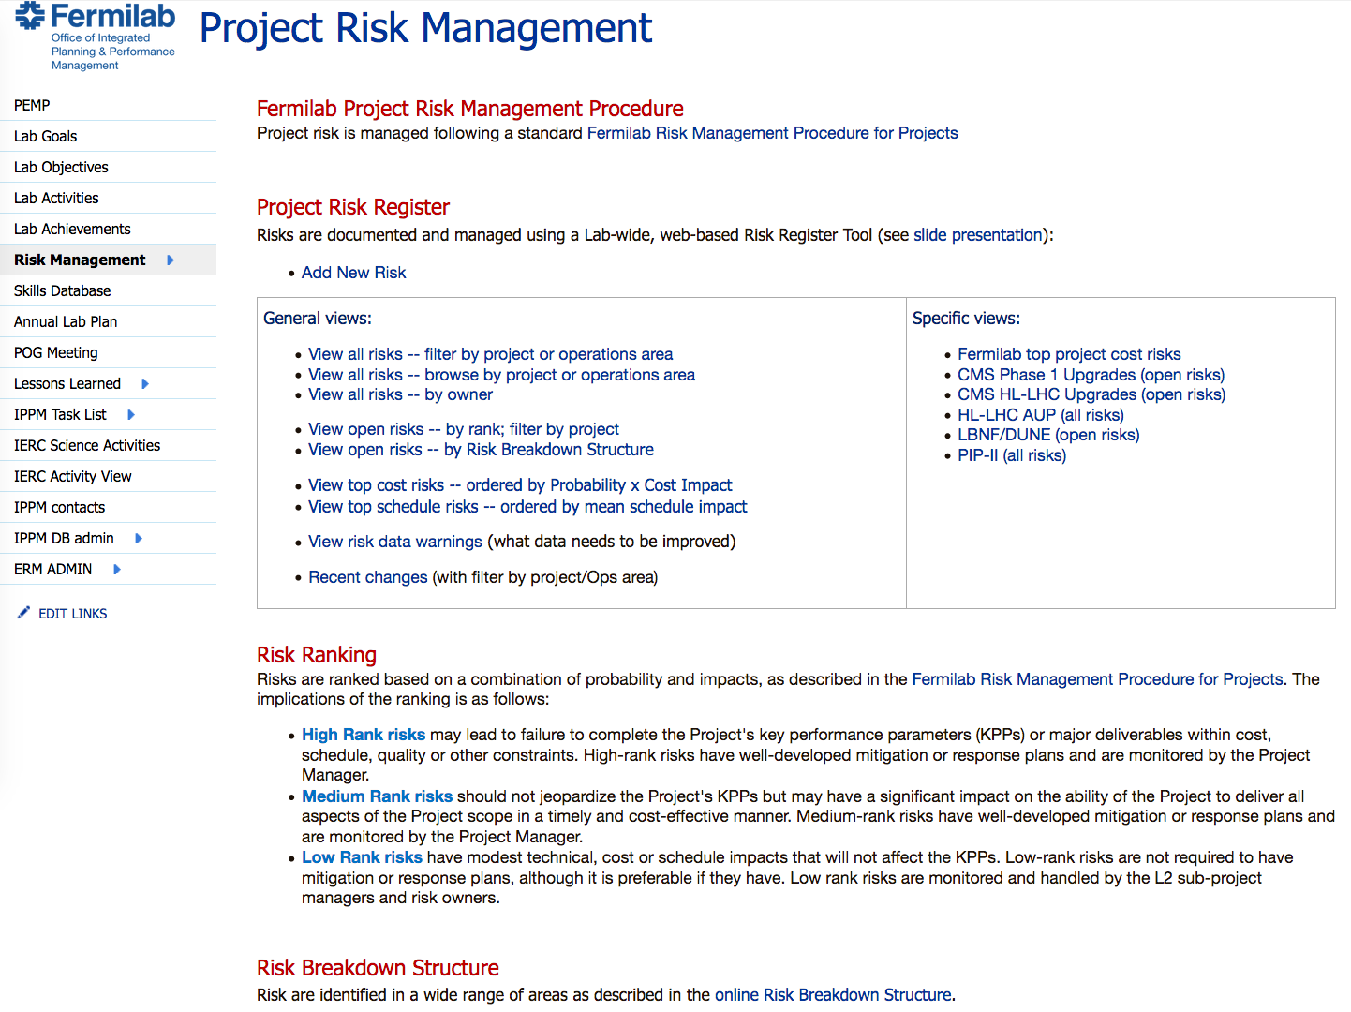
Fermilab Risk Register
https://go.usa.gov/x9sCm
Login: your-Fermilab-services-account
(ask Lucas.Taylor@cern.ch to get access)
Add new risk
PIP-II specific view
(we can easily tailor this)
Many views of risks

Slide 5
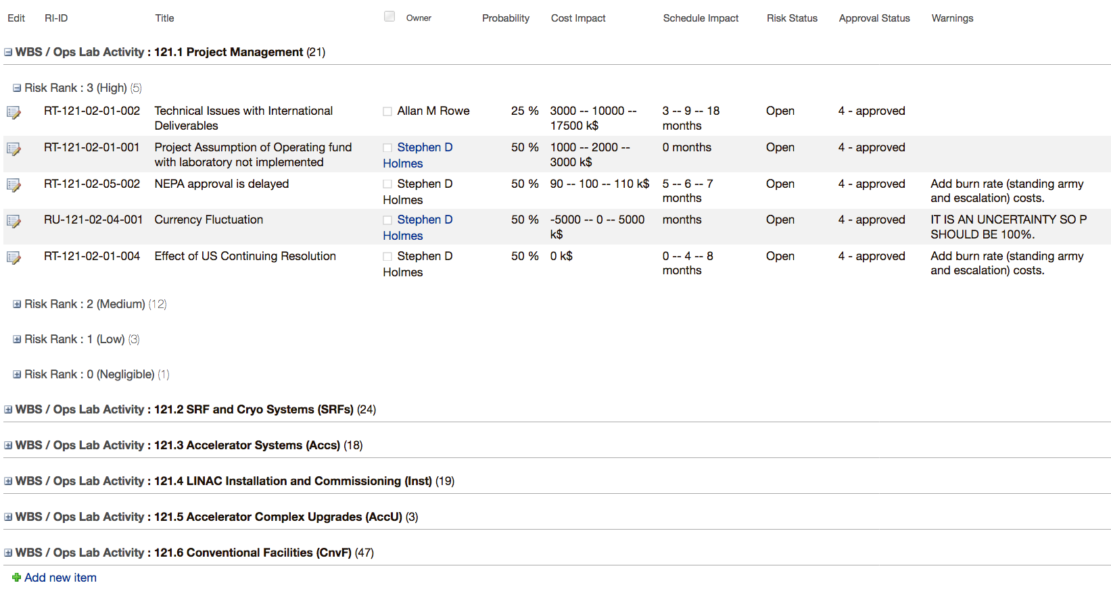
PIP-II Risk Register
https://go.usa.gov/xXRrr
https://go.usa.gov/xXRrr
Open / close WBS
Edit risk
Probability and Impacts
Warnings
This text = ADMIN COMMENT field concatenated with all warnings that are auto-generated generated by the system (like a software compiler).
You should aim for no warnings.
Add new risk

Slide 6
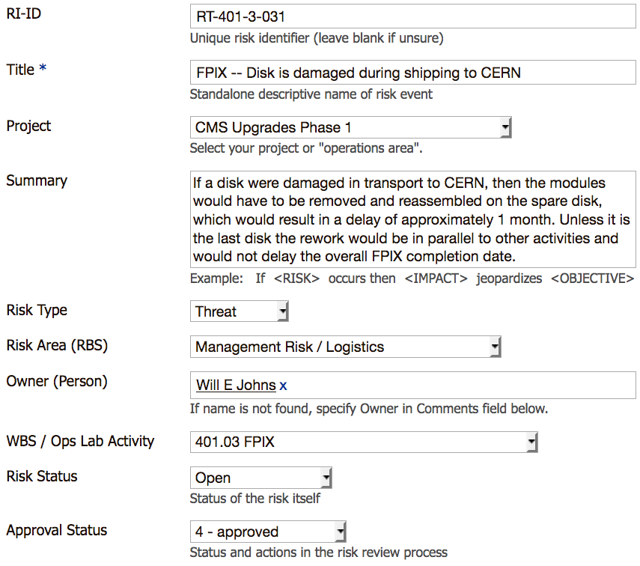
Risk Register: (1) General description & metadata
Risk ID = Rx-nnn-i-jjj
x = “T” (threat) or “O” (opportunity)
nnn = P6 project ID (121 for PIP-II)
i is the L2 P6 ID (= 1,2,3,4)
jjj is risk number (001, 002, etc.)

Slide 7
Risk Register: (1) General description & metadata
Risk title describes a risk event
rather than a consequence of a risk
It should make sense standalone
Examples:
Not good: “Delivery damage”
Better: “FPIX – Disk is damaged during shipping to CERN”
Not good: “Cost increases”
Better: “Niobium price increases faster than assumed escalation rate”

Slide 8
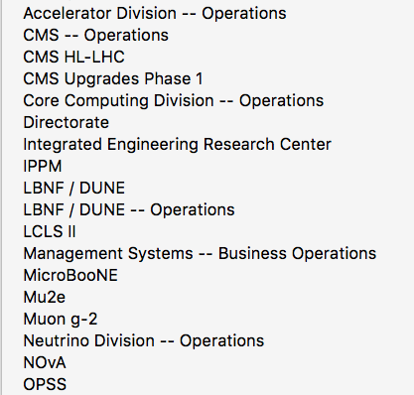
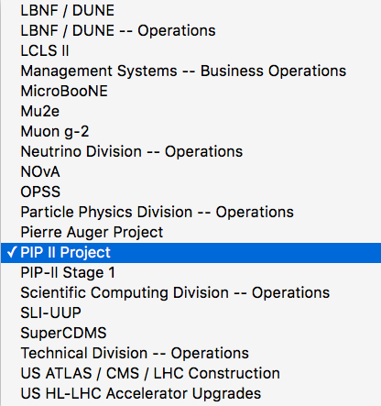
Risk Register: (1) General description & metadata

Slide 9
Risk Register: (1) General description & metadata
Risk “grammar” captures risk causes and effects, and hence points towards mitigation actions
If <RISK EVENT> occurs then
IMPACTS to technical scope, or
IMPACTS to cost, or
IMPACTS to schedule
would jeopardize the Project’s
Technical OBJECTIVES (e.g. KPP)
Cost OBJECTIVES (e.g. TPC)
Schedule OBJECTIVES (e.g. CD-4)
( If it does not jeopardize a project
objective, is it really a risk? )

Slide 10
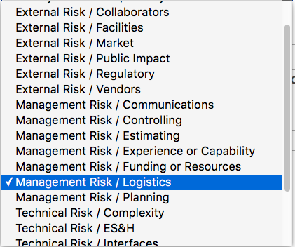
Risk Register: (1) General description & metadata
Risk Breakdown Structure
(common areas of risk)

Slide 12
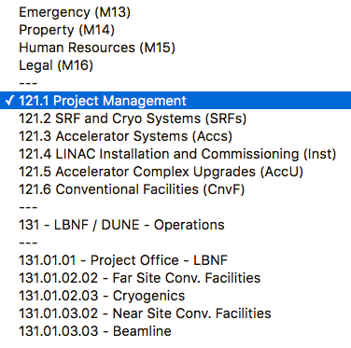
Risk Register: (1) General description & metadata
Personnel DB lookup
(includes external people with Fermi services account)
PIP-II

Slide 13
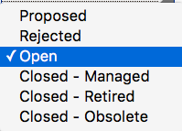
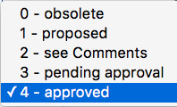
Risk Register: (1) General description & metadata
Risk Status:
Used in project execution phase to track if risk is still a concern
Approval status:
Used in planning phase (e.g. risk workshop) to tag progress
Enter proposed risks freely – use this field to tag approval (or not)

Slide 14
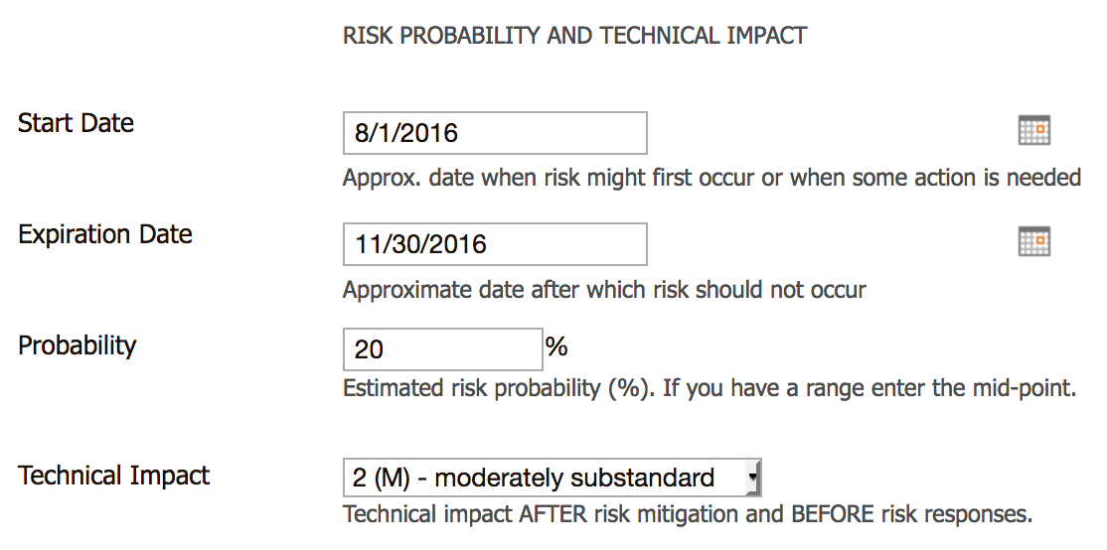
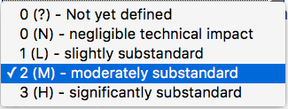
Risk Register: (2) dates, probability, tech. impact
Entering dates is optional They can be used for risk reports (e.g. “6-month look-ahead”) and to track risks to closure
Probability that risk occurs
This is critical input to the choice of risk mitigation strategy, and the contingency and float MC analysis
It does not need to be very precise! (by its very nature, risk is imprecise)
Used in risk ranking. Impact levels are project-specific.

Slide 15
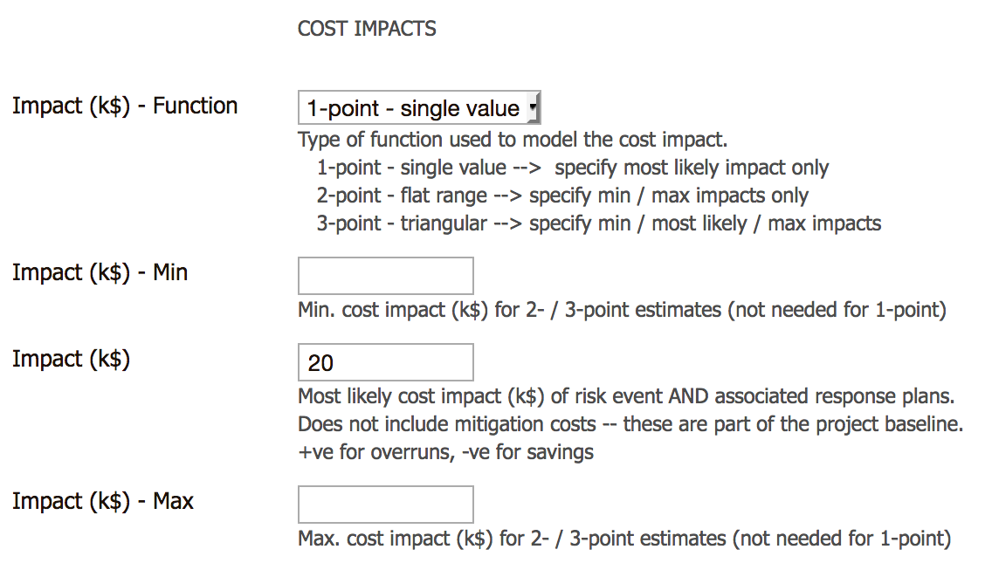
Risk Register: (3) cost impact
Impact (assessed after mitigations in the baseline were done) includes
Cost of risk if it happens (e.g. higher cost of a backup vendor)
Cost of response plans (e.g. rework or repair of damage)
Burn rate costs from delays (standing army and increased escalation)

Slide 16
Risk Register: (3) cost impact – single value
Probability, P
P = 80%
(risk does
not occur)
P= 20%
(risk occurs)
Most likely value
Impact
(k$)
0
10
20
30
1-point estimate (single value) for impact
If risk occurs, impact is always exactly 20k$

Slide 17
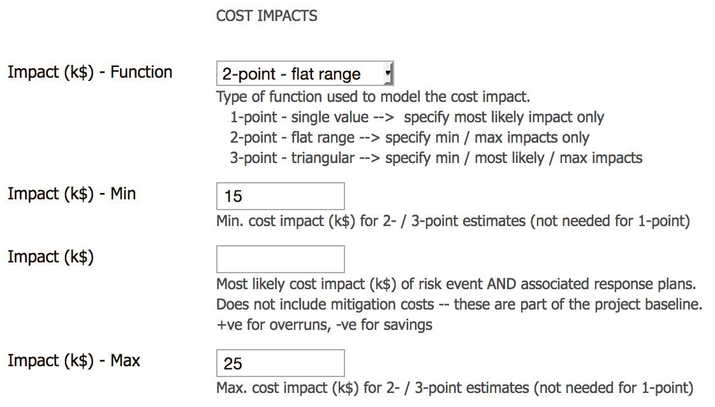
Risk Register: (3) cost impact – range
Probability, P
P = 80%
(risk does
not occur)
Minimum value
P= 20%
(risk occurs)
Impact
(k$)
0
10
20
30
Maximum value
2-point estimate (flat range) for impact
If risk occurs, impact is in range 15k$ – 25k$ (all equally likely)
Most likely impact = 20k$; Mean impact = 20k$

Slide 18
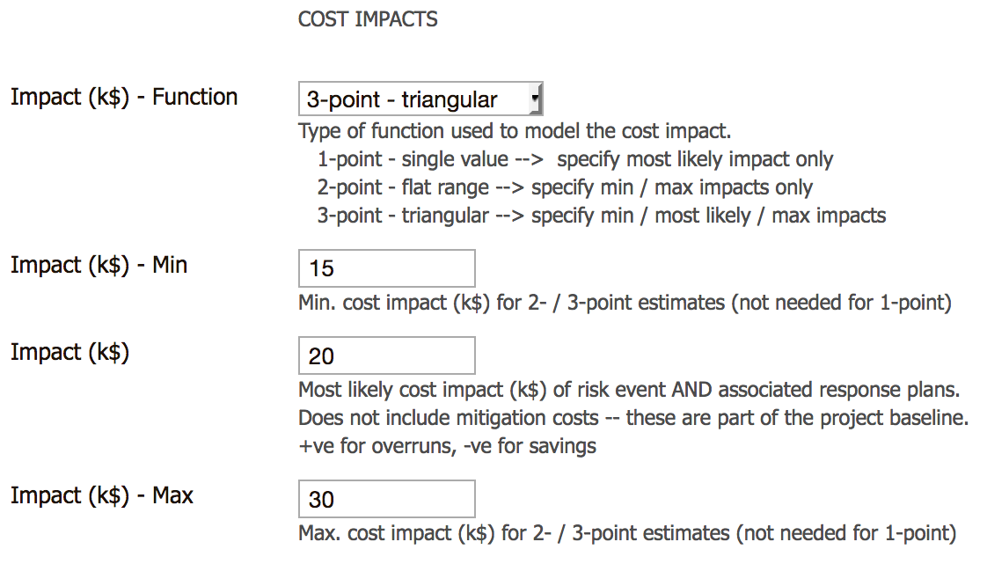
Risk Register: (3) cost impact – 3-point estimate
Probability, P
P = 80%
(risk does
not occur)
Minimum value
Most likely value
P= 20%
(risk occurs)
Impact
(k$)
0
10
20
30
Maximum value
3-point estimate (triangle distribution) for impact
If risk occurs, impact in range 15k$ – 30k$ (extremes less likely)
Most likely impact = 20k$; Mean impact* = 21.7k$
* Mean x of triangular probability distribution function = (minimum x + most likely x + maximum x) / 3

Slide 19
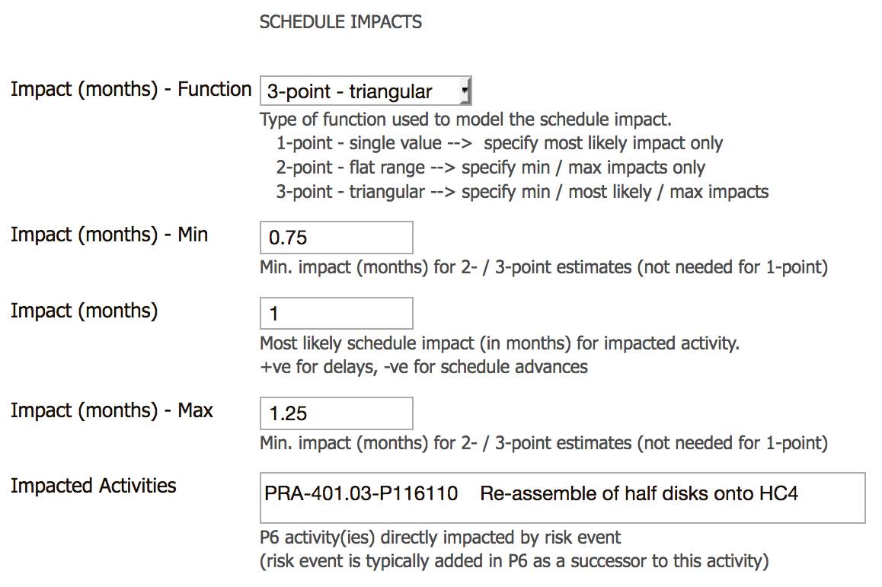
Risk Register: (4) schedule impact
1-, 2-, 3-point schedule impacts (in months)
(similar to cost impacts)
For now, just say in a few words what work is delayed

Slide 20
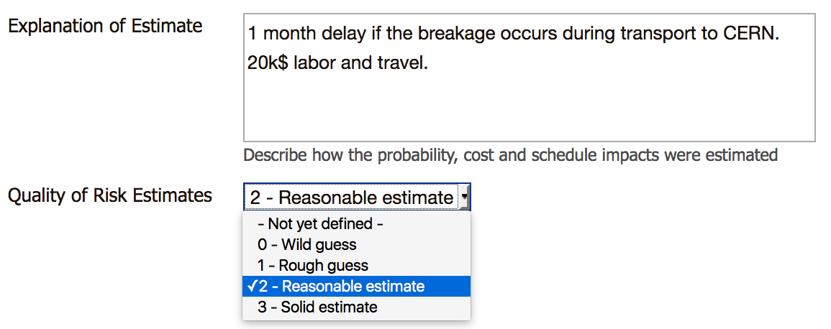
Risk Register: (5) explanation & quality of estimate
Brief explanation of how the risk probability and impacts were estimated
See “Link to more details” field below, to add a URL
Tag your level of confidence in the estimates so you know what might need follow-up analysis

Slide 21
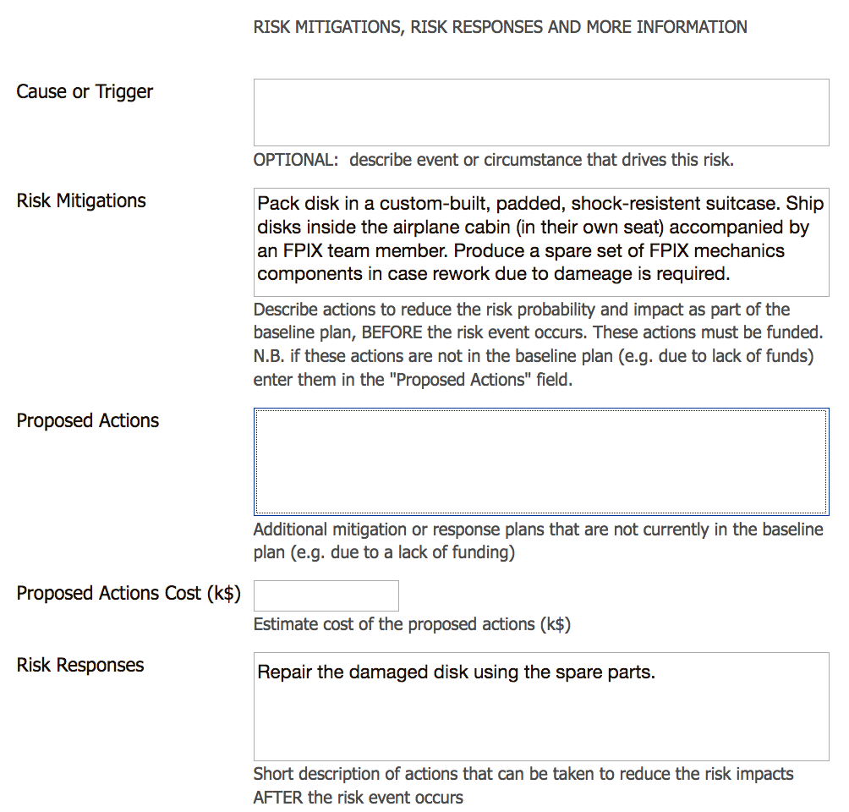
Risk Register: (6) mitigation and response plans
Risk mitigations
Proposed Actions
Risks responses
→ next slides

Slide 22
Risk Mitigations
Inherent Risks
Mitigations – actions taken before a risk occurs, to reduce risk probability / impacts
Mitigations are often part of standard operating procedures and controls
Funds for mitigations must be in base plans
Examples: build and test prototypes, work with multiple vendors, manufacture spares, safety training, financial controls, IT security…
Mitigations
Current
(Residual) Risks

Slide 23
Risk Responses
Inherent Risks
Mitigations
Current
(Residual) Risks
Risk responses – actions only taken after a risk occurs, to reduce the impacts
They are contingency (not baseline) plans
Risk responses use contingency funds
Examples: rework non-compliant items, replace failed hardware, respond to a fire, restore a hacked IT system…
Risk
Event
Consequences
and
Responses

Slide 24
Probability and Impacts
Inherent Risks
Mitigations
Probability and Impacts are estimated post-mitigation
Impacts cover the risk event itself and the response plans
Current
(Residual) Risks
Risk
Event
Probability (%)
For ops risk: chance that risk happens in a 1 year period
Cost impact (k$)
(including cost of response plans)
Consequences
and
Responses
Schedule impact
(including delays due to responses)
Technical impact

Slide 25
Risk Mitigations vs. Proposed Actions
Inherent Risks
IF mitigation IS in the base plan THEN
Describe in Risk Mitigation field (including mitigation cost if known)
ELSE
Describe in Proposed Actions field
Fill in Proposed Actions Cost (k$)
Workshop (and after) will need to decide whether to incorporate new, proposed actions into baseline mitigation plans
Mitigations
Current
(Residual) Risks

Slide 26
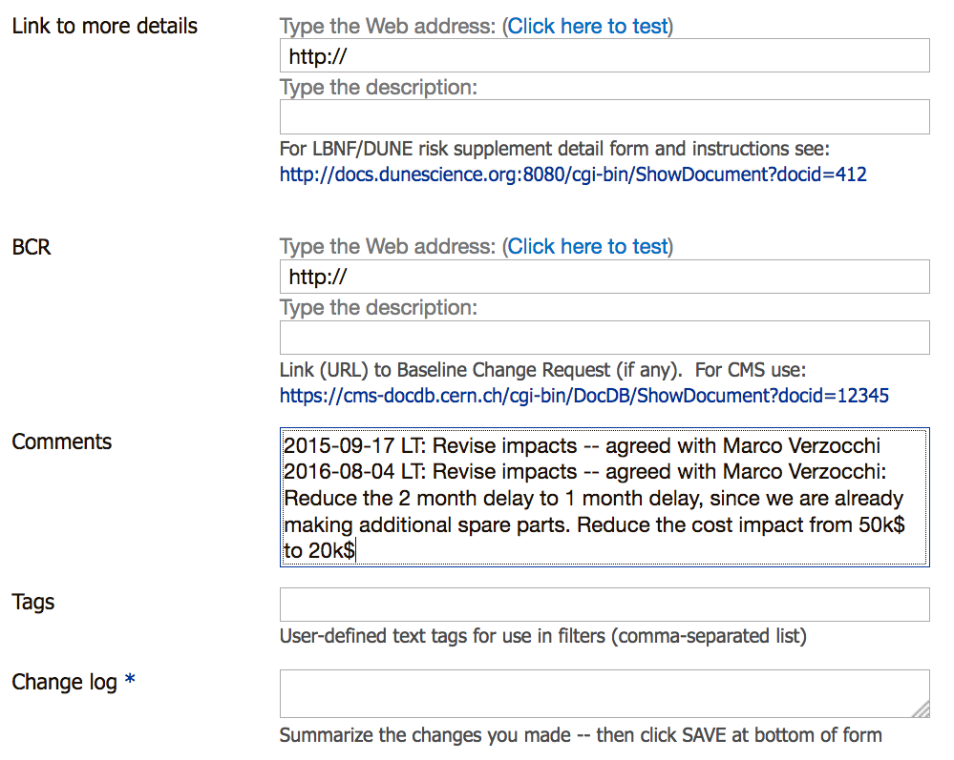
Risk Register: (7) more information
Optional: link to more information
(can be left blank)
Only used if risk occurs and requires a Baseline Change Request
Optional: any other comments (e.g. next steps to assess risk)
Optional: tags for creating custom filters or views
Obligatory: keeps track of what was changed and why

Slide 27
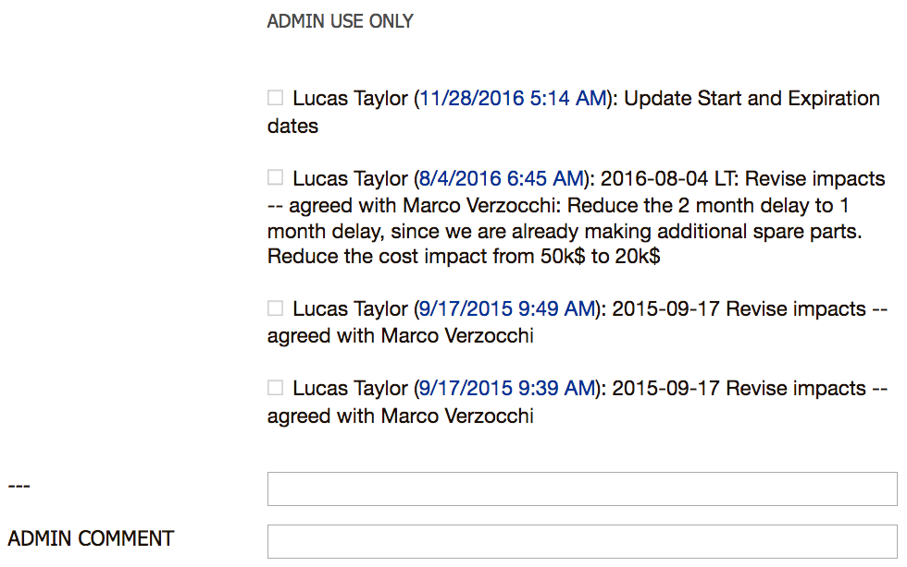
Risk Register: (8) version history
Displays the change log
Optional: text entered here is pre-pended to the Warnings field (shown in “list of all risks” view)
Be sure to save your changes

Slide 28
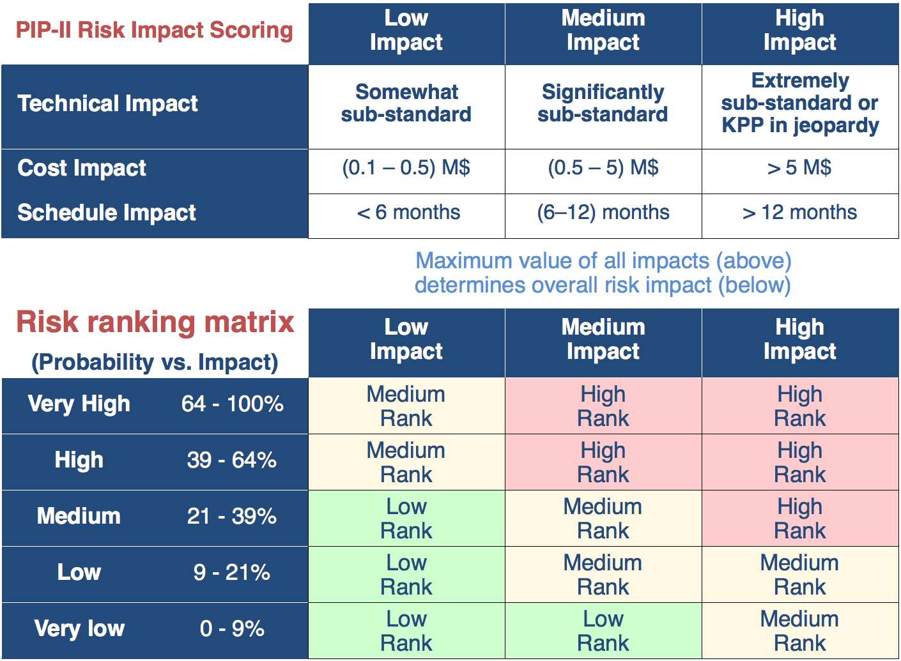
Risk Ranking
Risks are ranked according to the values of the Probability and Impacts (technical, cost, schedule). The register tool does the ranking automatically.

Slide 29
Risk Ranking – implications
High Rank → PM + Lab / DOE
May jeopardize the Project’s KPPs
May lead to failure to complete major deliverables within cost or schedule
Need mitigation or response plans
Medium Rank → L2 manager + PM
Not expected to jeopardize KPPs
Significant inability to deliver all scope in a timely & cost-effective manner
Need mitigation or response plans
Low Rank → L3 manager + L2
Will not jeopardize KPPs
Modest impacts
Mitigation or response plan not required

Slide 30
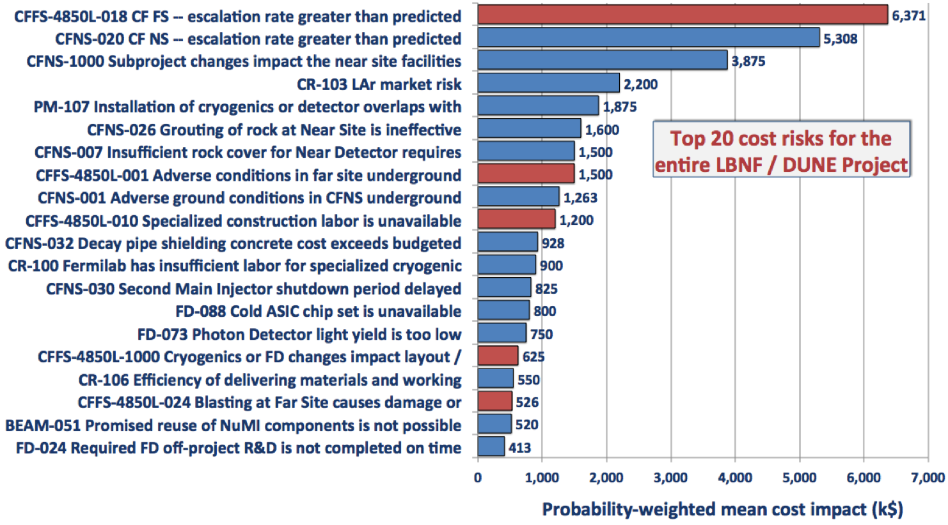
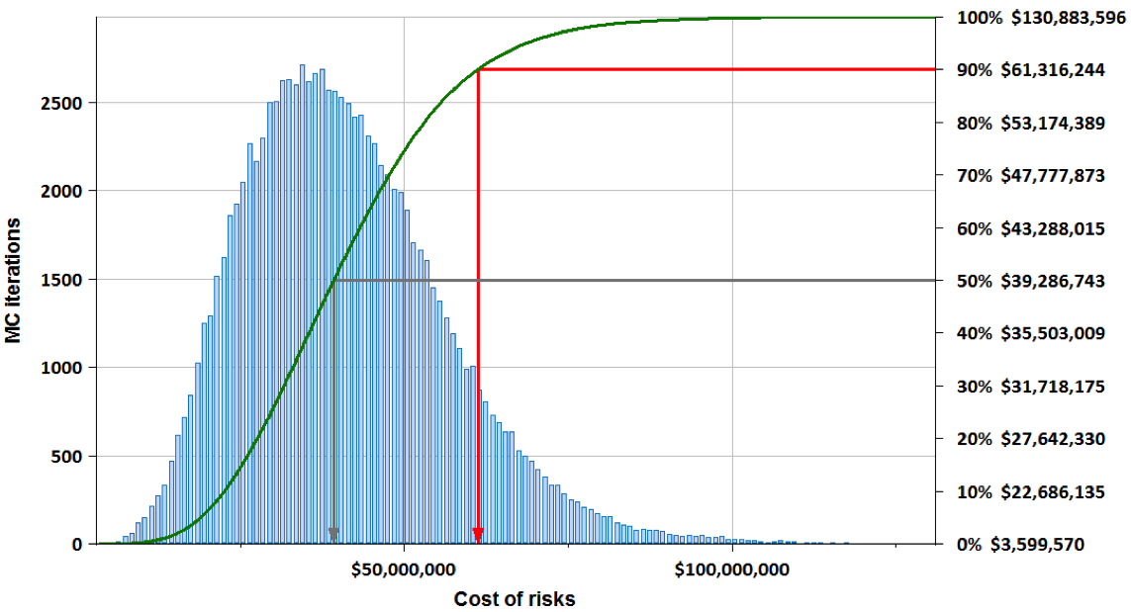
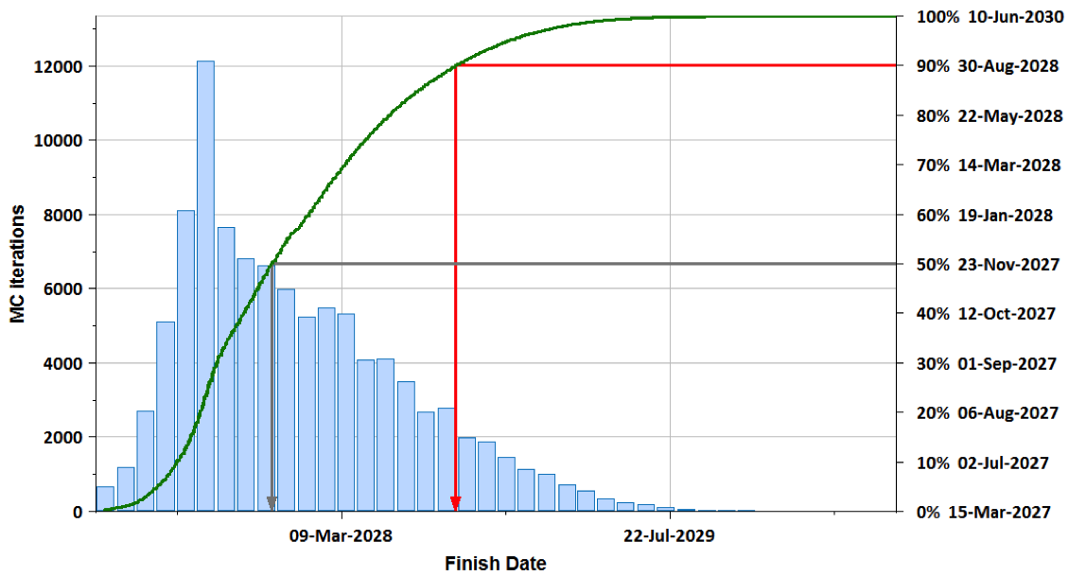
Risk Monte Carlo Modeling – Contingency Analysis
After the workshop
More Details
(documents)
Risk Register
(Web tool)
Full
Schedule
Summary Schedule
All activities to deliver the project, logically linked.
Can be the full schedule or a summary schedule.
DocDB
Risk
DB
P6
DB
Results of Risk Modeling
Evaluate effectiveness of risk mitigations
Identify cost and schedule risk drivers
Determine cost and schedule contingency to finish on time, within budget (at 90% C.L.)
Implements Risk Events as probabilistic activities in the P6 schedule
MC Risk Model
(Primavera Risk Analysis - PRA)
Costs of risks and contingency
Completion dates and float (e.g. to CD-4)
Cost and schedule drivers

Slide 31
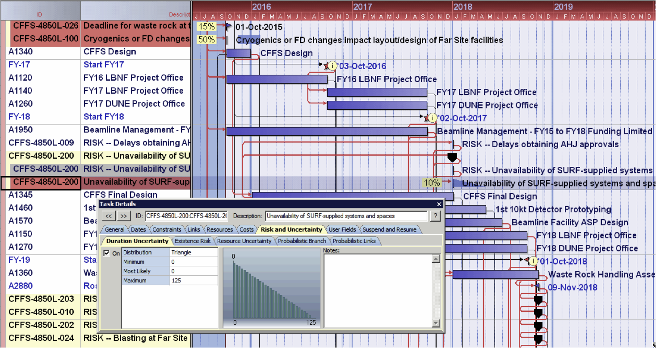
Risk Monte Carlo Modeling – Contingency Analysis
After the workshop
(1) Placeholder risk (hook) events are inserted into schedule with zero cost and zero duration
(2) Throw dice – if risk happens, risk activity is assigned risk impacts (cost and duration)
Primavera Risk Analysis (PRA) MC framework
(3) Choose cost and schedule impacts from distributions
(4) Update entire schedule to generate one complete project outcome (scenario)
(5) Repeat steps (2) – (4) thousands of times to study the statistical behavior of many scenarios

Slide 32
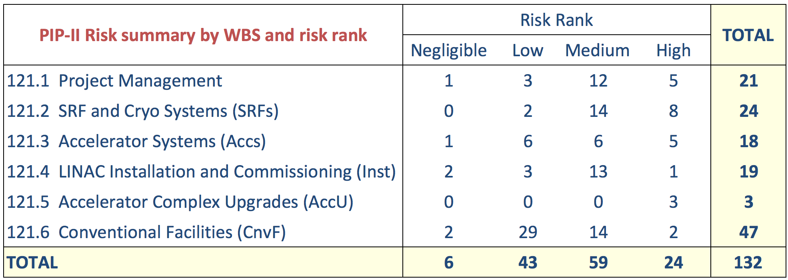
PIP-II risk register – some observations
Do ranks (H/M/L)
map well to oversight
level (PM/L2/L3)?
AccU:
only 3 risks but
all High rank
Total likely risk cost:
Sum (P * Cost Impact) =$17M
90% CL contingency will
be ~$(30-40)M
Most High rank
risks have P=50%.
~Half will happen!
→ review
Many risks – obscures big picture
(1) Merge similar risks & (2) tune
ranking matrix to move risks to
“negligible” (= watch list)
Sum (P * Schedule Impact)
= 11.4 years
Risks aren’t all in series on critical path
but total is still worryingly high
Include burn rate
costs for delays
(standing army
and escalation)

Slide 33
More information
Fermilab Risk Management → https://go.usa.gov/x9sCU
Project Risk Management → https://go.usa.gov/x9sCm
Risk Management Board → https://go.usa.gov/xXcyM
Operations Risk Management → https://go.usa.gov/x9sCp
Enterprise Risk Management → https://go.usa.gov/x9sCv
PIP-II Risk Summary → https://go.usa.gov/xXRrr
Any questions: Lucas.Taylor@cern.ch

