Slide 1
PIP-II WBS 121.2 Risk Overview
Genfa Wu
Risk Workshop
12,13-Jul-2018

Slide 2
Outline
Scope Overview
Critical Technology Elements
Interfaces
Cost and Schedule
Risk categories
PIP-II Risk Register is at:
https://fermipoint.fnal.gov/organization/ocoo/ippm/Lists/Risk%20Register/PIP-II-Project-Risks.aspx

Slide 3
Scope Overview

Slide 4
WBS 121.2
25 Cryomodules (not including spare)
  Five different cryomodules.
  Scope covers from cryomodule gate valve to gate valve
  All cryomodules will be tested at FNAL
Cryoplant
Cryogenic Distribution System
  Helium supply from cryoplant to cryomodule

Slide 5

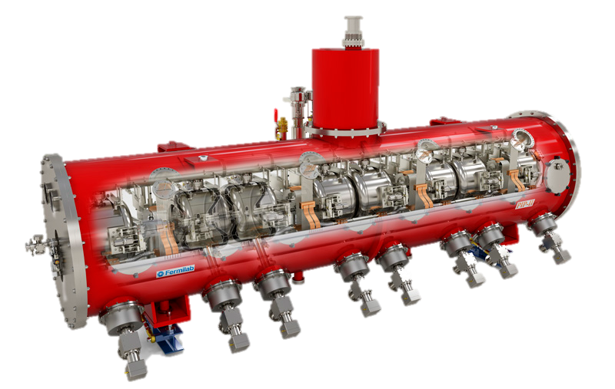
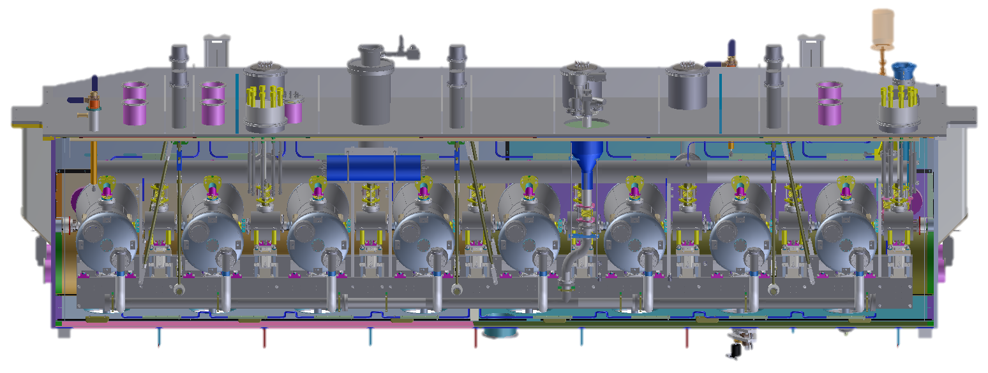
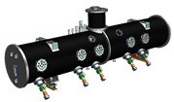

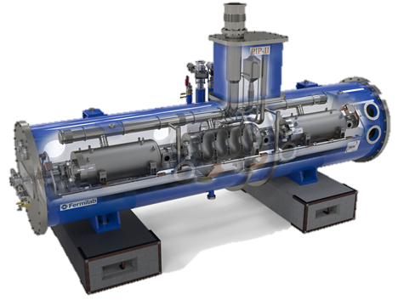


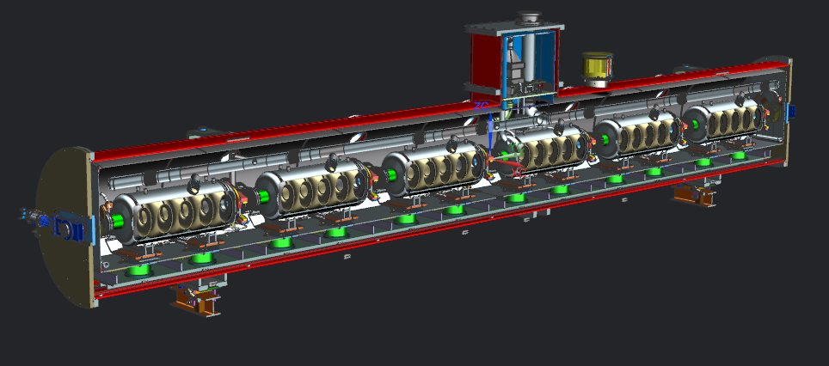

PIP-II SRF Linac & Areas of International Interest
HWR X 1
SSR1 X 2
SSR2 X 7
LB650 X 11
HB650 X 4

Slide 6
Cryomodule Design Overview
Cryomodule | Number | Cavity Number | Magnet Number | Style | Note
HWR | 1 | 8 | 8 | “Bath Tub” Style | ANL Led Design
SSR1 | 2 | 8 | 4 | Strong back support in circular tube | FNAL Led Design
SSR2 | 7 | 5 | 3 | Strong back support in circular tube | Integrated Design
LB650 | 11 | 3 | 0 | Strong back support in circular tube | Integrated Design
HB650 | 4 | 6 | 0 | Strong back support in circular tube | FNAL Led Design
Total | 25 | 116 | 37
Quadrupole doublets are outside and between 650 MHz cryomodules

Slide 7
Critical Technology Elements

Slide 8
WBS 121.2 Critical Technology Elements (CTEs)
Critical Technology Element (CTE)
Current Leads for Superconducting Solenoid
Spoke Cavity New to SRF Installation
  Limited Operational Experience and Project Lessons to Learn
650 MHz Cavity High Dynamic Heat Load
  Maintain High Q0 (3e10)
CW High Power Coupler
  Power Capability (70 kW)
  Particle Free
Tuners (Resonance Control)
  Narrow bandwidth
Strong Back (Cavity Support in Cryomodule)
Cryomodule Transportation System
Cryogenic Plant
  Cold compressor

Slide 9
Cost and Schedule

Slide 10
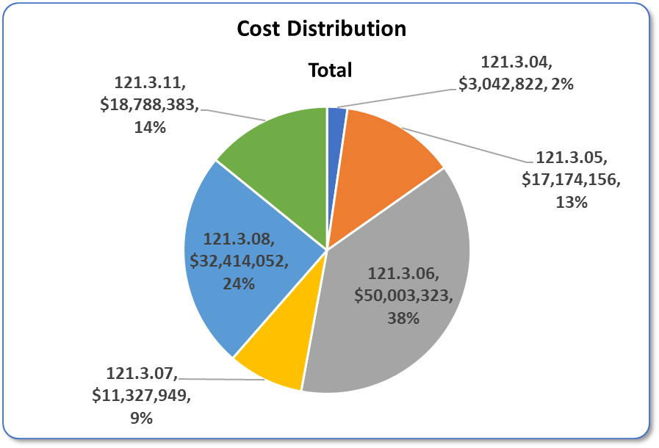
Cost from CD1
HWR
Cryo
SSR1
HB650
SSR2
LB650
Full Burden + Esc = BOE + Escalation + Overhead

Slide 11
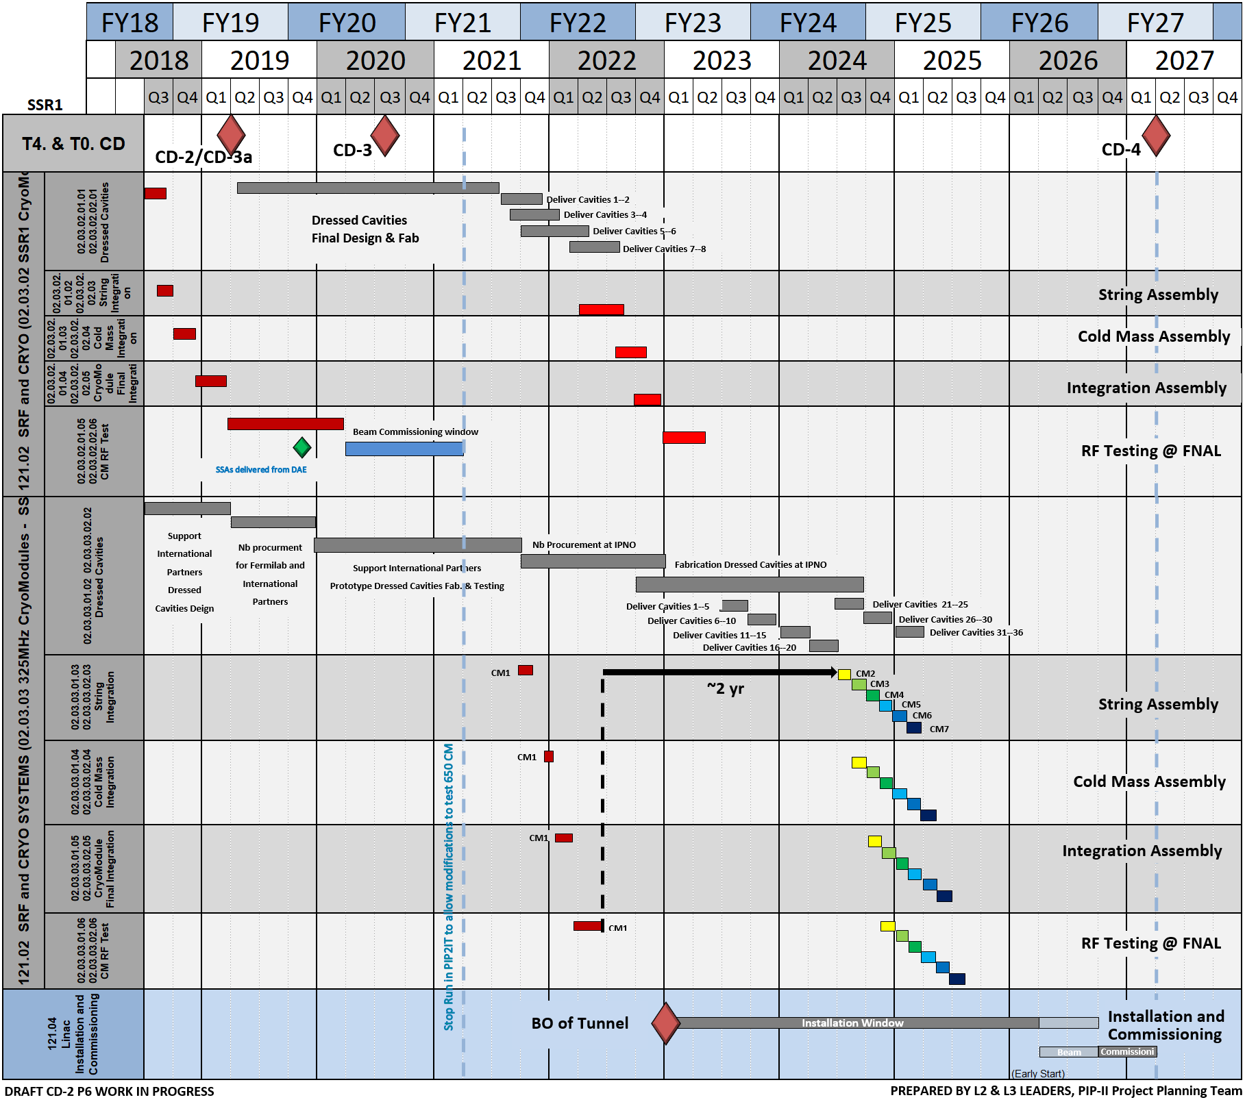
WBS 121.2 Cost and Schedule – SSR (Draft)
SSR1
SSR2

Slide 12
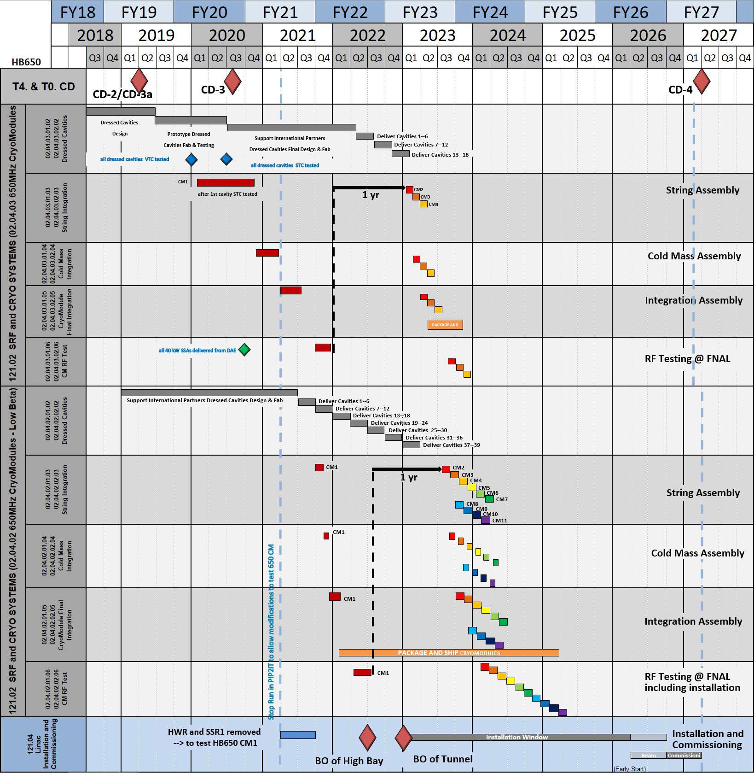
WBS 121.2 Cost and Schedule – 650 MHz (Draft)
HB 650
LB 650

Slide 13
Interfaces

Slide 14
WBS 121.2 Interface
Internal
  Interface among cavity, coupler and tuner
  Interface between solenoid and cavity
  Interface between cryogenic distribution and cryomodule
  Interface between cryoplant and cryomodule
External
  Cryomodule to Accelerator Physics
  Cryomodule to LLRF and HLRF
  Cryomodule to Vacuum, Instrumentation and Control
  Cryomodule to conventional facility
    Cooling water, compressed air, Compressed nitrogen
  Cryogenic plant and distribution to conventional facility
  Cryomodule and Installation
Notes:
Content of Interface slide(s): Describe any pertinent interfaces, whether internal to or external to your L2, and of any type - physical, energy/mass/information flow, software, managerial, organizational…

Slide 15
Risks

Slide 16
WBS 121.2 – Risk Levels and Types
8 High Risk
14 Medium Risk
2 Low Risk
Technical Risks
  Components
  Cryomodules
  Commissioning
Non Technical Risks
  Tight schedule
  Partner lab delivery
  Vendor delivery
  Staffing
  Facility availability

Slide 17
WBS 121.2 – Technical Risks
Technical Risks
  Component
    Coupler CW performance
    Cavity Q0 performance
      Chemistry imperfection
      Magnetic field management
    Tuner Performance
    Quality acceptance

Slide 18
WBS 121.2 – Technical Risks
Technical Risks
  Cryomodule
    Field emission
    Gradient degradation
    Excessive total heat load
    Cavity deformation
    Microphonics
    Thermal strap efficiency
    Alignment accuracy
    Procedure adequacy
    Magnetic field management
    Infrastructure and tooling failure
    Transportation

Slide 19
WBS 121.2 – Technical Risks
Technical Risks
  Linac Commissioning
    Field emission
    Gradient degradation
    Excessive total heat load
    Microphonics
    Magnetic field management
    Cryoplant pressure stability

Slide 20
WBS 121.2 – Technical Risk Complexity
How we can incorporate partner lab risks
How we define the risk details

