Slide 1
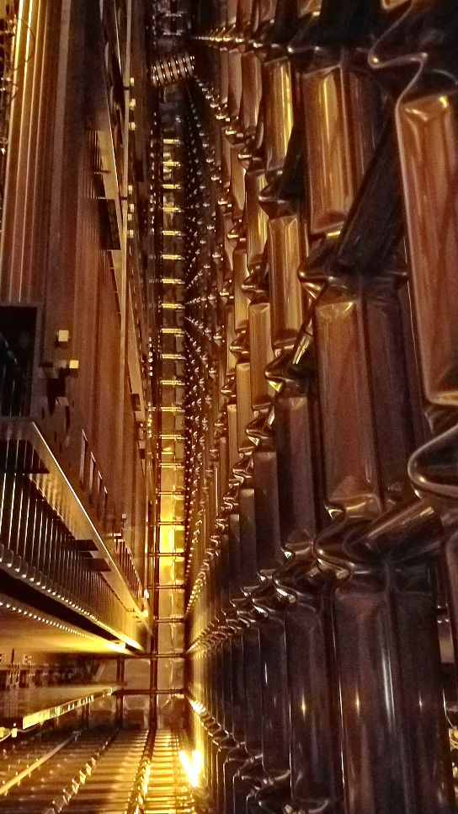
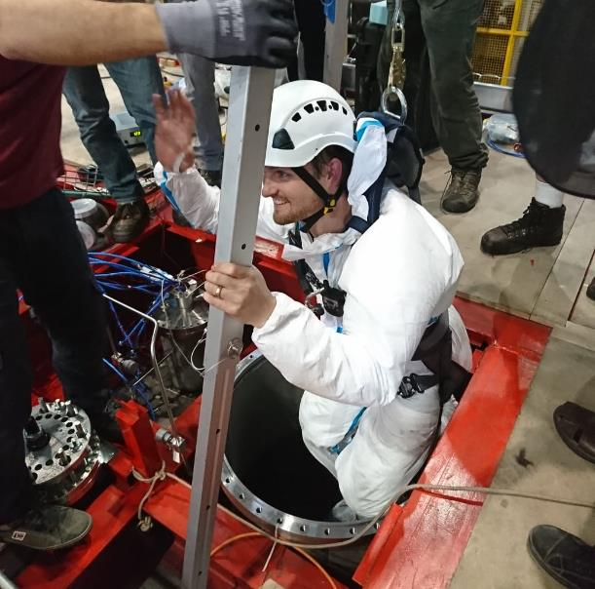
Last ProtoDUNE Status Update
Diamanto Smargianaki
William Miller
5 July, 2018
Photo by
Charles Cadeau

Slide 2
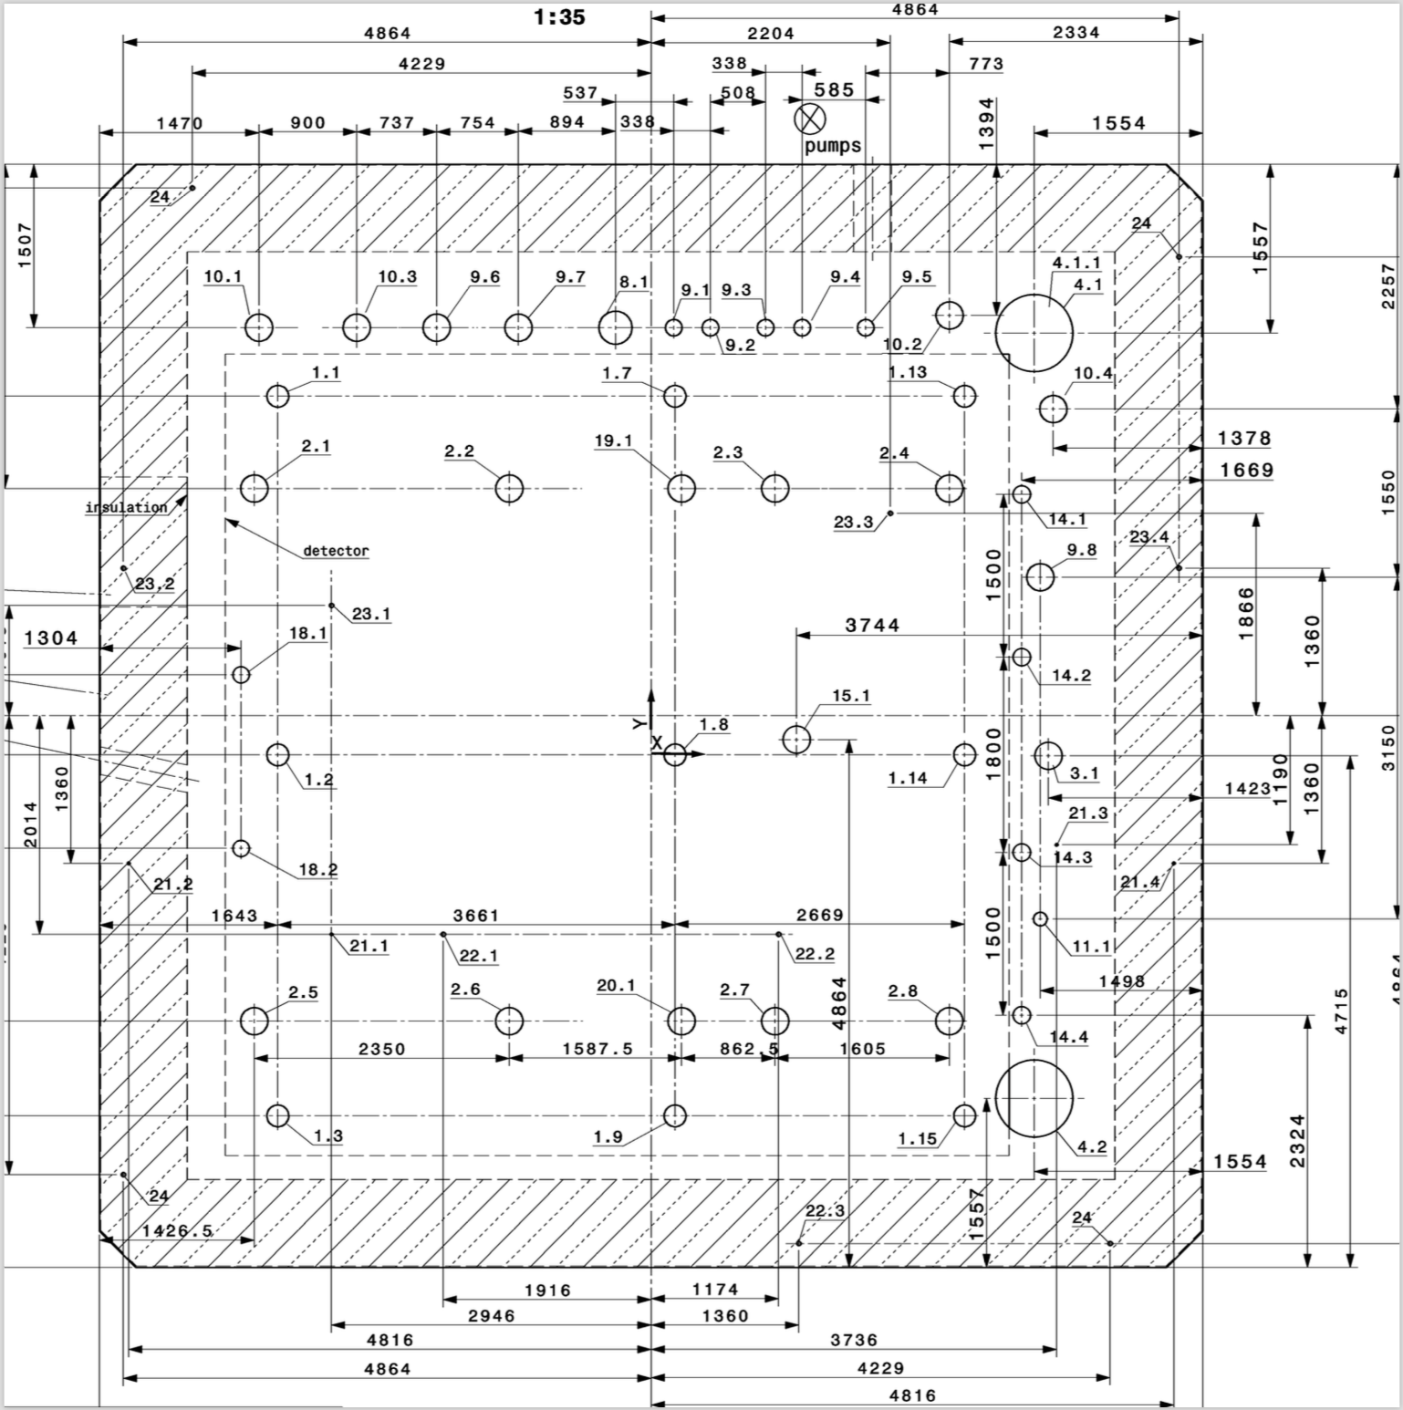
Leak Check Status
All flanges were tested and checked to be leak tight down to 2-4 x 10-6 mbar l/s (He- leak detector in sniffing mode), but:
3 Detector flanges: 9.1, 10.2, 14.4
2 Cryo flanges: 9.8, 10.4
Two manholes: 4.1, 4.2
14.4, 9.1 are closed and can be tested today, as soon as manhole 4.2 is in place.
Plan for the afternoon: put in place 4.2, tighten it and test it to check that viton gasket works. If so, test also 14.4, 9.1
Still to be closed: 10.2, 9.8, 10.4, 4.1
Side penetration for the beam plug (external) must also be tightened and leak tested.

Slide 3
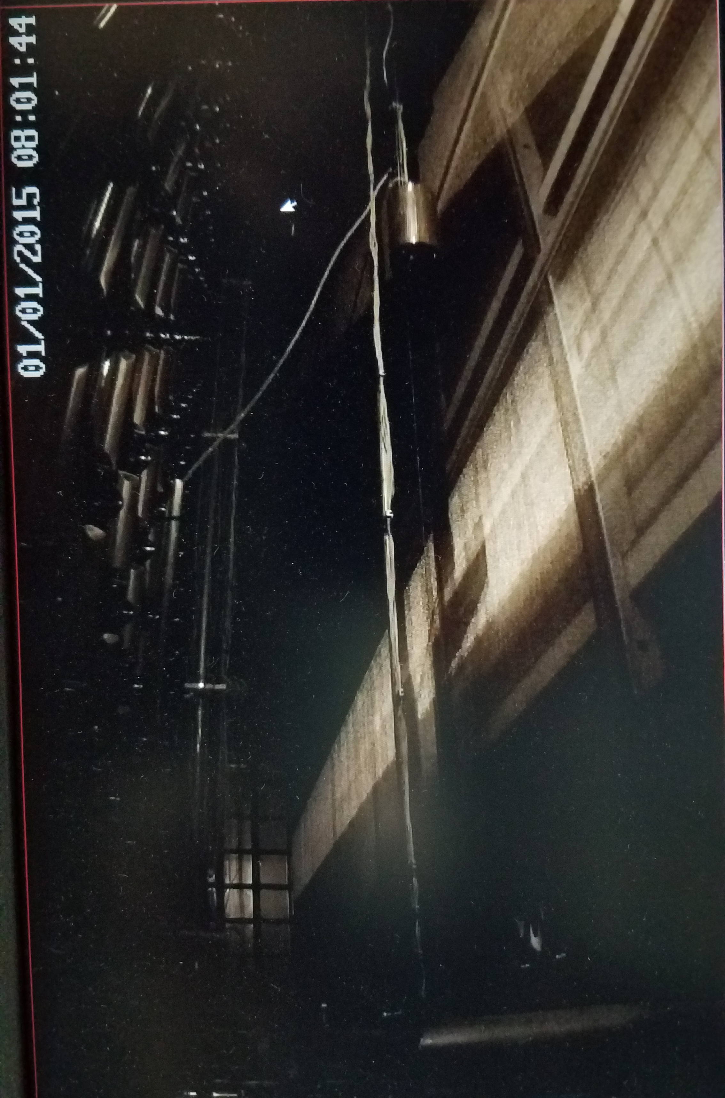
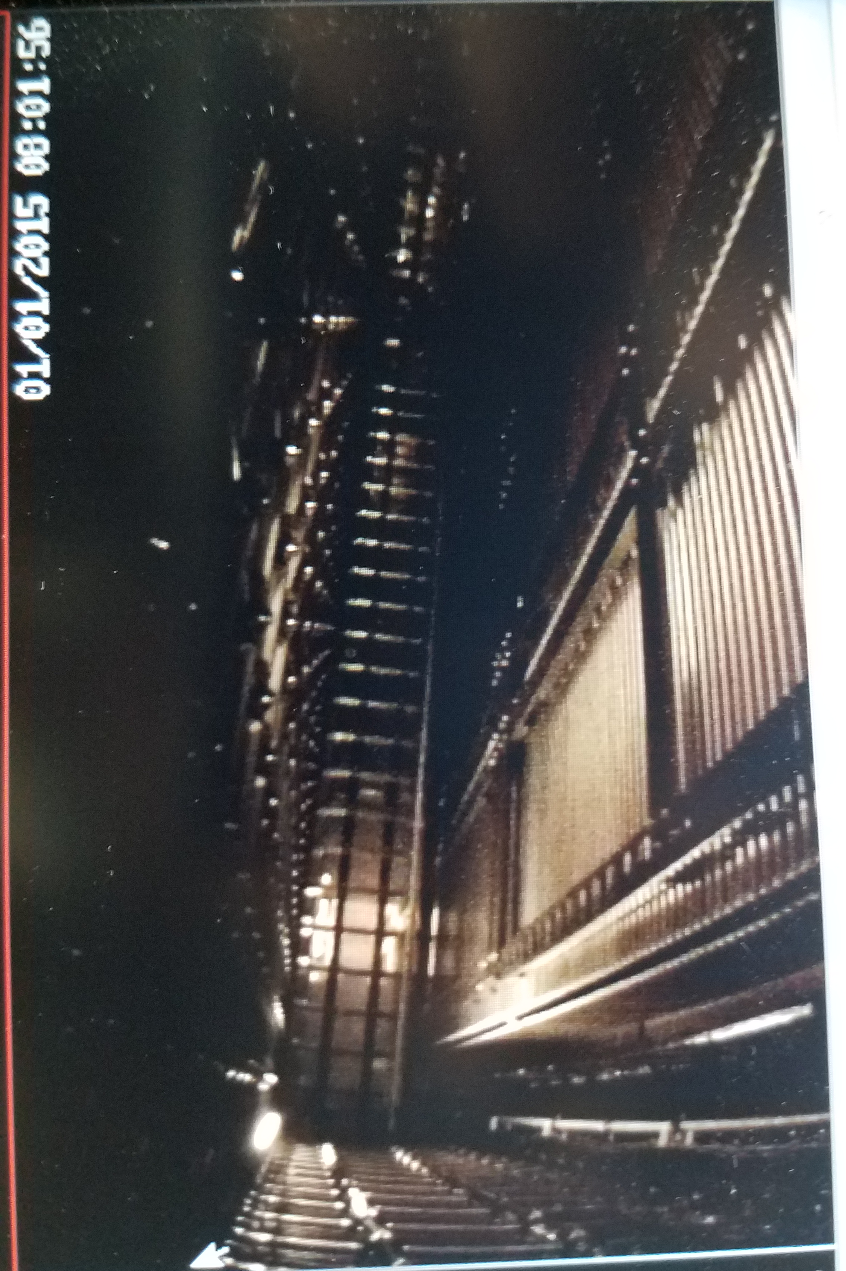
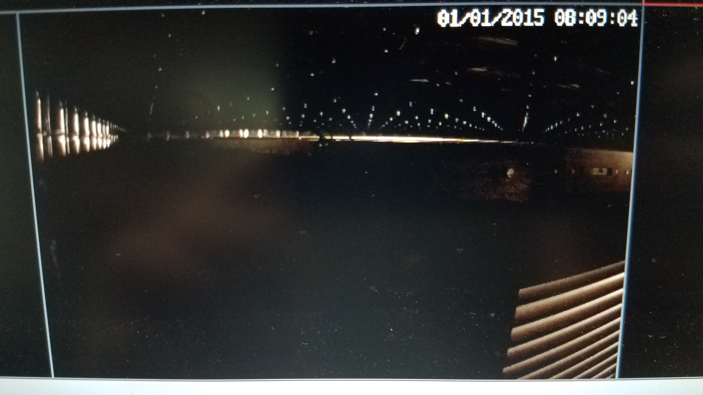
Camera Status
All 4 of Edgar’s W&M camera’s are reading out and all lights are functional
4 out of 5 of B0’s camera’s are reading out and infra red lights work. (1 is dead)
Both of Francisco's camera’s are reading out
Beam Left
Up Stream-Beam plug
Downstream
Beam
Right

Slide 4
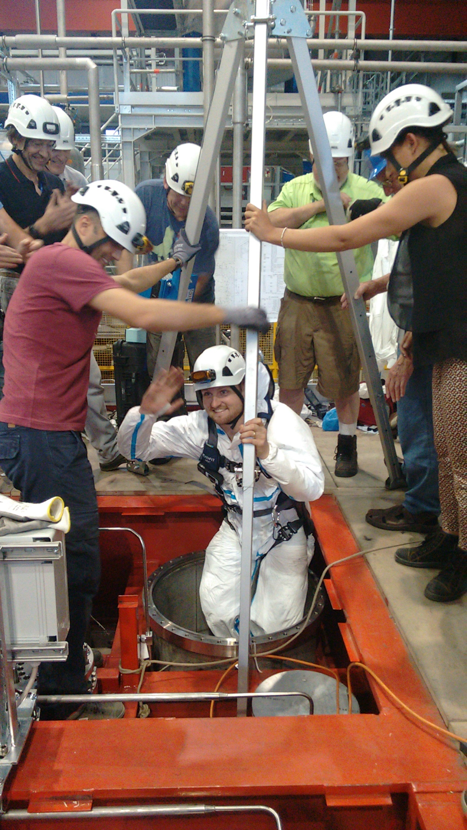
Inside was completed-29 June at 19:30
While we completed the TPC on Saturday, 23 June. There was a long list of items to complete.
Tests off all HV and grounding connections
Cleaning all the walls, floor and End Walls
Removing both set of scaffolds
Removing all the floor sections and blocks
Installing and testing additional cables and lights
Kevin earned the right to be the last man out of the cryostat!

Slide 5
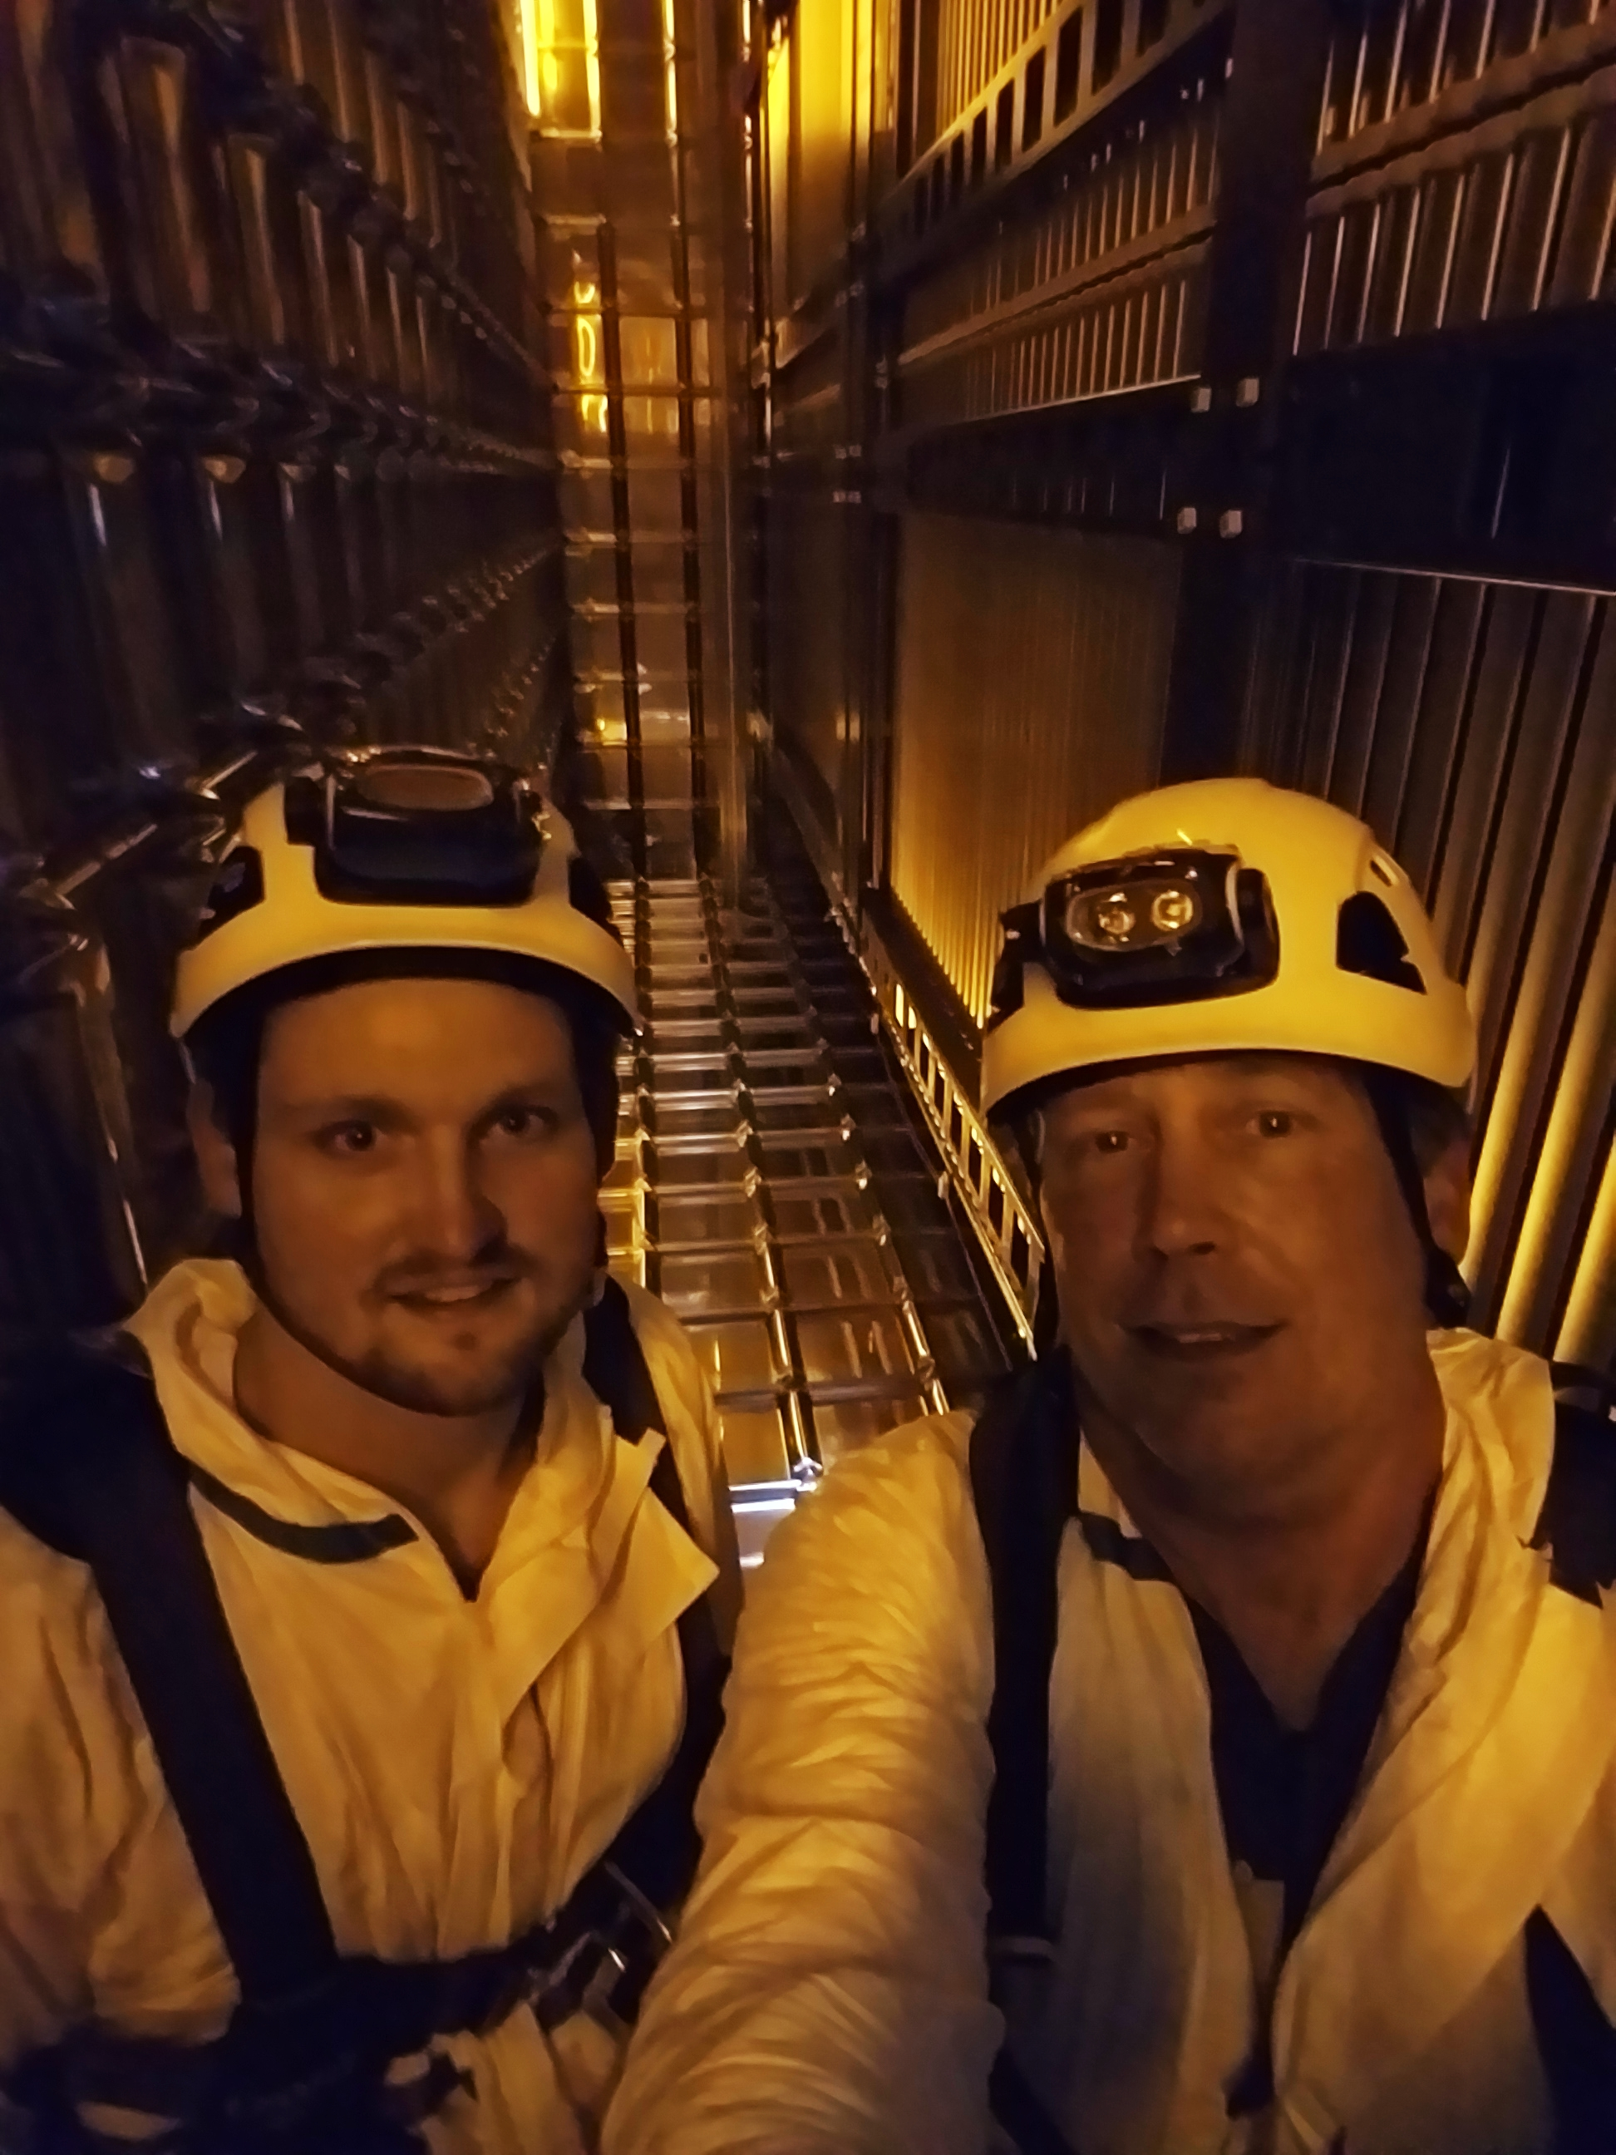
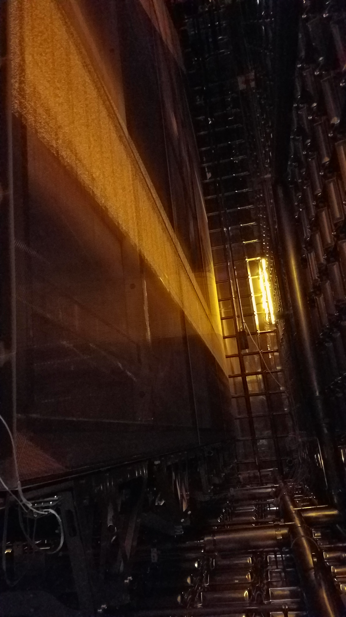
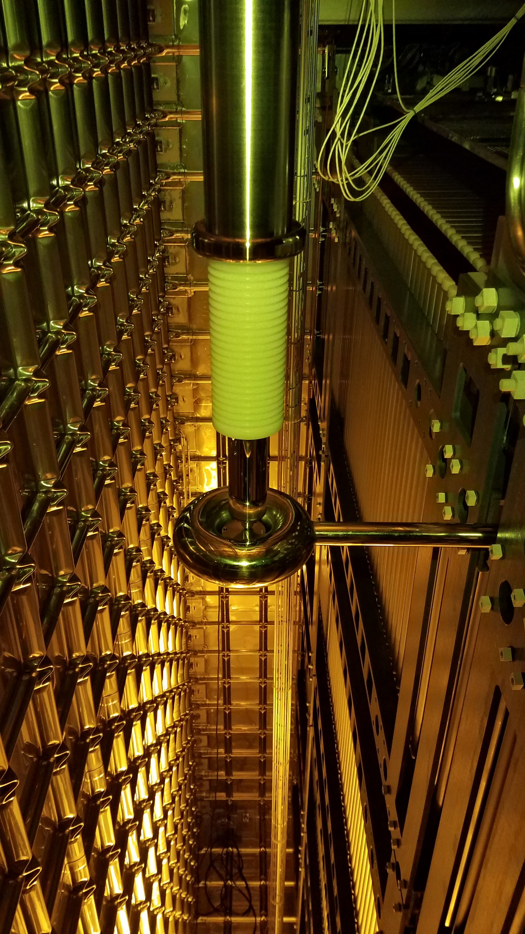
Some Pictures on the last day from Charles

Slide 6
University of Minnesota
Sad to say but we are all packed up and all our tools are ready to ship.
A special thanks from me to my entire crew for devoting so much time and energy to ProtoDUNE!
We look forward to coming back for phase two in 2020!
I have collected a few thousand picture which Diamanto and I will organize and put in a place that is accessible. We are also going to organize all the procedure and safety documents.

