Slide 1
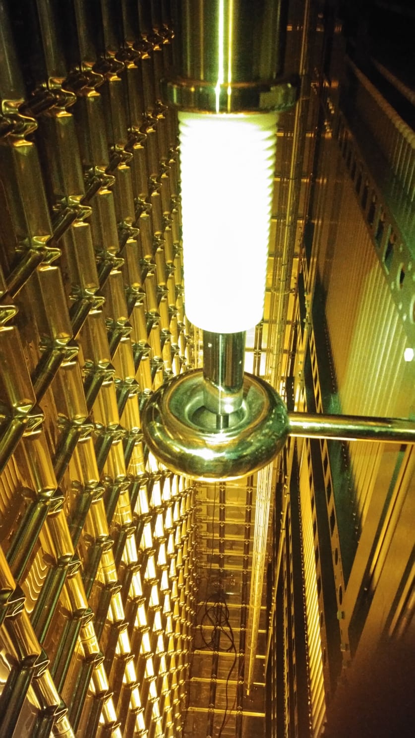
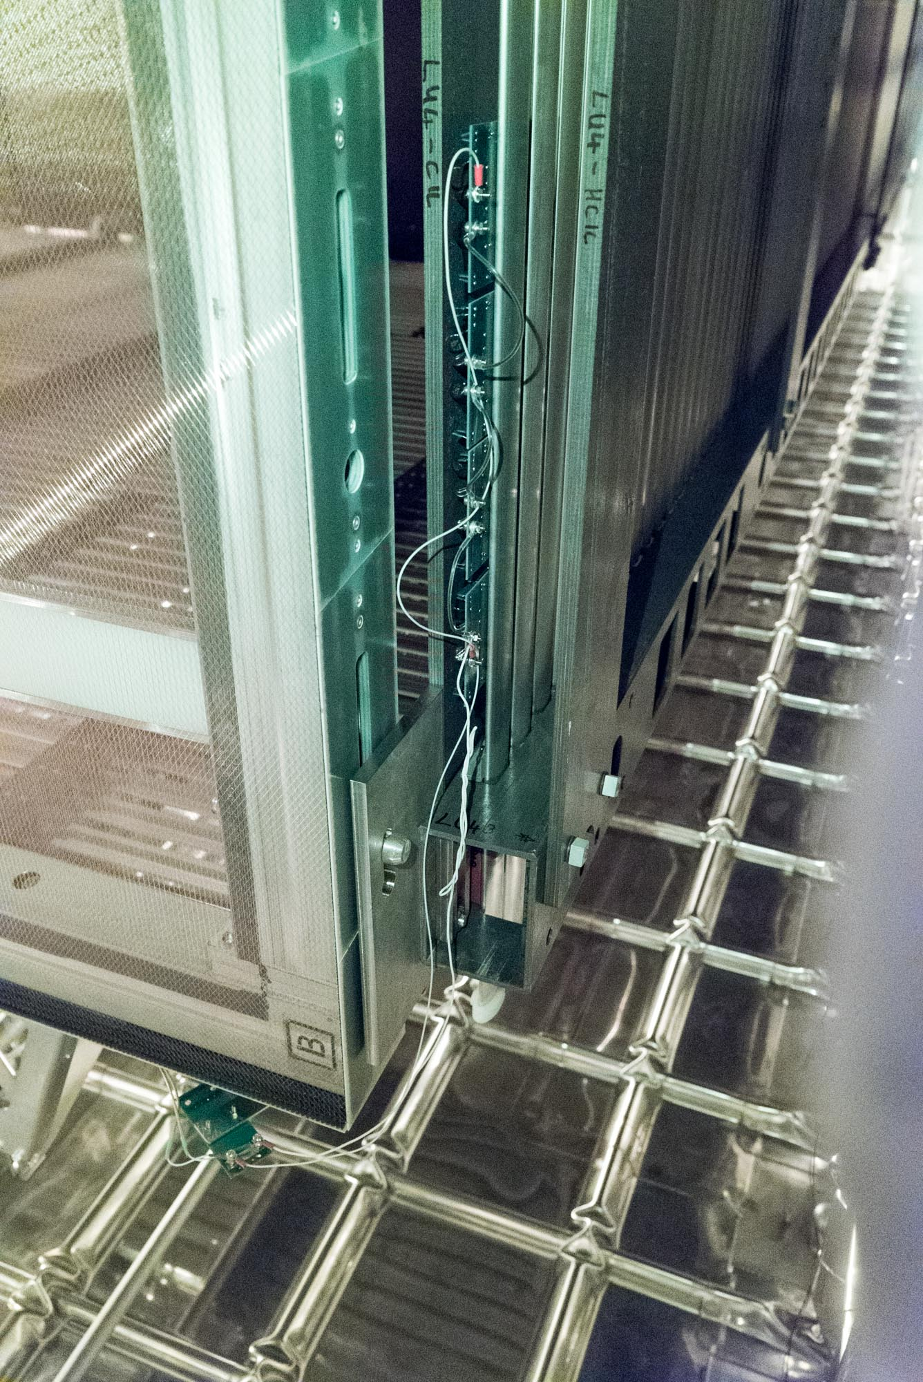
Installation of HV distribution
Full HV distribution installed:
Heinzinger PS
200 kV cable + two filters
15 MOhm + 6m cable (~0.6 nF) + 40MOhm + 14m cable (1.4 nF) + 40 MOhm + 6 m cable (0.6nF)
HV feed through
CPA Donut touched with spring loaded tip
Termination resistance to FC resistive chains:
Connections checked
values verified
Overall FC resistance check:
65 V applied at PS output
46.6 nA measured with Keithley Ammeter
Expected current: 46.3 nA due to 1.406 GOhm total resistance from the parallel of:
21 30-GOhm chains,
7 150-GOhm chains,
1 beam plug chain
One 150-GOhm missing chains would reduce the current by 0.44nA

Slide 2
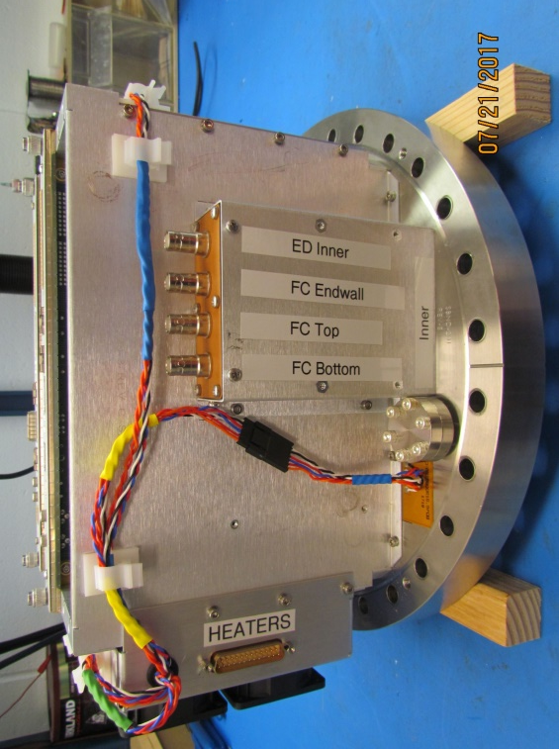
HV testing
With the whole HV chain connected, Voltage has been increased up to 19.5 kV:
Current increased linearly as expected (14.0uA at 19.5kV)
No “DP Field Cage effect” recorded
Voltage monitoring across termination resistance, to measure the current flowing along each FC divider chain
Voltage changes, proportional to applied HV, recorded on all termination except on four:
End-wall upstream, beam left
Termination on CE flange of APA US BL
End-wall, top FC, bottom FC downstream, beam left
Termination on CE flange of APA DW, BL

Slide 3
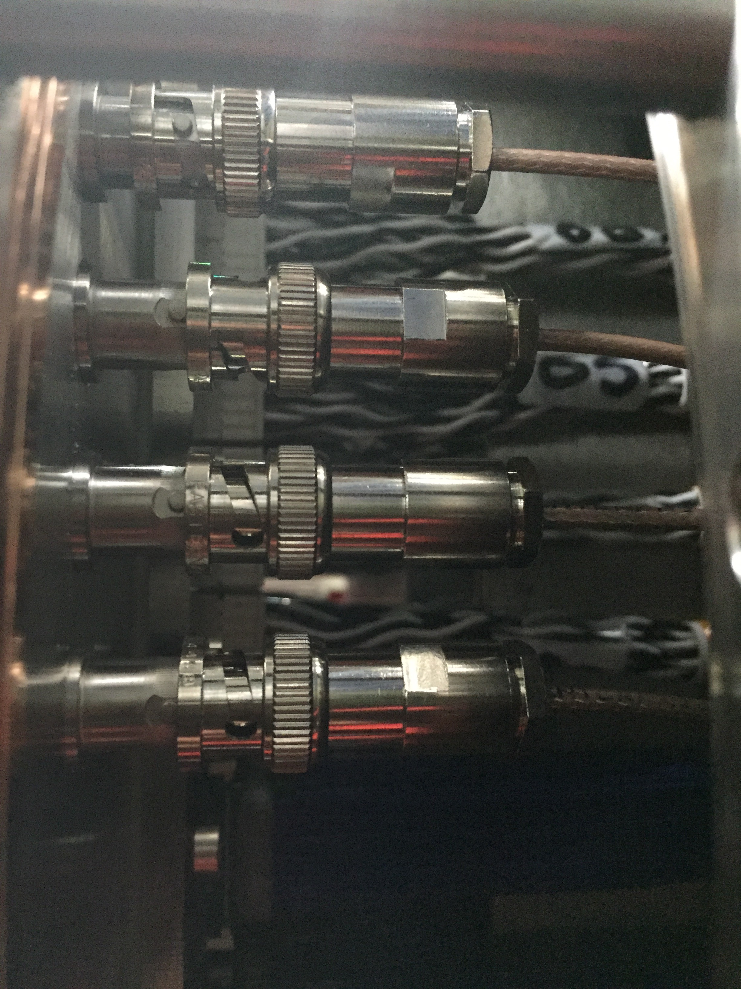
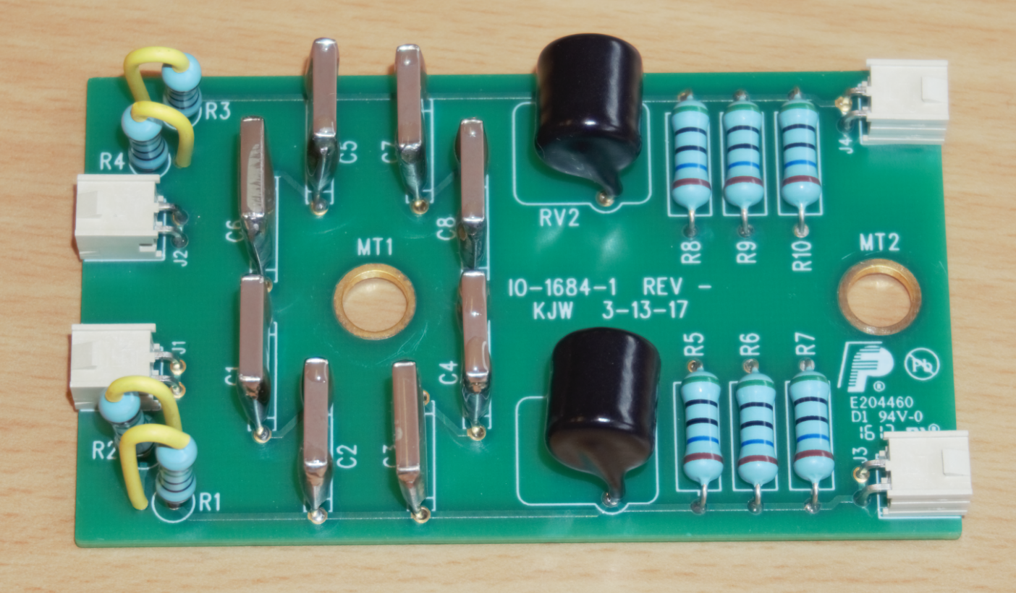
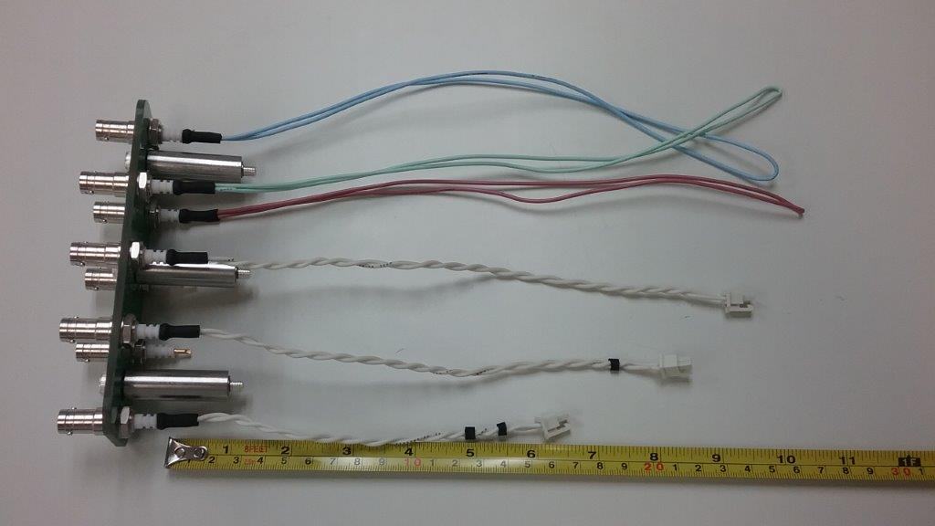
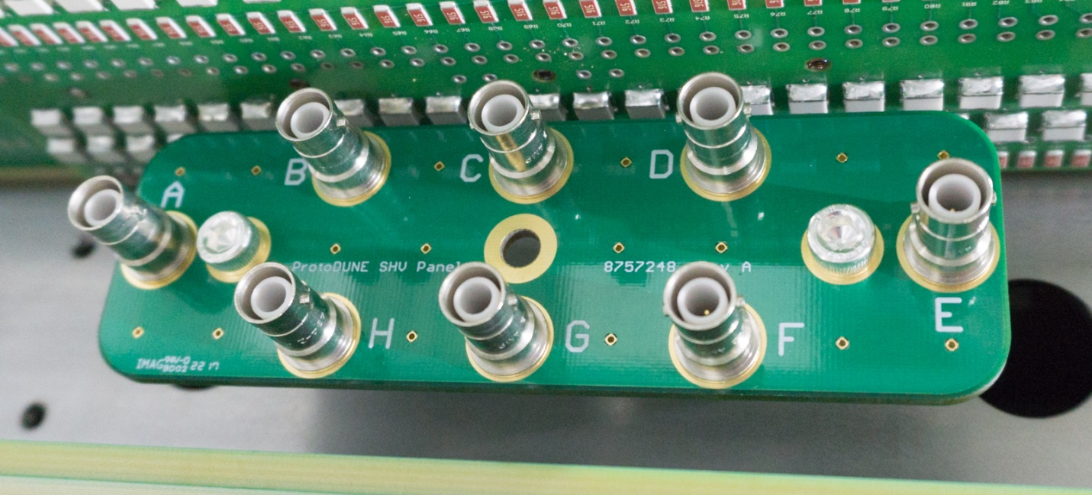
Recovering of FC terminations
DS, BL CE flange opened:
SHV connectors of termination resistances found not fully plugged-in
After re-plugging, the proper voltage drop across termination resistance was measured
US, BL flange opened:
All connector on CE flange well plugged in.
We suspect that the connection is open on the APA between the SHV board and the termination/filter board
We will not be able to monitor the current on the US,BL end wall and/or fine-tuning the voltage at the termination resistance.

