Slide 1
Project overview: Initializing and reading out a 3D qubit
Vinh San Dinh – St Andrews university
Helen Edward summer intern
Mentor: Dr. romanenko & Dr. Martinello

Slide 2
Introduction

Slide 3
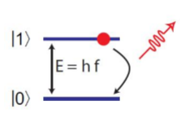
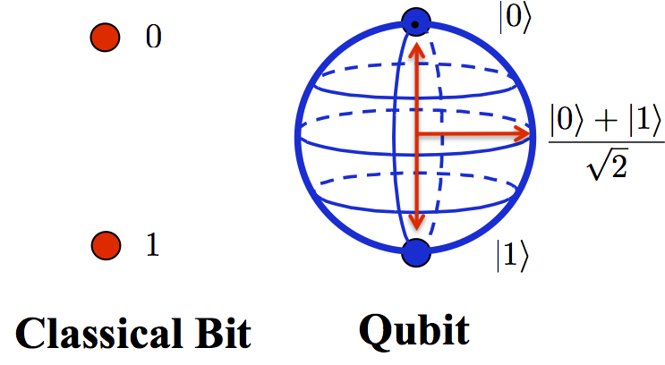
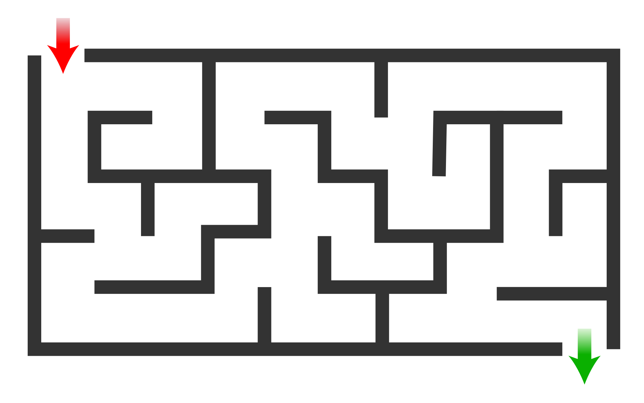
Introduction

Slide 4
Introduction

Slide 5
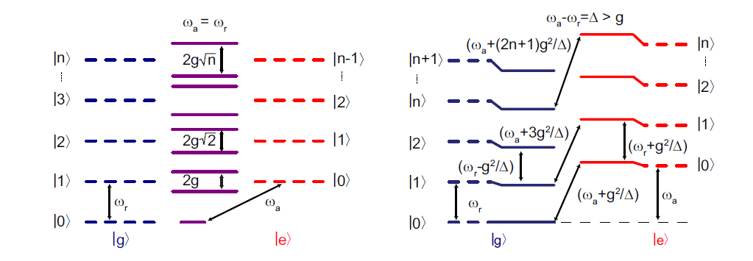
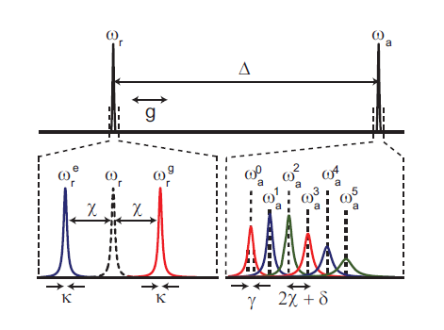
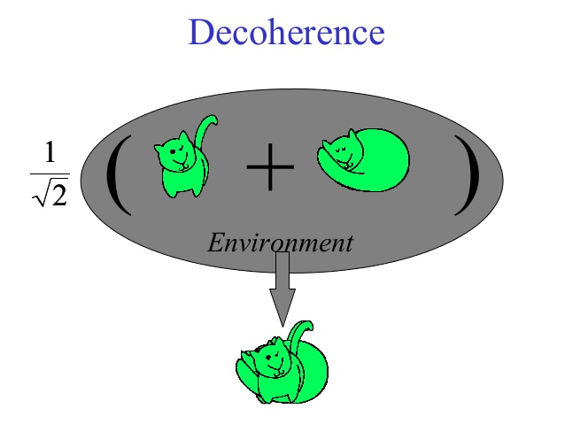
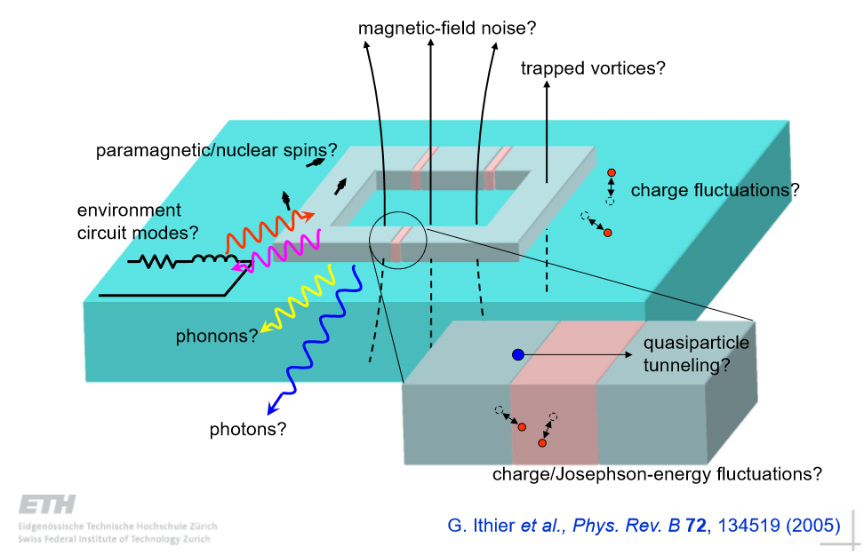
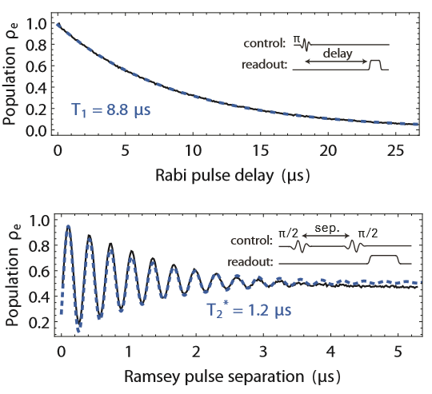
introduction
Qubit
Jaynes-Cummings Hamiltonian
Resonant
Dispersive
Cavity
Atom
Energy level
Spectrum
My project
Source of decoherences
Qubit characterization

Slide 6
Qubit characterization

Slide 7
Qubit characterization

Slide 8
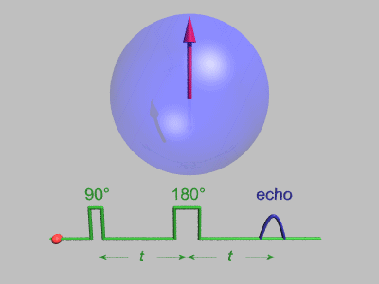
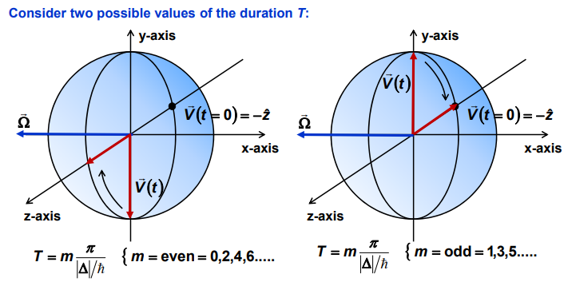
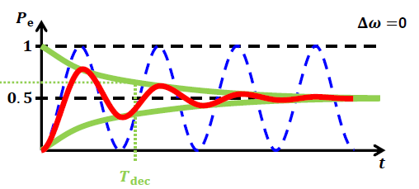
Qubit characterization

Slide 9
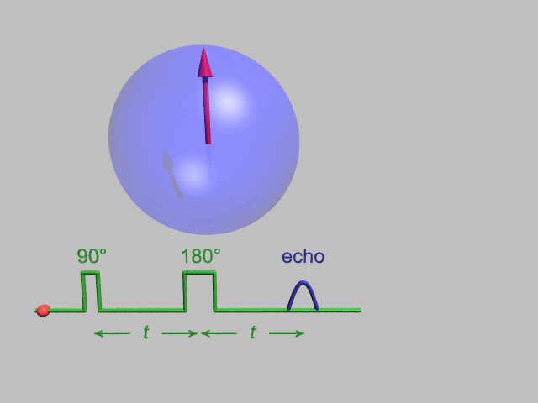
Qubit characterization

Slide 10
Overview

Slide 11
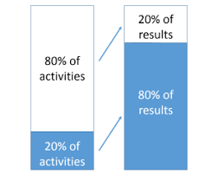
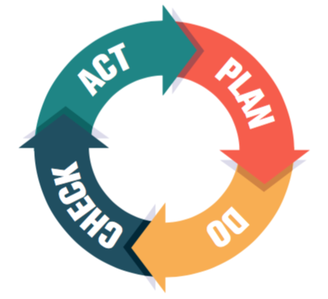
Planning
Focus
Asking questions
What have been done?
Finishing basic measurements
Fixing bugs Optimizing
Adding features
Exploring hardware
I am here
Finalising
Week 2
Week 6
Week 10

Slide 12
Thank you for your listening!
Any corrections, suggestions and recommendations?
Sources using in presentation: Schuster, David Isaac. Circuit quantum electrodynamics. Yale University, 2007 and ETH Zurich cQED research group

