Slide 1
Mu2e-II Calorimeter Suiting the Mechanics to new Crystals and Photosensors
F. Happacher, M. Martini
for the Calorimeter group

Slide 2
Mu2e – II technical specifications
Given the high radiation rate of the Mu2e-II environment the calorimeter requires to replace the crystals and the photosensors. The proposals is:
BaF₂ crystals, selecting the UV fast scintillation component
Fast photosensors and front end electronics able to stand the event rate and disentangle pileups.
Both crystals and photosensors need to stand a 10x higher dose with respect to Mu2e.
The photosensors may need to run at -25/-30 C to withstand the neutrons irradiation

Slide 3
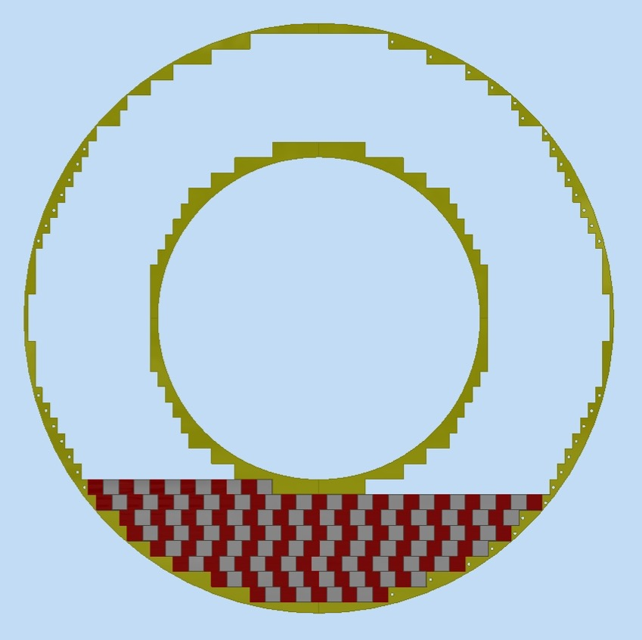
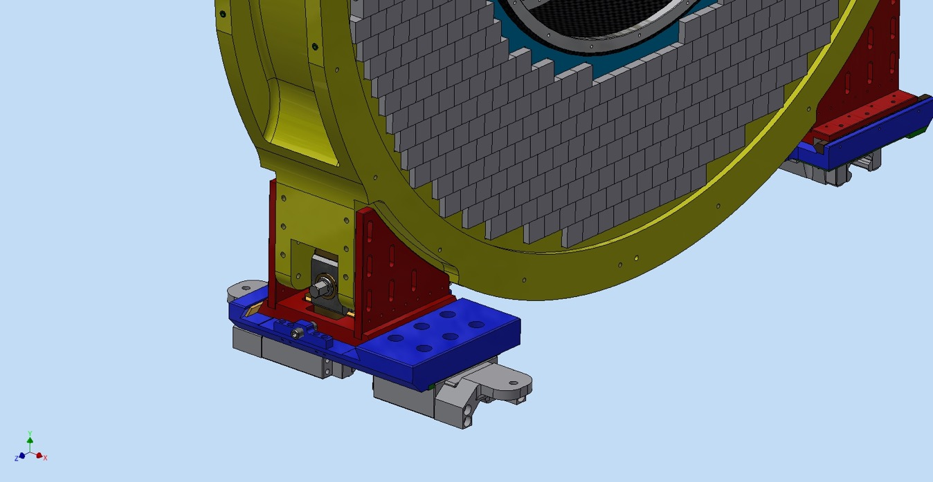
The Mu2e calorimeter view
The calo layout is designed to maximize the active area of the scintillating crystals. We made the effort of designing a structure that allows the self supporting arrangement of the cristals, reducing passive material

Slide 4
Calorimeter parts
non chi comincia ma quel che persevera
The calorimeter consists of two annuli each one composed of:
Source_Plate
n. 10 Readout elect . crates
Crystals
FEE_Plate
Inner ring
SiPM holder
Outer ring
Manifolds
Hydraulic connections
Inner steps
Outer steps
Alignment targets
Foot

Slide 5
Detector assembly sequence
non chi comincia ma quel che persevera
Step_6
Step_7&8
Step_3-5
Main assembly steps:
Outer ring
FEE plate (pre-assembled)
crystals
Inner ring
Crystals
crates
Alu sponge
Calibration source plate
EL boards
SiPM holders
Fibers (spheres, etc.)
Cables (LV connection)
Step_2
Step_3
Step_1
Step_10
The calorimeter components will be assembled using a workbench that allows also to move the calorimeter if needed.
The outer ring will be bolted on the workbench and all others components will be mounted on it.

Slide 6
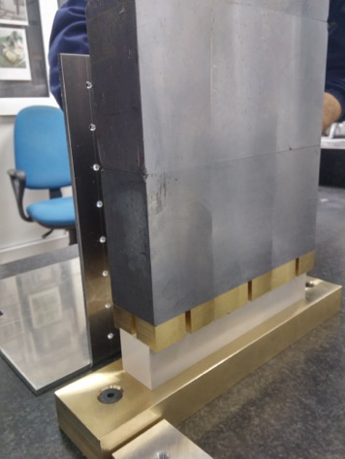
Impact on the mechanics – crystal choice
The mechanics of the Mu2e calorimeter is designed to allow the self supporting stack of CsI crystals.
The structural parts have been designed to minimize the static and dynamic stresses on the CsI crystals
In order to re-use the structural components
of the calorimeter we need to consider:
Mechanical properties differences between
CsI and BaF₂ crystals
geometry

Slide 7
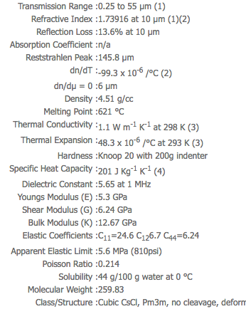
CsI vs BaF₂

Slide 9
CsI vs BaF₂
the mechanical properties relevant to the possibility of stacking the crystals on a self supporting are:
density
Young Modulus
Elasticity
Shear Modulus
Bulk Modulus
These properties are a factor 2 to 10 better in BaF₂ than CsI,
furthermore, BaF2 is not hygroscopyc.
All the performed stress test for CsI will pass for BaF2

Slide 10
Size and geometry
In order to make use of the current supporting structures we need to keep the same number of crystals and dimensions.
Since the Moliere radius is comparable, this layout should grant the same shower development and position resolution
Indeed, all the stepped margins for inner and outer rings are built- in and constrain the least granularity of the crystals array

Slide 11
Cooling the photosensors
The request of cooling the photosensors at a temperature between -25/-30 C implies the complete revisitation of the current cooling system
All the details of the effects of requiring to lower the temperature of the coolant, and therefore of the Front End plate where the cooling pipes are in thermal contact ti the photosensors, is described in DocDB 19447.
In this work L. Lucchesi has analyzed how requiring a lower T coolant reflects on a much more complicated cooling plant
Increase the glycol (40%) concentration to lower freezing T
Handle high coolant mass flow due to high viscosity
Increase of pressure drop and fluid velocity
Stresses on valves and corners
Not to increase fluid velocity too much we should increase pipes cross section
-> new cooling plant pumping
An alternative would be to use more dangerous and expensive coolants

Slide 12
In addition to this issue, we will need to model from scratch all the termal chain from the coolant to the SiPM surface and determine if the size of the current cooling pipes embedded in the FEE plate are enough to transfer the heat to reach low temperaures.
If not, we should build a new FEE plate
Another issue is the effect of such a lower runnig temperature on the equilibrium temperature of the calorimeter. This will be necessary lower than the current one, worsening the effects of heat irradiations from the tracker towards the calorimeter upstream end.

Slide 13
Conlusion
The current mechanical structure of the calorimeter can accommodate BaF2 crystals with the same size of the CsI crystals
A more detailed study has to be carried on to see whether we can cool down the photosensors to temperature around
-20/-30 C
We may need a more powerful cooling station and revise the design of the FEE plate that cools the photosensors.

