Slide 1
High Rate RPC for mu2e II CRV
Lei Xia
ANL - HEP

Slide 2
Potential application for mu2e II CRV
Mu2e II challenge for CRV: neutron/gamma background scale with luminosity
High counting rate due to neutron/gamma, especially in TS region
Potential higher dead time due to fake veto from accidental coincidences
Radiation damage to SiPM’s
CRV readout bandwidth limitation
If we cover the limited hot region with high rate RPC’s
Mostly immune to neutron/gamma background (eff < 1%)
Signal similar to SiPM (same readout?)
What is the charged particle rate?
(~kHz/cm² ???)

Slide 3
A rough rate estimate
From Mu2e simulation, in the highest rate region:
4x di-counter gets average ~10 hits/µBunch, in the live window (~1µs)
The high rate region is ~200cm long, and di-counter is 10cm wide
The beam flash creates comparable hits as the in the live gate (say, ~20 hits)
$$rate \sim (20+10)/1.7\text{µ}\text{s}\text{/(4}\text{x}\text{10}\text{cmx}\text{200}\text{cm}\text{) \sim 2.2}\text{kHz}\text{/}\text{cm}\text{2}$$
This is not bad at all!
A substantial fraction would be neutral particles (not visible to RPCs)
Hit rate used is for the entire counter
Rate won’t be even, some region will see higher rates
Beam variation
But still, this is probably the upper limit
Supposedly, the Mu2e II will have x10 rate → ~20kHz/cm²
This is within the limit of current high rate RPC technology
Knowing the exact charged particle rate would be a great help!

Slide 4
Efficiency requirement
Assuming 4 layers of RPC
From past experience with glass RPCs
98% efficiency is achievable for the best chambers (1 gap, avalanche mode)
>90% can be easily achieved in large scale production (1 gap)
If very high efficiency is required, 2-gap/layer would be the solution
What is the requirement for the high rate region?
We learned that in TS region, the CRV efficiency requirement is ~90%
RPC efficiency 2 / 4 veto efficiency 3 / 4 veto efficiency
90% 0.996 0.948
95% 0.9995 0.986
96% 0.9997 0.991
97% 0.9999 0.995

Slide 5
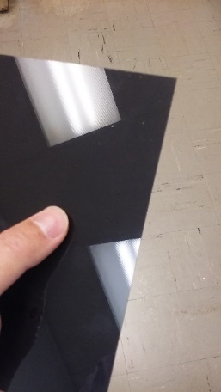
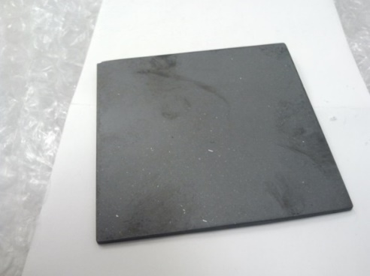
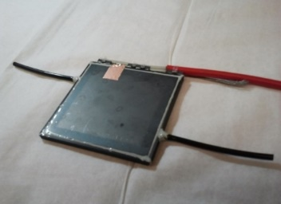
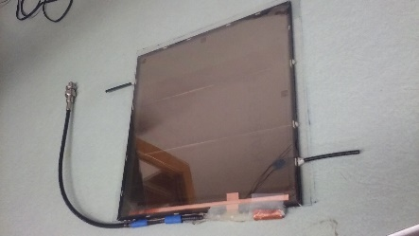
High rate RPC options: bulk material
Low R glass: Tsinghua U., China
Obtained sample, tested, good quality, readily available
Used in timing RPC for real experiment(s)
>10k/cm²
Cost: a little bit high
Low R glass: Schott
Tested samples, commercially available (?)
> several k/cm²
Cost: don’t know yet
Low R glass: ANL, COE College development
Produced samples, tested
> several k/cm²
Atom Layer Deposition (ALD) coated glass RPC
New idea, prototype exist
Low R glass sample
from Tsinghua
Low R glass sample from Schott
Low R glass sample from COE College
ALD coated glass RPC

Slide 6
Next steps
Simulation study to determine charged particle rate and safety factor
Test RPC with current CRV electronics to verify compatibility
Construction and testing of prototype high rate RPCs
(Construct small module to test in Mu2e TS region?)

