Slide 1
Accelerator R&D for Mu2e-II
Steve Werkema
Mu2e-II Workshop
Northwestern University
29 August 2018

Slide 2
Outline of Talk
Overview of beam delivery to Mu2e-II
List of accelerator issues
Target Station Taskforce

Slide 3
Mu2e-II Beam Delivery

Slide 4
Mu2e II Beam Delivery
M4
MI-8
New Beamline for Mu2e-II
PIP-II Linac

Slide 5
Mu2e-II Beam Delivery
PIP-II Linac delivers 800 MeV pulsed H⁻ beam to an extension of the Linac‑Booster beamline
H⁻ pulse rate can be varied between 0.5 MHz and 1.25 MHz
H⁻ pulses are 100 nsec long
Beam is switched to a dedicated Mu2e beamline
PIP II CDR contains a lattice design for the new Mu2e beamline
Notes:
PIP-II CDR version V.0.3: http://pxie.fnal.gov/PIP-II_CDR/default.htm (April 2018)

Slide 6
Potential Utilities Interference with Mu2e Beamline
Mu2e
CUB
MC-1
Approx. Location of Mu2e Beamline
Notes:
Cyan – ICW
Orange – Communication
Thick Black/Cyan – Cryo
Thin Black/Cyan – Chilled Water
Black/Blue – LCW

Slide 7
Mu2e and Mu2e-II Proton Beam Parameters
Parameter | Mu2e | Mu2e II | Units
Total Protons on Target (3 yr) | 4.7×10²⁰ | 5.2 × 10²² | protons
Pulse Repetition Rate | 590 | 500 - 1250 | kHz
Time Between Pulses | 1695 | 800 - 2000 | nsec
Pulse Base Width | 250 | 100 | nsec
Extinction Level | 10⁻¹⁰ | 10⁻¹¹
Average Intensity per Pulse | 3.9×10⁷ | 1.4 × 10⁹ | protons/pulse
Pulse-to-Pulse Intensity Variation | <50 | <10 | %
Beam Kinetic Energy | 7946 | 800 | MeV
Beam Power | 7.3 | 100 | kW
Duty Factor | 25 | 90 | %
NOTEs:
Blue numbers are calculated from the other parameters.
Total POT assumes 63% accelerator up-time (2 × 10⁷ sec/yr)
Notes:
Mu2e-II parameters are subject to change. This set of parameters is sufficient to illustrate the accelerator issues associated with Mu2e-II.
Mu2e beam power is calculated using the proton kinetic energy.
NOTEs:
Beam powers greater than 100 kW are possible at 800 MeV.
The Mu2e-II duty factor may be impacted by other users (e.g. LBNF).

Slide 8
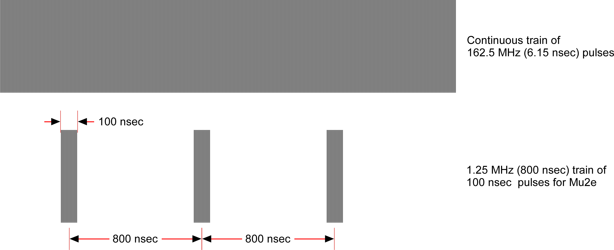
Pulse Formation for Mu2e-II
Most of the pulse formation for Mu2e will occur in the Medium Energy Beam Transport (MEBT) section of the PIP-II Linac. MEBT is the final stage of the warm front end of the linac.
The input to MEBT is a 162.5 MHz pulse train of 2.1 MeV H⁻ ions.
The chopper system in the MEBT forms 100 nsec pulses for Mu2e by the removing unwanted beam between pulses.
MEBT input
(CW Mode)
(162.5 MHz bunches too small to see on this scale)
MEBT output
Each 100 nsec pulse contains 16 162.5 MHz pulses

Slide 9
Pulsed Beam Formation – Beam transport through MEBT
PIP-II Medium Energy Beam Transport (MEBT) section.
Pulse formation is accomplished by a fast bunch-by-bunch chopper.
Chopper consists of two fast vertical kicker magnets and a beam absorber
Kickers are excited during transmission and chopping
Input: Bunch train of 2.1 MeV H⁻ ions @162.5 MHz (6 nsec bunch-bunch)
Transmitted bunch: Upstream kicker defects down, downstream kicker deflects up, bunch clears absorber
Chopped bunch: Upstream kicker defects up, downstream kicker deflects down, bunch hits absorber
This system can produce 100 nsec pulsed beam with variable 800 – 2000 nsec bunch spacing.
Notes:
Beam envelope plots from PIP-II CDR V0.03 Figure 3.16 (http://pxie.fnal.gov/PIP-II_CDR/default.htm).
Beam center is magenta
3-sigma beam envelope is in blue

Slide 10
MEBT Chopper Operation for 100 nsec pulse formation
Removed
Removed
Notes:
LEBT chopper will eliminate most leading and trailing bunches upstream of MEBT
Upstream collimation will remove transverse tails
This is the longitudinal profile seen by the production target
Notes:
LEBT = Low Energy Beam Transport

Slide 11
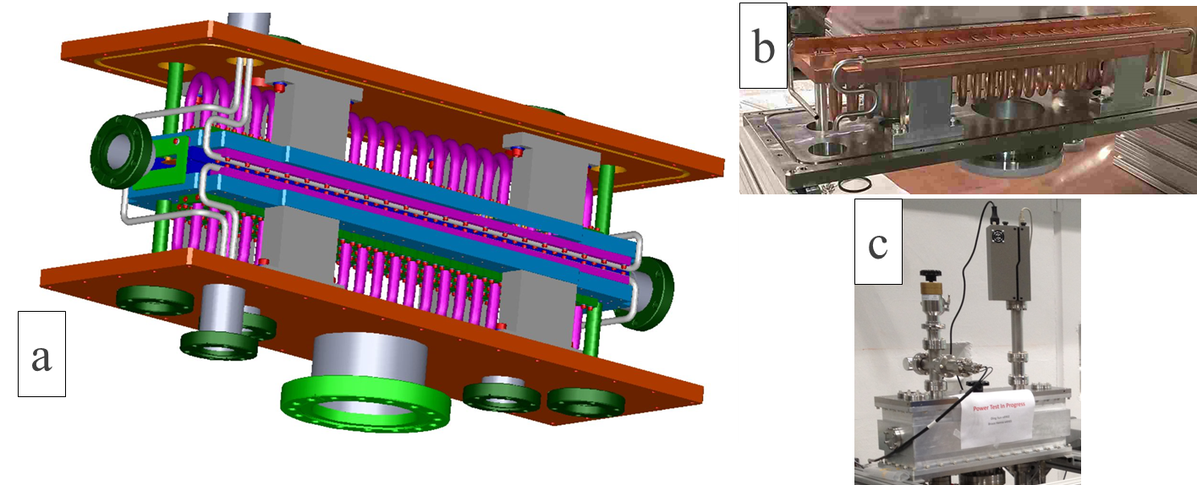
Fast Kicker for MEBT chopper
This is one of two prototype kickers built for testing in PIP2IT
Notes:
From PIP-II CDR V0.03 Figure 3.17 (http://pxie.fnal.gov/PIP-II_CDR/default.htm).

Slide 12
Accelerator Issues

Slide 13
List of Major Issues
Extinction depends on the MEBT chopper system – can this system in combination with the M4 AC dipoles achieve the required 10⁻¹¹ extinction factor? What modifications to the M4 AC dipoles and power supplies are required to accommodate 0.5 to 1.25 MHz variable pulse repetition rates?
Relatively Easy
Where do we strip the electrons in the H⁻ beam?
Worrisome
What upgrades to the radiation shielding of the M4 Beamline enclosure and Mu2e building are required? Present facilities designed for 8 GeV / 8 kW protons. Can the existing shielding be augmented to accommodate 100 kW? At what cost?
Difficult/Expensive
Primary beam transport through the TS and PS – can we still hit the target and the proton absorber? What are the implications for the extinction monitor?
Difficult/Expensive
Target station and target handling upgrades required for 100 kW beam.
Difficult/Expensive
HRS upgrades to provide the additional PS and TS thermal and radiation shielding required for 100 kW beam.
Worrisome/Expensive

Slide 14
H⁻ Stripping
Presently there is no provision for stripping the electrons in the PIP-II Linac
H⁻ has two electrons: one tightly bound (13.6 eV), the other is not so tightly bound (0.75 eV).
Two Options:
Transport H⁻ to Mu2e production target
Is this option available for consideration?
Need to keep the H⁻ intact all the way to the target
In each beamline magnet the electrons see a rest frame electric field given by: $\vec{E}=γc\vec{β}×\vec{B}$ ⇒ relatively easy to neutralize H⁻ to H. PS field could be a problem. What will the extinction dipole do to out-of-time H⁻?
Does this option require better beamline vacuum?
Strip the electrons:
Where? (225 μA e⁻ has to go somewhere)
Radiological issues?
Inefficiencies
Should be a solvable problem
Notes:
Note: stripping for present Booster injection is at 400 MeV. For a given B, the rest frame electric field is 1.5 times greater at 800 MeV.

Slide 15
Radiological Issues
Mu2e-II removes from consideration two very serious radiological liabilities
Resonant Extraction from the Delivery Ring (very lossy)
Poor shielding of the Delivery Ring enclosure
However, the increased beam power on target greatly aggravates the radiological hazard in the Mu2e building.
Radiological conditions for 8 kW primary beam:
Radiation does rates on berm above PS hall: 5 mRem/hr (steel shielding required to achieve these rates)
Sky shine does rate at Wilson Hall ≲ 0.1 mRem/yr
West wall concrete augmented to prevent surface and ground water activation
Mu2e-II beam 14× greater beam power, 14 – 22× greater intensity per pulse, 3.5× greater duty factor give:
increased dose rates on berm at the Mu2e building
increased sky shine dose rates in remote locations (i.e. Wilson Hall, Site Boundary)
much greater target and beam dump activation
Greater neutron and charged particle fluence toward Mu2e detectors
Very little space available to augment shielding
The radiological issues will be very difficult to solve

Slide 16
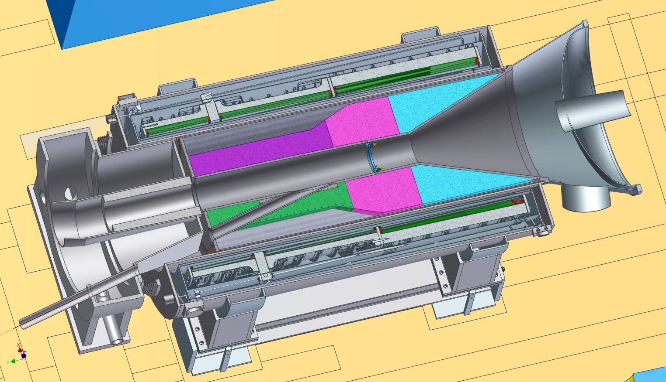
Primary Beam Transport through the Solenoids: 8 GeV Proton Beam Trajectory
8 GeV proton beam enters PS:
0.57 m off-axis
vertical pitch = -3.1°
horizontal bearing = 13.6° relative to the PS axis
For 8 GeV beam, the horizontal projection of the proton trajectory is well approximated by a straight line.
This is not the case at 800 MeV.
Target
~14°
Horizontal section of production solenoid.
PS axis is parallel to the magnetic field.
This is a difficult problem – smart people are working on it. See:
Tom Roberts, Mu2e-doc-6810, and
David Neuffer, Mu2e-doc-16328
See talk by David Neuffer at this workshop
Notes:
Notes:
The horizontal bearing changes from 13.6$°$ (at PS entrance) to 14$°$ (at target) due to the small vertical pitch of the beam velocity vector.
The vertical pitch of the beam increases from -3.1$°$ to 0$°$ due to the horizontal bearing of beam velocity vector
NOTE: the present extinction monitor layout is optimized for 4 GeV/c protons and pions – will need to be overhauled. Also, extinction monitor sensitivity must increase by a factor of 10.

Slide 17
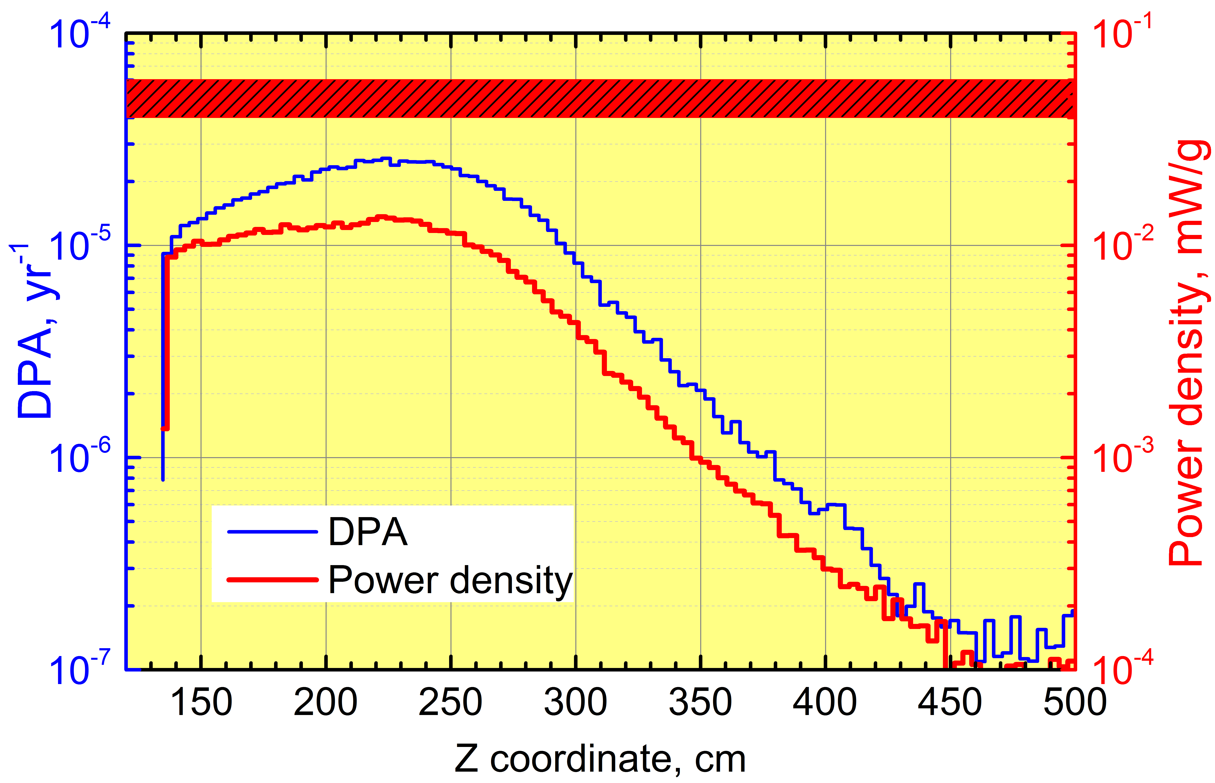
Simulated 8 GeV Bronze HRS Performance
MARS Simulations
Vitaly Pronskikh
PS DPA Limit
PS Pwr Density Limit
T
Notes:
The line labeled “T” is the proton target.
At 100 kW expect:
DPA and Power Density to increase everywhere
Peak DPA and Power Density will move upstream – toward the target

Slide 18
HRS Upgrades
At 8 GeV, HRS radiation damage and energy deposition margins are small
no room to increase beam power
do not want to warm up for annealing more than once per year
⇒ HRS must be replaced
HRS removal will be difficult
HRS is welded to the PS cryostat
HRS will be extremely radioactive after Mu2e run
Very likely we will remove the HRS and PS together
Options for improving heat and radiation shielding:
Change material (tungsten instead of bronze) – very expensive
Increase HRS thickness – lost muon yield
See talk by Vitally Pronskikh at this workshop

Slide 19
Target Station Issues
Present Mu2e target is radiatively cooled – designed to survive one year of 8 kW beam
One year target lifetime at 100 kW will require forced cooling of the target.
Plumbing for cooling system kills muon yield
Need real-estate for cooling plant
A conceptual design of a target cooling system exits (next slide)
At 100 kW, radiation damage to the target will be an important issue – may be the principle factor determining target lifetime ⟹ R&D Required
The present location of the target dump is optimized for 8 GeV beam, not 800 MeV
The present target beam dump is air cooled
Target dump for 100 kW primary beam will require water cooling
Requires disassembly of a highly radioactive component (i.e. the present dump after 3+ years of exposure)
Target handling system will require upgrade to accommodate a more radioactive target and the cooling system plumbing.
These could be the most difficult issues to be solved for Mu2e-II

Slide 20
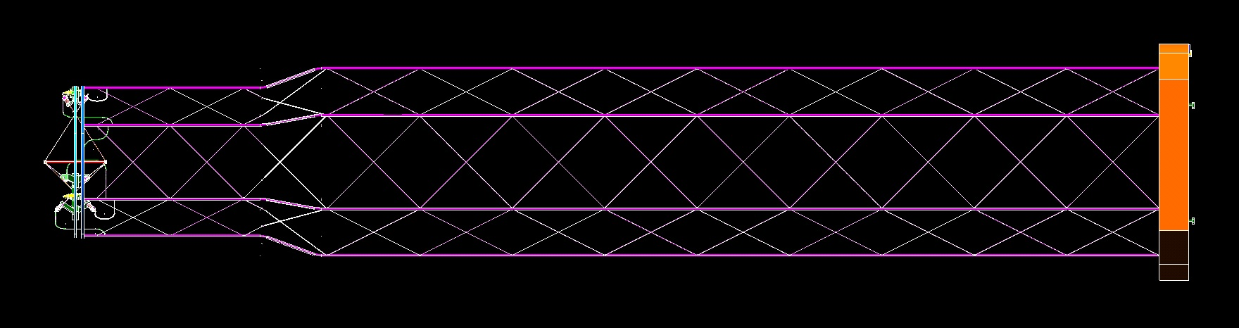
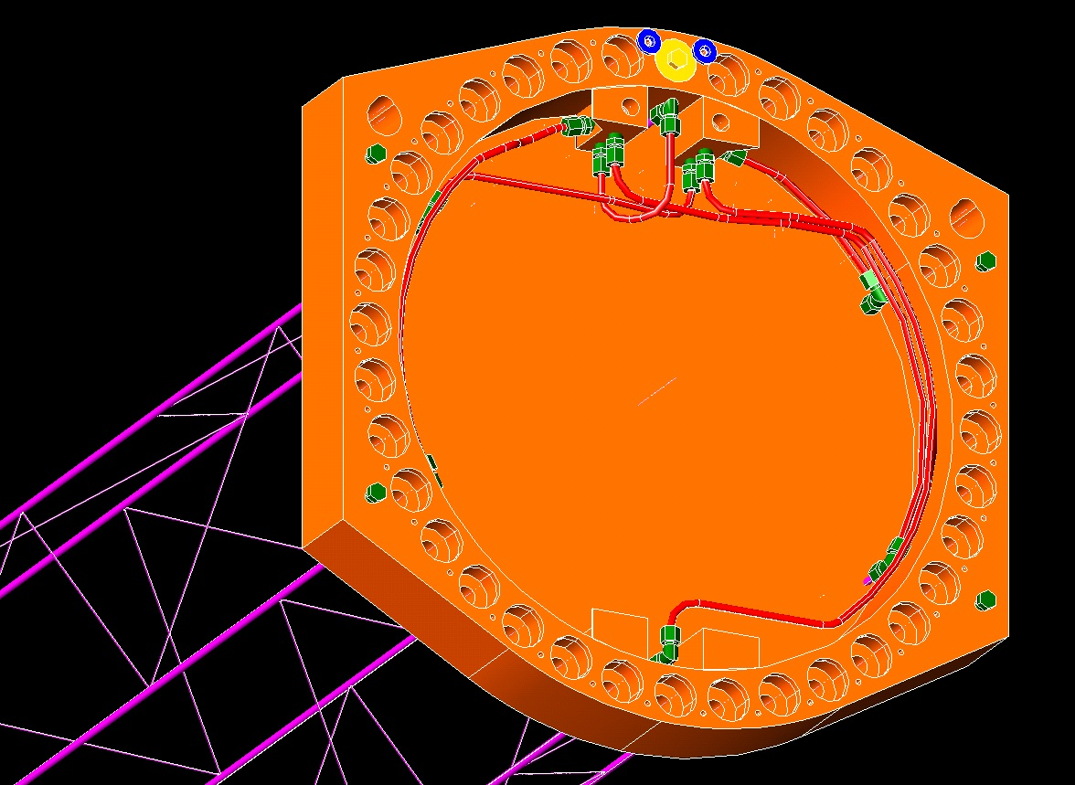
Target Cooling Scheme – Mike Campbell (Mu2e-doc-4146)
Target Ring
Concept for a plumbing scheme for a cooled target has been developed
Very low mass to minimize impact on muon yield
Target would be enclosed in a Titanium jacket
Target change-out includes plumbing replacement (more expensive)
PS End cap fittings

Slide 21
Target Station Task Force

Slide 22
Target Station Task force
In June, a task force was formed to study the target station issues of Mu2e II.
The task force participants (so far) are:
Bob Zwaska FNAL AD co-chair
Steve Werkema FNAL AD co-chair
Kevin Lynch York College
Jim Popp York College
Eliana Gianfelice-Wendt FNAL APC
Vadim Kashikhin FNAL TD
Dave Neuffer FNAL APC
Giorgio Ambrosio FNAL TD
The task force has had one meeting (yesterday)

Slide 23
Charge for Mu2e-II Target Station Task Force (1)
22 June 2018
The Task Force will develop conceptual design options for a production target capable of handling sufficient beam power to enable the Mu2e-II experiment. Mu2e-II is an upgrade that aims to improve the sensitivity to the flavor-violating process, μN → eN, by another order of magnitude relative to the Mu2e experiment. The production target will be located inside the Mu2e Production Solenoid and shall be designed to meet the following physics requirements:
will utilize a pulsed beam of 800 MeV protons from PIP-II
will tolerate a total number of protons on target large enough to produce at least 7 x 10¹⁸ stopped muons (i.e. about x10 more than the current Mu2e) over a total running time of 6 x10⁷ seconds (i.e. full intensity running for 3y at 2 x10⁷ seconds per year, the same as the current Mu2e)
The pulsed proton beam is expected to have these characteristics:
the proton pulses will have a full width of no more than 100 ns
the proton pulses will be spaced about 1700 ns apart
the pulse-to-pulse intensity variation will be no larger than +/-20% of the nominal intensity
the ratio of out-of-pulse beam to in-pulse beam (ie. extinction) is no more than 1 x 10⁻¹¹
the Mu2e pulses will be delivered uninterrupted for >900 ms of every second (on average) ⇒ Duty Factor ≥ 90%
Owing to the increased radiation and heat loads necessary for Mu2e-II, the Mu2e Production Solenoid (PS) will have to be replaced. Since the upgraded production target will be located inside the upgraded PS, the conceptual design of the two should be developed together. The new PS should:
fit within the existing Mu2e PS hall
match the TS field
house the production target and the associated supports and services
house an upgraded Heat and Radiation Shield.
 Assuming the same stopped-μ/POT ratio as the current Mu2e, this would correspond to an average beam power of about 80 kW. Any reduction in the stopped-μ yield, owing, for example, to significant changes to the geometry of the production target or its associated supports and services, should be compensated by an increase in beam power in order to meet this requirement.
Very similar to parameters given earlier
We expect to raise the beam power
Notes:
The good news is that the PIP-II linac is able to provide all of the power we could conceivably require.
The bad news is that some of the accelerator problems that must be solved for Mu2e-II are made worse by increased beam power.

Slide 24
Charge for Mu2e-II Target Station Task Force (2)
Provide a prioritized list of target and solenoid R&D items that must be investigated to further develop the production target and PS designs for the Mu2e-II experiment. This list should be annotated with specific questions that must be answered to begin estimating the cost for the upgrades necessary for Mu2e-II.
Issue preliminary report by 01-November-2018, and final report by 31-January-2019.
Note: it has not escaped our notice that we haven’t (yet) been asked to solve any problems

Slide 25
Target Station Task Force – Likely Beam Power Adjustments
Target will require convective cooling (Mu2e target is radiatively cooled). The plumbing required to bring the cooling media to the target will absorb secondaries.
Convectively cooled target will require a cooling jacket giving the target a larger footprint inside the PS bore.
Target material may need to be changed. A lower Z target would reduce the yield.
The curvature of the primary beam trajectory in the PS is greater causing some reduction in the overlap of the beam transverse distribution and the target.
HRS thickness may need to be increased, reducing the aperture for transport of secondaries. This also moves the target cooling pipes closer to the target where the secondary flux is greater.

Slide 26
Accelerator Issues Approximately Ordered by Difficulty
Delivery of beam to Mu2e-II will be a challenging and expensive undertaking.
Work has begun on some of the most important issues as you’ll hear in the next few talks.
The Target Station Task Force is up and running

