Slide 1
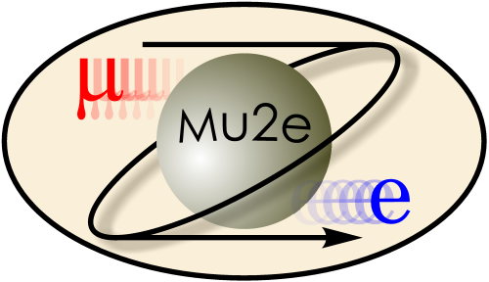
Solenoids Working Group
K. Badgley and A. Hocker
Mu2e-II
August 30, 2018

Slide 2
Mu2e Solenoids
TSD
TSU
PS
DS
Detector Solenoid
No upgrades
Transport Solenoid
Modification of TSU
Proton beam through upstream TSU
Production Solenoid
Will need to replaced
New conductor, larger bore, …

Slide 3
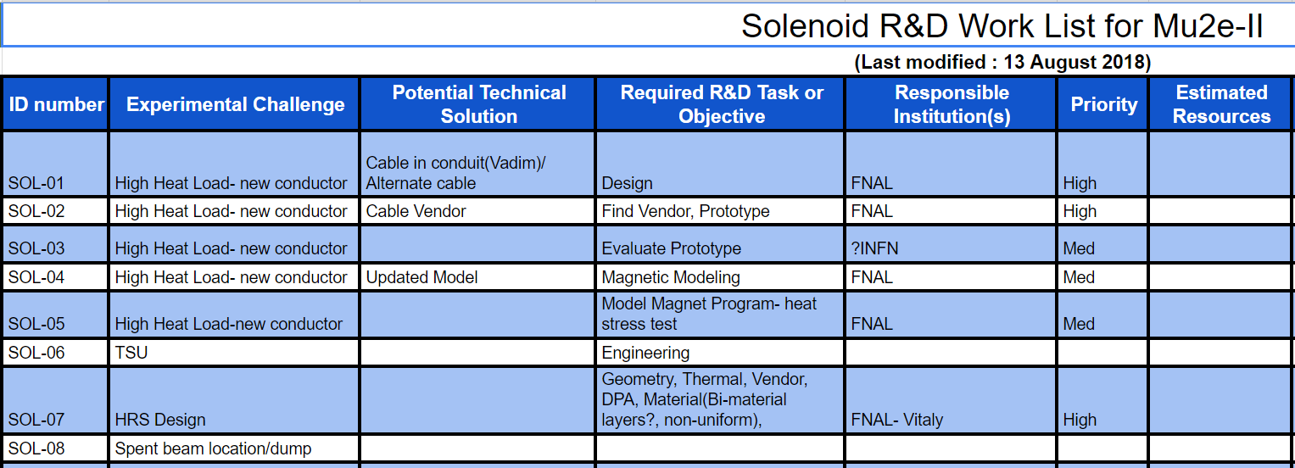
Experimental Challenges
Radiation Effects on the Superconductor
Peak Power Density
DPA
Proton Beam Line
Heat and Radiation Shield Design
TSU Modification

Slide 4
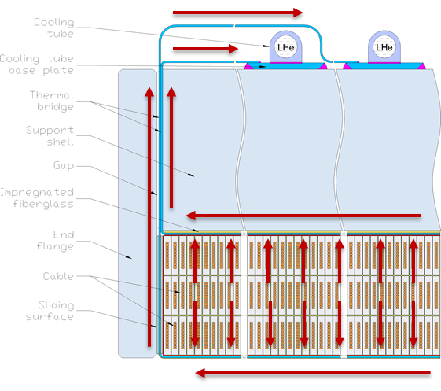
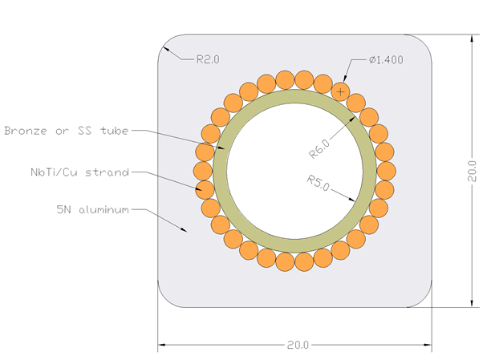
Superconductor Peak Power R&D
Increased Cooling- lower LHe temp
With W shield, run at ~3.7 K to keep required temperature margin of 1.5 K
New Cable with internal cooling (Vadim)
Easier to wind
~4-5 years to develop and verify
May be difficult to find cable vendor
LHe forced flow
Vadim

Slide 5
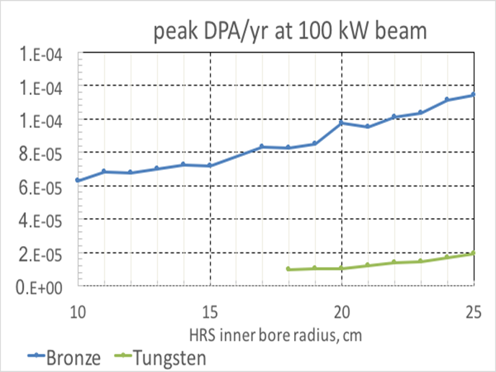
Superconductor DPA R&D
Tungsten HRS would solve DPA issues (Vitaly)
Vitaly
Vitaly

Slide 6
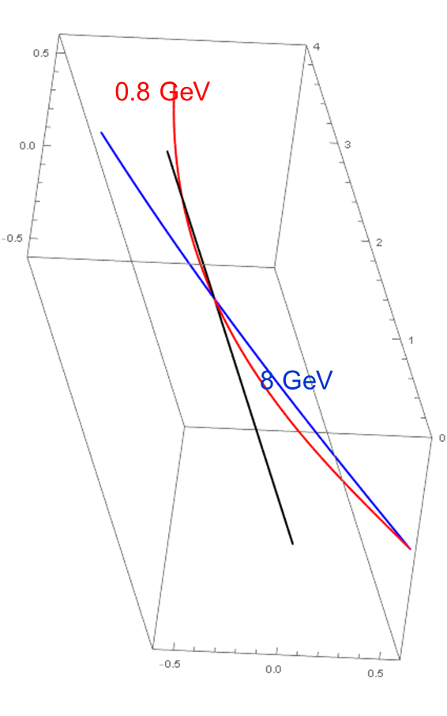
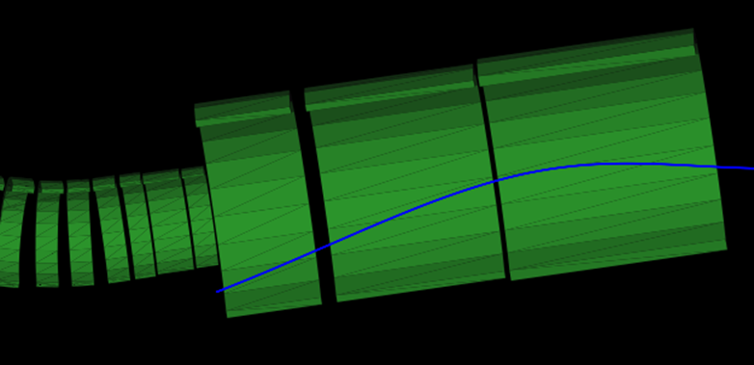
Proton Beam Line
Change incoming beam trajectory to hit target (Neuffer)
Bend outgoing beam to hit dump – additional dipole?
Requires TSU Modification
How do we get the TSU out of the
building
Neuffer
Neuffer

Slide 7
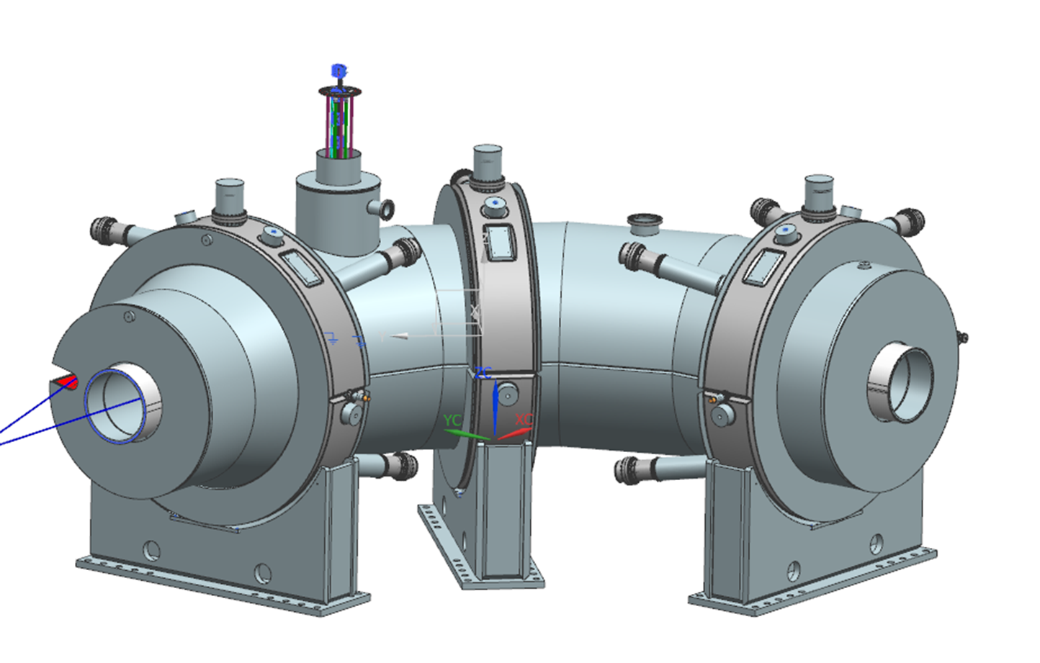
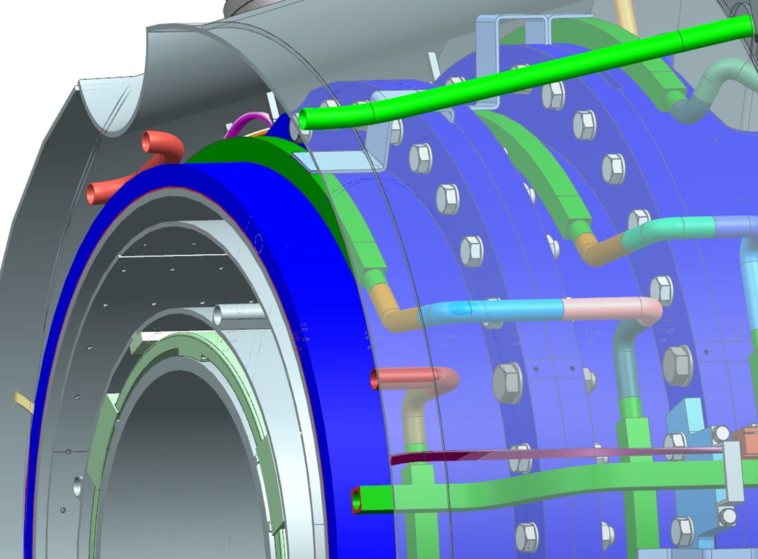
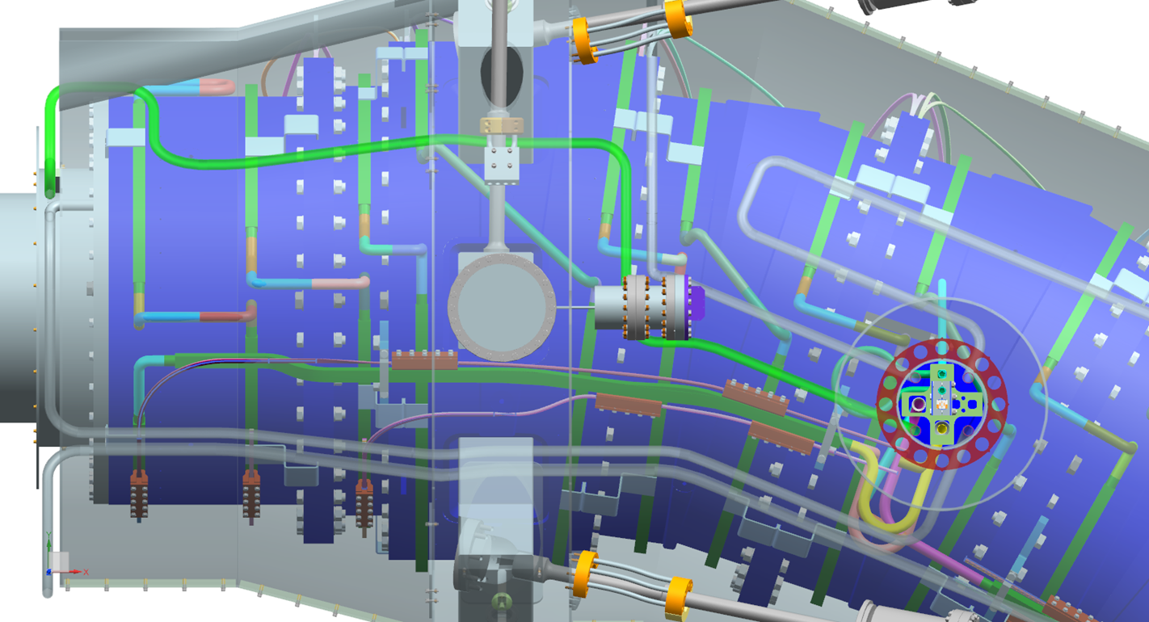
TSU Modification
Top View TSU Upstream

Slide 8
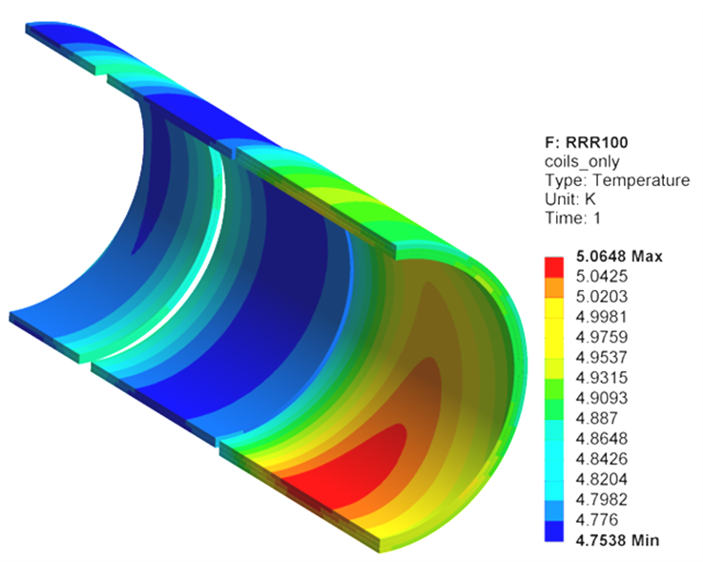
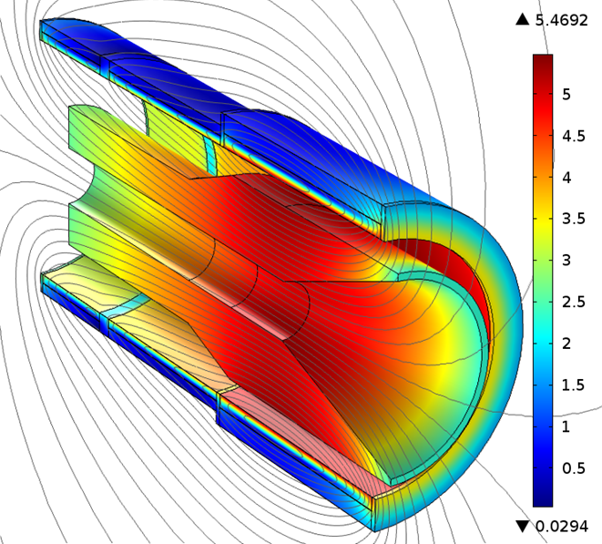
HRS
Materials
Bronze only will not work( Vitaly)
Tungsten option is heavy
Consider a layered option with Bronze and Tungsten
Reduce cost and weight
Geometry
Consider asymmetric design to shield more in the areas needed
Vendor and Design
Can we get full Tungsten or will
it be in large sheets
Currently hot spot and high field are in the same location

Slide 9
Summary- We can’t design in a vacuum
Peak Power Density (Heat Load On Target, Beam)
Heat and Radiation Shield Design
Superconducting Cable
Target Location
Magnet Design

Slide 10
Backup

Slide 11
Notes
Radiation Studies
(limited beam entry, target heat deposition?,)Peak Power Density-> feeds into HRS design-> Magnet design
DPA
Tungsten HRS
Magnetic Modeling and Winding Method
New Cable Vendor or design
Cooling limit on current design, set by LHe
New design could eliminate this
Other options?
Heat load on thermal shield in TS
Size limit in the existing building?
Can the TSU fit through the PS hatch?
Can the current feedbox cool this?
Heavy tungsten HRS- reduce cost and weight by using multi layers
Possible the peak power would not be in the location of the peak field
https://docs.google.com/spreadsheets/d/1K8et2APESzJiG1KM2ndy-xMq_N9LvFd7O6xOpn94fYQ/edit#gid=647684739

Slide 12
Alternative Ideas
Muon cooling ring
Forward beam

