Slide 1
Mu2e-II DAQ Thoughts
29-Aug-2018 Trigger & DAQ Working Session
Mu2e-II Workshop
Ryan Rivera – Mu2e TDAQ L2

Slide 2
Introduction
What are the requirements for the Mu2e-II DAQ?
Mu2e-II will have more beam on target and higher granularity detectors.
Assumptions:
Power and cooling limitations are solved by money
Installation around 2030
Control and Synchronization of the detector will work itself out, this talk focuses on Trigger and Data Paths
This talk introduces as many DAQ thoughts as I could come up with in a few days, hopefully our discussion will help make the thoughts coherent.
All corrections welcome!

Slide 3
Implications (1 of 2)
~2x more detector channels, and ~5x more pulses on target, for ~10x higher data rate.
Current expected Mu2e-I data rate from front-ends is 38GBps
More detector channels and more background implies bigger event sizes (maybe ~3x?)
Mu2e-I expected event size is 200kB

Slide 4
Implications (2 of 2)
Reduced OFF Spill periods (to no OFF Spill time?) implies less advantage to large front-end buffers for streaming data
In Mu2e-I, have second of downtime to play catchup
In Mu2e-II, steady event rate (could buffer just to handle event to event variation, not large accelerator time structures)
No large front-end buffers at CRV would imply need for low-latency trigger decision for CRV.
Low latency trigger decision implies an FPGA trigger layer.
Compare scenario cost:
Large CRV buffers and software trigger
Small CRV buffers and hardware trigger

Slide 5
Streaming vs Triggered
Important upfront decision as to which detector subsystems are triggered.
Same as Mu2e-I?
Stream all Tracker and Calorimeter data
Software Trigger for CRV based on Tracker and Calorimeter
Alternatives?
Stream Calorimeter Data
Hardware Trigger for Tracker and CRV based on Calorimeter
High-level Software Trigger for storage decision

Slide 6
Radiation Implications
Radiation levels at the detector will be higher than Mu2e-I
Calorimeter level of CMS phase-II?
For Mu2e-I, using the VTRx was a primary constraint
We had to change the DAQ topology as a result
Mu2e-II likely will not want to design their own rad-hard links, so we will be at the mercy of CMS/Atlas (again)
This should be worked out as soon as possible.

Slide 7
Generic Data Readout Topology
Front-ends
Data Concentrator
Layer
Event Builder
Layer
Storage Decision
Layer

Slide 8
Generic Data Readout Topology
Data Concentrator Layer
Aggregate small front-end fragments into larger chunks for efficient event building
Event Builder Layer
Data is switched from Concentrator Layer to Event Builder Layer such that full events arrive at Event Builder Layer and are buffered.
Preprocessing or filtering could occur
Storage Decision Layer
Available decision nodes make high level storage decision on full events retrieved from Event Builder Layer buffer.

Slide 9
Generic Data Readout Applied to Mu2e-I
ROCs
DTCs
DTCs
PCs
10Gb 96-port Switch
10Gb PCIe
Data Concentrator
Layer
Event Builder
Layer
Storage Decision
Layer

Slide 10
Data Concentrator
Layer
Event Builder
Layer
Storage Decision
Layer

Slide 11
Notes from CMS Run II Data Path
Triggered CMS data rate of 700 x 4kB x 100kHz = 280 GBps
Mu2e-II data rate of 38GBps x 10 = same!
Just wait by CERN garbage can?
CMS slides say chose InfiniBand event building switch for cost and reliability
Readout Unit of Concentration Layer is a PC – seems like an FPGA would be more efficient here.
High Level Trigger reduces from 100kHz to 1kHz
16K cores. For comparison, Mu2e-I plans to use 800 cores.

Slide 12
CMS Run II PCs (1 of 2)

Slide 13
CMS Run II PCs (2 of 2)

Slide 14
Generic Trigger Path Topology
Front-ends
Triggered Data
Triggered Data
Trigger Layer
Streaming Data

Slide 15
Generic Trigger Path Applied to Mu2e-I
Front-ends
CRV Triggered Data
Software Trigger Layer
Streaming Tracker/Calorimeter Data

Slide 16
CMS Run-II Trigger Path Notes
Trigger input data rate is much higher (1000x?) than Mu2e-II potential trigger input data rate
Level-1 Trigger reduces event rate from 1GHz to 100 kHz with ~3 microseconds of fixed latency (pipelined)
Several FPGA trigger layers:
FPGA Layer to generate trigger primitives (my guess: ~20-100 boards, small to medium FPGAs < $10K each)
Local Trigger FPGA layer for subset of detector trigger decision accept (my guess: ~1-10 boards with large FPGAs > $10K each)
Global Trigger FPGA layer that takes trigger primitive objects as input and generates Level-1 accept (my guess: ~1 board with large FPGA > $10K each)

Slide 17
Where are the FPGAs for Mu2e-II?
At the detector front-ends, need rad-hard ASICS (Maybe already too late to design a new one) or FPGAs.
Low-Latency trigger
Data concentration
Event building
Can do custom application specific switching behavior
High Level Trigger preprocessor/co-processor?
Other co-processors? GPUs?

Slide 18
FPGA Landscape
Altera/Intel – Stratix 10
Up to 10 TFLOPS of single-precision floating-point DSP performance.
Up to 70% lower power than prior-generation high-end FPGAs
Up to 80 GFLOPS/Watt of single-precision floating point power efficiency.
Up to 144 full duplex transceivers in a single package.
Over 2.5 Tbps bandwidth for serial memory with support for Hybrid Memory Cube.
Over 2.3 Tbps bandwidth for parallel memory interfaces with support for DDR4 at 2,666 Mbps.
HLS C++ to RTL

Slide 19
FPGA Landscape
Xilinx – Virtex UltraSCALE+
Up to 128 33G transceivers deliver 8.4 Tb of serial bandwidth
460GB/s HBM bandwidth, and 2,666 Mb/s DDR4 in a mid-speed grade
Up to 60% lower power vs. 7 series FPGAs
HLS C++ to RTL

Slide 20
FPGA scaling

Slide 21
FPGA scaling
Mu2e-I DTC

Slide 22
FPGA Trend to HLS
High Level Synthesis is now good enough to rival manual VHDL or Verilog algorithm development.
Allows physicists to easily understand and develop low and fixed latency FPGA algorithms.
Makes emulation easy for offline.
Debug and verify in a software environment (often 10x faster iterations than firmware simulation tools).
CMS is heavily investing in HLS approach to FPGA algorithm development.
There is a hls4ml collaboration developing machine learning (neural network) tools using HLS.

Slide 23
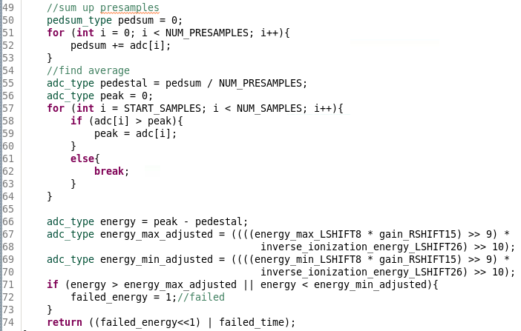
HLS Code

Slide 24
FPGA Algorithm Development
It’s important to realize that FPGA development can take place now – hardware is not needed!
Starting now would help decide how many resources are needed, what size FPGA is in the ballpark, and could inform DAQ topology choices.
Could consider associative memories for pattern matching.
Could inform custom trigger board design or commercial board selection.

Slide 25
Decision Process
Which subsystems are streaming?
What are the constraints imposed by rad-hard links?
Is it possible to have a low-latency Level-1 trigger with rejection power?
Lock an HLS developer and a firmware-system developer in a room for six months and tell them to understand the specs of a hardware trigger layer (what type of FPGA, how much memory) that would do the job.
A hardware trigger layer may save money
downstream due to data reduction.
upstream due to reduced buffer size.
How much processing is needed for High Level Trigger?

Slide 26
Example Solution for 10x
Keep same topology
Assume gain of 2x in technology
Buy 5x more hardware and software resources
Multi-stage event building switch

Slide 27
Backup Slides

Slide 28
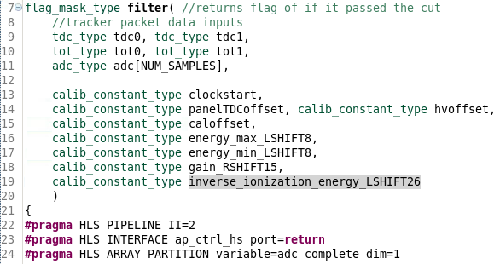
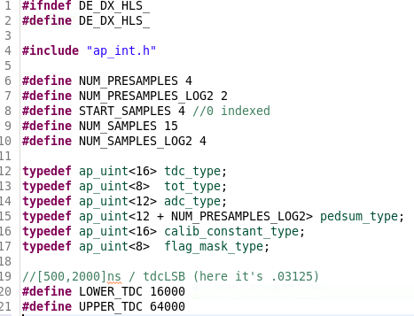
HLS Code

