Slide 1
PIP2IT Extinction Measurment
Myron Campbell
University of Michigan

Slide 2
Outline
PIP II Injector Test (PIP2IT)
Basics of H-
Outline of insertion region
  Entrance sweeping magnet
  Laser system
  Exit sweeping magnet
  Electron detection

Slide 3
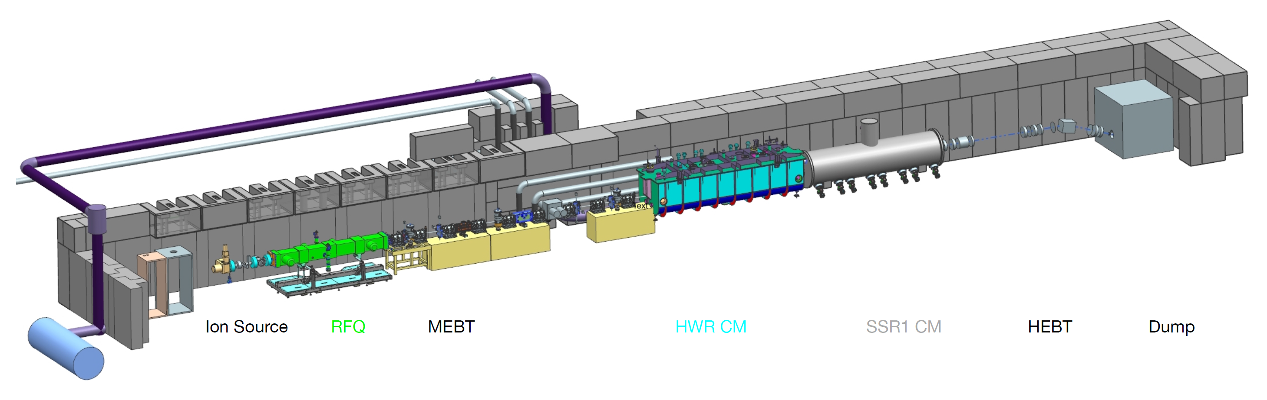
PIP II Injector Test
The PIP-II Injector Test (PIP2IT) accelerator is located at CMTF
Will be operating with a 25 MeV H⁻ beam by 2020
There is a location designated for diagnostic instruments where the extinction measurement system could be installed

Slide 4
PIP II Beam Chopper
The PIP-II project has developed a beam chopper that can create a programmable bunch pattern at 162.5 MHz.
The ratio of beam in the programmed bunches to beam in the ‘empty’ bunches is important for calculation of backgrounds.
The requirements for the PIP-II project are much weaker (ratio of 10⁻³) than the requirements for Mu2e-II (ratio of 10⁻¹¹).

Slide 5
Basics of H⁻
We will talk about three species:
  Proton - p
  Neutral Hydrogen – H
  Hydrogen with an additional electron - H⁻
H⁻ has one stable state – no excited states
The “second” electron is bound at 0.7542 eV
H⁻ can be photoionized:
  Neutralize: H⁻ + γ → H + e⁻
  Ionize: H⁻ + γ → p + 2e⁻

Slide 6
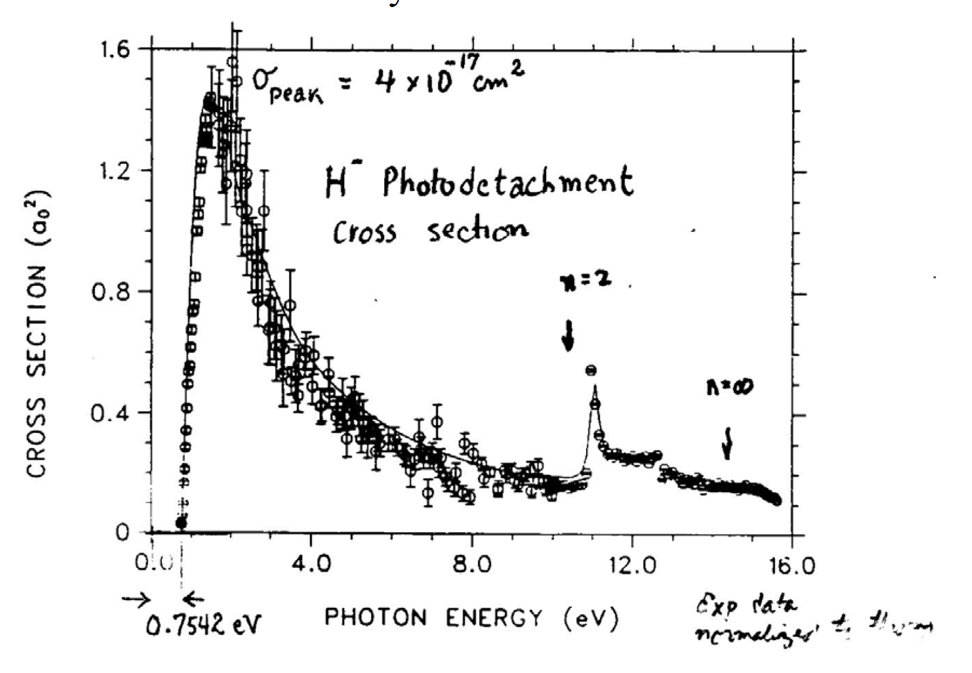
Basics of H⁻

Slide 7
Neutralization
As the H⁻ propagates through the accelerator there are several neutralization processes:
  Interaction with black body radiation
  Interaction with changing electric or magnetic fields
  Interaction with residual gas
Our initial calculations show black body radiation and residual gas are the largest effect.
Consequently, the beam will consist of H⁻, H and e⁻

Slide 8
Insertion region
Because there will be electrons in the beam from the neutralization processes, we insert a few hundred gauss dipole to sweep the electrons out of the beam
We then introduce a laser beam, synchronized to the RF system so it only pulses during the time when the beam should be extinguished.
The laser system is reflected several times down the insertion region.
The liberated electrons will have the same velocity as the H⁻, so the momentum will be 12.5 keV.
This is similar to the Notcher in use in the linac.

Slide 9
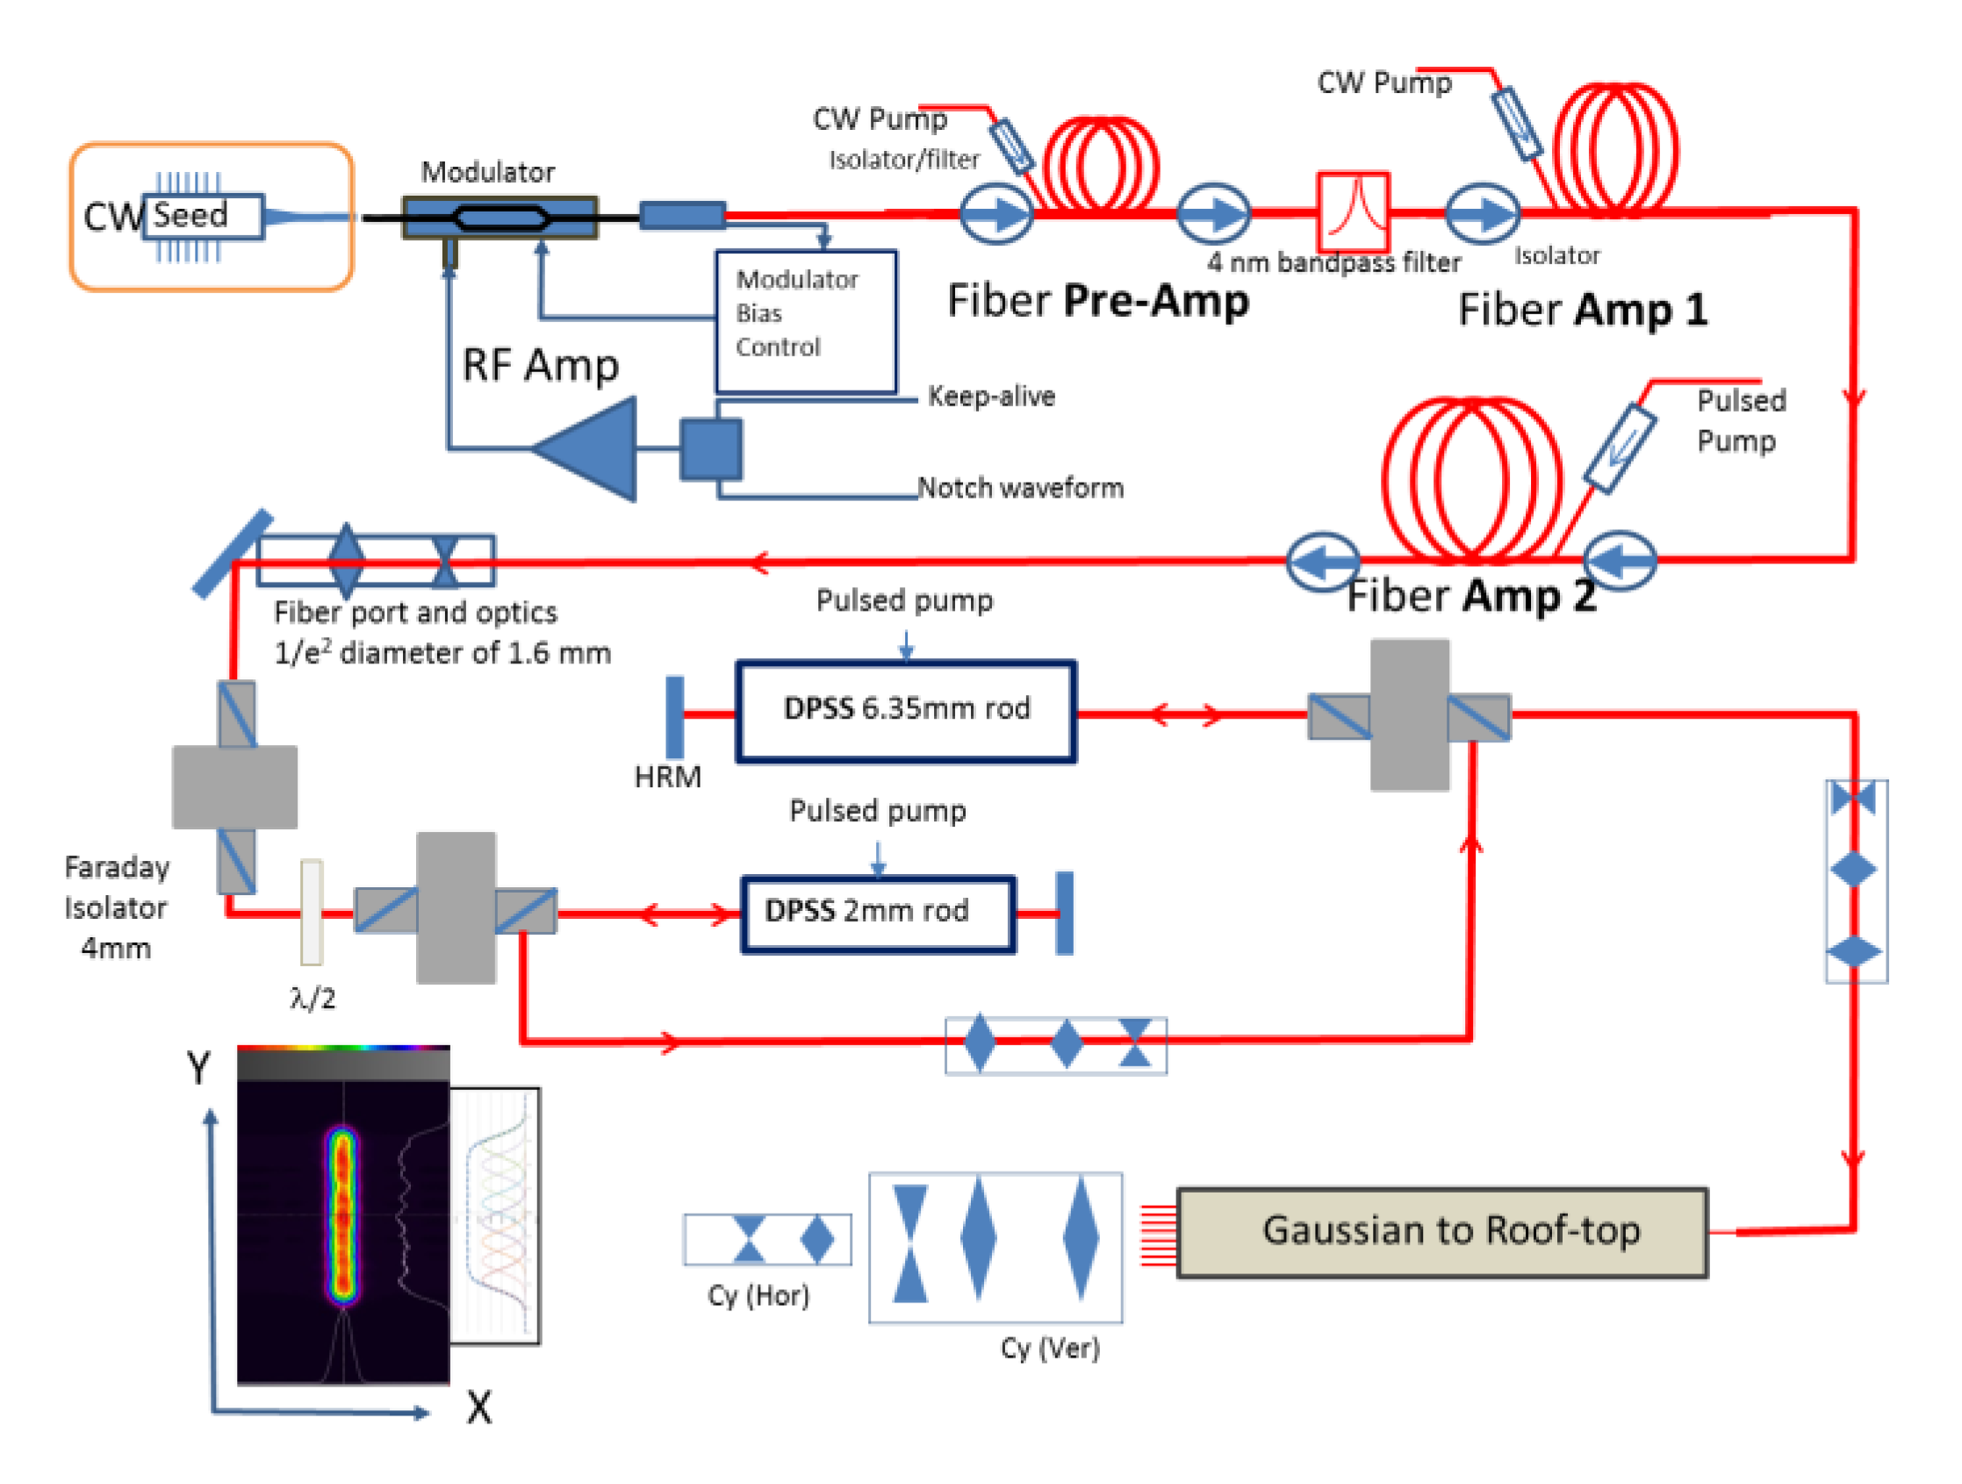
Simplified Notcher Laser System

Slide 10
Insertion region
A second dipole magnet sweeps the 12.5 keV electrons into a detector, and restores the direction of the H⁻ beam, although with a shift.
To measure extinction to 10⁻¹¹ need to look for a single H⁻ in 1000 pulses.
Need high efficiency of neutralization and high efficiency of electron detection.
Have looked at several devices
  MPPC with thin coating
  Electron multiplier tube
  Micro channel plate

Slide 11
Status
We have submitted a LDRD proposal.
We have been working on making detailed calculations.
We are setting up a test for 10 keV electrons, starting with a UV MPPC from Hamamatsu.

