Slide 1


Test Stand Functional Requirements
Joseph F Muratore
Superconducting Magnet Division
Brookhaven National Laboratory
Review for the HL-LHC AUP Vertical Magnet Test Stand at BNL– August 1-2, 2018

Slide 2
Outline
Charge 1a
Scope and Deliverables
Test Stand Functional Requirements Document US-HiLumi-doc-1109
Test Stand Requirements
Instrumentation
High Voltage Withstand Tests (hipots)

Slide 3
Scope and Deliverables
From WBS Dictionary US-HiLumi-doc-39
Receive MQXFA magnet from LBNL
Prepare magnet for test at 1.9K in vertical test cryostat
Test magnet and analyze results
Ship magnet to FNAL (for assembly into a cold mass) or to LBNL (for re-build if test failed)
Deliverables: 27 magnet tests

Slide 4
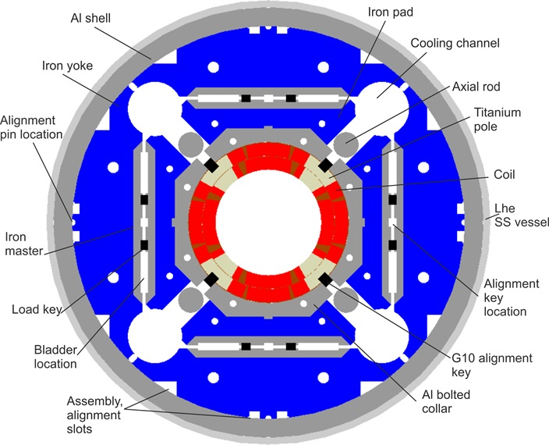
Functional Requirement Specifications
  MQXFA NOMINAL PARAMETERS AND DESIGN
Coil inner aperture : D = 150 mm
Coil magnetic length: L = 4.2 m
Coil actual length: L = 4.523 m
Yoke length L = 4.5629 m
Total length with end plates L = 5 m (nom)
Operational temperature T = 1.9 K
LHC nominal operating current (1.9 K) I_{nom} = 16.470 kA
LHC ultimate operating current (1.9 K) I_{ult} = 17.890 kA
Maximum current (300 K) I₃₀₀ = 10 A
Conductor limit at 1.9 K: I_{ss} = 21.600 kA
Conductor limit at 4.5 K: I_{ss} = 19.550 kA
Peak field in the coil at I_{nom} (1.9 K): B_{nom} = 11.4 T
Peak field in the coil at I_{ult} (1.9 K): B_{ult} = 12.3 T
Peak field in the coil at I_{ss} (1.9 K): B_{ss} = 14.5 T
Field Gradient at I_{nom} (1.9 K): G_{nom} = 132.6 T/m
Field Gradient at I_{ult} (1.9 K): G_{ult} = 143.2 T/m
Field Gradient at I_{ss} (1.9 K): G_{ss} = 168.1 T/m
Magnet resistance at room temperature: R = 2.37 Ω
Magnet inductance (20 Hz at room temperature): L = 38.1 mH
Magnet inductance (at 1.9 and 1 kA) : L = 40.9 mH (see note below)
Magnet inductance (at 1.9 and I_{nom}=16.5 kA) : L = 32.8 mH (see note below)
Operating stored energy (at B_{nom}, I_{nom}): E_{max} = 4.5 MJ assuming L=32.8 mH
Ultimate stored energy (at B_{ult}, I_{ult}) E_{max2} = 5.31 MJ assuming L=32.8 mH and I_{ult}=18 kA
Maximum allowed temperature at quench: T_{max} = 350 K
Maximum allowed voltage across magnet V_{max} = 1000 V (500 V to ground) with 50 mΩ EE
Dump resistor (energy extraction) options R_{D} = 30, 37.5, 50, 75, 150 mΩ

Slide 5

Functional Requirement Specifications
Charge 1a
US-HiLumi-doc-36
MQXFA Functional Requirements Specification
Each magnet must meet the requirements set forth in US-HiLumi-doc-36 before shipping to FNAL for assembly into cold masses. Each magnet will be tested to the criteria set forth in US-HiLumi-doc-1109.
US-HiLumi-doc-1109
Test Stand Functional Requirements for Testing MQXFA Magnets and Q1/Q3 Cryostat Assemblies
Test Requirements include:
Quench training at 1.9 K to ultimate current
Magnetic field measurements
Splice joint measurements
Quench protection verification (CLIQ and quench protection heaters)
High voltage withstand tests (hipot)
Magnet Run Plan and Traveler

Slide 6
Test Stand Functional Requirements
US-HiLumi-doc-1109

Slide 7
Test Stand Functional Requirements
US-HiLumi-doc-1109
Requirements are for testing MQXFA quadrupole magnets needed for the Q1/Q3 triplets for HL-LHC.
PURPOSE OF TESTS: Full qualification and acceptance of the US AUP deliverables – 2 pre-series and 19 series MQXFA quadrupoles

Slide 8
Test Stand Functional Requirements
During cooldown and warmup, maximum ΔT ≤ 100 K
Up to 5 Cernox temperature sensors for monitoring between room temperature and 1.9 K (± 10 mK)
Magnet current to 19.8 kA (prototypes) and 18.0 kA (series magnets)
Ramp rates adjustable 10 - 150 A/s
3 quenches per day
RRR measurements during warmup

Slide 9
Test Stand Functional Requirements
Splice joint measurements with precision ≤0.1 nΩ
Voltage spike measurements (prototype only)
  Voltage signals over two magnet half coils
  Sampling rate 100 kHz
  Triggered by exceeding threshold 5 – 1000 mV, as needed
  Snapshot time window of 0.5 s centered on spike
Strain gauge measurements
  Sampling interval during cooldown and warmup ≤60 s
  Sampling interval during current ramps 1 s

Slide 10
Test Stand Functional Requirements
Magnetic field measurements with rotating coil system in warm bore tube
  Integrated quadrupole field with accuracy 0.1%, precision 0.01%
  Harmonics with accuracy 5 ppm/10 ppm for n = 3-10 /11–14
  Integral harmonics
  End field harmonics in steps of 0.25 m axially
Energy loss measurements at 1.9 K in range 500 – 6500 A in a range of ramp rates

Slide 11
Test Stand Functional Requirements
Quench protection to be provided by:
Coupling loss induced quench (CLIQ) system - (see following slide)
Energy extraction (EE) system to have range of 30 – 150 mΩ and adjustable delays 0 – 1000 ms.
Quench protection heaters (strip heaters) – 8 heater firing units required; firing units should provide same integrated surface power as used in LHC
Also –
1. Each of the three protection systems should have capability of independent delays for quench protection studies (prototypes).
2. At least two out of three quench protection systems must work.

Slide 12
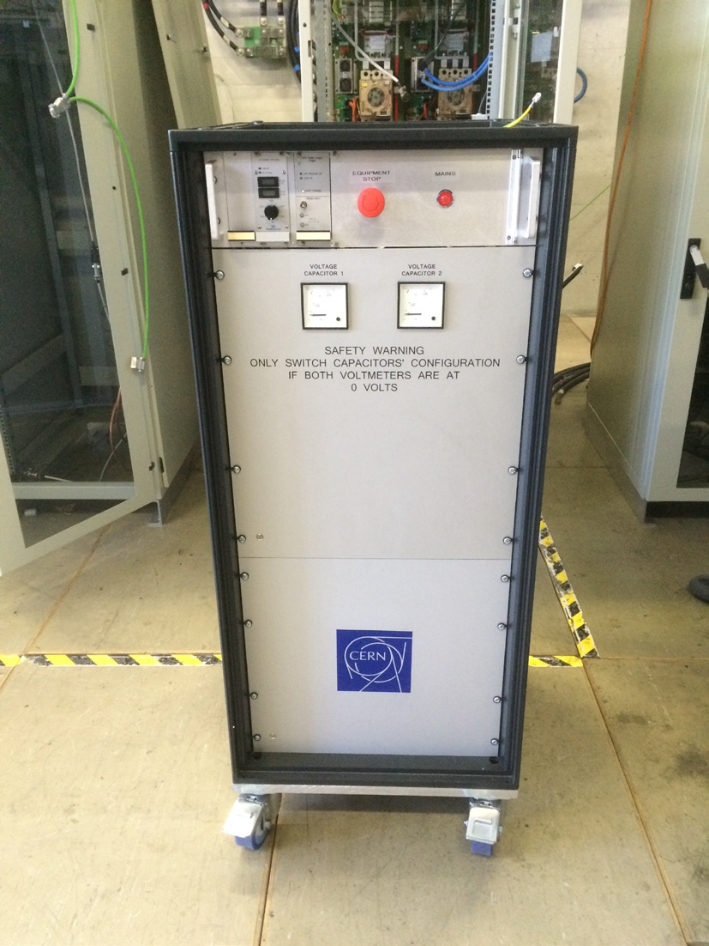
Test Stand Functional Requirements
CLIQ SYSTEM
CLIQ to be operated at 500 V and 40 mF, without inner layer heaters
String of diodes to be connected in reverse across power supply to prevent back current
CLIQ is in place and has been implemented successfully and used during MQXFAP1 training
CLIQ = Coupling Loss Induced Quench
The recently developed Coupling-Loss-Induced Quench (CLIQ) protection system is a new method for initiating a fast and voluminous transition to the normal state for protecting high energy density superconducting magnets. Upon quench detection, CLIQ is triggered to generate an oscillating current in the coil sections by means of a capacitive discharge. This in turn introduces a high coupling loss in the superconductor that provokes a quick transition to the normal state of the coil windings. The system has been implemented for the protection of magnets of different sizes, geometries, superconductor types, and cable and strand characteristics in the CERN magnet test facility.

Slide 13
Test Stand Functional Requirements
Quench detection to be provided by the following voltage signals and requirements:
Total magnet coil
Total magnet coil – L dI/dt (I_{dot})
Half magnet coil difference (Delta)
Superconducting leads
Gas-cooled (copper) leads (slow discharge without EE)
Ground fault (slow discharge without EE)
Delta signal threshold must be current dependent
Validation time for QD trigger must be adjustable in range 0 – 20 ms; can be made current-dependent

Slide 14
Test Stand Functional Requirements
Quench characterization to be provided by:
Voltage taps - both main and auxiliary (prototypes)
Quench antenna in warm tube
Fast data logger – simultaneous QD-triggered acquisition, with minimum requirements:
  Sampling rate 10 kHz
  Pre-trigger samples 20 k
  Post-trigger samples 20 k
  Time window (snapshot) 4 s
  Ramp down for slow discharge 50 A/s

Slide 15
Test Stand Functional Requirements
Minimum instrumentation wiring requirements:

Slide 16
Test Stand Functional Requirements
From MQXFA Final Design Report (US-HiLumi-doc-948, 5/16/18)
  HIGH VOLTAGE WITHSTAND TEST PARAMETERS

Slide 17
Summary
Test Stand Requirements are defined and approved
Deliverables and scope are clear
Final design (for Vertical Magnet Test Facility) is complete and meets the requirements
Thank you for your attention.

Slide 18
Test Stand Functional Requirements

Slide 19
Test Facility Readiness
Past Experience
P. Joshi

