Slide 1


Tests that have been performed to meet requirements
Joseph F Muratore
Superconducting Magnet Division
Brookhaven National Laboratory
Review for the HL-LHC AUP Vertical Magnet Test Stand at BNL– August 1-2, 2018

Slide 2
Outline
Charge 1a
Charge 3e
MQXFA Functional Requirements Specification - US-HiLumi-doc-36
Test Stand Functional Requirements for Testing MQXFA Magnets and Q1/Q3 Cryostat Assemblies - US-HiLumi-doc-1109
Test of MQXFPM1 - single QXF coil in mirror configuration
Test of MQXFAP1 – first MQXFA prototype
Other tests
Future upgrades to meet requirements

Slide 3
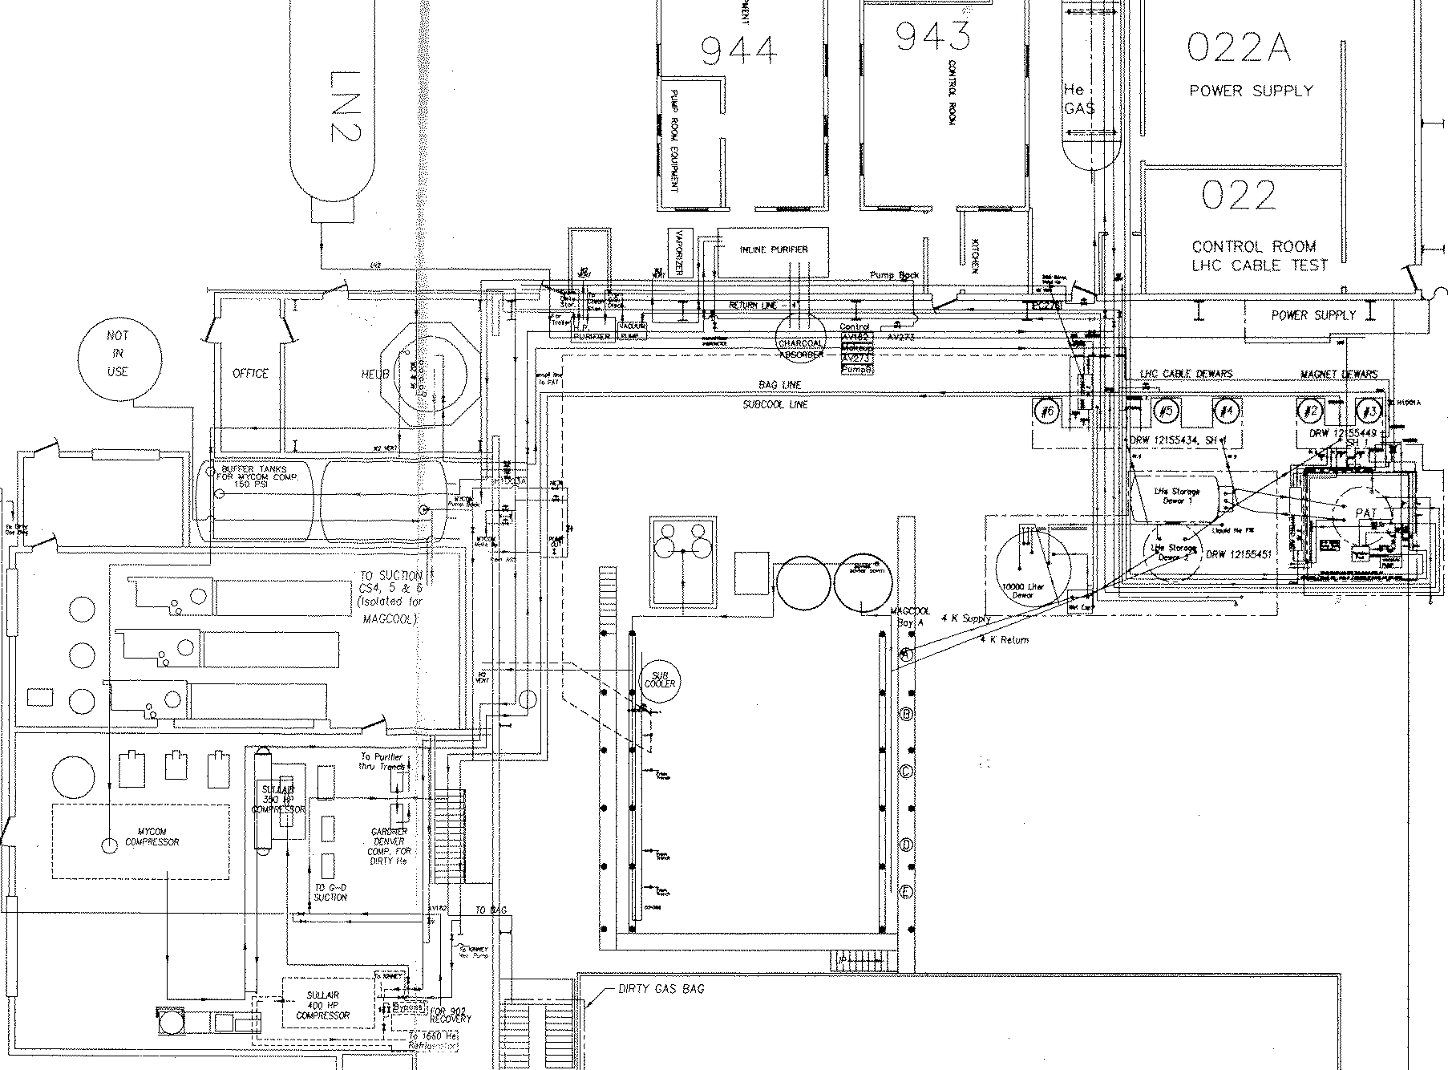
BNL Magnet Test Facility - Final Design
Nash “high capacity” vacuum Pump (1.9 K)
Building 902 Test Facility Floor Plan and Overview
30 kA Power Supply
MQXF
CTI 4000 He Refrigerator
CONTROL ROOM
2.7 m Deep Test Dewars
6.1 m Magnet Deep Test Dewars
Vertical Test Dewars 2-6

Slide 4
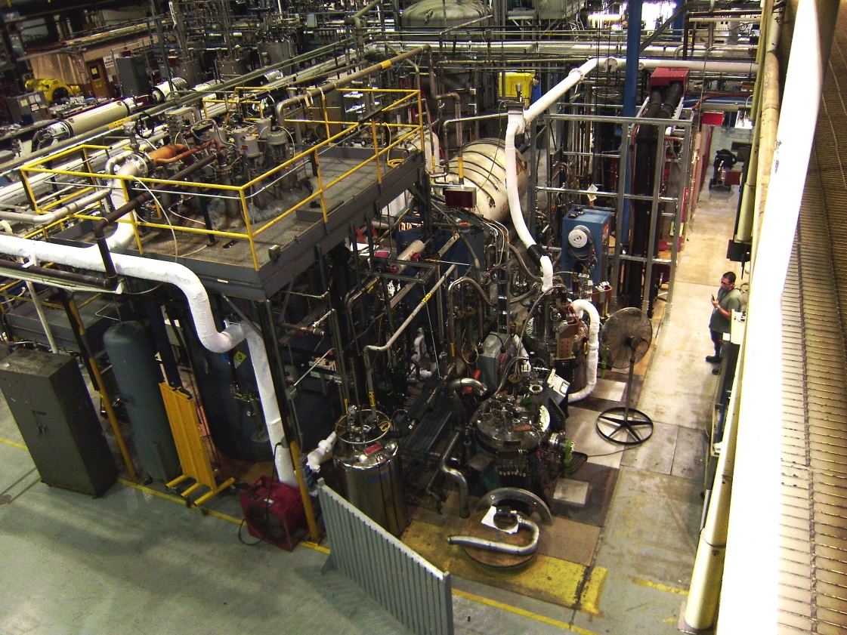
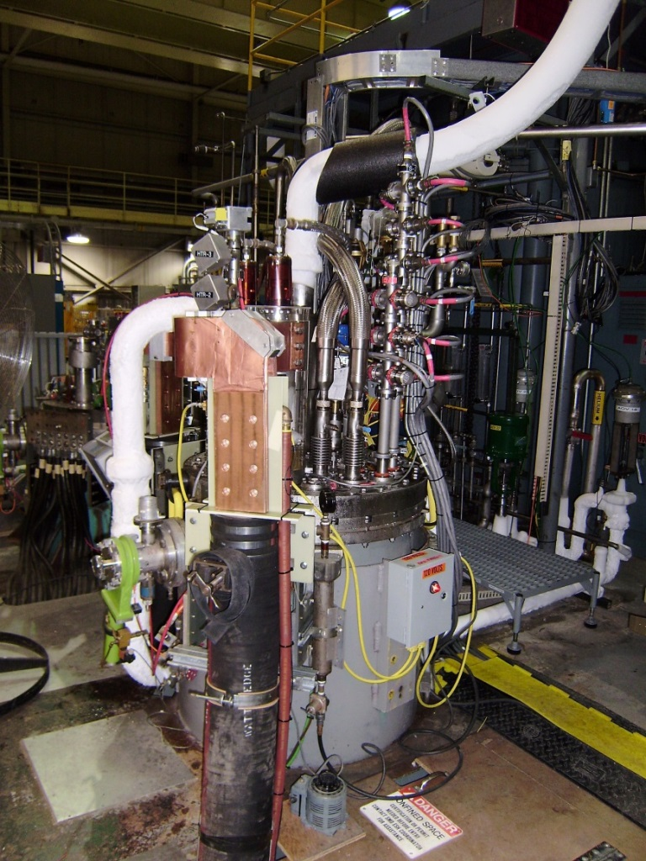
BNL Magnet Test Facility
Vertical Test Facility at BNL, showing two of the five test cryostats and the backup refrigerator. Long arrow points to Vertical Test Cryostat 2 (1.9K and 24kA).
Short arrow points to Test Cryostat 3, which will be used as a cold buffer for the He return during quenches on future MQXFA tests in Test Cryostat 2.
Vertical Test Cryostat 2, upgraded to provide 1.9 K at 1 bar (nom) and 24 kA, for testing of the 4.2 m-long MQXFA quadrupoles. The picture shows the test stand with the mirror MQXFPM1 under test.

Slide 5
Design Maturity
US-HiLumi-doc-948
Design approved at FNAL Director’s Review July 2018

Slide 6
Functional Requirement Specifications
From MQXFA Functional Requirements Specification US-HiLumi-doc-36

Slide 7

Functional Requirement
Specifications & Documentation
Charge 1a
US-HiLumi-doc-36
MQXFA Functional Requirements Specification
Each magnet must meet the requirements set forth in US-HiLumi-doc-36 before shipping to FNAL for assembly into cold masses. Each magnet will be tested to the criteria set forth in US-HiLumi-doc-1109.
US-HiLumi-doc-1109
Test Stand Functional Requirements for Testing MQXFA Magnets and Q1/Q3 Cryostat Assemblies
Test Requirements include:
Quench training at 1.9 K to ultimate current
Magnetic field measurements
Splice joint measurements
Quench protection verification (CLIQ and quench protection heaters)
High voltage withstand tests (hipot)
Magnet Run Plan and Traveler

Slide 8
Operational Test Requirements
Charge 1
Main Requirements for Test Facility:
Operation at 1.9 K superfluid and 1 bar
Cooldown and warmup with temperature gradient ≤ 100 K
Powering to 19.8 kA (18.0 kA for production tests)
Capability to avoid QD trips due to flux jump spikes
3 quenches per day (production tests only)
Calculation for each quench of quench integral in MIIts to determine hot spot temperature
Analysis of voltage tap signals to determine quench start location
Capability to operate QPH, CLIQ, and EE independently
6 magnet tests per year during production testing period
Total energy at quench - up to 6 MJ at 19 kA (training quenches) with 33 mH inductance – Need to be ready for this
See US-HiLumi-doc-1109
Test Stand Functional Requirements for Testing MQXFA Magnets and Q1/Q3 Cryostat Assemblies

Slide 9
Test Results – Mirror (1st Long Coil)
MQXFPM1 Mirror Magnet = single QXF coil in iron that simulates full QXF field
Thermal Cycles
The magnet was still training by end of test – locations of quenches varied and highest current quench at end was at 4.4 K. A quench at 300 A/s showed no change in quench current.

Slide 10
Test Results – MQXFAP1 (1st Long Magnet)
All quench tests were at 1.9 K (nom) and 20 A/s.
Last four quenches included CLIQ and last three did not use inner strip heaters.
Testing ended after 18 training quenches due to development of ground short.

Slide 11
Test Facility Readiness
Past Experience
The following milestones have been met:
Operation at 1.9 K and lower, at 1 bar (nom)
Powering of mirror magnet to 19.4 kA (20 kA in SC busbar test; 24 kA in shorted power supply tests)
Training of first long coil (mirror) and first long magnet (prototype), showing similar performance to the short versions of each
Holding test with MQXFPM1 at 17.900 kA for 2 hr (Quench 13 (18.4195 kA afterwards)
Range of ramp-to-quench rates, up to 300 A/s
Successful implementation of CLIQ at 500 V and 40 mF; lowering of MIIts
Operation of quench protection heaters satisfied LHC power density requirements or better
Repeated thermal cycles, which demonstrated magnet memory
Variable QD voltage thresholds as a function of current, as needed to avoid false QD trips due to flux jump spikes

Slide 12
Test Facility Readiness
Past Experience
The following milestones have been met:
Successful energy extraction (EE) in training quenches of 20-25%
Use of different values of EE dump resistance depending on quench current
Fast data and slow data loggers were operated at high level of efficiency
  Fast data logger sampling rate was 10 kHz
  Slow data logger sampling interval was 1 s to 60 s and longer
  Fast data logger simultaneously sampled the following signals for use in analysis:
    Voltage tap signals
    Quench antenna signals
    Quench heater voltages, currents, and ground currents
    Power supply parameters such as current, voltage, ground currents
    Pressure above lambda plate and various other key pressures for diagnostics
    Quench detector trigger signals
Strain gauge data acquisition operated successfully at ≥ 3 s interval
FPGA-based primary quench detector with previous PXIe QD as backup and for slow discharge events – tested and operated as designed

Slide 13
Test Facility Readiness
Past Experience
P. Joshi
Correct timing with respect to quench and trigger has been verified.

Slide 14
Test Facility Readiness
Past Experience
The following milestones and upgrades have been performed:
Successful in avoiding false trips due to flux jump spikes while ramping using QD threshold voltages as a function of current
Localization of quench origins using voltage taps
Operation of quench antenna for axial quench location; signals included in fast data logger files and are simultaneous with voltage tap and other signals
Independent operations of EE, QPH, and CLIQ, with independent delays when needed
Redundant quench detector systems; correct timing has been verified
Improvements to power supply and EE systems
Data sharing accessible to and in a format compatible with the other collaborators – fast and slow data logger files
Operation of both Vishay and HBM style strain gauges, and in compatible data file formats
Upgrades to cryogenics quench He return system to mitigate loss of He gas due to high quench pressures
Approval by AUP/BNL Cryogenics Review Committee10-May-2018 at BNL

Slide 15
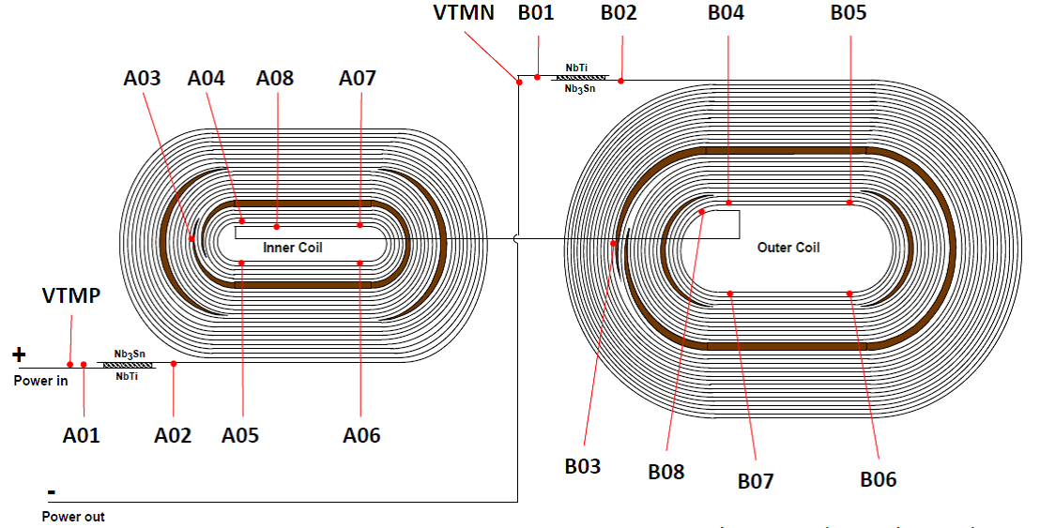
Test Facility Readiness
Past Experience
Quench characterization using voltage taps and fast data logger:
MQXFA Voltage Tap configuration as used at BNL, FNAL, LBNL, and CERN
All quenches were localized to the best capability of the instrumented voltage taps.

Slide 16
Test Facility Readiness
Past Experience
Quench characterization using voltage taps and fast data logger:
MQXFPM1 Voltage Tap Signals at Quench Start

Slide 17
Test Facility Readiness
Past Experience
Quench characterization using voltage taps and fast data logger:
MQXFAP1 Quench #1
I_{Q} = 15476 A
Magnet Half Difference -40.4 ms
Location: Coil 2 A8-A7 Inner Layer Short SS -40.7 ms
A7-A6 Inner Layer Nonlead End -25.4 ms
A4-A3 Inner Layer Multiturn -24.5 ms
A6-A5 Inner Layer Long SS -9.0 ms

Slide 18
Test Facility Readiness
Past Experience
Quench characterization using voltage taps and fast data logger:
A7-B8 POLE TURN STRAIGHT SECTION + RAMP SECTION (TAP A8 LOST)
MQXFAP1 Quench #4 I_{q} = 15697 A
No propagation seen anywhere else before quench trigger.
Quench integral = 30.1 MIIts
Verification of correct timing for detection and trigger
QD voltage threshold = 150 mV
Validation time = 4 ms
FPGA QUENCH DETECTOR COIL DIFFERENCE SIGNAL
(Coils 2+5) - (Coils 3+4)

Slide 19
Test Facility Readiness
Past Experience
Quench characterization using quench antenna signals and fast data logger:
Axial quench locations were determined using quench antenna
All quench antenna signals appear in fast data file with voltage tap and other signals, using simultaneous sampling (here at rate of 10 kHz)
MQXFAP1 Quench #12 I_{Q}=16746A
Quench Antenna Coils #9-24

Slide 20
Cryogenic System Upgrades
Test Facility Readiness
These upgrades will be implemented to meet testing requirements:
Newly designed relief valve assembly – to mitigate burst disc problem and decrease loss of He gas at quench
Use of Test Cryostat 3 as a cold buffer tank next to Test Cryostat 2 (with magnet) to mitigate He gas loss at quench – all parts (including newly designed transfer line) are ready for use in next test (Aug 2018)
Increased number of pressure transducers and thermometers to provide better diagnostics and control of valves
Future addition of two more buffer tanks (29874 L each) to mitigate He gas loss at quench (available after next test)
Linde Model 1610 He Liquefier will be shipped to BNL from PNNL at minimal Project cost – to increase liquid He rate by 80-100 L/hr (in addition to CTI 4000 246 L/hr), and allow for 3 quenches/day and more efficient operation between tests (available after next test)

Slide 21
Test Facility Readiness
Other Test Facility Upgrades
These upgrades will be implemented to meet testing requirements:
Variable validation time as a function of current to lower voltage thresholds during quench tests and avoid false trips due to flux jump spikes
Addition of second top plate and hanging fixture to meet testing rate of 6 magnet tests per year during production testing
New wiring stand platform to meet safety requirements
Magnetic field measuring system is in final stages of testing and will be ready for test of second prototype in Aug 2018.
Newly designed indium mechanical joints for connection of magnet leads to test fixture leads without solder - to improve durability of connections during course of production magnet tests
Test fixture (without magnet) will be cooled down to 4.5 K in Test Cryostat 2 in order to measure leakage to ground during high voltage withstand tests (hipots), and to verify efficient operation of the cryogenics system
The resistances of newly designed mechanical joints (magnet leads to test fixture leads) will be measured at 4.5 K prior to use in magnet testing.
BNL funding request ($378,066) has been submitted for FY19 for cryogenics system critical parts, in addition to upgrades already implemented
BNL funding request ($203,871) has been submitted for FY19 for crane critical parts

Slide 22
Summary
MQXFA Test Stand Requirements are defined and approved
Deliverables and scope are clear
Final design for Vertical Magnet Test Facility is complete and meets the requirements
Three tests at 1.9 K have been done: SC busbar, mirror magnet, first prototype magnet
Most test requirements have already been satisfied in these three previous tests
Upgrades since last test are being finished now to satisfy the remaining requirements for tests of the prototypes, for next test in Aug 2018 with second MQXFA prototype
Thank you for your attention.

Slide 23
Test Facility Readiness
Past Experience
Quench characterization using voltage taps and fast data logger:
MQXFAP1 Quench #1
I_{Q} = 15476 A
Location: Coil 2 A8-A7 Inner Layer Short SS -40.7 ms
A7-A6 Inner Layer Nonlead End -25.4 ms
A4-A3 Inner Layer Multiturn -24.5 ms
A6-A5 Inner Layer Long SS -9.0 ms

Slide 24
Test Facility Readiness
Past Experience
Quench characterization using voltage taps and fast data logger:
MQXFAP1 Quench #1
I_{Q} = 15476 A
Coil Half Difference -40.4 ms

