Slide 1
Hi Lumi Magnet Test Stand Electrical Systems
Piyush N Joshi
Superconducting Magnet Division
Brookhaven National Laboratory
Upton NY 11973 USA
2nd International Workshop on Magnet Test Facilities
BNL, May 8-9, 2018
Review for the HL-Review for the HL-LHC AUP Vertical Magnet Test Stand at BNL– August 1-2, 2018
LHC AUP Vertical Magnet Test Stand at BNL– August 1-2, 2018

Slide 2
Outline
Slides in this presentation address charge 3c
Is the electrical system for test stand adequate, properly designed, documented and tested ? As per the test stand requirement document: US-HiLumi-doc-1109
Magnet main power supply
Quench heater power supply
Quench detection and energy extraction system
Signal conditioning and isolation system
Fast and slow data logging system
Strain gage measurement system
Quench antenna data acquisition system
Power supply control and monitoring system
Magnet instrumentation and Test Dewar instrumentation
CLIQ system
Fault detection and interlocks

Slide 3
Magnet Main Power Supply
Two 15KA, 14V DC, SCR based power supplies connected in parallel
Each PS is current limited to 12KA. Combined limit of 24KA
Has been in operation for twenty years.
Partially upgraded using modern controls
Very reliable operation
Very low risk of failure which can cause long down time
Short term down time (few days) can be caused by:
Deionized cooling water system failure
Power semiconductor (Thyristor) failure
AC main breaker or sub station trip
All current carrying bus work to magnet is water cooled
Ground fault current monitoring and temperature monitoring of all critical components
PS control interlocked with magnet protection systems

Slide 4
Magnet Power Supply and energy extraction

Slide 5
Quench detection and protection system
Magnet is protected using three systems operating in co-ordination.
Quench detector
Energy extraction
Quench heater activation
Main quench detector: National Instrument CRIO FPGA chassis with 12 channels of differential analog input, 24 bit simultaneous sampling (10kHz) and 24 channel digital output lines.
Secondary quench detector: National Instrument PXI chassis with 24 channels of differential analog input, 16 bit simultaneous sampling (1kHz) and 24 channel digital output lines.
Adjustable validation time and thresholds for quench detection
Adjustable energy extraction dump resistor. (30mΩ, 37.5mΩ, 50mΩ, 75mΩ, 150mΩ) can absorb up to 10MJ maximum.
Energy extraction is achieved by solid state switch based on 12 parallel IGBTs diverting magnet current in to a dump resistor in less than 10µs
Quench heater power supply controlled by an independent CRIO chassis with adjustable charge voltages and discharge delay time for each PS.

Slide 6
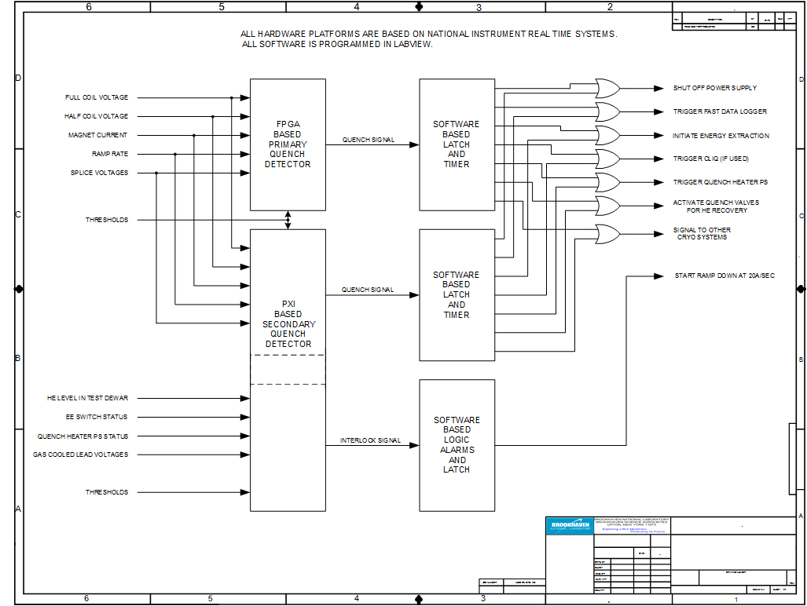
Quench detector system
Review for the HL-LHC AUP Vertical Magnet Test Stand at BNL– August 1-2, 2018

Slide 7
Quench Heater Power Supply
Brand new system build for Hi-Lumi project
Twelve capacitor banks of about 13mF each
Eight capacitor banks capable of charging up to 600V DC
Four capacitor banks capable of charging up to 900V DC
Discharge currents and voltages of each bank captured in fast logger
Discharge delay of each bank is adjustable with respect to quench detection signal
System controlled and monitored using National Instrument real time hardware and LabView program
Very low risk of failure which can cause long down time
Enough spares on hand

Slide 8
Quench heater Power Supply

Slide 9
Fast and slow data logging system
Fast data logger based on NI real time PXIe platform
200 channels of differential input simultaneous sampling
NI PXIe-4300 ADC modules with16 bit resolution
Maximum sampling rate 250KHz (used sampling rate =10KHz)
Analog input ranges: +/-10V, +/-5V,+/-2V,+/-1V
Triggered by quench signal from quench detector
Captures all voltage tap signals, quench heater PS discharge currents and voltages, quench antenna signals, ground current, dewar pressure and temperature, magnet current, power supply voltage. Window of capture is 5 seconds
Slow Logger based on NI real time PXI platform
64 channels of multiplexed differential input
NI PXI-6289 ADC modules with 16 bit resolution
Sampling rate of 1KHz
Records all slow varying magnet power and cryogenic parameters
Both systems have low risk of failure
Enough spares on hand

Slide 10
Strain gage data logger
Two systems for two type of strain gages
40 Channel simultaneous sampling HBM make strain gage read out system for “CERN” type gages
60 Channel multiplexed readout system based on Agilent model 34970A. This system is used for “LARP” type gages.
Agilent system has accuracy of 45uV over 1V range.
LARP type strain gages are configured with six independent excitation current circuits
Both systems have low risk of failure which can cause long down time
Some spares on hand

Slide 11
Magnet and test dewar instrumentation
Level Probes and Cernox temperature sensors above Lambda plate to protect Gas Cooled Leads
All Sensors are redundant

Slide 12
Magnet and test dewar instrumentation
Test dewar is fitted with multiple level probes and Cernox temperature sensors to verify temperature gradient while cooling and during quench
Redundant sensors calibrated for 4.2K and 1.9K operation
Sensor readings captured in slow logger and fast logger
Risk of long down time due to failure of sensors or readout system is very low.
Some spares on hand

Slide 13
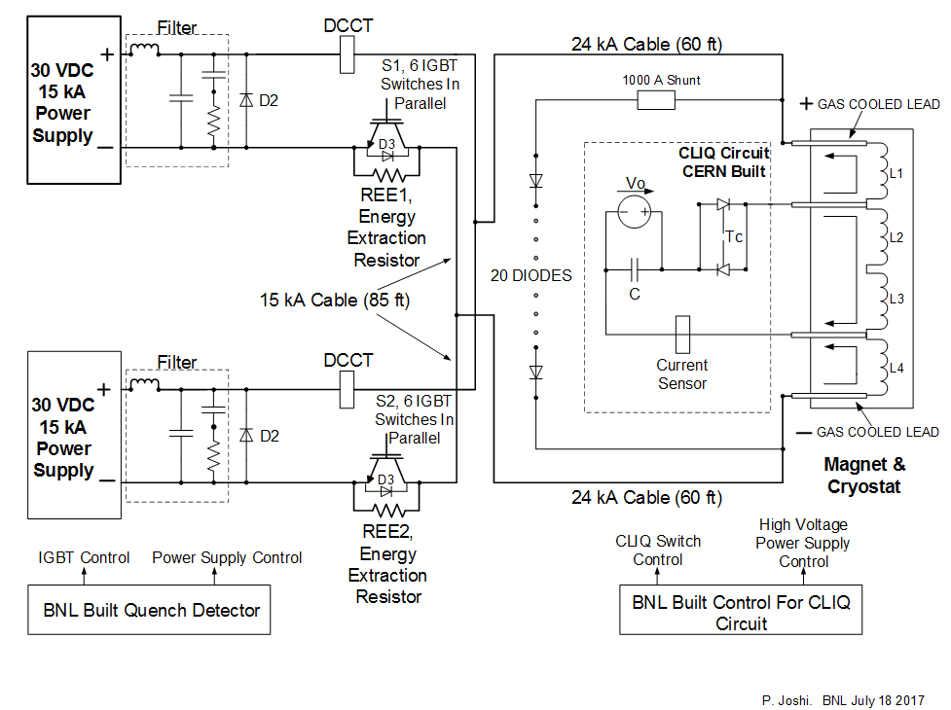
Integration of CLIQ
CLIQ unit supplied by CERN was successfully integrated for quench protection

Slide 14
Monitoring and controls
BNL Magnet test facility is monitored and controlled using 16 real time system based on various National Instrument hardware platforms from two control rooms. Cryo control room and Test control room. All systems are programed in LabView
Cryo control room controls and monitor:
Helium liquefaction
All Compressors
Clean He gas storage
Dirty He gas storage
He gas recovery during quench
Vacuum pumps
Deionized and cooling water system
Liquid Nitrogen facility
Test Dewar parameters
Test control room controls and monitors:
Power supply
Energy Extraction switch
Fast Data logger
Slow data logger
Quench detectors
Strain gage readouts
Quench heater power supplies

Slide 15
Questions ?

