Slide 1
Vertical Test Stand at BNL
Cost and Schedule
For
Operations During Production
M. Anerella
August 1, 2018

Slide 2
Outline
Responding to Charge 3. Equipment and Design Documentation
f. Is the cost and schedule estimate for the deployment of the Vertical Magnet Test system credible?
Responding to Charge 5. OPERATIONS
e. Is the cost and schedule estimate for operations of the Vertical Magnet Test system during production credible?
        Schedule
        Cost
        Summary

Slide 3
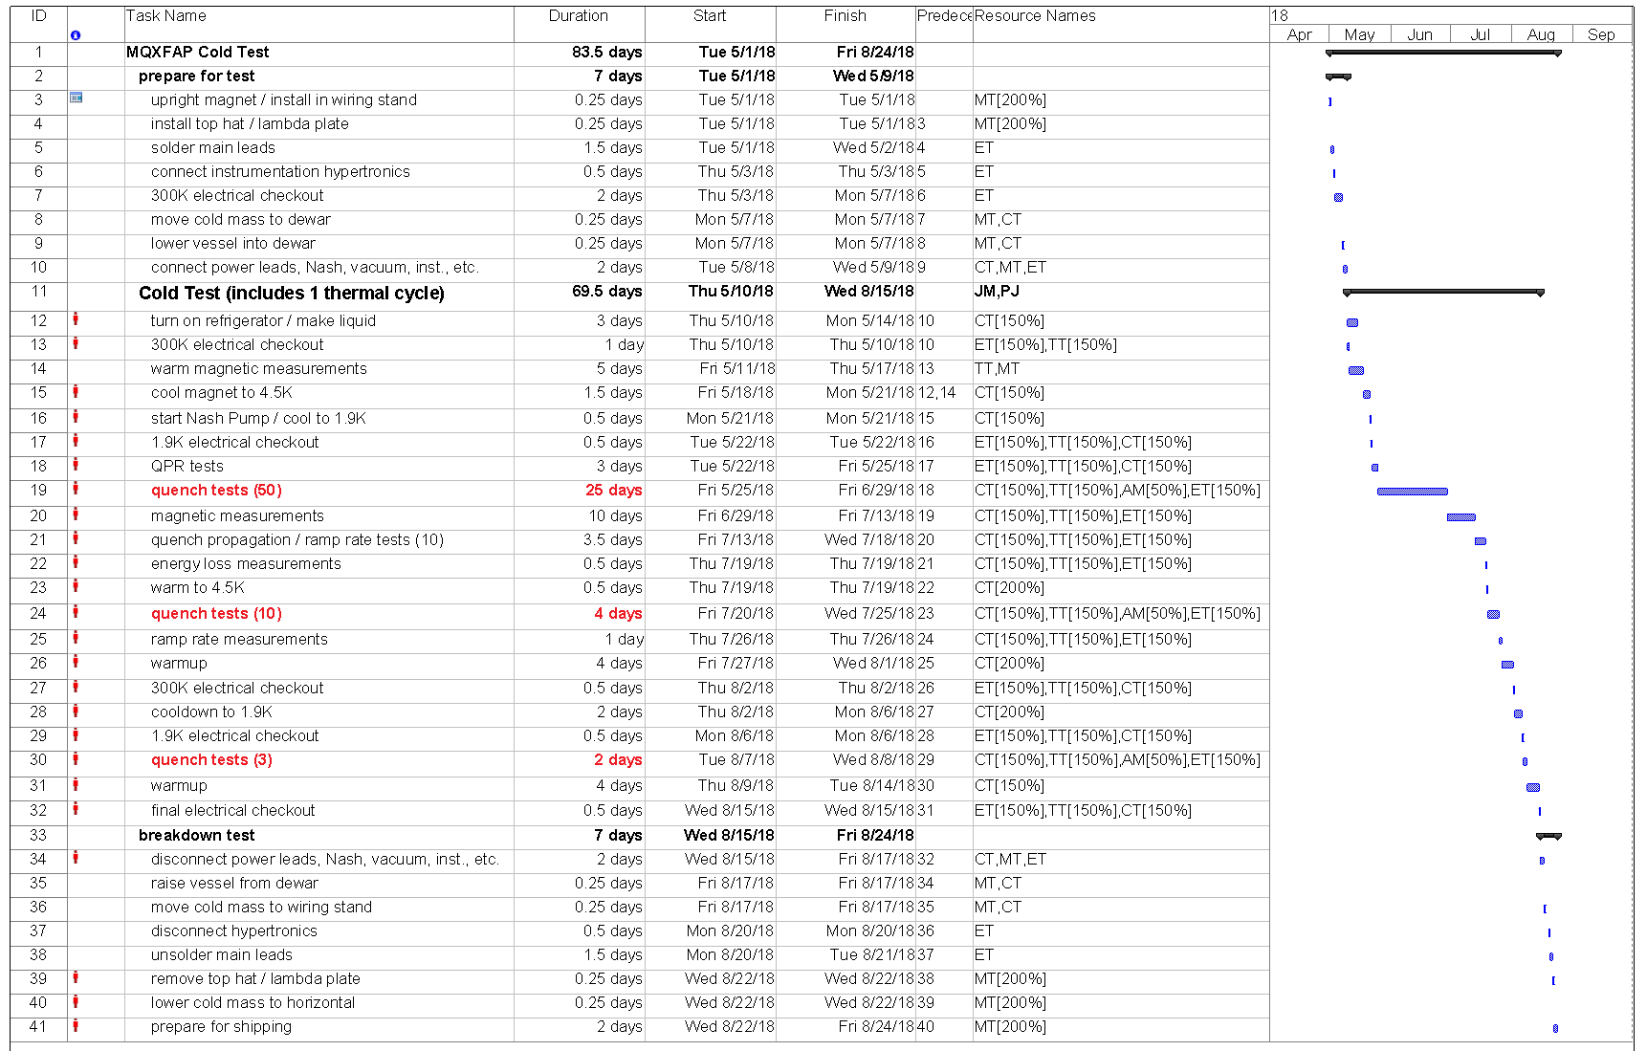
Prototype Schedule, Resources
Needs BCR to add incoming electrical tests
2 quenches / day, 12 hr. days
Schedule subject to changes in Run Plan

Slide 4
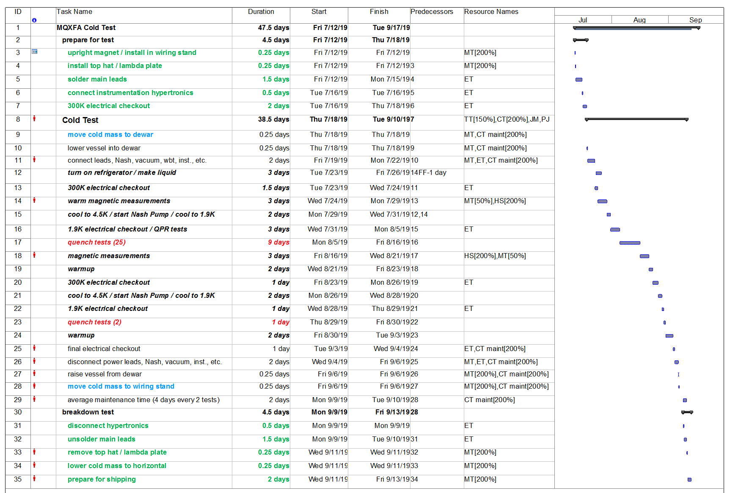
Production Schedule, Resources
Needs BCR to add incoming electrical tests
3 quenches / day, 16 hr. days
25 quenches per G.A / R.C.

Slide 5
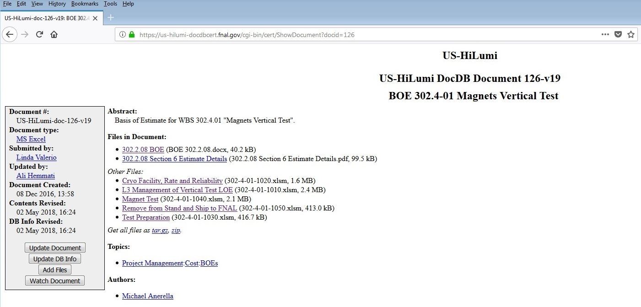
BOE’s for Magnet Test during Operation (3)
2
3
1

Slide 6
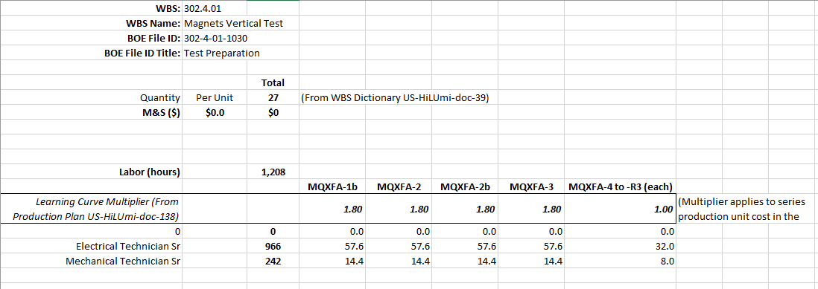
BOE 302-4-01-1030
Magnet Test Preparation
1
Reference: US-HiLumi-doc-126
no M&S – need BCR for rigging

Slide 7
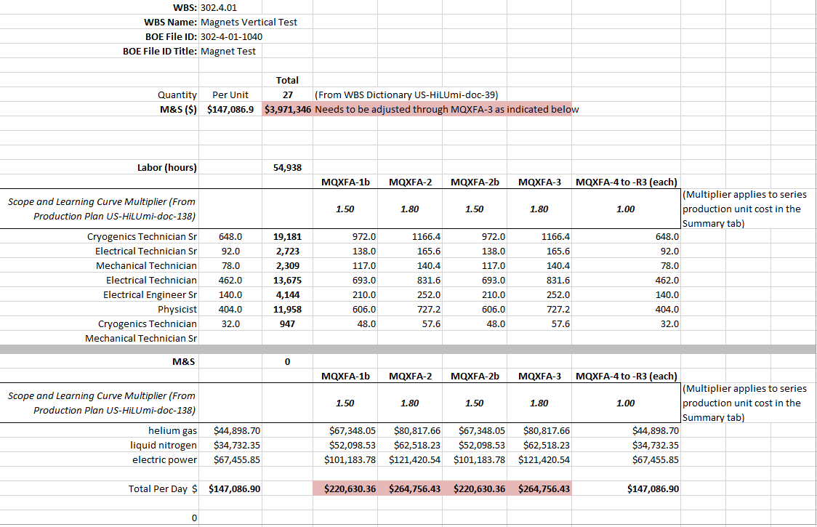
BOE 302-4-01-1040
Magnet Test p.1
2
Reference: US-HiLumi-doc-126

Slide 8
BOE 302-4-01-1040
Magnet Test p.2
2
Reference: US-HiLumi-doc-126

Slide 9
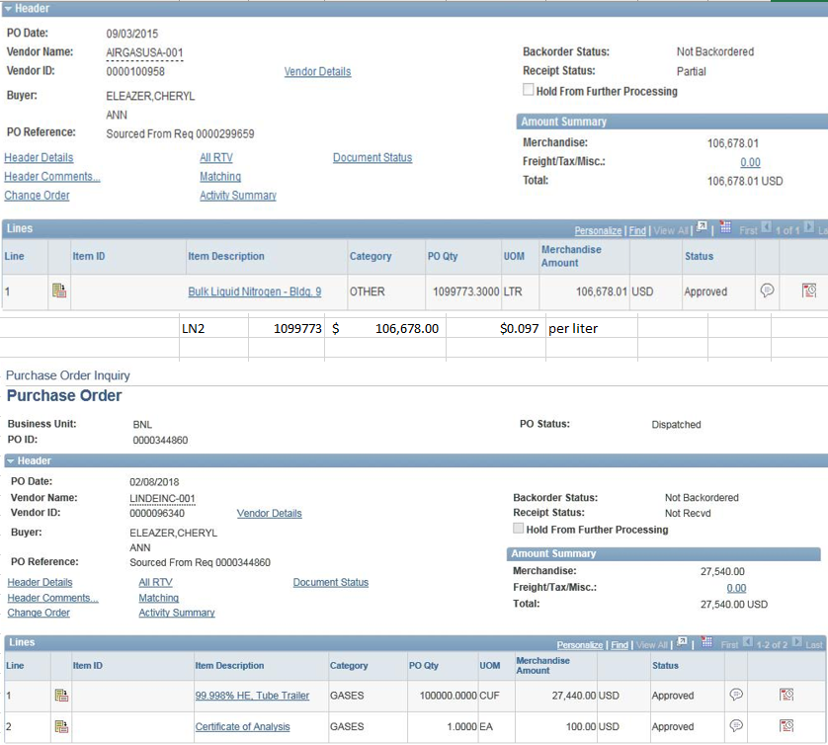
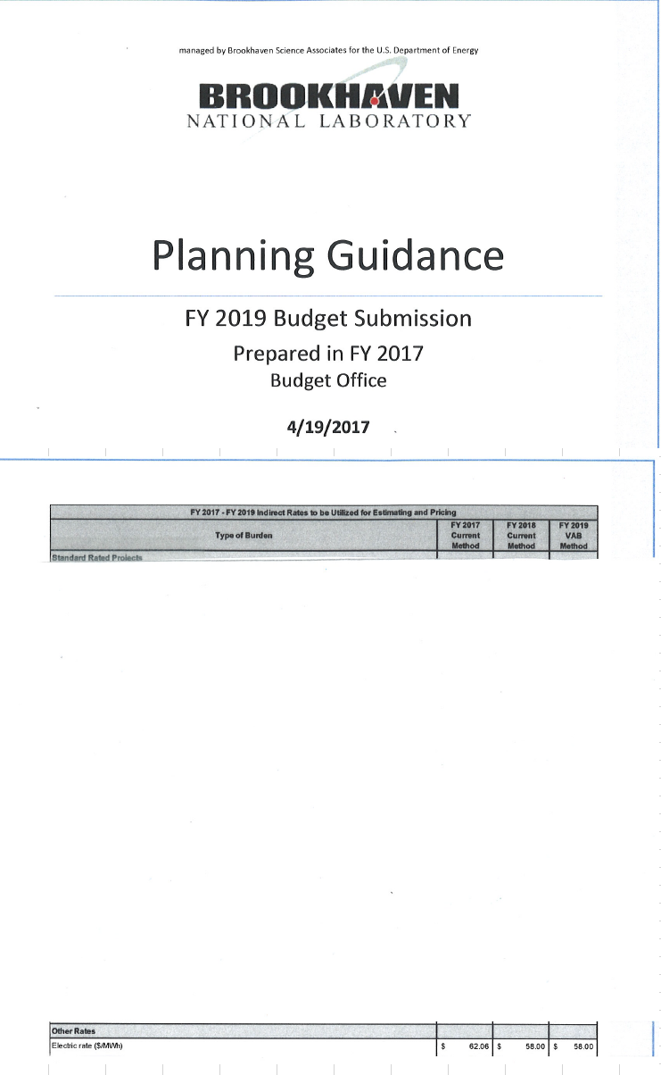
BOE 302-4-01-1040
Magnet Test p.3
2
Reference: US-HiLumi-doc-126

Slide 10
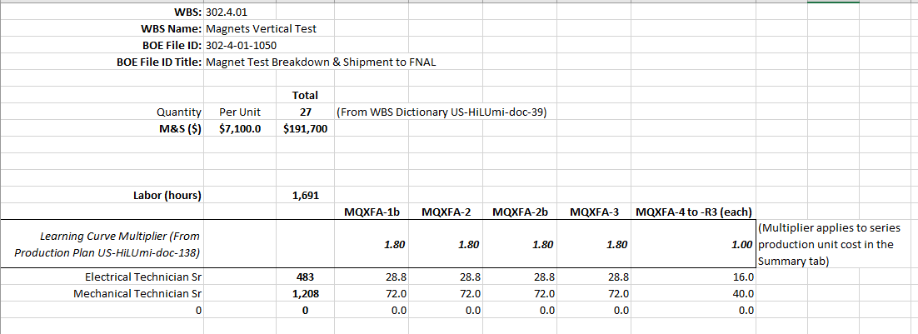
BOE 302-4-01-1050
Magnet Test Breakdown & Shipment to FNAL
3
Reference: US-HiLumi-doc-126
$7,100 M&S per magnet for shipping freight only – need BCR for rigging

Slide 11
BOE for Magnet Test Deployment

Slide 12
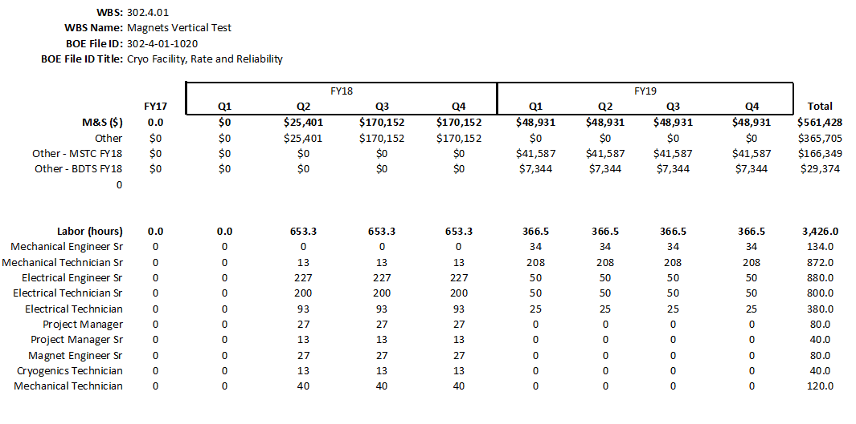
BOE 302-4-01.1020
Cryo Facility, Rate and Reliability p.1

Slide 13
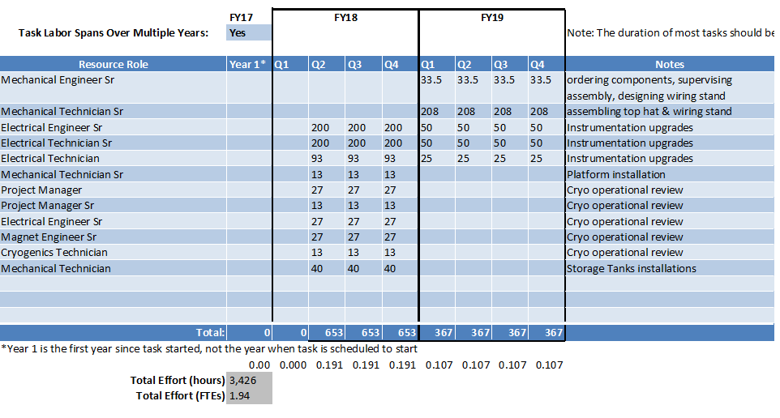
BOE 302-4-01.1020
Cryo Facility, Rate and Reliability p.3

Slide 14
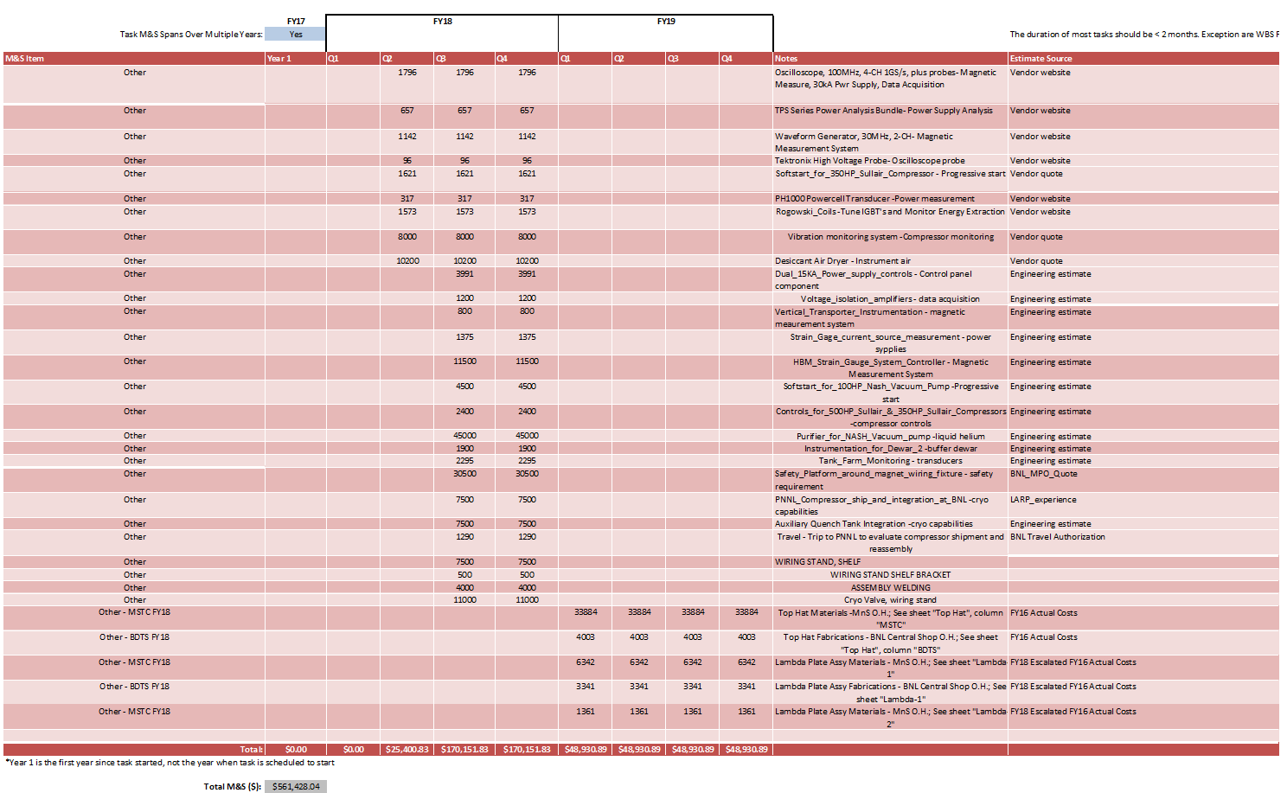
BOE 302-4-01.1020
Cryo Facility, Rate and Reliability p.2
Many large $ items are based on quotes or actuals
$365,704 (FY18)
$195,723 (FY19)

Slide 15
Summary
Cost and Schedule are well understood
  Based on previous experience with test facility during Mirror magnet test and MQXFA-01 test
  Based largely on actual purchase orders for cryogenic materials and actual daily electric power usage & BNL rates, and previous experience with regard to reliability / rate items
  Based on directed scope of work for prototypes and production magnets

Slide 16
Backup slides

Slide 17
Testing Day Durations, Usage
17.9KA Ultimate Current Quenches, 25% Energy Extraction – 3 QUENCHES/DAY, PRODUCTION; 16 hour cryo
Task Name | Duration (hr) | Helium Usage (gal) | Helium Usage (L)
refill 4.5K liquid | 1.5 | 250 | 946
pump down to 1.9K | 3 | 150 | 568
ramp #1 (17.9KA @20A/s) | 0.5
refill 4.5K liquid after 4.0 MJ | 2 | 300 | 1136
pump down to 1.9K | 3 | 150 | 568
ramp #2 (17.9KA @20A/s) | 0.5
refill 4.5K liquid after 4.0 MJ | 2 | 300 | 1136
pump down to 1.9K | 3 | 150 | 568
ramp #3 (17.9KA @20A/s) | 0.5
partial refill 4.5K liquid after 4.0 MJ | 1 | 200 | 757
total cryo tech (CT) * | 17 | 1105 | 4183
total test tech (TT) | 11.5
total helium |  | 2605 | 9861
17.9KA Ultimate Current Quenches, 25% Energy Extraction – 2 QUENCHES/DAY, PROTOTYPE; no 16 hour days
Task Name | Duration (hr) | Helium Usage (gal) | Helium Usage (L)
refill 4.5K liquid | 1.5 | 250 | 946
pump down to 1.9K | 3 | 150 | 568
ramp #1 (17.9KA @20A/s) | 0.5
refill 4.5K liquid after 4.0 MJ | 2 | 300 | 1136
pump down to 1.9K | 3 | 150 | 568
ramp #2 (17.9KA @20A/s) | 0.5
partial refill 4.5K liquid after 4.0 MJ | 1 | 200 | 757
total cryo tech (CT) * | 11.5 | 747.5 | 2830
total test tech (TT) | 6
total helium |  | 1798 | 6804
* boil-off of 250 L/hr. is calculated based on cryo tech time for full day

Slide 18
Testing Performance
Production testing analysis based on G. Ap’s request for 30 quenches in 10 working days –
AGREED by R. Carcagno that Functional Test Requirements to be updated to 25 quenches (5 to be added to Risk Registry)
Prototype testing based on 1/10/17 Functional Test Requirement US-HiLumi Document 137-v3
of 50 quenches
Prototype: 2 quenches-12hrs/day defensible due to marginal improvement at 16hrs/day with present liquefaction capability
Days in red denote testing does not occur; liquefaction only to rebuild inventory

Slide 19
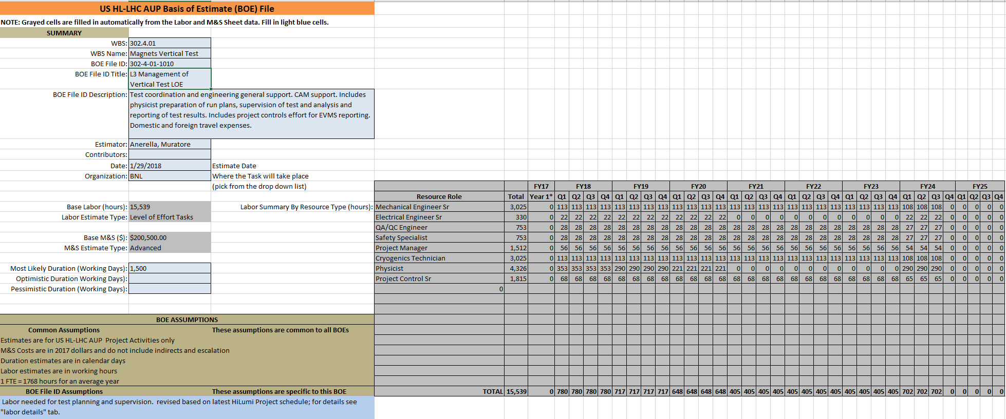
BOE 302-4-01-1010
L3 Management of Vertical Test LOE

