Slide 1
Examination of Quenching in SRF cavities
Thomas J. Smart
Supervisor: Mattia Checchin, PhD

Slide 2
Introduction: What are SRF Cavities?
Superconducting Radio Frequency (SRF) cavities are resonant structures designed to accelerate particles.
Designed to be ’in sync’ with the incoming particle, so the particle only experiences a force in one direction.
Driven by RF radiation and typically composed of Niobium
Operates at 2K (1.3GHz)

Slide 3
Why is Quenching a problem?
Q-factor improvement after N-doping – up to 4 times higher Q than standard Nb cavities
Quench limits our max gradient (E_{acc}).
Want High Q₀ / High E_{acc}
Reduce Costs
Quench!
Typical Q vs Eacc curve obtained with 120C bake (standard ILC treatment)

Slide 4
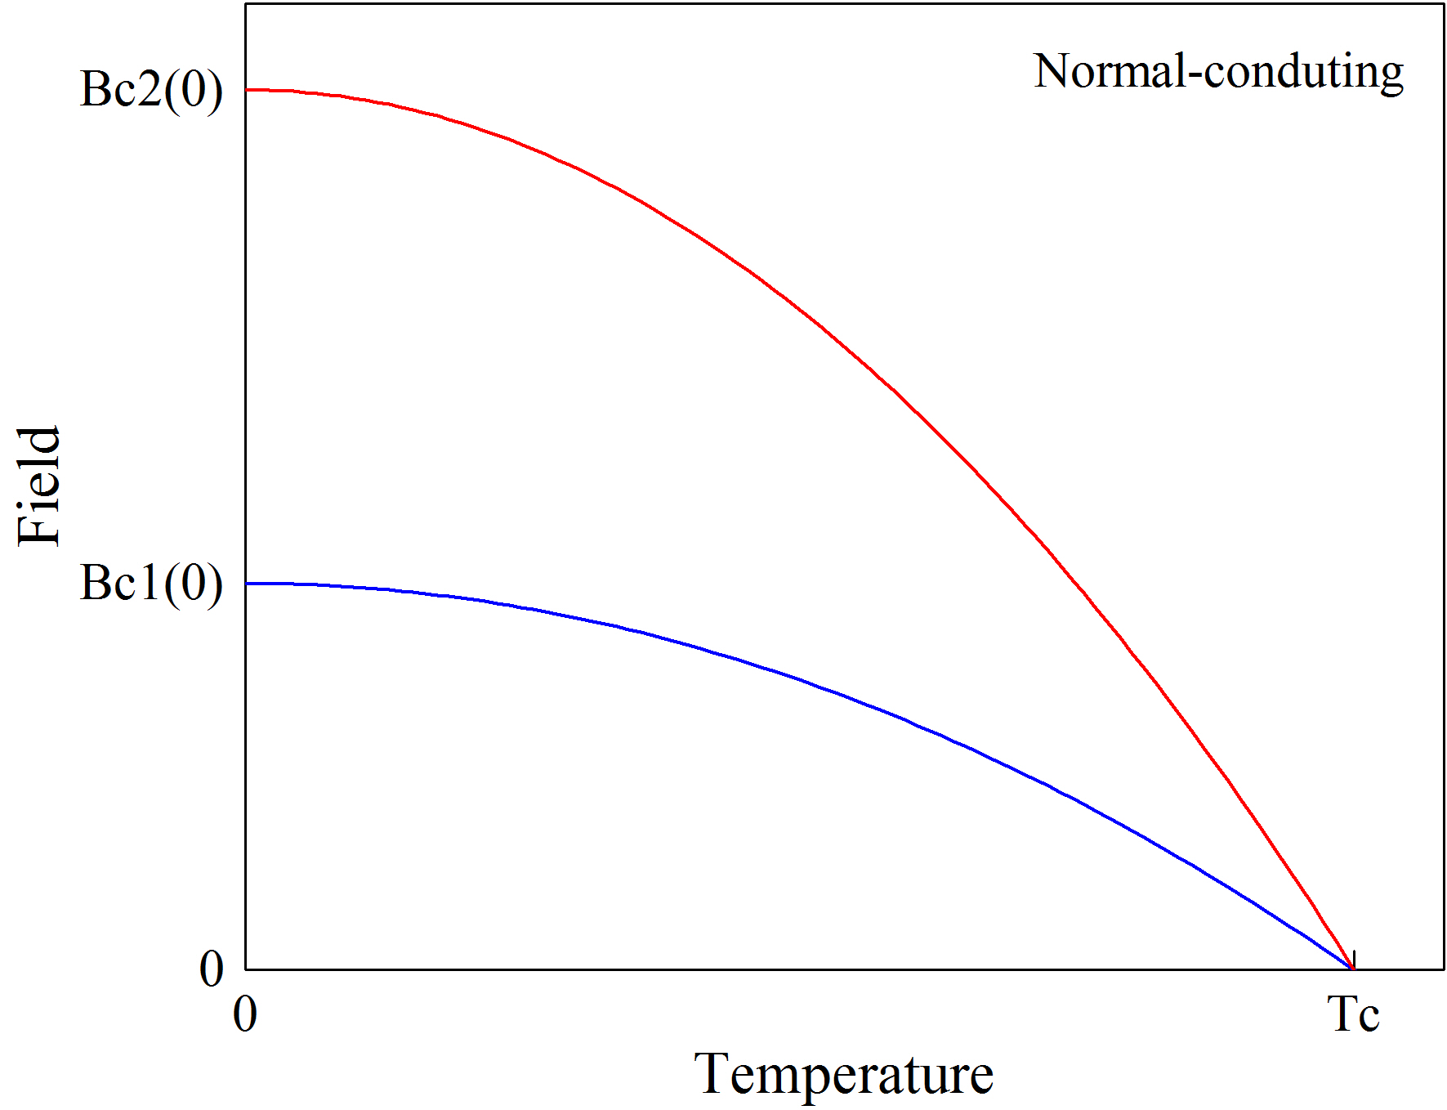
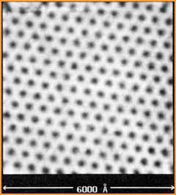
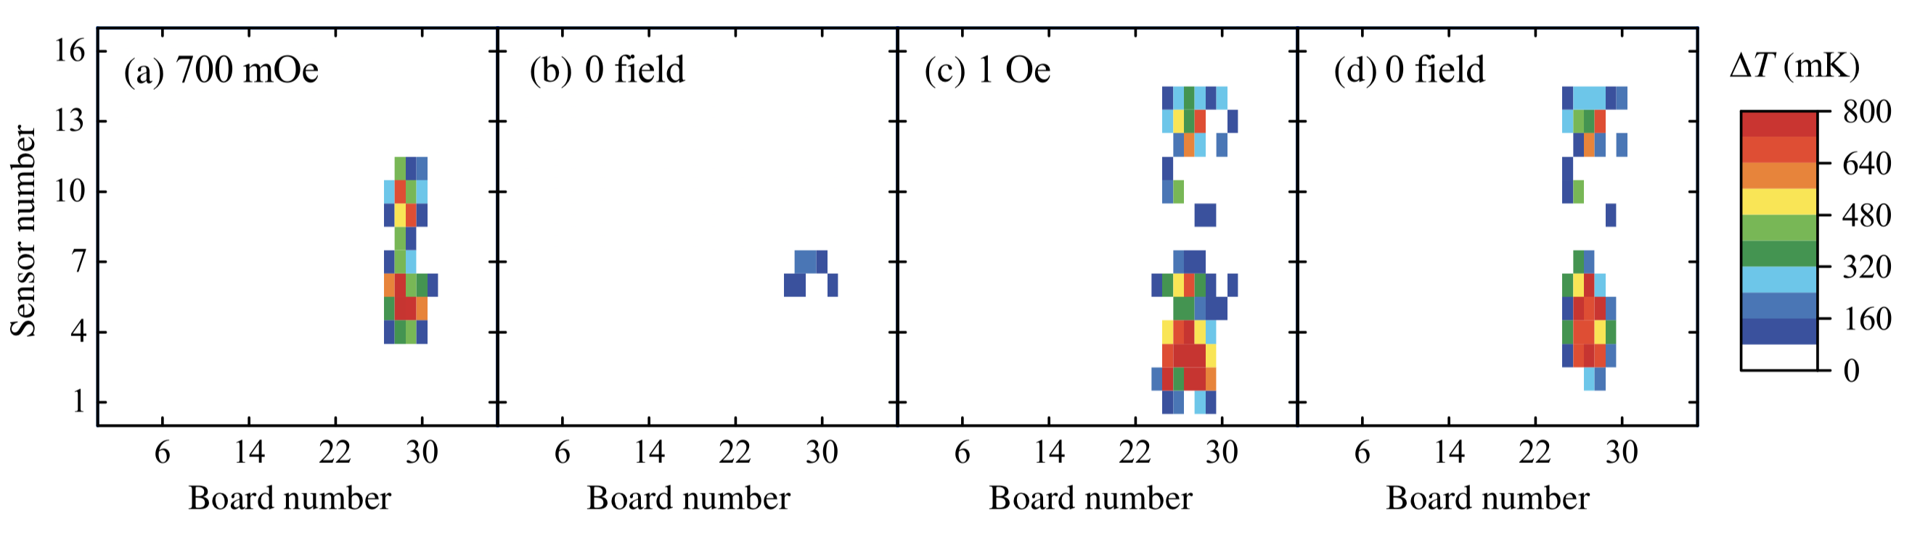

Causes of Quench
Many sources of quenching from secondary effects (e.g Multipacting and FE).
Focus on surface treatments and the effect on vortex nucleation and flux trapping -> R change.
H. F. Hess et al., Phys. Rev. Lett. 62, 214 (1989)
$$B$$
Cooldown

Slide 5
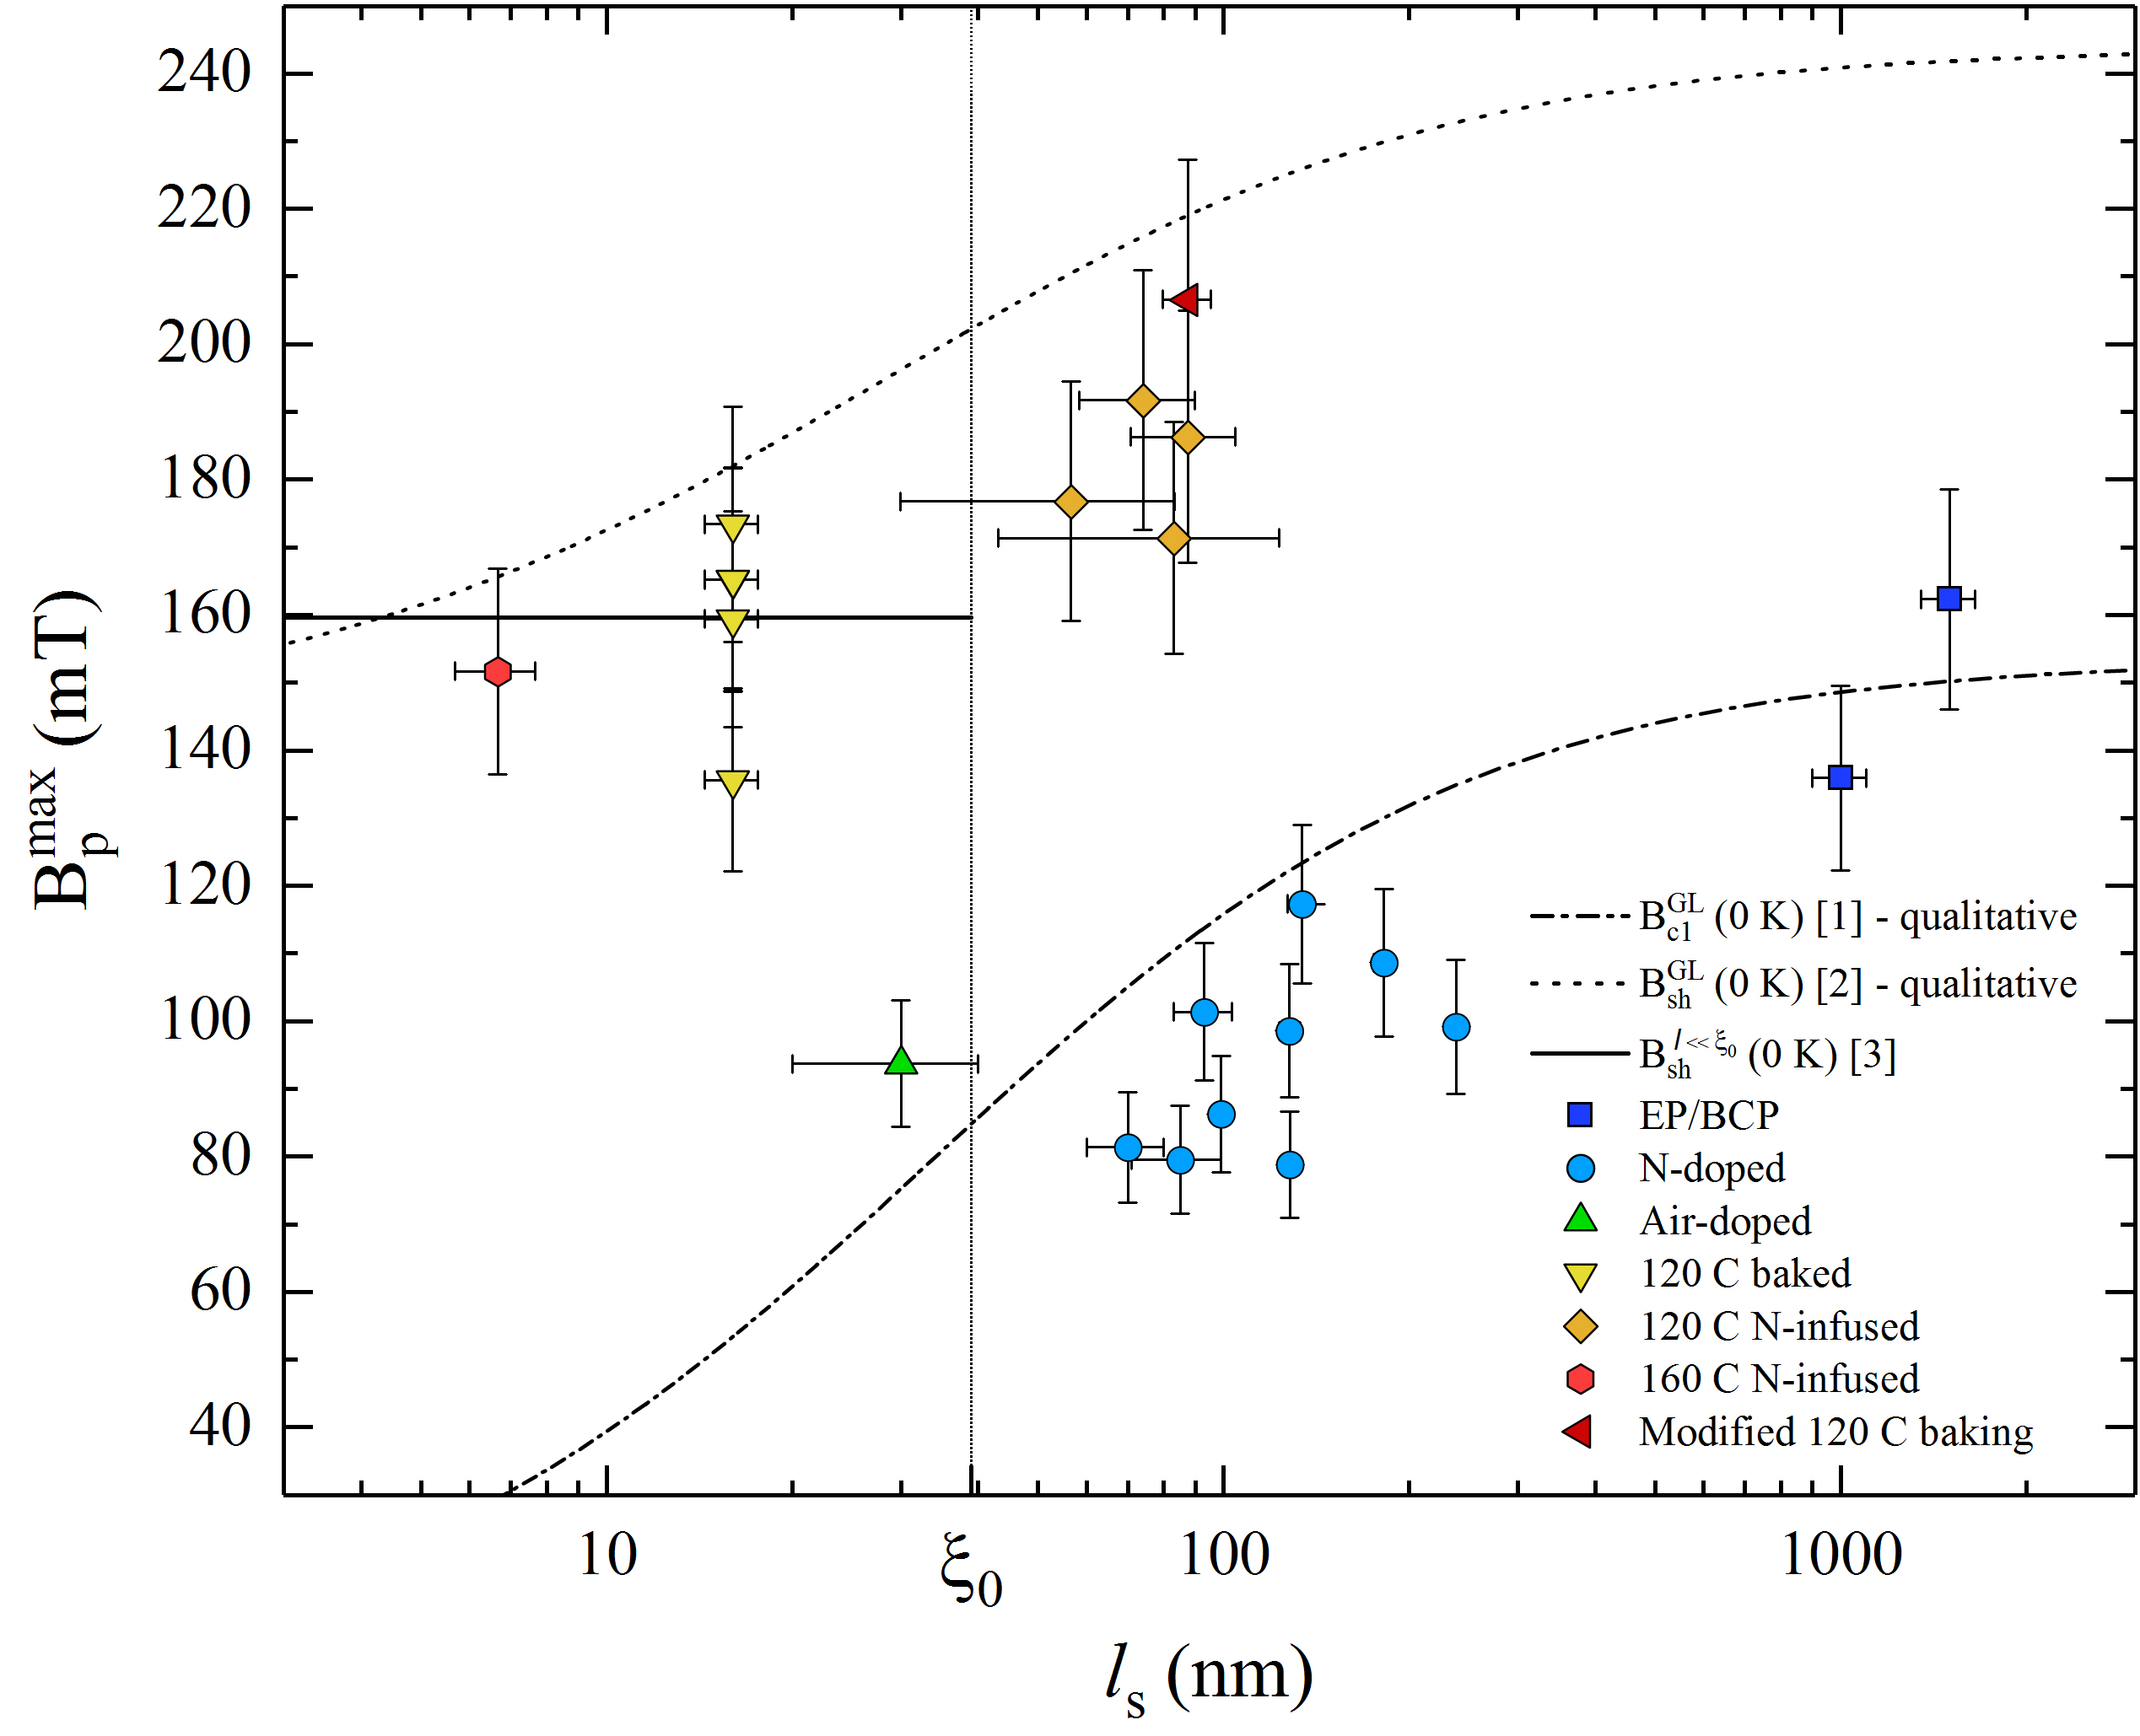
My Project
Test N-Infused and N-Doped cavities to examine effect of surface treatments on quenching.
Compare results to theoretical models to determine characteristic parameters.
Examine a brand new treatment found a few months ago at FermiLab.
Work could be applicable to ILC.

Slide 6
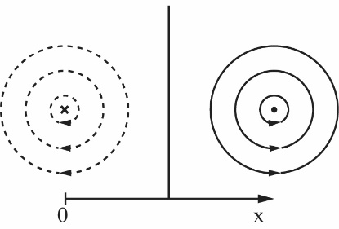
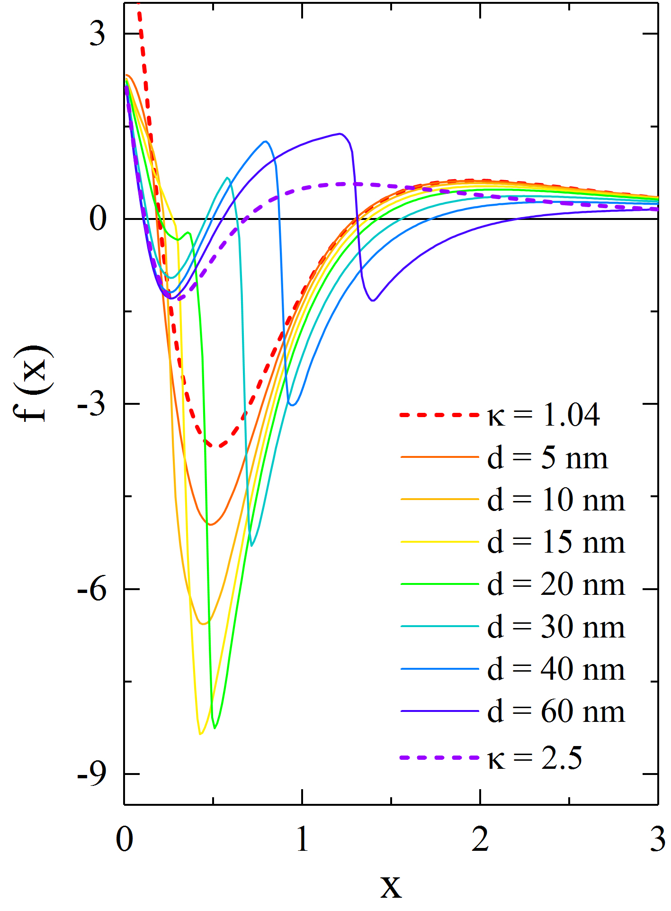
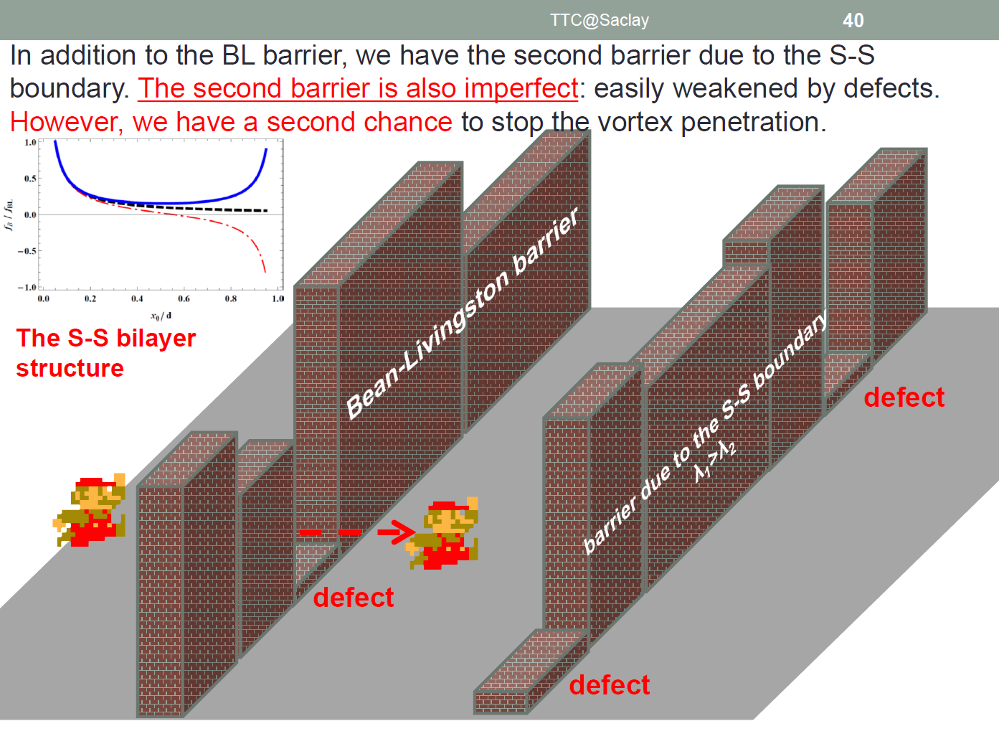
Vortex moves to boundary of region with higher ƛ (S-S), arises from GL Theory
Anti-Vortex (MOI)
Vortex
S-S
C. P. Bean and J. D. Livingston, Phys. Rev. Lett. 12, 14 (1964)

