Slide 1
Review Introduction & Charge
Giorgio Ambrosio
MQXFA Magnets L2
HL-LHC Accelerator Upgrade Project
Internal Review to address issues re wind-and-cure at BNL
July 12, 2018

Slide 2


Introduction
The HL-LHC AUP project is going to have two coil fabrication sites (BNL and FNAL). Both sites will make identical coils for the MQXFA magnets to be used in Q1 and Q3 of the High Luminosity LHC.
MQXF short model coils and prototype coils were fabricated using the “LARP scheme”: all coils wound-and-cured at FNAL, half coils reacted-and-impregnated at BNL, half coils reacted-and-impregnated at FNAL.
In preparation for the AUP project LARP initiated procurement of parts for a wind-and-cure line for MQXFA coils at BNL. The AUP project took over this effort including installation and commissioning of this line. AUP aims at starting MQXFA coil production at BNL on October 31, 2018.

Slide 3
Introduction
During practice winding the BNL team found seven issues and reported them to the MQXFA magnet L2. The L3s involved with these issues discussed them and found a solution to four of them. This internal review is called to address the three remaining issues.

Slide 4
CHARGE
Each committee member is requested to answer the following questions:
What are your recommendations and comments (optional) for addressing each one of the three remining issues?
Do you have any other comment or recommendation regarding these issues or the issues closed by the L3s?
Do you have any comment or recommendation for next steps in commissioning the MQXFA wind-and-cure line at BNL?

Slide 5
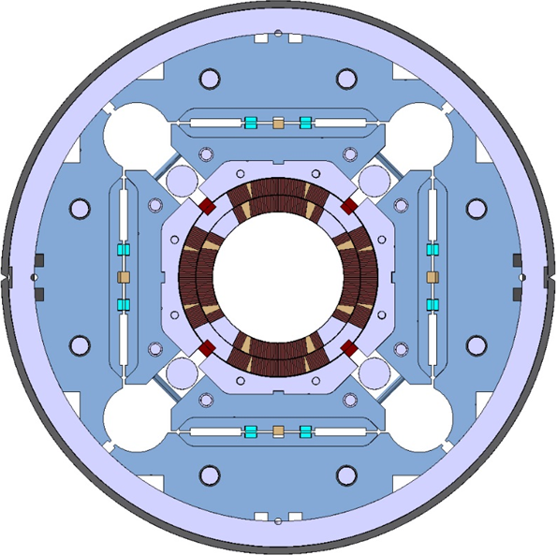
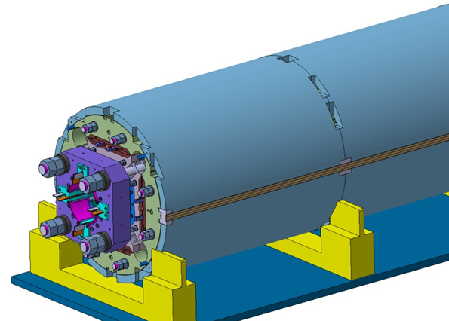
MQXFA/B Main Parameters
Parameter | Unit | MQXFA/B
Coil aperture | mm | 150
Magnetic length | m | 4.2/7.15
N. of layers |  | 2
N. of turns Inner-Outer layer |  | 22-28
Operation temperature | K | 1.9
Nominal gradient | T/m | 132.6
Nominal current | kA | 16.5
Peak field at nom. current | T | 11.4
Stored energy at nom. curr. | MJ/m | 1.2
Diff. inductance | mH/m | 8.2
Strand diameter | mm | 0.85
Strand number |  | 40
Cable width | mm | 18.15
Cable mid thickness | mm | 1.525
Keystone angle |  | 0.4
P. Ferracin et al., “Development of MQXF, the Nb₃Sn Low-β Quadrupole for the HiLumi LHC ” IEEE Trans App. Supercond. Vol. 26, no. 4, 4000207
G. Ambrosio et al., “MQXFS1 Quadrupole Design Report” LARP DocDB 1074

Slide 6
MQXFA Final Design Report
Charge 1, 3
Final Design Report is approved and available on Review website
  Details will be presented by L3s
Drawings are available on Review website
US-HiLumi-doc-948
Electronic signature on DocDB

Slide 7
W&C line commission – Value Engineering
Value Engineering may be performed at any step of the AUP project
Nonetheless the 1st goal for the commissioning of the new W&C line is to demonstrate that it can produce MQXFA coils according to the design in the MQXFA FDR
  Value engineering proposals will be evaluated after this step is accomplished
  “It would have been much better to perform this commissioning under LARP before freezing the design… unfortunately we could not do it!”

