Slide 2
Status & Outlook for the LHC
US-LHC User Association Annual Meeting 2018, 24 –26 October
Fermilab – Batavia, Illinois - USA
Rende Steerenberg – CERN
On behalf of the LHC team

Slide 3
Content
Looking Back at 2018
LHC Performance 2018
The Remainder of 2018
Some of the Challenges Ahead
Some Words on the LIU Project
Conclusion

Slide 4
Looking Back at 2018

Slide 5
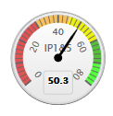
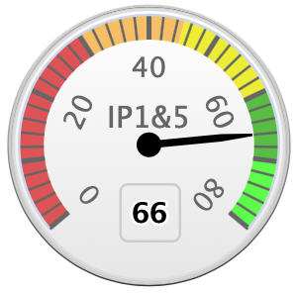
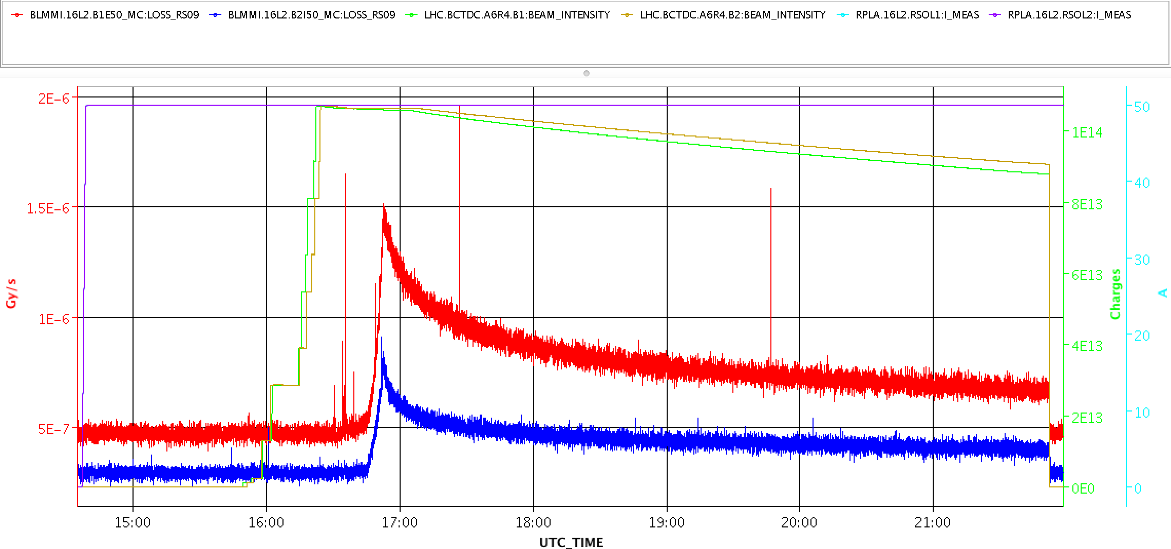
A quick look back at 2018…
Planned
May 5th
Collisions with 2556 bunches
Dec 3rd
End of 2018 run
Apr. 28th
Collisions with 1200 bunches
May 12th
Record Peak Lumi: 2.07x10³⁴
Oct. 27th
End of 2018 p-p-run
YETS
Apr. 17th
First Stable Beams
Jun. 18th – 21st
TS #1
Sep 17th – 21st
TS #2
Nov. 5th
Start Pb-Pb
run
Mar. 29th
First 2018 beam
2018
Jan Feb Mar Apr May Jun Jul Aug Sep Oct Nov Dec
Partial heat up of sector 1 -2 to mitigate 16L2
Mar. 5st
Start of powering tests
May 31st
16L2 Storms Recovery strategy established
Aug. 7th
16L2 with successful recovery
Oct. 31th – Nov. 2nd
TS #3
Apr. 23rd
1 day scrubbing
1st signs of 16L2 activity
Dec. 3rd – 9th
7 TeV Magnet Tests
May 20th
16L2 Storms with beam dumps
Sep. 6th
50 fb-1 reached
May 14th & 15th
16L2 Storms with beam dumps

Slide 6
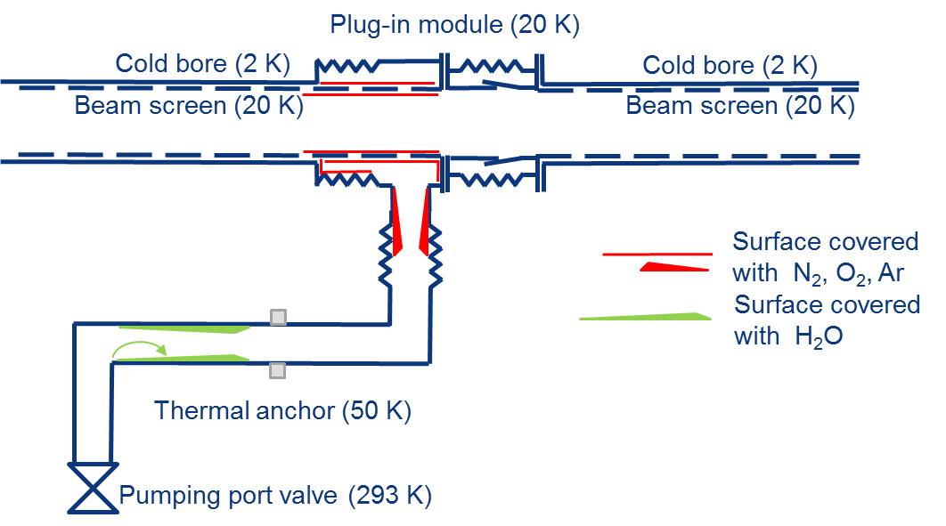
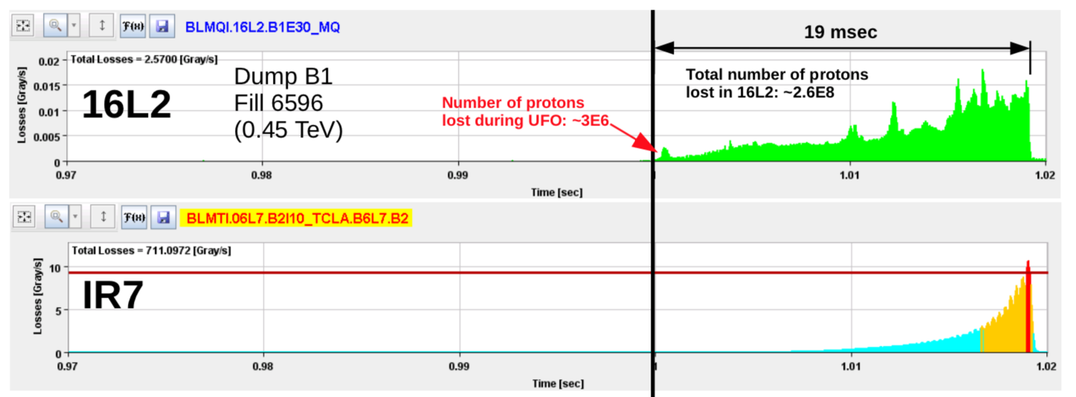
16L2: Beam Dumps Due to Fast Losses
Accidental air Inlet in beam vacuum in half cell 16 left of IP2 (16L2) during 2016-2017 Year-End Technical Stop (YETS)
Initially mitigated by 8b4e beam and “home-made” solenoid that suppress e-cloud
Later (YETS 2017-2018) by partial warm-up an vacuum pumping
Not fully recovered yet, but no longer limiting performance

Slide 7
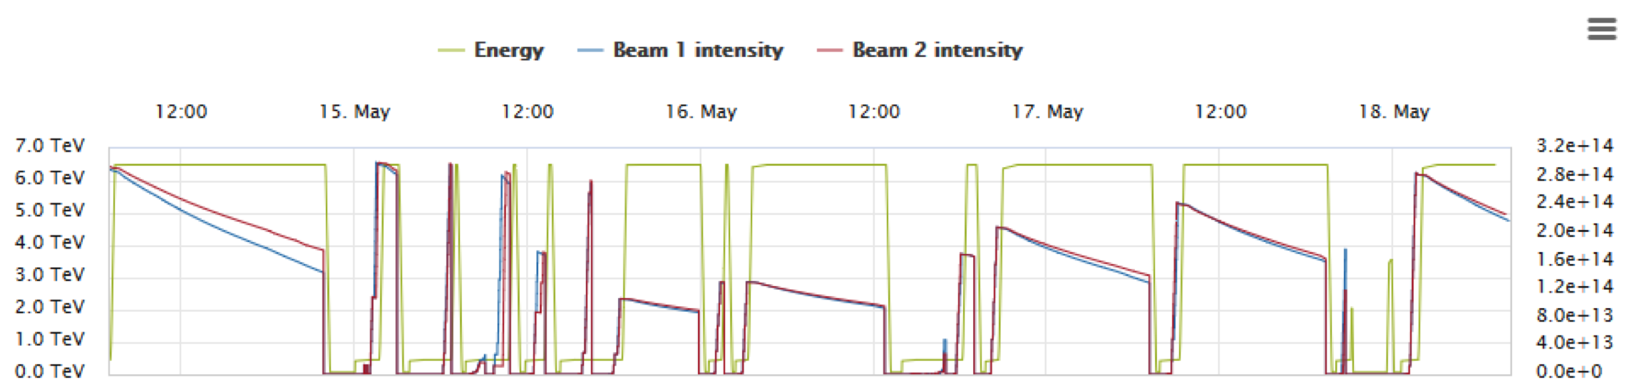
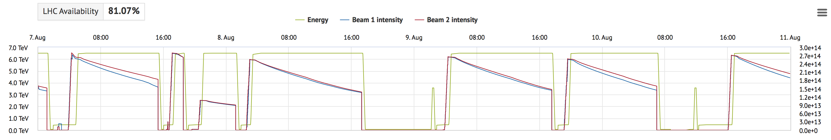
16L2 Storms & Recovery Strategy
Production
16L2 Storms
16L2 Storms recovery by intensity ramp up
2556
bunches
987
bunches
1227
bunches
1551
bunches
1887
bunches
2556
bunches
“Classical” recovery as applied in 2017 (several days)
16L2
Production
16L2 recovery
Production
2556
bunches
987
bunches
2556
bunches
2556
bunches
2556
bunches
2556
bunches
Fast recovery as applied in 2018 (within the same day)

Slide 8
ATS Optics, since the start of 2018
ATS = Achromatic Telescopic Squeeze
  Increase 𝛽-function in the arcs to enhance effect of inner triplets around the experiments
  Baseline optics for the HL-LHC, to allow for 𝛽*=0.15 m
In addition, depending on the “telescopic factor” octupoles will have more effect for same current, thanks to larger 𝛽-functions in the arcs
Deployed as proof of principle and to gain operational experience
Further development continues during Machine Development sessions
𝛽*=0.4 m
𝛽*=0.1 m
S. Farthouk et al.

Slide 9
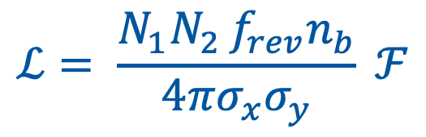
Luminosity Levelling & Anti-levelling
In certain conditions and depending on the experiments request, it is desirable to adapt the luminosity dynamically with beams in collision – levelling
Methods for Levelling
Beam offset / separation
$$ℒ= \frac{N_{1}N_{2 }f_{rev}n_{b}}{4πσ_{x}σ_{y}} ℱ$$
crossing angle
β* (= beam size at IP)

Slide 10
Luminosity (Anti-)Levelling Operational
In 2017 step-wise crossing angle anti-levelling was introduced
  3 steps depending on the luminosity burn-off
In 2018:
  The crossing angle anti-levelling is done continuously, down to 130 𝜇rad
  A step-wise 𝛽* anti-levelling has been added
  𝛽*=30 cm → 27.5 cm → 25 cm
Crossing angle anti-levelling
Allows few % gain in integrated luminosity, but is a vital exercise for future (HL-LHC) levelling
𝛽* levelling tests during MD

Slide 11
LHC Performance 2018

Slide 12
LHC Machine & Beam Availability
2018
Preliminary
Best production year ever for the LHC
Performance mainly through machine availability, but also thanks running close to twice the design (peak) luminosity and anti-levelling
  High brightness beams from the injector
  Various optimizations in LHC to minimize beam blow up and maximize life time

Slide 13
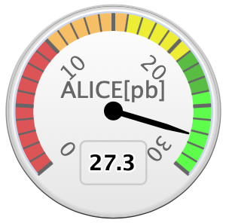
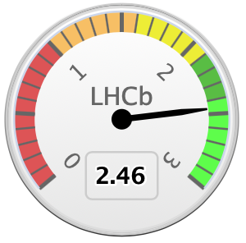
2018 Luminosity Forecasted & Achieved
Average of ATLAS & CMS
LHCb
ALICE Luminosity is
levelled
LHCb luminosity
is levelled
Data taken on: 09.09.2018@15:00 UTC

Slide 14
Run I + Run II Goals
Period | Int. Luminosity [fb⁻¹]
Run 1 | 29.2
Run 2: 2015 | 4.2
Run 2: 2016 | 39.7
Run 2: 2017 | 50.2
Run 2: 2018 | 66
Total Run 1+ 2 | 189.3
The LHC goal up to LS2 was 150 fb⁻¹ and has been achieved in Run II alone
The goal for 2018 was 60 fb⁻¹, hence 6 fb⁻¹ (10%) beyond target

Slide 15
Peak Luminosity and its Evolution
2016: the LHC well beyond its design luminosity
  Despite a reduced number of bunches
  Thanks to the brighter injectors beam
Design
Luminosity
Every year:
  The peak luminosity is higher than previous years
  The time in which the peak luminosity is reached is shorter
Thanks to a combination of:
Continuous improvement of beam brightness from the injectors
Good understanding of LHC and experience in re-commissioning
After Long Shutdown 2, many things will have to be “learned” again

Slide 16
Peak Luminosity during 2018
Bunch intensity is not really pushed to avoid issues with 16L2
Steadily cruising close to 2 x 10³⁴ cm⁻²s⁻¹ (twice the LHC design value)
Achieved record peak luminosity 2.2 x 10³⁴ cm⁻²s⁻¹

Slide 17
2018 Machine/Beam Parameters
Parameter | Design | 2018
Bunch population N_{b} [10¹¹ p] | 1.15 | ~1.1
No. bunches per train | 288 | 144
No. bunches | 2780 | 2556
Emittance 𝜀 [mm mrad] | 3.5 | ~2.2
𝛽* [cm] | 55 | 30 → 27.5 → 25
Full crossing angle [𝜇rad] | 285 | 300 → 260
Peak luminosity [10³⁴ cm⁻²s⁻¹] | 1.0 | ~2
Integrated luminosity [fb⁻¹] |  | 66
The “CMS bump” to compensate ground movement was increased from -1.5 mm to -1.8 mm

Slide 18
The Remainder of 2018

Slide 19
Remainder of 2018
Magnet training tests to aiming for 7 TeV after LS2
Pb-Pb ions run
The Proton luminosity production run has been completed
The Special Physics run at low energy and high beta has been completed
Presently an extended MD period is ongoing
The Pb-Pb ions run is upcoming and prepared
LS2 will start with a magnet training test campaign to learn more on the magnet training quenches to be expected for running at 7 TeV after LS2

Slide 20
Summary Table 2018 - 2017 - 2016
 | 2018 |  | 2017 |  | 2016
Phase | Days | Ratio [%] | Days | Ratio [%] | Days | Ratio [%]
Comm. & Intensity ramp up | 33** | 13.4 | 35 | 16.1 | 28* | 11.3
Scrubbing | 1 | 0.4 | 7 | 3.3 | 2 | 0.8
25 ns Proton Physics | 130 | 52 | 127 | 58.5 | 139 | 56.3
Special Physics Runs | 14 | 6.5 | 18 | 8.3 | 10 | 4
Setting up Pb-Pb ion run | 4 | 1.6 | - | - | 6 | 2.4
Pb-Pb ion run | 24 | 9.8 | - | - | 23 | 9.3
Machine Developments (MD) | 24 | 9.8 | 18 | 8.3 | 21 | 8.5
Technical Stops (3x) | 12 | 4.9 | 8 | 3.7 | 12 | 5
Technical Stop Recovery (3x) | 4 | 1.6 | 4 | 1.8 | 6 | 2.4
Total | 246 | 100 | 217 | 100 | 247 | 100
Integrated luminosity [fb⁻¹] | 66 |  | 50.2 |  | 39.7
* Did not fully include intensity ramp up – interleaved commissioning and interleaved intensity ramp up was as of 2017
** With 1200 bunches per beam, previously with 3 bunches
Based on the 2018 LHC Schedule Version 1.6

Slide 21
Some of the Challenges Ahead

Slide 22
Reaching 7 TeV after LS2
All dipole magnets were trained for 6.5 TeV operation since 2015. Just over 150 quenches were required to reach 6.5 + 𝛆 TeV
  Spread in number of quenches between the sectors is due to the mixture of producers
  Two sectors were pushed to 6.75 TeV in December 2016
Magnet training campaign to 6.5 TeV (2015)
Estimate for 7 TeV:
One very slow sector → ~110 quenches
3 slow sectors → 75-85 quenches
3 fast sectors → ~60 quenches
One very fast sector → ~25 quenches
Considering 2 quenches/day, the training for each sector will be between 10 days and ~2 months

Slide 23
Electron Cloud
Running with small bunch spacing provokes an avalanche-like process, e-cloud, due to the Secondary electron Emission from the chamber’s wall
Controlled and prolonged electron bombardment of the surface has proven proved to reduce drastically the secondary electron yield (SEY)
Scrubbing provides a mean to mitigate e-cloud build-up, resulting in a clear improvement of beam quality
Consequences:
  degraded vacuum
  impact on beam quality (instabilities, emittance growth, losses)
  excessive energy deposition

Slide 24
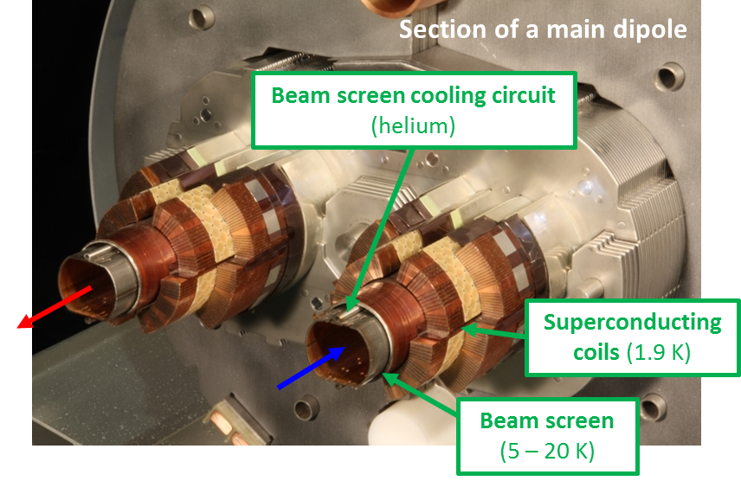
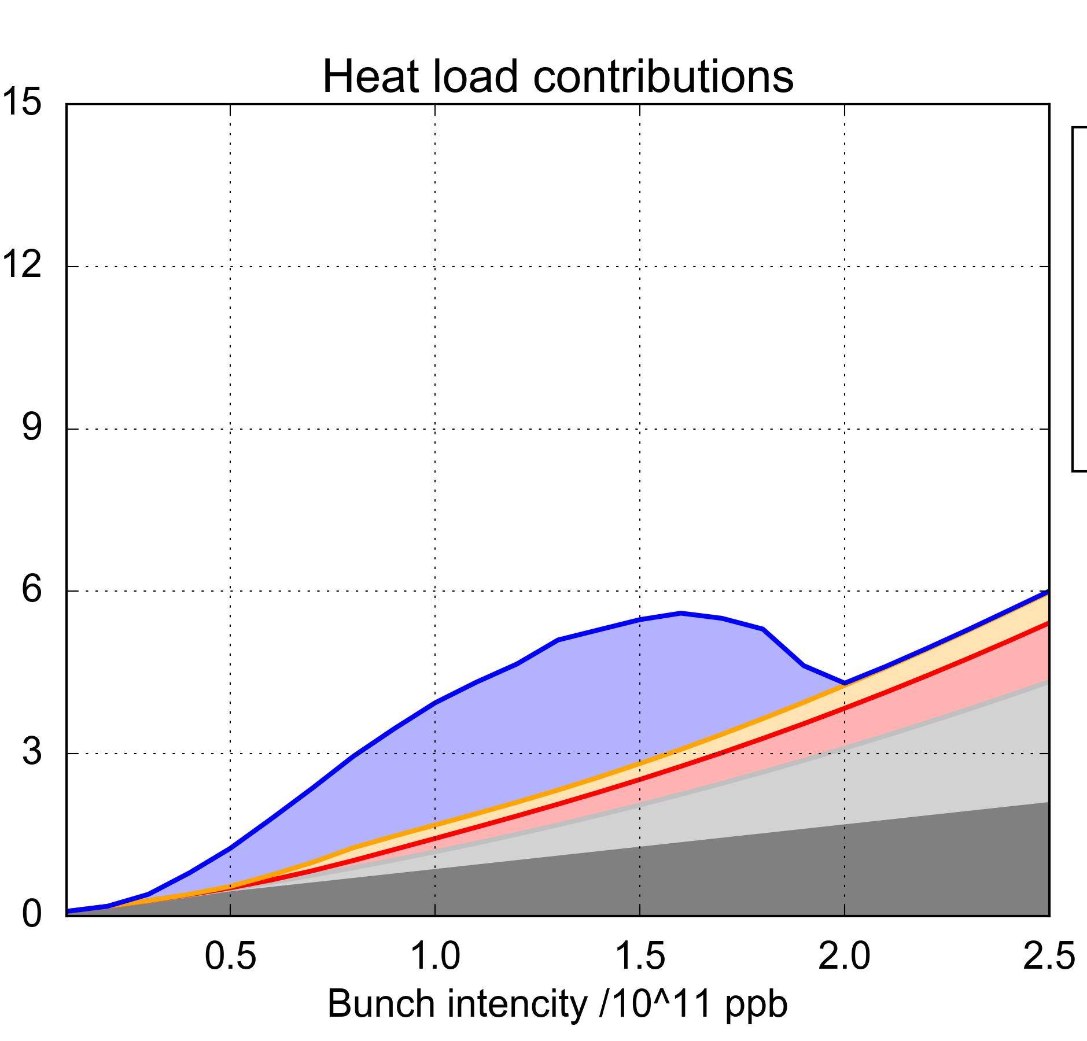
Heat Load and e-Cloud
  Measuring the thermodynamic properties of helium, it is possible to know the heat load on the beam screen
e-cloud in dipoles
e-cloud in quadrupoles
e-cloud in drifts
Impedance
Synchrotron radiation
  8 kW/arc (~160W/hcell)
The heat load represents a limitation as it challenges the cryogenic system and can eventually lead to beam dump (beam screen warm-up)

Slide 25
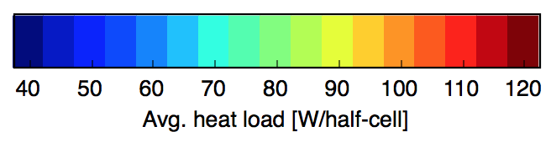
Heat Load Around the Machine
S45
S56
The only sector that was warmed-up (S12) and vented after LS1 was conditioned back to the high level of heat load
S34
S67
Good sectors
Bad sectors
S23
S78
S12
S81
Heat loads are distributed unevenly.
  High-load sectors (S12, S23, S78, S81)
  Low-load sectors (S34, S45, S56, S67)
This division appeared after LS1, but presently unclear why

Slide 26
Some Words on the LIU Project

Slide 27
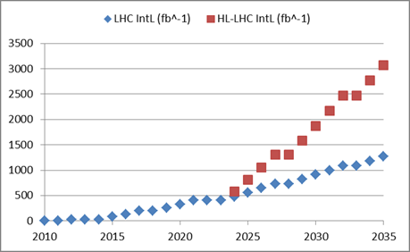
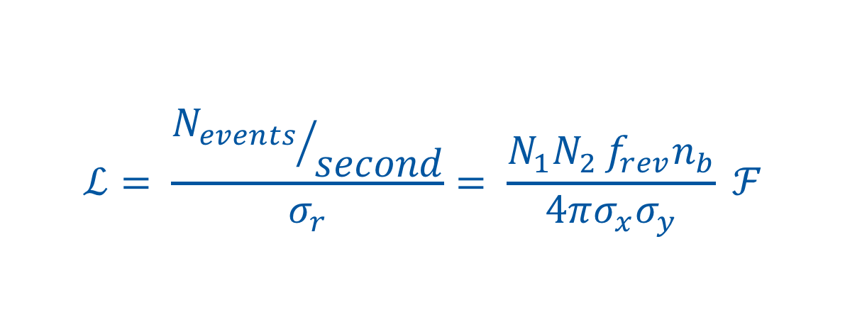
Luminosity, the Figure of Merit
Intensity per bunch
Number of bunches
$$ℒ= \frac{{N_{events}}/{second}}{σ_{r}}= \frac{N_{1}N_{2 }f_{rev}n_{b}}{4πσ_{x}σ_{y}} ℱ$$
Geometrical
Correction
factors
Beam dimensions
More or less fixed:
Revolution frequency
Number of bunches
High-Luminosity LHC
Parameters to optimize:
Intensity per bunch
Transverse beam dimensions
Geometrical correction factors
X 2
LHC

Slide 28
The Aim of HL-LHC
Levelled luminosity of L_{levelled} = 5×10³⁴ cm⁻²s⁻¹,
This should allow for:
  An integrated luminosity of 250 fb⁻¹ per year, with the goal of L_{int} = 3000 fb⁻¹ twelve years after the upgrade.
This luminosity is more than ten times the luminosity reach of the first 10 years of the LHC lifetime
Two projects to realize this:
LHC Injector Upgrade
HL-LHC upgrade

Slide 29
Present Injectors Performance Limitation
LHC Beam | Nb [x10¹¹ ppb] | ε_{x,y} [μm]
Present | 1.3 | 2.7
HL-LHC target | 2.3 | 2.1
Increase brightness limit for PSB and PS with H⁻ injection and increase of injection energy
Reduce longitudinal dipolar coupled bunch instability in PS that limits bunch intensity (Longitudinal damper/feedback)
Increase RF power in the SPS and reduce coupled bunch instability that limits bunch intensity (add 800 MHz RF and impedance reduction)

Slide 30
LIU Performance Ramp-up Run III
2020 - 2021
2022
2023
2024
Commissioning of 1.2x10¹¹ ppb with LINAC 4 & LIU
Re-produce all pre-LS2 beams
Pb ions with LIU performance and slip stacking in SPS
Commissioning of 1,8x10¹¹ ppb with design brightness and loss budgets out of SPS
Commissioning of 2.1x10¹¹ ppb up to SPS extraction and tests of higher intensity at least up to the SPS injection
Commissioning of 2.3x10¹¹ ppb up to SPS extraction with the desired brightness and loss budgets
However, the LHC will not yet be able to benefit fully from the Injector performance, but some performance increase is to be expected
The “LHC Run III Working Group” investigates limitations and opportunities and will try to establish an optimum run scenario

Slide 31
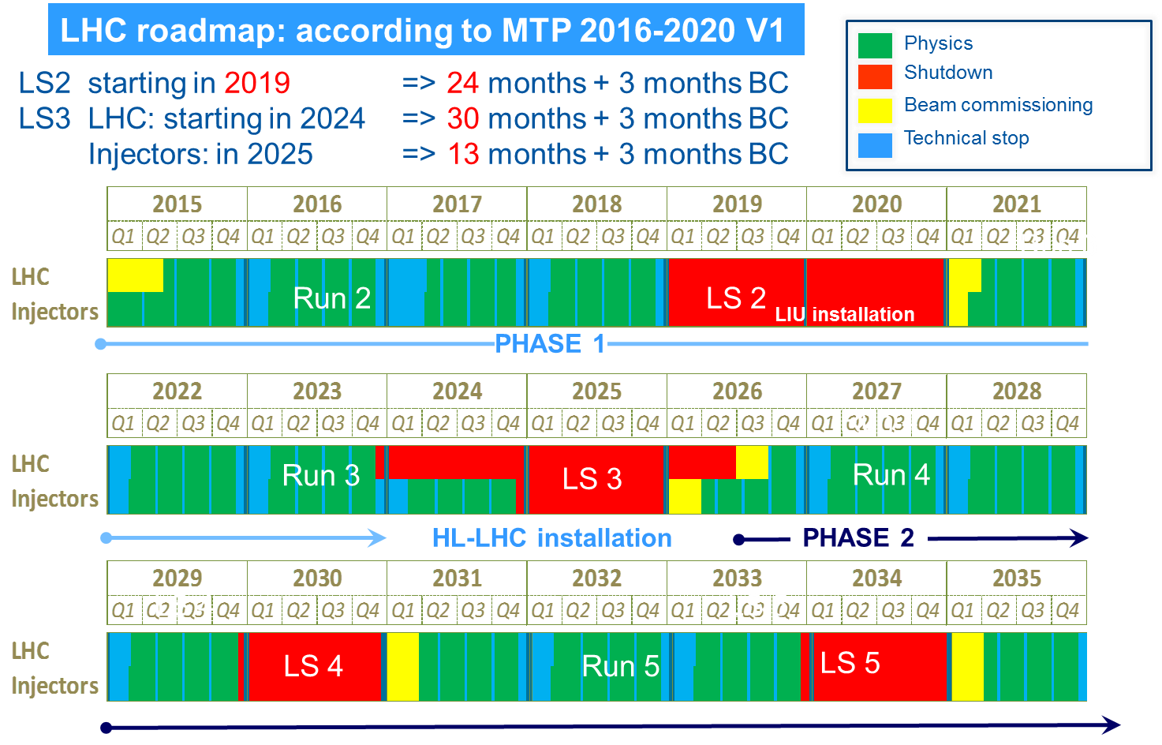
The CERN Long-Term Planning
LIU Deployment
HL-LHC Civil engineering
HL-LHC deployment
HL-LHC Running
Injector Performance Ramp up

Slide 32
Conclusion

Slide 33
Conclusions
The LHC had its best production year ever with rather stable running and high machine availability
  ATLAS/CMS integrated 66 fb-1
  LHCb integrated 2.46 fb-1
  ALICE integrated 27.3 pb-1
Methods and principles for future HL-LHC running are being tested and deployed
  ATS optics
  Various types of luminosity levelling
Aiming at 7 TeV for after LS2, requiring magnet training
Electron Cloud and heat load differences are still a challenge to be tackled
During LS2 the LIU project will be deployed followed by a performance ramp-up of which the LHC can partially profit

Slide 34
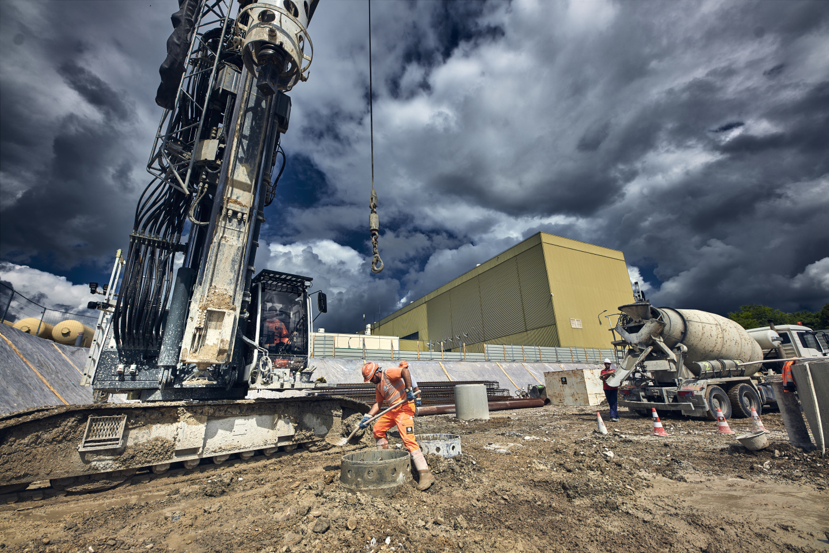
HL-LHC is under way..., much will change

Slide 36
Effect of Civil Engineering on Lumi
Ground compacting on the surface is visible on the luminosity signal

Slide 37
Running with 2556 bunches
Contrary to 2017, steady running with 2556 bunches per beam
In 2017 we ran for large part with the 8b4e beam due to the 16L2 issue

Slide 38
Towards High Luminosity LHC

Slide 39
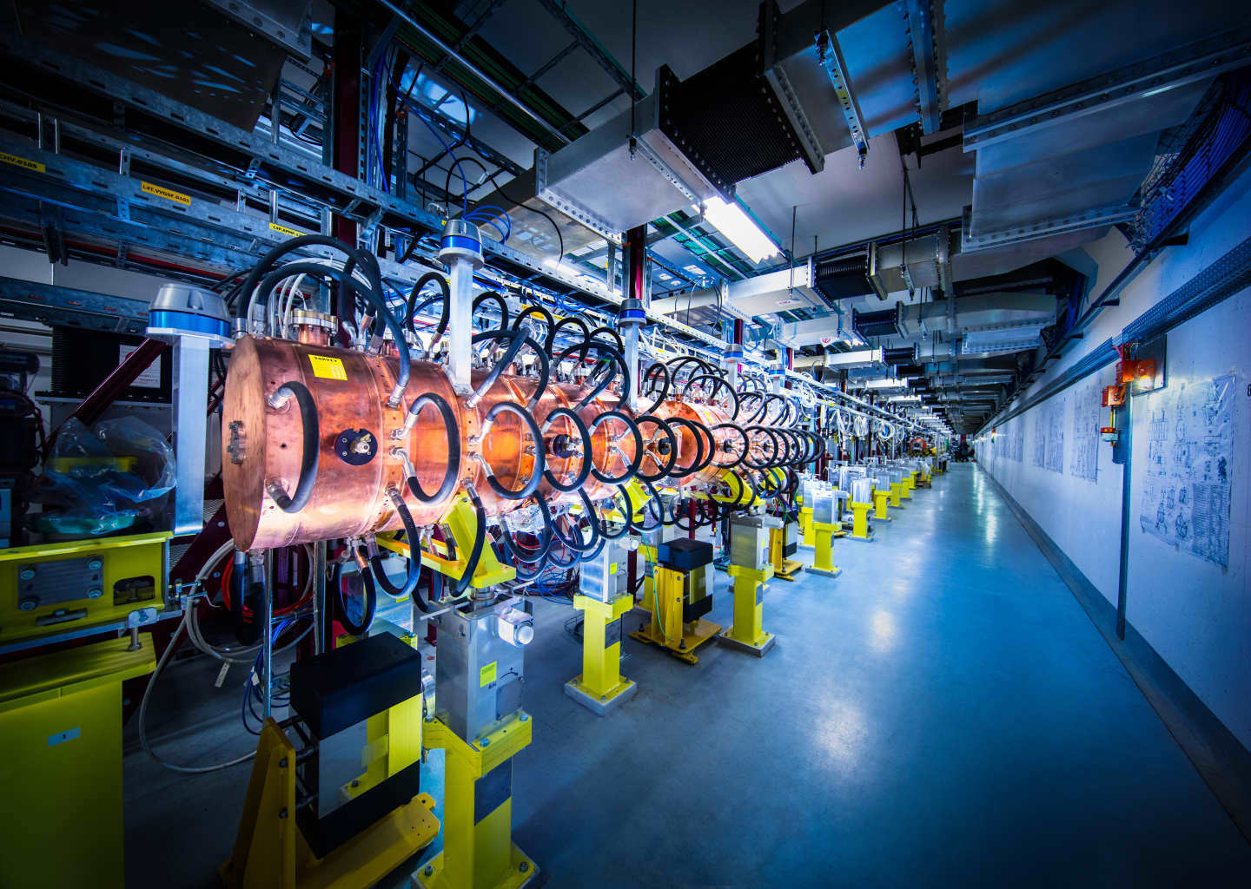
LHC Injectors Upgrade
Main ingredient is LINAC 4 with H⁻ injection
  Higher beam brightness after injection into the PSB than with the present proton LINAC 2
Majority of the other injectors changes are focused on:
  Ability to accelerate intense and bright beams
  Maintaining the brightness until injection into the LHC, minimize blow up
  Improving diagnostics to be able to measure beam characteristics precisely

Slide 40
Intensity and Density With LINAC2
With the present multi-turn proton injection the intensity is increased with about constant density
Injection from LINAC4 with H⁻ will allow increasing phase space density when injecting into the PSB

Slide 41
LINAC4 & Charge Exchange Injection
Before stripping foil
Use H⁻ beam from LINAC 4
x’
+
-
+
+
-
-
-
+
-
+
+
-
+
-
+
-
+
x
+
-
+
-
+
+
-
+
Behind stripping foil
x’
+
+
+
+
+
+
+
+
+
+
+
+
+
+
+
+
+
x
+
+
+
+
+
+
+
+
Phase Space Painting is possible (various particle distributions)

Slide 42
LIU Performance Ramp-up Run III
2020 - 2021
2022
2023
2024
Commissioning of 1.2x10¹¹ ppb with LINAC 4 & LIU
Re-produce all pre-LS2 beams
Pb ions with LIU performance and slip stacking in SPS
Commissioning of 1,8x10¹¹ ppb with design brightness and loss budgets out of SPS
Commissioning of 2.1x10¹¹ ppb up to SPS extraction and tests of higher intensity at least up to the SPS injection
Commissioning of 2.3x10¹¹ ppb up to SPS extraction with the desired brightness and loss budgets
However, the LHC will not yet be able to benefit fully from the Injector performance, but some performance increase is to be expected
The “LHC Run III Working Group” investigates limitations and opportunities and will try to establish an optimum run scenario

Slide 43
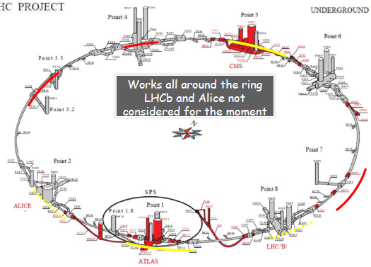
HL-LHC: What will be changed ?
New IR-quads (inner triplets)
  New 11T short dipoles
  Collimation upgrade
  Cryogenics upgrade
  Crab Cavities
  Cold powering
  Machine protection
  …
Major intervention on more than 1.2 km of the LHC
These are only the main modifications and this list is not exhaustive
Just a very few selected items in the next slides

Slide 44
11 Tesla dipoles
To be installed in Point 7 already during LS2 :
collimator
11 Tesla Dipole
11 Tesla Dipole
2.16 m
6.75 m
6.75 m
15.66 m

Slide 45
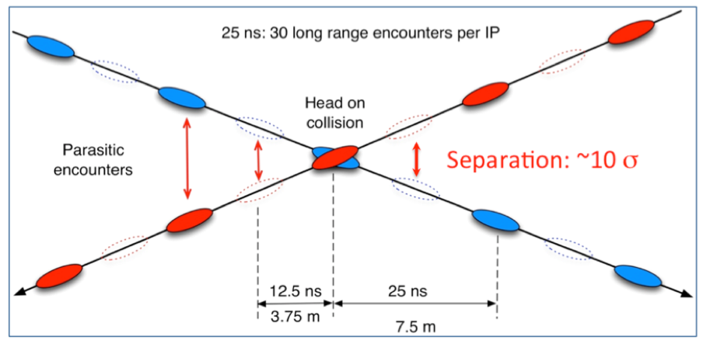
Crab Cavity Tests Stand in SPS
Increased beam-beam effect in LHC with higher beam intensity
  Requires increase of the crossing angle, hence reduction of the geometrical factor
World’ s first crabbing on a proton beam
(23 May 2018)

Slide 46
LHC & HL-LHC Parameters
Parameter | LHC | LHC 2018 | HL-LHC | HL-LHC
Beam type: | Design | BCMS | Design Stand. | Design BCMS
Energy [TeV] | 7 | 6.5 | 7 | 7
Number of bunches per ring | 2808 | 2556 | 2748 | 2604
Bunch spacing [ns] | 25 | 25 | 25 | 25
Bunch population N_{b} [10¹¹ p/b] | 1.15 | 1.1 | 2.2 | 2.2
Transv. norm. emittance SB ε_{n} [mm mrad] | 3.75 | 2 | 2.5 | 2.5
Betatron function at IP1 and IP5 b* [m] | 0.55 | 0.3/0.25⁽²⁾ | 0.2 (0.15) | 0.2 (0.15)
Half crossing angle in IP1/5 [μrad] | 142.5 | 160/130⁽¹⁾ | 260 | 260
Geometrical factor w/o crab cavities at min. b* | 0.836 | - | 0.369 | 0.369
Geoetrical factor with crab cavities at min. b* | - | - | 0.715 | 0.715
Peak Luminosity w/o crab cavities [10³⁴ cm⁻²s⁻¹] | 1 | 2.1 | 6.52 | 6.18
Peak luminosity with crab cavities [10³⁴ cm⁻²s⁻¹] | - | - | 12.6 | 11.9
Levelled luminosity [10³⁴ cm⁻²s⁻¹] | - | - | 5.32 | 5.02
Expected levelling time [h] | - | - | 5.23 | 5.23
Events/crossing μ (with levelling & crab cavtities) | ~25 | ~60 | 140 | 140
Stored beam energy [MJ] | 360 | 320 | 675 | 640

