Slide 1
Fermilab GARD Program Overview and Accelerator & Beam Physics
Sergei Nagaitsev
Fermilab
July 31, 2018

Slide 2
Biographical Sketch
Head of Accelerator Science Programs, Fermilab (since March 1, 2018)
Professor (Part Time), Department of Physics and Enrico Fermi Institute, The University of Chicago
APS Fellow, DPB Vice Chair
Chief Accelerator Officer and Accelerator Division Head (2013-2018)
  700 kW beam to NOvA, 15 Hz Booster operation, Muon g-2 commissioned
  Record-high beam energy in ILC cryomodule; IOTA ring construction complete
  Successful PIP-II R&D
PhD in Accelerator Physics (Indiana, 1995)
Fermilab Wilson Fellow, USPAS Prize (2007), Dieter Möhl Medal (2015)

Slide 3
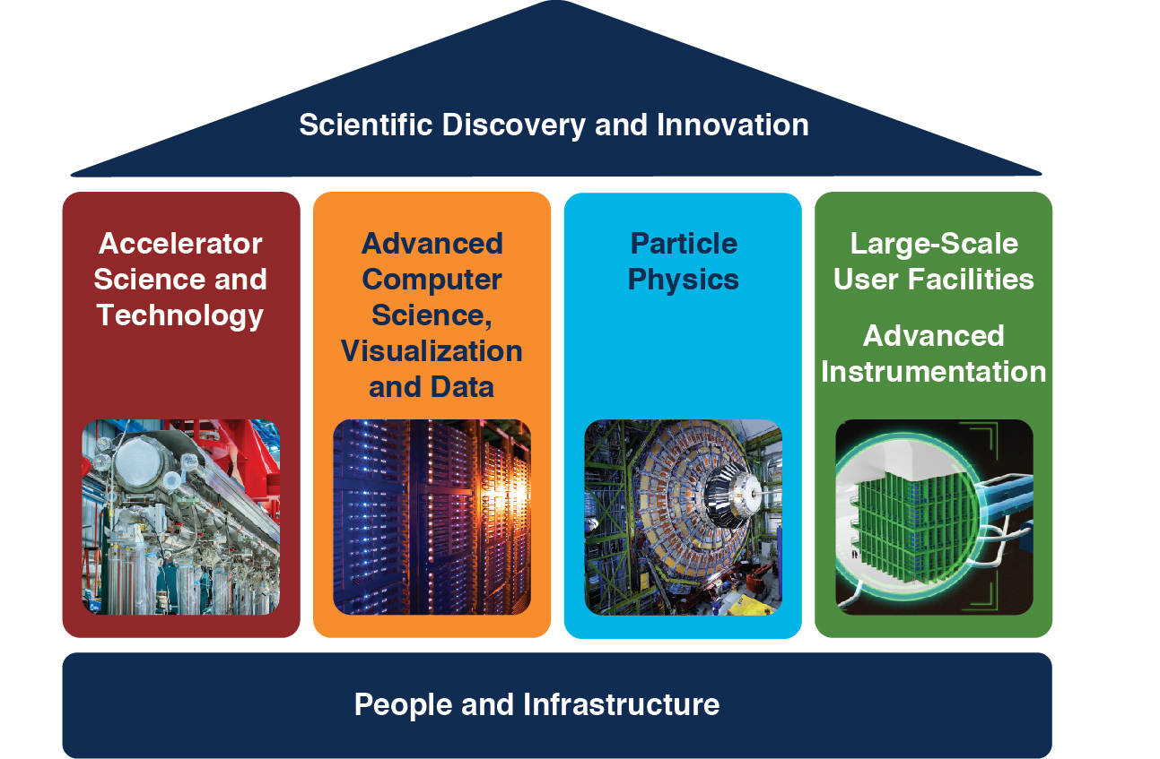
Fermilab core capabilities
Fermilab has four core capabilities that depend on people and infrastructure. These are the elements that define the scope of what we do.

Slide 4
Fermilab strategy in a nutshell
Fermilab GARD is an integral part of lab strategy
Our overall strategy: exploit core capabilities to strengthen the field of particle physics in the U.S.
  Aggressively pursue US HEP priorities, based on P5 report
  Expand connections by exploring opportunities to address other priority issues (e.g. DOE initiatives requiring accelerator science and technology, QIS, industrial connections) and to smooth out resource/funding profiles.
Implications of this strategy
  If HEP community does not succeed, lab does not succeed & vice versa
  International engagements are viewed primarily through lenses of advancing the P5 priorities, keeping U.S. engaged, respecting key partners

Slide 5
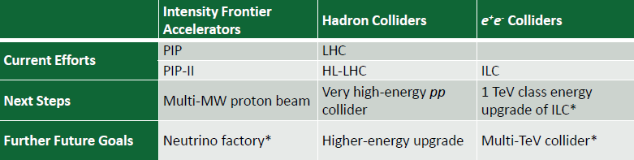
Strategic context
The 2014 P5 report and 2015 Accelerator R&D subpanel report
  Provided prioritization advice to GARD Program
  Fermilab leads and/or contributes to all of these areas, as should be expected from a single-program HEP National lab
* dependent on how physics unfolds

Slide 6
Fermilab GARD Thrusts
Superconducting RF (RF Acceleration Technology)
Superconducting Magnets and Materials
Accelerator and Beam Physics (ABP)
Particle Sources and Targets
  Focus on Targets
Advanced Accelerator Concepts
  Focus on collider physics (luminosity)
USPAS (a separate B&R since 2015)
We aim to impact:
  Accelerator Science & Technology, Projects, Directed R&D, Tech Transfer, Education

Slide 7
GARD org chart
GARD and Test Facility Ops (Fermi-CARD) are managed together as one activity
Fermilab Director
Office of the CRO
Joe Lykken, CRO
Sergei Nagaitsev, Head of Accel Science Programs (GARD Lead)
Office of the CTO
Sergey Belomestnykh, CTO
(Fermi-CARD Lead)
GARD Test Facility Ops

Slide 8
Fermilab GARD, Ops, LARP, USPAS funding

Slide 9
Fermilab GARD key accomplishments since 2013
Made several key discoveries – from nitrogen doping, to efficient magnetic flux expulsion to 49-MV/m in Tesla shaped cavities, and more – we have shaped the worldwide R&D directions of the SRF field since 2013, and our R&D is now enabling new more powerful accelerators such as LCLS-II.
Made key contributions to the successful development of Nb3Sn dipoles and quadrupoles, which are now instrumental for the HL-LHC upgrade
Successfully tested an ILC cryomodule with beam at 31.5 MV/m
Developed a comprehensive theory and modeling analysis of beam instabilities with space-charge
Formed RADIATE collaboration and completed several proton irradiation studies on graphite and beryllium
Established a new management model for the USPAS

Slide 10
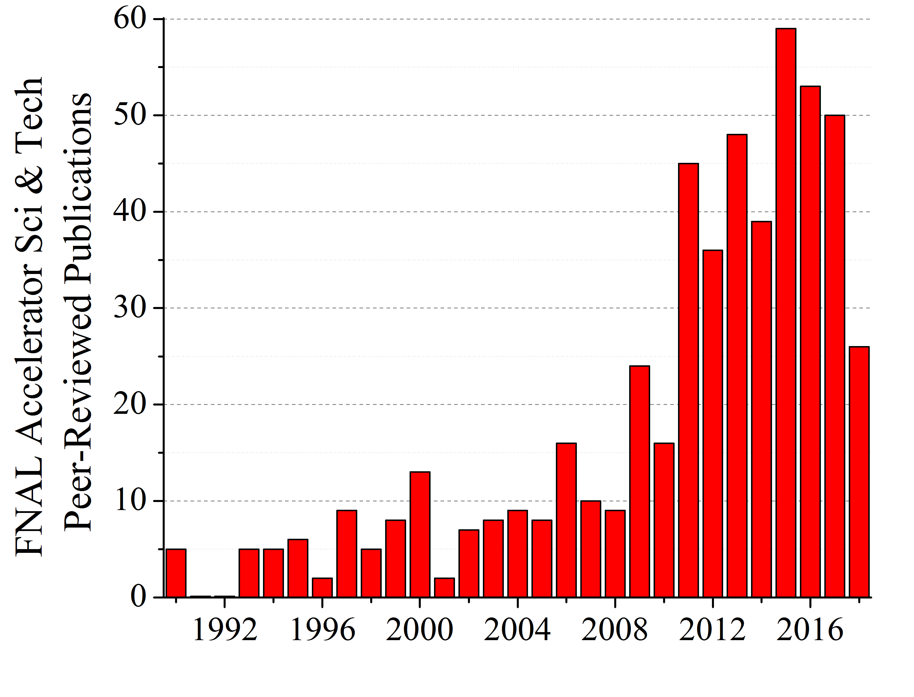
Fermilab Publications in Accelerator Sci and Tech
(part year 2018)

Slide 11
Fermilab GARD highlights
(for SRF and high-field magnets, see next talk)

Slide 12
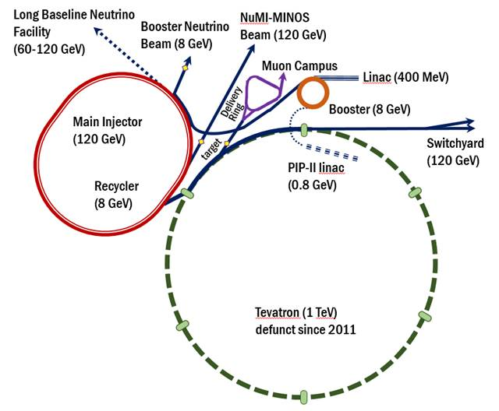
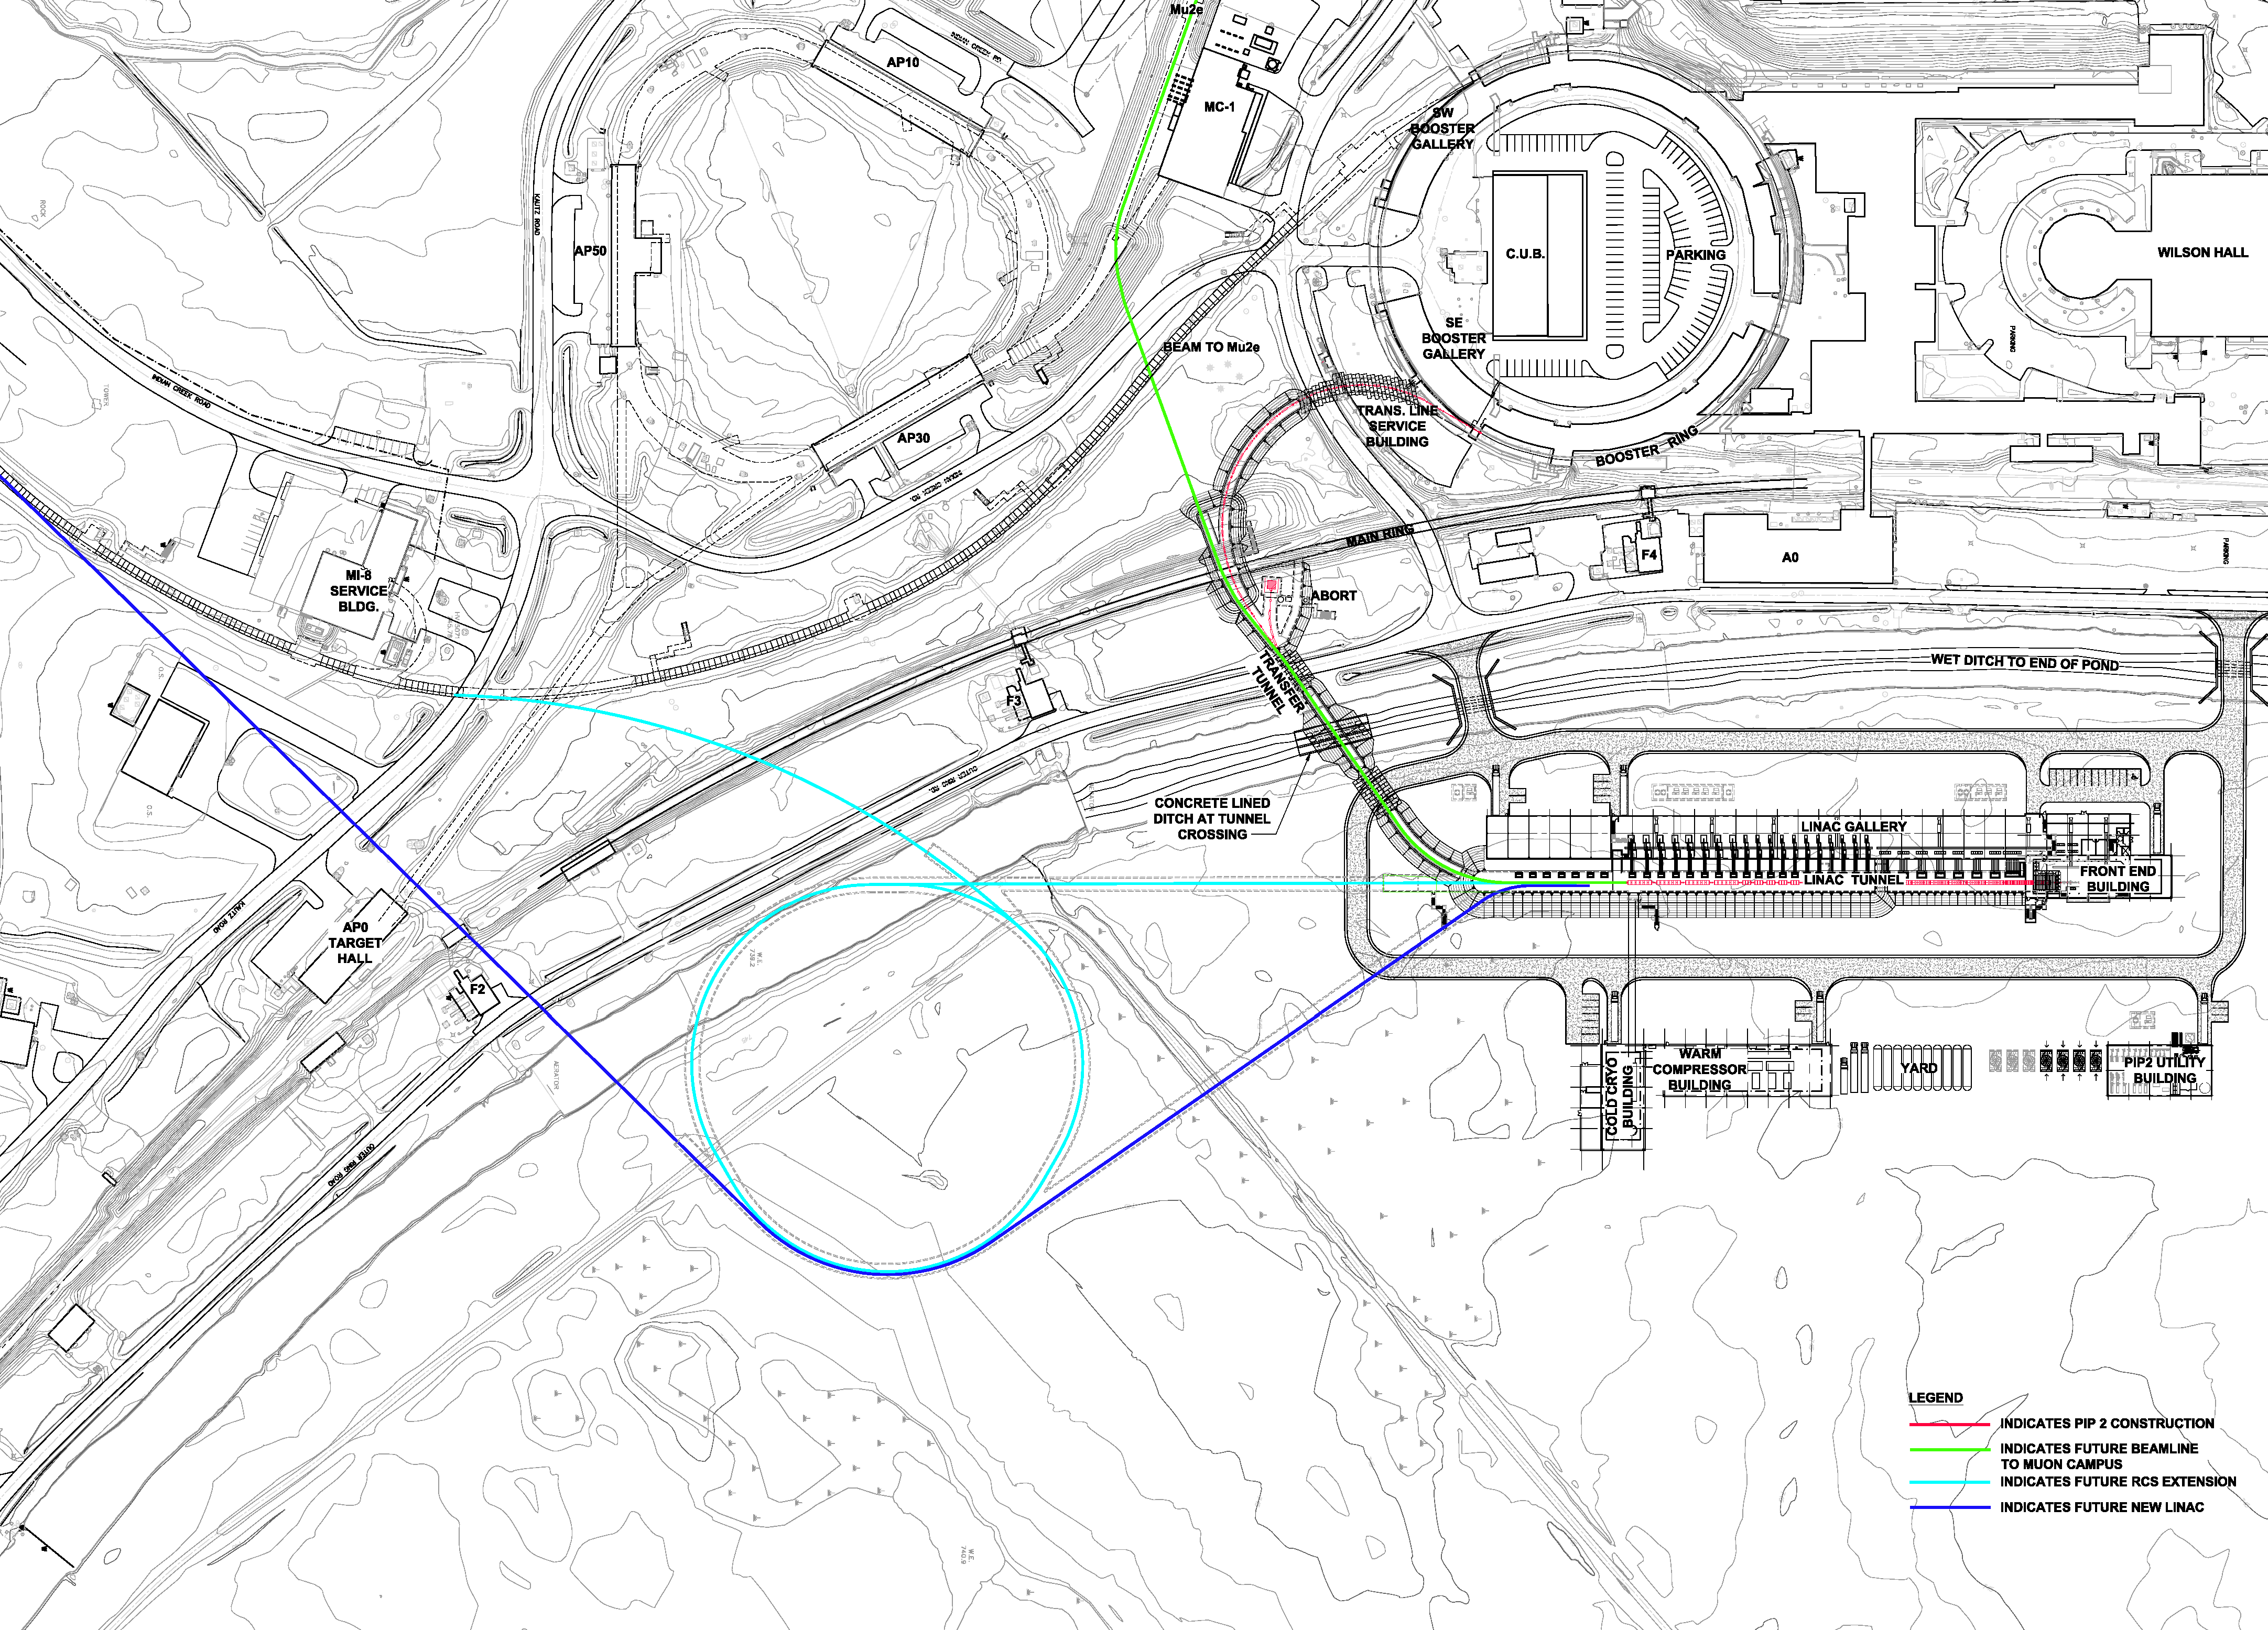
Accelerator and Beam Physics Thrust
Fermilab is a recognized world leader in building and operating accelerators
Delivering 8 GeV and 120 GeV
protons for neutrino experiments;
Muon beams to the g-2 experiment
PIP-II
PIP-III

Slide 13
Beam power evolution beyond PIP-II (an example), as recommended by P5
 | Present | PIP-II | PIP-III (New RCS)
MI
Beam Energy[GeV] | 120 | 120 | 120
Cycle Time[s] | 1.33 | 1.2 | 1.45
Protons per pulse[1e12] | 49 | 75 | 190
Power[MW] | 0.7 | 1.2 | 2.5
Proton Source
Injection Energy[GeV] | 0.4 | 0.8 | 0.8-2.0
Extraction Energy[GeV] | 8 | 8 | 8
Protons per Pulse[1e12] | 4.3 | 6.4 | 32
Beam Power to MI [kW] | 38 | 82 | 168
Increase the number of particles by a factor of ~8 compared to Booster now!

Slide 14
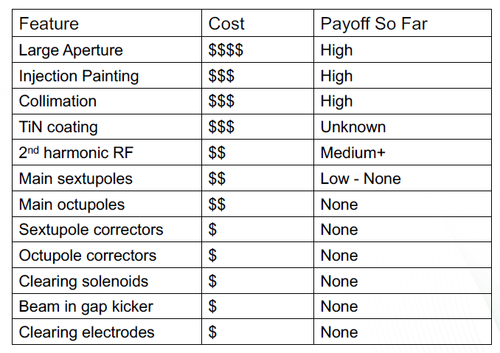
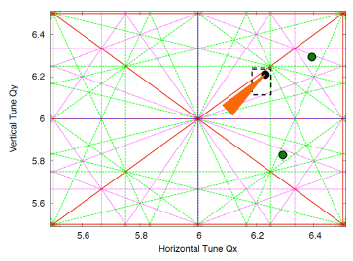

SNS ring experience
SNS ring: 1 GeV, 1.4e14
fixed energy, storage for
~1000 turns, 1.4 MW
Beam losses are all
controlled by collimators
Vacuum chamber: stainless steel, 20 cm diam
Large aperture → high cost of magnets and
other devices.
Courtesy of S. Cousineau (SNS)

Slide 15
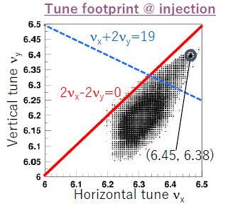
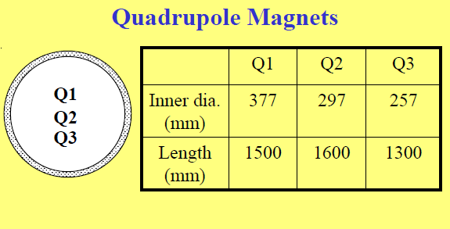
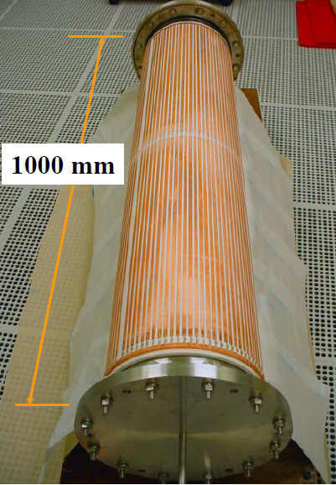
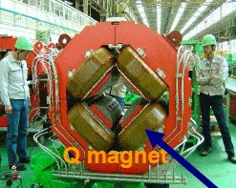
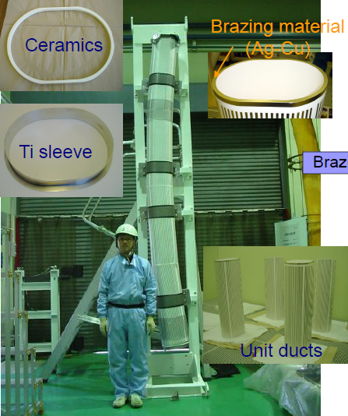
J-PARC RCS experience
RCS ring: 0.4 → 3 GeV, 8.3e13
25 Hz, ~14000 turns, 1 MW
Beam losses are ~300 W (< 1W/m)
Vacuum chamber: ceramic + TiN coating + rf shield
High cost of both vacuum chambers and magnets
Courtesy of J-PARC colleagues

Slide 16
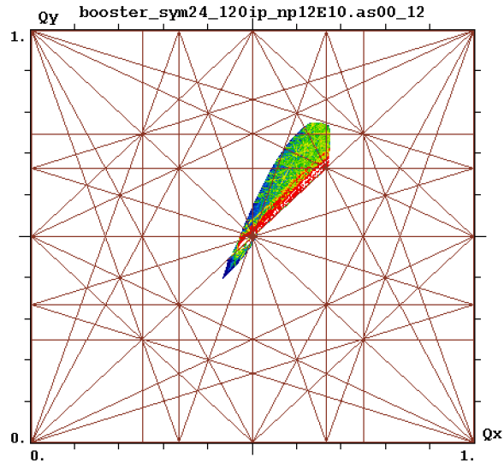
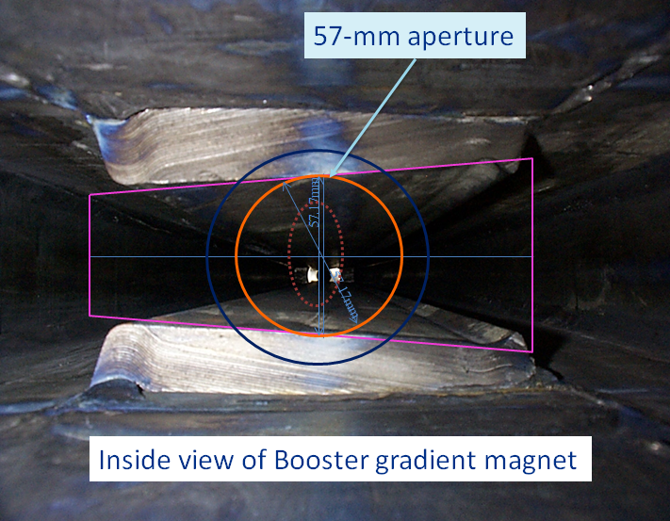
Fermilab Booster experience
Booster: 0.4 → 8 GeV, 4.5e12
~15000 turns
Beam losses are ~400 W (< 1W/m)
Small aperture, low-cost magnets,
no vacuum chamber → instabilities
The Main Injector vacuum chamber is also small: 120 mm x 50 mm
An RCS for PIP-III would require to accelerate 32e12 protons
The physics of space charge and instabilities is fundamental to all future multi-MW rings!

Slide 17
Challenges of high-power beams
Uncontrolled beam losses
  Keep losses at < 1 W/m
    Fermilab Booster is presently running at the limit of losses (~400 W)
  Space-charge causes beam halo!
Beam instabilities (loss of entire beam, emittance degradation)
  Common resistive-wall instabilities can be mitigated by external dampers
  As beam space-charge increases, there are more severe types of instabilities appear, e.g. an “electron cloud” instability (observed in the Recycler) can be very fast and can not be damped by dampers
  Connection to linear accelerators (only BNS damping at present to suppress the BBU instability)

Slide 18
Fermilab Accelerator and Beam Physics components (see V. Shiltsev’s talk)
Beam Instabilities and mitigation
  Multi-MW facilities, future colliders
Space-charge and mitigation
  Multi-MW facilities
Beam cooling
  Future colliders
Modeling tools and theory development in support of the above
Fermilab and collaborating labs have many common interests and are looking for a common Roadmap strategy for the "Accelerator and Beam Physics" GARD thrust

Slide 19
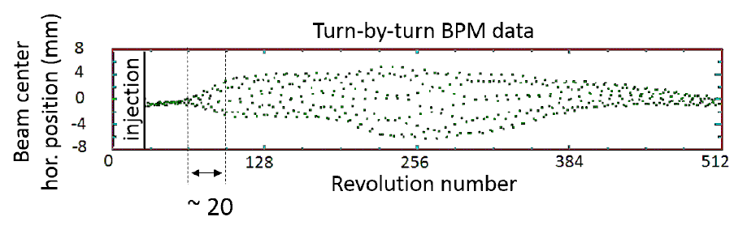
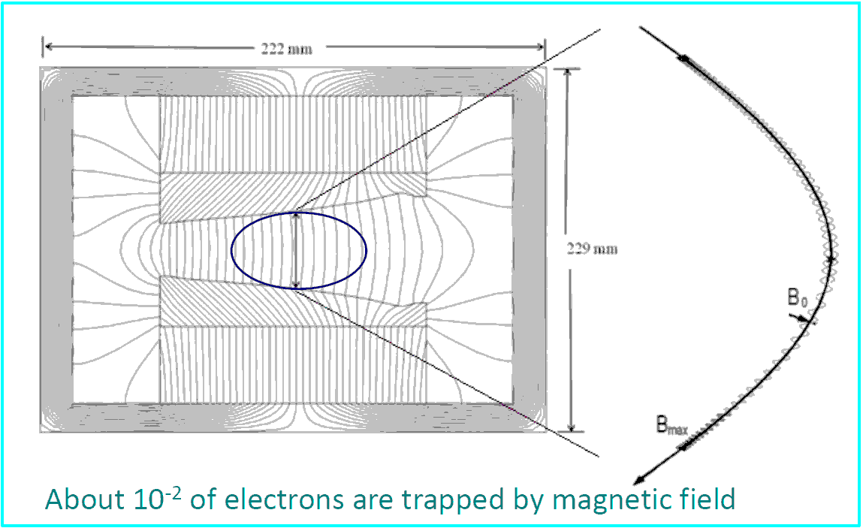
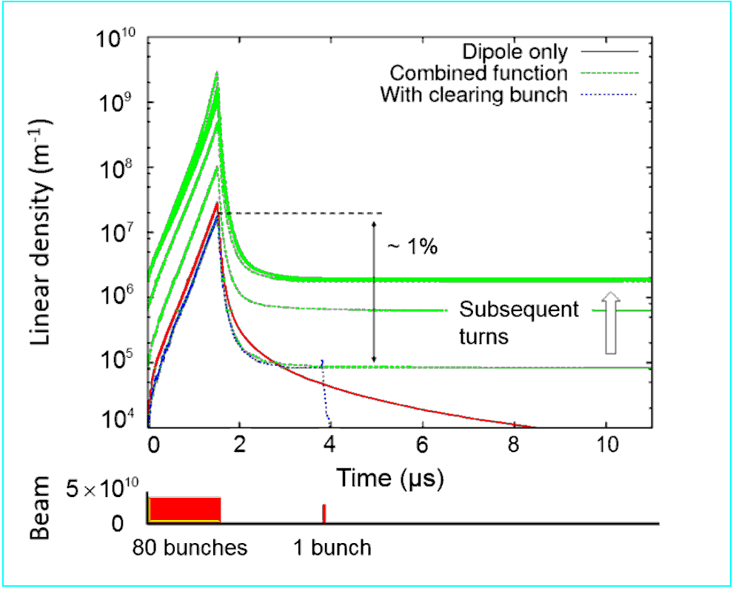
Example: Fast Transverse Beam Instability
Caused by Electron Cloud
Recycler Ring :
proton multibunch
instability due to
“magnetic bottle” effect
Exp. studied, simulated
and cleared by extra bunch
PEI code (K.Ohmi)

Slide 20
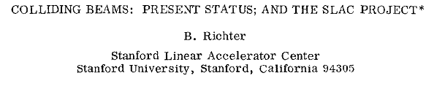
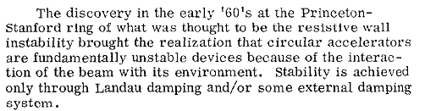
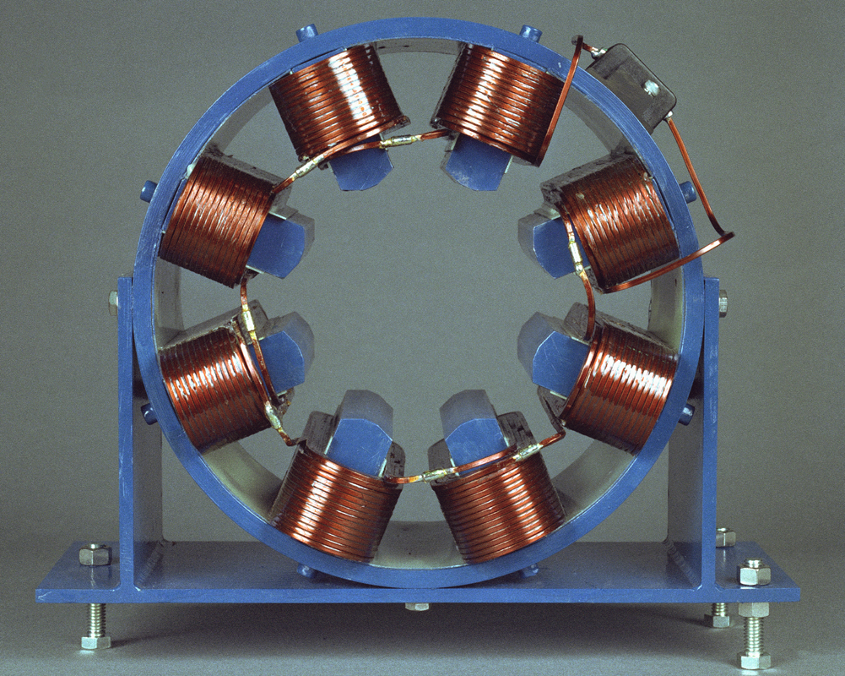
Instability mitigation – Landau damping with nonlinear magnets
Landau damping – the beam’s “immune system”. It is related to the spread of betatron oscillation frequencies. The larger the spread, the more stable the beam is against collective instabilities.
  The spread is presently achieved by adding special magnets -- octupoles
External damping (feed-back) system – presently the most commonly used mechanism to keep the beam stable.

Slide 21
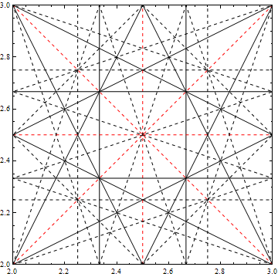
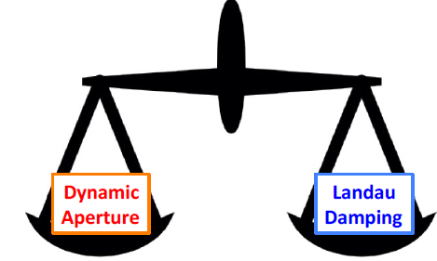
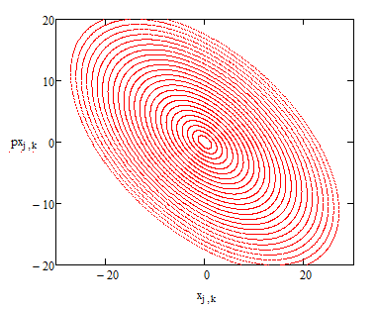
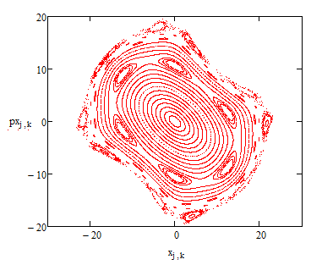
Octupoles introduce tune spread

Slide 22
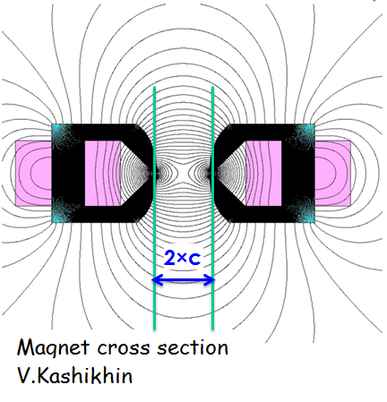
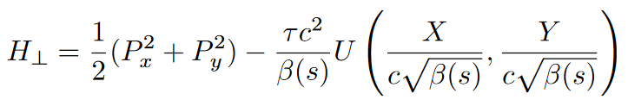
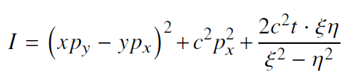


Are there “magic” nonlinearities with zero resonance strength?
Yes, we call them “integrable”
Chaotic motion
Integrable motion
Nonlinear beam dynamics:
A new concept for nonlinear
focusing in rings
Two integrals of motion :
$$×$$
We found several examples suitable for accelerators

Slide 23
IOTA is our facility to test advanced concepts for high-intensity accelerators
P5 GARD subpanel recommendation: “Construct the IOTA ring, and conduct experimental studies of high-current beam dynamics in integrable non-linear focusing systems.”
We will test:
  Nonlinear focusing systems for Landau damping
  Space-charge compensation
  Optical stochastic cooling
E-gun
ILC –type CM
Proton RFQ
IOTA

Slide 24
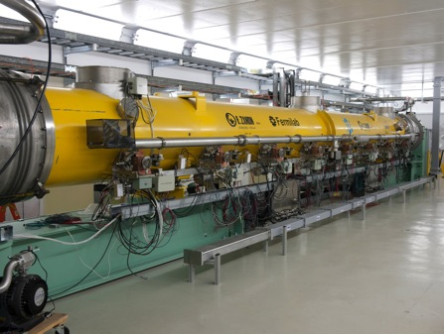
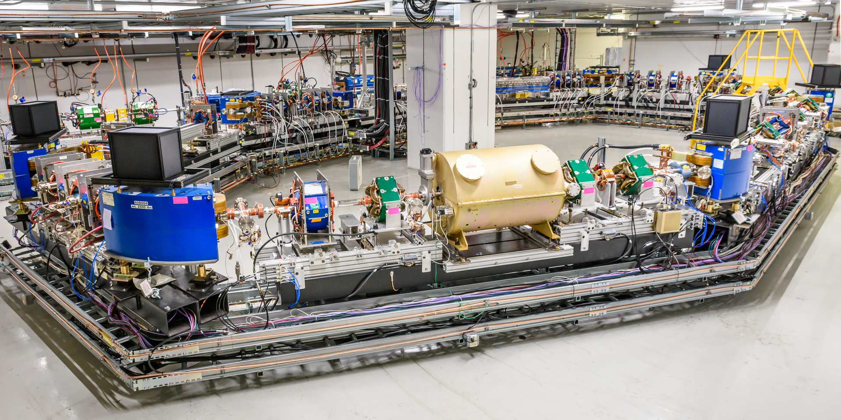
Fermilab Accelerator Science & Technology (FAST) Facility
FAST Electron Linac commissioned in 2017
ILC Cryomodule
IOTA Ring (beam expected in 2018)
Dec. 2017 – achieved the ILC design goal for a CM, 255 MeV
Highest-energy ILC cryomodule
While commissioning the FAST linac, also conducted several experiments: (1) Flat beam transformations (NIU PhD thesis) and (2) HOM effects on beam quality (with LANL, CEA-Saclay)

Slide 25
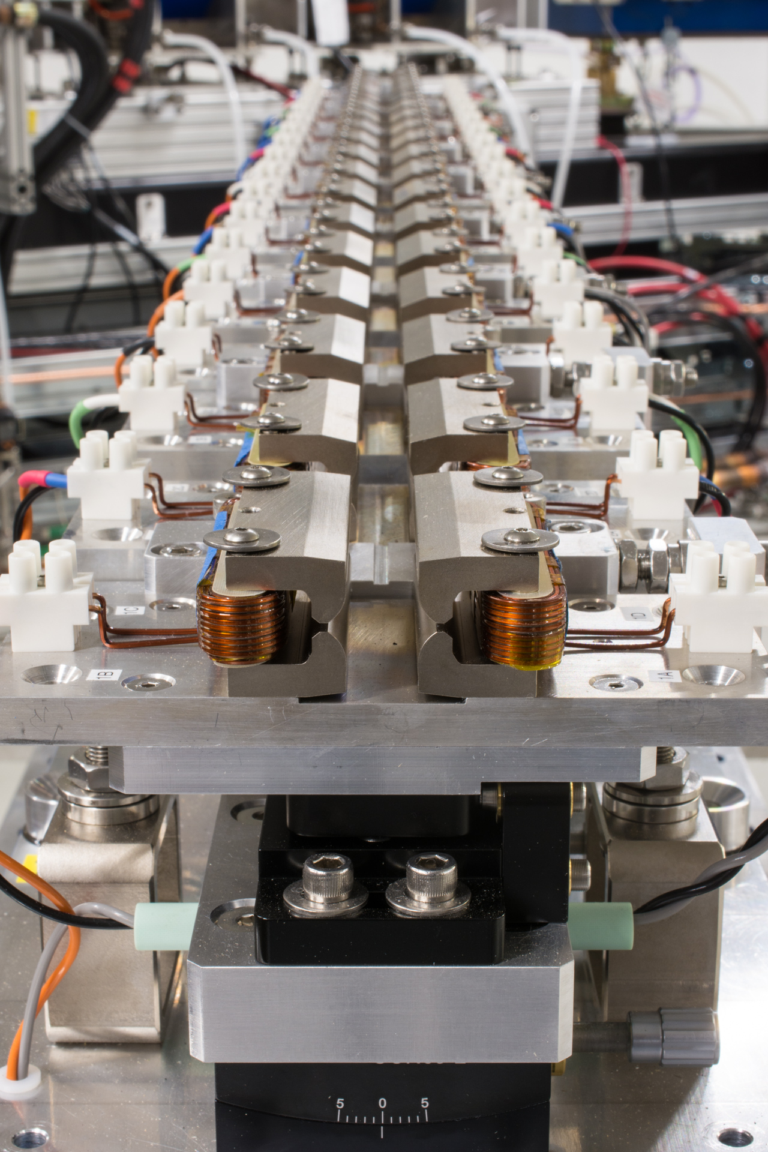
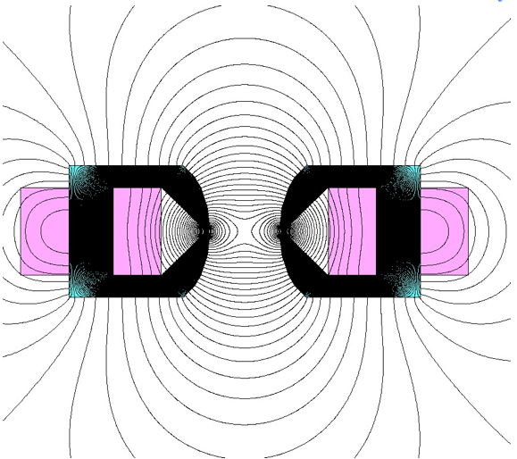
Improved Landau damping and reduced resonances
This new focusing system will be tested in IOTA in 2018

Slide 26
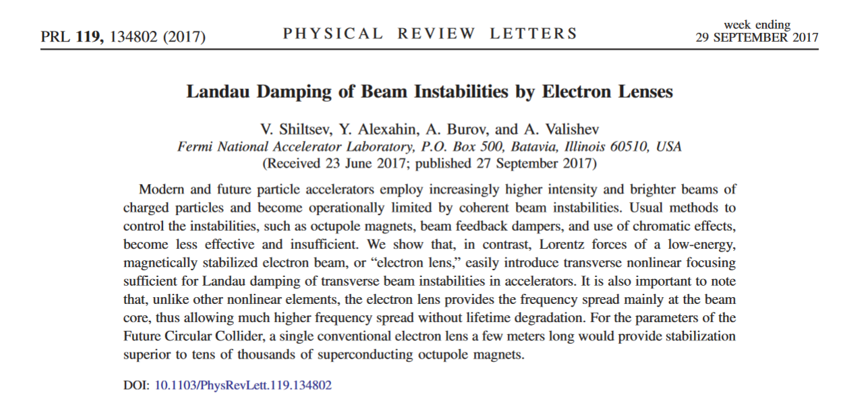
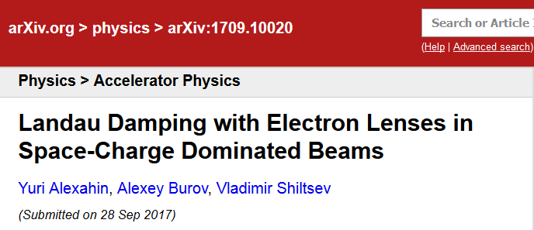
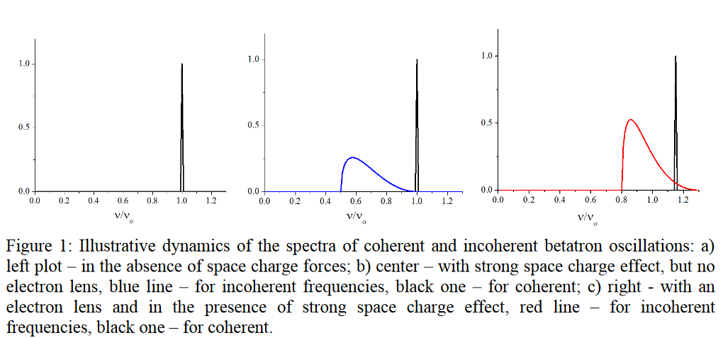
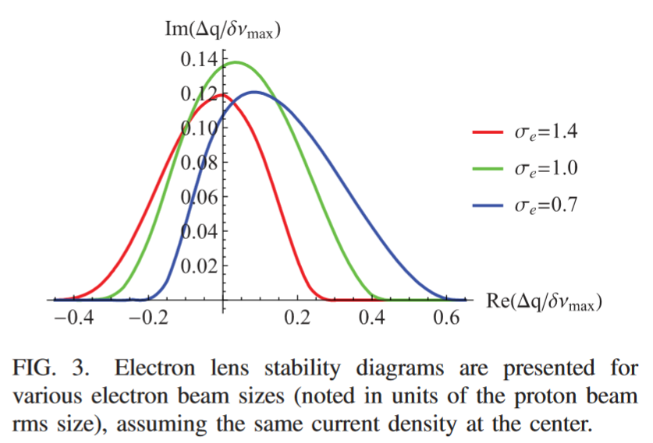
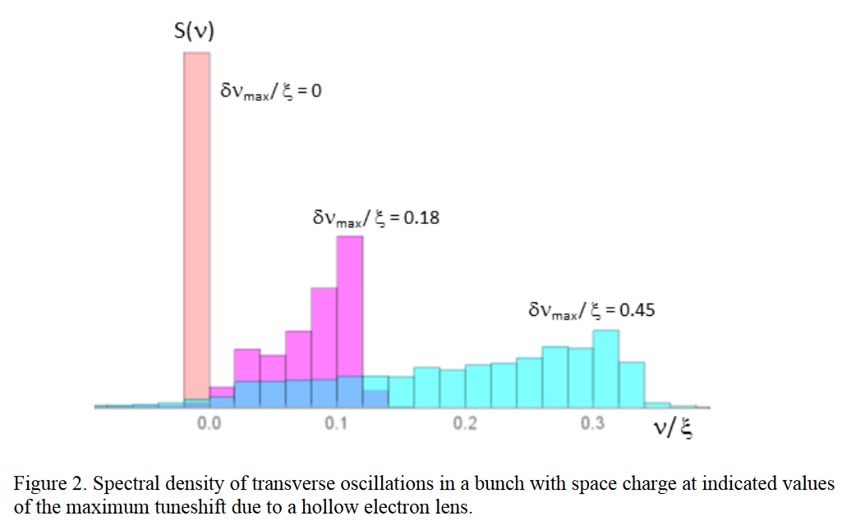
Landau Damping with Electron lenses
A.Burov, Y. Alexahin, V.Shiltsev, A.Valishev
“…For the parameters of the Future Circular Collider, a single conventional electron lens a few meters long would provide stabilization superior to tens of thousands of superconducting octupole magnets.”

Slide 27
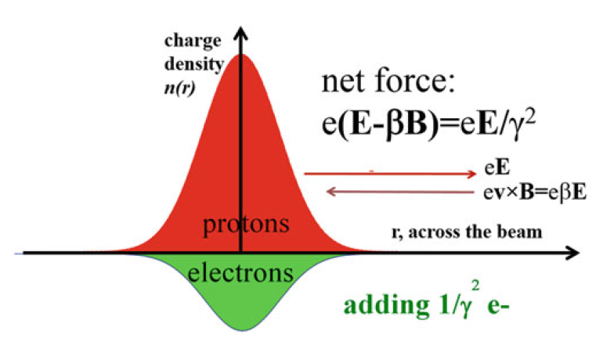
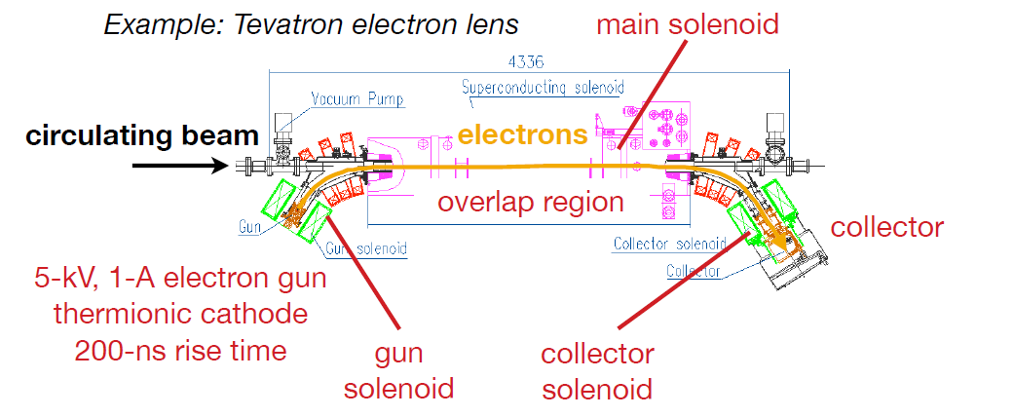

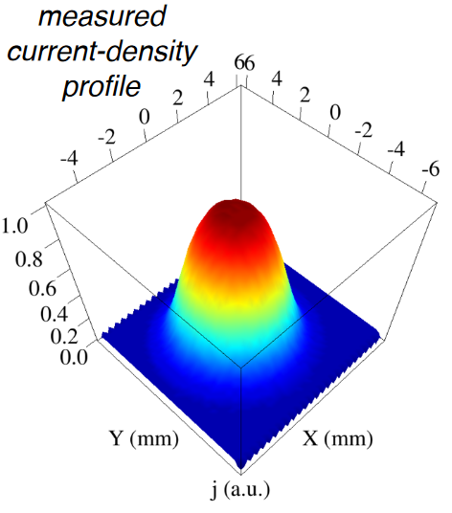
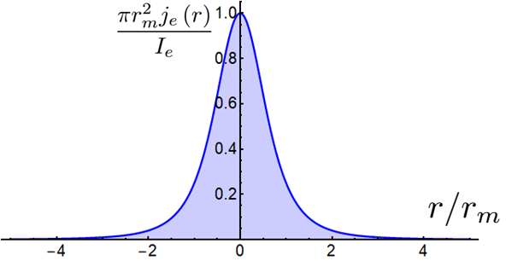
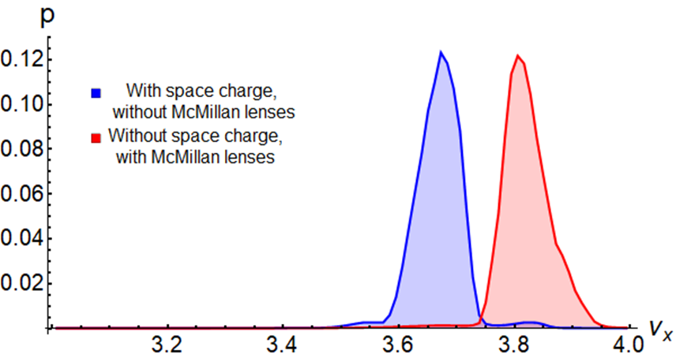
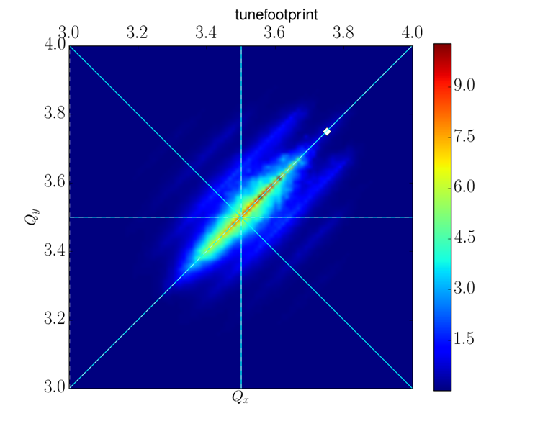
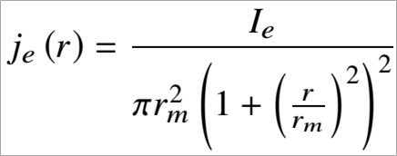
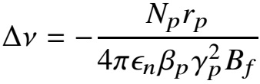
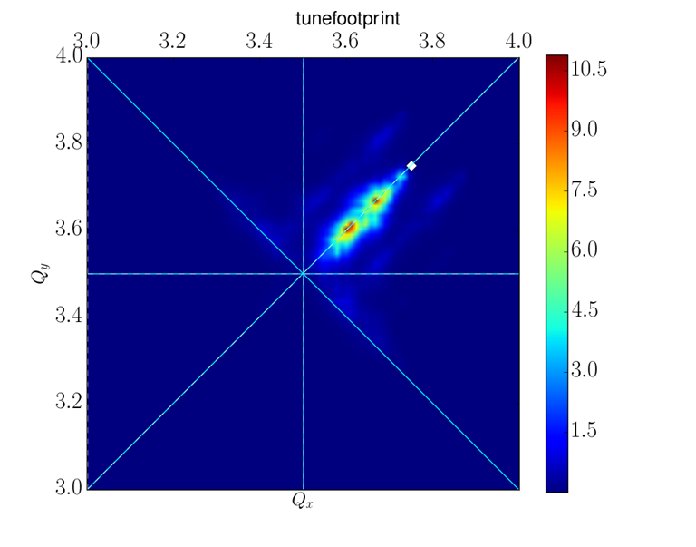
Proton Space-Charge compensation by electrons
Special e-beam profile
Qualitative concept:
~50% tune spread
reduction with a single
electron lens
I. Lobach, S. Nagaitsev, E. Stern, and T. Zolkin,
IPAC 2018, THPAF071

Slide 28
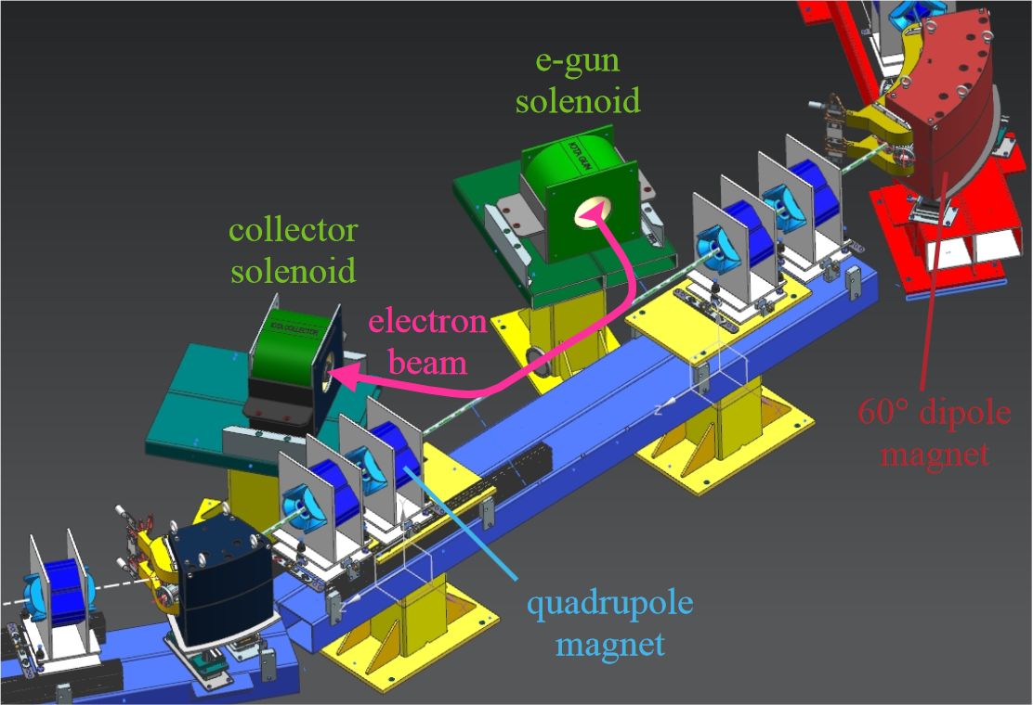
Electron lens experiment in IOTA
see Giulio Stancari ’s talk

Slide 29
Beam-cooling
Fermilab is a world-recognized leader in beam cooling:
  Both stochastic and electron cooling systems in the past
  World’s highest energy electron cooler in operation, 2005-2011
  IOTA: optical stochastic cooling experiments
Two EIC R&D projects (FY18-19),
supported by DOE/NP:
  P. Piot (PI): a collaboration with Jlab and BNL
    Development of Innovative, High-energy, Magnetized Electron Cooling for an EIC
  S. Nagaitsev (PI): Ring-based high-energy electron cooler
PRL 96, 044801, 2006

Slide 30
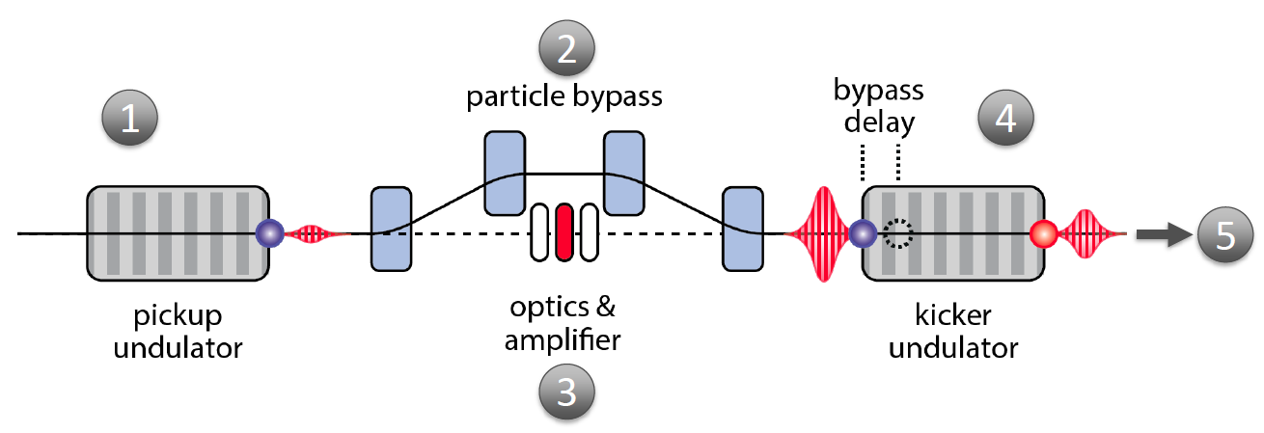
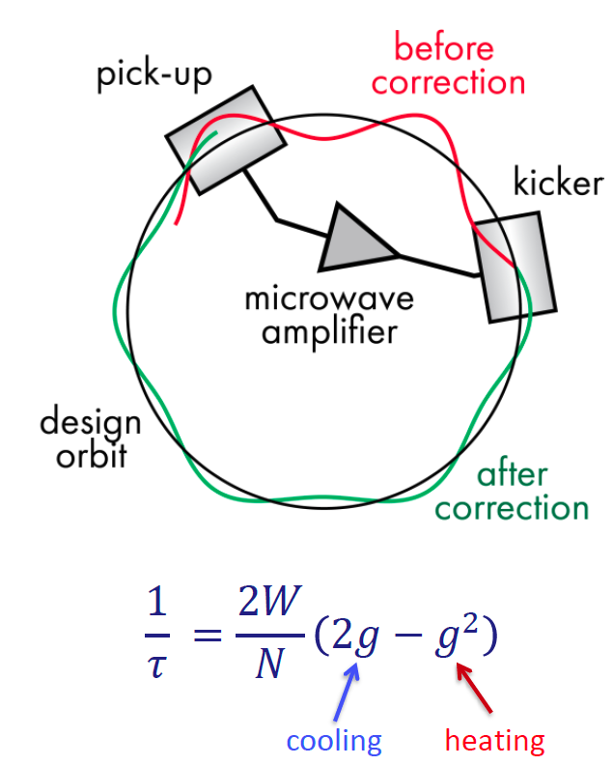
Optical Stochastic Cooling from ~10 cm to 1 um wavelength
Simon van der Meer,
1984 Nobel Prize
Each particle generates EM wavepacket in pickup undulator
Particle’s coordinates are “encoded” by transit through a bypass
EM wavepacket is amplified (or not) and focused into kicker undularor
Induced delay relative to wavepacket results in corrective kick
Coherent contribution (cooling) accumulates over many turns
OSC promises a new cooling scheme of relevance to high-energy, high brightness proton storage rings and colliders
The IOTA ring is designed to accommodate an OSC insert and a proof-of-principle experiment with electrons (see Johnathan Jarvis’s talk)

Slide 31
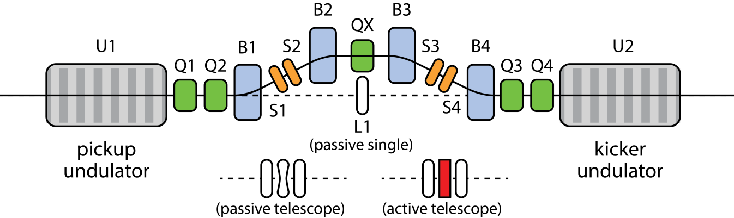
The OSC experiment and an application example

Slide 32
IOTA plans and staging
Two experiments in nonlinear beam dynamics are planned for the 2018 run
  See a PhD student (N. Kuklin) talk in breakout
Phase I with electron beam will concentrate on the science aspects of single-particle motion stability using e- (pencil) beams
  Demonstrate large amplitude-dependent detuning
  Machine tuning must be at the state-of-the-art level to satisfy integrable optics requirements
  e- beams best for the purpose
Phase II – After commissioning with e-, we will move the existing 2.5 MeV (HINS) proton/H- RFQ to FAST to inject protons into the IOTA ring
  Opens a path to intense-beam and space-charge studies

Slide 33
Accelerator science at FAST
We are mostly interested in the IOTA science
  IOTA is capable of circulating both protons and electrons
  Research focused on high-intensity proton rings: space-charge effects, instability mitigation, beam loss control, beam cooling
However, there are excellent science opportunities with the FAST electron linac and with IOTA (electrons)
  Radiation generation (P. Piot’s talk)
  High average current experiments
  Complementary to FACET-II (see breakout talks)
  Suitable for LCLS-II commissioning studies, MARIE and EIC R&D

Slide 34
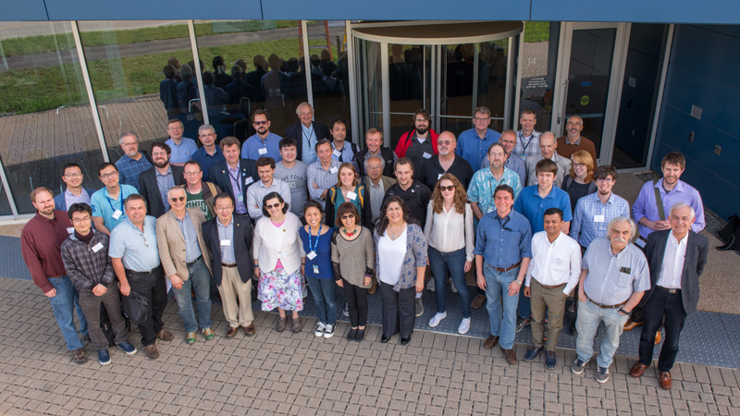
FAST User Facility
Our goal is to establish a new Fermilab user facility, FAST, on the time scale of ~2022
  Establish a science advisory committee first, evolve into the FAST PAC
  Double the number of collaborators, 30 → 60
6th Annual IOTA/FAST CM 2018

Slide 35



High-power Targets: Accomplishments & Impacts
(see P. Hurh talk in the breakout)
RaDIATE collaboration grew from 5 institutions (2013) to 14 institutions (2017) on the MOU and 70 participants
Completed Proton Irradiation Studies on Graphite
Completed Proton and Ion Beam Studies on Beryllium
Completed In-beam Thermal Shock Test on Beryllium at CERN’s HiRadMat
Completed RaDIATE organized proton irradiation at BNL’s Isotope Production (BLIP) facility
Preparations for In-beam Thermal Shock Test on previously irradiated material at CERN’s HiRadMat
Informed design of LBNF target cooling system and choice of graphite grade
Will inform design of Be beam windows for LBNF
Enabled prediction of stress and deformation of Be beam windows or targets (alternate target material for LBNF)
Benefits many facilities including LBNF, T2K, BDF at CERN, FRIB, and even LHC-HiLumi
Brings together radiation damage and thermal shock on Be, Graphite, and Ti alloys for the first time

Slide 36
Simplified HPT R&D Plan
FY18 - 24
  Complete Post-Irradiation Examinations (PIE) on all currently irradiated materials
  Complete in-beam thermal shock experiment on previously irradiated materials
  Perform low energy ion irradiations on graphite, beryllium, and titanium
  HE and LE irradiations on promising materials to benefit next-gen HPT facilities
With extra funds, expand R&D plan to
  Increase scope of Materials R&D
  Increase size of team to perform experiments in parallel
  Initiate Advanced Targetry Technologies R&D starting with Advanced Robotics for Remote Handling Applications
Confirm material choices, operating parameters, and lifetimes for 1 - 2 MW operation (benefits LBNF at PIP-II) by 2020
Inform designs for 2 - 4 MW operation of graphite, beryllium and titanium beam intercepting components by 2021
Target concepts must be developed to identify materials of interest. Expected to start in 2021 time frame.
Develop new radiation and thermal shock tolerant materials & innovate to reduce cost and time to discovery
Needed to keep on pace with future facility designs and develop future experts/leaders
Modernize and innovate to enable maintenance on high power accelerator facilities and reduce dose to worker

Slide 37

Advanced Accelerator Concepts
This is a relatively small area of GARD for us (now), but it is ripe for investments
  We are interested in beam physics for collider applications
  We are focusing on establishing an AAC program at FAST Facility and on participating in FACET-II experimental program
  This research has received interest from our colleagues and we were invited to join a collaboration to propose an experiment

Slide 38
Advanced Accelerator Concepts (continued)
More info. in the AAC breakout session

Slide 39
Fermilab GARD: education
Fermilab manages and safeguards the USPAS on behalf of the DOE HEP and the entire accelerator community:
  Recently appointed new director, Prof. Steve Lund (MSU)
  Not part of this review, but part of the Fermilab GARD portfolio
Fermilab GARD supports two undergraduate summer internship programs in accelerator science and technology
Fermilab has a well-established Ph.D. program in accelerator science and technology (not funded by GARD)
We closely collaborate with several universities on accelerator science and technology (joint appointments, formal agreements):
  NIU, Northwestern, UChicago, IIT, MSU, Cornell (CBB)
    You will hear more from other speakers

Slide 40
PhD Degrees Bases of Research at Fermilab : 20 over 2013-2018
Sergey Koshelev 2013 Bauman Moscow State Tech.
Meghan McAtter 2014 University of Texas – Austin
Chris Prokop 2014 Northern Illinois University
Timofey Zolkin 2014 University of Chicago
Gene Kafka 2014 Illinois Institute of Technology
Yulia Trenikhina 2014 Illinois Institute of Technology
Ao Liu 2014 Indiana University
Jeffrey Eldred 2015 Indiana University
Francois Lemery 2015 Northern Illinois University
Alexander Vostrikov 2015 University of Chicago
Liyang Ye 2015 North Carolina State University
Sushantra Panuganti 2015 Northern Illinois University
Donato Passarelli 2015 University of Pisa
Mattia Checchin 2016 Illinois Institute of Technology
Martina Martinello 2016 Illinois Institute of Technology
Sergey Antipov 2017 University of Chicago
Alexei Halavanau 2018 Northern Illinois University
Alexey Kochemirovskiy 2018 University of Chicago
Matthew Andorf 2018 Northern Illinois University
Auralee Edelen 2018 Colorado State University

Slide 41

Martina Martinella – 2018 IEEE-NPSS award!
PhD 2016, Illinois Institute of Technology
Particle Accelerator Science and Technology (PAST) Doctoral Student Award
For contributions to physical understanding of limiting factors in SRF cavities.
Now a Peoples Fellow at Fermilab

Slide 42



Sergey Antipov – 2018 APS Award !
Outstanding Doctoral Thesis Research in Beam Physics Award
Ph.D. in 2017 – U.Chicago
Investigated the fast transverse instability observed in Recycler
Participated in the design of IOTA and performed numerical simulations of single-particle dynamics in its nonlinear focusing lattice
Now a Fellow at CERN.

Slide 43
Current PhD Students at Fermilab - 15 in Accelerator S&T
Darren Veit University of Chicago
Nikita Kuklev University of Chicago (CBB – funded)
Ihar Lobach University of Chicago
Yichen Ji Illinois Institute of Technology
David Tarazona Michigan State University
Jibong Hyun KEK - SOKENDAI
Tanaz Mohayai Illinois Institute of Technology
Saba Fatima Norther Illinois University
Matt Urfer Norther Illinois University
Asama Mohsen Norther Illinois University
Aaron Fewtterman Norther Illinois University
Sebastian Szustkowski Norther Illinois University
Daniel Bafia Illinois Institute of Technology
Crispin Contreras Michigan State University (ASET)
Chris Richard Michigan State University (ASET)
* see also his talk

Slide 44
Fermilab Accelerator Science and Technology
PhD cycle (~ 6 years)
Accelerator Students – from Undergraduate through Ph.D. Research at a National Laboratory
Undergraduates:
Accelerator classes at IIT, NIU, UChicago, MSU, USPAS
Summer Internships (Juniors, some Sophomores):
Lee Teng Internships (Fermilab and Argonne):
US citizens at US institutions non-US citizens at US institutions
Helen Edwards Internships (Fermilab only):
non-US citizens at European Univers
Graduate School Classes (first 1-2 years):
University of Chicago NIU
IIT
Northwestern University
PhD Research in AST at National Laboratories ( 3 years)
Supported by:
Fermilab Ph.D. program, GARD, Operations, University Grants, DOE, NSF
Ph.D. Candidacy
MSU – ASET (DOE)
Cornell University – CBB (NSF)
USPAS Classes

Slide 45

Helen Edwards Internship
10-week summer internship program in accelerator physics
and related technologies for international undergraduate
students started in 2003. Named in honor of H. Edwards in 2017.
Aims to familiarize international students with opportunities at the frontier of scientific research in accelerators.
  Pipeline young international physicists and engineers into graduate schools in the US, and further into the workforce of National laboratories.
109 students from 20 universities, 7 European countries.
  Highly selective, 8-10 candidates/opening
16 former students came to Fermilab as Masters or Ph.D. students (15%).
6 received a Ph.D. in accelerator physics or technology (6%).
3 employed at Fermilab, 1 is a CERN Fellow (4%).
2 enrolled in the Ph.D. program at the University of Chicago.
1 APS Outstanding Doctoral Thesis Research in Beam Physics Award
See “Extra Slides” for our plans on this internship

Slide 46
Lee Teng Undergraduate Summer Internship in Accelerator Science and Technology
Joint Fermilab – ANL - USPAS program – est. in 2007
Established to attract undergraduate students into the world of particle accelerator physics and technology.
This program is open to both US citizens and foreign nationals, who are legally enrolled full time at US universities.
This program is intended for students who are in their junior year at the time they apply;
Typically 10 interns 5 at Argonne, 5 at Fermilab 58 Argonne LTIs & 59 Fermilab LTIs since 2008
nominally 10 week summer program including two-week “Fundamentals” course at USPAS (11 weeks in 2018 due to scheduling of USPAS)
LTI as a “feeder” program to local grad schools (NIU, NWU, UC, IIT) and MSU (ASET)

Slide 47

Fermilab Summer School of the University of Pisa, a Training program of Physics and Engineering graduate students from Italy and beyond
2-month program for Masters’ students, stringently selected and distributed each Summer in Technical, Accelerator, Computing, Particle Physics, and Neutrino Divisions.
About 20% students in GARD, i.e. 30 between 2013 and 2018.
Since 2015, provides 6 European Univ. Credits to participants.
Year | Accepted | Physicists | Engineers
2008 | 20 | 12 | 8
2009 | 22 | 9 | 13
2010 | 24 | 16 | 8
2011 | 23 | 16 | 7
2012 | 21 | 10 | 11
2013 | 23 | 11 | 12
2014 | 25 | 9 | 16
2015 | 35 | 17 | 18
2016 | 40 | 21 | 19
2017 | 30 | 14 | 16
2018 | 25 | 11 | 14
Former students of this Program: A. Grassellino, S. Zorzetti, M. Checchin, Bianca Giaccone.

Slide 48
Summary
Fermilab GARD Program is very strongly aligned with the community P5 Plan, and supports the US’s ambitions in the Intensity and Energy Frontiers
  We are focused on key technologies (SRF, HFM, Targets) and fundamental science (Beam Physics, materials)
The Fermilab GARD program elements
  Have high relevance to DOE mission and goals
  Are well-managed and focused, carried out by highly qualified research teams with a record of technical accomplishment
  Leverage extensive resources of the laboratory and collaborations
We are seeking opportunities to increase support in all thrusts to accelerate research and to better (and more timely) capitalize on investments made so far.

Slide 49
Extra Slides

Slide 50
What is GARD?
GARD supports accelerator science and technology R&D aimed at enabling HEP discovery science. It does so by developing new accelerator concepts, materials, designs and by pushing the performance limits, while acquiring and broadening the knowledge base of accelerator science.
GARD funds medium and long term accelerator R&D primarily aimed at supporting the High Energy Physics mission. However, the long-term generic R&D may also benefit other applications — one can regard it as [small case] “accelerator stewardship”.
  Medium term accelerator R&D refers to work performed in the support of possible new facilities or of upgrades to existing ones. This applies to facilities that possess a reasonable conceptual idea for implementation.
  Long-term accelerator R&D refers to the development of ideas and underlying technologies that could support facilities for which we do not currently have an integrated implementing concept

Slide 51
Helen Edwards Internship – the Present and Vision
Increasing costs mean decreasing participation.
  The work of running the program is the same – inefficient use of program administrators’ time.
Significant change in demographics.
  Many Western European students do not consider continuing their career in the US, pursue CERN.
  With limited number of openings, it is difficult to identify promising groups.
We seek to move the H. Edwards Internship out of GARD into Fermilab’s Education Office and
  Strive to increase participation to ~12 interns.
  Expand to other areas of research LBNF/DUNE/PIP-II, and perhaps open to wider groups.

Slide 52

Lee Teng Internship
Fermilab LTI program has been funded by GARD
Argonne LTI program funded through Director of ANL
2018 → 4 US citizen interns and 6 non-US citizen interns
2008-2017 → 64 US citizens + 44 non-US = 108 total
First 5 years: 2008-2012, where are the LTI’s now?
  10 of 48 got MS, 21 of 48 got PhD, 12 of 48 are grad students
  11 of 45 in accelerators, plasma-laser interactions, and National Laboratories.
2018 Cohort

Slide 53
13 APS Fellows Are/Were Involved in Fermilab’s Accelerator R&D
Emanuela Barzi
Alan Bross **
Valery Lebedev
Nikolai Mokhov
Sergei Nagaitsev
David Neuffer
Vladimir Shiltsev
including those elected in 2013-2017
Giorgio Apollinari
Sergey Belomestnykh *
Alexei Burov
Shekhar Mishra
Eric Prebys **
Alexander Zlobin

Slide 54

Fermilab Complex
1.98 TeV com p-pbar, 6.3 km
120 GeV proton, 3.3 km

Slide 55
GARD Funding (FY18 Plan)

