Slide 1
Superconducting Magnets and Materials, Magnet Test Facilities
George Velev
GARD review
31 July 2018

Slide 2
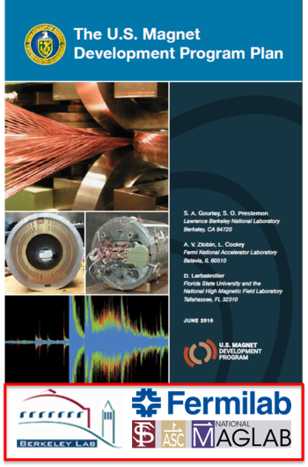
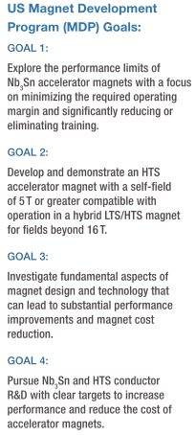
Premise
Fermilab SC Magnet R&D is fully aligned with the goals of the P5 and HEPAP
We are part of the the U.S. Magnet Development Program (MDP) Plan, keeping our responsibility for the program. Independently, we are looking for independent R&D keeping our identity as a group
We keep our finger on the pulse of the future in the High Energy Physics. The just-finished ICHEP in Seoul confirmed the most like scenario for the next 25-30 years is: FCC or SppC vs HE-LHC, decision 2025.

Slide 3
Outline
Short introduction
Program Description
  Mission and Goals
  Funding Level
  Synergy with the U.S MDP
Achievements (from 2013 review) and Present Activities
  SC Magnets
  Strand and Cable R&D
Test Facilities Status
Future Plans
Upcoming Needs
Conclusion

Slide 4
Introduction
Description of the Program
  Before MDP
  Part of of MDP - 15T Stoyan Stoynev
  Current SC Strand&Cable (SCSC) R&D - Xingchen Xu
Keeping own identity - Magnet Task Force and future plans – Giorgio Ambrosio

Slide 5
SC Magnets Program Mission and Goals
The Mission Specific to Fermilab - focus on accelerators:
  Develop baseline technologies for present and future particle accelerators.
    Strand and cable R&D
    Technology advances in materials
    Training studies
    Modeling and structural design
  Development of advanced SC “accelerator quality” magnets
    (Accelerator quality defines and usable magnet for accelerators. For circular collider includes: appropriate aperture and field for beam, alignment properties, control of high-order multipoles during injection and energy ramp, appropriate length, heat load and quench management)
Our Present Focus:
  Development of high-field accelerator dipoles with operating fields up to 16+T based on Nb₃Sn superconductor.
  The result and knowledge of current R&D directly support not the just-started LH-LHC AUP project but future possible direct R&Ds (HE-LHC,FCC) and Other Applications
  “Spin-off”: possible use this technology in a large aperture dipole for cable and small coil test facility as an outsert
In the longer term, the program aims to support the development of hybrid accelerator dipole magnets (LTS+HTS insert) for fields 20+T

Slide 6
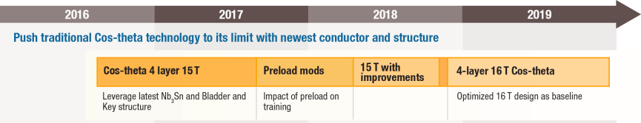
Synergy with US-MDP
HEPAP Recommendations:
  5a. Support accelerator design and simulation activities that guide and are informed by the superconducting magnet R&D program for a very high-energy proton-proton collider.
  5b. Form a focused U.S. high-field magnet R&D collaboration that is coordinated with global design studies for a very high-energy proton-proton collider. The over-arching goal is a large improvement in cost-performance.
  5c. Aggressively pursue the development of Nb3Sn magnets suitable for use in a very high-energy proton-proton collider.
Push the Tradition: cos-theta design coil technology with the newest conductor and modern structure
Step 1
Step 2
Step 3
15 T dipole demonstrator design
    Explore target field and force range.
    Serve as technical and cost bases for comparison with new concepts.
    Is an opportunity for program integration, particularly in the area of support structure design, and for exploration of different mechanical structures.
    Most cost effective way to exceed the field obtained 20 years ago in the LBNL D20 dipole.

Slide 7
Funding
Staying practically flat from Fy15 on the level of $2.1M

Slide 8
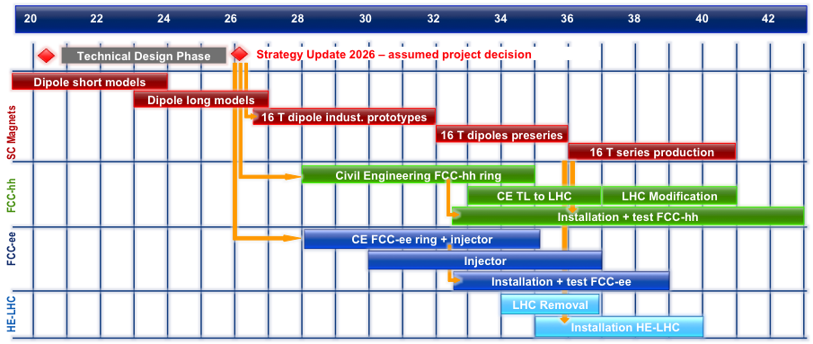
HEP Landscape: 10-20 years in the future – HE-LHC/FCC
Fully supported from HEP community
Magnet design(s) and models are progressing
EuroCirCol is fully working on 3 types of design

Slide 9
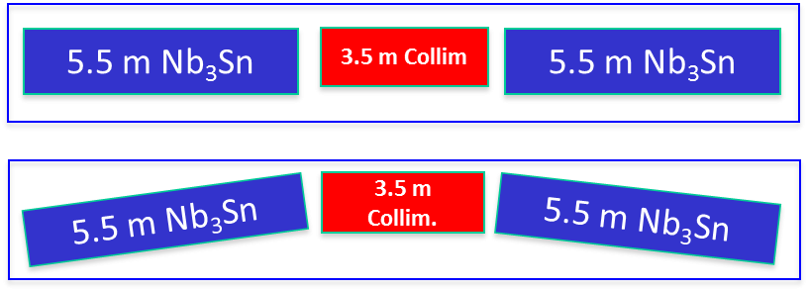
Magnet R&D - 11 T Program
The original FNAL-CERN plan for FY11-15:
  Phase 1 (FY11-12): a single-aperture 2-m long dipole demonstrator
    11 T at 11.85 kA and 1.9 K in a 60 mm bore with 20% margin
  Phase 2 (FY13-14): two 2-m long, 2-in1 dipole models
    confirm the final magnet design, demonstrate the magnet performance parameters and their reproducibility
  Phase 3 (FY14-15): a 5.5-m long 2-in-1 dipole prototype
    technology scale up
In 2013 the FNAL plan was modified to take into account the reduction of the HFM budget as well as CERN priorities and schedule for U.S. contributions to HL-LHC
  the 3rd phase of the program has been cancelled
  the scope of the 2nd phase has been optimized
    the model length has been reduced from 2-m to 1-m to cut the cost of Nb₃Sn cable and magnet parts (mainly collar and yoke)

Slide 10
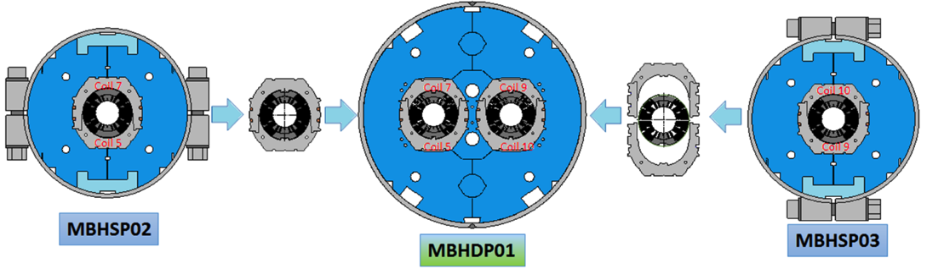
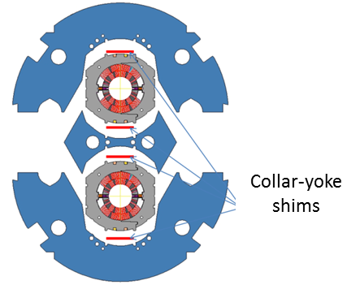
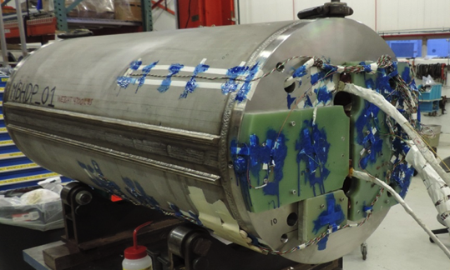
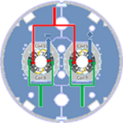
Twin-aperture model MBHDP01
Smaller collar-yoke mid-plane shim
Re-collaring with larger radial shim

Slide 11
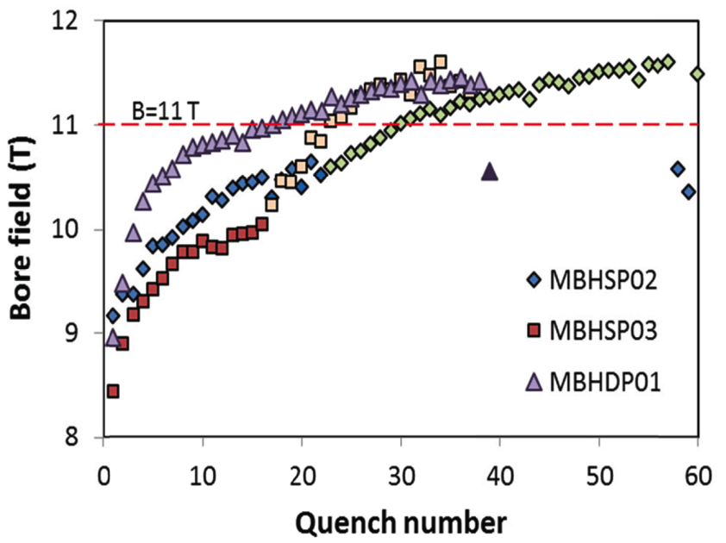
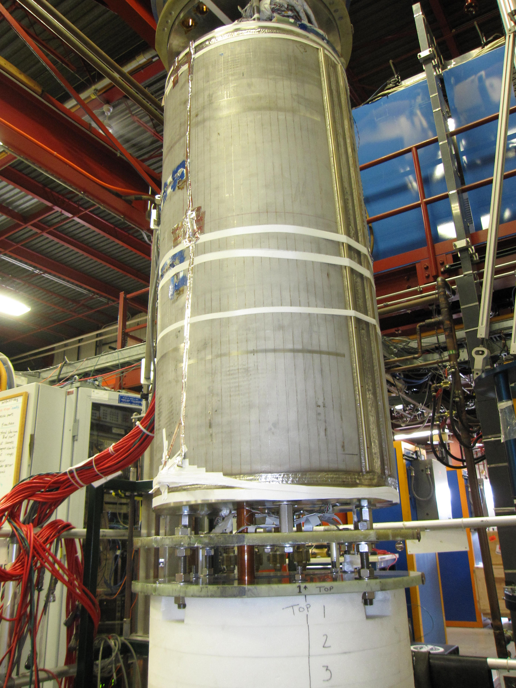
MBHDP01 Quench Performance Measurement
Success!
As expected, the magnet demonstrated similar quench performance limited by the coil used in MBHSP02
No additional coil degradation due to re-assembly of one of the collared coils and twin-aperture dipole assembly process
MBHDP01 reached 11.5 T at 12.1 kA

Slide 12
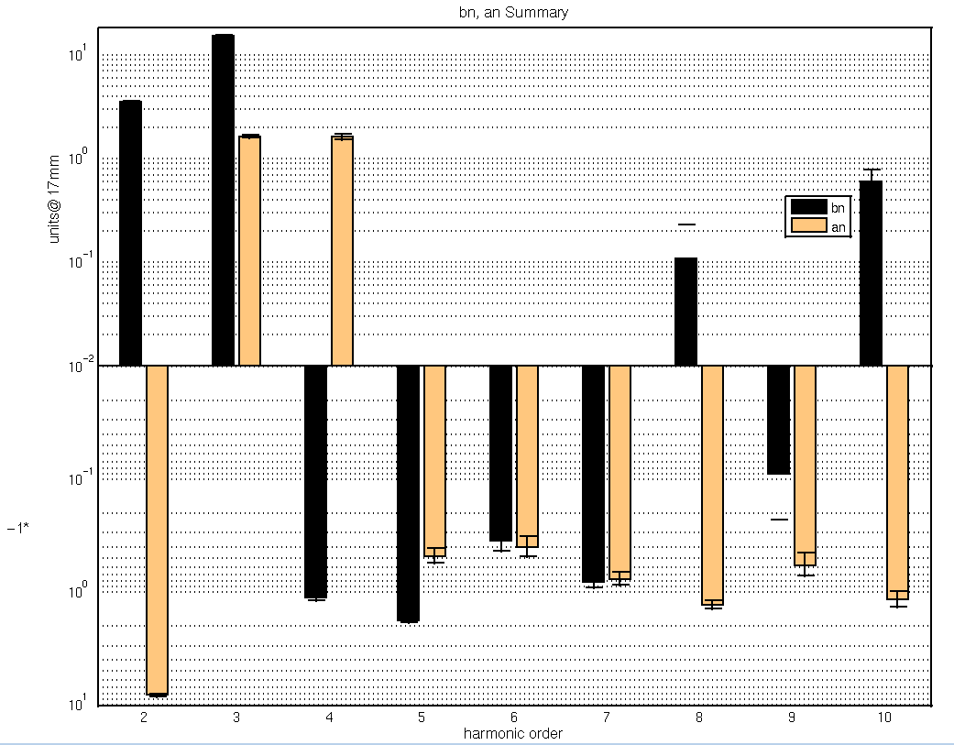
11 T Magnetic Measurements/Summary
MBHDP01

Slide 13
11 T Program
MBHSD01 was the final magnet of the program.
It showed that 11 T accelerator type dipoles can be successfully built.
Technology was fully transferred to CERN.
As today, several successful short models were built at CERN.
  Long prototypes are in progress
This will be the first Nb3Sn magnets placed in operation in HEP accelerator!
https://acceleratingnews.web.cern.ch/printpdf/69

Slide 14
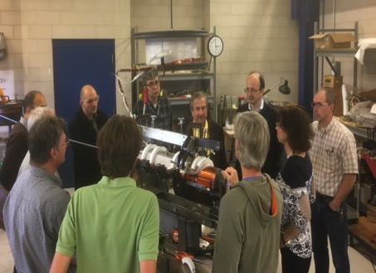
Magnet R&D - 15 T Program (Stoyan’s talk)
Started in FY15 after 11 T
Major external review (April 2017) concluded:
Several technical coil reviews were executed:
  Coil production readiness review Sep 2017.
  Internal coil production review Jan. , 2018
The 15 T later on was consolidated as part of the U.S. MDP as leading goal

Slide 15
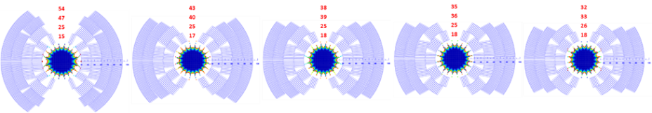
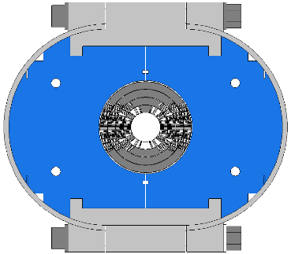
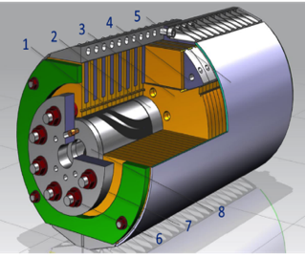
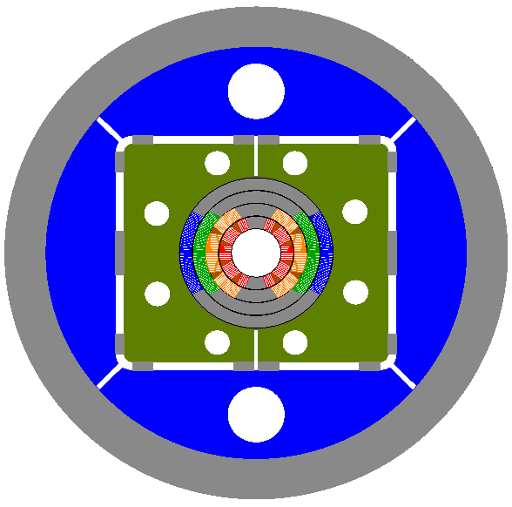
15 T Dipole Demonstrator: design selection
Approach:
use the available tooling and FNAL fabrication and test infrastructure
to reduce the magnet R&D cost and time
Selected!
Coil:
60-mm aperture
4-layer graded cos-theta coil
5 cross-sections studied
Mechanical structure:
Design 1: SS C-clamps and
20-mm thick SS skin
Design 2: Al I-clamps and
12-mm thick SS skin
Design 3: 50-mm thick Al shell
Design 1
Design 2
Design 3

Slide 16
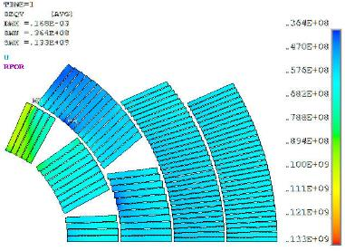
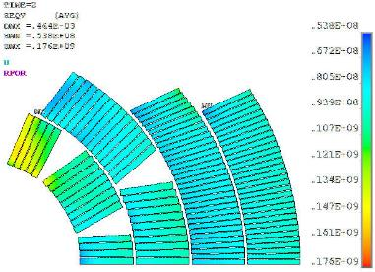
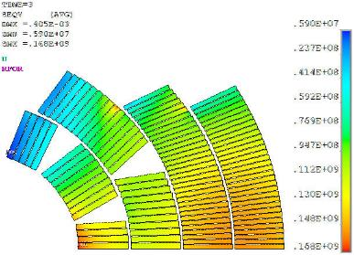
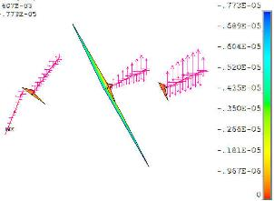

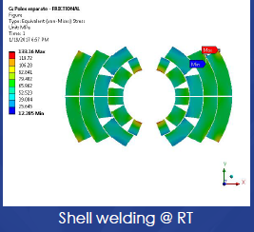
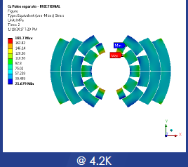
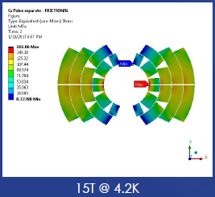
2D mechanical analysis and limit
300K
4K
4K+15T
L3
L4
L2
L1
S_{eqv}=133 MPa
S_{eqv}=176 MPa
S_{eqv}=168 MPa
Limits:
150 MPa
200 MPa
200 MPa
Second, independent,
analysis yields similar results:
Magnet design limit is determined
by the mechanical constraints – coil
maximum stress and pole turn
separation from pole
S_{eqv}=133MPa
S_{eqv}=182MPa
S_{eqv}=161MPa

Slide 17
Coil fabrication status
Coil (Layer ) | Coil # | Winding, curing | Reaction, witness samples | Instrumentation, epoxy impregnation | Measurement and Instrumentation
Inner (L1-L2) | 1 | complete | complete | complete | in progress
 | 2 | complete | complete | in progress
 | 3 | complete
Outer (L3-L4) | 1 | complete | complete | complete | complete
 | 2 | complete | complete | in progress
 | 3 | waiting for cable

Slide 18
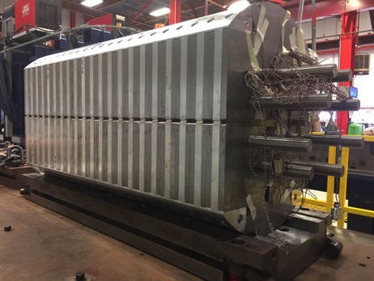
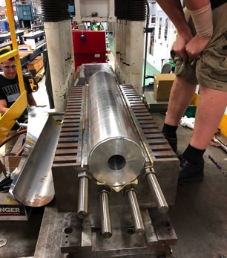
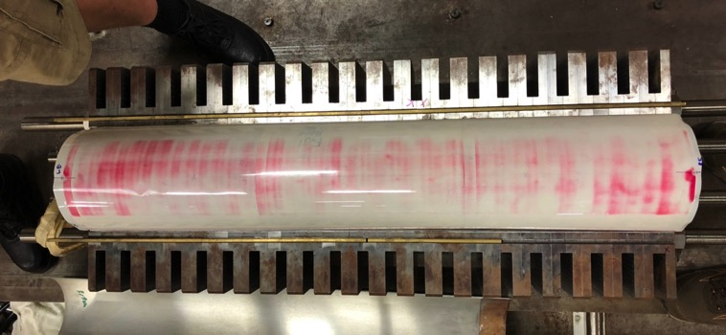
Long Mechanical Model
Goals:
To test all main components of the mechanical structure and assembly tooling
Develop a coil assembly plan and pre-stress targets
Check instrumentation
FEA validation.
Test plan:
Cylindric dummy coil instrumented
Model assembly with various shims and Fuji film

Slide 19
Magnet fabrication and test schedule
 | Jun | Jul | Aug | Sep | Oct | Nov
Coil fabrication
Mechanical model test
Magnet assembly
Magnet test

Slide 20
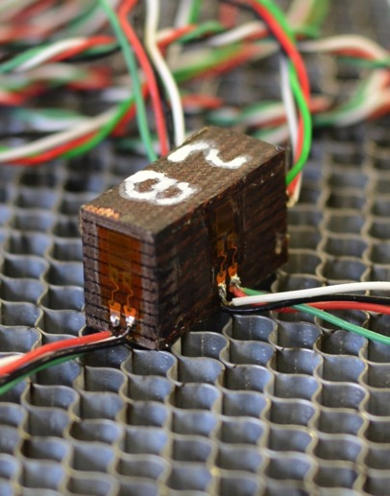
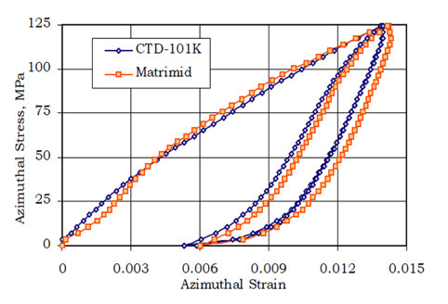
Material R&D – 10 stack
Ten stacks serve as a way to work to characterize coil mechanical properties with less work and well defined.
Cable is subject to all fabrication steps (Curing, reaction, impregnation)
  Coil Modulus and poisons ratio measurements in 3 directions
  Thermal contraction measurements
Notes:
the ratio of the proportional decrease in a lateral measurement to the proportional increase in length in a sample of material that is elastically stretched.

Slide 21
Summary: SC Magnets
11T programs was successfully finished and transferred to CERN - first Nb₃Sn in accelerator operation
Cos-theta 15 T model, as part of MDP, is near completion; test is expected later this year.
  Europe (CERN) is looking at us for the first results

Slide 22
SC Strand and Cable R&D
The goal: to support the HF accelerator magnets
  Preform internal design of the Nb₃Sn stands and cables
  Work with industrial partners - OST, Bruker-OST, Hypertech, Inc.
  Tests of the strands/cables
  The work is performed in collaboration with: NHMFL, OSU, LBNL, Hypertech.
Revival of the HTS R&D and Fermilab
  Small Iron dominated HTS magnets for Linear colliders – Fermilab LDRD
  Possibly going in direction of Fe-based superconductor R&D

Slide 23
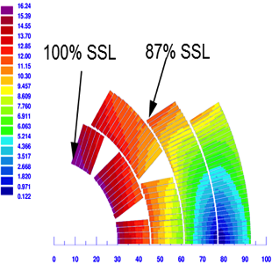
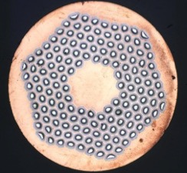
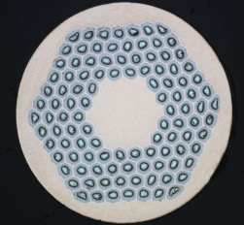
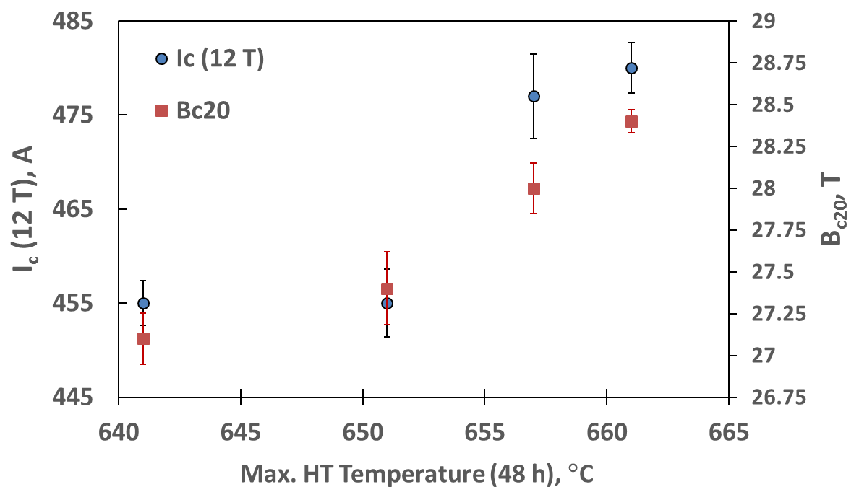
Example: Heat Treatment Optimization for 15 T
Inner Layer: 1 mm RRP150/169
28-strand cable with SS core
Outer Layer: 0.7 mm RRP108/127
40-strand cable with SS core
11 T dipole

Slide 24
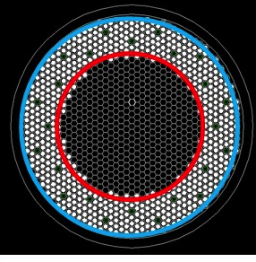
RRP Strand Optimization with Bruker OST
Goal: increase J_{c}(15T) with an ultimate target of 2 kA/mm² for a 169 stack strand at 1.0 mm (D_{s}~58 µm) by modifications to sub-element.
The following 3 billets with standard Nb:Sn=3.4:1 (highest J_{c}) and 150/169 Ti doped sub-element were produced:
  Nb7.5wt%Ta diffusion barrier, standard monofilament LAR ~0.20
  Monofilament LAR increased from the standard ~0.20 to ~0.23
  Graded monofilament LAR – innermost row LAR ~ 0.25, all middle rows LAR ~ 0.20, outermost row LAR ~0.14
All billets, as well as 0.8 to 1.2 mm wire samples, were delivered end of July 2016.
Notes:
Cu/Nb area ratio (named “local area ratio”, LAR)

Slide 25
Using the ZrO₂ APC technique to improve J_{c} - LDRD
The biggest opportunity for improving Nb₃Sn wire J_{c} lies in improving pinning capacity by Artificial Pinning Center (APC) method.
J_{c} is the essential for the higher fields
Internal oxidation method forms ZrO₂ nanoparticles in Nb₃Sn, which refine Nb₃Sn grain size from 100-150 to 35-50 nm, and thus improves J_{c}.
Doubling of layer J_{c} has been achieved in proof-of-principle binary wires.
Adding Ti optimizes B_{c2}, increases 3-3.5 times J_{c} at 15-20 T, reduces cost.
This is the most promising path to meet the requirements for future accelerators and keep the cost down
Critical current density (J_{c})
Binary wire
Ti doped wire
I_{c}-B curve
Improved I_{c}-B curve
Critical Current, I, A
Load line: B ∝ W*I
B, T
B_{ss}’
B_{ss}
B_{c2}

Slide 26
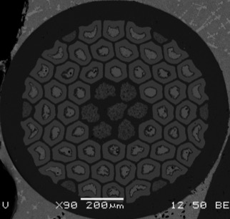
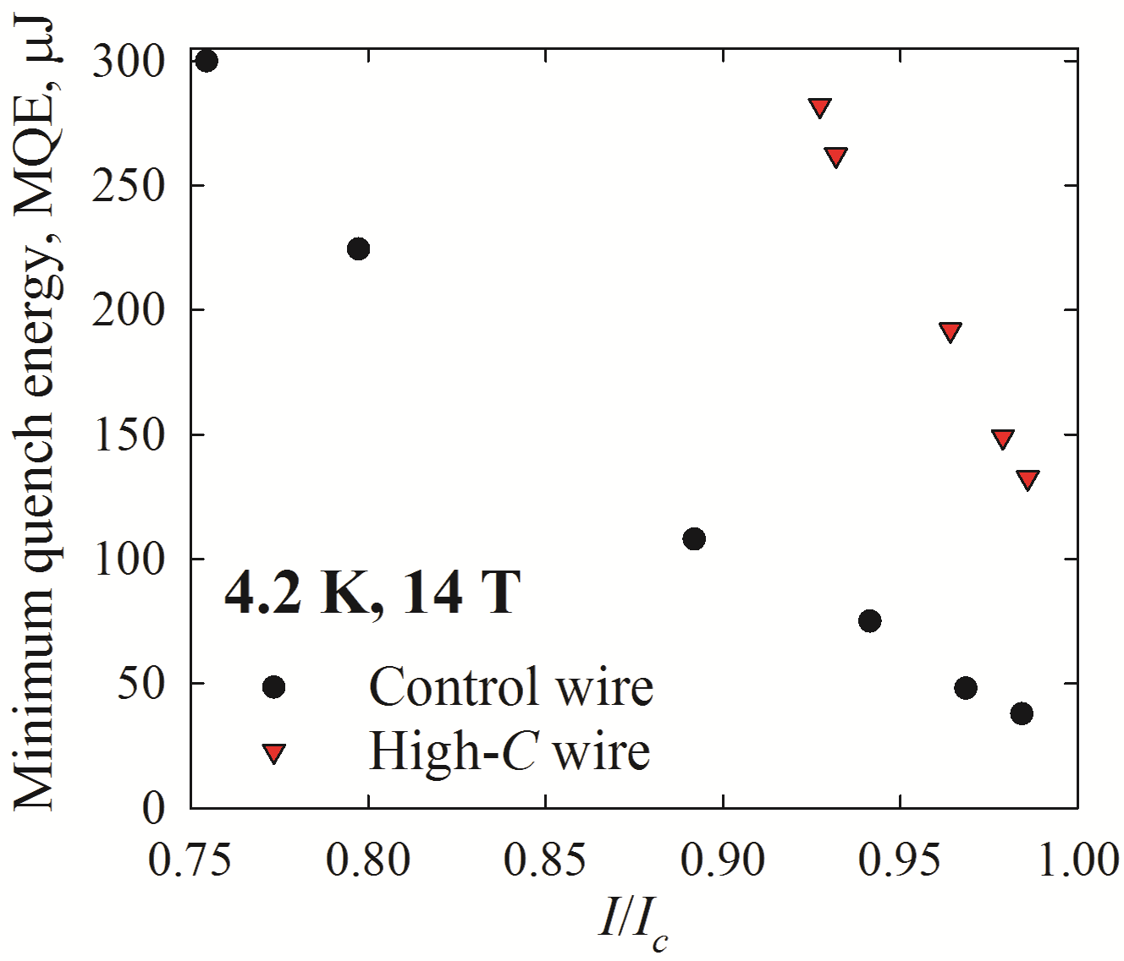
Enhance C_{p} of composite superconducting wires
First high-C_{p} wire:
Motivation to suppress instability of superconducting magnets:
  reduce or eliminate magnet training
  operate magnet closer to short sample limit
  avoid quenches during magnet operation
Adding high-C_{p} substances can improve wire C_{p}.
Some high-C_{p} materials: CeCu_{6,} Gd₂O₃
Adding 1 vol.% of Gd₂O₃ to a Nb₃Sn wire can increase its C_{p} by several times.
Latest APC and High-Cp results: see Xingchen’s talk.
The first high-C_{p} wire is far from optimization, but still MQE tripled.
Notes:
Ce – cerium

Slide 27
Summary/Plans: SC Strand&Cable R&D
Directed for the current needs of the accelerator magnets
In the next 2-3 years, increasing of the Nb₃Sn J_{c} by factor of 2-3 is expected, meeting the current requirements for future colliders
Answering the question: Improving the thermal conductivity of the SC wire, is it a “silver bullet” to solve the Nb3Sn accelerator type magnet training?
If funds allow, restart Fermilab HTS R&D with collaboration of NHMFL and LBNL.

Slide 28
Test Facilities
Fermilab Complex for Accelerator science and technology R&D is an ensemble of comprehensive capabilities and facilities that enable Accelerator Science and Technology R&D, superconducting RF science and technology R&D and high-field superconducting magnet R&D for future accelerators, as well as a number of projects and national programs.
The capabilities of Fermi-CARD are in high demand for a large number of national and international users. The demand continues to grow as the prototyping phase of projects and programs accelerates, and projects approach production.

Slide 29
Test Facilities – Magnets
Support Magnet R&D (MDP and Fermi-specific)
  15 T dipole
  Conductor R&D
  Material R&D
  SC magnets instrumentation R&D: magnetic measurement, quench detection/protection and etc.
  R&D on manufacturing capabilities
Support Projects
  HL LHC-AUP - coil production, cryo-module assembly, testing
  Mu2e - Solenoids assembly, testing
  LCLSII - Cryomodule quadrupoles
  G-2 – Experiment support (inflector)
  LCLSII - Cryomodule quadrupoles
  Some external users (SC Undulators R&D ANL)
Magnet thrust budget for test facilities B&R: $4.7-4.8M

Slide 30
Magnet Personnel and Facilities
About 60 staff members (SC scientists, technicians, engineers) with long term experience in magnet design, fabrication and test - deep roots from TeV and SSC
Superconducting Magnet Facility
  Coil fabrication for AUP
  15T dipole
Strand and Cable Lab (testing superconductors)
Magnet Test Facility
  Room Temperature Magnet Measurements
  Superconducting Magnet Testing
    Vertical Magnet Test Facility (cold masses)
    Stand 4 Horizontal Test Stand (SSC, LHC IR quads, AUP quads)
    Stand 3 (small magnets, HTS leads, LCLSII quads)
    Solenoid Test Facility (Mu2e Transport solenoid)
Quality Control Lab (incoming inspection)

Slide 31
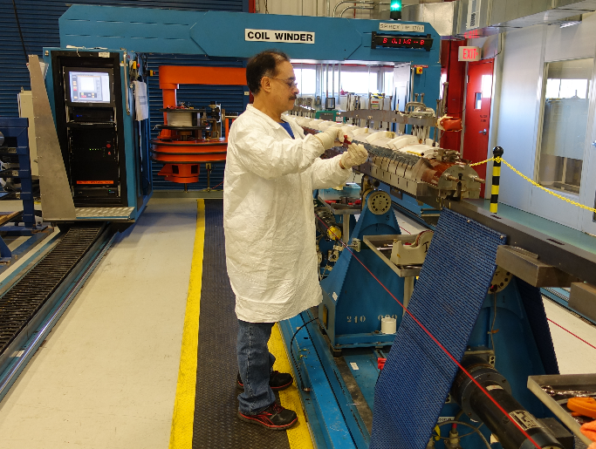
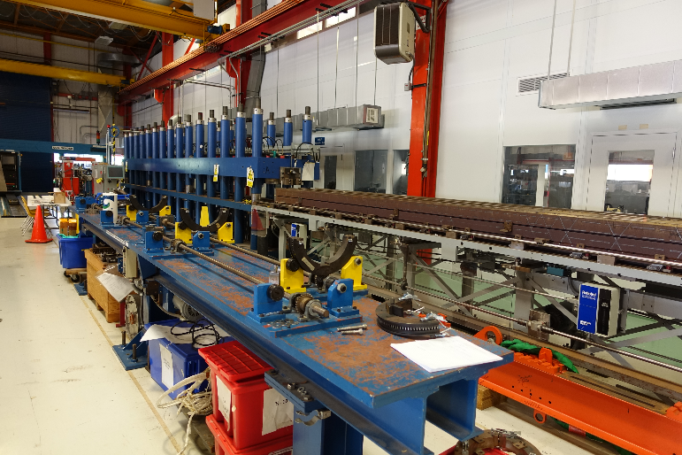
FNAL magnet coil fabrication facility (new pict)
Superconducting magnets
  Coil winding and reaction
  Collaring
  Yoking
  Instrumentation
Magnet fabrication and other direct work is charged to projects and programs.
  High Field Magnet Program (MDP)
  HL-LHC AUP
Number of produced coils since 2013: 32

Slide 32
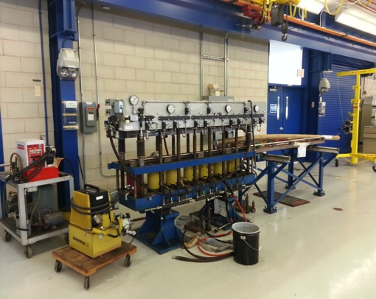
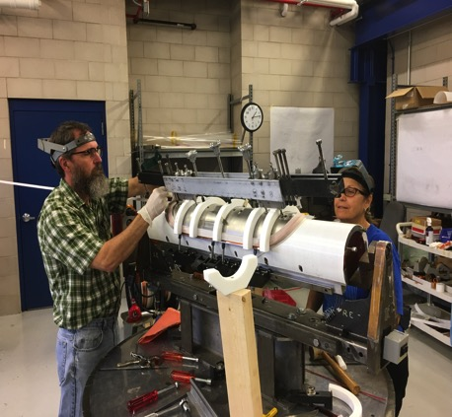
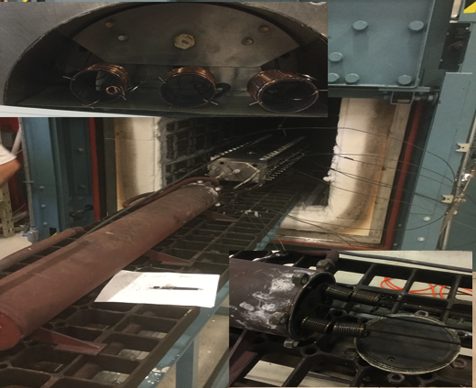
15 T Fabrication (HFM@MDP)
Separate manufacturing shop
  Winding table and tensioner
  Curing press
  Reaction oven and retort

Slide 33
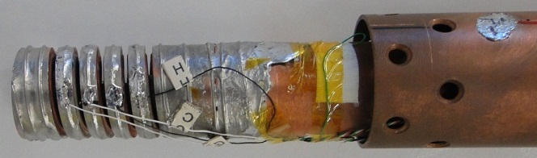
Strand and Cable Lab Scope
Main functions
Measure performance of superconductors
  Process samples as needed after forming and before testing
  Test samples of individual strands and cables varying temperature, pressure, field, etc.
Testing is charged to projects and programs.
  Nb₃Sn strand and cable R&D
  QC for High Field Magnet, AUP, Mu2e
  High Temperature Superconductor R&D

Slide 34
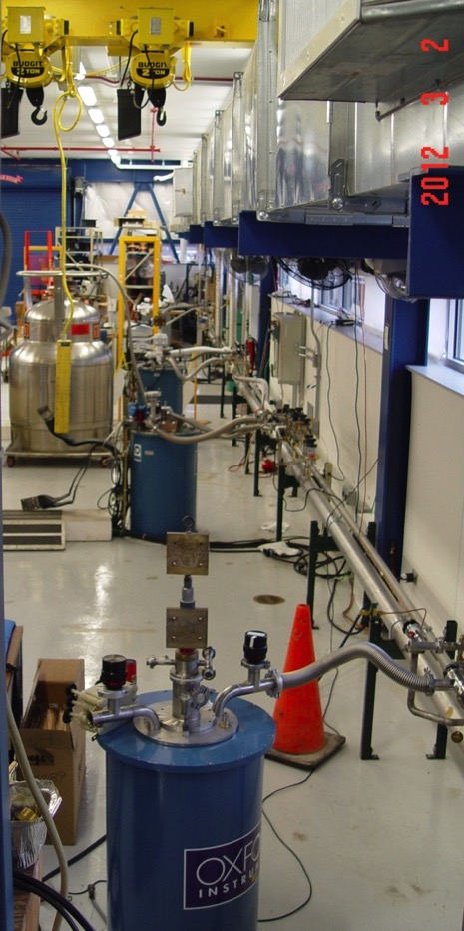
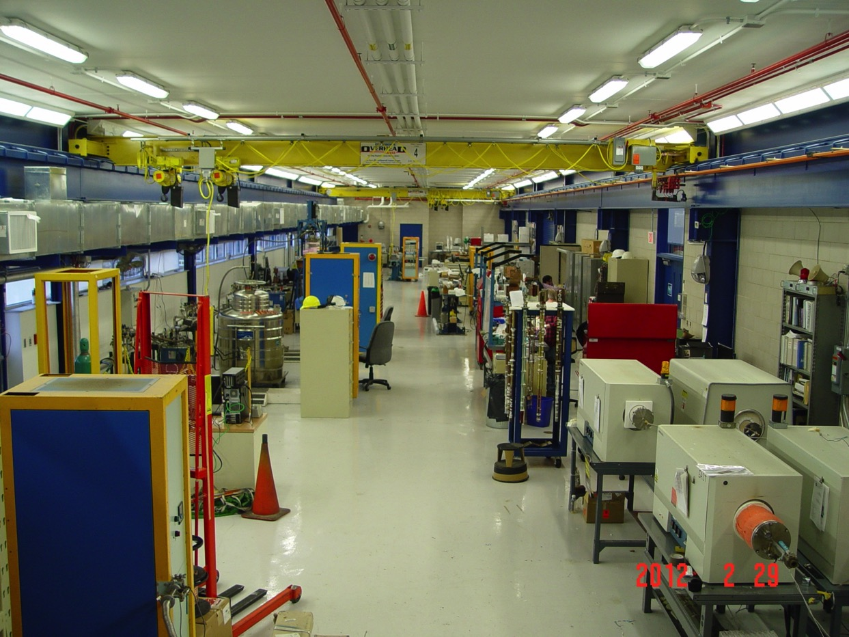
Strand&Cable R&D Lab
IB3-A, a ~6000 square feet addition built in 2010
Each system has its own DAQ and PSs up to 2400 A.
VT Inserts with T range 1.5-60 K.
Four cryostats with B up to 15T/17 T, cold apertures between 64 and 147 mm.
Five ovens up to 1250◦C for heat treatment in Argon and in Oxygen.

Slide 35
SC Magnet Testing
Supporting Projects and Magnet R&D
VMTF was the working horse for LARP and HFM 1.9K tests: 20 for the last 7 years

Slide 36
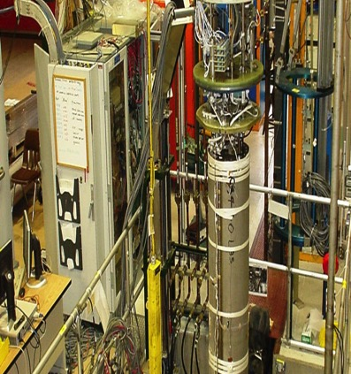
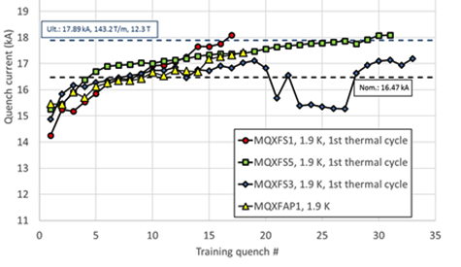
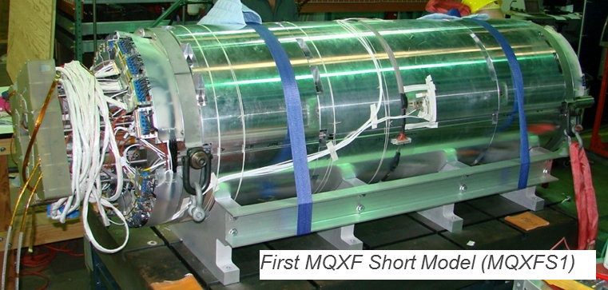
VMTF
VMTF has been “the working horse” for LARP and HFM 1.9K tests: 20 for the last 7 years
Limitations: cryostat ID of 620 mm. HFM are growing with OD.
Depending on the funding decisions for new HFVMTF:
  we will continue to support it
  We will use QP and other electronics for the new stand

Slide 37
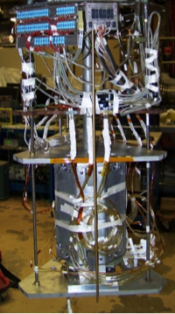
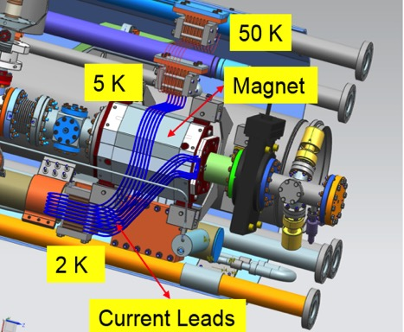
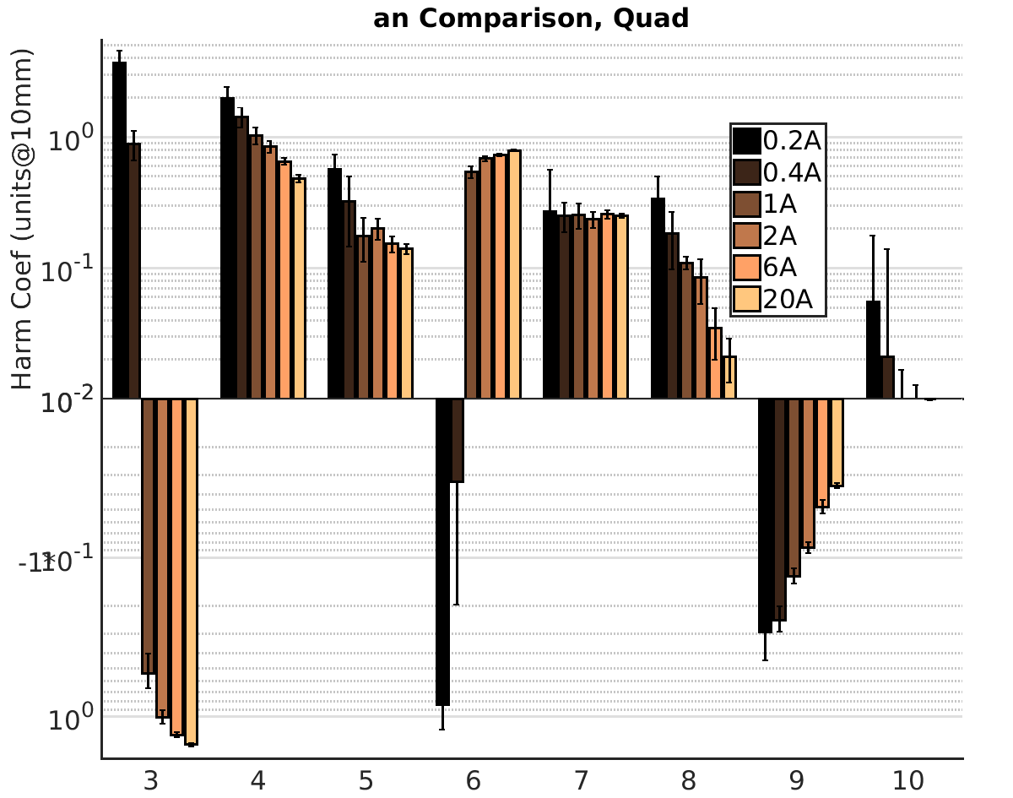
Stand 3
A 4.2 K test stand dedicated to small magnets and current leads
For the last two years supports LCLS II small quadrupoles testing for FNAL and JLab cryomodules, 33/36 magnets are tested
Stand 3: future plans:
  Finish LCLS II
  Test HTS current leads for Mu2e transport solenoid
  Dedicate to fast-turn-around R&D tests: racetrack coils, 10 stack conductor and etc.

Slide 38


Stand 4
On-line in 2019 for HL-LHC AUP
Main functions
  Test and measure large superconducting magnets
  Maximum capacity: ~14 m long magnets
  1.85K minimum temperature
  20 kA maximum current
  Measurements
    Quench performance
    Rotating coil for field strength and uniformity
    Single stretched wire
Working hard to meet the project requirements

Slide 39




Mu2e Transport Solenoid Test Facility at HAB
Commissioned of the stand is finished.
  Two Top Plates with cryo, mechanical, instrumentation, power interfaces to TS coil modules
First production module of Mu2e transport solenoid, TSUN1 is tested
TSUN1

Slide 40


Future Proposal - HFVMTF for Conductor, Cable and Magnet R&D
High Field Vertical Magnet Test Facility for Conductor, Cable and Magnet R&D
Synergy with Fusion interests
  The facility will have similar parameters like FRESCA2@CERN and EDIPO@PSI
  Possibility to test HTS cables and small coils
  External filed ~ 14-15 T – magnet provided with MDP collaboration

Slide 41
Magnet facilities: upcoming needs - 3-5 years
Support HFVMTF test stand for future HFM tests, possible synergy with the US Fusion Community
  FY19 need – 0.6 M to start the civil construction
  Total cost: from $1.3 (support only HFM) to $2.9M (HFM+Fussion) depending of the options, duration 2.5 years
Support Superconducting Magnet Test Facility
  Need upgrade of 40 years old, Tevatron era, infrastructure.
    Instrumentation, monitoring, measurements
  Need 4-5 years constant injections of $0.6M/year
Increasing the funding for magnet SC accelerator magnet R&D in US, especially Nb₃Sn
  Europe is accelerating – EuroCirCol and 16T Magnet Technology Program
  Leadership capabilities are quickly lost if not funded adequately
  HFM (together with SRF) is one of the enabling technologies for any future machine. Control of all aspects of the technology will allow US HEP to play a major role in the future facilities: $0.5M/year to support 2 postdocs

Slide 42
FY19/20: Short Term Priorities
High-field Magnet Program in collaboration with MDP:
Assemble and test 15 T dipole demonstrator. Depending on measurement results, iterations with spare coils maybe needed.
Conceptual/Preliminary design studies of 16 to 20 T accelerator type dipole and Integration region quadrupole for FCC
Increase the fast-turn-around SC and epoxy materials, coil and mechanical R&D.
Continue the SC strand studies with main goal: test APC and High-C_{p} cables in-situ, and in small racetrack coils
Build HFVMTF test stand for future HFM tests

Slide 43
Long Term Plans
See Giorgio’s talk.

Slide 44
Team
A new SC magnet R&D group is created. It includes a lot of young PI, scientist and engineers.
The group is led by Giorgio Ambrosio and myself.
X. Xu
Conductor R&D
S. Stoynev
Fast Turnaround R&D, advanced instrumentation
S. Krave
Fabrication Cost Reduction
V. Kashikin
Magnet Design
V. Lombardo
HTS development

Slide 45
Summary
GARD-supported HFM effort contributes to the essential role of the magnet technology development in support of future accelerators projects.
  11T programs was successfully finished and transferred to CERN - first Nb₃Sn in accelerator operation
  Cos-theta 15 T model, as part of MDP, is near completion; test is expected later this year.
  Nb₃Sn conductor development is progressing extremely well, expect applications in the next 2-3 years
A new Fermilab HFM plan was developed, it diversities our internal plans, elevates the fast-turn-around SC R&D
Test facilities efficiently supported the projects and R&D.
  HFVMTF is needed for the HF magnet R&D

Slide 46
Summary – cont.
Our program is clear and ambitious: relatively small increasing of the funding will help to achieve the results in a shorter time frame
In the next decade, the goal of the program to achieve results which will reinforce US control of the HFM technology for accelerator quality magnets for future machines

Slide 47
Backups

Slide 48
HFM: Importance of the Program Breadth
Copy some part of
FNAL HFM is a leadership program in the world
  In era of reducing R&D funds, areas of leadership need to be protected to preserve the breadth and leadership qualities of the program itself.
Why it’s critical to the US to preserve HFM program
  Leadership capabilities are quickly lost if not funded adequately
    Ex: Europe started “crack” programs to recover and re-establish Nb₃Sn capability after all R&D was postponed during LHC construction.
    This is an inefficient and expensive R&D policy, not viable in the US-funding environment.
  HFM (together with SRF) is one of the enabling technologies for any future machine. Even if future facilities will not be built on US soil, control of all aspects of the technology will allow US HEP to play a major role
    It is risky to become the experts in just a restricted technology aspect, such as only Nb₃Sn quadrupoles or only β=0.22 cavities

Slide 49





MBHDP01 Quench Performance Measurement
Most regular quenches originated in the IL pole blocks.
Holding current quenches were in the OL MP block of coil 07.

Slide 50
P5
Recommendation 5. Participate in international design studies for a very high-energy proton-proton collider in order to realize this Next Step in hadron collider facilities for exploration of the Energy Frontier. Vigorously pursue major cost reductions by investing in magnet development and in the most promising superconducting materials, targeting potential breakthroughs in cost-performance.
Recommendation 5a. Support accelerator design and simulation activities that guide and are informed by the superconducting magnet R&D program for a very high- energy proton-proton collider.
Recommendation 5b. Form a focused U.S. high-field magnet R&D collaboration that is coordinated with global design studies for a very high-energy proton- proton collider. The over-arching goal is a large im- provement in cost-performance.
Recommendation 5c. Aggressively pursue the development of Nb3Sn magnets suitable for use in a very high- energy proton-proton collider.
Recommendation 5d. Establish and execute a high- temperature superconducting (HTS) material and mag- net development plan with appropriate milestones to demonstrate the feasibility of cost-effective accelerator magnets using HTS.
Recommendation 5e. Engage industry and manufacturing engineering disciplines to explore techniques to both decrease the touch labor and increase the overall reliability of next-generation superconducting accelerator magnets.
Recommendation 5f. Significantly increase funding for superconducting accelerator magnet R&D in order to support aggressive development of new conductor and magnet technologies.

Slide 51

Premise Open questions and US-MDP goals
Open questions
  long training
  conductor degradation
  maximum field limit
  cost
US-MDP - since 2016
Goals and driving questions

Slide 52





Instrumentation and test plan
Instrumentation
Voltage taps
Strain gauges
Quench antenna
Rotating probes
Temperature sensors
Vertical Magnet Test Facility (FNAL)
Test temperature range 1.9-4.6 K
Coordinated test plan and procedures
Quench performance
Magnetic measurements
Heater study
Splice resistance
Coil RRR
Quench antenna
Voltage taps

Slide 53








Coil fabrication process
Coil winding and curing
Coil and witness sample reaction
Coil lead splicing and epoxy impregnation
Coil measurement & instrumentation
Planned coil fabrication time ~3 months
Actual time is longer – part and tooling modification, labor availability, etc.

Slide 54
List of GARD Activities under since 2013, not including APC and High-Cp
HFM Wire
Studies of Jc strain sensitivity of RRP wires were performed with a helical Walters’ spring device, equipped with two concentric copper tubes that act dually as current and torque carriers.
R&D with B-OST with the goal of pushing Jc(15T) to 2000 A/mm2 for an RRP 169 stack strand at 1.0 mm (Ds~58 µm) by modifying subelement design, i.e. change diffusion barrier material, use variable local area ratio along wire radius.
Nb3Sn Superconductor studies for undulators in collaboration with ANL Advanced Photon Source (APS).
HFM Cable
Development and fabrication of Rutherford cables for 15 T Dipole Demonstrator.
Tests of Rutherford cables to be used in high field dipoles up to 15 T external field and 28 kA of current, by means of a superconducting transformer with bifilar sample.
Critical current sensitivity of Rutherford cable samples under uniaxial transverse load up to 200 MPa.

Slide 55
HFM Technology
15 T Inner and Outer Coil heat treatment optimization.
Feasibility study of 1T HTS dipole coil within existing 60 mm aperture 11T dipole.
Conceptual design of mechanical structure and stress management for a HTS 5T insert dipole within a 15T Nb3Sn dipole.
Finite Element Sub-modelling vs. Homogeneous models to understand how stresses and strains are distributed inside the conductor.
Study of Azimuthal Quench Propagation in 11 T Dipole.
Nb3Sn Films & Infrastructure
For the purpose of eventually testing an experimental flux pinning model, Nb-Sn films produced by electro-chemical deposition at Politecnico di Milano were studied at FNAL, where the appropriate heat treatment was developed. A number of samples were then heat treated to produce Nb3Sn film, and characterized in-house, including SEM/EDS analyses, test of critical current Ic, upper critical field Bc20 and DC critical temperature Tc0.
Design of Surface Impedance Characterization System for flat samples using RF host cavity.
Since 2016, work in this area continued under Task 3, SRF cavity thin-film coating technologies for transformational performance, of the U.S.-Japan Science and Technology Cooperation Program in High Energy Physics - LAB 17-1699 Advanced Accelerator Technology, under FNAL Special Projects.

Slide 56


Heat Treatment Optimization for 15 T inner coil
1 mm RRP150/169
28-strand cable with SS core

Slide 57

Using the ZrO₂ APC technique to improve J_{c} - LDRD
The biggest opportunity for improving Nb₃Sn wire J_{c} lies in improving pinning capacity by Artificial Pinning Center (APC) method.
J_{c} is the essential for the higher fields
Internal oxidation method forms ZrO₂ nanoparticles in Nb₃Sn, which refine Nb₃Sn grain size from 100-150 to 35-50 nm, and thus improves J_{c}.
Doubling of layer J_{c} has been achieved in proof-of-principle binary wires.
Adding Ti optimizes B_{c2}, increases 3-3.5 times J_{c} at 15-20 T, reduces cost.
This is the most promising path to meet the requirements for future accelerators and keep the cost down
Regular Nb₃Sn subelement:
Nb or Nb-Ta
Nb₃Sn
HT
Sn source
Residual core
Residual Nb
Modified Nb₃Sn subelement:
Nb-1%Zr
Nb₃Sn with ZrO₂ particles
HT
Sn source + Oxide
Residual core
Residual Nb
Binary wire allows
Ti doped wire allows

Slide 58








Short Mechanical Model: iron lamination test
Load provided using internal support cylinders (aluminum and iron) and various radial shims.
Iron lams and clamps are instrumented with strain gauges.
Main goal: test iron laminations and aluminum clamps
(both are brittle at low temperatures)
Clamp design optimization
Larger radiuses.
No holes.
New clamps for the magnet straight section will be procured.

Slide 59




Single-aperture models MBHS
MBHSP01: 2-m dipole demonstrator
  RRP108/127
  Cable w/o core
  Coils #2, #3
MBHSP01
MBHSP02: 1-m dipole model
  RRP150/169
  Cable with 11.5 mm core
  Coils #5, #7
MBHSP02
MBHSM01: 1-m dipole mirror
  RRP108/127 (114/127)
  Cable with 11 mm core
  Coil #8
  Low pre-load
MBHSM01
MBHSP03: 1-m dipole model
  RRP108/127
  Cable with 11 mm core
  Coils #9, #10 – modified end parts (FNAL)
  Low pre-load
MBHSP03

Slide 60



15 T Dipole: Wire and Cable Parameters
Wire made by OST

