Slide 1
Study of beam echoes in the IOTA ring
Dhruv Desai, University of Illinois at Urbana-Champaign Mentor: Tanaji Sen
08/08/2018
1
Dhruv Desai | Beam Echoes
Notes:
This intro itself should take about 1 min
Three important points that the talk should cover:
What are echoes? Why are they important at all? (6 mins)
Cover how they are produced, explain phase space diagrams, explain why they are important (diffusion), and then explain how diffusion can be calculated based off of that.
Your results and conclusions (9 mins)
The ultimate goal is to get values of echo amplitudes and widths, reasonable enough for diffusion measurements. So, we try and adjust parameters such that they optimize echo amplitudes. Things that we did are:
See that echoes actually can be produced in the bare IOTA lattice, and have reasonable amplitudes and widths for diffusion measurements.
Test the predictions of the nonlinear theory.
See how robust echoes are against quad strengths, coupling, resonance, etc.
Perform simulations on echo dependence on coupling. That will help construct a full 2-D theory of echoes.
Conclusions: nonlinear theory OK, echoes fairly robust against 1-D parameters, Strong coupling affects echo amplitudes, addition of misalignment errors affects echoes much??
1

Slide 2
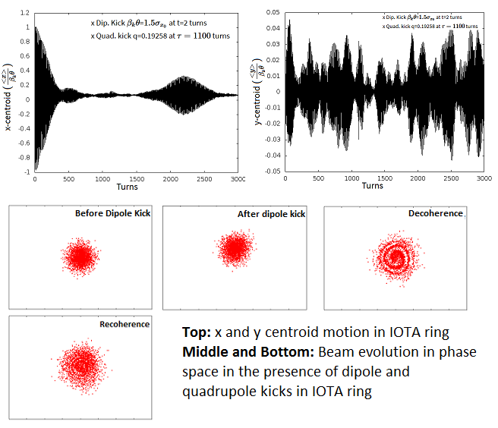
Beam echoes and significance
Recoherence of particles following decoherence as a result of non linear elements in the ring (e.g. sextupoles).
Diffusion measurements of a ring are necessary to keep track of beam evolution in phase space and minimize loss of particles.
Current methods (beam scraping) take hours; transverse beam echoes take milliseconds.
To observe echoes, we:
  Apply a dipole kick at time t=0.
  Apply a quadrupole kick at time t=τ, long after beam decoheres.
  Echo observed at time t=2τ.
2
08/08/2018
Dhruv Desai | Beam Echoes
Notes:
Time: (3 mins)
What are echoes? How are they produced? What happens in phase space?
What? – Steady beam, kick it once, presence of non linear elements gives a tune spread depending linearly on action, motion decoheres due to this, kick it again, at some point in time, frequencies start to recohere again, but get a diminished response.
Phase, space, dipK=constant, quad kick=linear dependence on x, particles cluster again at t= 2τ.
Why echoes? How to use them for diffusion? How are they better than current method of beam scraping??
Beam Scraping: Take a collimator to scrap off beam from the ends, wait for the beam to diffuse to the jaws, use that to measure diffusion. Takes a long time. Instead, use beam echoes.
2

Slide 3

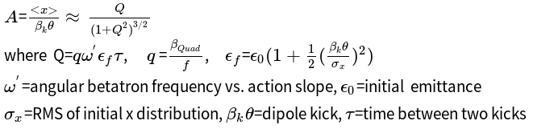

Recap of Nonlinear theory
Final emittance increases with dipole kicks as [2]
Relative echo amplitude is [2]
The optimum quadrupole strength can be calculated as [2] ,
for time delay τ much larger than decoherence time.
Relative echo amplitude saturates at A= 0.38 at typical emittances [2].
Relative echo amplitude increases at smaller emittances.
Multiple echoes are generated by large enough dipole kicks.
[2] Tanaji Sen and Yuan Shen Li. 2018. Physical Review Accelerators and Beams 02, 021002
3
08/03/2018
08/08/2018
Dhruv Desai | Beam Echoes
Notes:
put ellipse
3

Slide 4
Project Goals
Low intensity beams without space charge effects can be used for testing integrability of nonlinear optics.
Study echo dependence on ring parameters, and test echo theory.
Test robustness of dynamic aperture and echoes against coupling and synchrotron oscillations with longitudinal momentum spread.
Simulate echo generation in IOTA under realistic conditions.
Tools Used:
MADX with IOTA lattice (without nonlinear inserts) and FODO lattice with octupoles.
C++ codes for data analysis.
4
08/08/2018
Dhruv Desai | Beam Echoes
Notes:
4

Slide 5
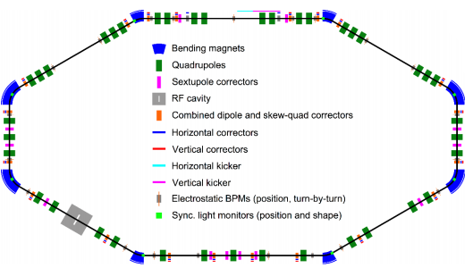
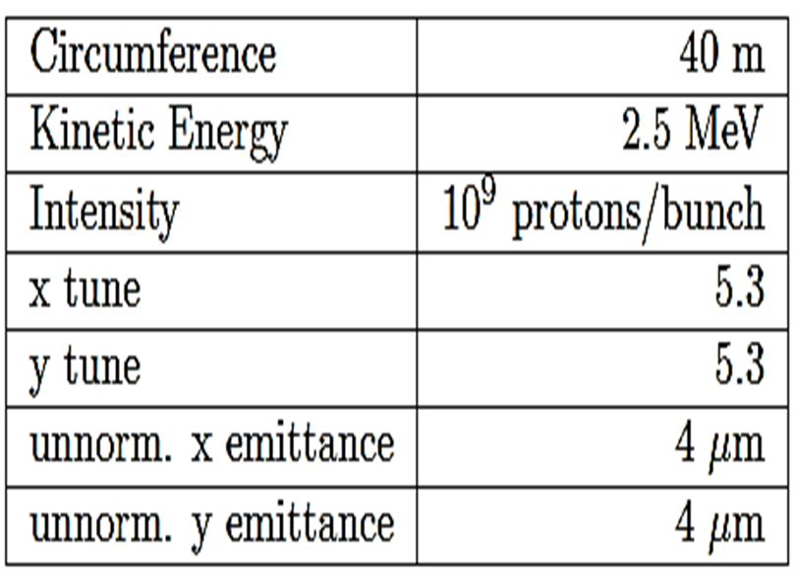
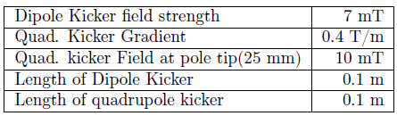
IOTA Ring- Layout and Parameters
Current Pulse width of both kickers should be less than one revolution period (2µs) to avoid multiple kicks
Dipole Kicker
Quad. Kicker
5
08/08/2018
Dhruv Desai | Beam Echoes
Notes:
(30 seconds)
Talk about parameters of the IOTA ring, and also that of the dipole and quad kickers.
They are reasonable enough.
5

Slide 6
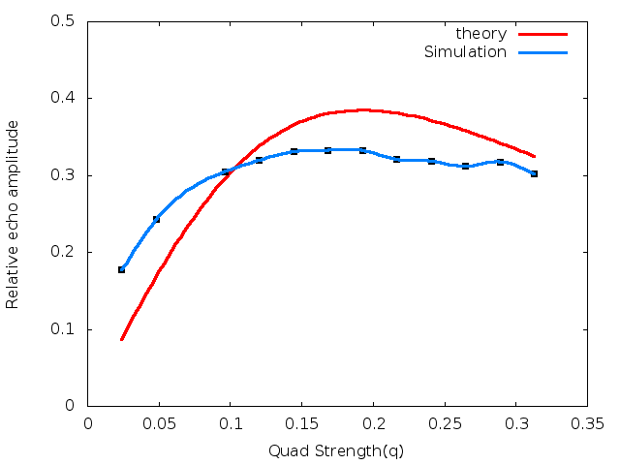
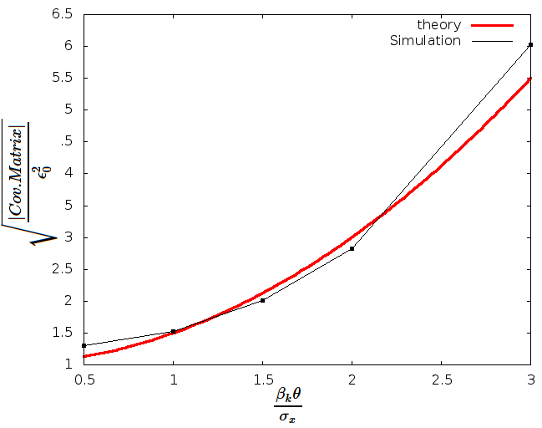
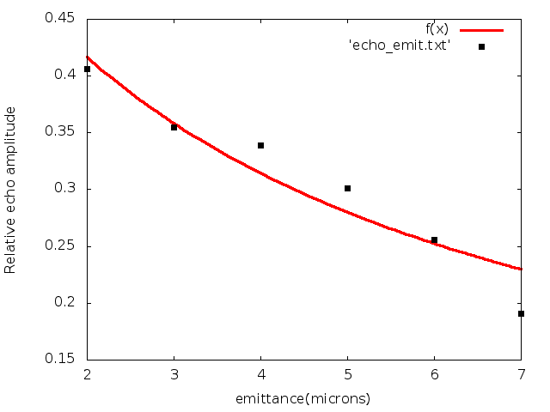
IOTA ring- Verification of 1-D theory
Small tune split suppresses echo amplitude, hence simulated value less than 0.38.
Final x emittance does not agree with theory because of coupling, however the determinant of the covariance matrix does.
Relative echo amplitude attains values higher than 0.38 at lower emittances; decreases as emittance increases.
6
08/08/2018
Dhruv Desai | Beam Echoes
Notes:
Time: 1.5 mins
Explain how theory predicts a maximum value consistent with the simulations for quad strength. Also explain how the echo amplitude saturates for q>q_{opt}. Proof of robustness.
As emittance increases, the relative echo amplitude decreases. Why?
First tried plotting only x emittance vs. kick strength, did not agree well with the theory curve. Why? The kicker changes y emittance with time too, on account of coupling. So, plotted the square root of determinant of the full covariance matrix, agrees really well with theory.
6

Slide 7
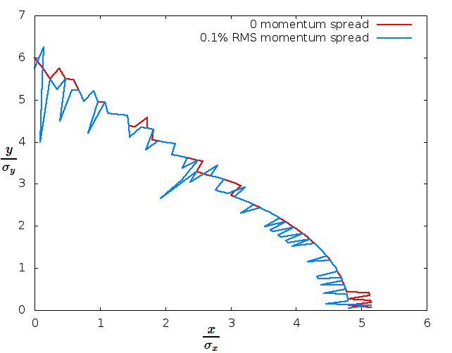
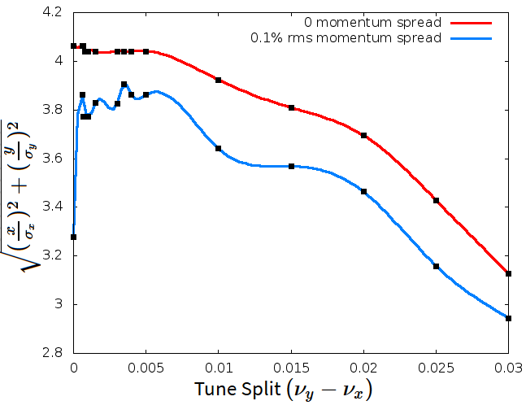


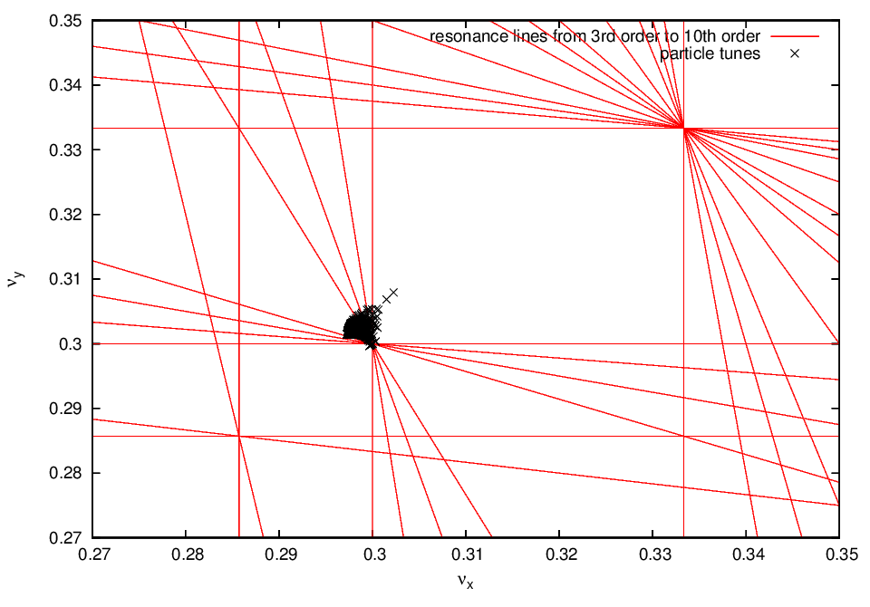
Dynamic Aperture and resonances
Dynamic Aperture is the maximum phase space limit beyond which particles get lost due to nonlinear fields.
Chromaticity corrected to 0, and tunes were split equally between x-y planes.
Plots show that beam can be kicked to 3σ_{x} without particles loss.
10th order resonances not driven by sextupoles; could change with other nonlinearities.
7
08/08/2018
Dhruv Desai | Beam Echoes
Notes:
Time: 1 min
What is dynamic aperture? Maximum limit in phase space beyond which if you go, you start to lose particles.
Explain that before observing echoes, it’s essential to check if the dynamic aperture is not too low to ensure minimum loss of particles. Dynamic aperture fairly small. Not much room to do stuff around here.
Also plotted dynamic aperture as a function of tune splits, to check for optimum tune split that minimizes particle loss. Also need to check if momentum dispersion does not affect dynaperture much.
Avoid resonance lines, why?? Particles get lost, big tune spread, tune vs action deviate from linearity.
Nominal tunes far enough from 3rd order resonance, ensure tune split is less than +/- 0.03 to avoid that. 10th order is fine, not much effect.
7

Slide 8
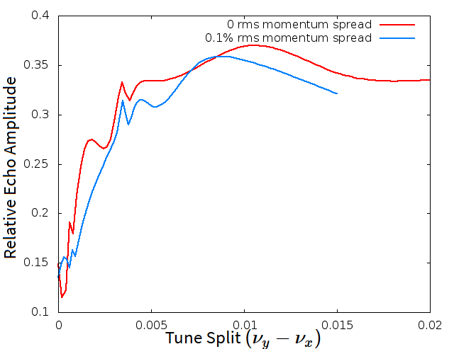
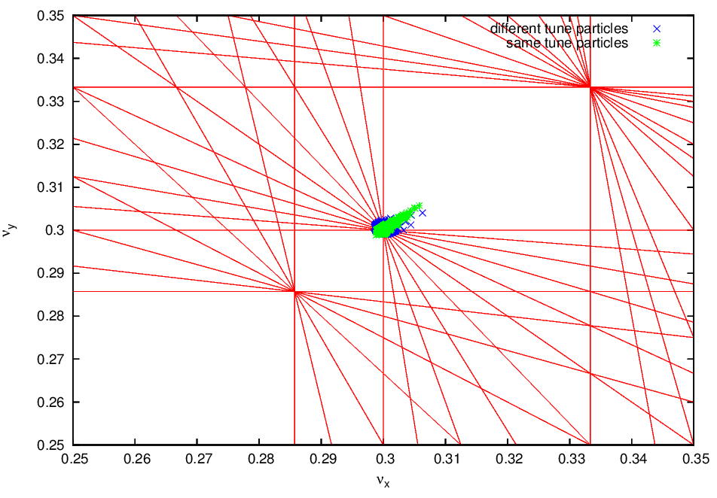
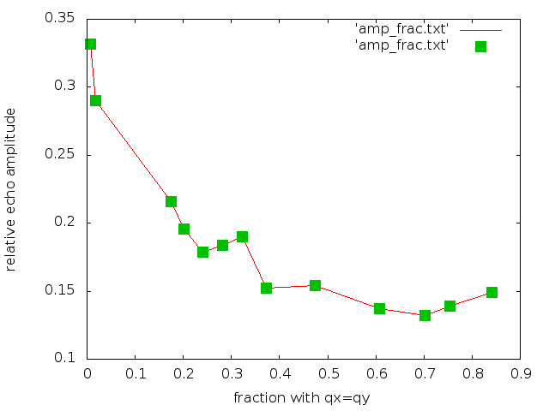

Effects of coupling on echoes
Echo amplitudes stable over large range of tunes.
Echo amplitude suppressed at lower tune splits due to stronger coupling.
Decoherence time increases with stronger coupling.
At stronger coupling, more energy from the kick in x plane transferred to the y plane.
Stable region
8
08/08/2018
Dhruv Desai | Beam Echoes
Notes:
Time: 1 min
Explain what the decoherence time is.
New result: Echo amplitude decreases with decrease in tune splits. Even though dynamic aperture and resonance favor smaller tune splits, amplitude does not. Opposing effects.
Nominal Tune split decreases, fraction of particles with same tune increases, echo amplitude decreases. Same thing, expressed differently.
8

Slide 9
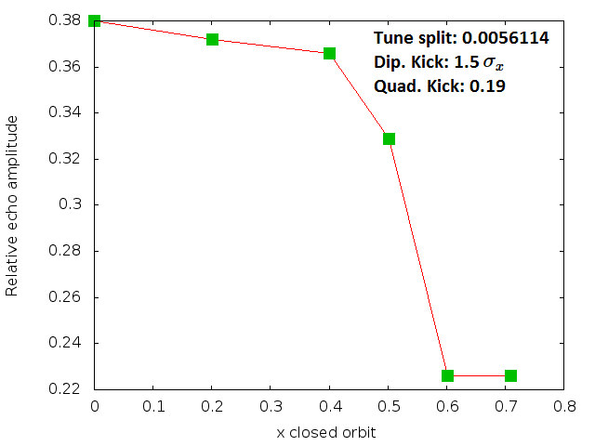
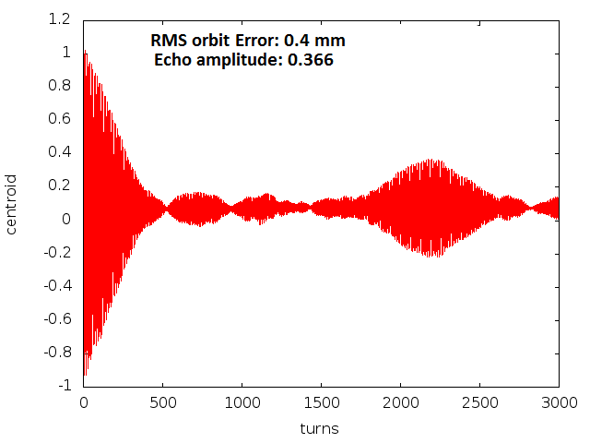
Impact of orbit errors
Echo amplitudes stable against orbit errors of RMS 0.4 mm.
Echo amplitude is reduced for orbit errors larger than RMS 0.4 mm.
Even in the presence of these errors, echo amplitude sufficient enough for diffusion measurements.
Stable Region
Closed orbit error in x, rms [mm]
9
08/08/2018
Dhruv Desai | Beam Echoes
Notes:
- For practical realizability of echoes.
put a curve around stable region
Remove random numbers from tune splits
9

Slide 10
Conclusions
Echoes generated in IOTA at low intensities (~100 pc) have relative amplitudes reaching 0.38. Good enough for testing integrability quickly.
Dipole and quadrupole kickers have reasonable lengths and strengths.
Echo amplitudes fairly robust against choice of tunes (except at very close tunes) and longitudinal momentum spread.
Echoes robust against closed orbit errors to an rms of 0.4 mm.
Echoes robust against gradient errors under 0.1%.
Echo amplitude increases at smaller emittance. Strong coupling suppresses echo amplitudes.
Simulations in good agreement with nonlinear theory.
10
08/08/2018
Dhruv Desai | Beam Echoes
Notes:
Time: 1 min
10

Slide 11
In progress and future work
Addition of rotation errors in the simulations.
Using simulations to construct a full 2-D theory on echoes.
Add nonlinear lenses to test echo generation.
Check echo properties at non-zero chromaticity.
Increase beam intensity to take space charge effects into account.
Calculate beam diffusion in the IOTA ring
Multiple echoes increase accuracy of calculations.
Tanaji Sen
Peter Garbincius
Rosa Foote
LaMargo Gill
Lee Teng Fellowship in Accelerator Science and Engineering
Acknowledgements
11
08/08/2018
Dhruv Desai | Beam Echoes
Notes:
Time: 1 min
11

Slide 12
Backup slides
Notes:
12

Slide 13
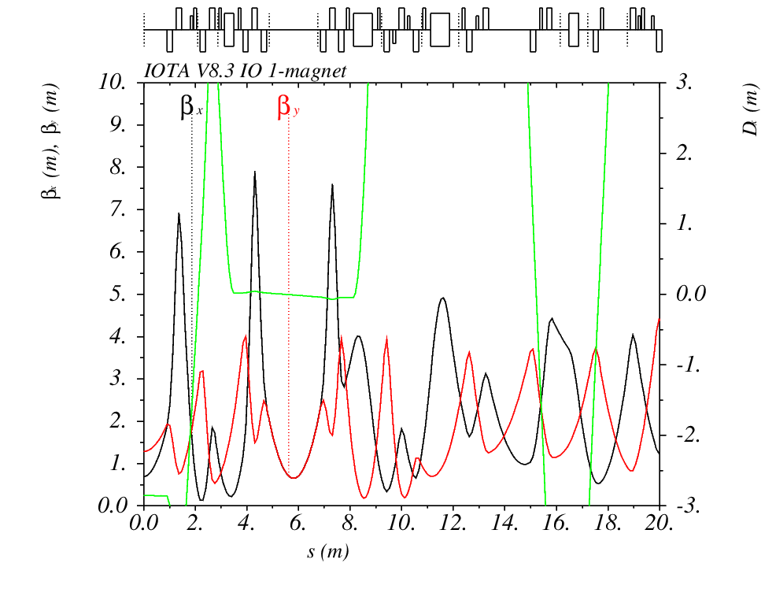
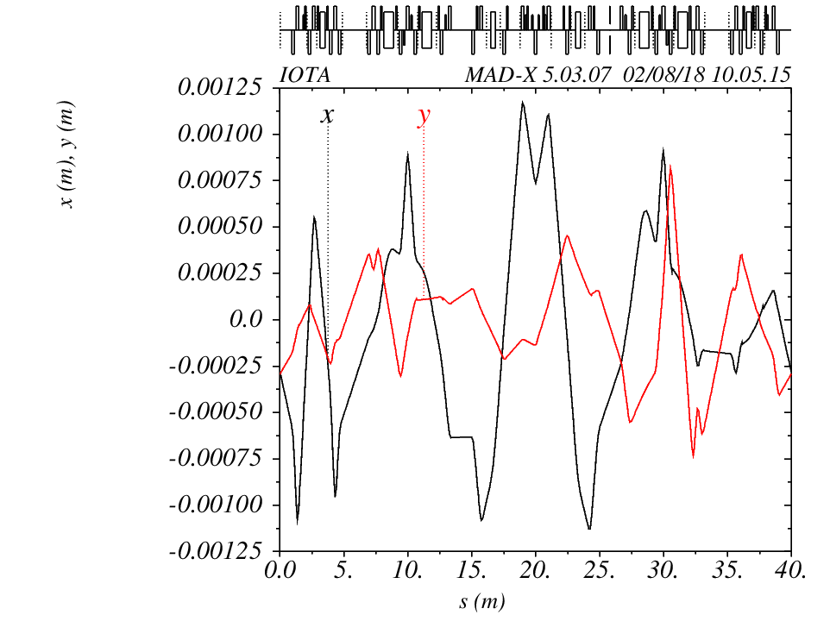
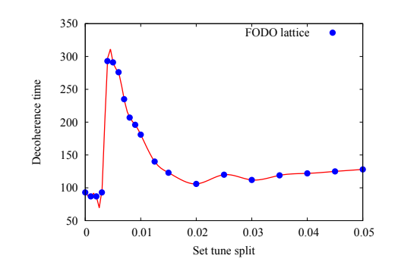
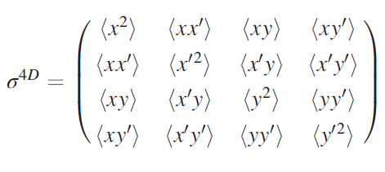
13
08/08/2018
Dhruv Desai | Beam Echoes
Notes:
13

Slide 14
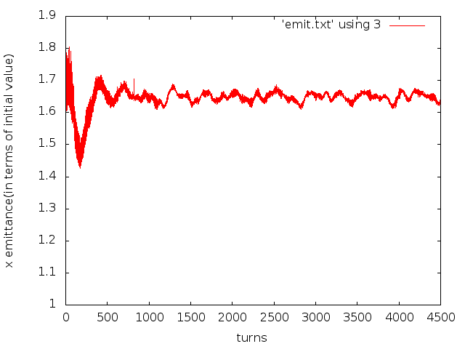
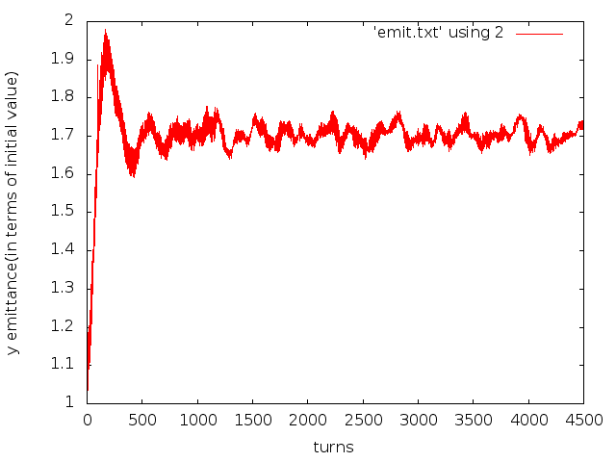
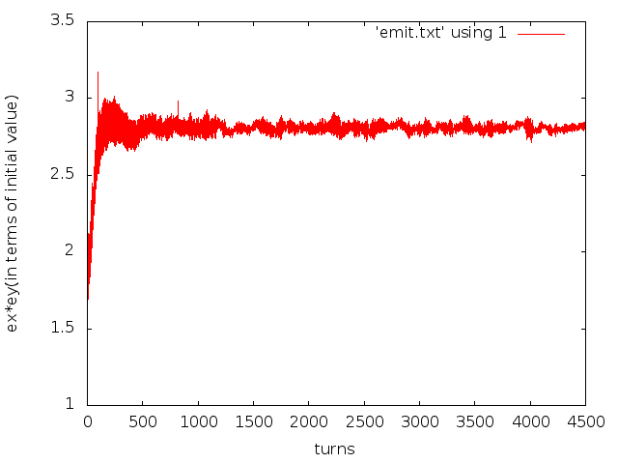

14
08/08/2018
Dhruv Desai | Beam Echoes

Slide 15



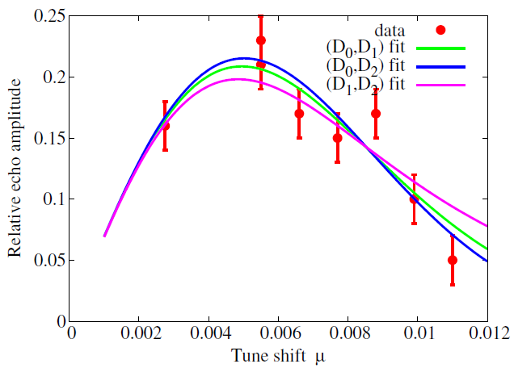
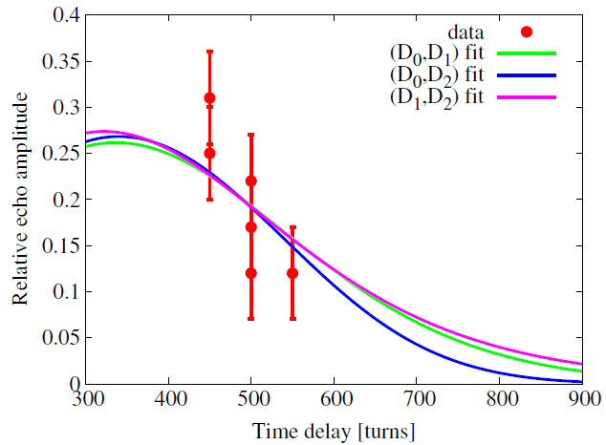


Diffusion coefficient measurements applied to RHIC data
Echo Amplitudes and pulse shapes are affected by diffusion, with the beam evolution described by the diffusion equation:
Take the simplest case, , the centroid motion depends on tune shift and delay time.
Optimize nonlinear tune shift μ and delay time 𝛕 independently of each other, to get two equations, and solve for d₀ and d₁ (Scaled diffusion coefficients).
RHIC data [Tanaji Sen and Wolfram Fischer. 2017. Physical Review Accelerators and Beams 20, 011001]
15
08/08/2018
Dhruv Desai | Beam Echoes
Notes:
Time (3 mins)
Any beam distribution in the ring will evolve according to the diffusion equation, and the beam will give a different echo(amplitude, width, etc.) than a beam with no diffusion. The main idea is to quantify this difference, and somehow use it to calculate diffusion rates.
Assume a simple model for example, with only zeroth and first order terms, and work out the math for the centroid motion around the nominal trajectory. Doing so gives a certain expression for centroid in terms of many parameters, out of which two of them will be the time interval between the two kicks and tune shift. (Quick recap: time interval between two dipole and quadrupole kicks, and tune shift is difference between actual and nominal tunes).
From the nonlinear theory of echoes, we already know what the optimum delay time and tune shifts are (Of course while keeping the other parameter constant) that maximize echo amplitude. Find experimentally, these parameters(while keeping others constant again), and plug them into the equations (1) and (2), to solve them for d0 and d1.
Show the RHIC data.
15

Slide 16
