Slide 1
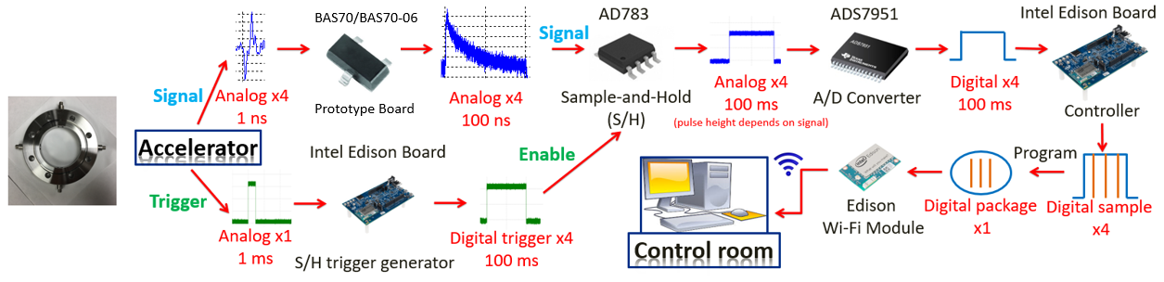
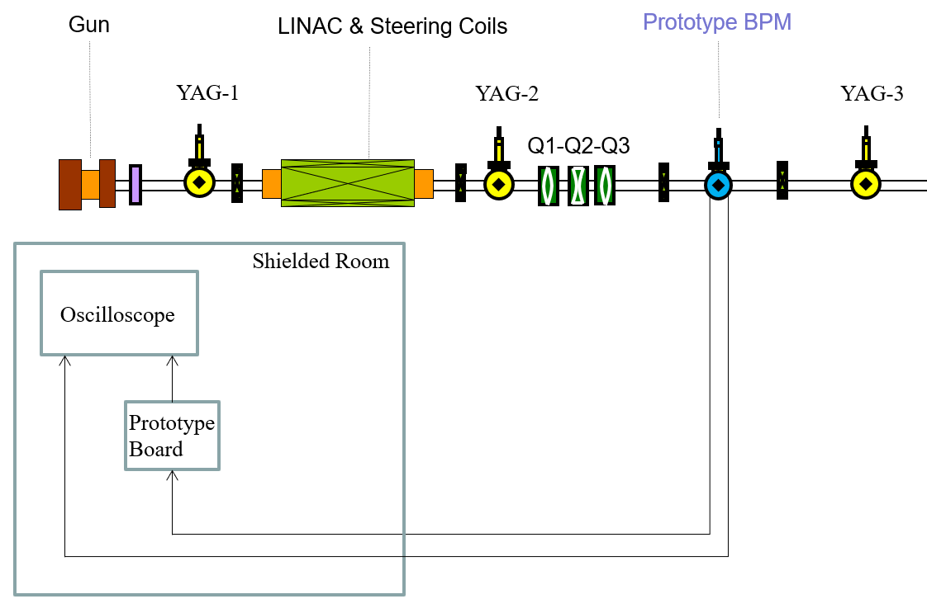
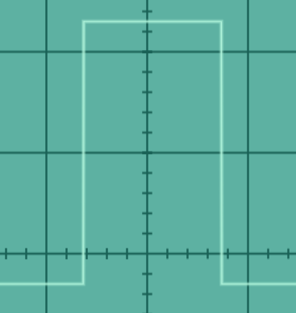
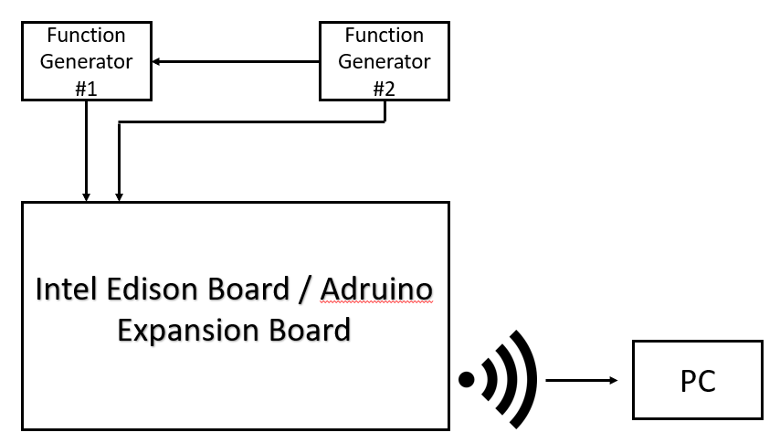
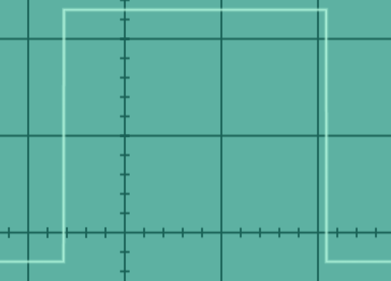
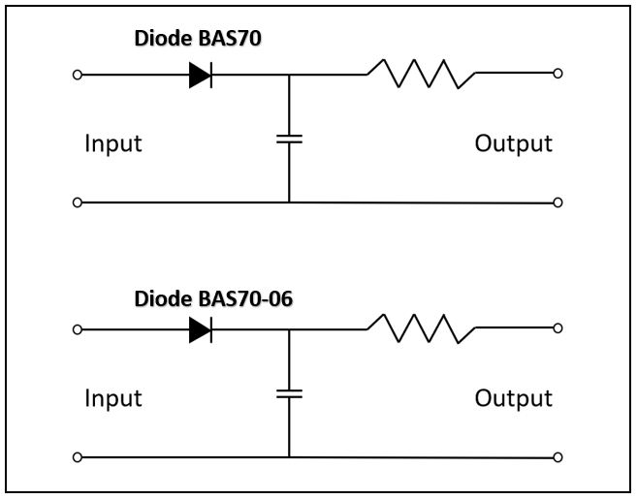
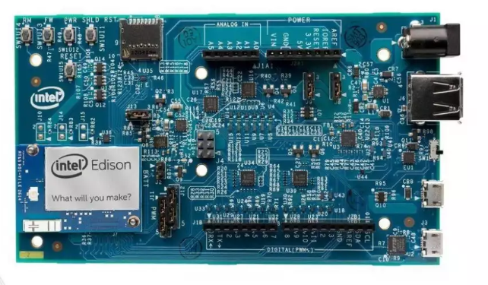
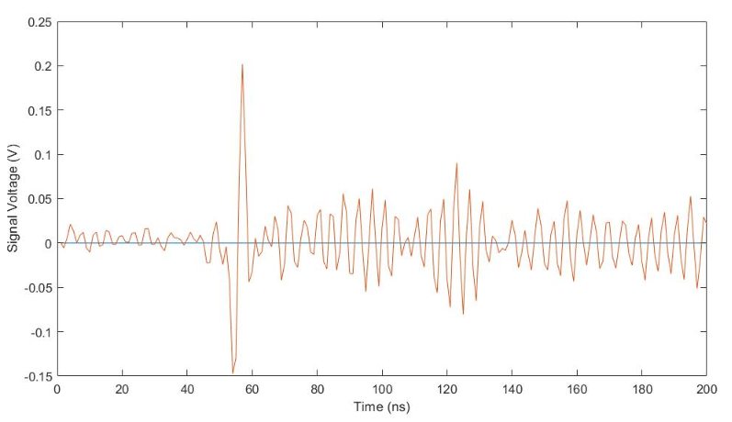
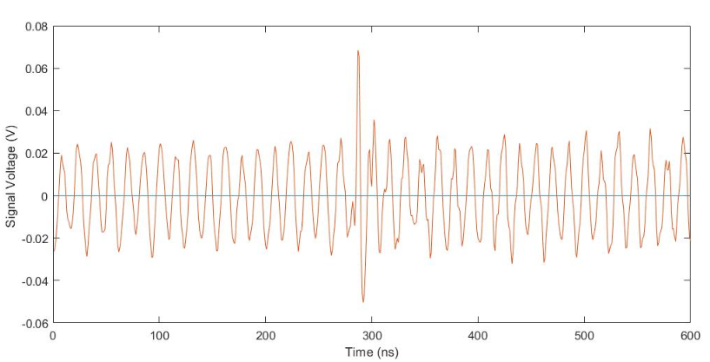
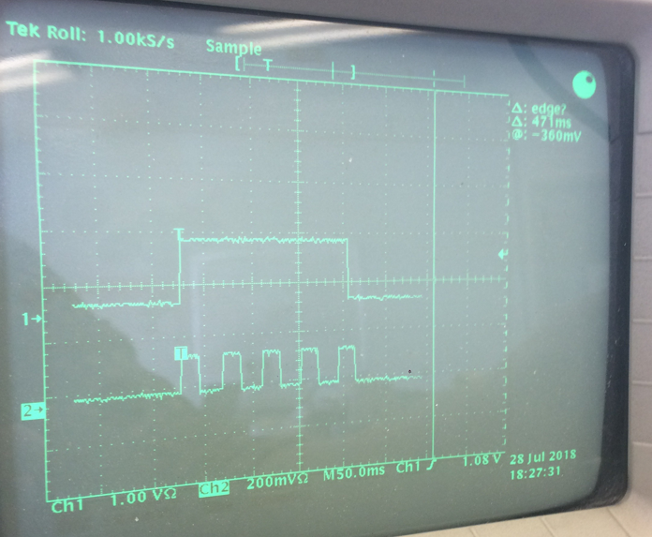
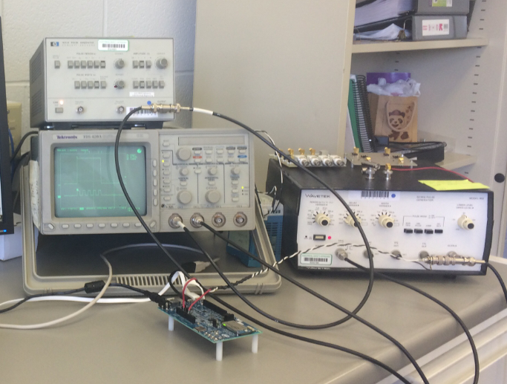


Development of Low-Cost BPM at AWA
Jens Carter, University of Wisconsin Colleges – Lee Teng Internship Program
John Power, Jiahang Shao, Chunguang Jing, Argonne Wakefield Accelerator Facility
Abstract
A beam position monitor (BPM) is a piece of particle accelerator hardware that allows for operators to determine the location of the beam without impeding the beam's trajectory. For this project, a button-type BPM was fabricated as seen in Figure 1. The device couples with the electric field of the beam as is passes through the device. Four buttons surround the beam line; each button is composed of a pick-up pin that connects to a radio-frequency connector on the outside of the device. As the beam passes through the device, current of the same magnitude but opposite polarity is picked up by each of the buttons. The strength of the signal is dependent on the beam's distance from the pick-up pin. Downstream electronics are then used to process the signal to determine where the beam is located in the beam line, and corrections can be applied to upstream trim and quadrupole magnets to align the beam to the nominal path. The objective of the project is to develop a low-cost BPM that can be utilized for accelerators in various fields including: Industry, Medical, Academic and Research/Design. Most of the BPM systems in use today were developed for a specific accelerator, making components expensive and not allowing for any set standards for BPM development and use. This project outlines the development of a low-cost BPM system that can be mass produced, standardized for smaller accelerators, and developed further for alignment automation.
Workflow of BPM
System
Diode BAS70/BAS70-06
Test on Witness Beam line
Intel Edison Board
Communication Cold Test
Beam: 13 MeV, 1.0 nC
Beam Simulation:
- 2.5-5V
- 100 ms pulse width
Trigger:
- 2.5-5V
- 200 ms pulse width
Resistance: 200 – 2000 Ω
Capacitance: 100 – 1000 pF
Signal Straight From BPM
Signal Through Prototype Board
Future Work
1. Witness beamline diode connection coupling experiment; 2. Witness beamline test with the sample and hold board; 3. Design a quad correction system using the multiple low-cost beam position monitors on the witness beamline.
August 9, 2018

