Slide 1

Electromagnetic (EM) Design of an Annular Coupled Accelerating Structure for the Advanced Compact Carbon Ion Linac (ACCIL)
Yuchen Han, Cornell University
Mentor: Dr. Brahim Mustapha
Lee Teng Internship Presentation
8 August 2018
Notes:
Lee Teng Intern @ Argonne
Mentor
Title

Slide 2
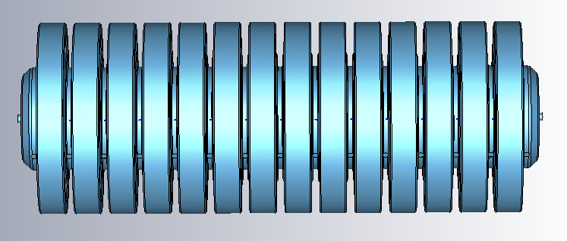
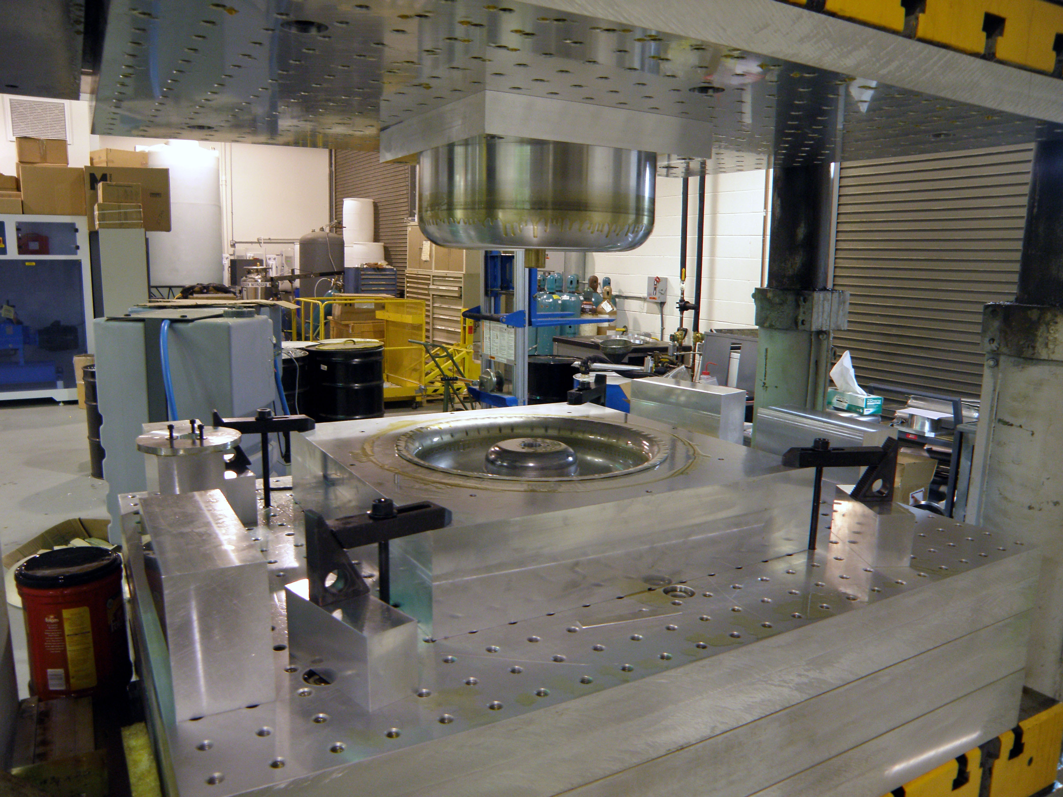

Content
Introduction
Optimization
  Frequency
  Field Flatness
Sensitivity and Tuning
  Sensitivity Analysis
  Tuning Capabilities
Coupled Resonator Model
Conclusion and Future Work
Reference
Q&A
Notes:
Background – the structure that I’ve been playing with basically for the entire summer
Highlighted – three main part of my research this summer
Future work – parts that I wish I had more time to work on

Slide 3
Introduction - ACCIL
Advanced Compact Carbon Ion Linac (ACCIL)
3D scanning of tumor
Radiotherapy treatment of cancer
Compact:
High gradient structure
B. Mustapha, ANS AccApp’17 Topical Meeting 2017, Quebec City, Canada
Notes:
3D imaging
Radiotherapy (bragg peak -> carbon ion)
How the linac looks like
Compact -> *only* 45m long
Most impt part -> CCL -> what I’ll be working on
Compact -> high freq ~ 3 GHz
Higher breakdown limit ~f^2
Effective shunt impedance/length scales with ~sqrt(f)
-> high gradient
CCL – coupled cavity linac
HIMAC @ NIRS (Japan) : Size: 7200 m2 (60 x 120 m)
Heidelberg Ion Therapy Facility (HIT) : 5,027 square meters

Slide 4
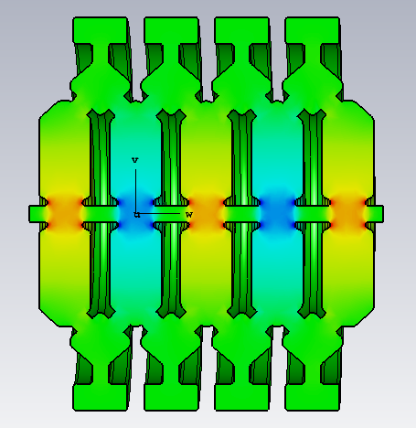
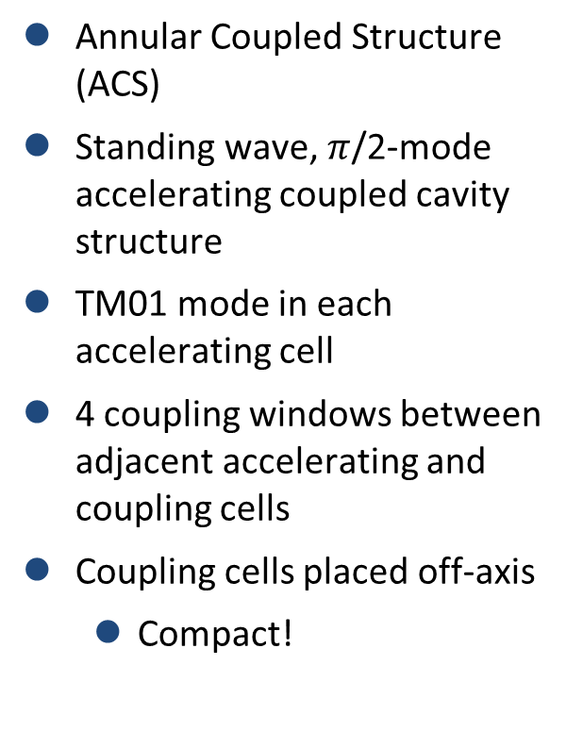
Introduction – ACS
Annular Coupled Structure (ACS)
Standing wave, $π$/2-mode accelerating coupled cavity structure
TM01 mode in each accelerating cell
4 coupling windows between adjacent accelerating and coupling cells
Coupling cells placed off-axis
  Compact!
Notes:
3D imaging
Radiotherapy (bragg peak -> carbon ion)
How the linac looks like
Compact -> *only* 45m long
Most impt part -> CCL -> what I’ll be working on
Compact -> high freq ~ 3 GHz
Higher breakdown limit ~f^2
Effective shunt impedance/length scales with ~sqrt(f)
-> high gradient
CCL – coupled cavity linac
HIMAC @ NIRS (Japan) : Size: 7200 m2 (60 x 120 m)
Heidelberg Ion Therapy Facility (HIT) : 5,027 square meters

Slide 5
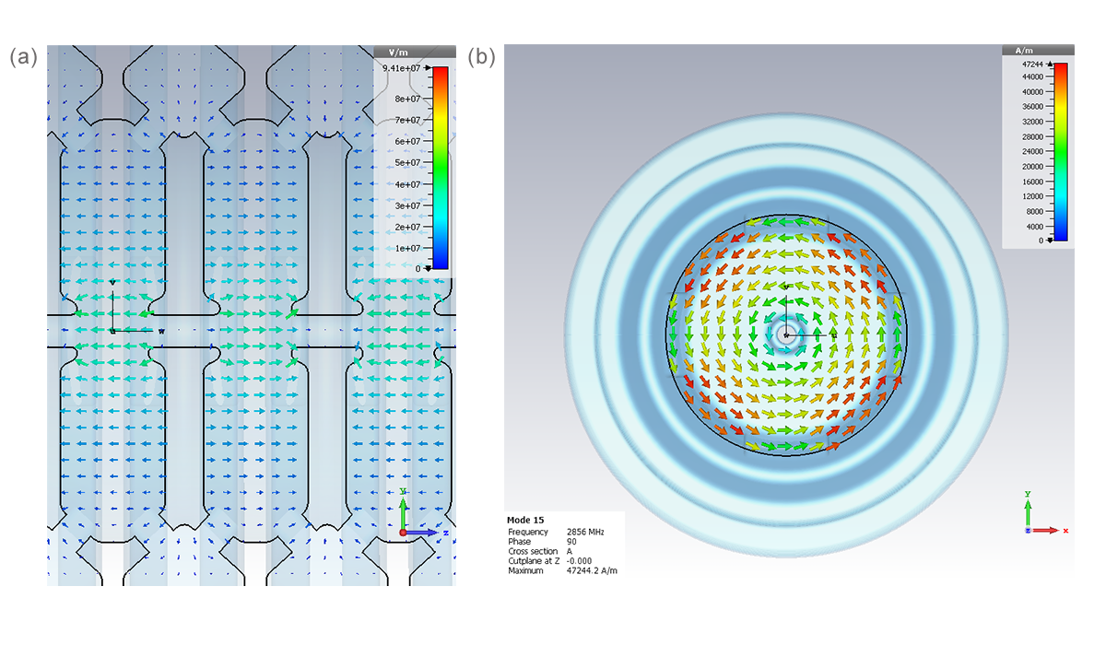

Optimization - Frequency
972 MHz (J-PARC Linac) $→$ 2856 MHz (ACCIL)
TM01 mode in each accelerating cell
$$f_{0}=2.405×\frac{c}{2πR}$$
Optimized accelerating cell radius
$$R=\text{38.853 }\text{mm}$$
Notes:
TM01 mode – Nicole talked about in her lecture in USPAS
LHS - E field; RHS – B field
Will be seeing them again throughout the talk

Slide 6
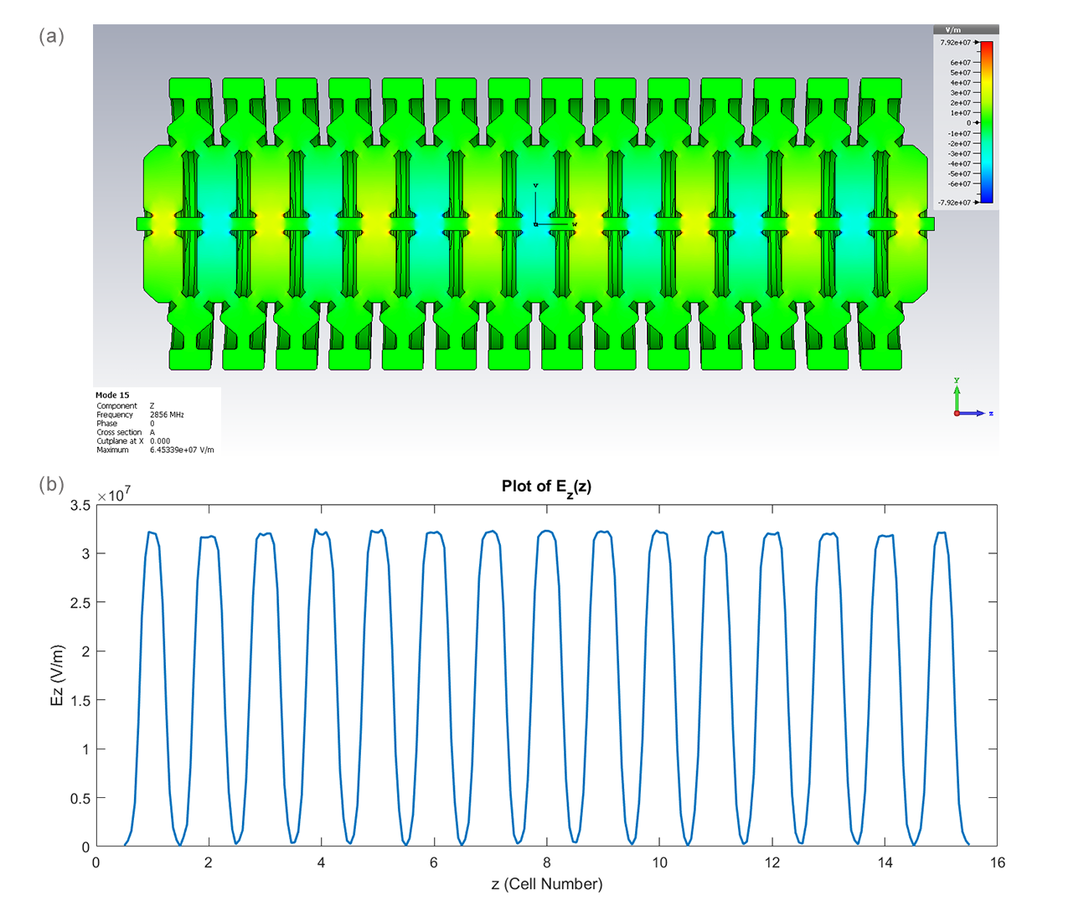
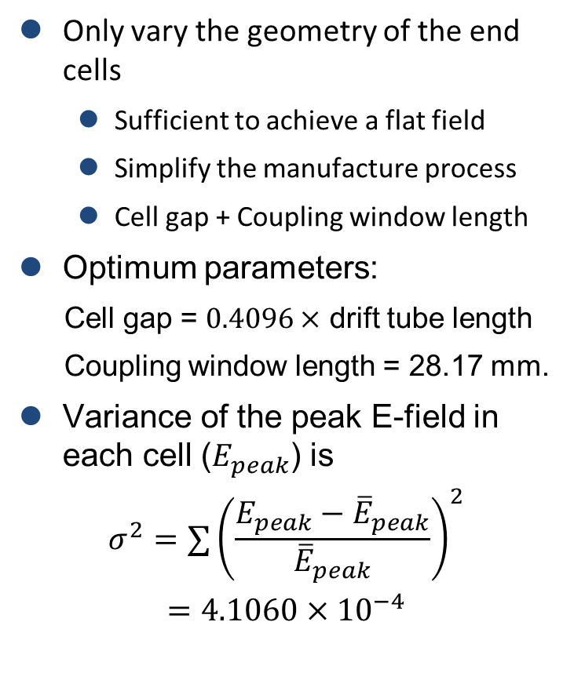
Optimization – Field Flatness
Only vary the geometry of the end cells
  Sufficient to achieve a flat field
  Simplify the manufacture process
  Cell gap + Coupling window length
Optimum parameters:
Cell gap = $0.4096×$ drift tube length
Coupling window length = 28.17 mm.
Variance of the peak E-field in each cell ($E_{peak}$) is
$$σ^{2}=∑{\left(\frac{E_{peak}−{\overline{E}}_{peak}}{{\overline{E}}_{peak}}\right)}^{2}$$
$$=4.1060×{10}^{−4}$$
Notes:
Color plot – E_z
Distribution really uniform – can imagine how happy I was seeing this
Cell gap – related to capacitance – narrower -> stronger field
Coupling window length – the fact that field in second cell not behaving – control how much coupling from end cell to second-to-last cell

Slide 7
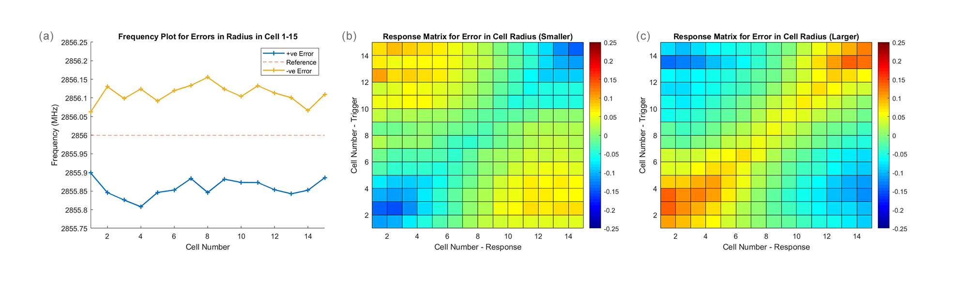
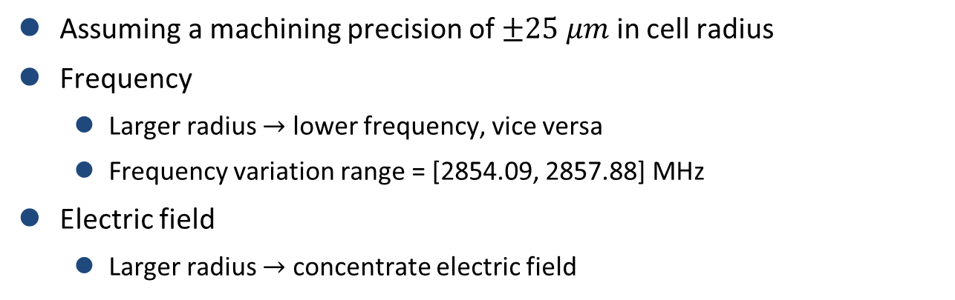
Sensitivity and Tuning - Sensitivity
Assuming a machining precision of $±25 μm$ in cell radius
Frequency
  Larger radius $→$ lower frequency, vice versa
  Frequency variation range = [2854.09, 2857.88] MHz
Electric field
  Larger radius $→$ concentrate electric field
Notes:
Range obtained by comparing all cells \pm 25 micron
Frequency range ~ \pm 2 MHz

Slide 8
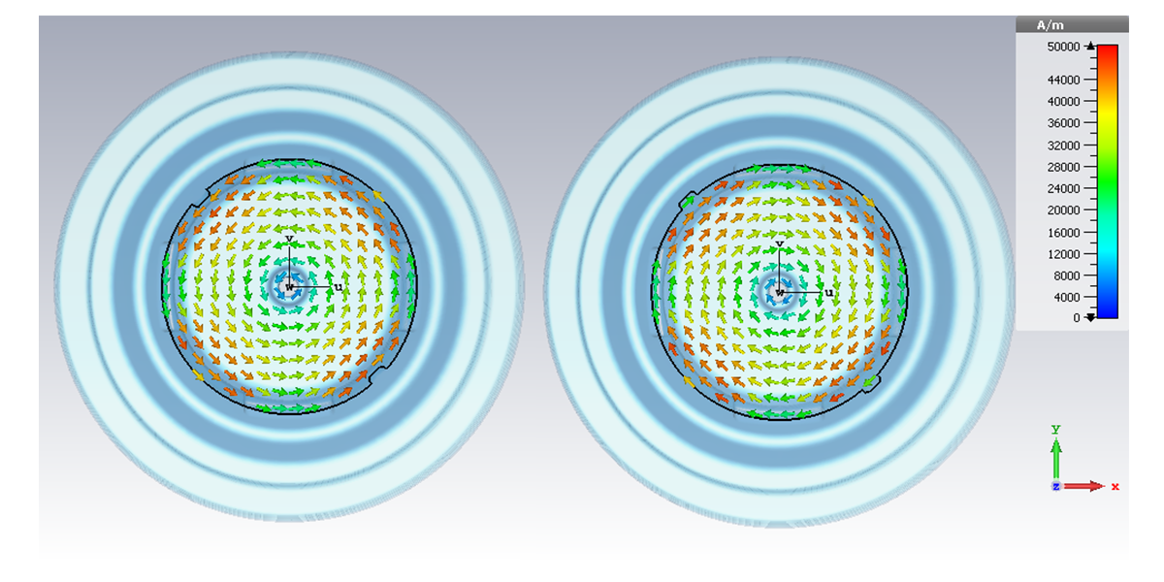
Sensitivity and Tuning - Tuning
Tuner dimensions
  Radius = 3.2 mm
  Maximum depth = 2 mm
Placed where B-field is the strongest
  Greater perturbation to frequency and field
Notes:
Said will be seeing this again
Strongest = 45 deg => can put max 4 tuners

Slide 9
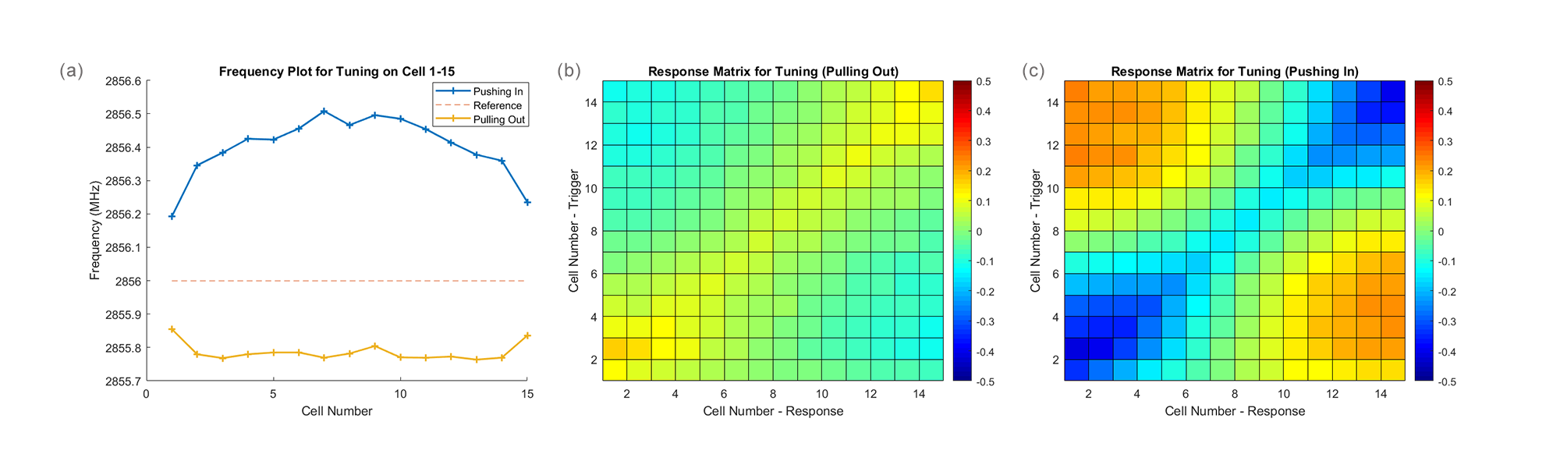
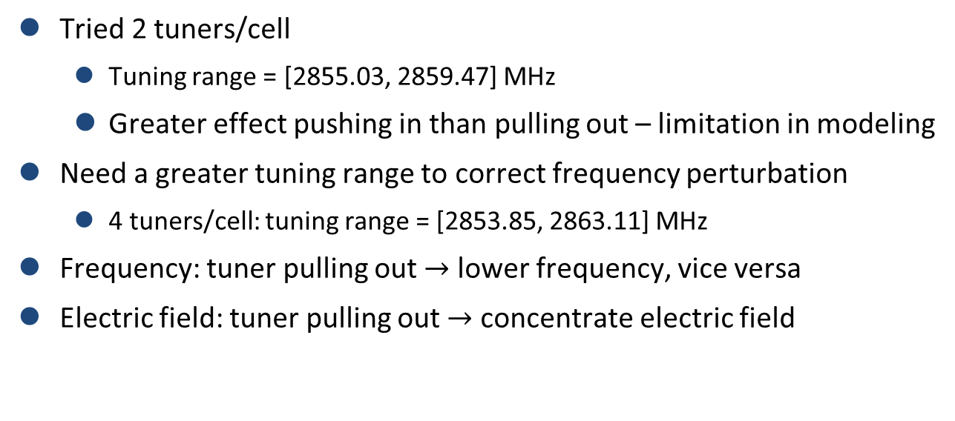
Sensitivity and Tuning – Tuning with 4 Tuners
Tried 2 tuners/cell
  Tuning range = [2855.03, 2859.47] MHz
  Greater effect pushing in than pulling out – limitation in modeling
Need a greater tuning range to correct frequency perturbation
  4 tuners/cell: tuning range = [2853.85, 2863.11] MHz
Frequency: tuner pulling out $→$ lower frequency, vice versa
Electric field: tuner pulling out $→$ concentrate electric field
Notes:
2-tuner tuning range – [-1, 3.5] – lower bound not enough to tune the cavity
Pulling out - similar effect as +ve cell radius error
All 4 tuners having the same depth – can exploit symmetry in simulation – less computationally expensive

Slide 10
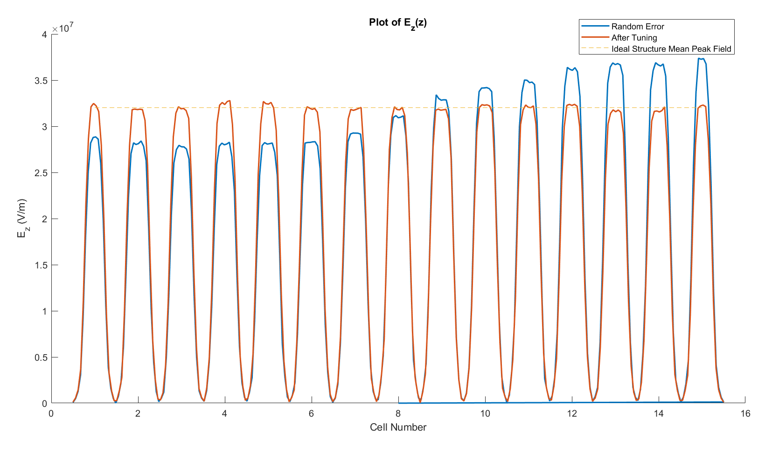

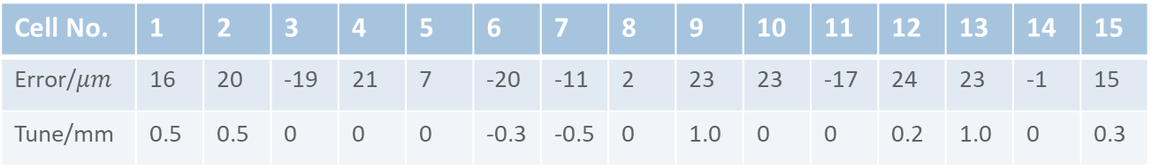
Sensitivity and Tuning – Application
Random errors in cell radius (generated with MATLAB)
Frequency:
  2856 $→$ 2855.5 $→$ 2856
E-field variance:
  Ideal structure: 0.0004106
  With errors: 0.2014
  After tuning: 0.001069
Cell No. | 1 | 2 | 3 | 4 | 5 | 6 | 7 | 8 | 9 | 10 | 11 | 12 | 13 | 14 | 15
Error/$μm$ | 16 | 20 | -19 | 21 | 7 | -20 | -11 | 2 | 23 | 23 | -17 | 24 | 23 | -1 | 15
Tune/mm | 0.5 | 0.5 | 0 | 0 | 0 | -0.3 | -0.5 | 0 | 1.0 | 0 | 0 | 0.2 | 1.0 | 0 | 0.3
Notes:
Tuning – try and error
freq lowered – push more in
left lower than right – push more on the right
Flatness – not as good as the ideal structure but approximately the same order of magnitude
With the response function – possible to develop a more detailed, systematic way of tuning

Slide 11
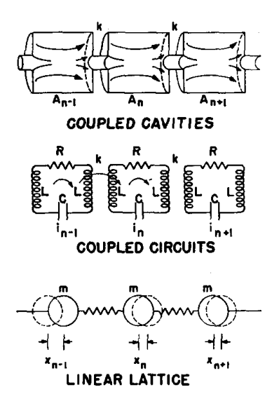
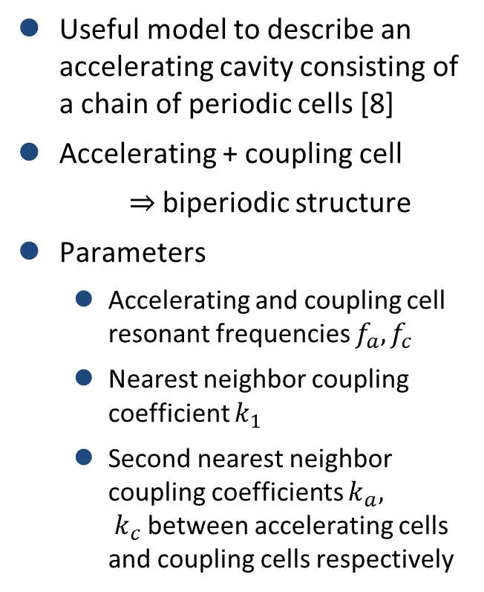
Coupled Resonator Model
Useful model to describe an accelerating cavity consisting of a chain of periodic cells [8]
Accelerating + coupling cell
$⇒$ biperiodic structure
Parameters
  Accelerating and coupling cell resonant frequencies $f_{a}, f_{c}$
  Nearest neighbor coupling coefficient $k_{1}$
  Second nearest neighbor coupling coefficients $k_{a}, k_{c}$between accelerating cells and coupling cells respectively
Figure from: T.P. Wangler. RF Linear Accelerators. Physics textbook. Wiley, 2008.
Notes:
Part that I started pretty late into the project – the part that I really wish I had spent more time on
Interesting – strong attachment to SHM – you know what I mean if you took quantum before

Slide 12
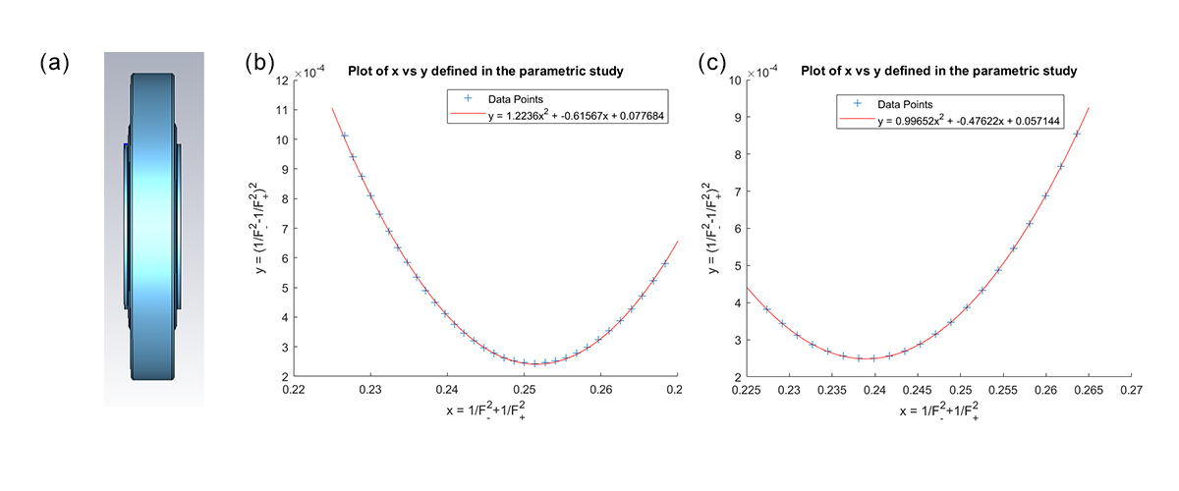
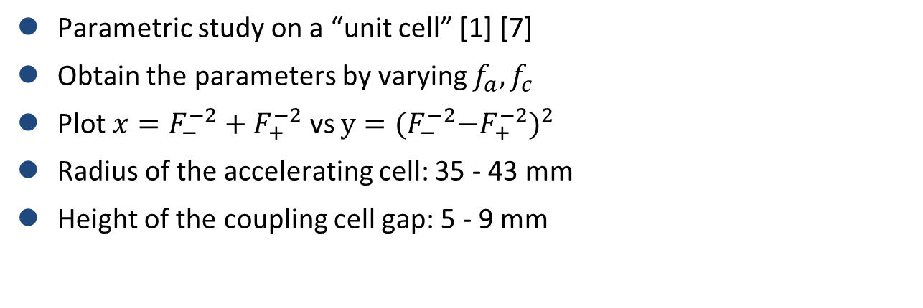
Coupled Resonator – Parametric Study
Parametric study on a “unit cell” [1] [7]
Obtain the parameters by varying $f_{a}, f_{c}$
Plot $x=F_{−}^{−2}+F_{+}^{−2}$ vs $y={{(F}_{−}^{−2}−F_{+}^{−2})}^{2}$
Radius of the accelerating cell: 35 - 43 mm
Height of the coupling cell gap: 5 - 9 mm
Notes:
Unit cell – figure – full coupling cell sandwiched between 2 half-acc-cell
PEC termination
Half-cell – image charge – similar to periodic condition
If full cell – not periodic (like our 15 cell structure) troublesome

Slide 13
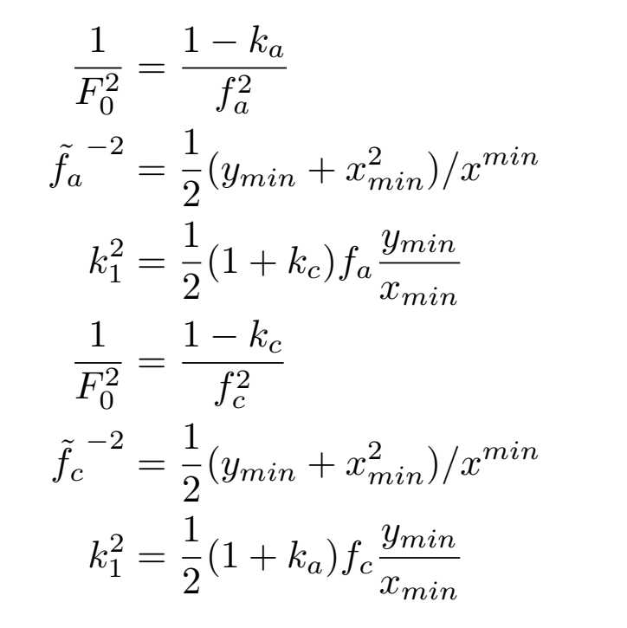
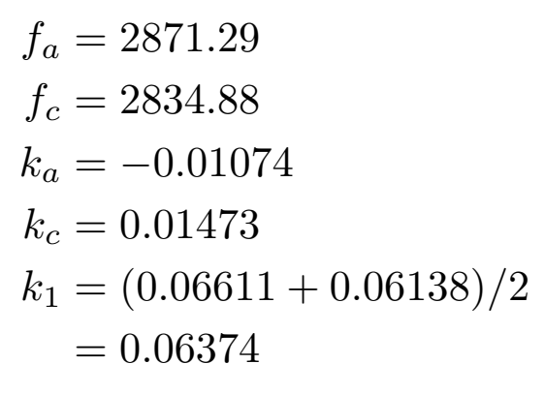
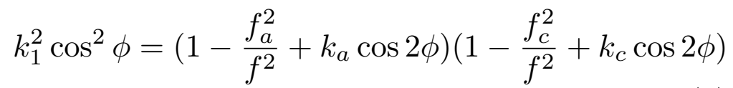

Coupled Resonator – Parametric Study
For detailed math, see [1] [5] [7]
Notes:
Unit cell – figure – full coupling cell sandwiched between 2 half-acc-cell
PEC termination
Half-cell – image charge – similar to periodic condition
If full cell – not periodic (like our 15 cell structure) troublesome

Slide 14
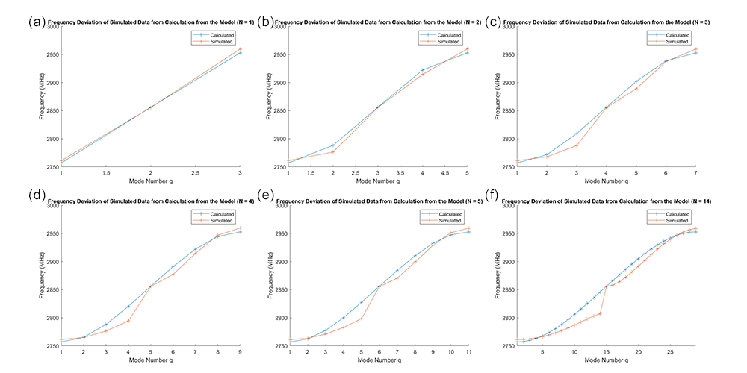
Coupled Resonator – Compare with Simulation
Captures general shape of dispersion relations
Model assumed closed stopband, but simulation data suggests that the stopband might not be closed
Notes:
Figured out stopband not closed – future projects can look into closing the stopband – could improve mode separation

Slide 15
Conclusion and Future Work
Optimization of a 15-cell cavity
Effect of geometric errors on frequency and field distribution
Tuning capabilities
Application of coupled resonator model
Future projects can look into:
Engineering design and mechanical simulation
  E.g., the exact cell deformation during tuning and the effects on frequency and field flatness
Detailed tuning algorithm to automate the tuning process
Further tuning to close the stopband
  May also help to improve the mode separation

Slide 16
Reference
[1] V. G. Vaccaro A. DElia, M. R. Masullo. An analysis of lumped circuit equation for side coupled linac (scl). Proceedings of EPAC 2006, Edinburgh, Scotland, pages 1600{1602, 2006.
[2] N Hayashizaki, H Ao, K Hasegawa, Y Yamazaki, and T Kato. Structure design of the annular coupled structure linac for the jaeri/kek joint project. 08 2018.
[3] Brahim Mustapha. Prospects for a linac-based carbon ion therapy facility in the chicago area. 8 2017.
[4] P N Ostroumov, A Goel, Brahim Mustapha, A Nassiri, Alexander Plastun, Luigi Faillace, Sergey Kutsaev, and Evgeny Savin. Compact carbon ion linac. 10 2016.
[5] D. E. Nagle, E. A. Knapp, and B. C. Knapp. Coupled resonator model for standing wave accelerator tanks. Review of Scientific Instruments, 38(11):1583-1587, 1967.
[6] R. Wegner P. Ugena Tirado, F. Gerigk. Tuning procedure for the linac4 pi mode structure (pims). 7 2012.
[7] V. G. Vaccaro, A. D’Elia, and M. R. Masullo. A rationale to design Side Coupled Linac (SCL): A faster and more reliable tool. Conf. Proc., C060626:1606-1608, 2006. [,1606(2006)].
[8] T.P. Wangler. RF Linear Accelerators. Physics textbook. Wiley, 2008
Notes:
Books, papers, presentations that helped me a lot in the project

Slide 17
Questions?
(END)

