Slide 1
Magnetic Field-Shape Deformation Relation of A Thin Glass Plate Coated With Magnetic Smart Material
drhgfdjhngngfmhgmghmghjmghfmf
Luis Felipe Morales Bultron.
Advanced Photon Source, X-ray science division, Optics group.
University of Arkansas
Mentor: Lahsen Assoufid
August 8, 2017

Slide 2
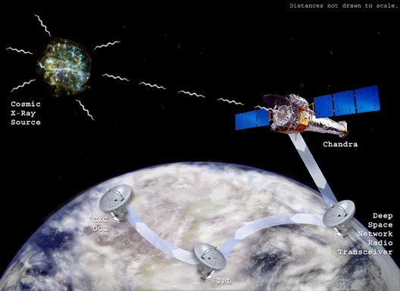
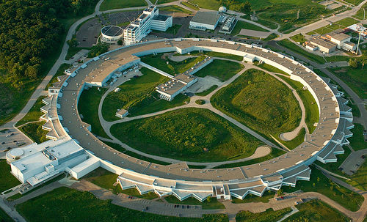
Deformable mirrors and adaptive optics systems are used in many applications including optics for astronomy, astrophysics, and synchrotron radiation beamlines. Many different schemes have been used to control the shape of deformable mirrors for wave-front aberration correction and shape optimization. The most common actuators used in deformable mirrors include PZT, voice coils, and mechanical actuators, each one with its own advantages and disadvantages. Here, we explore the possibility of using deformable mirrors based on magnetic smart materials actuators. We developed a model that relates the curvature and thickness of a mirror, and the magnetic field applied to the mirror.

Slide 3

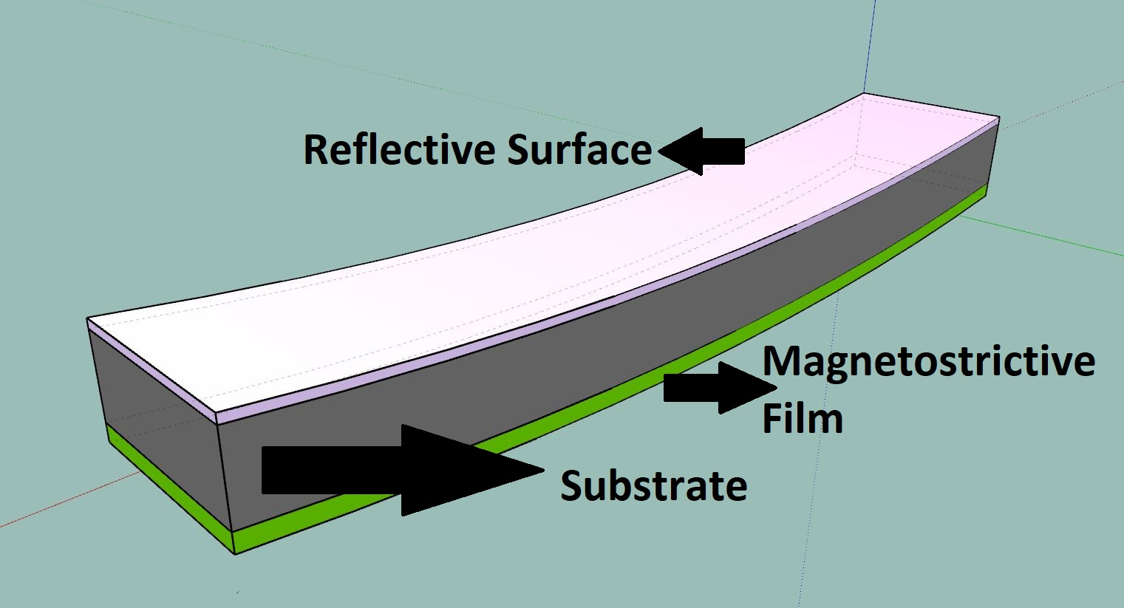
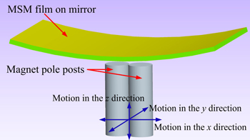
Schematic of the mirror shape

Slide 4
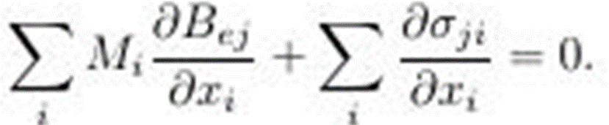
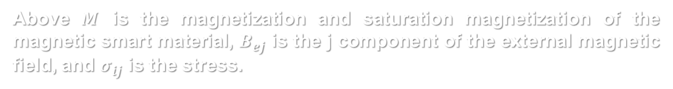
Objective
Develop mathematical expressions that describe all components of the magnetic field that should be applied to a substrate-coating system (mirror)
Methods and Theory
We use classical electrodynamics to describe the magnetic forces and magnetization produced on a magnetic smart material based mirror under an external magnetic field.
Classical theory of elasticity provides us with mathematical formalism that can be used to relate these magnetic effects to the stress state of the system. Here we use the Cauchy’s stress tensor components to describe the mechanical equilibrium of the mirror (substrate-coating system) . The general equation obtained is,
Above $M$ is the magnetization and saturation magnetization of the magnetic smart material, $B_{ej}$ is the j component of the external magnetic field, and $σ_{ij}$ is the stress.

Slide 5
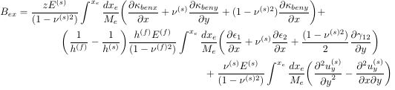
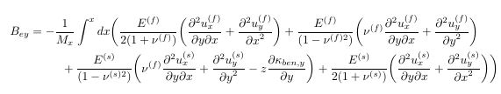
Assumptions
The thickness of the film is much smaller than it’s transverse dimensions. As a result, the magnetization in the axis perpendicular to the mirror surface is minimal.
The thickness of the substrate is significantly greater than thickness of the magnetic smart material thin film.
There is a principal axis of magnetization, called easy axis of magnetization [1], that is significantly greater than the rest of the other magnetizations present in the magnetic smart material.
Components of the magnetic field
Use of theory and assumptions yields,

Slide 6

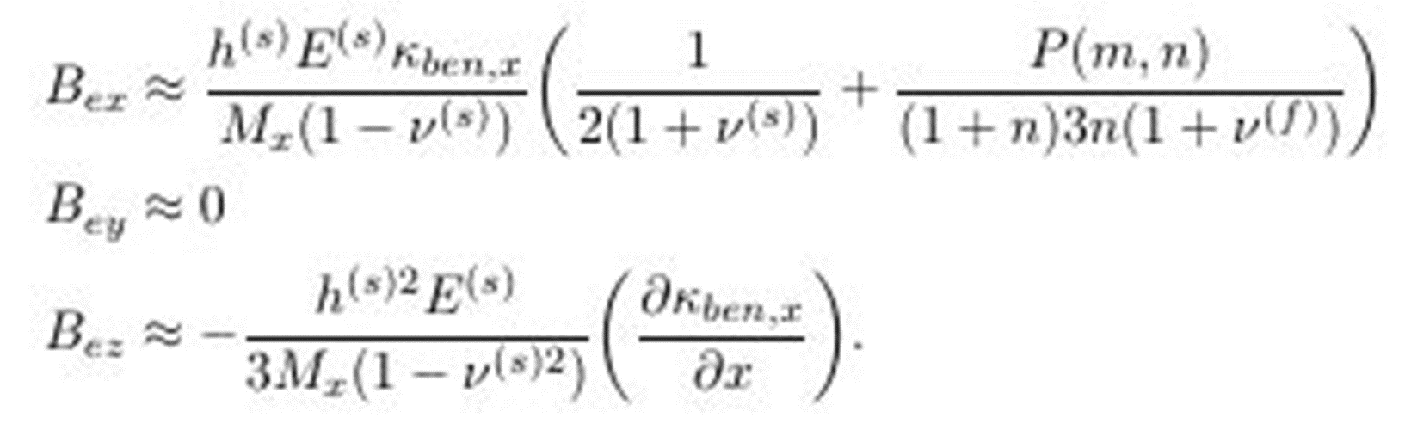

Simplifications
These expressions are general and not illuminating. Thus, we simplify them through constraints that contain information of characteristics we want in our mirror’s shape to obtain
Applications of the model
Here we present we two cases to curvatures to illustrate the applicability of the model.

Slide 7
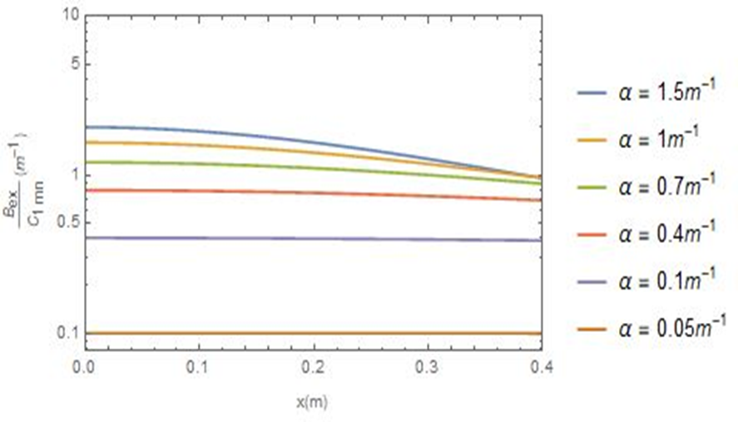
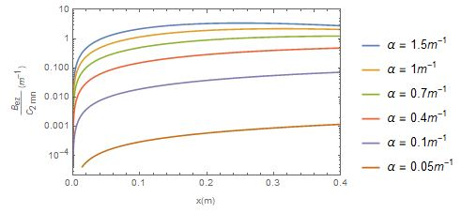
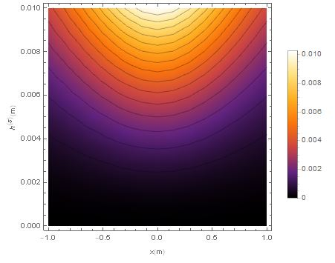
Parabolic Curvature
Constant thickness
Ratio of the magnetic field in the x-direction
Ratio of the magnetic field in the z-direction
Variable thickness and length of the mirror
Density of the magnetic field in the x- and z-direction

Slide 8
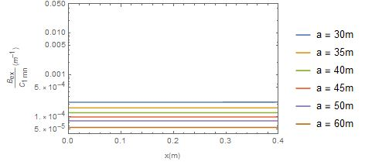
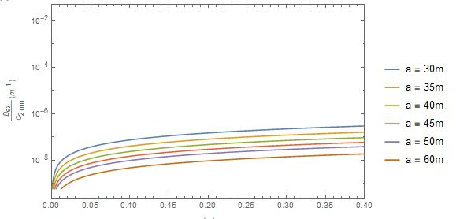
Elliptical shape
Constant thickness
Ratio of the magnetic field in the x-direction
Ratio of the magnetic field in the z-direction

Slide 9
Conclusion and further work
We developed a model that relates an external magnetic and shape parameters of a mirror.
The validity of the model is limited to small deformations.
An improvement of the model can be made by accounting for smaller terms in the expressions for the magnetic field and performing simulations under more extreme bending conditions.
References
Jackson, J. D. (2013). Classical electrodynamics. Hoboken, NY: Wiley.
Huang, Shusen, and Xin Zhang. “Extension of the Stoney Formula for Film-Substrate Systems with Gradient Stress for MEMS Applications.” IOPscience, Journal of Micromechanics and Microengineering, vol. 16, 13 Jan. 2006, pp. 382–389., doi:10.1088/0960-1317/16/024.
Wang, Xiaoli, et al. “Deformation of a Rectangular Thin Glass Coated with Magnetostrictive Material.” IOPscience, Smart Materials and Structures, vol. 25, no. 8, 19 July 2016, doi:10.1088/0964-1726/25/8/085038.

Slide 10
Acknowledgements
This project was possible through the support of the Lee Teng Fellowship, the US Department of Energy, and Office of Basic Energy Sciences, under Contract No. DE-AC02-06CH11357.
Questions?
Thanks for the attention!

Slide 11
Modular Deposition System (MDS) Interface
drhgfdjhngngfmhgmghmghjmghfmf
Luis Felipe Morales Bultron
Advanced Photon Source, X-ray science division, optics group.
University of Arkansas
Mentor: Raymond Conley
August 8, 2017

Slide 12
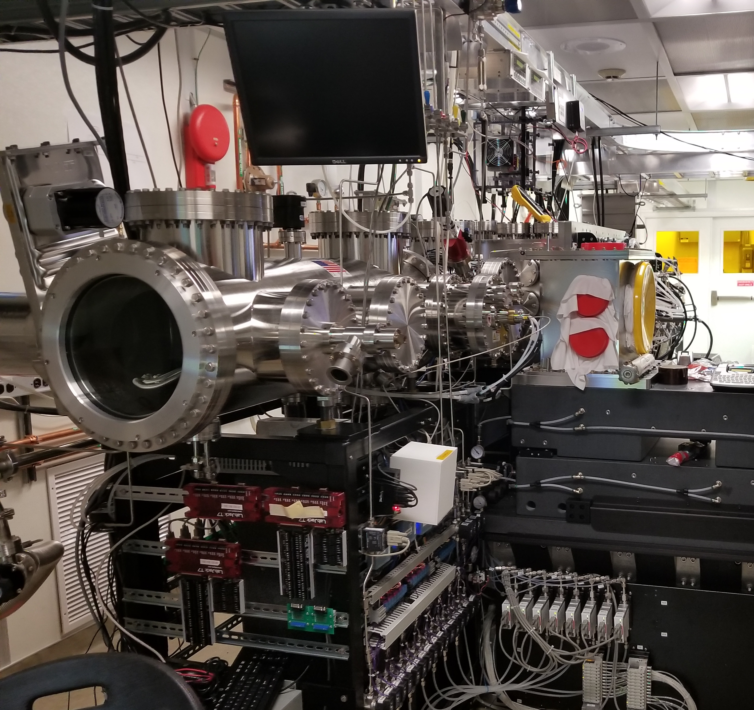
What is a “ Modular Deposition System”?
Tools
CQTDM
Process Variables for Gui (widgets functions).

Slide 13
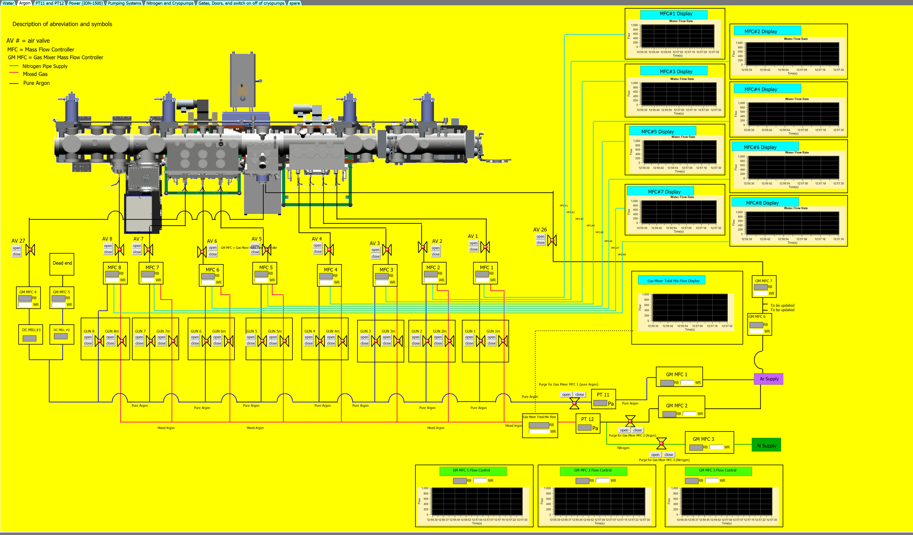
Interfaces For User Controls
Argon

Slide 14
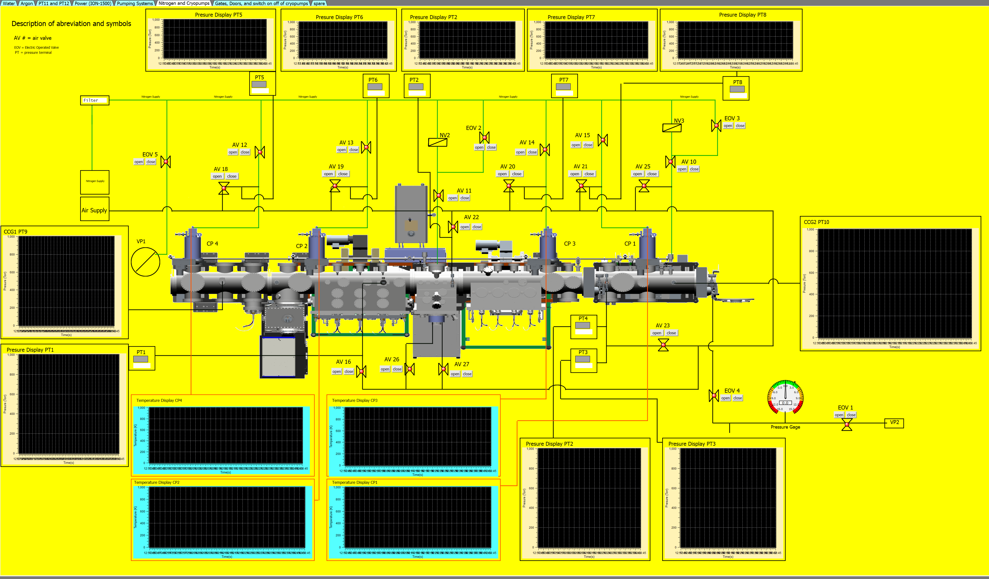
Interfaces For User Controls
Cryopumps and Nitrogen

Slide 15
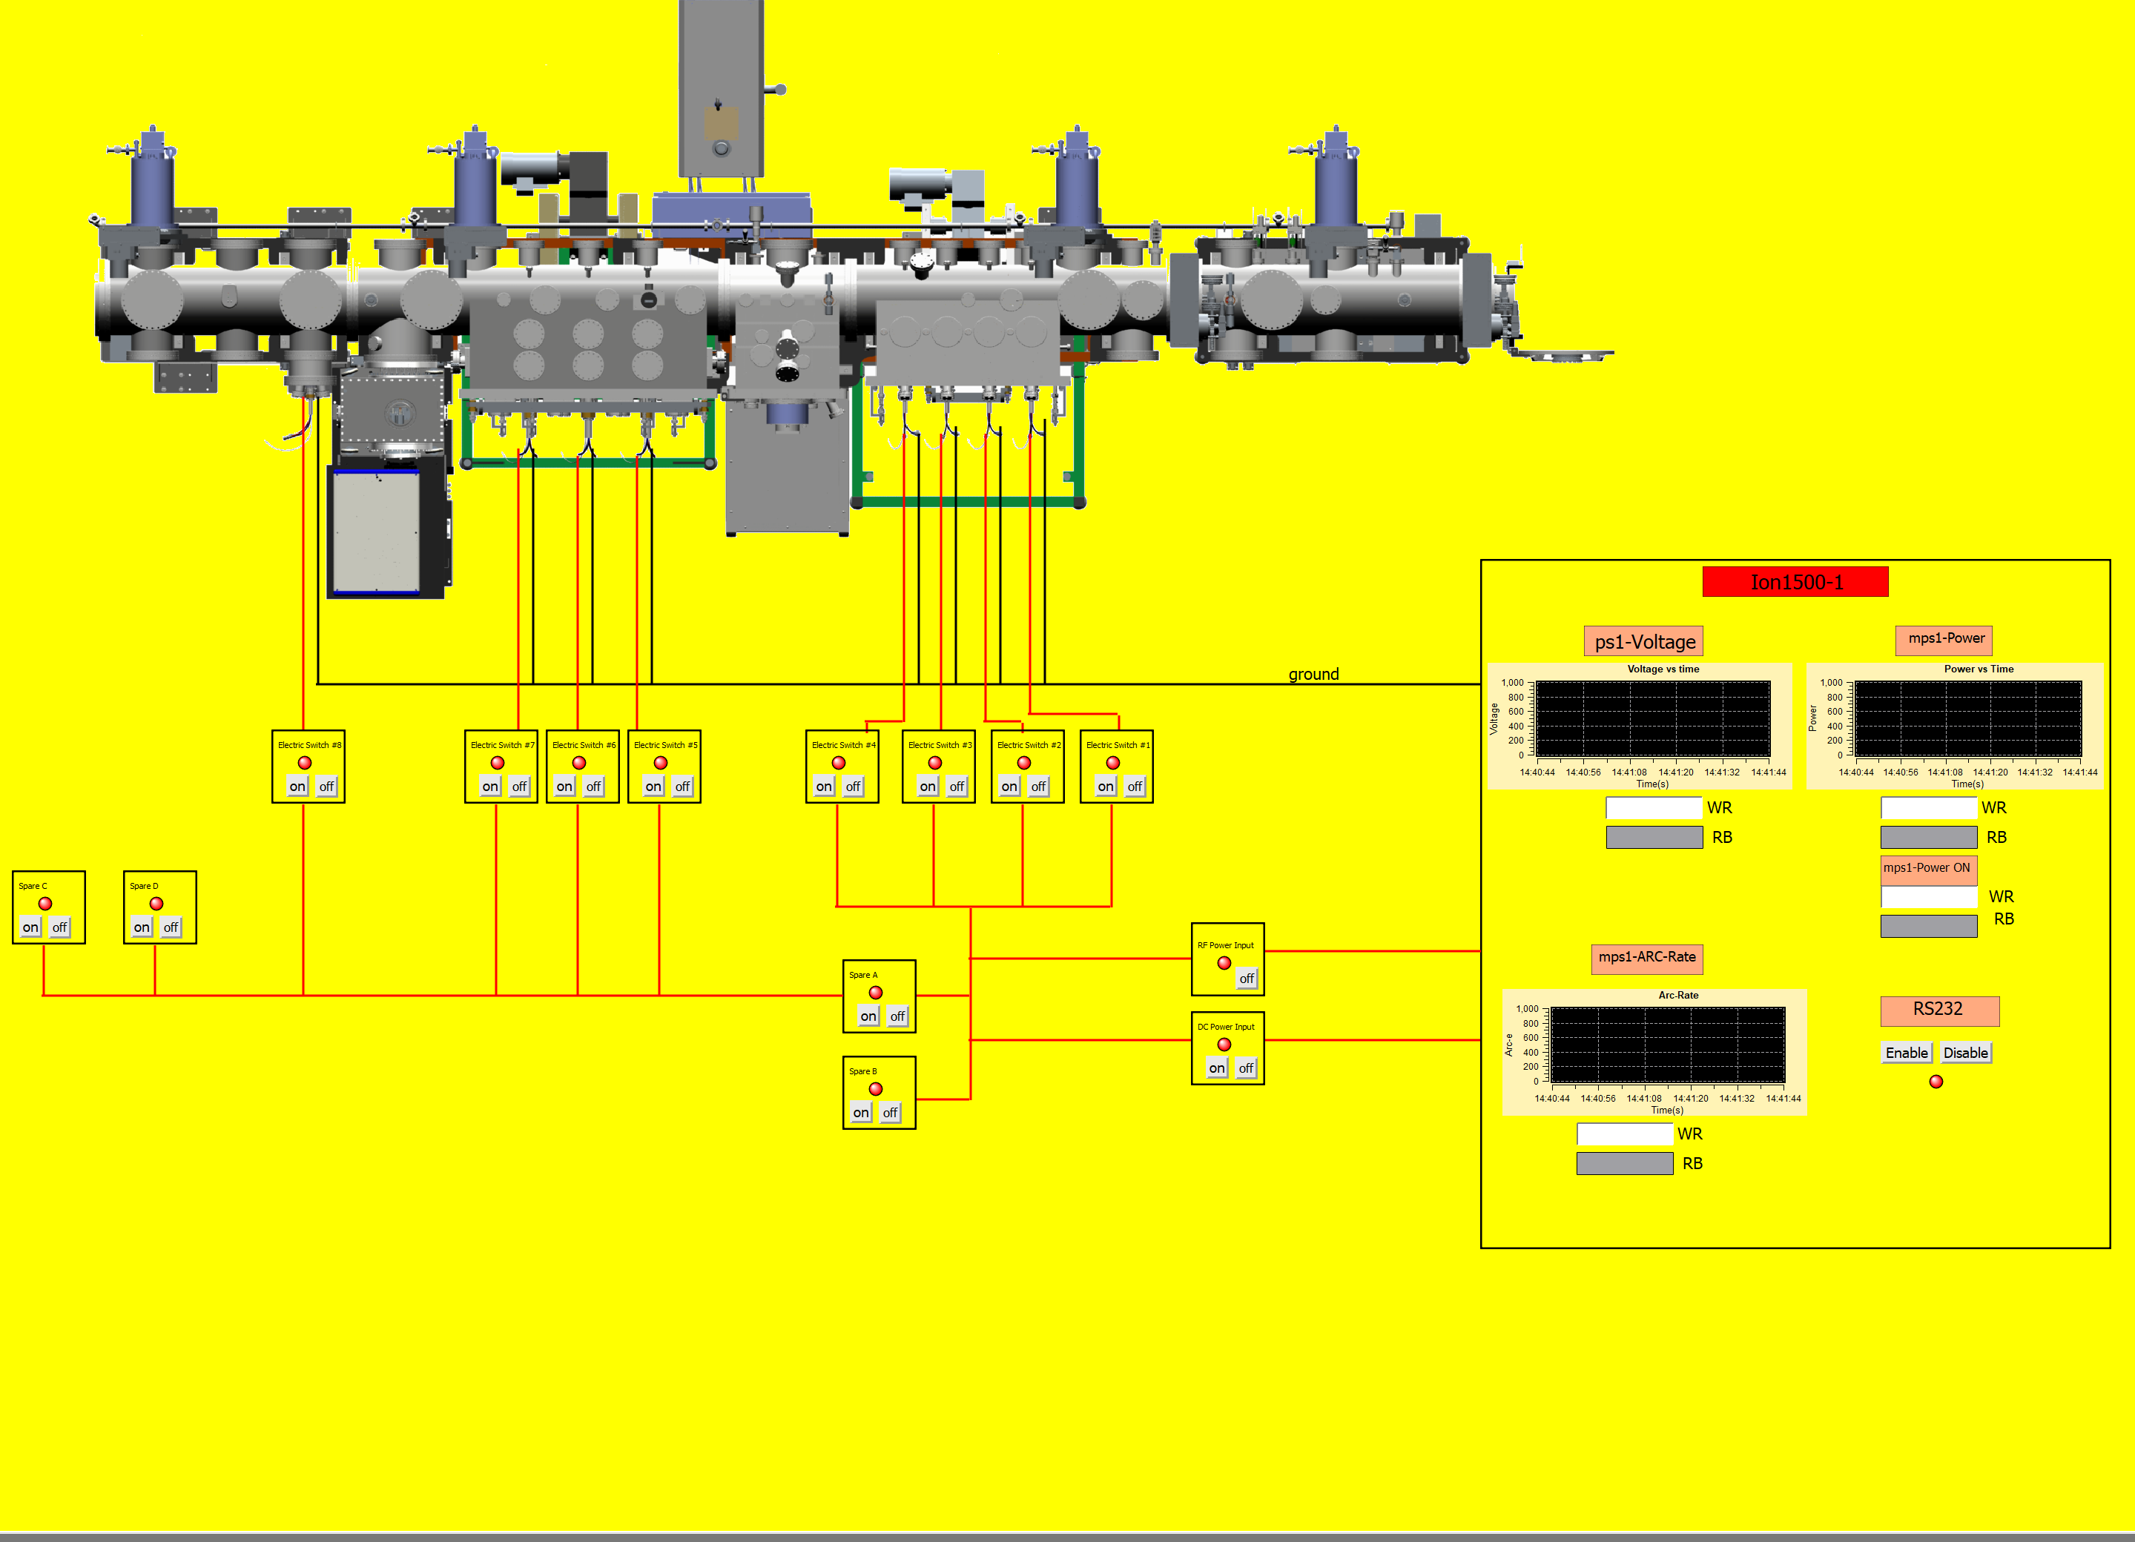
Interfaces For User Controls
Power

Slide 16
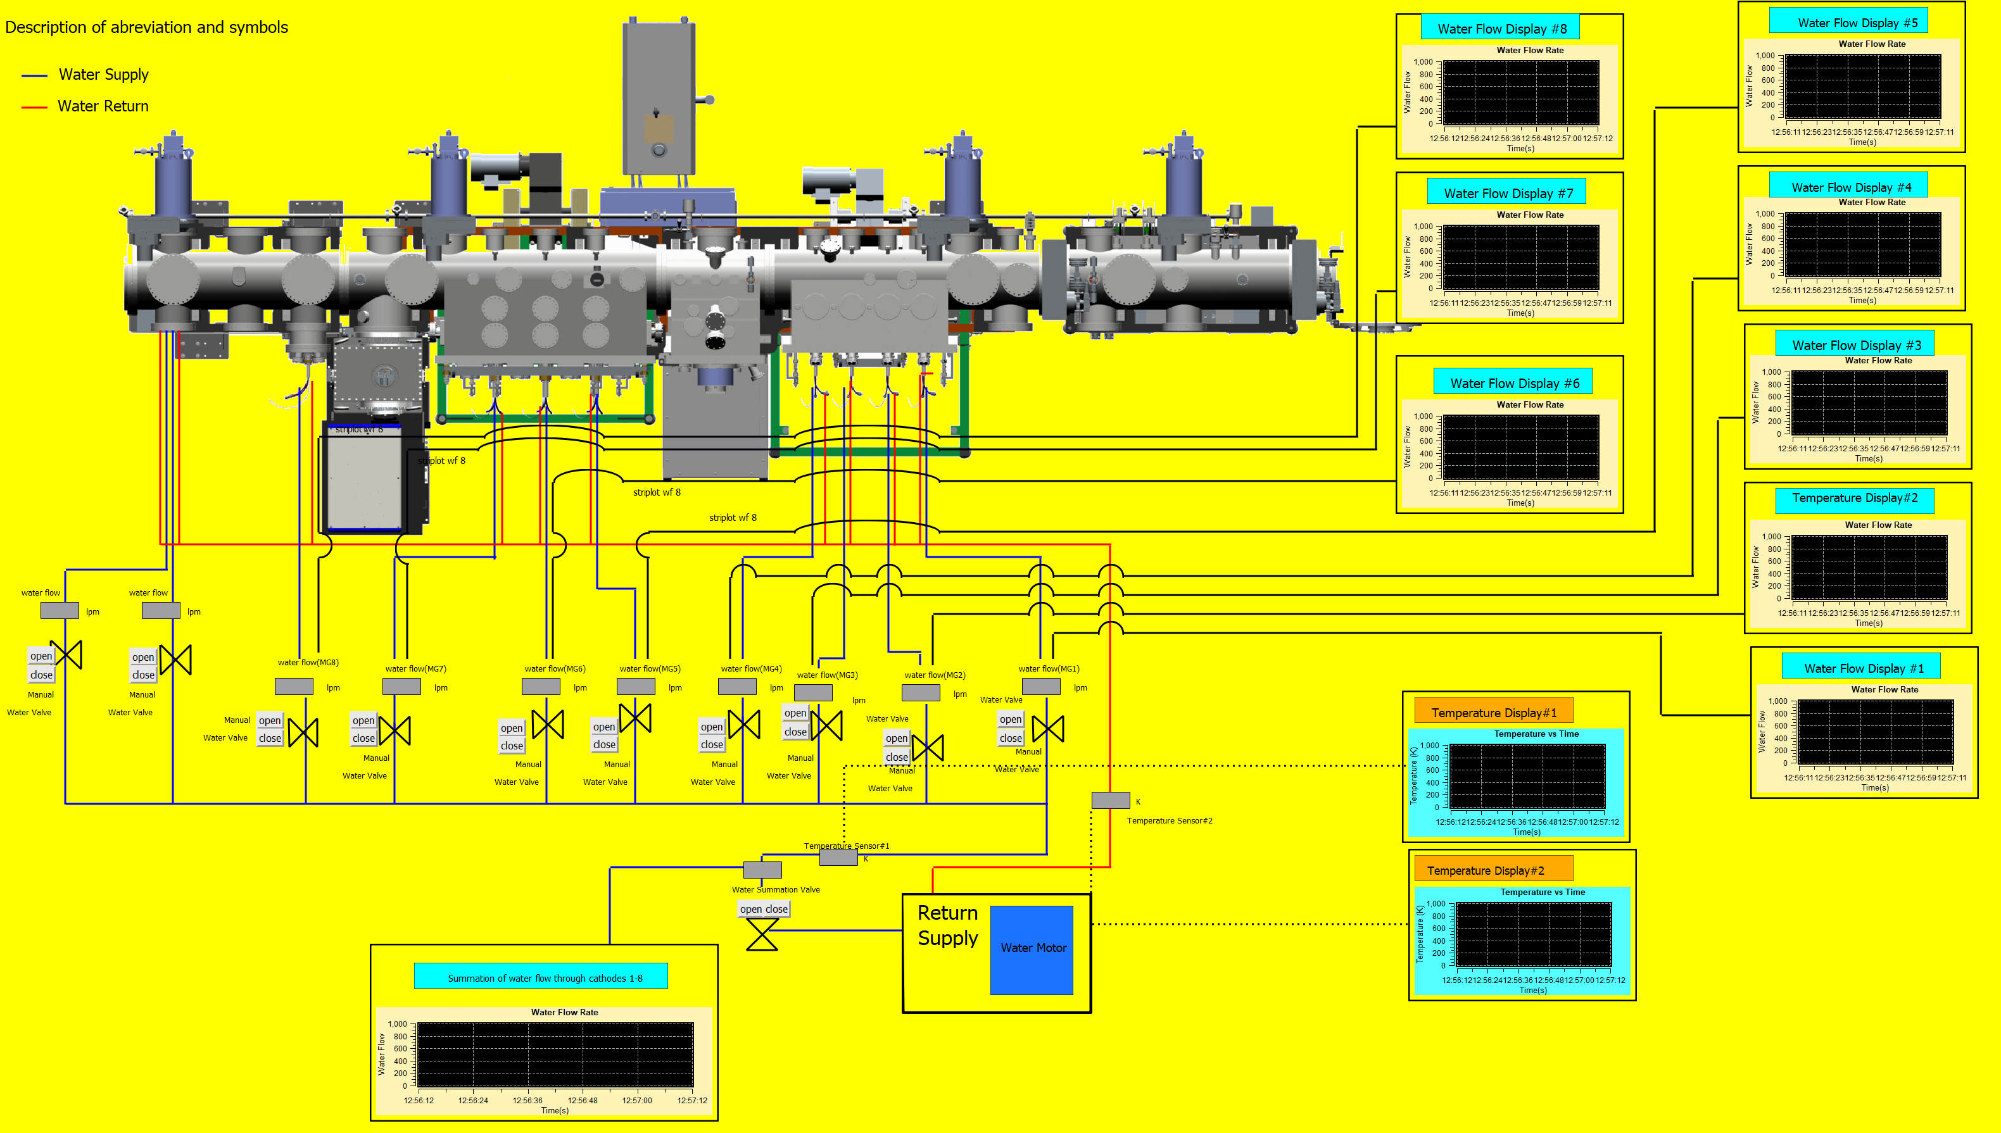
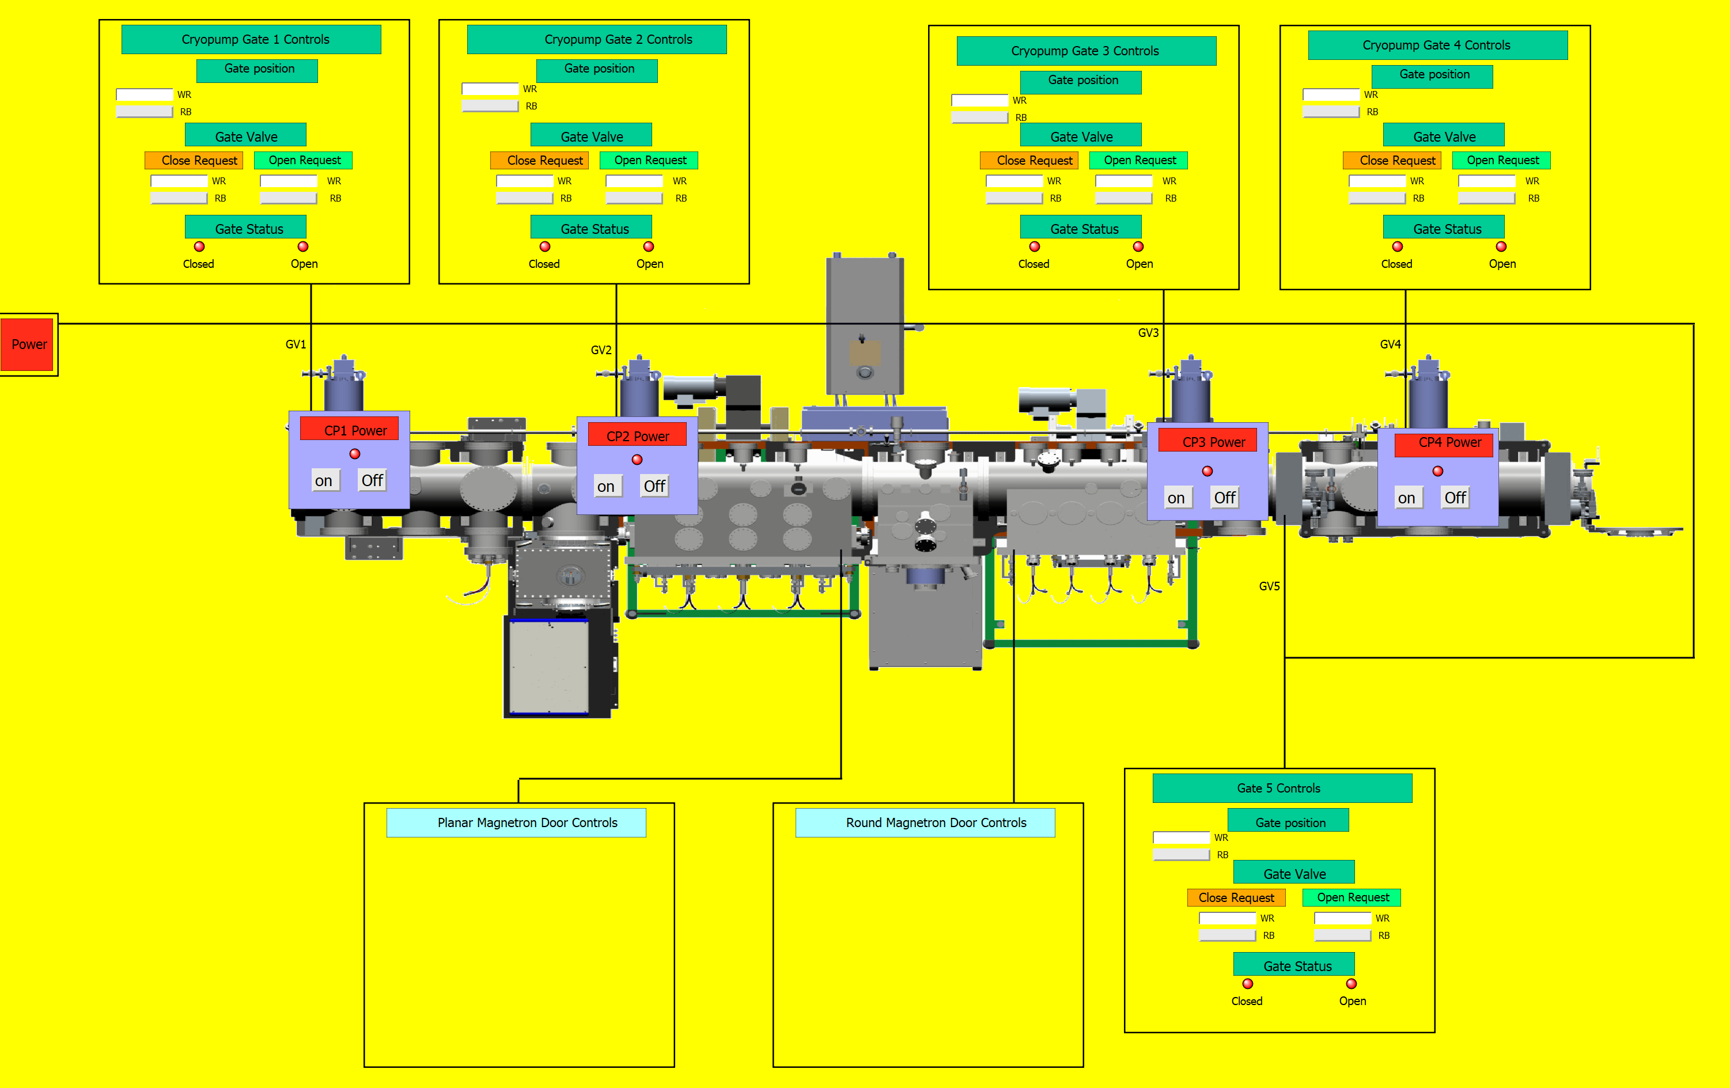
Interfaces For User Controls
Water and Gate Controls

Slide 17
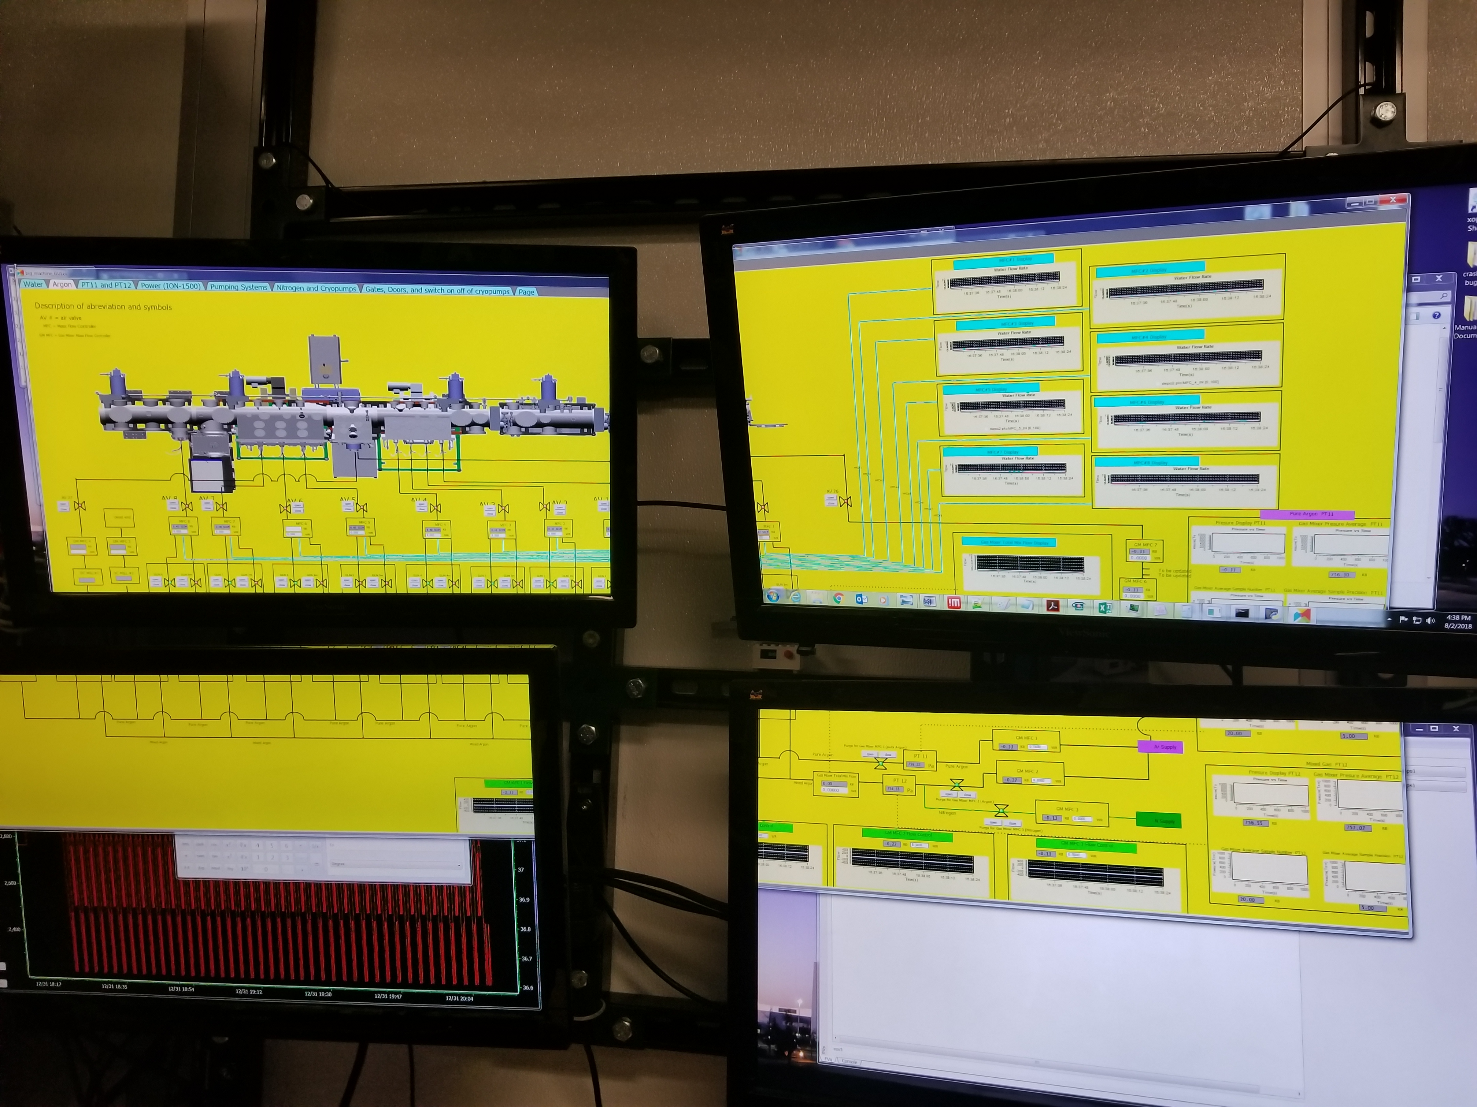
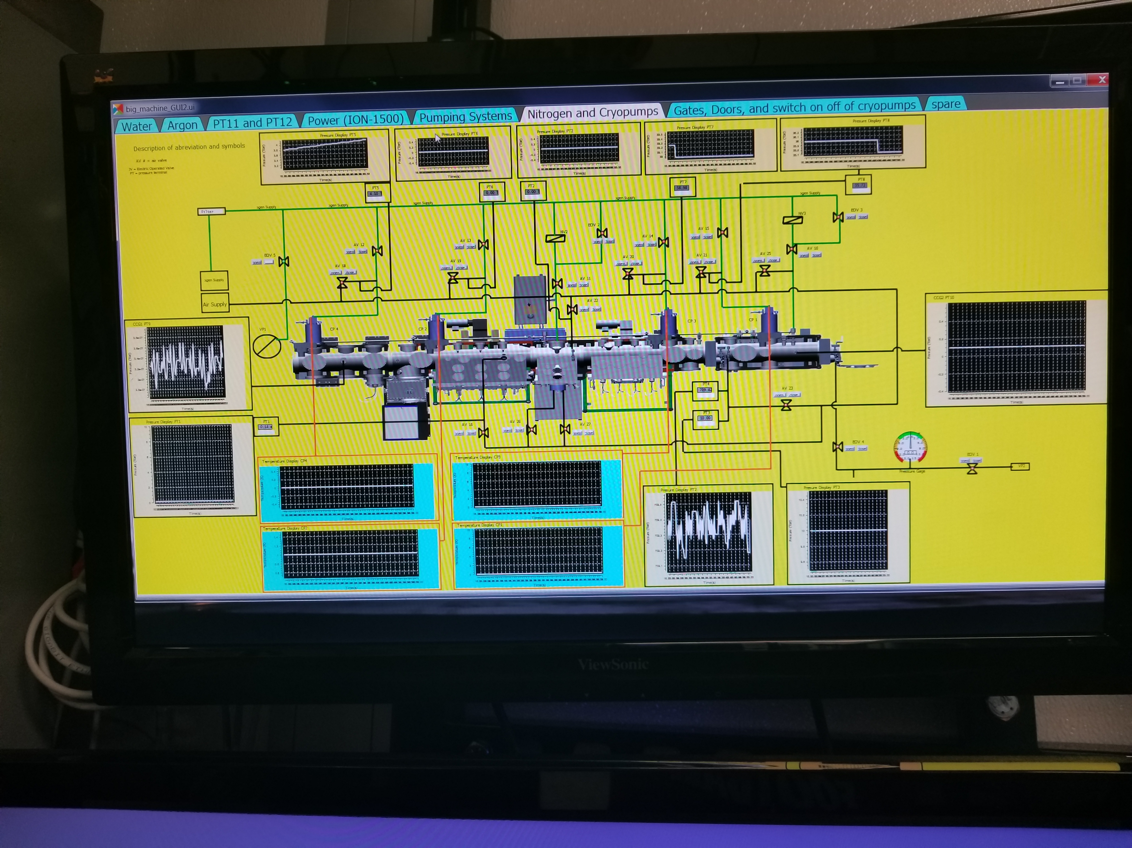
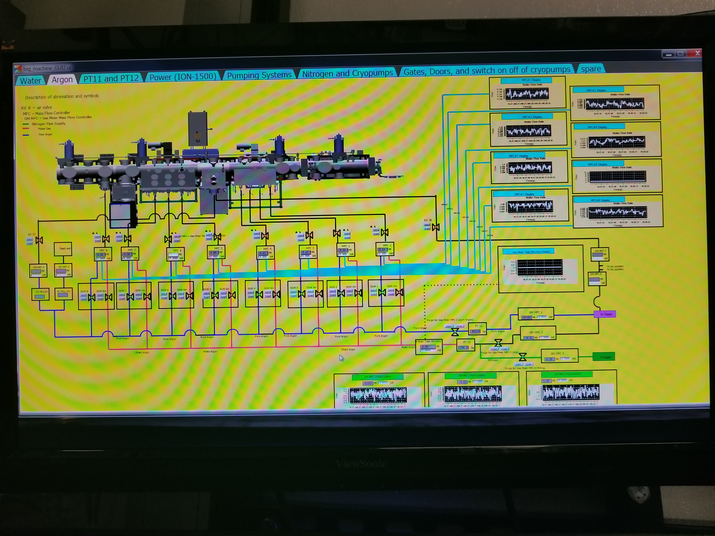
Interface running with MDS

Slide 18
Questions ?
Further work
Update PV’s as the hardware is improved
Change interface
Update widgets with more advanced functionalities
Thanks for the attention!

Slide 19
Questions ?
Further work
Update PV’s as the hardware is improved
Change interface
Update widgets with more advanced functionalities
Thanks for the attention!

