Slide 1
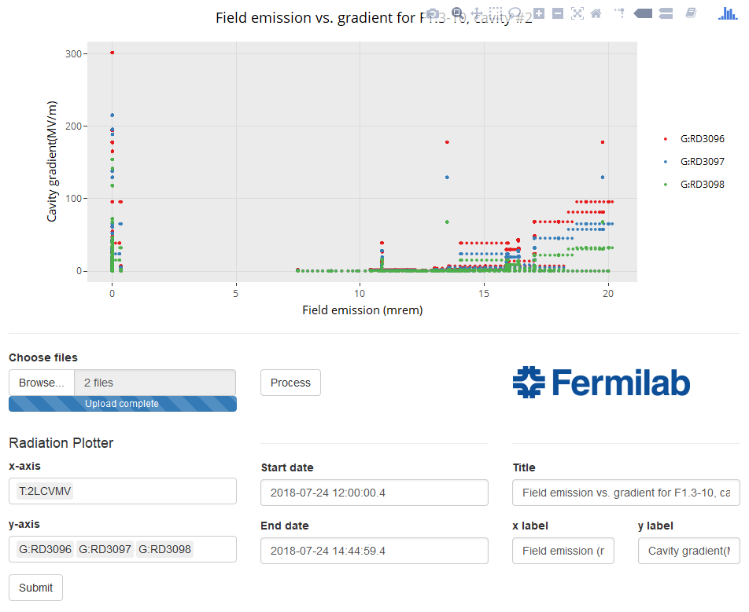
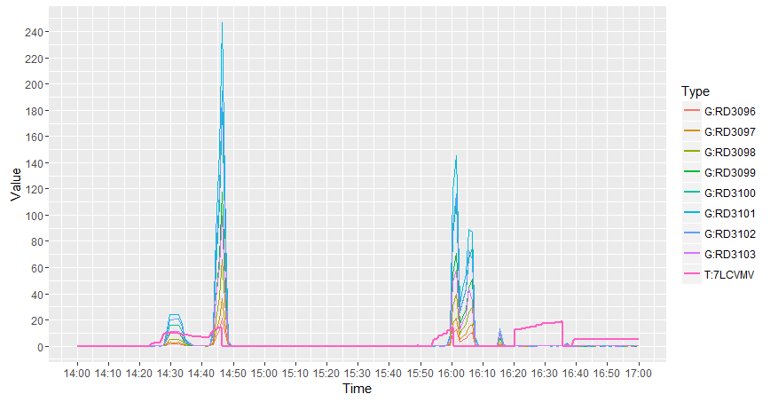
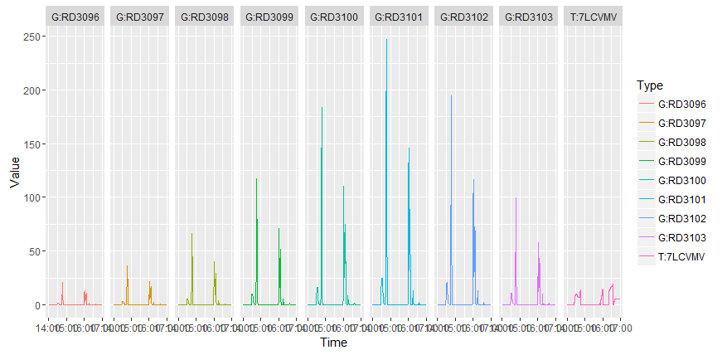
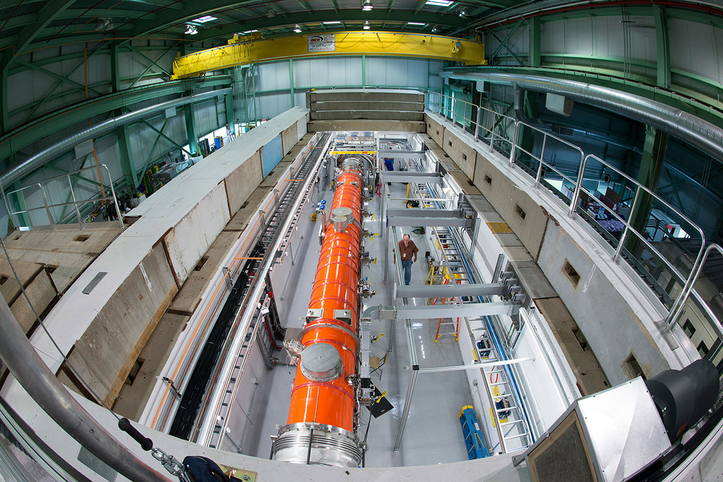
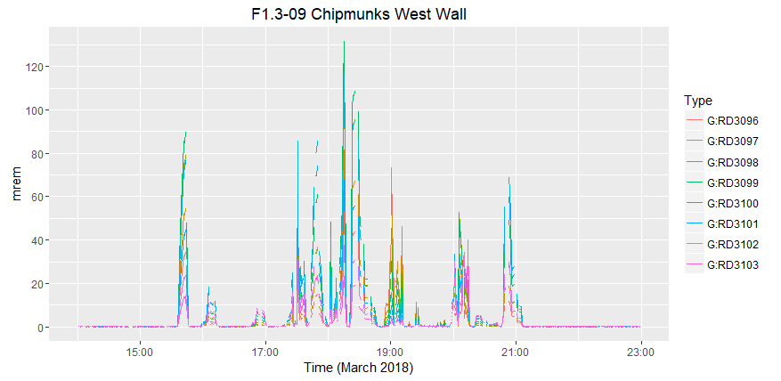
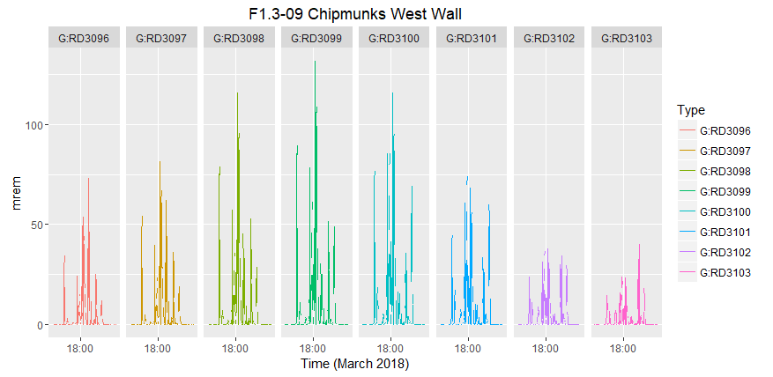
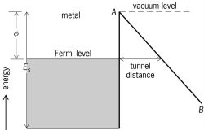
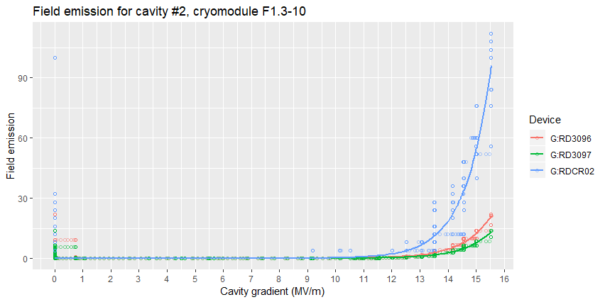
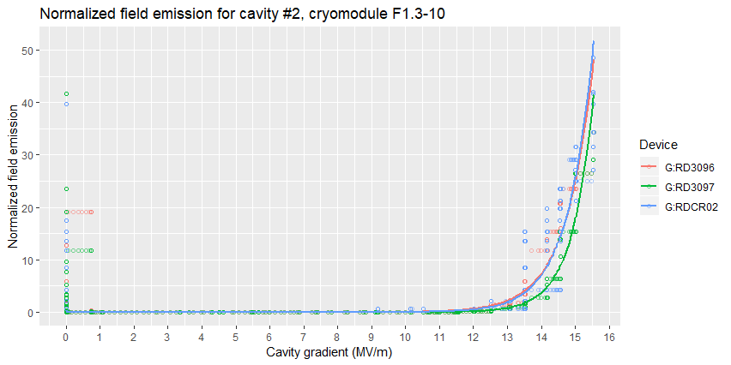
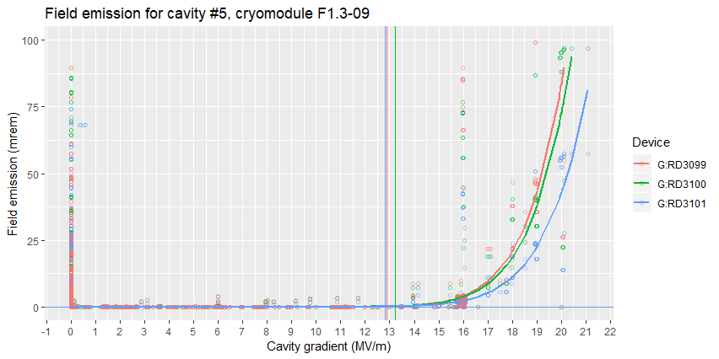
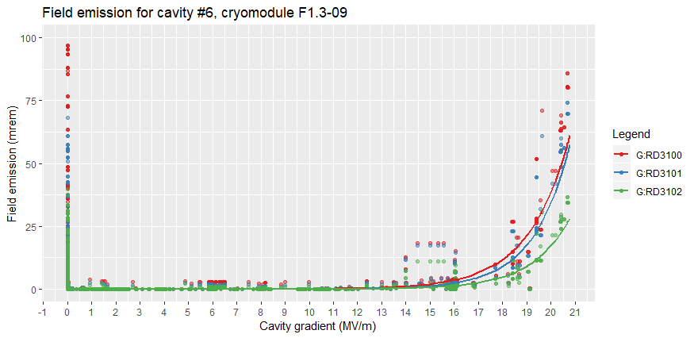
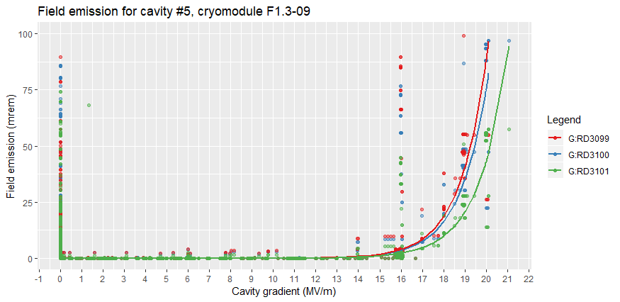
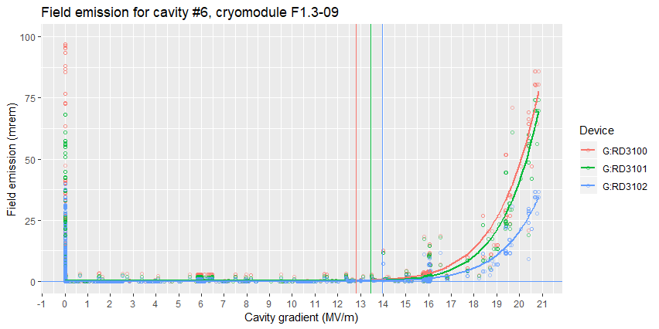
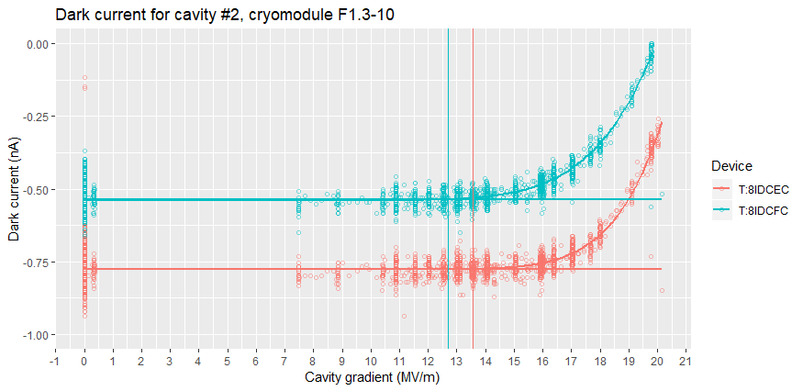


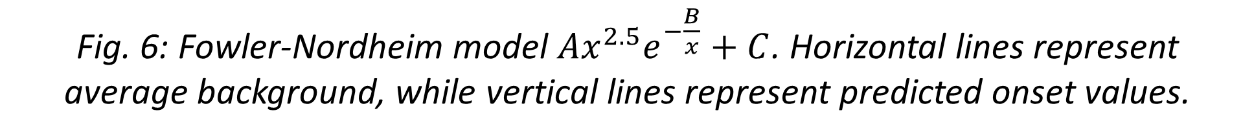
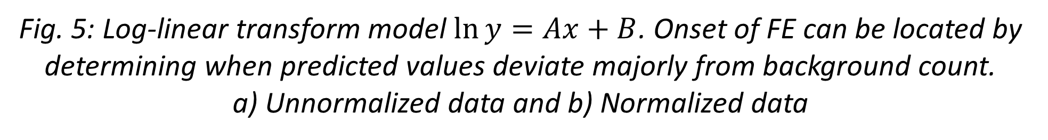
LCLS-II Cryomodules Performance Characterization
Hieu Le, Dickinson College, Carlisle, PA – Lee Teng Internship Program
Elvin Harms, Accelerator Division, Fermilab, Batavia, IL
Introduction
Analysis Tools
Examples
Linac Coherent Light Source (LCLS-II ) is a second-generation X-ray free-electron laser currently being constructed at SLAC.
Fermilab is responsible for the design, construction and testing of seventeen 1.3 GHz and two 3.9 GHz cryomodules for the LCLS-II.
Test data is collected and stored via ACNET. We developed tools in R that analyze data exported from ACNET including:
Preprocessing and outputting a data table in an easy-to-manipulate format (data wrangling).
Producing interactive time series plots or scatter plots of arbitrary devices for quick preliminary analysis.
Fitting a log-linear transform model to FE data. This model allows us to determine onset of FE for a cavity. With the addition of a radiation detection scheme with different reading scales, we quantile normalize the data in order to obtain a better onset prediction from the model.
Fitting the Fowler-Nordheim equation governing FE current to dark current data. The model is fitted using nonlinear least square method. For the algorithm to converge, initial guesses are calculated from linear regression of the FN equation’s series expansion.
All tools developed above had been used to analyze testing data and characterize performance for cryomodules F1.3-08, F1.3-10 and retrospectively F1.3-09, F1.3-07.
During the testing of cryomodule F1.3-08, heavy FE was observed on cavity #7 during initial gradient (~10 MV/m) operation, which peaked at 15 MV/m. The FE distribution across detectors seem to follow a Gaussian distribution, peaking at G:RD3101 (compared to other chipmunks). FE was processed away during high-power pulsed processing, with no FE detected up to 20 MV/m afterwards.
We also analyzed FE data for cryomodule F1.3-09 in March for cavity #5 and #6 to test the fitting model. Using a log-linear transform model, emission onset was determined to be at a gradient of 13 MV/m and 13.4 MV/m respectively. This agrees well with empirically obtained data.
We developed tools in R (a statistical computing language) to analyze the recorded testing data and utilized them to assess the performance of cryomodules in an efficient and reproducible way.
Fig. 1: LCLS-II cryomodule in the CMTS1 test cave.
Fig. 7: FE data for cryomodule F1.3-08. The FE distribution across detectors allows for the determination of exact FE location.
Acceptance Testing and Purpose
Fig. 4: Web application for quick analysis. The interactive graph output is feature-rich, including zooming, selecting certain data points, etc.
Each cryomodule undergoes rigorous testing at Fermilab to ensure that it meets stringent performance criteria. An important part of testing is monitoring for cavity field emission.
Field emission (FE) can be observed from bremsstrahlung radiation and dark current. Dark current is caused by the accelerating emitted electrons inside the cavity, while radiation is produced when emitted electrons get deflected by the cavity wall.
Using radiation detectors and cavity gradient data, it is possible to determine onset, intensity, location and range of FE.
In a high electric field, electrons tunnel out of the cavity wall at localized points. This field electron emission scales exponentially with the cavity gradient.
a)
b)
Fig. 2: Fowler-Nordheim tunneling governing electron field emission. High electric field decreases the vacuum potential barrier.
Fig. 5: Log-linear transform model $\ln{y}=Ax+B$. Onset of FE can be located by determining when predicted values deviate majorly from background count.
a) Unnormalized data and b) Normalized data
Fig. 8: FE data for cryomodule F1.3-09. Predicted FE onset agrees with empirical data, thus showing that the fitted model works well.
Conclusion
ACNET data output can be preprocessed in a way that allows for easy manipulation for any purpose.
Field emission data can be easily visualized and analyzed using developed tools. This data can help with reactive troubleshooting and logging data travelers for each cryomodule.
These tools can also be applied to analyze data outside of cryomodule testing.
G:RD3110
Cryomodule
G:RD3111
Legend
Total loss monitor
Chipmunk
Scarecrow
FOX
Additional detectors
Cavity
G:RD3105
T:4LCVMV
G:RD3112
G:RD3106
T:1LCVMV
T:2LCVMV
T:3LCVMV
G:RDCR04
T:5LCVMV
T:6LCVMV
T:7LCVMV
T:8LCVMV
G:RDCR01
G:RDCR02
G:RDCR03
G:RD3099
G:RDCR05
G:RDCR06
G:RDCR07
G:RDCR08
G:RD3096
G:RD3097
G:RD3098
G:RD3100
G:RD3101
G:RD3102
G:RD3103
Fig. 6: Fowler-Nordheim model $Ax^{2.5}e^{−\frac{B}{x}}+C$. Horizontal lines represent average background, while vertical lines represent predicted onset values.
G:RD3113
G:RD3114
Fig. 3: Layout within the test cave with ACNET device names. TLM, chipmunk, scarecrow, and FOX are all different types of radiation detectors.
August 9, 2018

