Slide 1

Characterizing Dirty Layer in Superconducting RF Cavities
Anil Radhakrishnan, Mentor: Mattia Checchin
Lee Teng Final Presentation
08 August 2018

Slide 2
Motivation
Superconducting Cavities are used to accelerate particles in most high energy accelerators due to their reduced power consumption and high accelerating gradient( ~45 MV/m).
These high gradient cavities have an impurity enriched or dirty layer on their surface
Theoretical models suggest that tuning this layer can help enhance the accelerating gradient obtained

Slide 3
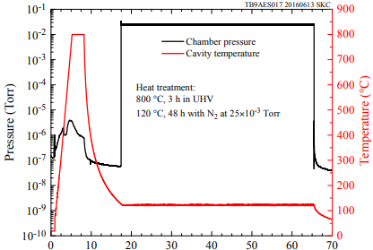
Background
RF Cavities:
  RF cavities are devices used to accelerate charged particles in accelerators by creating a resonant electromagnetic field in RF range.
Nitrogen Infusion:
  Cavity Treatment process that modifies the first ~100 nm of the cavity by adding interstitial nitrogen.
  The standard N-infusion thermal treatment is composed of the following steps:
    Electropolishing 150 µm
    Cavities are treated for 3 hours at 800ºC in High Vacuum
    Nitrogen is then injected at the temperature of 120ºC for a time period
    ranging in between 24 to 90 hours.
  No chemistry is needed after the treatment.
Time(hour)
3
8/08/2018
Anil Radhakrishnan | Characterizing Dirty Layer in Superconducting RF Cavities

Slide 4
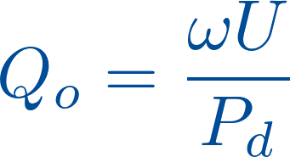
Background
Mean Free Path
  The average distance traveled by a moving particle between successive impacts, which modify its direction or energy or other particle properties.
Penetration Depth
  The distance to which a magnetic field penetrates into a superconductor and becomes equal to e⁻¹ times that of the magnetic field at the surface of the superconductor
Quench
  The quench is due to a point on the cavity surface that suddenly turns normal conducting, causing a dramatic increasing of the surface resistance and of the dissipation.
  This, in turn, causes the spreading of the normal-conducting area that increases consuming all the stored energy in the resonator.
Quality factor
  How well the cavity holds energy without dissipation.
4
8/08/2018
Anil Radhakrishnan | Characterizing Dirty Layer in Superconducting RF Cavities

Slide 5
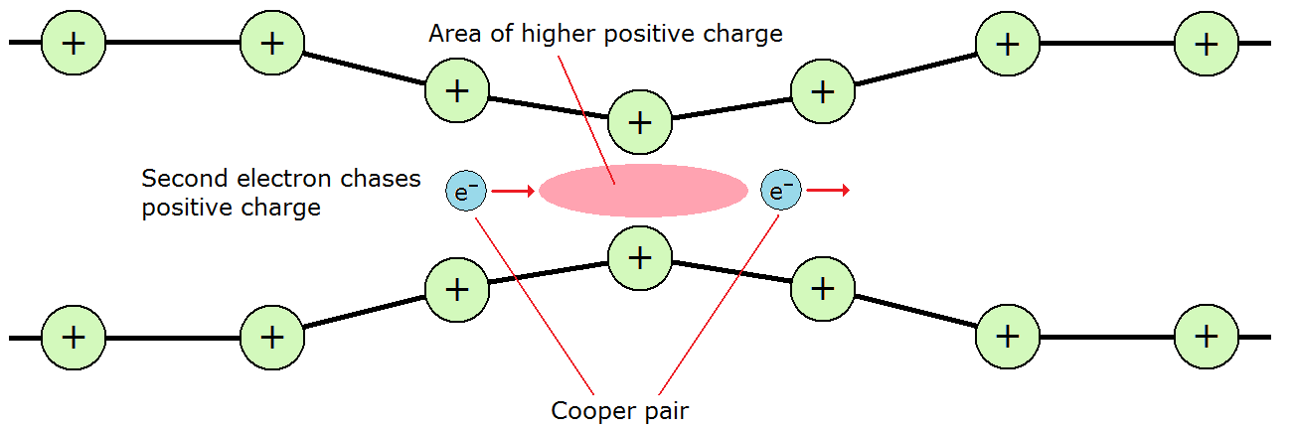
Theoretical Grounding
BCS(Bardeen–Cooper–Schrieffer) Theory
This was the first microscopic theory of superconductivity.
It uses electron-phonon interactions to explain formation of cooper(electron) pairs that follow Bose-Einstein statistics.
The phonon exchange interaction allows for an attractive potential between electrons which causes them to pair up
The effects of electrons on the phonons themselves are not considered(strong coupling), which makes it a crude approximation for materials like Niobium

Slide 6
Theoretical Grounding
Kubo’s Model
Takayuki Kubo developed a model for finding the maximum attainable quench field using an Superconductor-Superconducting substrate structure[1].
It can be regarded as a model of the surface of a superconductor that consists of superconductors with different penetration depths.
Nb surface after the low temperature Nitrogen infusion has a depth dependent mean free path and hence a depth dependent penetration depth, can be described by an S-S bilayer with a thin dirty Nb and a clean Nb substrate as the simplest model.
Superconductor
Superconducting
Substrate
d

Slide 7
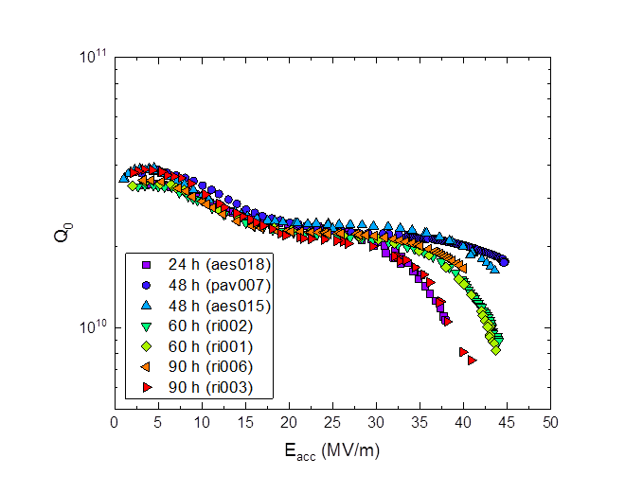
Cavity Testing
N-infused cavities prepared at the same temperature but different infusion durations were tested at the Vertical Test Facility.

Slide 8
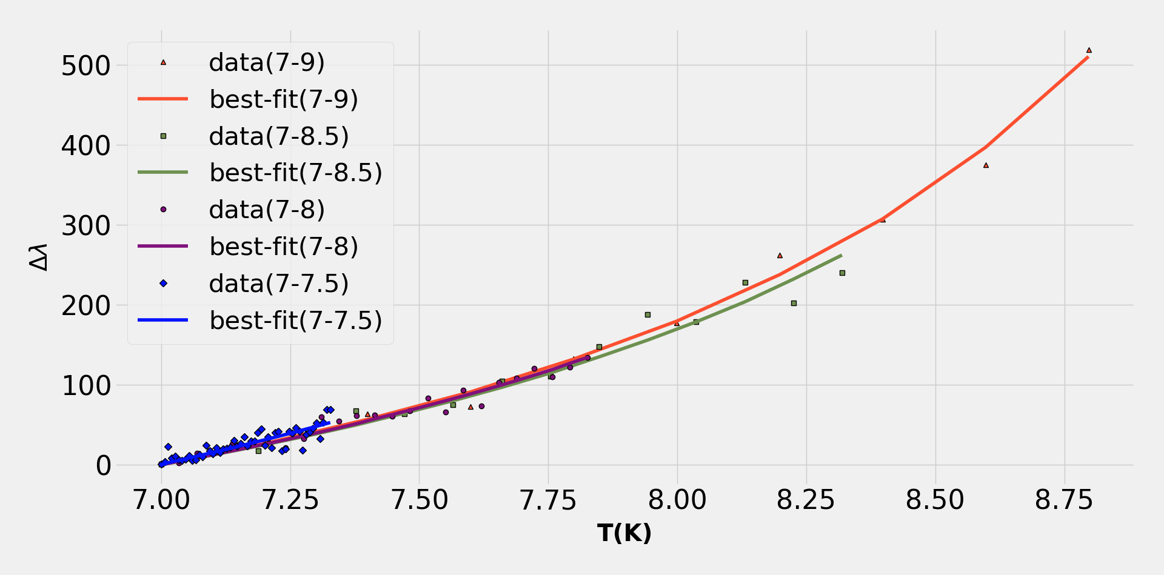
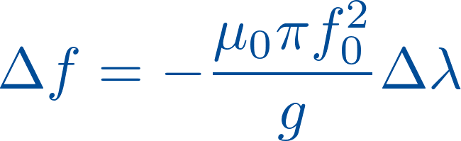
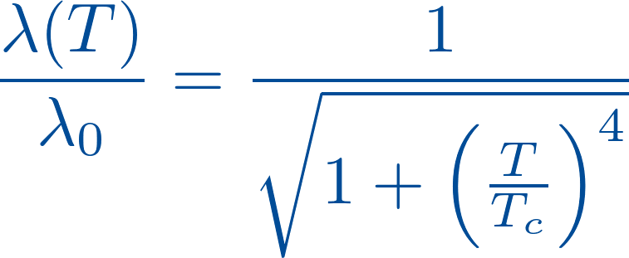
BCS Fitting
The different temperature scales allow to probe at different depths

Slide 9
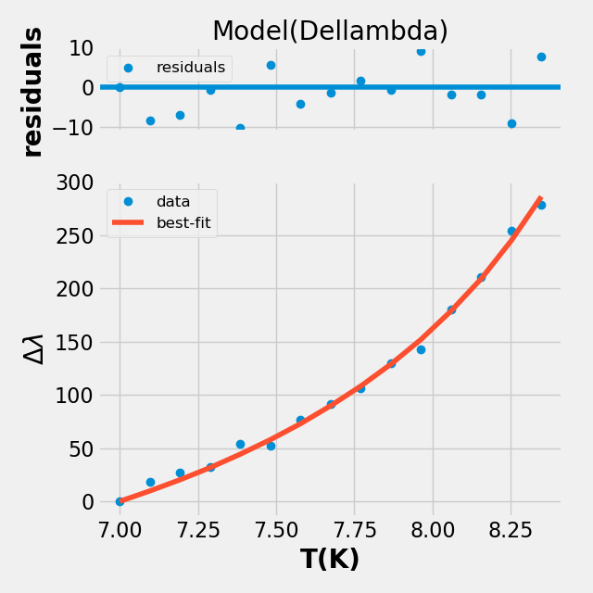
BCS Fitting
The data processing and BCS fitting was performed in python after implementing a wrapper for Halbritter program.
This implementation is capable of effortlessly handling bulk data and resulted in ~48x increase in computational speed for such processing.

Slide 10
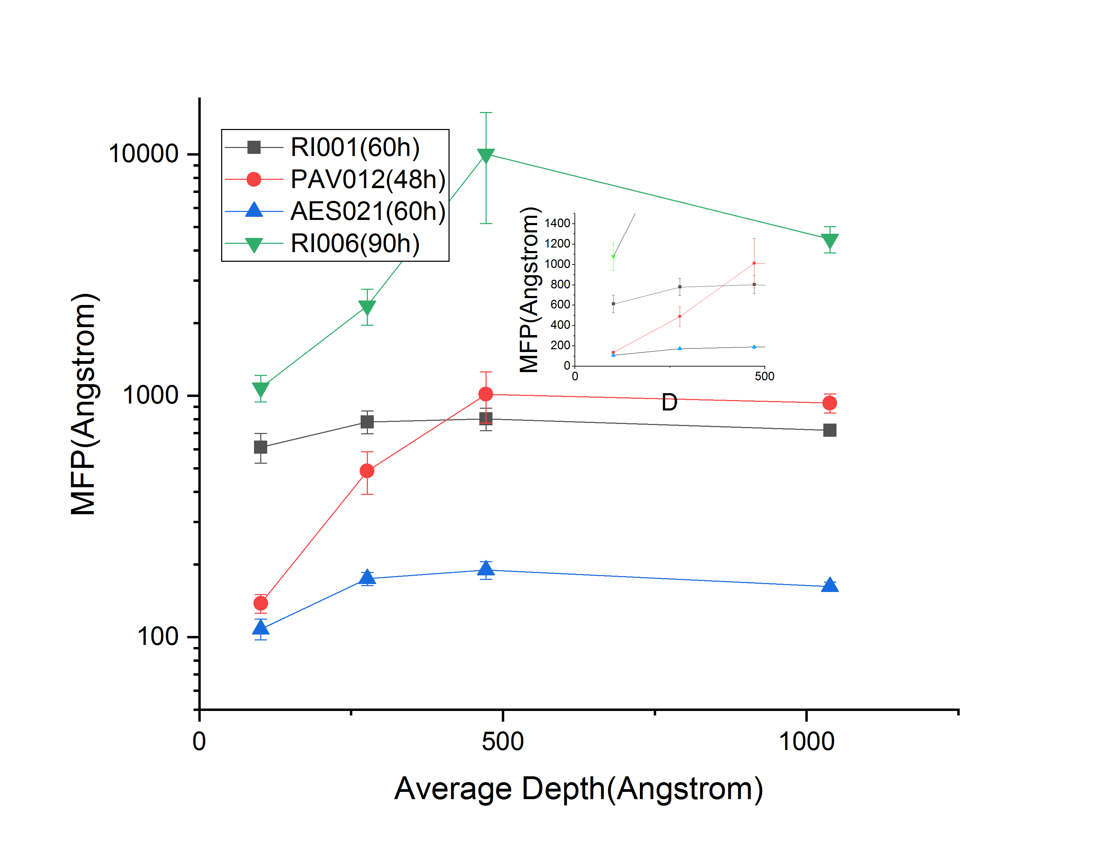
BCS Fitting
The BCS fit allows us to extract parameters like Mean Free Path(MFP) which are useful in characterizing the superconductor
The MFP at shallow depth is pertinent to the dirty layer and is averaged while implementing theoretical models
Averaged for Dirty Layer

Slide 11
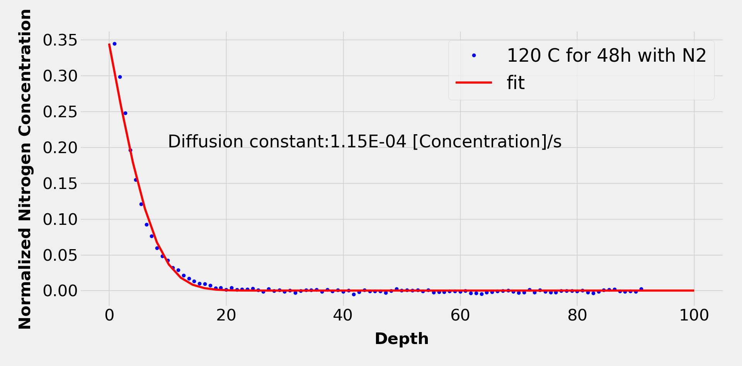
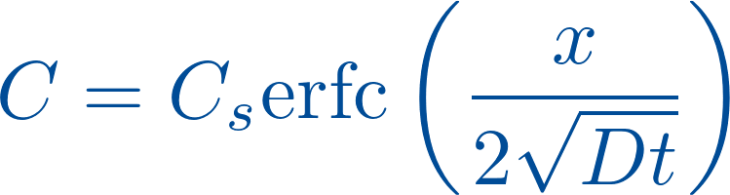
Fick's law and diffusion simulations
Depth dependent Nitrogen concentration data was fit with Fick’s Law[2] to find Diffusion Constant(D)
The data used for the fit was from a cavity baked at 120ºC for 48 hours with Nitrogen

Slide 12
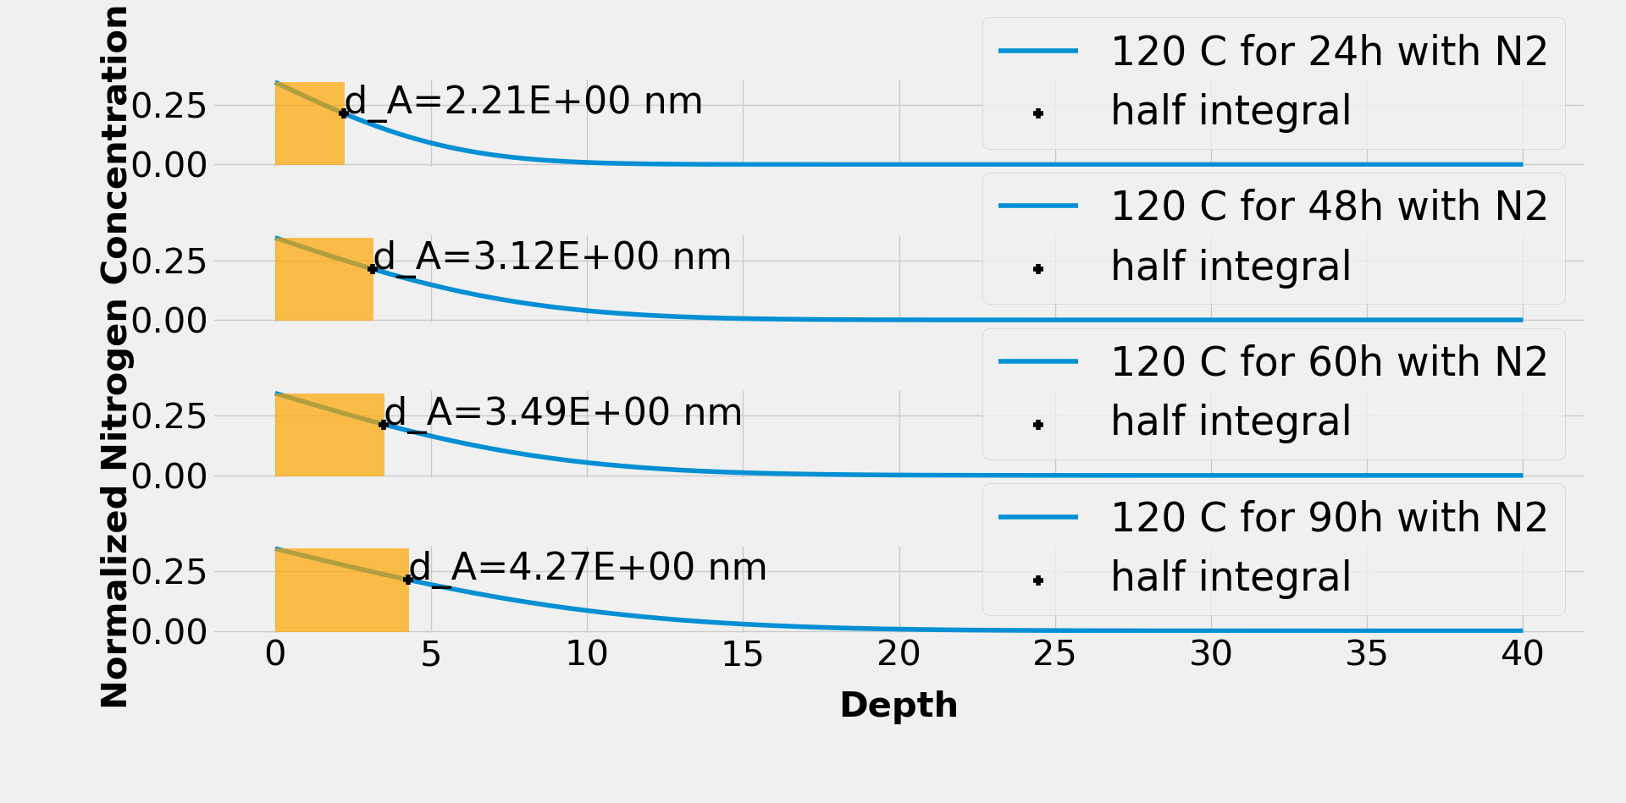
Fick's law and diffusion simulations
The Diffusion Constant was then used to simulate the diffusion curve for different time scales
The curve was then split into 2 components each having equal contribution to the total concentration
The depth at which this split occurs is noted as thickness of superconducting layer
Dirty Layer increases

Slide 13
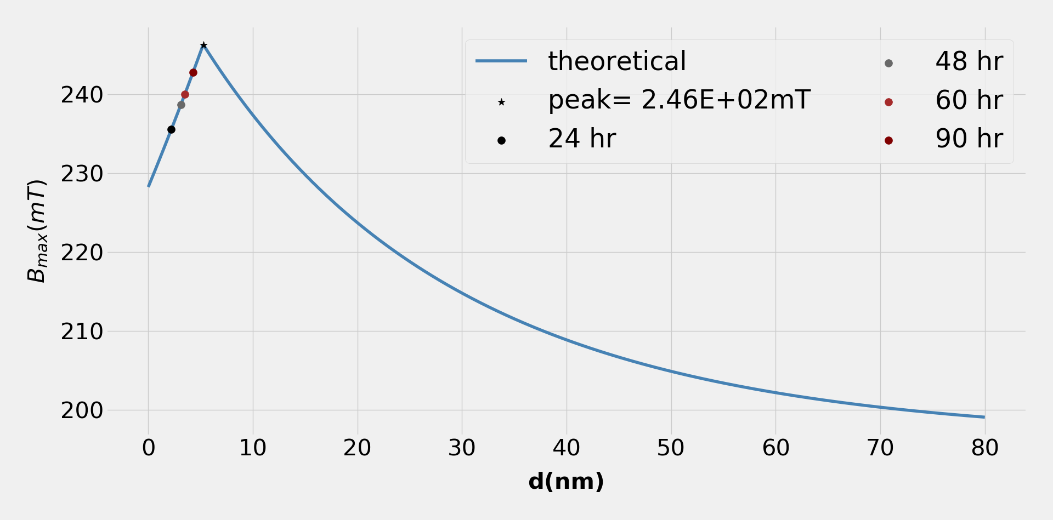
B_{max} vs d
The superconductor layer is assumed to have an MFP of 48.4 nm(shallow depth average from BCS analysis) and the substrate to have an MFP of 1000 nm.
The depth values found from simulation were overlaid to understand where the current processes ideally lie.

Slide 14
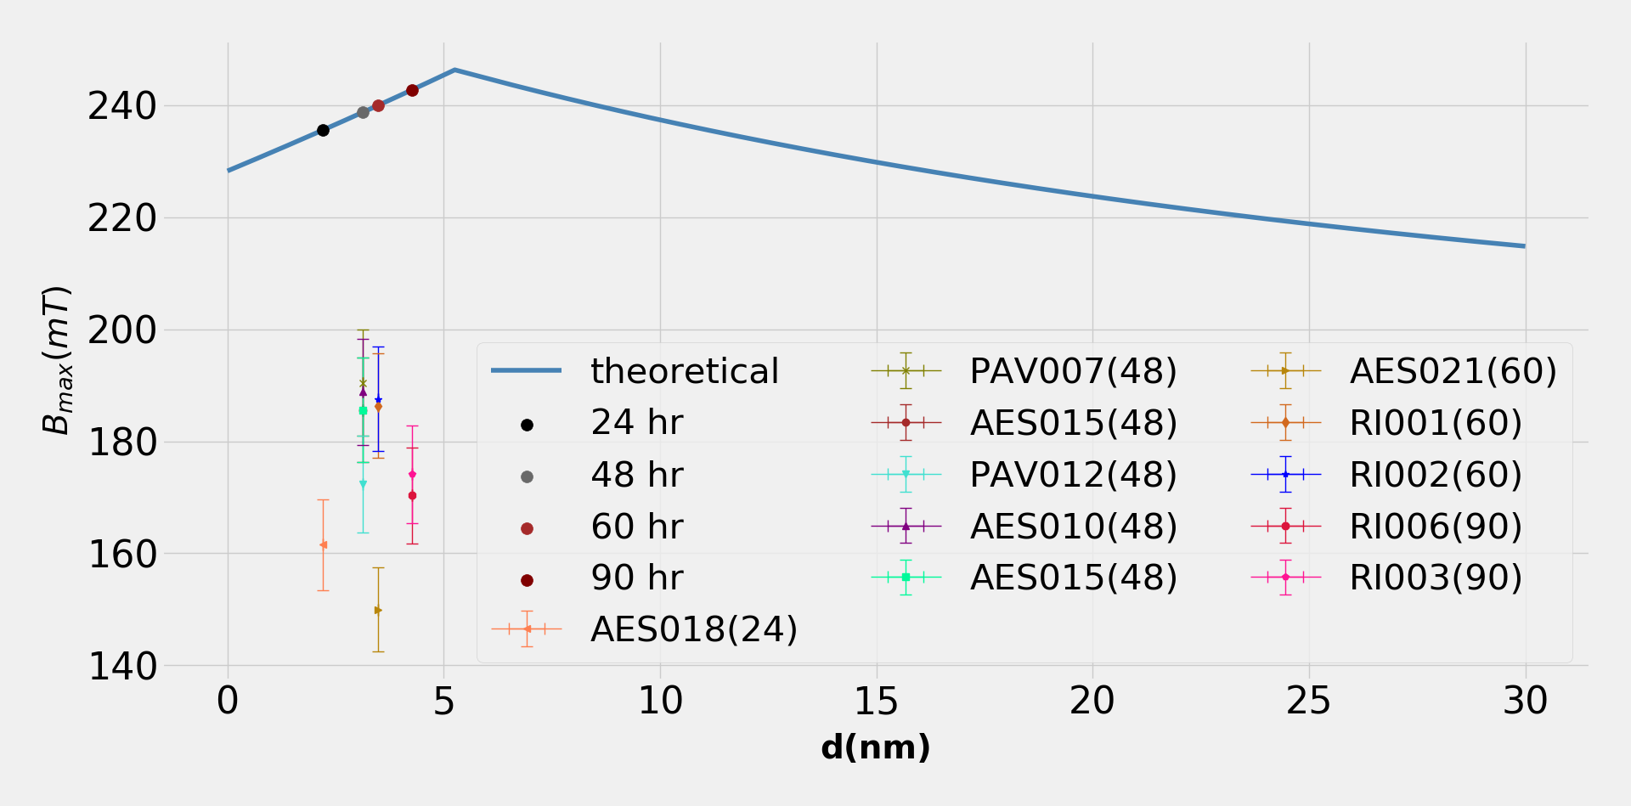
B_{max} vs d
The experimentally obtained values for cavities processed this way were then plotted along the theoretical graph.
The theoretical model suggests that we are still in the increasing region of the curve.
Without nitrogen infusion

Slide 15
Conclusions and Caveats
An efficient software for BCS theory based data analysis was developed. This allowed for:
  Effortless bulk data handling
  ~4800% increase in computational speed
The average MFP value at the surface and the nitrogen concentration profile was used to compare the maximum quench field achieved in N-infused cavities with a theoretical model.
Predicted quench field values are higher than what experimentally measured. Such a discrepancy can be explained by:
  Presence of local defects that limit the gradient to lower values.
  The model was developed in the London limit, which is not the case of clean niobium.
  The rough estimation of the “dirty layer” based on simulated concentration profiles (except for 48 h case) might be source of errors.
In light of our analysis we conclude that the cavities under study were not limited by their dirty
layer( global superconductor effects) but most likely by local defects

Slide 16
Acknowledgements
I would like to thank my mentor Dr.Mattia Checchin for his mentorship and support;
The Lee Teng commitee, especially Dr.Peter Garbincius, the program administrator at Fermilab, for their guidance and assistance;
Dr.Oleksandr Melnychuk for help during VTS Testing.

Slide 17
Bibliography
1. Kubo, T. Multilayer coating for higher accelerating fields in superconducting radio-frequency cavities: a review of theoretical aspects. Superconductor Science and Technology 30, 023001 (2017).
2. Mehrer, H. Continuum Theory of Diffusion. in Diffusion in Solids 27–36 (Springer, Berlin, Heidelberg, 2007). doi:10.1007/978-3-540-71488-0_2
3. Romanenko, A., Grassellino, A., Crawford, A. C., Sergatskov, D. A. & Melnychuk, O. Ultra-high quality factors in superconducting niobium cavities in ambient magnetic fields up to 190 mG. Applied Physics Letters 105, 234103 (2014).
4. Grassellino, A. et al. Unprecedented quality factors at accelerating gradients up to 45 MVm −1 in niobium superconducting resonators via low temperature nitrogen infusion. Supercond. Sci. Technol. 30, 094004 (2017).
5. Grassellino, A. et al. Nitrogen and argon doping of niobium for superconducting radio frequency cavities: a pathway to highly efficient accelerating structures. Supercond. Sci. Technol. 26, 102001 (2013).
6. Padamsee, H. Cavity Treatment Advances. in RF Superconductivity 237–261 (Wiley-Blackwell, 2009). doi:10.1002/9783527627172.ch7
7. M. Checchin et al., in Proc. of IPAC 2018, Vancouver, Canada
8. A.Romanenko et al., in Proc of IPAC 2018, Vancouver, Canada

