Slide 1
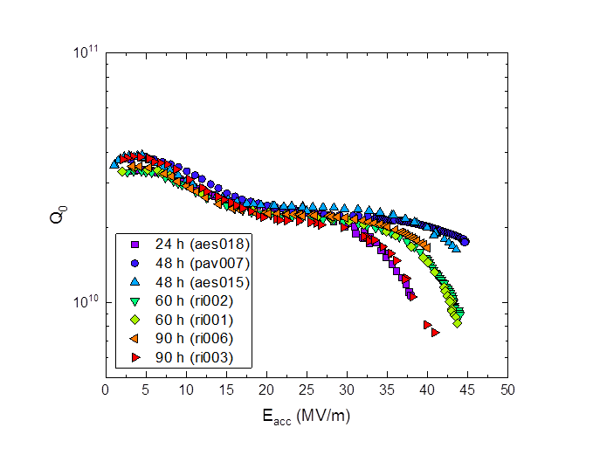
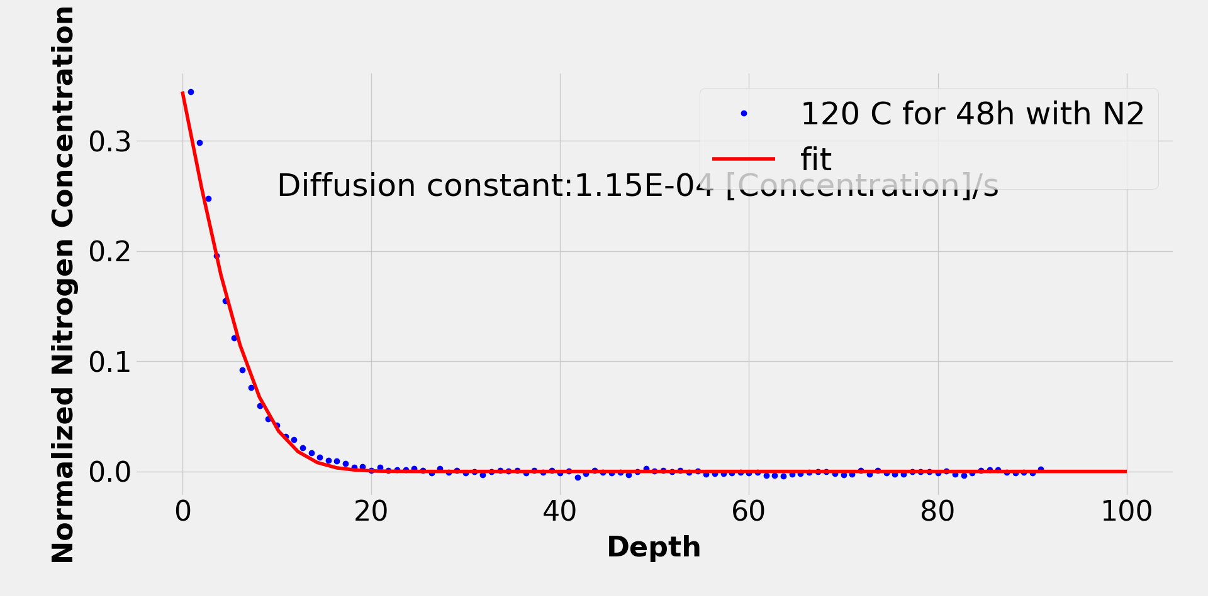
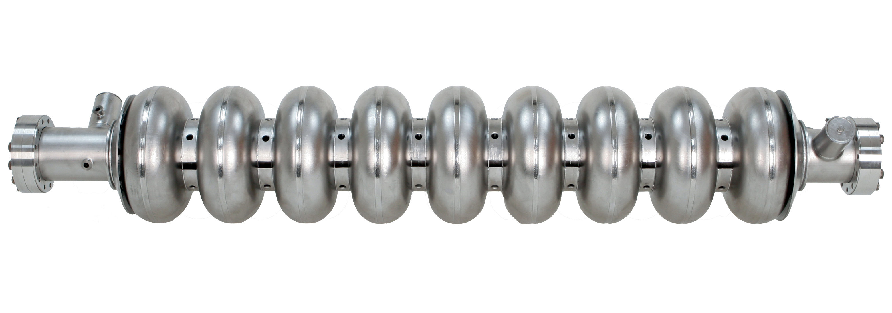
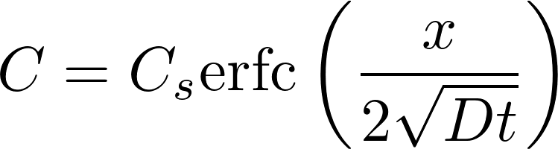
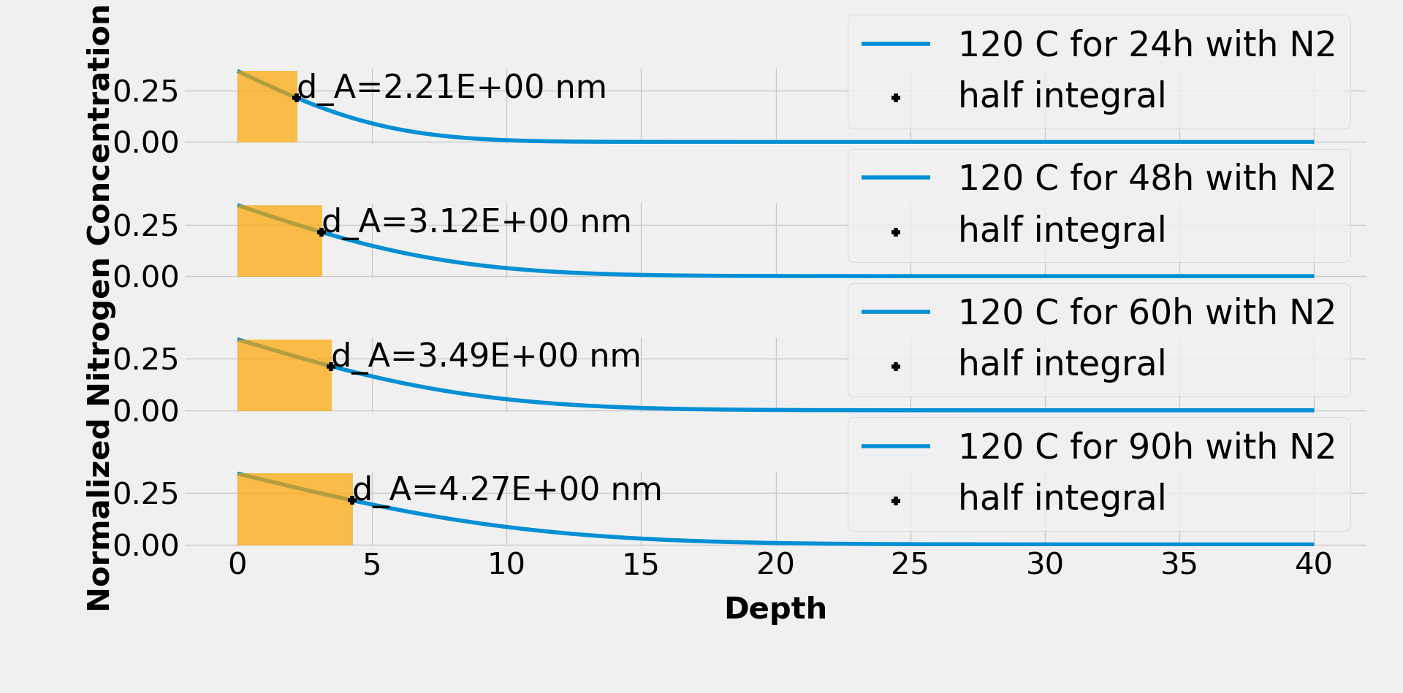
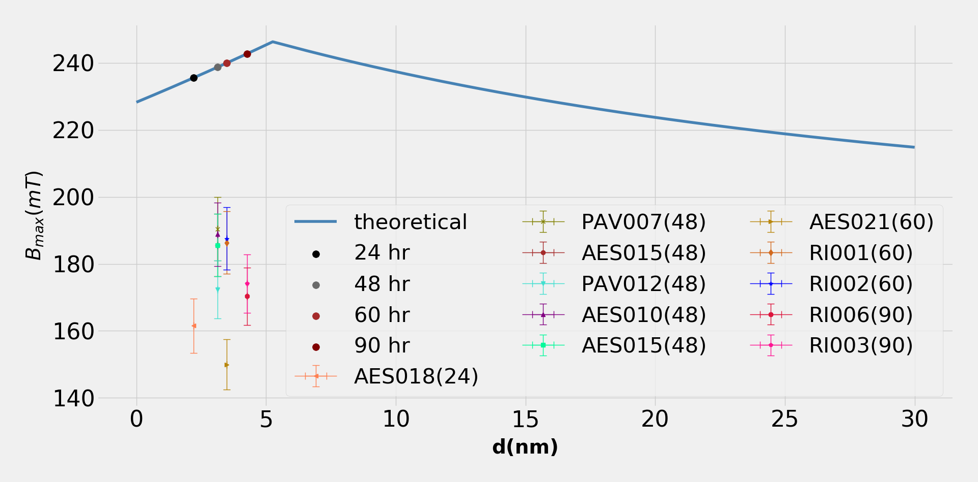
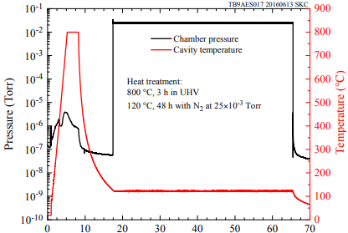
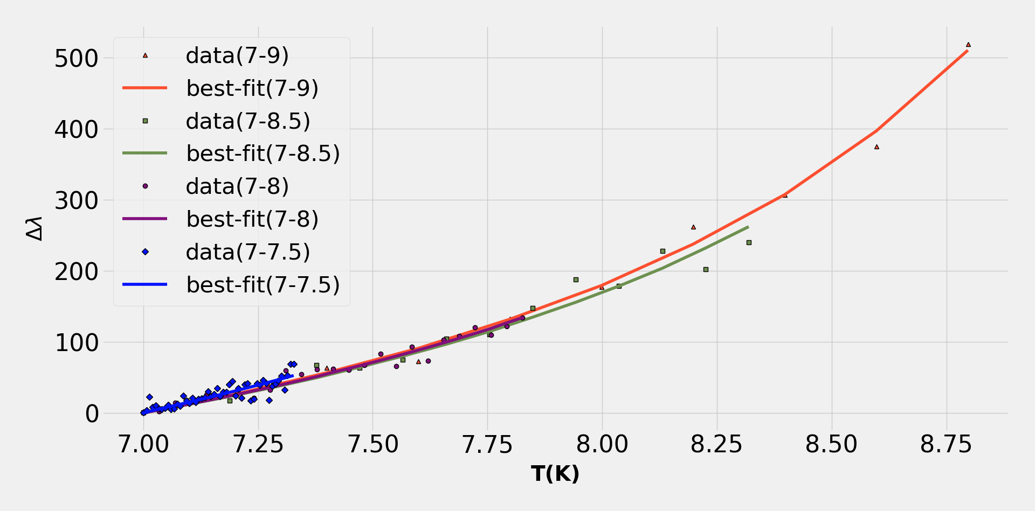
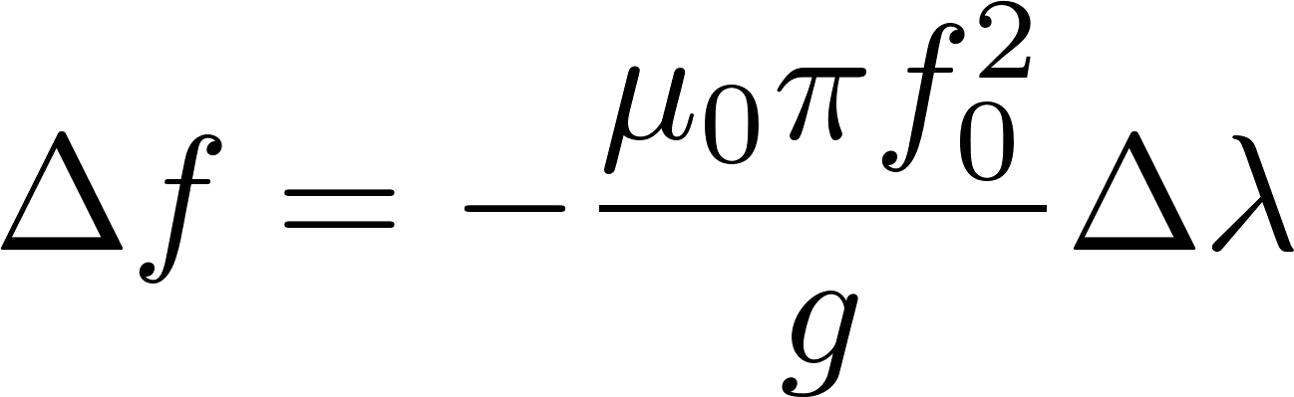
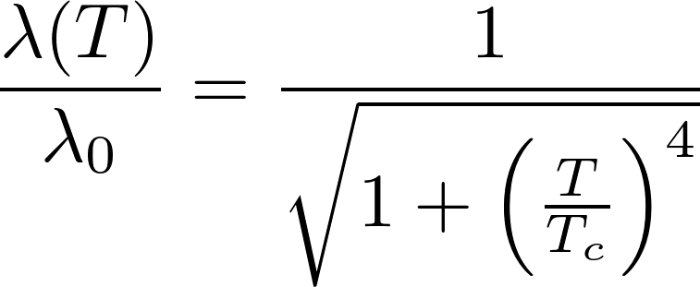
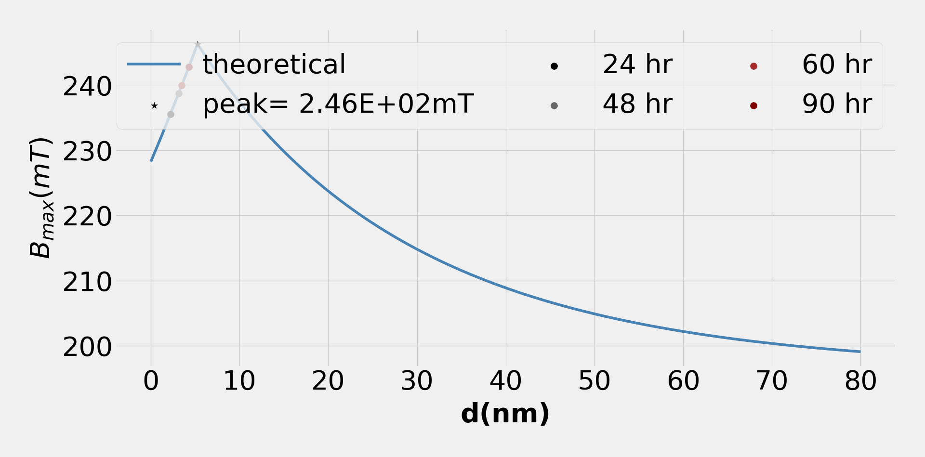

Characterizing the Dirty Layer in Superconducting RF Cavities
Anil Radhakrishnan, University of Illinois at Urbana-Champaign – Lee Teng Internship
Mattia Checchin, Technical Division, Fermi National Accelerator Laboratory
Motivation
Cavity Testing
Theoretical Grounding
Impurity enriched surface layer is shown to create improvement in accelerating gradients achievable in SRF cavities.
Theoretical investigations show the gradients can be further improved by tuning this layer.
N-infused cavities prepared at the same temperature but different infusion duration were tested at the Vertical Test Facility to record their response to RF signal under different conditions.
To obtain the thickness of the superconductor, nitrogen concentration data was fit with Fick’s law.
The parameters obtained were used to simulate diffusion for different time scales.
Background
Cavities
RF cavities are devices used to accelerate charged particles in accelerators by creating a resonant electromagnetic field in RF range.
Superconducting cavities are used in most high-energy accelerators due to their reduced power consumption and high accelerating gradient (~45 MV/m).
Nitrogen Infusion
N-infusion modifies the first ~100 nm of the cavity by adding interstitial nitrogen.
Typical treatment involves:
The half concentration point is taken as depth of
film in the simulation. The experimental data is then
overlaid on it
BCS Fitting
The data processing and BCS fitting was performed in Python after implementing a wrapper for Halbritter program in C. The module is capable of easily handling bulk data and resulted in a ~4800% increase in computational speed.
The BCS fit of this data lets us extract parameters like mean free path (MFP), which are useful for characterizing the superconducting material.
Cavities that are treated for
3 hours at 800 °C in HV.
Nitrogen is then injected at 120 °C.
Conclusions
Kubo’s Model
An efficient software for BCS theory based data analysis was developed. This allowed for:
  Effortless handling of bulk data.
  ~4800% increase in computational speed.
The MFP at surface and the N₂ concentration profile was used to compare the maximum quench field achieved in N-infused cavities with a theoretical model.
Predicted quench field values were higher than what experimentally measured. Such a discrepancy can be explained by:
  Local defects in the cavity limiting the gradient.
  The model being developed in the London limit.
  Simulating diffusion profiles with only one diffusion constant from concentration profile at 48 hours.
For theoretical analysis, we use a Superconductor-Superconducting substrate model proposed by Takayuki Kubo.
Nb surface after the low-temperature nitrogen infusion has a depth-dependent penetration depth which can be described by an S-S bilayer with a thin dirty Nb and a clean Nb substrate as the simplest model.
The model lets us
calculate the maximum
and optimal magnetic
fields for a given
thickness of superconductor, which is then used to find optimal thickness for best accelerating gradient.
Superconductor
Superconducting
Substrate
Acknowledgments
I’d like to thank my mentor, Mattia Checchin, and the Lee Teng program administrator, Peter Garbincius, for their mentorship and support, and Oleksandr Melnychuk for help during VTS testing.
[1] Kubo, T. “Multilayer coating for higher accelerating fields in superconducting radio-frequency cavities: a review of theoretical aspects.” Superconductor Science and Technology 30, 023001 (2017).
[2] Halbritter, J. “On the penetration of the magnetic field into a superconductor.” Z. Physik 243, 201–219 (1971).
August 9, 2018

