Slide 1
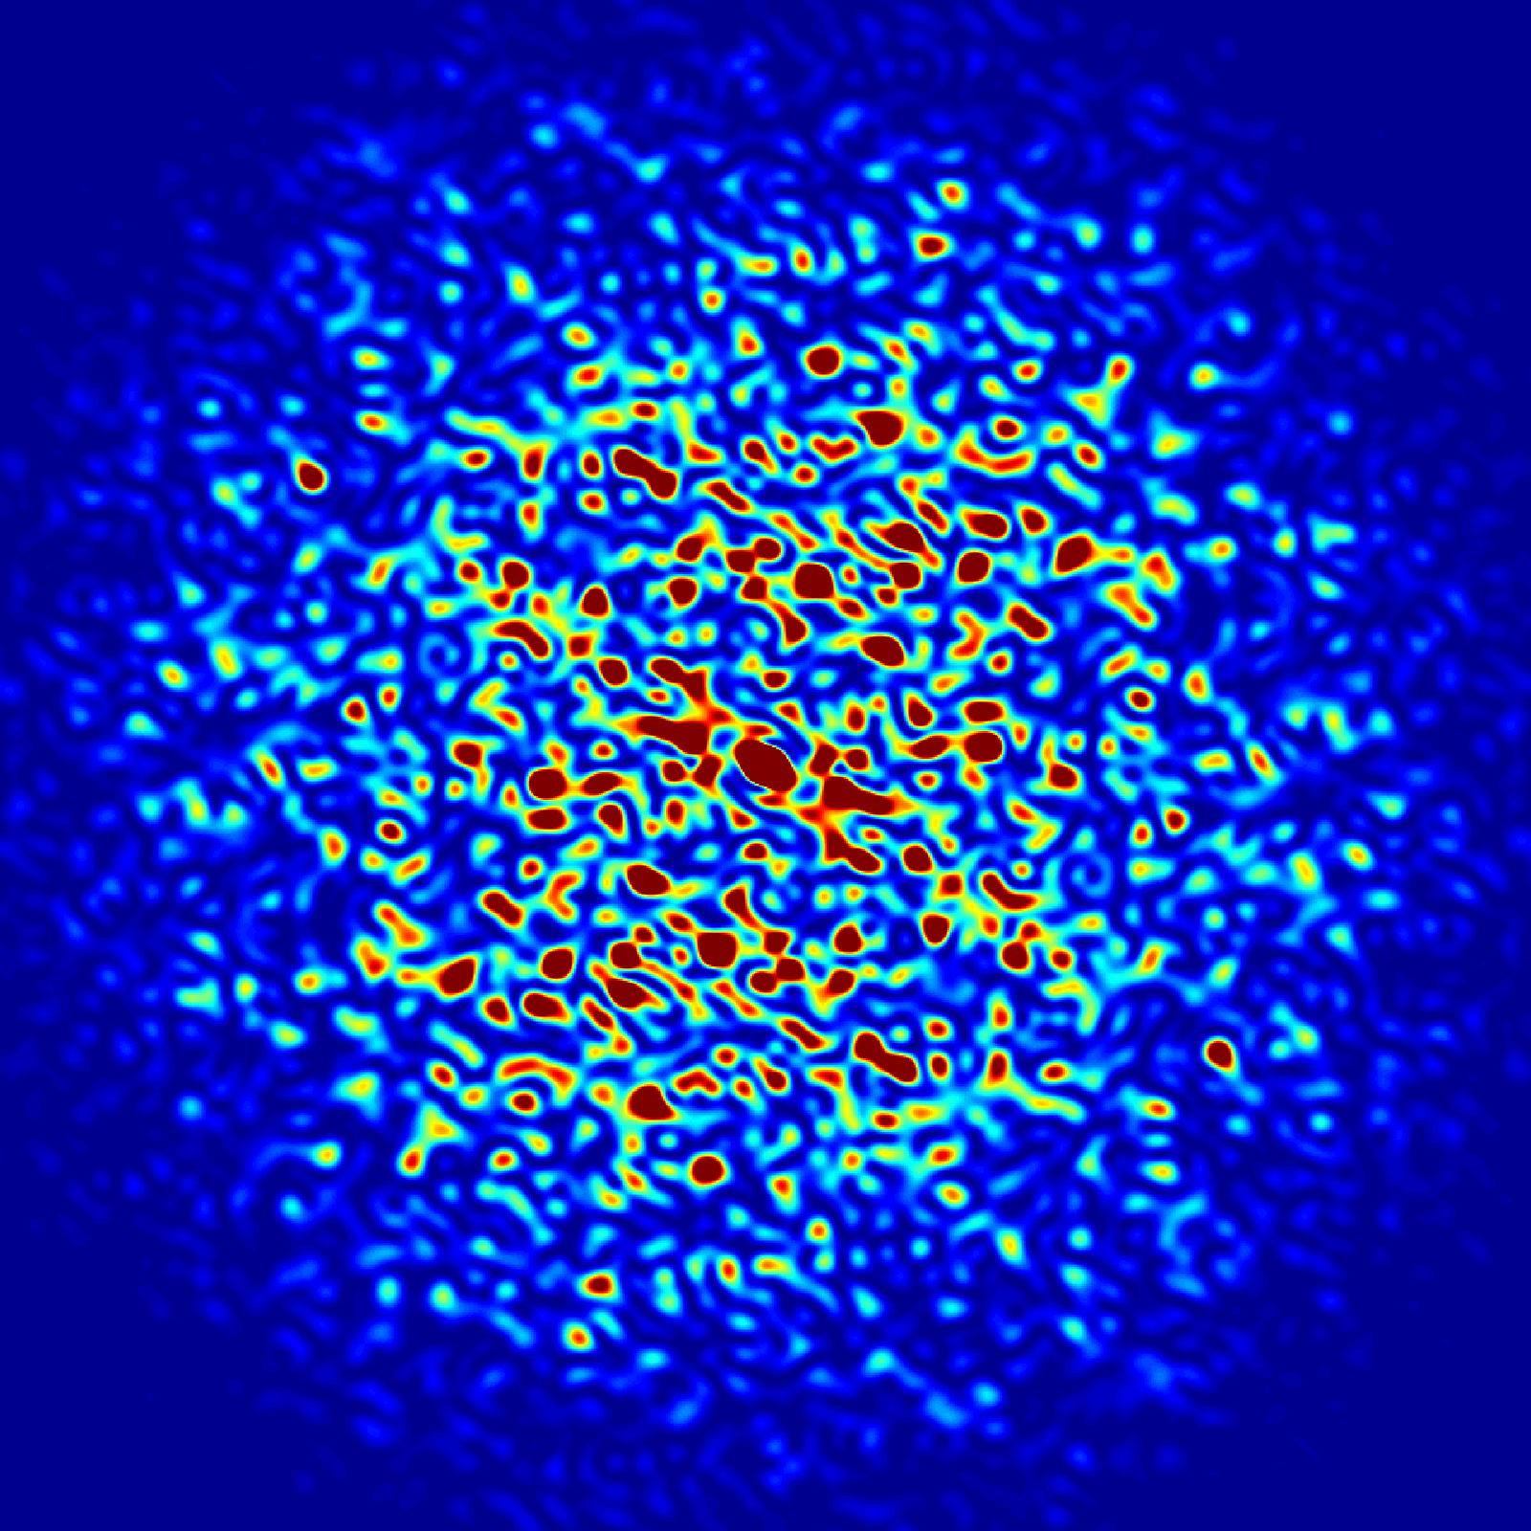
Improving Beam Stability in the APS Booster Synchrotron
Chang Xu
J. Calvey, K. Harkay, C. Yao
Aug 8th, 2018
Notes:
1
Univ of Chicago Review, Aug. 30, 2010
1

Slide 2
Outline
Tune measurements
Controlling the beam with reference ramp files
Simulation
Verifying the simulation with more measurements
Controlling coupling by bringing the tunes together
Attempts to straighten the tunes
Conclusions and future work

Slide 3
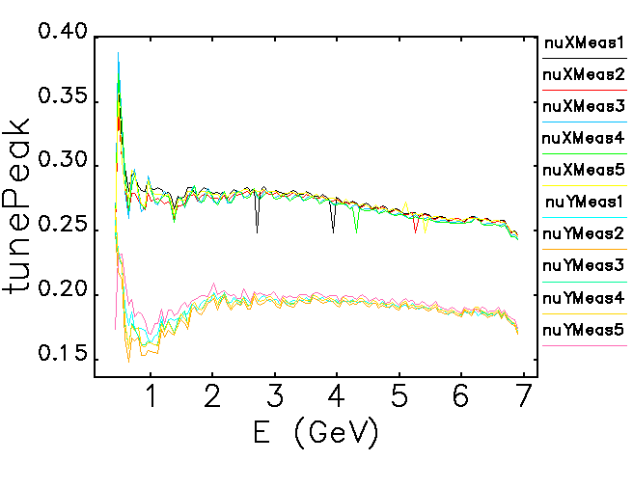
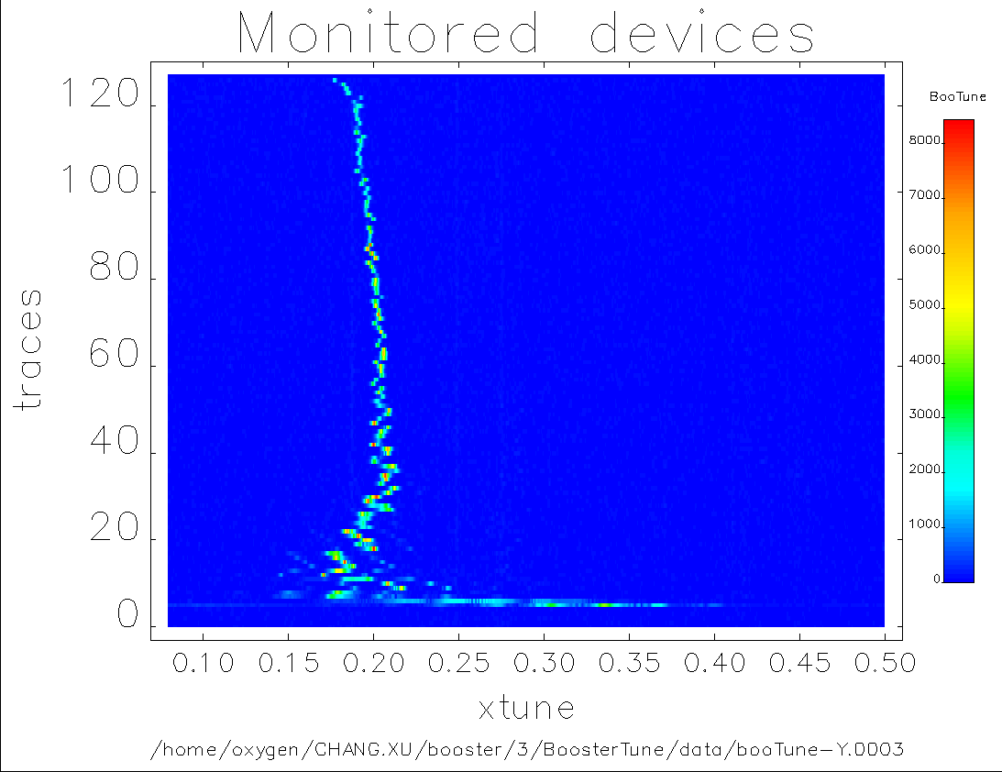
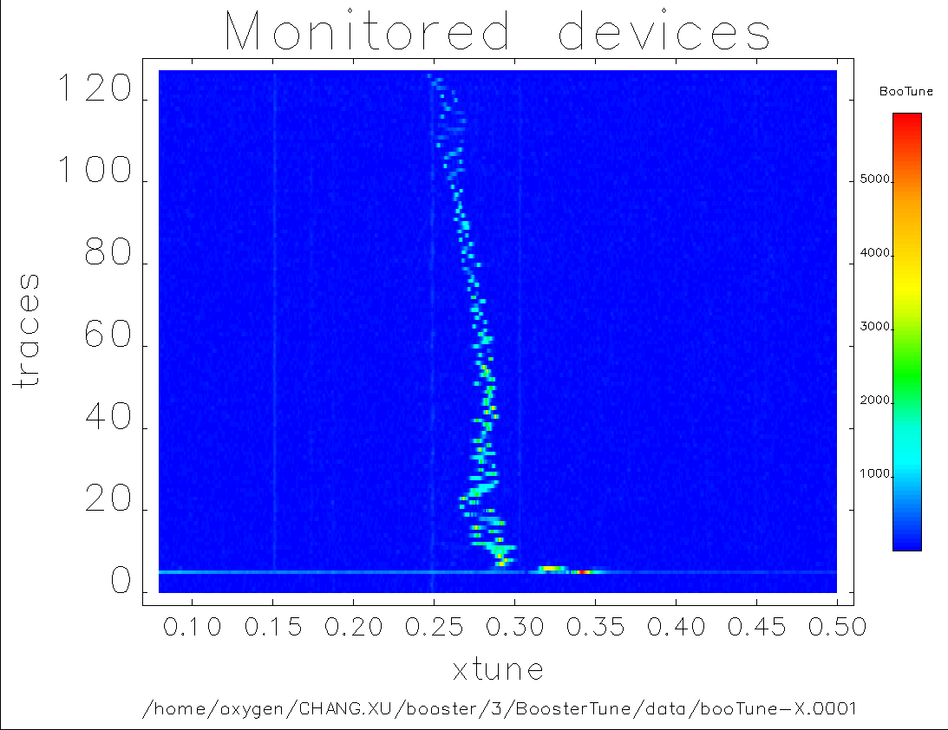
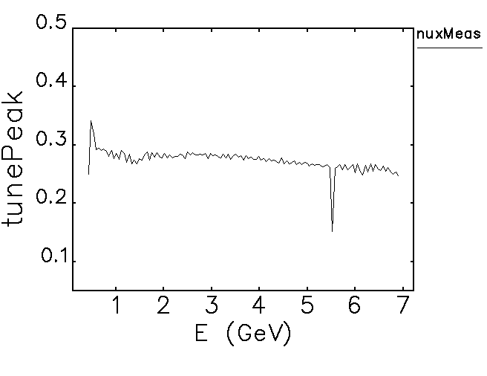
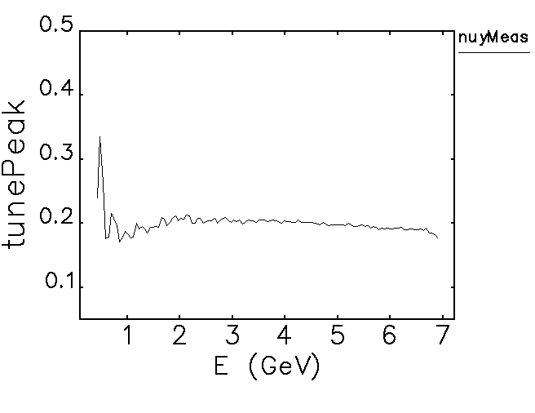
Tune measurements
Tune: Frequency of the transverse motion.
Desired to be straighter, nux=11.75, nuy=9.8.
The booster accelerates the beam from 0.425GeV to 7GeV.
The fractional tunes:

Slide 4
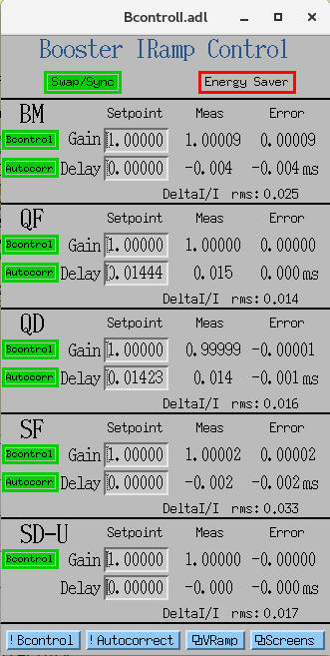
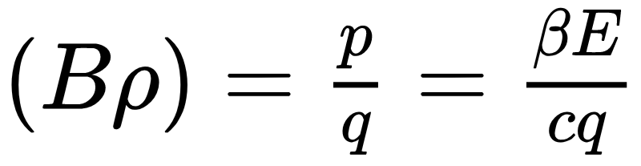
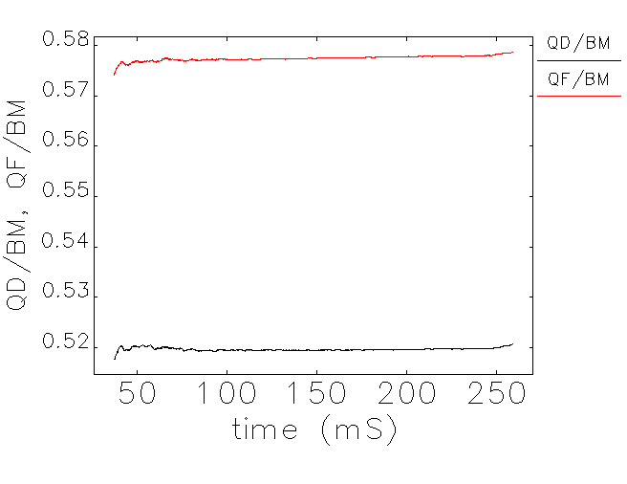
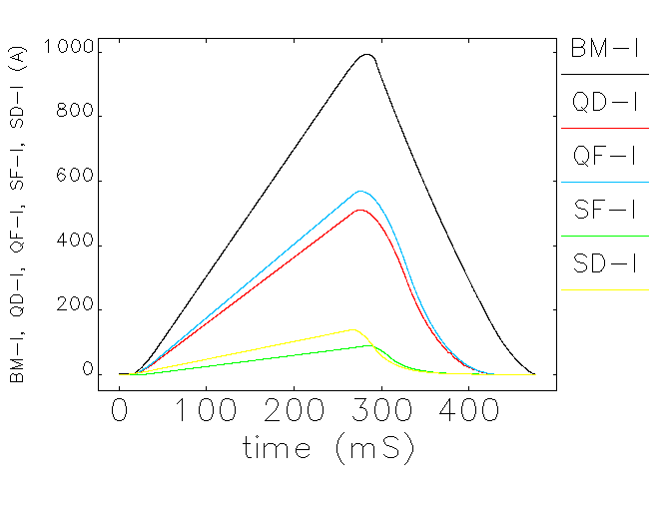
Controlling the beam with reference ramp files

Slide 5
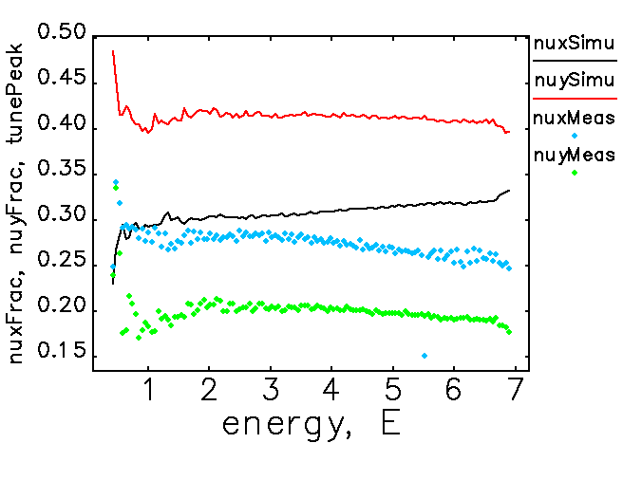
Simulation
A few parameters have to be modified and recalculated for simulation.
Fix BM (injection time and energy).
With correct injection time, extraction time and energy, we run particle tracking simulation in elegant¹ with 125 interpolated points based on the reference ramp file.
Fix quadrupoles (gains and delays).
M. Borland. "elegant: A flexible sdds-compliant code for accelerator simulation." Technical Report LS-287, Advanced Photon Source, September 2000.

Slide 6
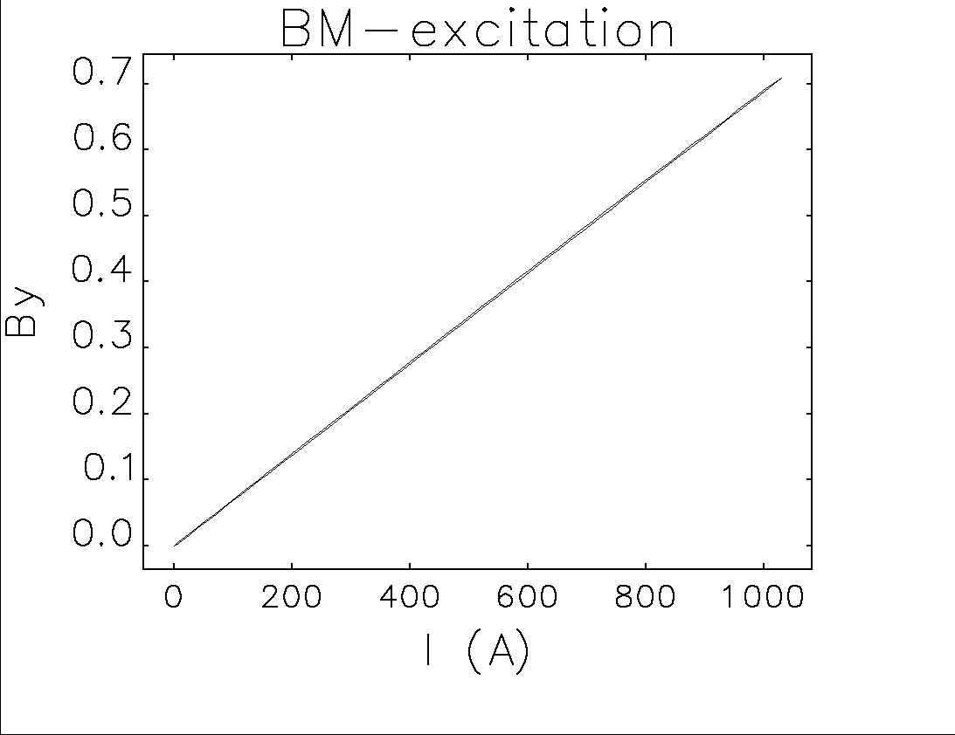
Simulation - fix BM
Match time with energy for injection and extraction (injTime=38.499, rampTime=222.814)
time ∝ I ∝ By ∝ energy
fudgeFactor:
By = fudgeFactor * (BMSlope * I + offset)
fudgeFactor * BMSlope = ΔBy/ΔI = 0.0007514
=>fudgeFactor = 1.09099
offset = 0 => injection time = 35.59ms
extB=0.701
slope=0.0007514
injB=0.0425
injI=56.563
extI=932.968

Slide 7
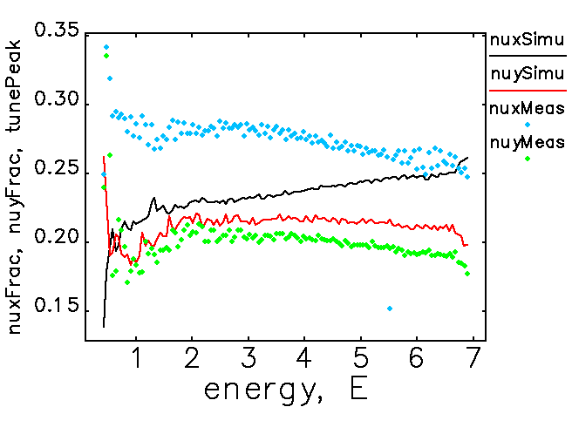
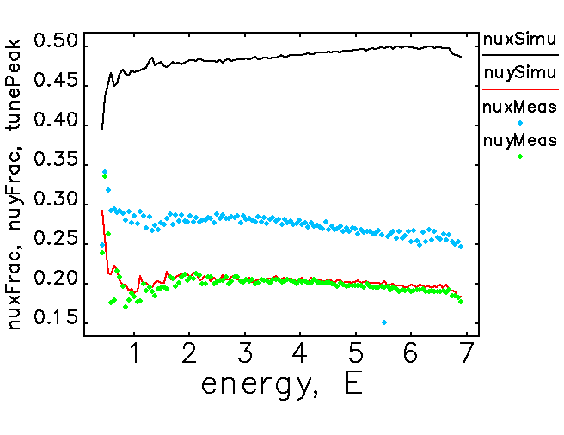
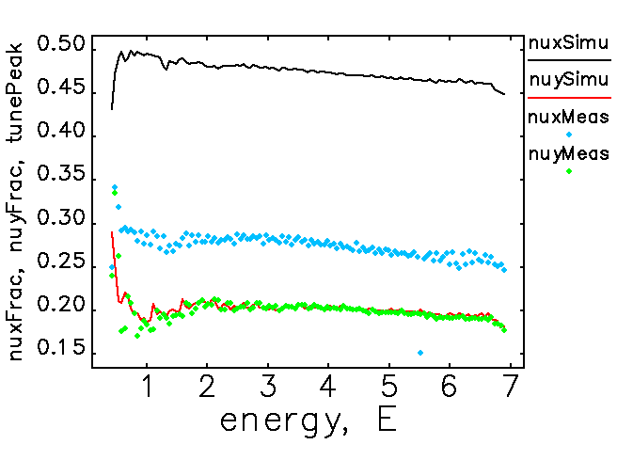
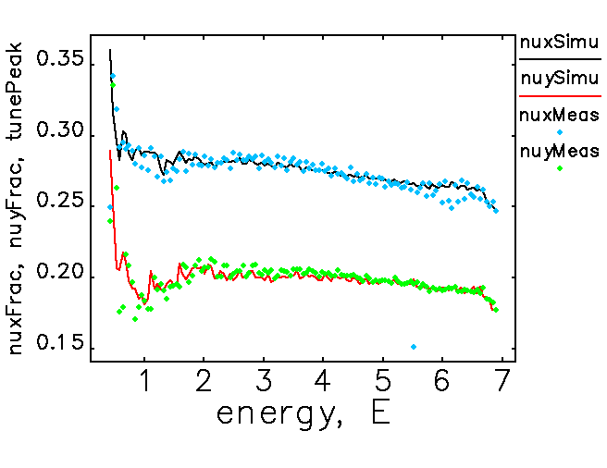
Simulation - fix quadrupoles
Quadrupole reference ramp is manipulated by “gains” and “shifts”, which simulate “gains” and “delays” in the control panal.
From inspection, “gain” generally moves the whole picture up or down; “shift” tilts the low energy tail but has little effects on high energy tail.
4 parameters: QDGain, QDShift, QFGain, QFShift
QDGain QDShift QFGain QFShift
(nuy_f) (SSEy) (nux_f) (SSEx)
↑ ??? ??? ???
✔ ↑ or ↓ ??? ??? (stop changing QDGain when nuy ≈ 9.8)
✔ ✔ ??? ??? (stop changing QDShift When SSEy is small)
✔ ✔ ↑ ??? (pause QFGain When QDGain/QDShift is off)
✔ ✔ ✔ ↑ or ↓ (stop changing QDGain when nux ≈ 11.75)
✔ ✔ ✔ ✔ (finish when SSEy is small)

Slide 8
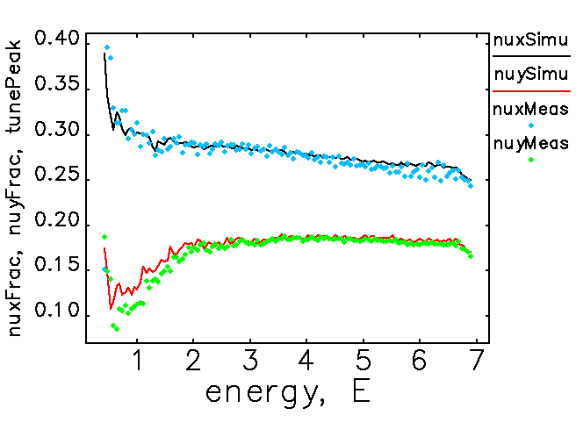
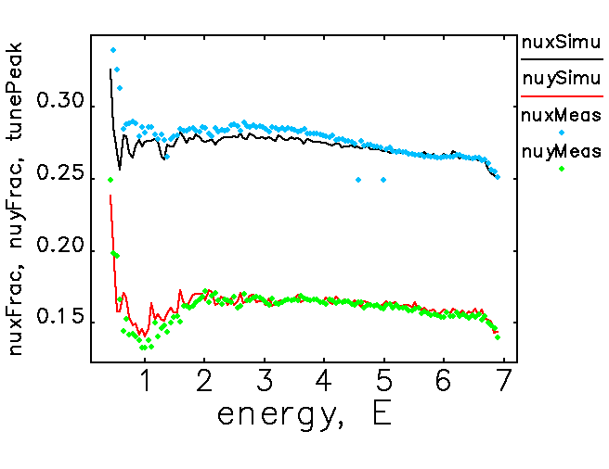
Verify the simulation with more measurements
[QD gain = 1.002] [QD shift = 0.104]
Vary quadrupole parameters on top of
the simulation result.
Try experiments with the same variation.
Compare.

Slide 9
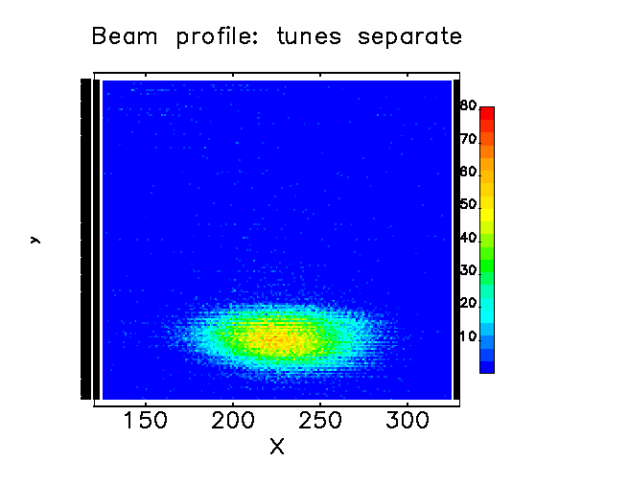
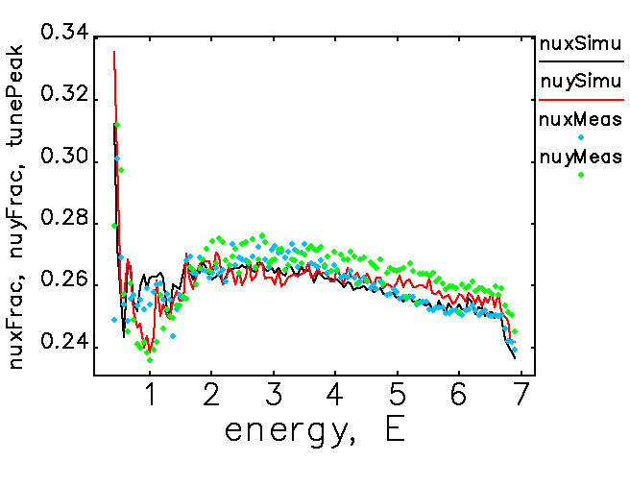
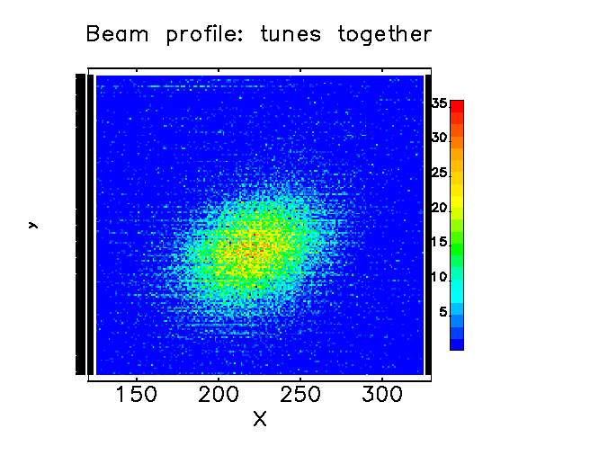
Controlling coupling by bringing the tunes together
Try bringing both the tunes together.

Slide 10
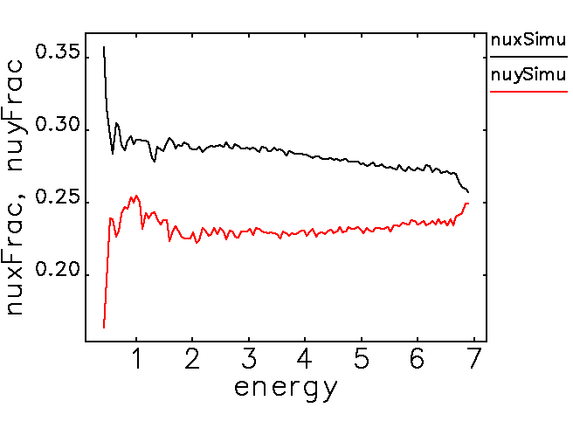
Controlling coupling by bringing the tunes together
Try bringing both the tunes together.
Try curving the high energy tail.

Slide 11
Controlling coupling by bringing the tunes together
Try bringing both the tunes together.
Try curving the high energy tail.
  Shift nuy to be around 9.25 instead of 9.8.

Slide 12
Attempts to straighten the tunes
Try simply shifts.
Try adding bumps.

Slide 13
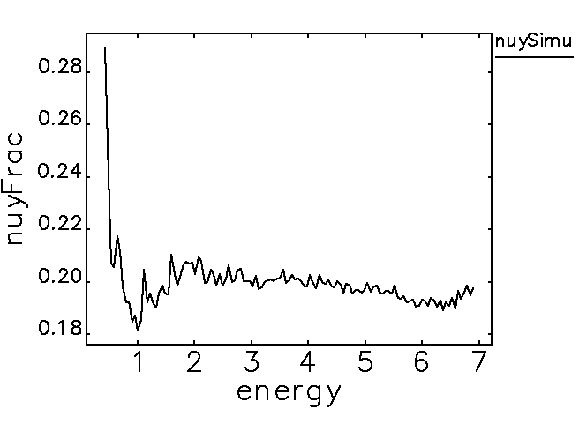
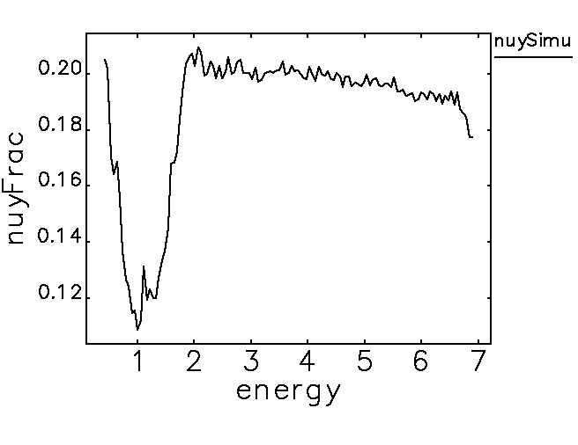
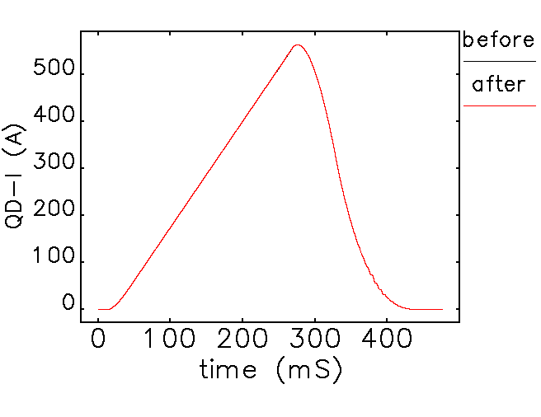

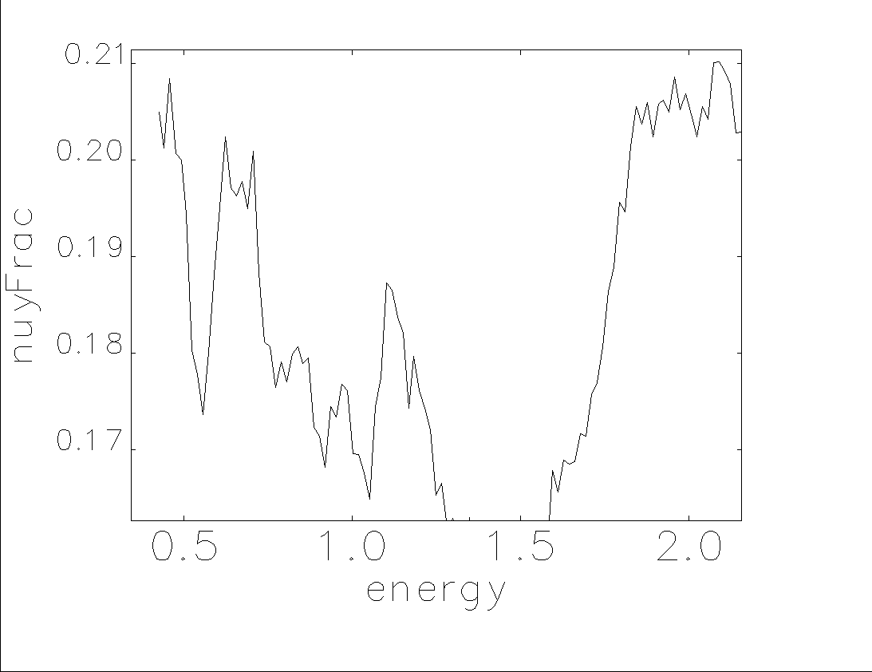
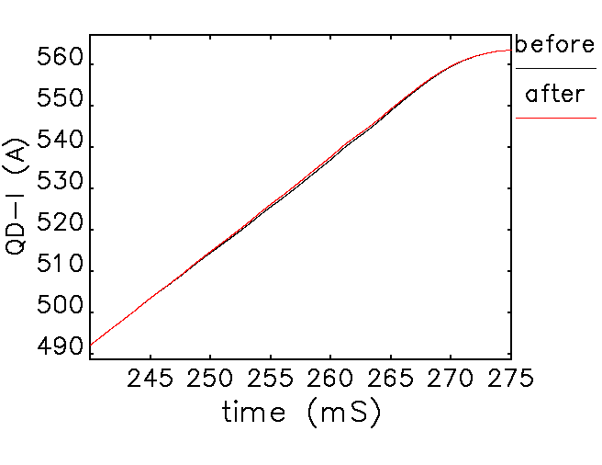
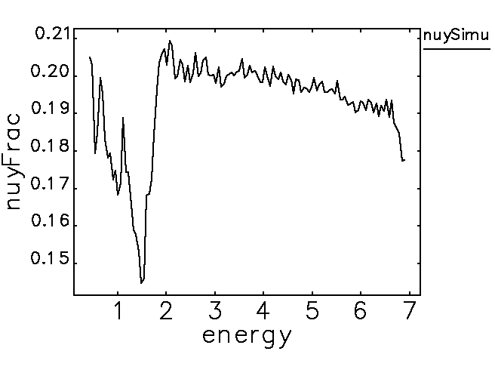
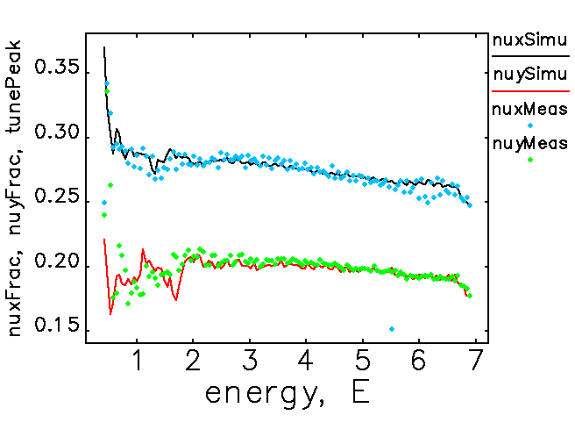
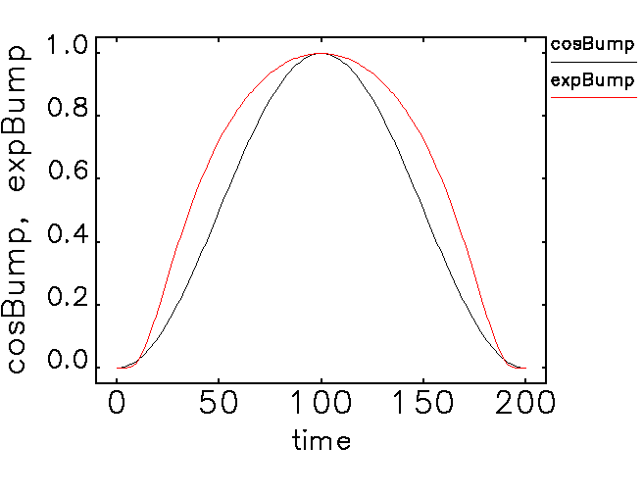
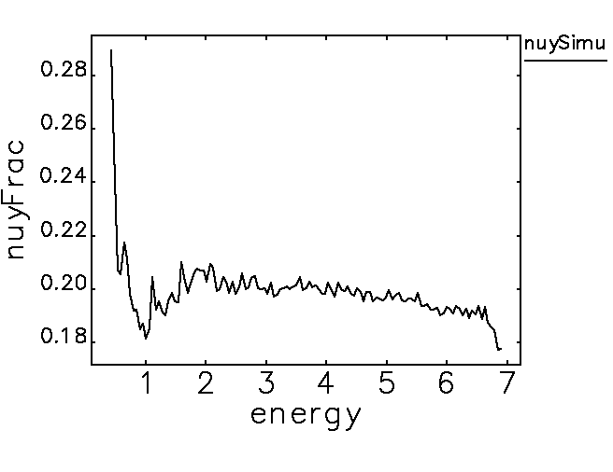
-0.7 bump -0.5 bump
(with 400 points)

Slide 14
Conclusions and future work
Developed a way to match simulation with measurements.
Use machine learning to process the data to simulate better results considering sextupoles with chromaticity.
Understand the “zig-zags” that appear when adding bumps. Smoothing out dipole ramp might help.
Couple tunes at high energy tail to try to get a smaller x emittance.
Better eddy current calculation.

Slide 15
References
C. Yao, H. Shang, S. Xu, and G. Fystro. "A new ramp correction process for booster main supplies." Technical Report OAG-TN-2014-033, Accelerator Division, Advanced Photon Source, June 2014.
M. Borland. "elegant: A flexible sdds-compliant code for accelerator simulation." Technical Report LS-287, Advanced Photon Source, September 2000.
C. Yao and H. Shang. "Chromaticity measurement of the APS booster." In Proceedings of 2012 Beam Instrumentation Workshop, pages 225–227, 2012.
N. Sereno and S. Kim. "Eddy-current-induced multipole field calculations." Technical Report LS-302, Advanced Photon Source, September 2003.

Slide 16

Simulation - fix BM
Match time with energy for injection and extraction (injTime=38.499, rampTime=222.814)
time I By energy
injection: E=0.425GeV => B=0.0425T;
extraction: E=7GeV => B=0.701T;
measured slope of I By, BMSlope=0.0006887
injection: B=0.0425T => I=56.563mA;
extraction: B=0.701T => I=1017.84mA; (932.968)
fudgeFactor:
By = fudgeFactor * (BMSlope * I + offset)
fudgeFactor * BMSlope = ΔBy/ΔI = 0.0007514
=>fudgeFactor = 1.09099
offset = 0 => injection time = 35.59ms
extB=0.701
slope=0.0007514
injB=0.0425
injI=56.563
extI=932.968

Slide 17
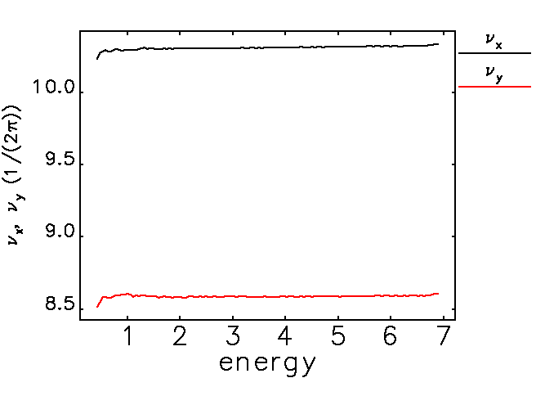
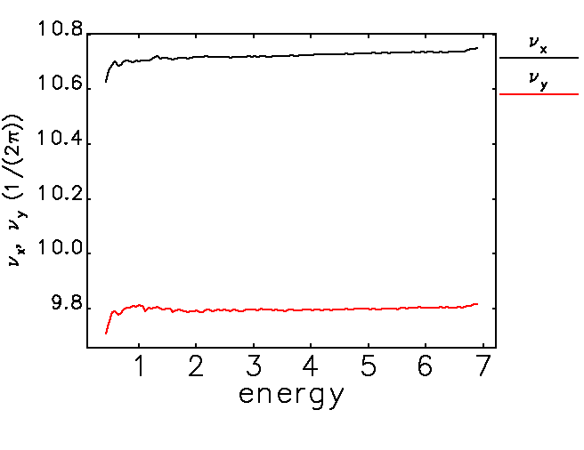
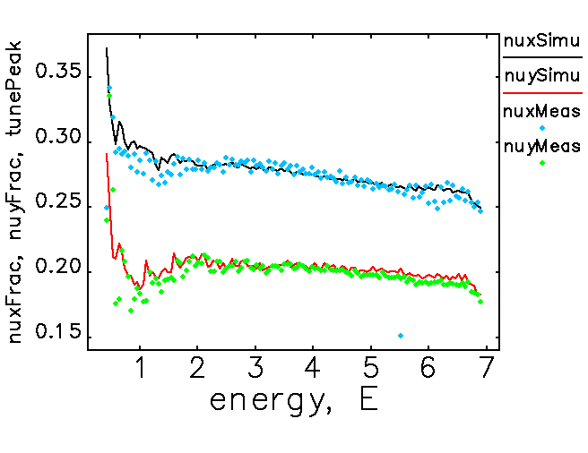
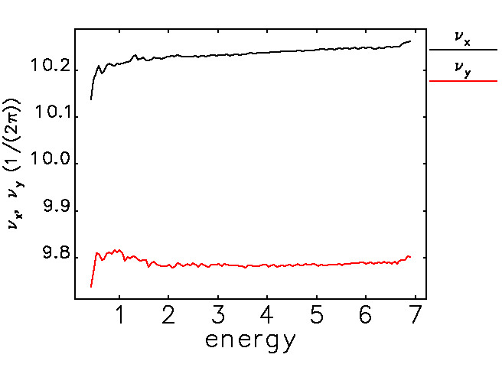
Simulation - fix quadrupoles
Quadrupole reference ramp is manipulated by “gains” and “shifts”, which simulate “gains” and “delays” in the control panal.
From inspection, “gain” generally moves the whole picture up or down; “shift” tilts the low energy tail but has little effects on high energy tail.
4 parameters: QDGain, QDShift, QFGain, QFShift
QDGain QDShift QFGain QFShift
(nuy_f) (SSEy) (nux_f) (SSEx)
↑ ??? ??? ???
✔ ↑ or ↓ ??? ??? (stop changing QDGain when nuy ≈ 9.8)
✔ ✔ ??? ??? (stop changing QDShift When SSEy is small)
✔ ✔ ↑ ??? (pause QFGain When QDGain/QDShift is off)
✔ ✔ ✔ ↑ or ↓ (stop changing QDGain when nux ≈ 11.75)
✔ ✔ ✔ ✔ (finish when SSEy is small)

Slide 18
Simulation - fix quadrupoles
Quadrupole reference ramp is manipulated by “gains” and “shifts”, which simulate “gains” and “delays” in the control panal.
From inspection, “gain” generally moves the whole picture up or down; “shift” tilts the low energy tail but has little effects on high energy tail.
4 parameters: QDGain, QDShift, QFGain, QFShift
QDGain QDShift QFGain QFShift
(nuy_f) (SSEy) (nux_f) (SSEx)
↑ ??? ??? ???
✔ ↑ or ↓ ??? ??? (stop changing QDGain when nuy ≈ 9.8)
✔ ✔ ??? ??? (stop changing QDShift When SSEy is small)
✔ ✔ ↑ ??? (pause QFGain When QDGain/QDShift is off)
✔ ✔ ✔ ↑ or ↓ (stop changing QDGain when nux ≈ 11.75)
✔ ✔ ✔ ✔ (finish when SSEy is small)

Slide 19
Simulation - inspecting sextupoles and eddy current
Sextupole parameters could be determined by looking at plots of chromaticity vs. energy with algorithm similar to the one used for quadrupole.
Sextupole parameters are not varied in the simulation.
Eddy current effect is considered in the process but needs further verification on the actual value.

Slide 20
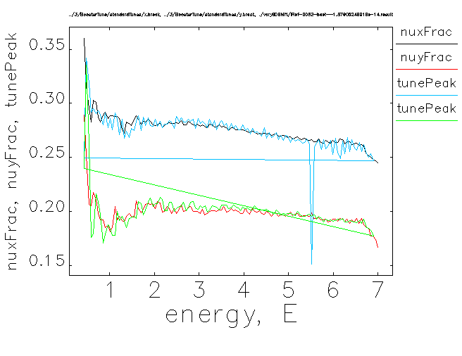
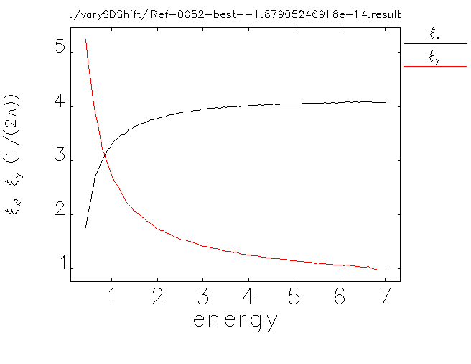
Simulation - inspecting sexts
Varying SD Shift:
[original]:
tunes plot chromaticity plot

Slide 21
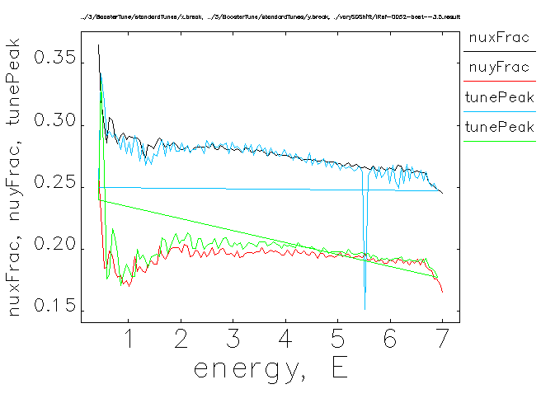
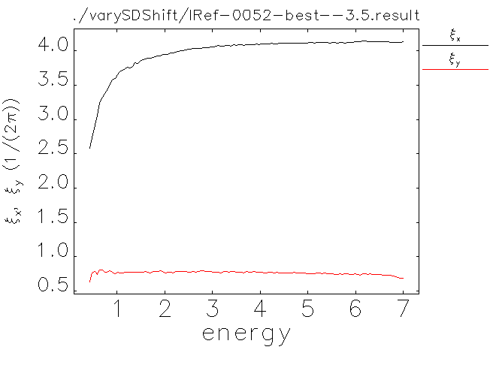
Simulation - inspecting sexts
Varying SD Shift:
[SDShift = -3.5]:
tunes plot chromaticity plot

Slide 22
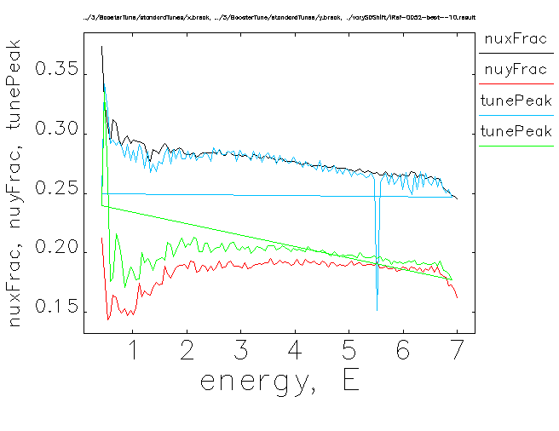
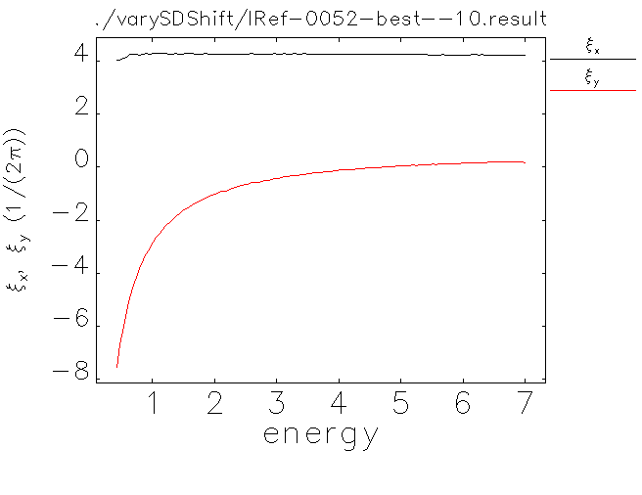
Simulation - inspecting sexts
Varying SD Shift:
[SDShift = -10]:
tunes plot chromaticity plot

Slide 23
Simulation - inspecting sexts
Varying SD Gain:
[original]:
tunes plot chromaticity plot

Slide 24

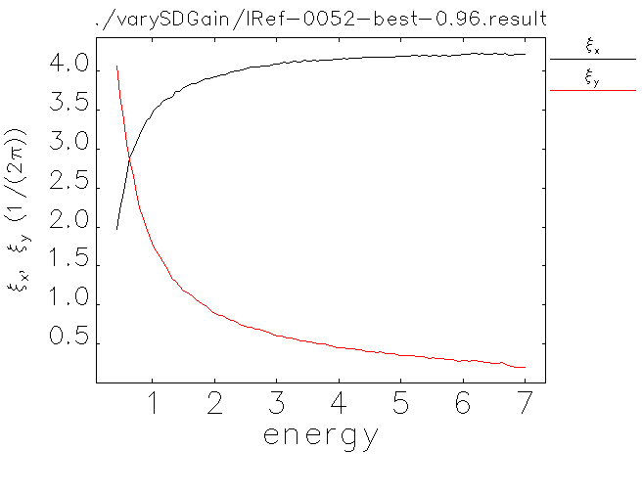
Simulation - inspecting sexts
Varying SD Gain:
[SDShift = -10]:
tunes plot chromaticity plot

