Slide 1
Active ganging status July 2018
Dante Totani, Ken Treptow, Gustavo Cancelo

Slide 2
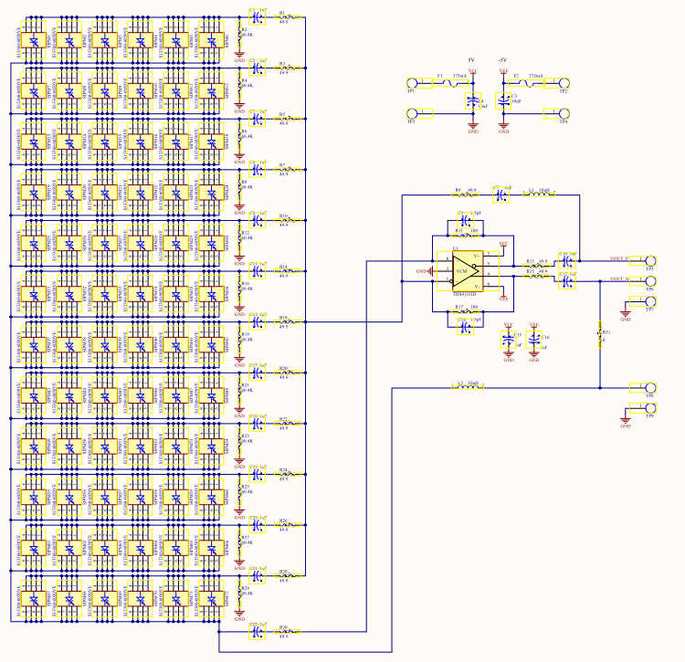
72 SiPM active ganging board: 12 x 6 matrix
Each row has 6 MPPCs in parallel.

Slide 3
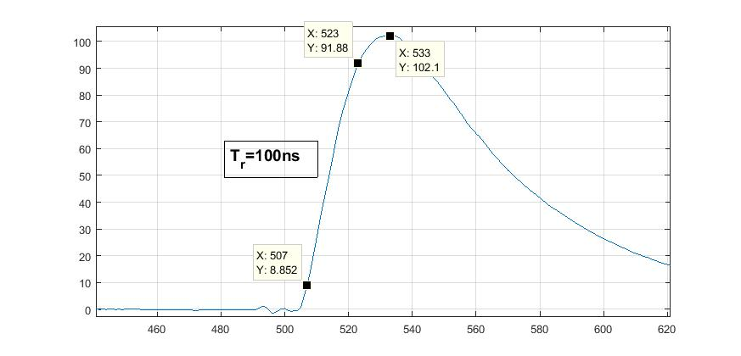
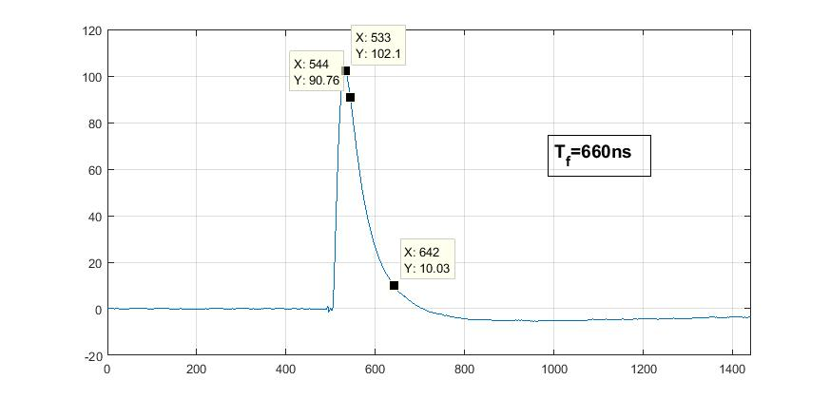
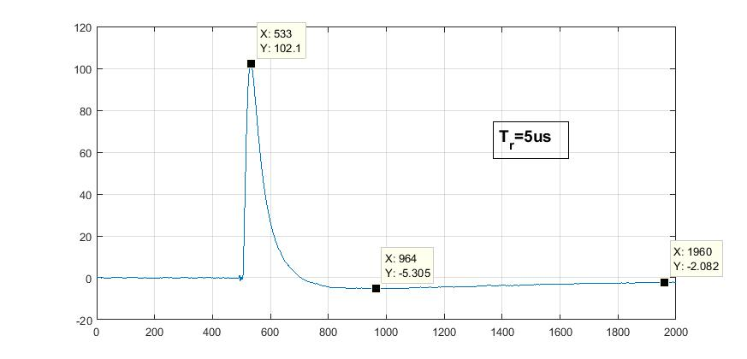
Mean signal 72 MPPCs at -70C and Vb=47
Rise time 100ns, Fall time 660ns, slow undershoot recovery.
SSP time constant has not been modified.

Slide 4
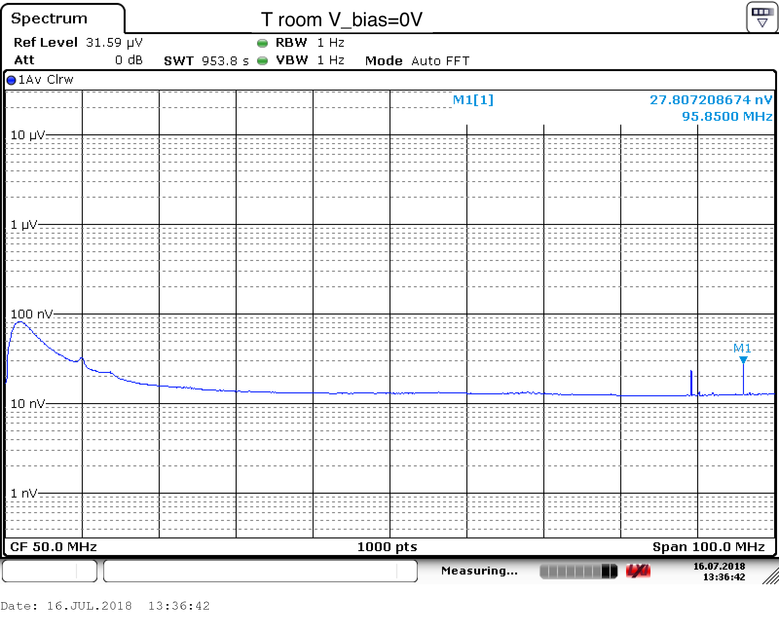
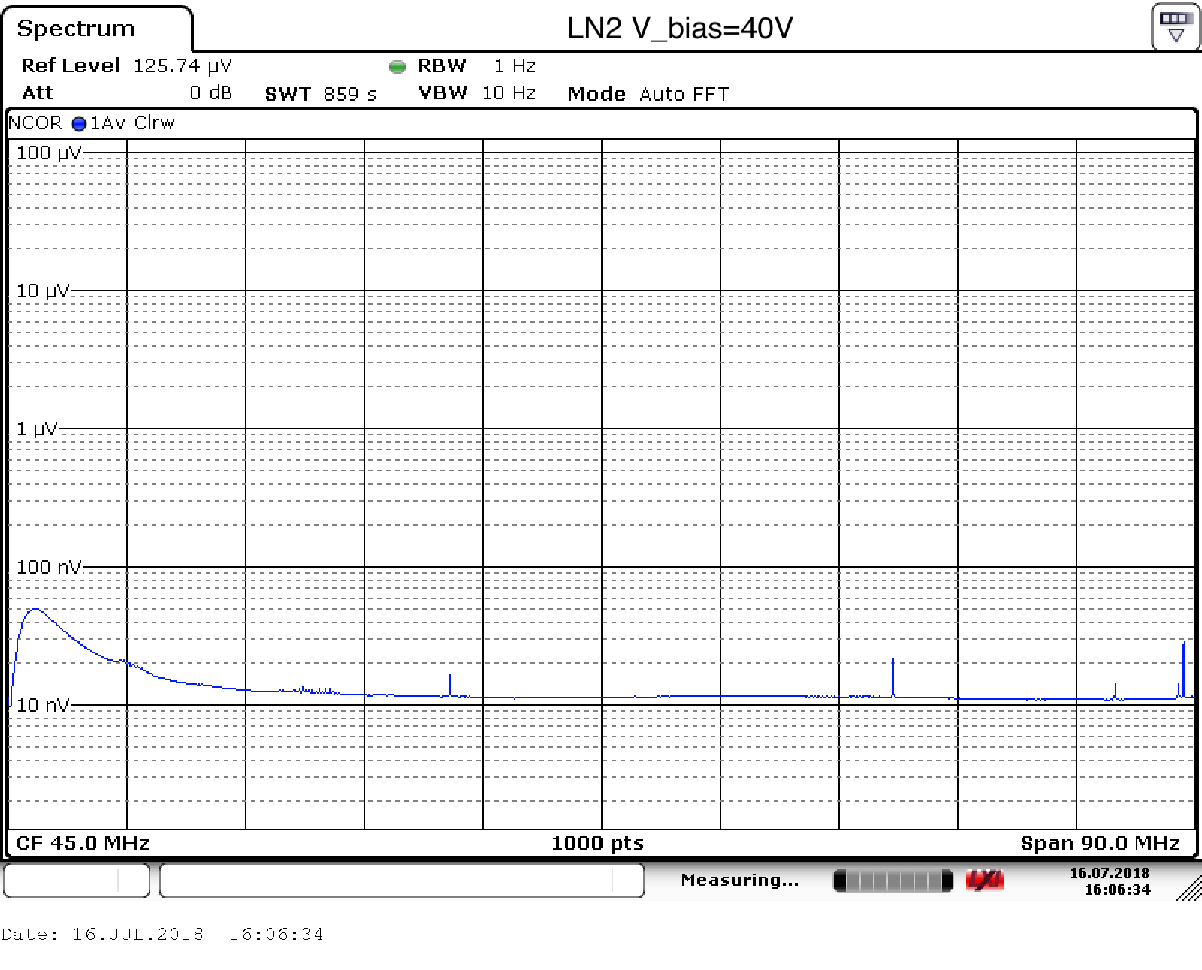
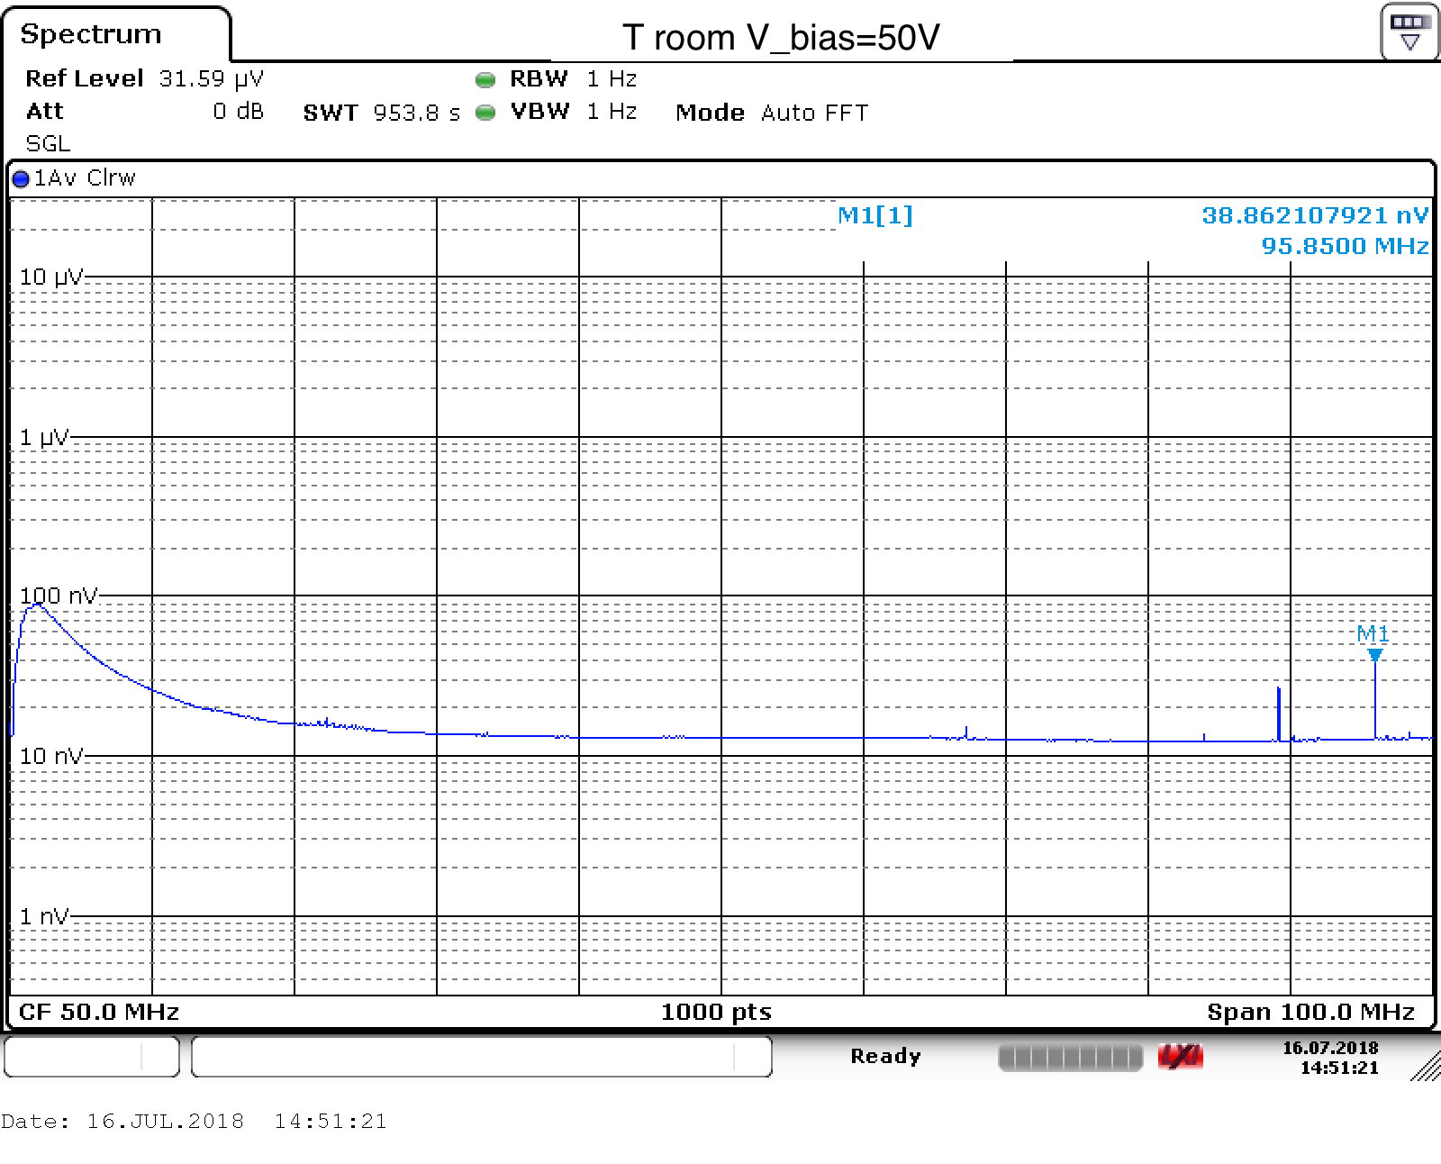
Noise spectrum
Noise is 10nV/sqrt(Hz)
1/f at lower frequencies.
It does not vary much with T and Vb

Slide 5
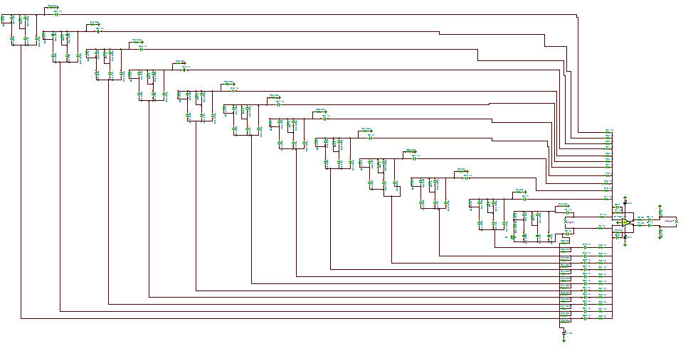
Simulations
Simulations are in agreement with results from data.

Slide 6
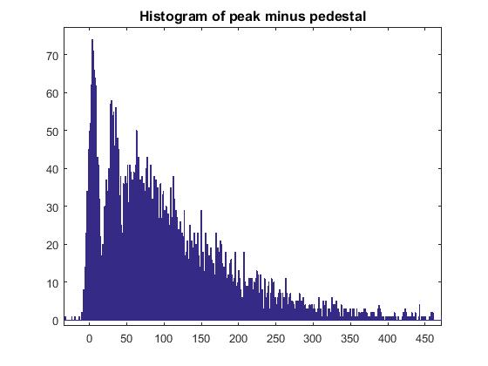
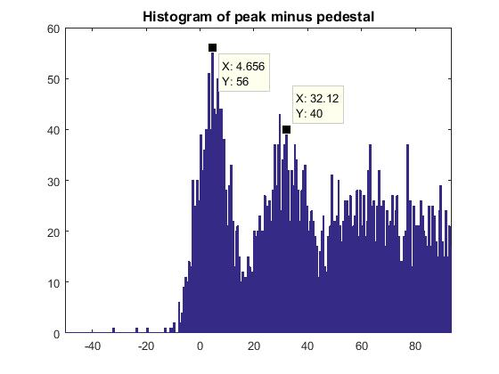
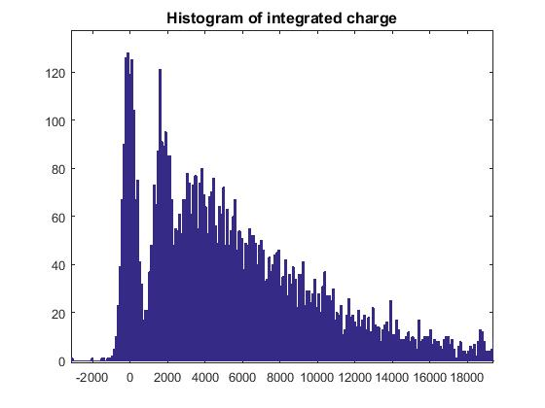
Mean signal 72 MPPCs at LN2 and Vb=47
Noise is about 7 ADUs FWHM

Slide 7
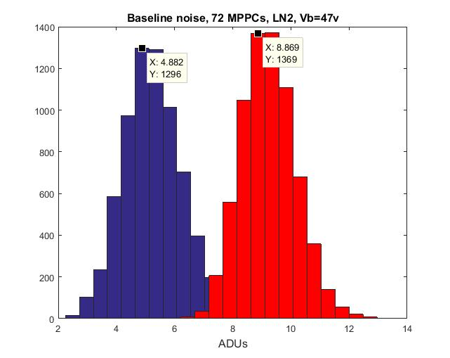
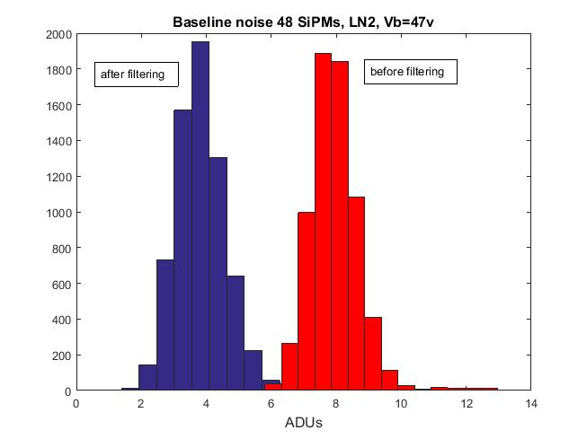
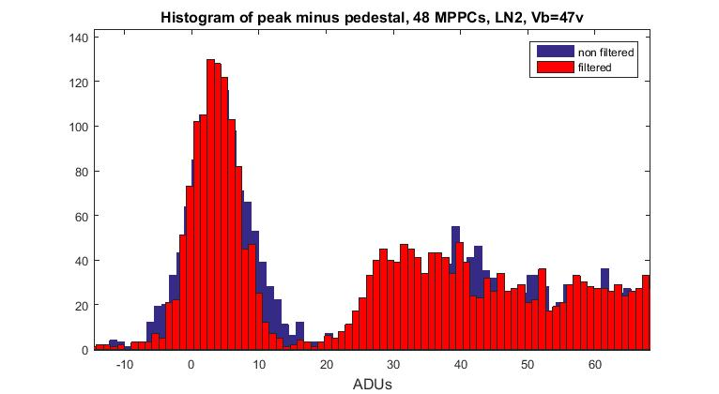
Filtering the signal with a matched filter (50 taps long)
Histograms of
σ_{noise}
Good reduction of noise by filtering.
The 1st, 2nd PE spectrums do not change.
Histograms of
Noise and 1st , 2nd PE

Slide 8
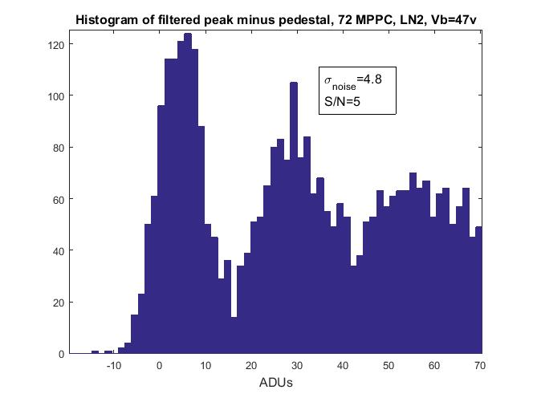
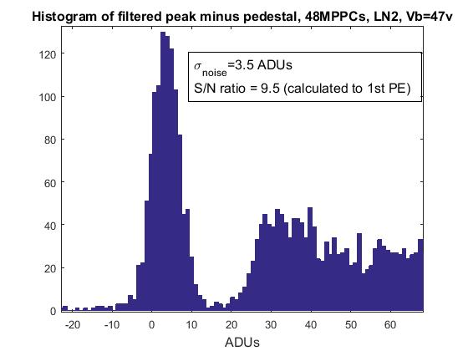
72 MPPCs vs 48 MPPCs
72 MPPCs: noise is higher and signal is smaller. S/N=5.
48 MPPCs: S/N=10.
S/N measured as the fit of the 1st PE peak to the σ_{noise}.

Slide 9
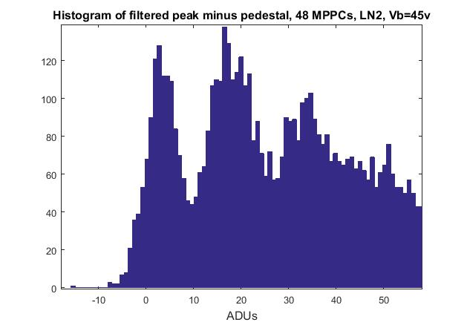
Effect of bias voltage on 48 MPPC
48 MPPCs Vb=47v: S/N=10.
48 MPPCs Vb=45v: S/N=5.
S/N measured as the fit of the 1st PE peak to the σ_{noise}.
For Vb=45v the 1st and 2nd PE histograms are better defined. Probably due an effect of Vb in the relative gains.

Slide 10
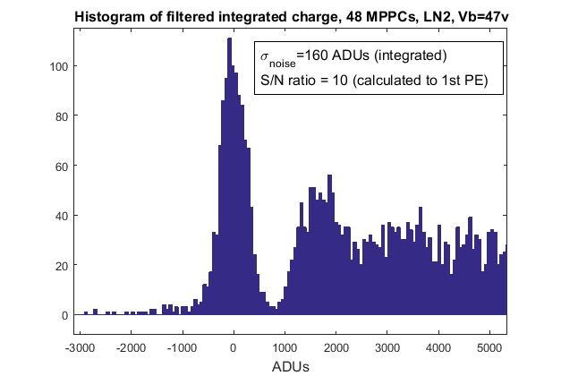
Peak minus baseline vs integrated charge (0.6usec)
Very similar S/N.

Slide 11
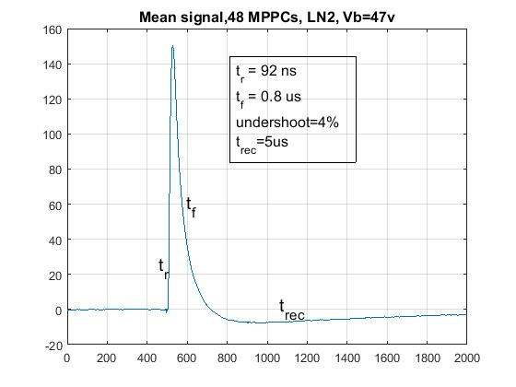
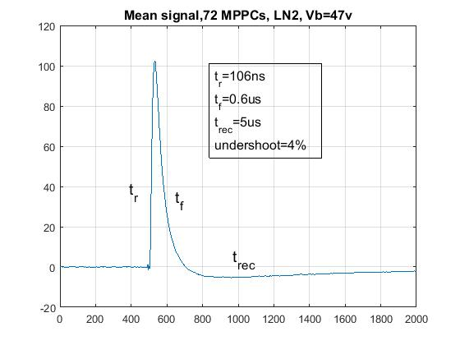
Mean signal 48 MPPC
Rise time increases from 10% from 48 MPPCs to 72

Slide 12
Conclusions
Board operates correctly with 48 and 72 MPPCs.
Noise is low
Simulations and measurements are in agreement.
Characterization will continue.
NIU will probably help.

