Slide 1
Can Space Charge Stabilize a Bunch Greatly?
Alexey Burov
Fermilab
Many thanks to T. Zolkin and E. Metral
APC talk, Aug 1 & 2, 2018
AB

Slide 2
Problem
Single bunch in a circular machine;
Linear optics;
Zero chromaticity;
Short wake;
Space charge (SC);
Can SC make bunch transverse coherent oscillations (much) more stable?
AB

Slide 3
What we know
Threshold wake of the transverse instability (TMCI) may be elevated significantly by SC (Theory)
It had to be elevated by the strong SC at CERN SPS Q26 (Theory)
This did not happen (CERN observations and macroparticle simulations)
AB

Slide 4
What we do not know
Threshold wake of the transverse instability (TMCI) may be elevated significantly by SC (Theory)
It had to be elevated by the strong SC at CERN SPS Q26 (Theory)
This did not happen (CERN observations and macroparticle simulations)
What is wrong in the picture?
AB

Slide 5
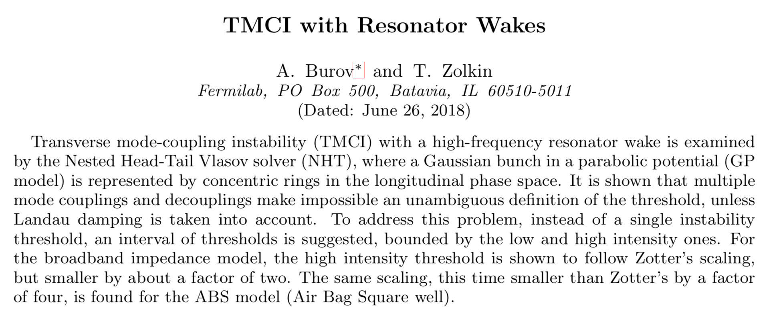
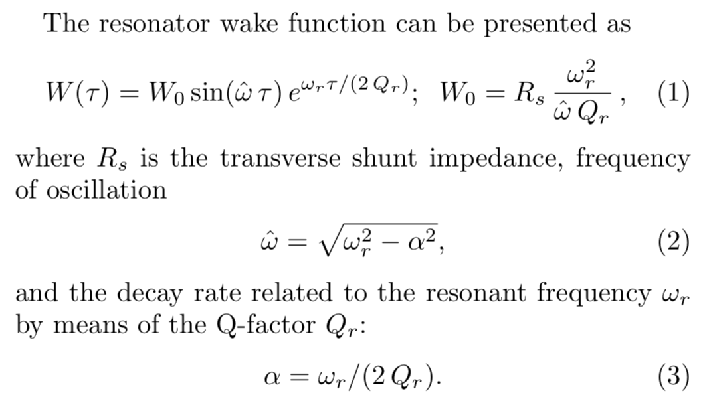
No SC
https://arxiv.org/abs/1806.07521
AB

Slide 6
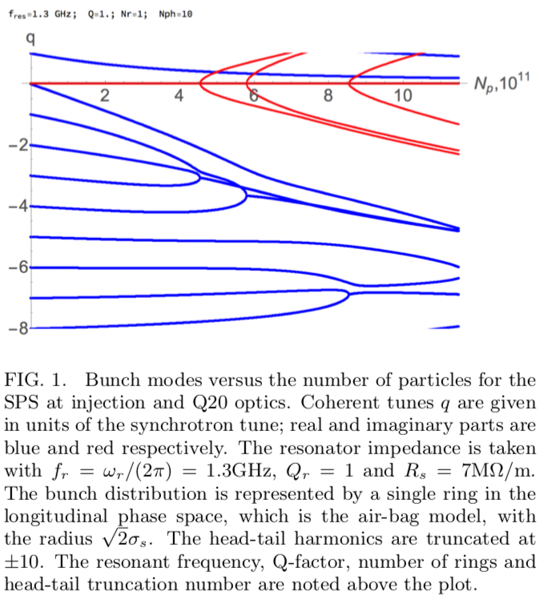
TMCI, no SC
TMCI is a single bunch instability at zero chromaticity, having a sharp threshold
CERN SPS Q20
Airbag model
$σ_{s}=23$ cm;
$f_{r}=1.3$ GHz;
$Q_{r}=1$;
$R_{s}=7$ MOhm/m
AB

Slide 7
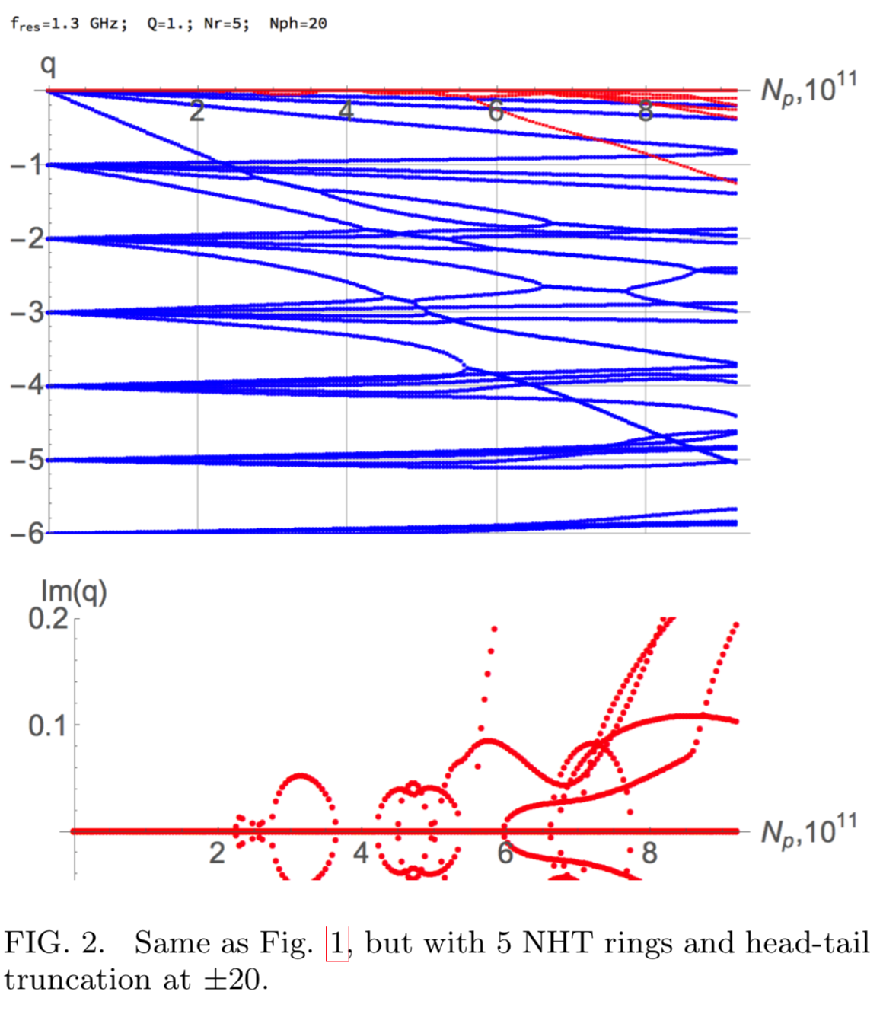
TMCI, no SC
With more rings, the threshold is not that sharp:
A low and high intensity thresholds can be introduced.
low
high
AB

Slide 8
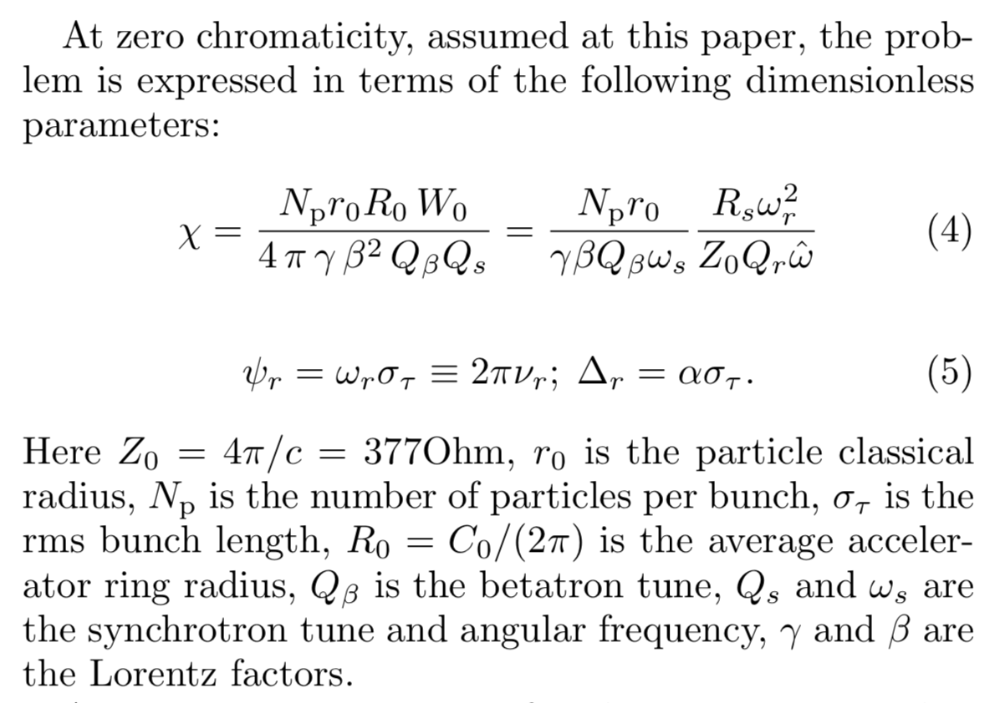
Parameters
AB

Slide 9
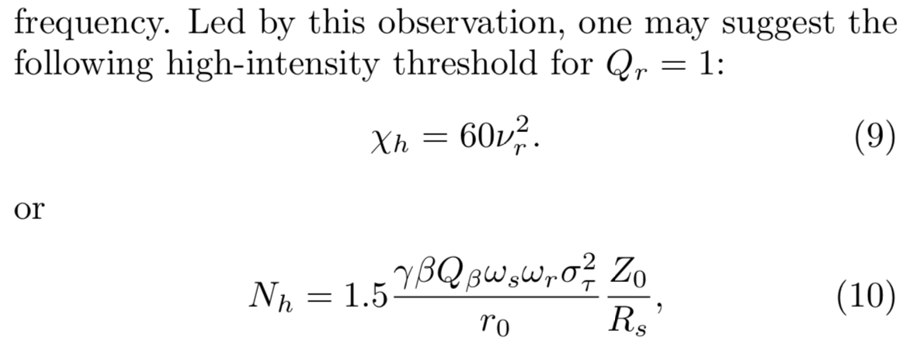
Thresholds
The HI TMCI threshold, expressed in terms of dp/p and line density,
is very close to the stability threshold of a coasting Gaussian beam,
thus confirming Ruth-Wang (1981) microwave stability criterion.
AB

Slide 10
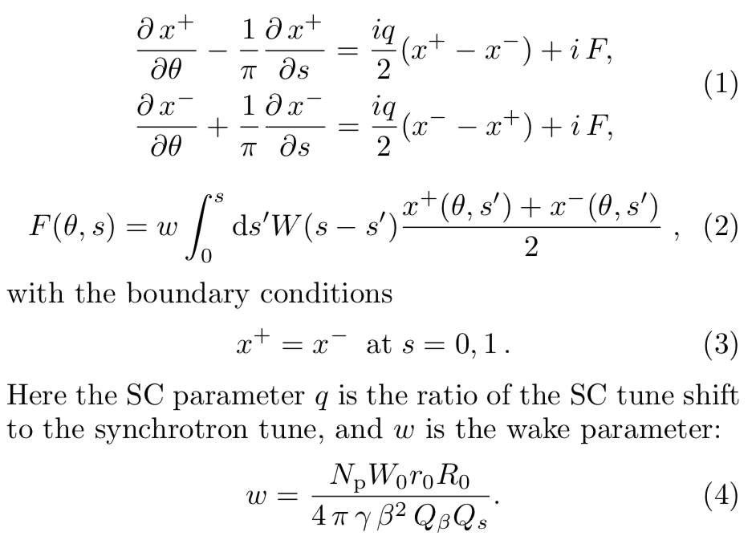
Air-Bag, Square well (ABS)
M. Blaskiewicz, 1999
AB

Slide 11
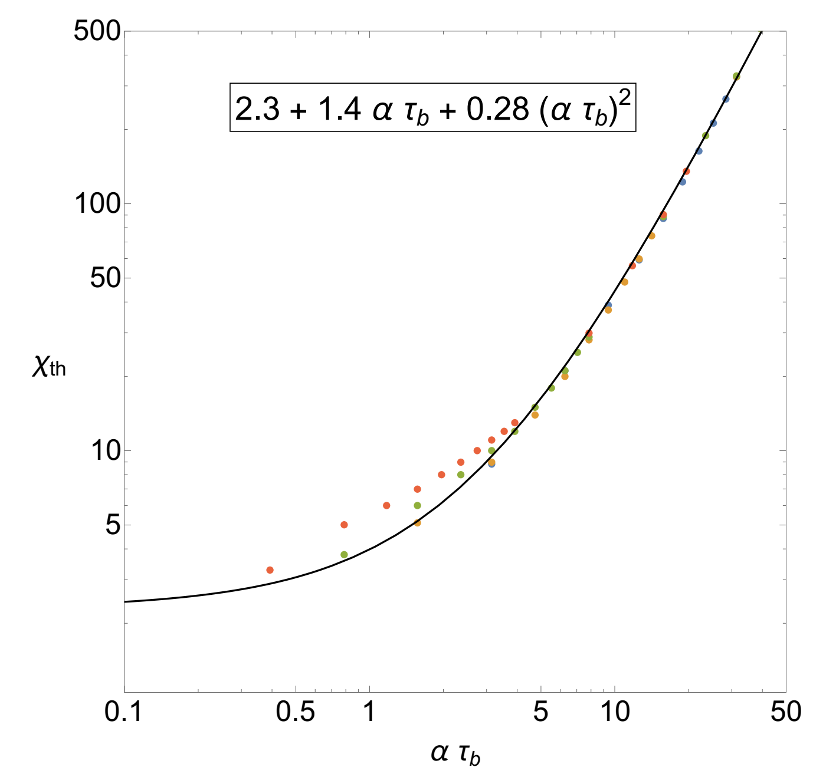
ABS model
Similar long-bunch asymptotic formula was found to be valid for the ABS.
With τ_{b}=4σ_{s}
it is almost identical to the parabolical Gaussian TMCI and Gaussian coasting beam.
AB

Slide 12
Conclusion for no_SC:
TMCI threshold
is close
to the coasting beam
transverse microwave stability threshold
AB

Slide 13
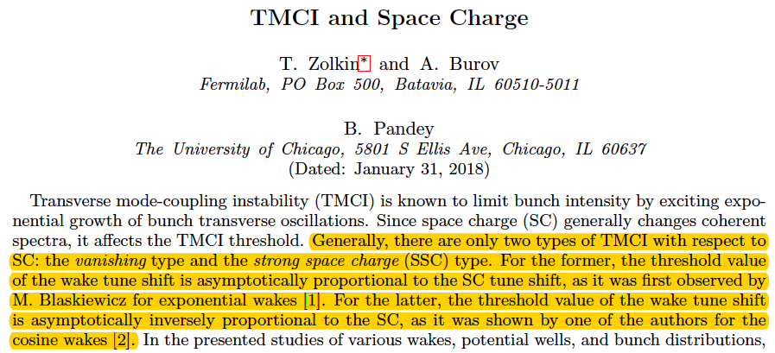
TMCI with SC: only 2 types are possible
https://arxiv.org/abs/1711.11110
AB

Slide 14
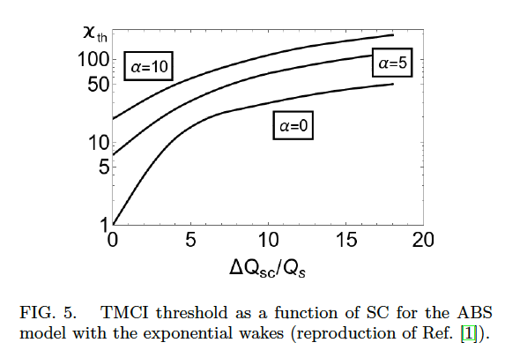
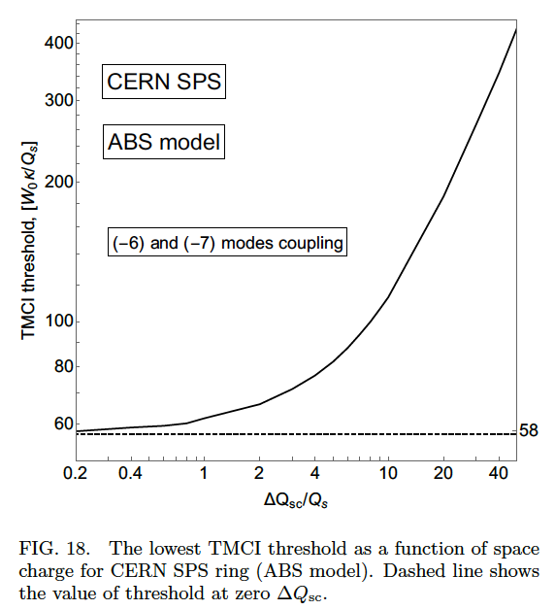
TMCI with SC: vanishing TMCI
Coherent tune shift ~ SC tune shift
BB impedance model f=1.3GHz
sigma_s = 30cm
(Quatraro & Rumolo, IPAC’10)
AB

Slide 15
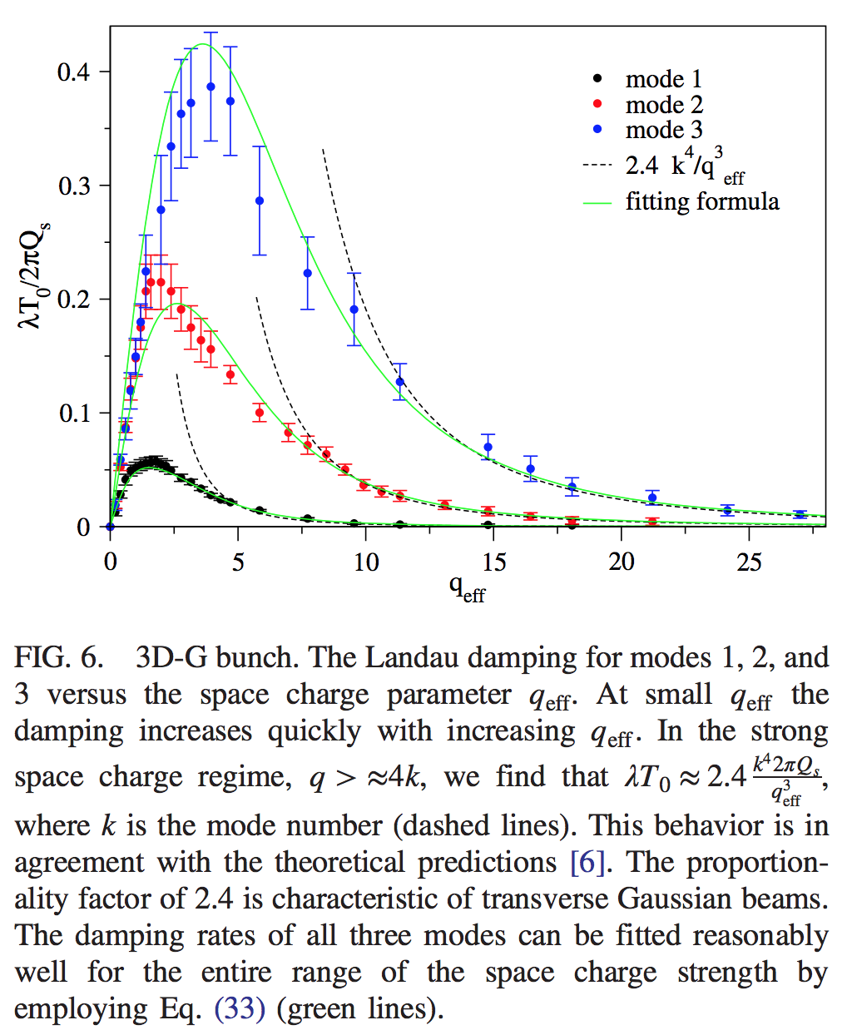
Intrinsic Landau Damping
SC introduces LD for bunched beams
$$λ_{max}≈0.05 k^{2}ω_{s}$$
$$q_{max}≈1.5 k$$
AB

Slide 16
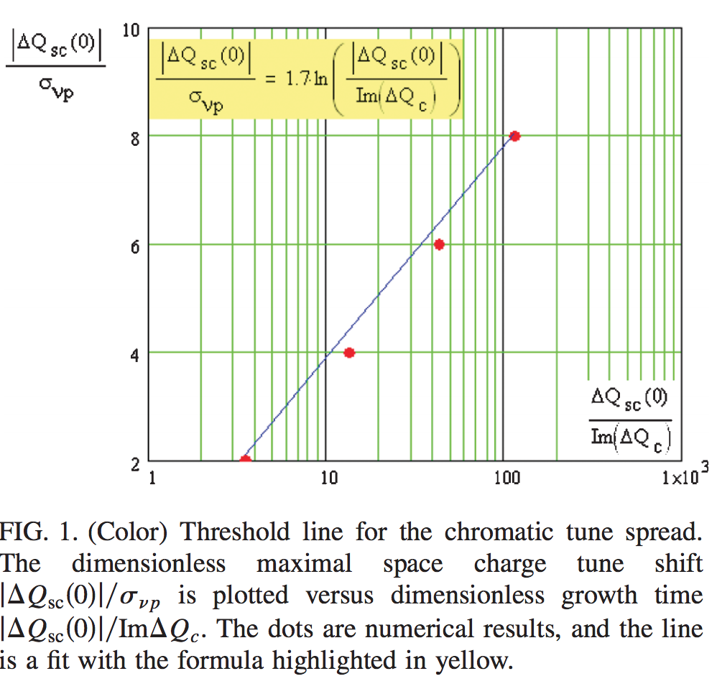
Stability vs SC for Coasting Beams
For coasting beams,
SC suppresses LD, so
wake threshold drops exponentially with SC
AB

Slide 17
Contradiction
Without SC, TMCI threshold is similar to the coasting beam one.
With SC, TMCI threshold goes up (linearly),
while coasting one goes down (exponentially).
Isn’t anything lost in the picture?
Also:
At CERN SPS Q26, with SC parameter ~23, the stability threshold did not show any dependence on SC !!!
AB

Slide 18
Resolution
AB

Slide 19
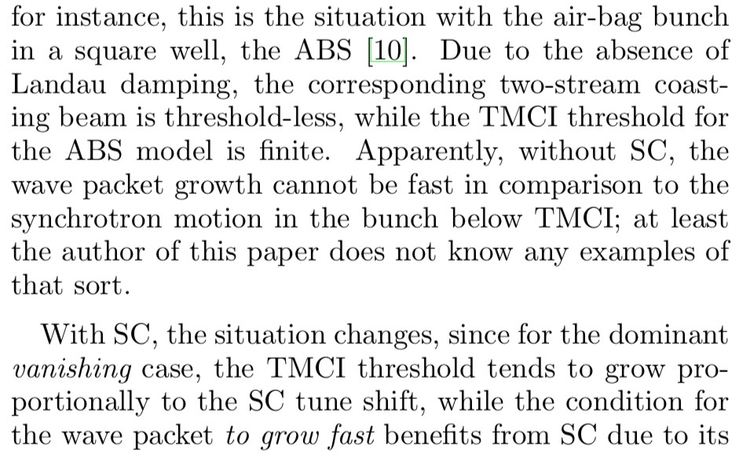
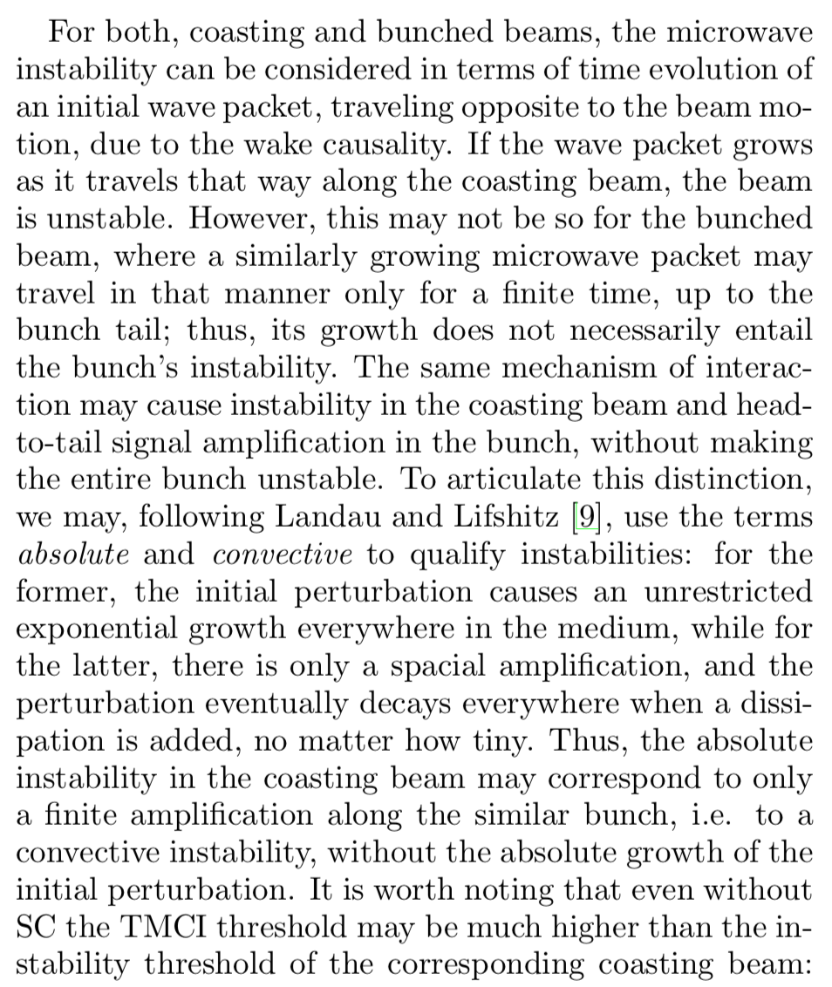
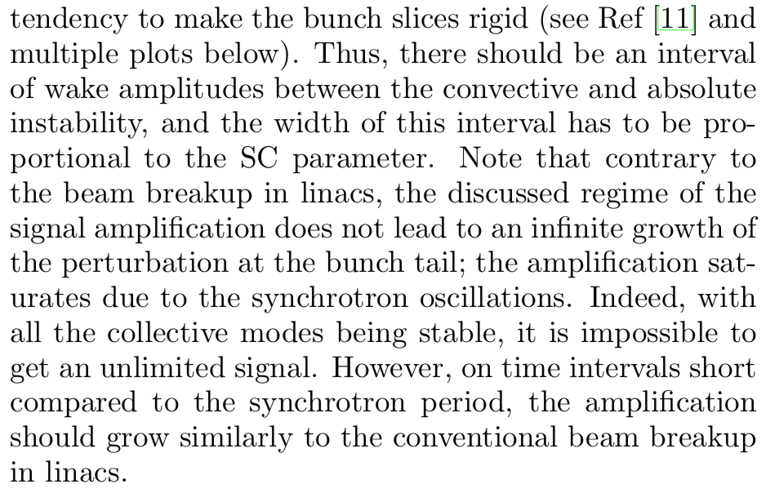
Convective Instabilities
AB

Slide 20
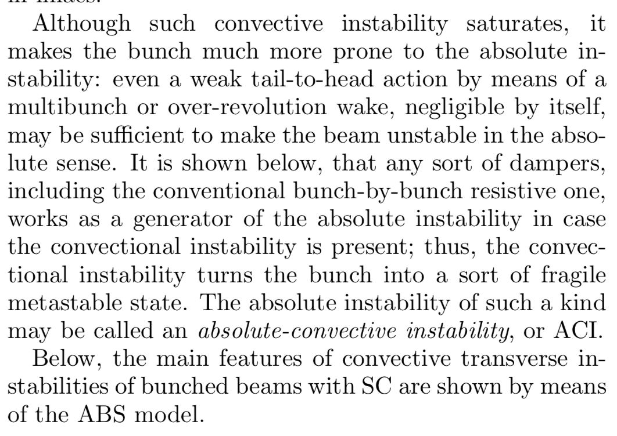
ACI
AB

Slide 21
Air-Bag, Square well (ABS)
AB

Slide 22
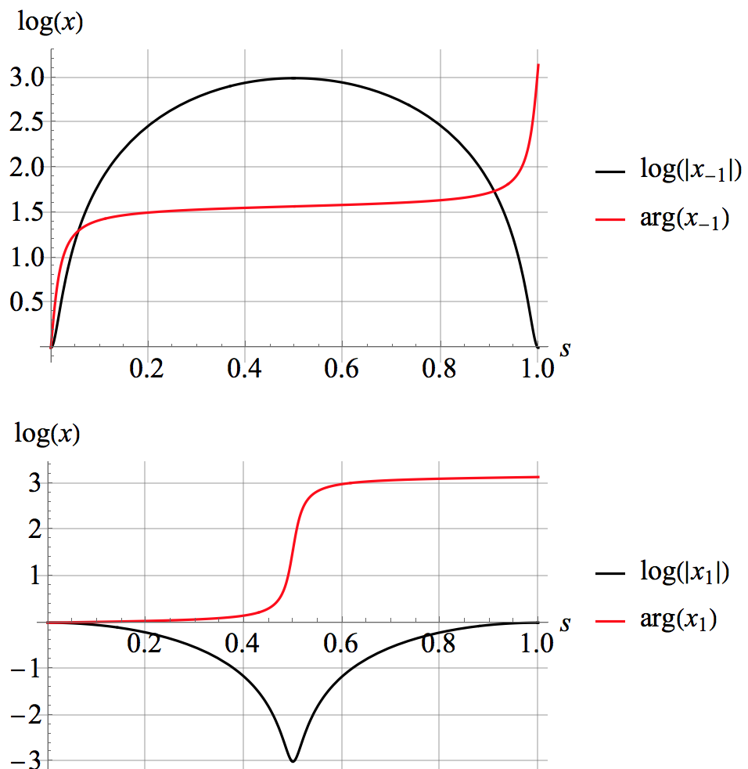
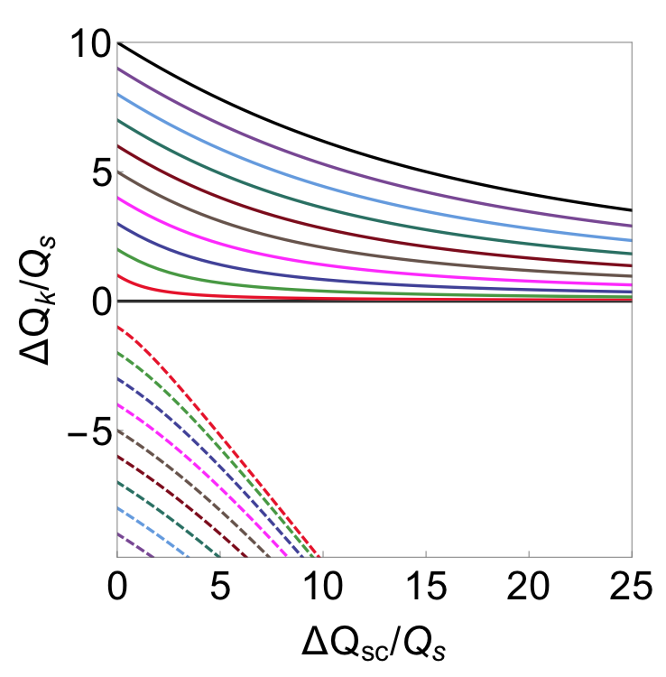
No-Wake Eigensystem
q = 20
$$q$$
AB

Slide 23
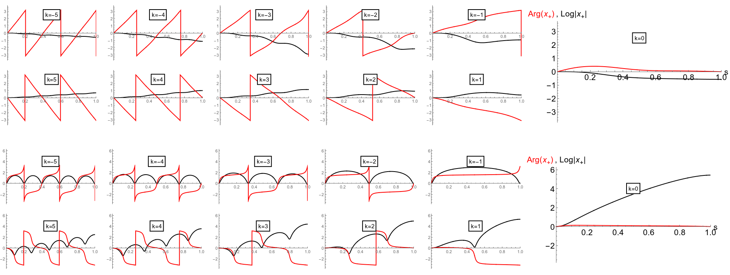
ABS Eigenfunctions: Broadband wake
$$\overline{k}=\sqrt{k_{r}^{2}−α^{2}}$$
$$W\left(s\right)=exp\left(−αs\right) sin\left(\overline{k}s\right)$$
$α=k_{r}/$ (2$Q_{r}$)
No SC
Strong SC
q = 20
$$k_{r}=10 Q_{r}=1$$
w = 13
by Tim Zolkin
At no-SC, $w_{th}=15$
AB

Slide 24
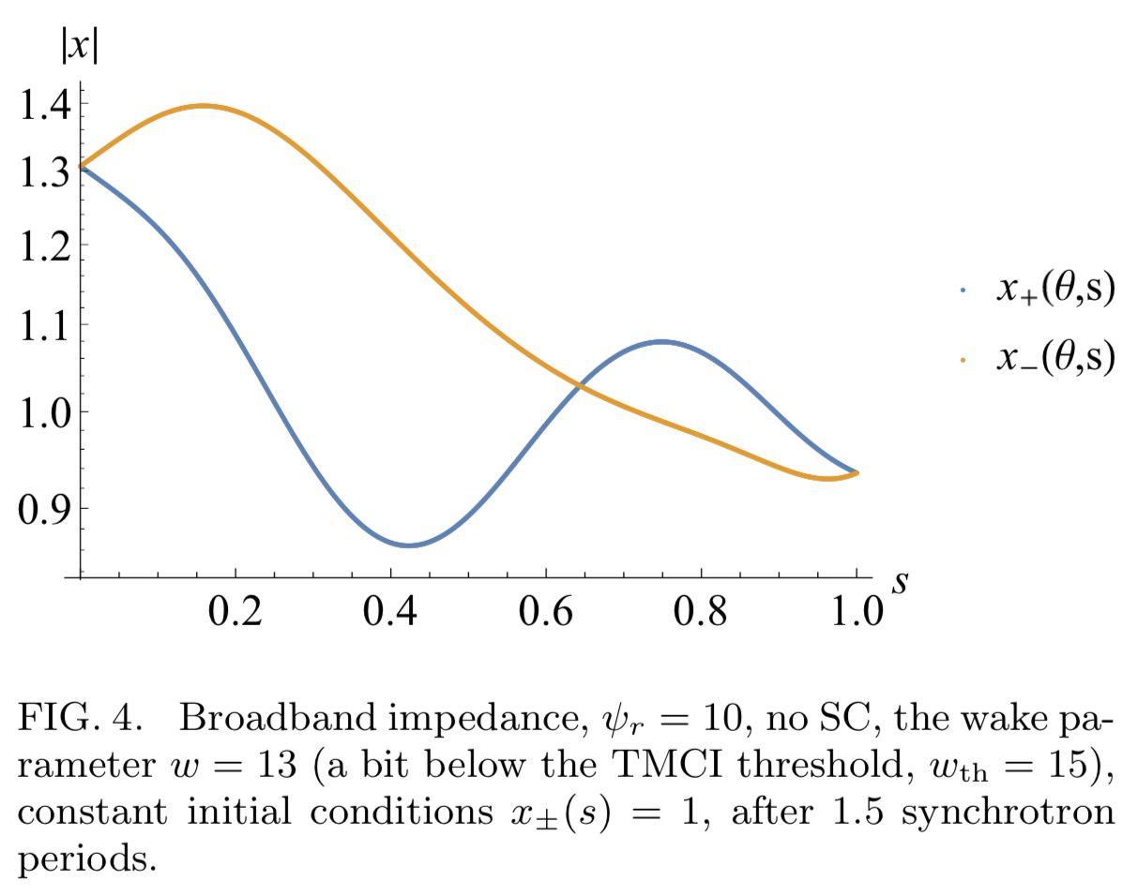
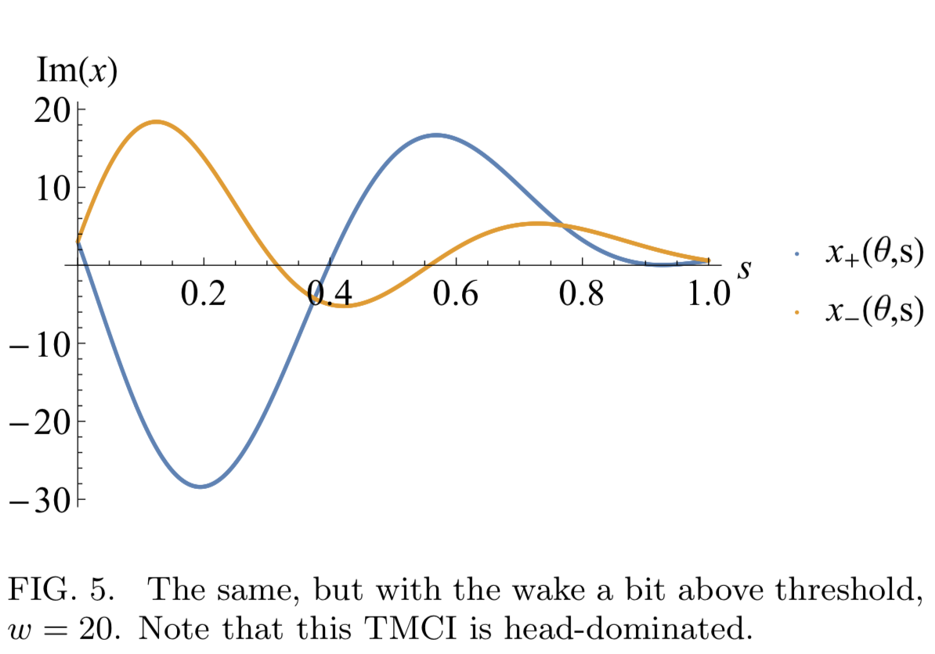
Broadband, no SC: TMCI
w = 13
w= 20
AB

Slide 25
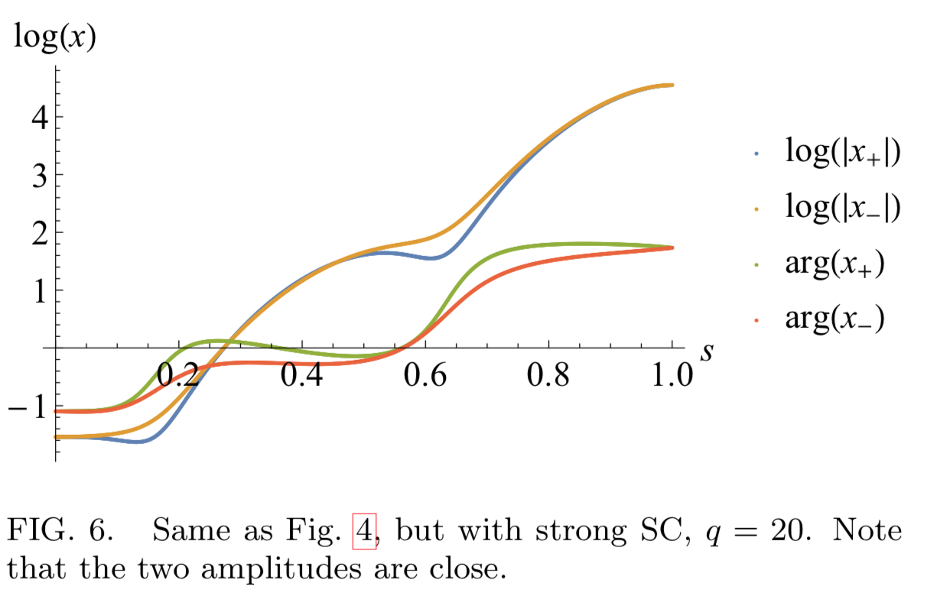
SC Effect at the no SC threshold: Convective Instability
q = 0
q = 20
AB

Slide 26
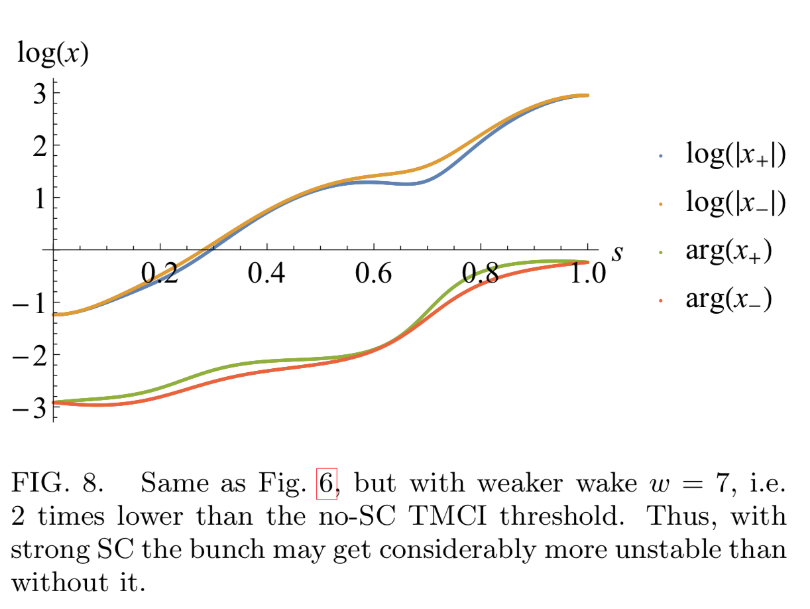
SC can even reduce the threshold
AB

Slide 27
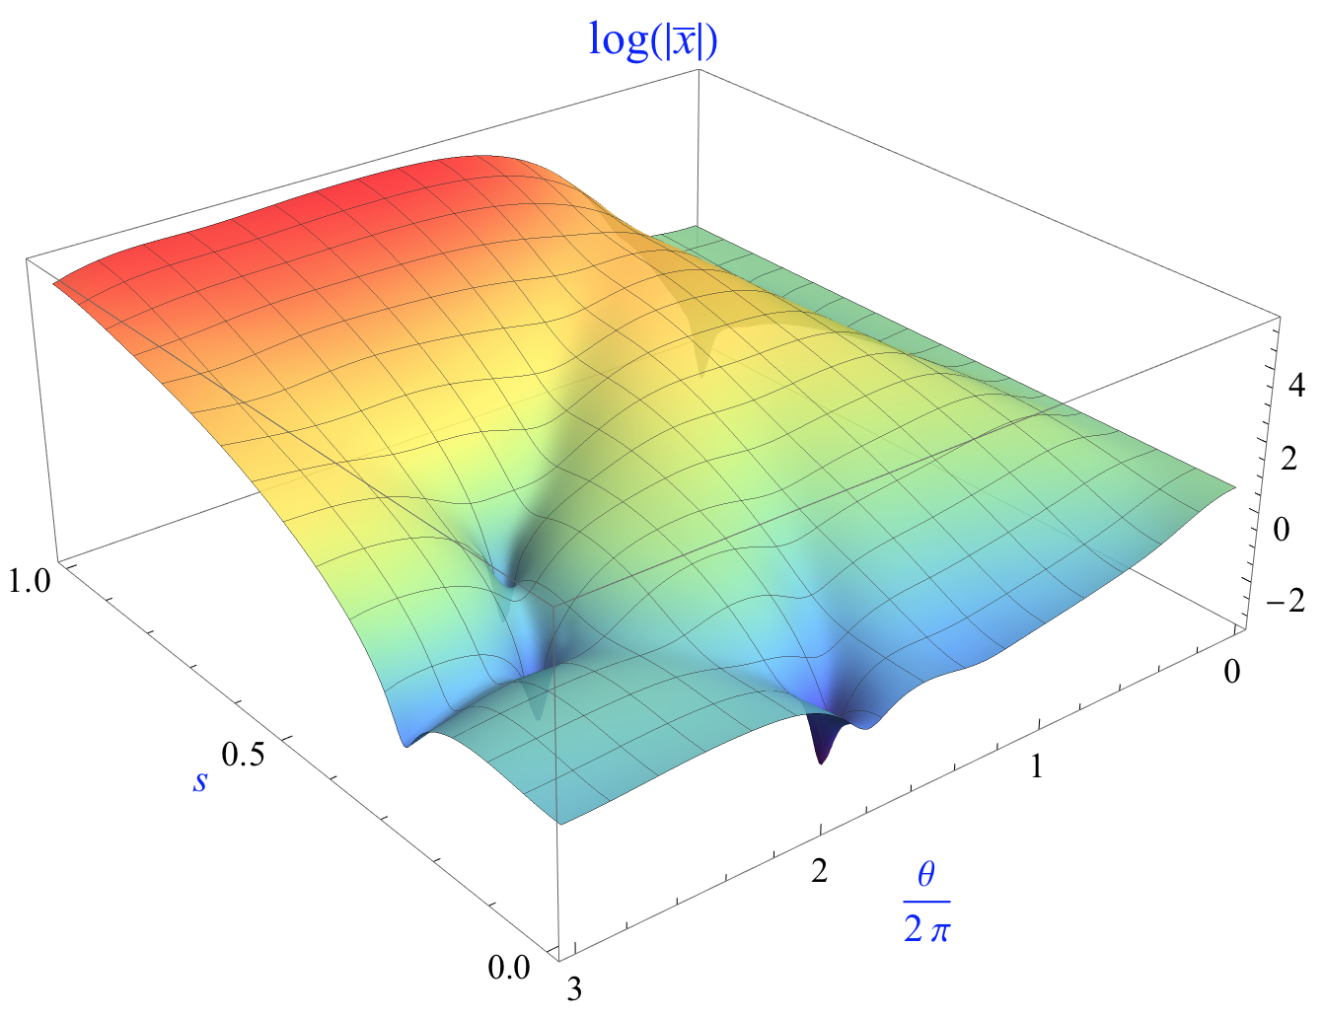
SCI time evolution
$$\overline{x}=(x^{+}+x^{−})/2$$
q = 20
w= 13
AB

Slide 28
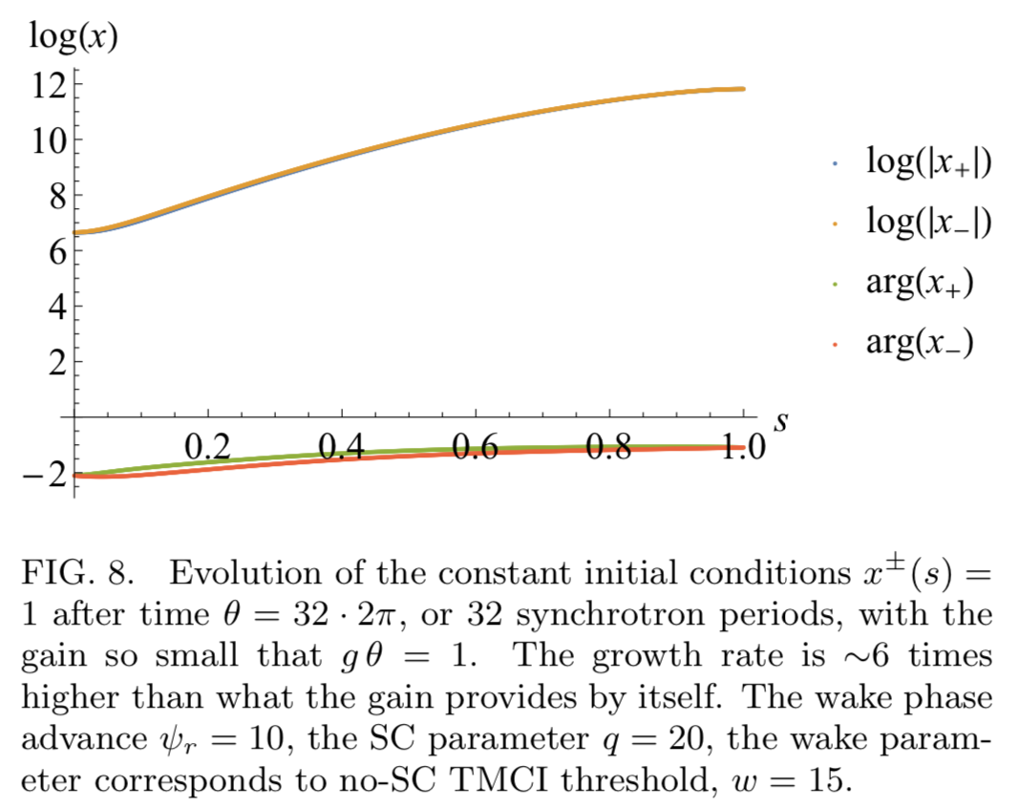
Absolute-Convective Instability (ACI)
AB

Slide 29
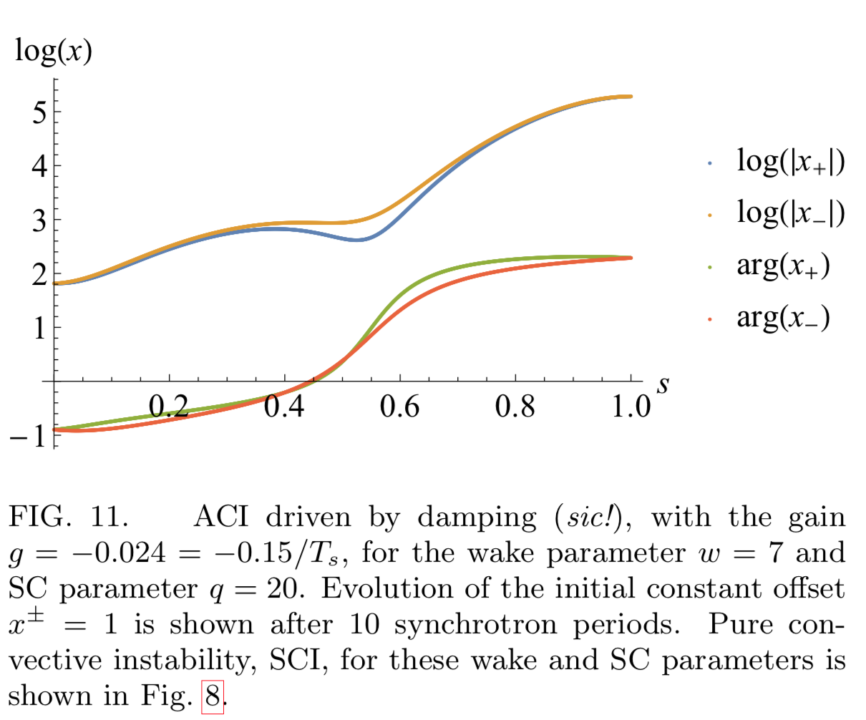
ACI excited by damping
AB

Slide 30
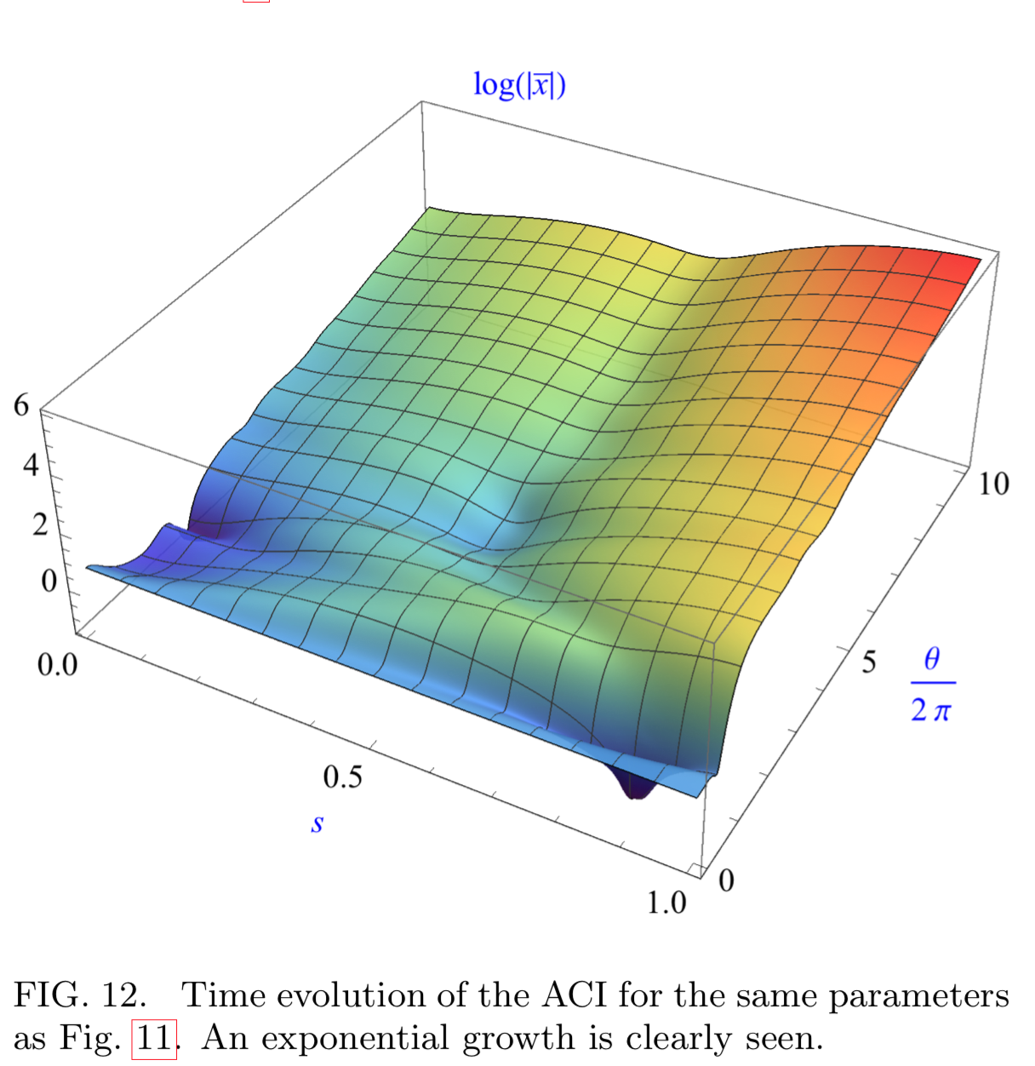
ACI excited by damping
AB

Slide 31
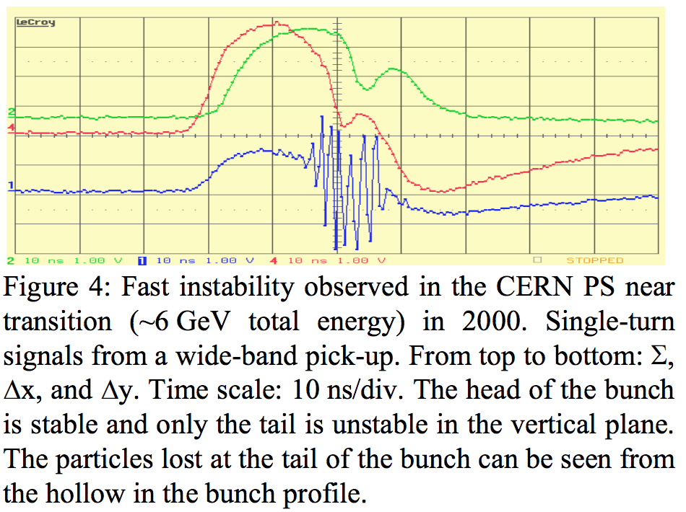
PS Observations
E. Metral, HB 2005
AB

Slide 32
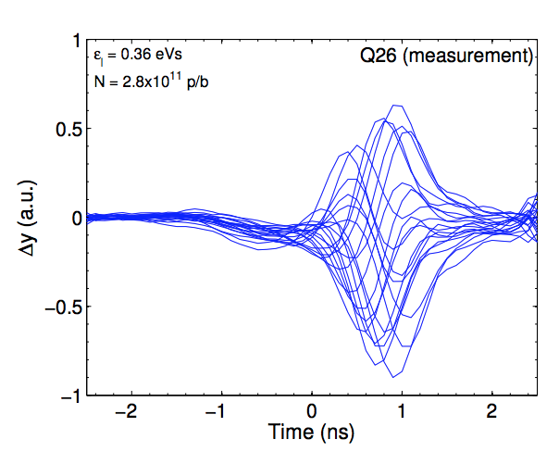
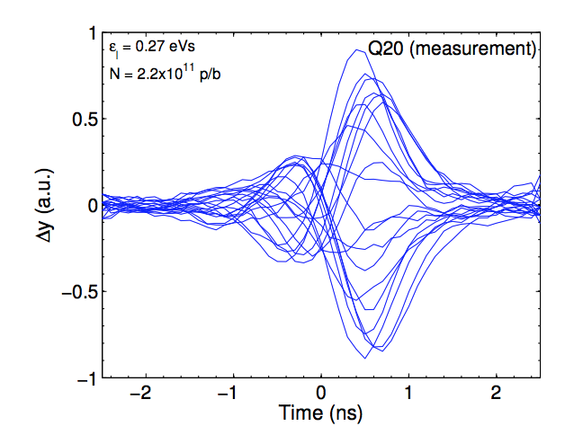
SPS Observations
H. Bartosik, 2013
AB

Slide 33
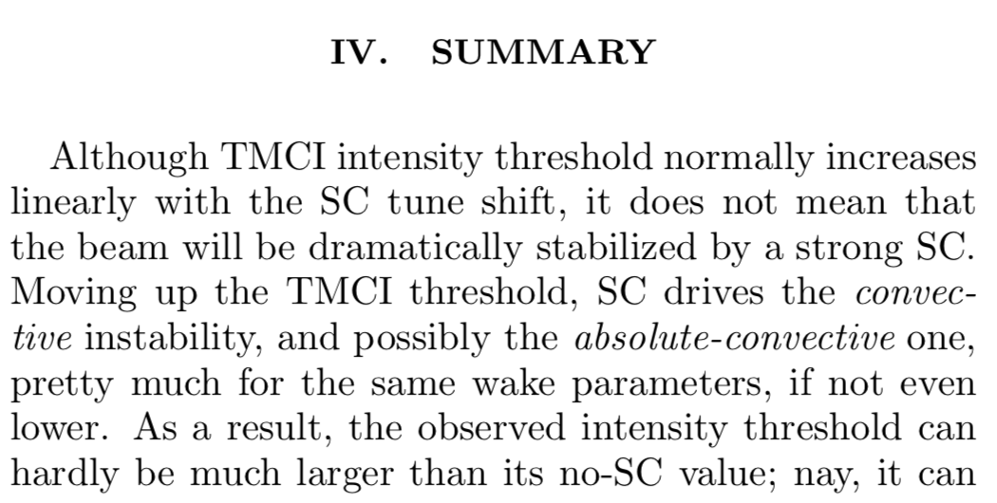
TMCI with SC: vanishing TMCI
AB

Slide 34
Many thanks!
AB

Slide 35
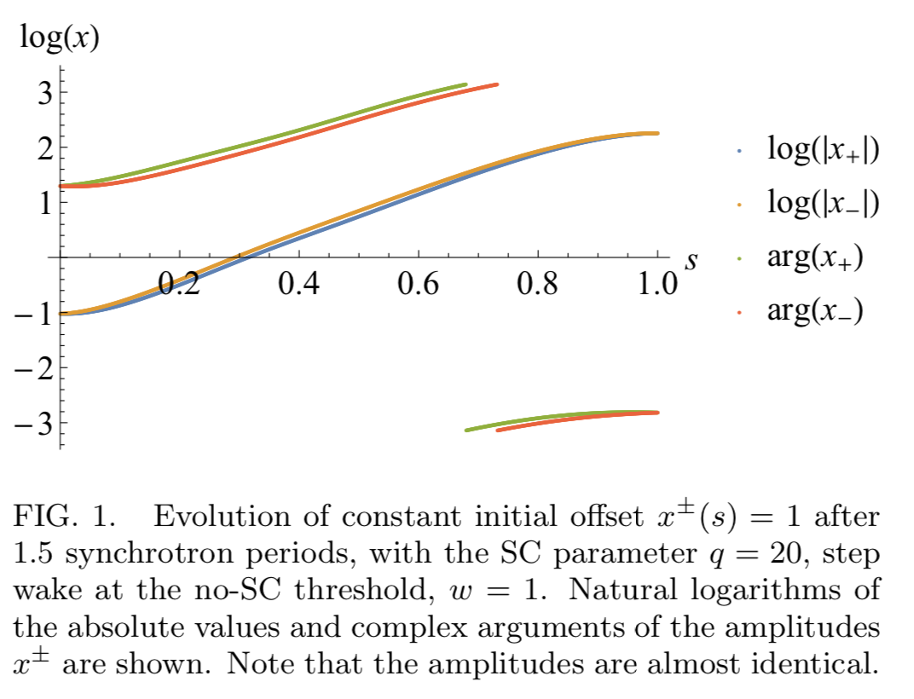
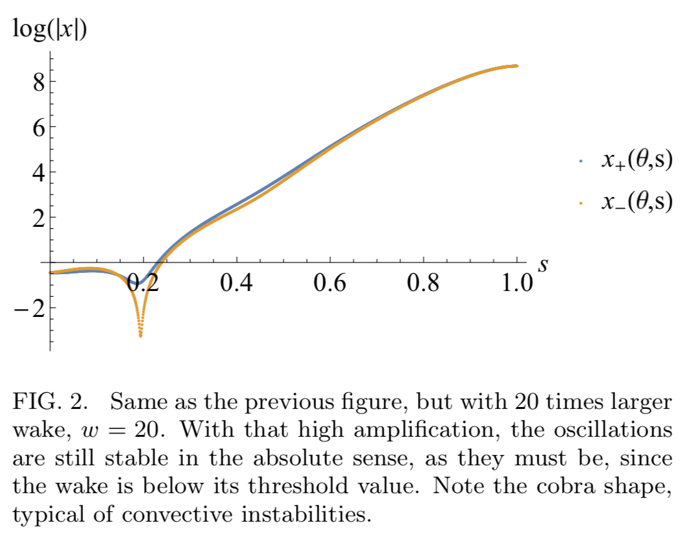
W(s)~Θ(s)
$$w=1$$
$$w=20$$
AB

