Slide 1
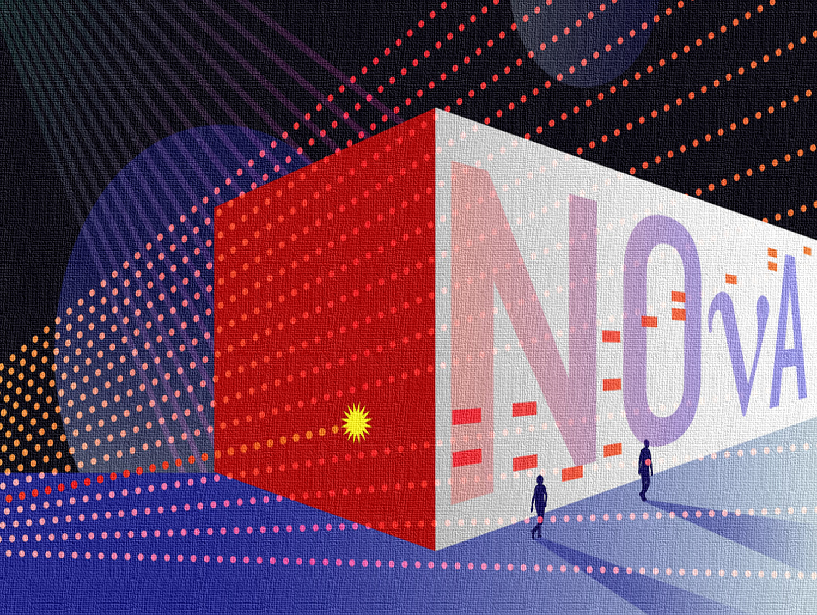
NOvA (NuMI Off-Axis ν_{e} Appearance) Neutrino Experiment – Neural Network Analysis
Twymun K. Safford
SIST/GEM Summer Program - 2018
Advisor: Dr. Alex Himmel
Michigan State University
08/09/2018

Slide 2
Outline
Introduction and Theory
The NOvA Experiment
Project Goals
Deep Learning and Convolutional Neural Networks
Training
Results and Analysis
Conclusions
2
8/9/18
Twymun K. Safford | SIST\GEM Presentation

Slide 3
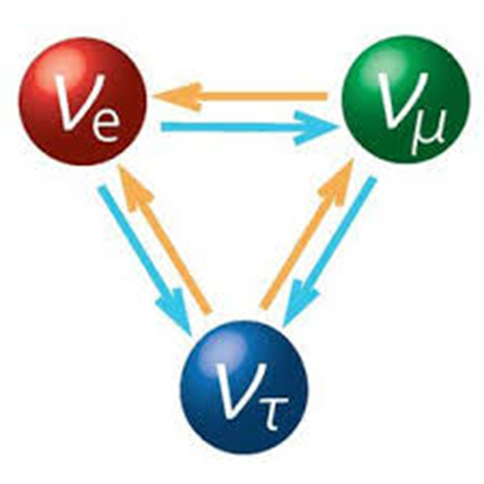
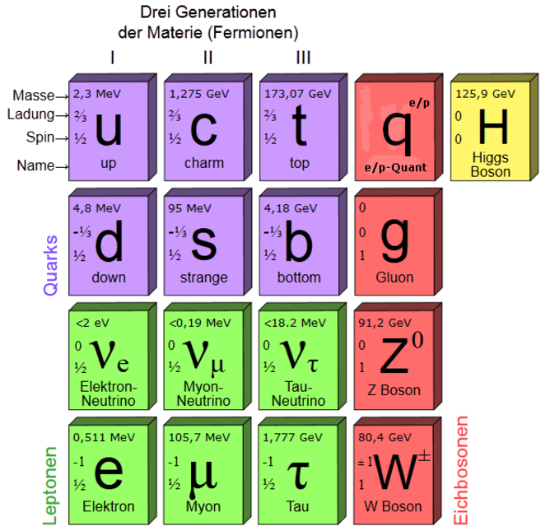
Properties of Neutrinos
Come in three flavors – electron, muon, and tau
Oscillate into one of three different flavors
Once thought to be massless – extremely light
Interact via the weak force mechanism
3
8/9/18
Twymun K. Safford | SIST\GEM Presentation

Slide 4
Neutrino Oscillations
Create in one flavor (ν_{μ}), but detect in another (ν_{e})
4
8/9/18
Twymun K. Safford | SIST\GEM Presentation

Slide 5
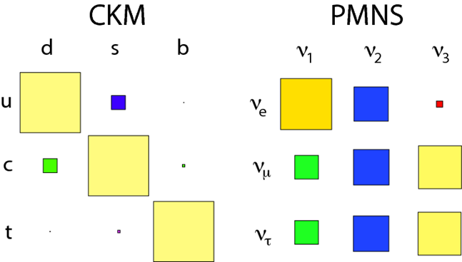
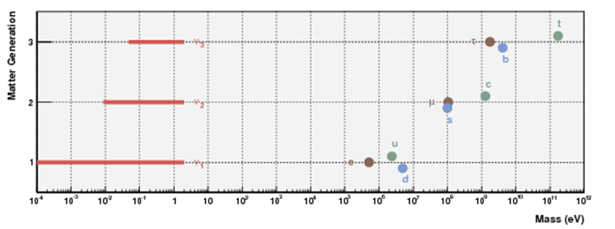
Why study neutrinos?
Neutrinos are unique:
Neutrino mixing looks very different from CKM.
Neutrino masses are really small compared to the rest of the SM.
Potentially CP-violating:
Might be a window into matter-antimatter asymmetry.
Physics beyond the standard model!
Oscillations are an interferometric effect – gives access to high-scale or unknown physics.
5
8/9/18
Twymun K. Safford | SIST\GEM Presentation
Notes:
5

Slide 6
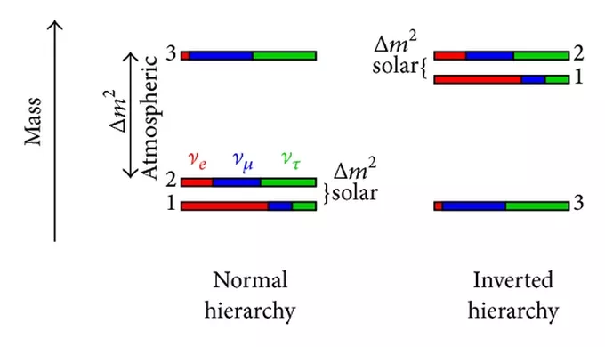
Ordering of neutrino masses?

Slide 7
Matter-antimatter asymmetry?
Do muon antineutrinos oscillate at a different rate than muon neutrinos?
Would imply broken symmetry between neutrinos and anti-flavors are broken
If antineutrinos do not follow the same pattern as neutrinos when they change from one flavor to another - a signal of CP violation

Slide 8
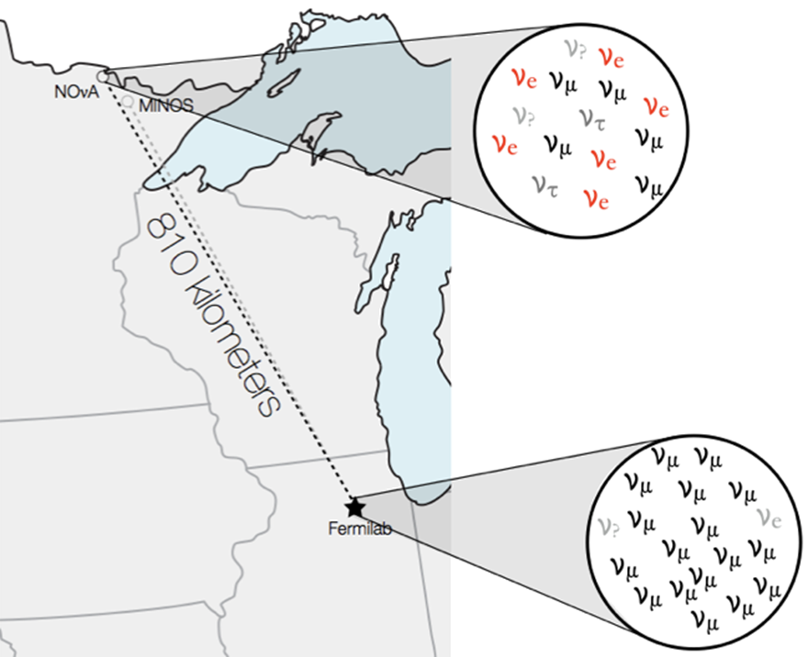
The NOvA Experiment
Long-baseline neutrino oscillation experiment.
NuMI neutrino beam at Fermilab
Near Detector to measure the beam before oscillations
Far Detector measures the oscillated spectrum.
Detectors located 14 mrad off-axis of the beam.
2-body π decay gives narrow range of ν energies
Tune peak energy for oscillations
More events at max oscillations
Fewer backgrounds
8
8/9/18
Twymun K. Safford | SIST\GEM Presentation

Slide 9
NuMI (Neutrinos at the Main Injector) Beam
9
8/9/18
Twymun K. Safford | SIST\GEM Presentation

Slide 10
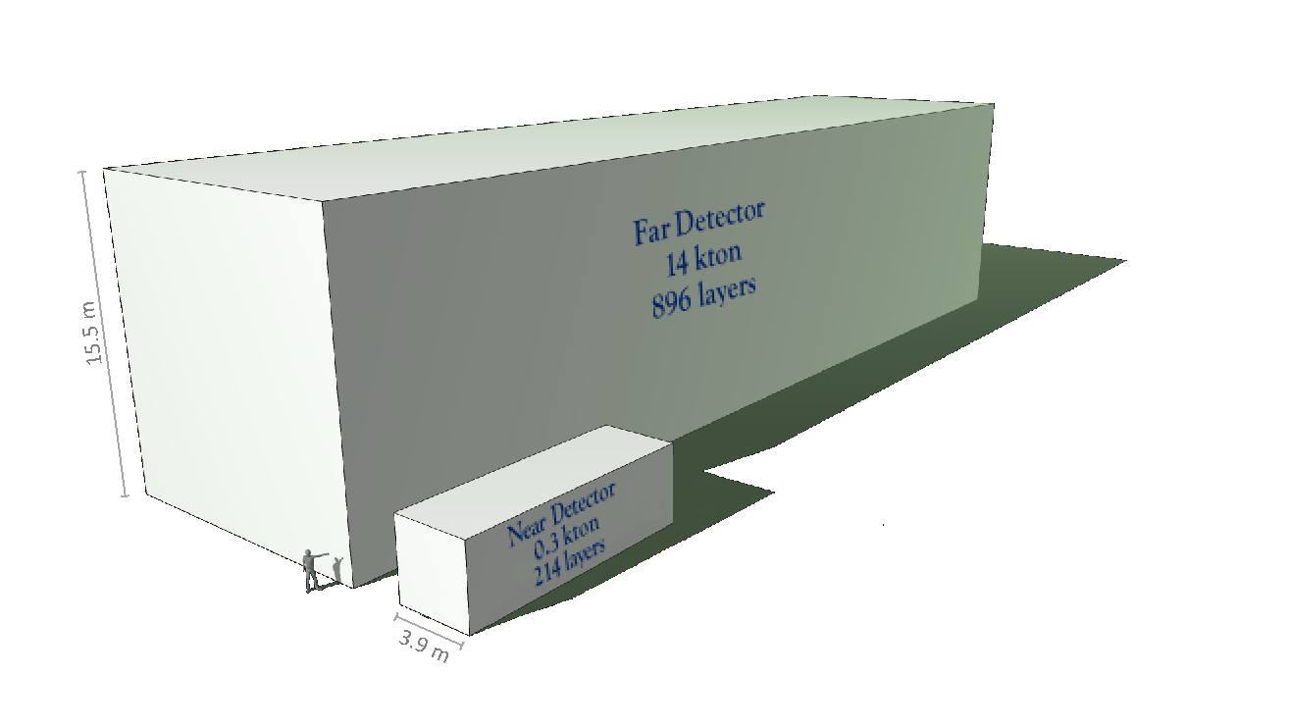
The NOvA Detectors
Large, 14 kTon at the Far Detector – 385,000 scintillator cells
Consist of plastic cells filled with liquid scintillator
Arranged in alternating directions for 3D reconstruction
NOvA Measures:
CP-violating phase
θ₂₃ octant
Sign of Δm²₃₂ – “Mass Hierarchy”
10
8/9/18
Twymun K. Safford | SIST\GEM Presentation

Slide 11
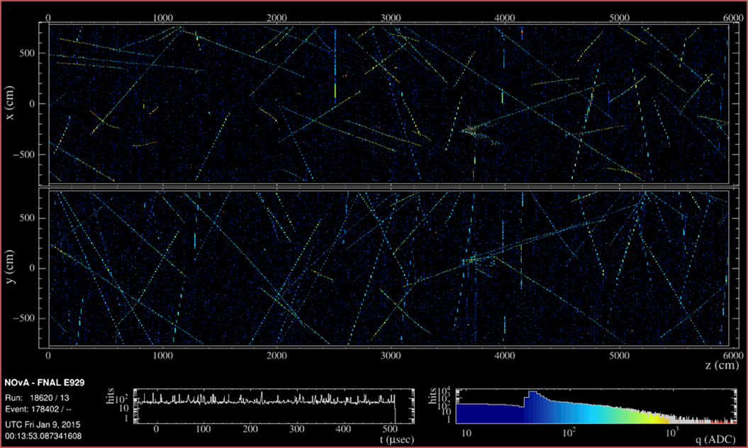
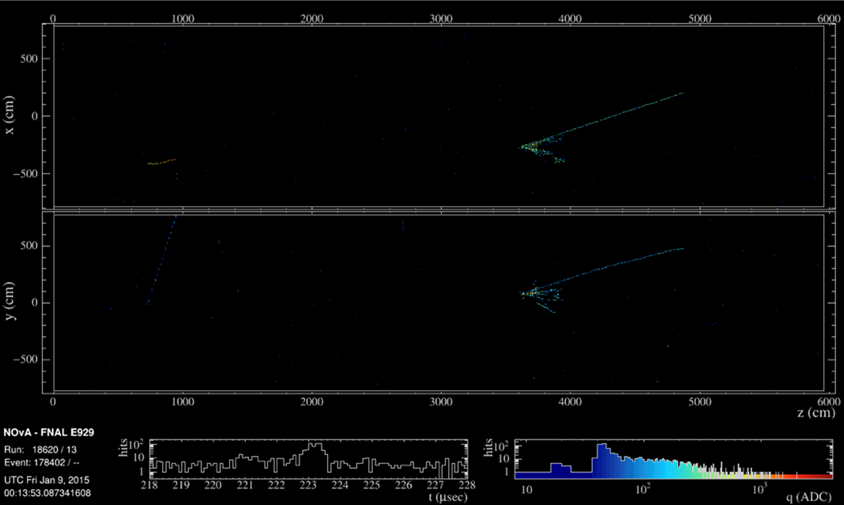
Project Goals
The far detector is above ground
Subject to approximately 11 billion cosmic rays per day
Approximately 10⁷ events need to be rejected to process and reconstruct pixel maps
Construct a cosmic rejection network via machine learning able to identify events based on event topology
11
8/9/18
Twymun K. Safford | SIST\GEM Presentation

Slide 12
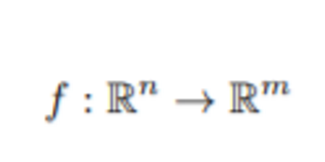
Deep Learning and Convolutional Neural Networks
The multilayer perceptron (MLP), or traditional neutral network- a machine learning algorithm
Scales poorly to a large number of raw inputs.
The number of nodes necessary in that hidden layer may approach infinity
Large number of free parameters in a large network runs the risk of possibly over-training
12
8/9/18
Twymun K. Safford | SIST\GEM Presentation

Slide 13
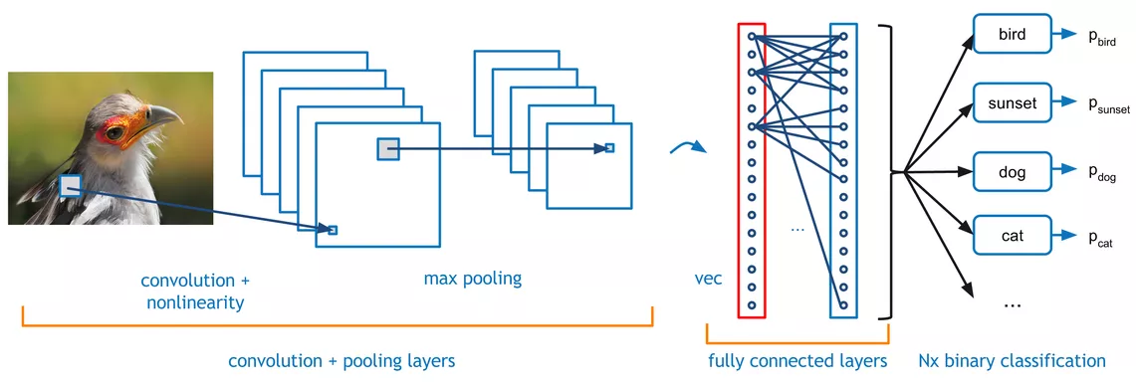
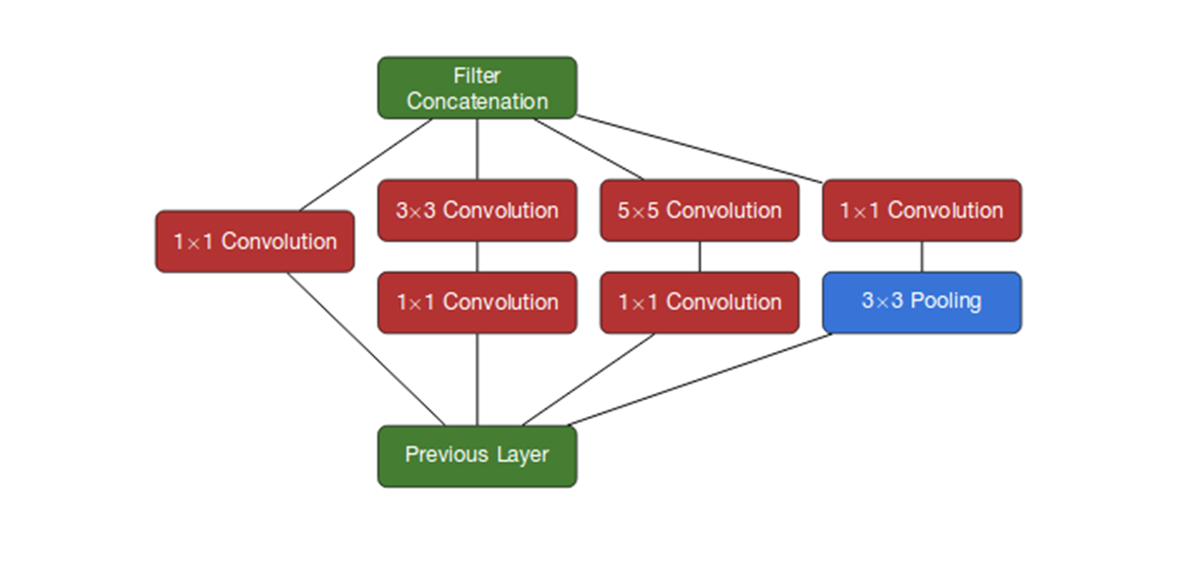
Convolutional Neural Network
13
8/9/18
Twymun K. Safford | SIST\GEM Presentation

Slide 14
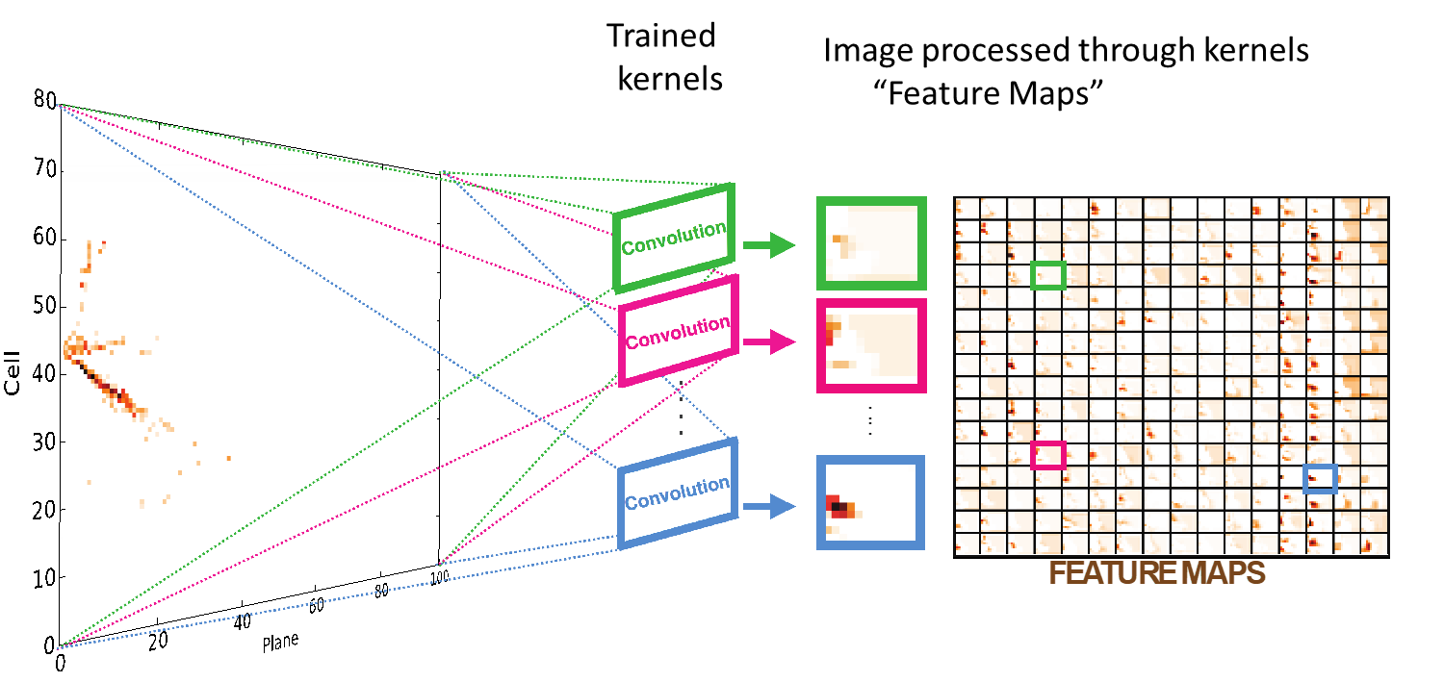
14
8/9/18
Twymun K. Safford | SIST\GEM Presentation

Slide 15
Identifying Events
ν_{µ} CC - A muon plus a hadronic component; long, low dE/dx track
ν_{e} CC - An electron plus a hadronic component; is typically a wide shower
ν_{τ} CC - A tau plus a hadronic component. The tau is extremely short lived and not visible in the detector; may produce pions, electrons, muons, and neutrinos.
ν NC- The outgoing lepton in these interactions is a neutrino; will travel onward undetected; hadronic component only is visible
Cosmic events – (Usually) Long muon tracks entering tops or sides
15
8/9/18
Twymun K. Safford | SIST\GEM Presentation

Slide 16
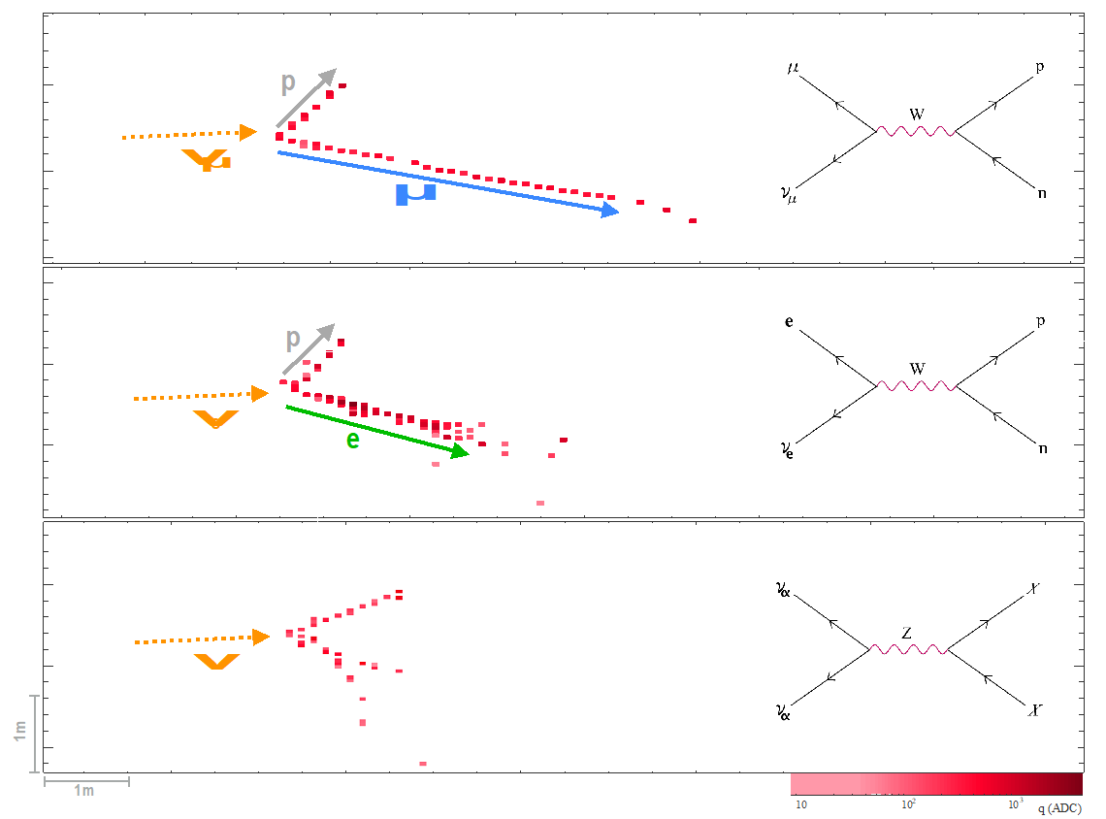
16
8/9/18
Twymun K. Safford | SIST\GEM Presentation

Slide 17
Training
Create Pixel Maps
Full FD events sliced in time to spill window width ~12 µS
Select one random window and the spill window
Cuts on empty windows and less than 10 interaction hits
Create LevelDBs
Large LevelDBs needed to be “chunked”
250 files per LevelDB = ~470k pixelmaps (over 12k files available)
376k training / 94k testing (80/20)
Reduced Labeling
17
8/9/18
Twymun K. Safford | SIST\GEM Presentation

Slide 18
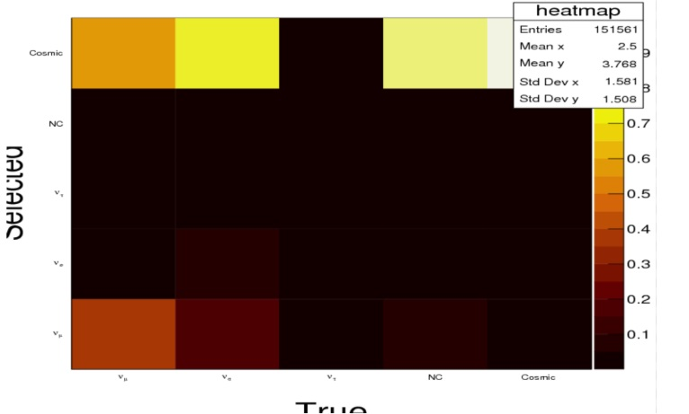
Before Training
Composition ration of 34:1 cosmics
18
8/9/18
Twymun K. Safford | SIST\GEM Presentation

Slide 19
 | ν_{µ} CC | ν_{e} CC | ν_{τ} CC | ν NC | cosmic | total
Chunk-05 | 13.0% | 10.6% | 3.4% | 14.2% | 58.8% | 463708
Chunk-06 | 13.1% | 11.4% | 3.8% | 15.9% | 55.8% | 460792
19
8/9/18
Twymun K. Safford | SIST\GEM Presentation

Slide 20
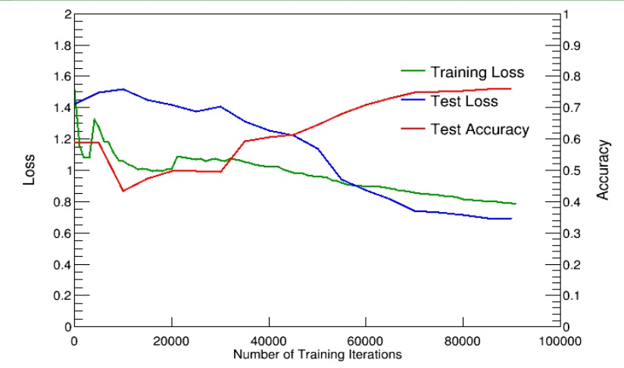
First Training (1st chunk)
20
8/9/18
Twymun K. Safford | SIST\GEM Presentation

Slide 21
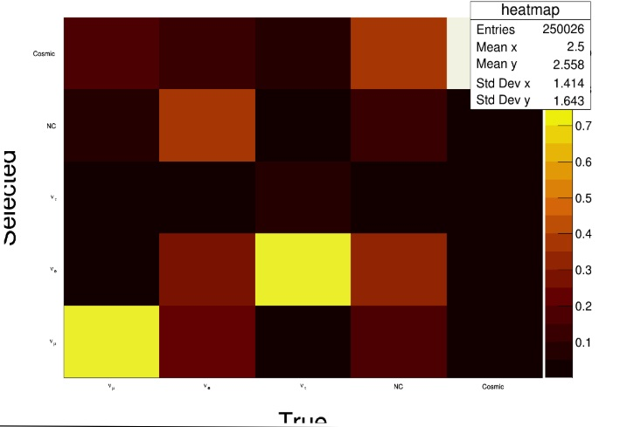
First Training – Confusion Matrix
21
8/9/18
Twymun K. Safford | SIST\GEM Presentation

Slide 22
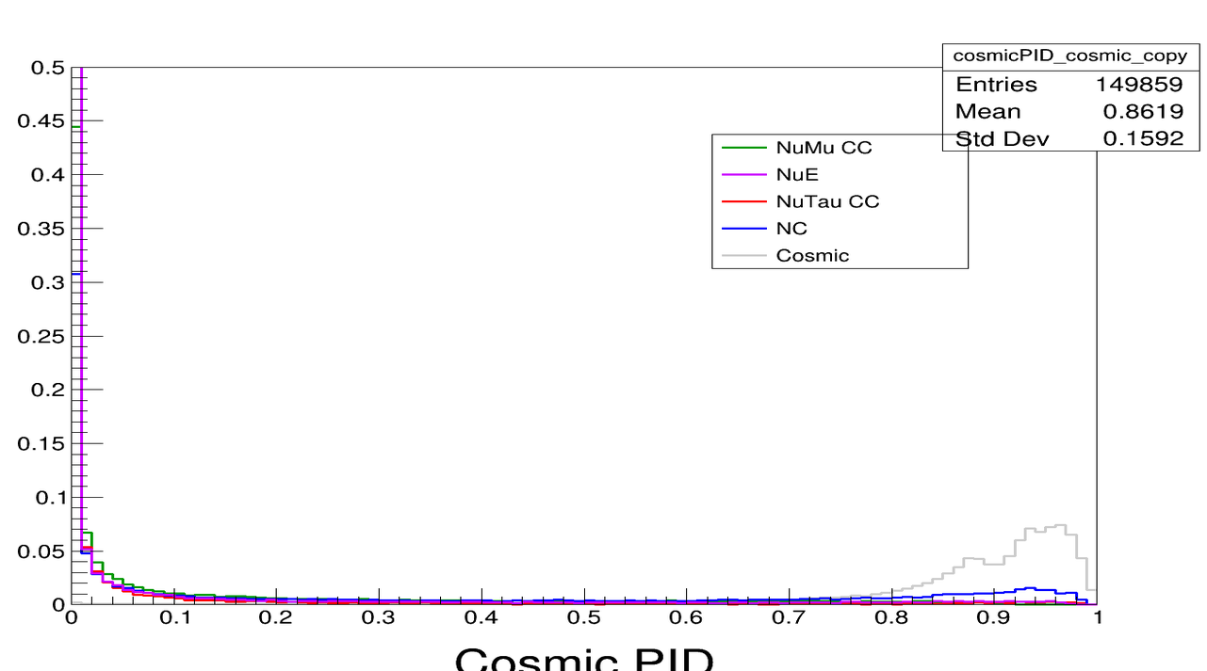
First Training – PID Plot (Cosmic)
22
8/9/18
Twymun K. Safford | SIST\GEM Presentation

Slide 23
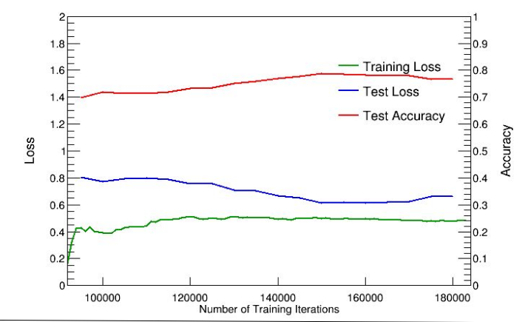
Second Training(2nd chunk)
23
8/9/18
Twymun K. Safford | SIST\GEM Presentation

Slide 24
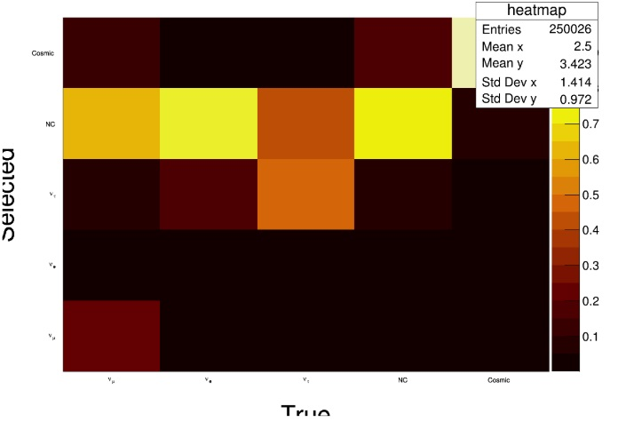
Second Training – Confusion Matrix
24
8/9/18
Twymun K. Safford | SIST\GEM Presentation

Slide 25
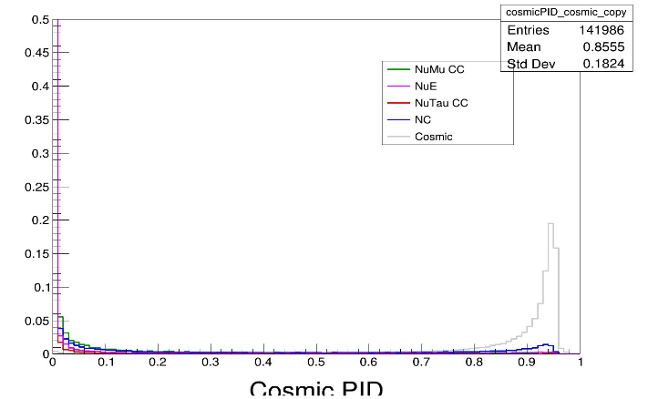
Second Training – PID Plots (Cosmic)
25
8/9/18
Twymun K. Safford | SIST\GEM Presentation

Slide 26
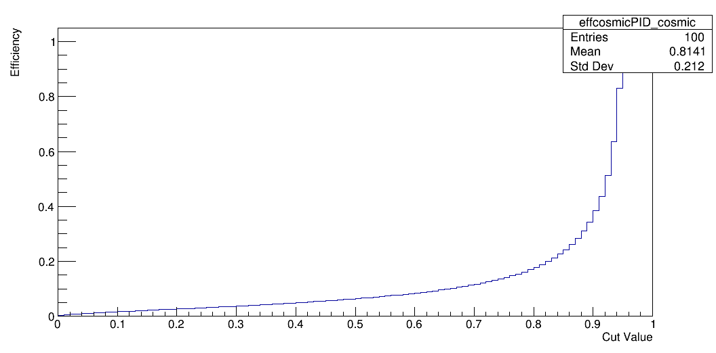
Efficiency vs. Cut(Cosmic)
26
8/9/18
Twymun K. Safford | SIST\GEM Presentation

Slide 27
Efficiency vs. Cut(Cosmic)
~60% efficiency
27
8/9/18
Twymun K. Safford | SIST\GEM Presentation

Slide 28
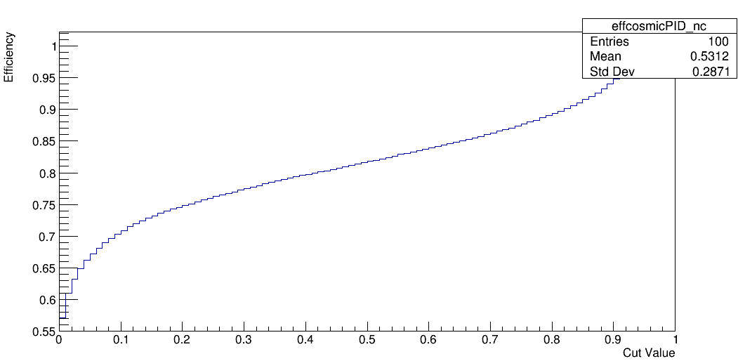
Efficiency vs. Cut(NC)
28
8/9/18
Twymun K. Safford | SIST\GEM Presentation

Slide 29
Efficiency vs. Cut(NC)
29
8/9/18
Twymun K. Safford | SIST\GEM Presentation

Slide 30
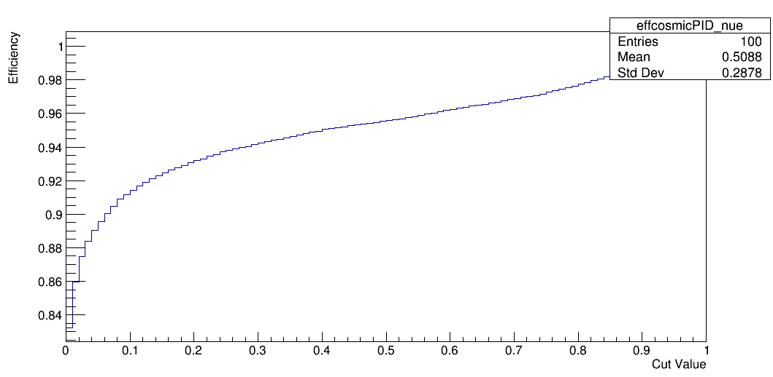
Efficiency vs. Cut(v_{e})
30
8/9/18
Twymun K. Safford | SIST\GEM Presentation

Slide 31
Efficiency vs. Cut(v_{e})
31
8/9/18
Twymun K. Safford | SIST\GEM Presentation

Slide 32
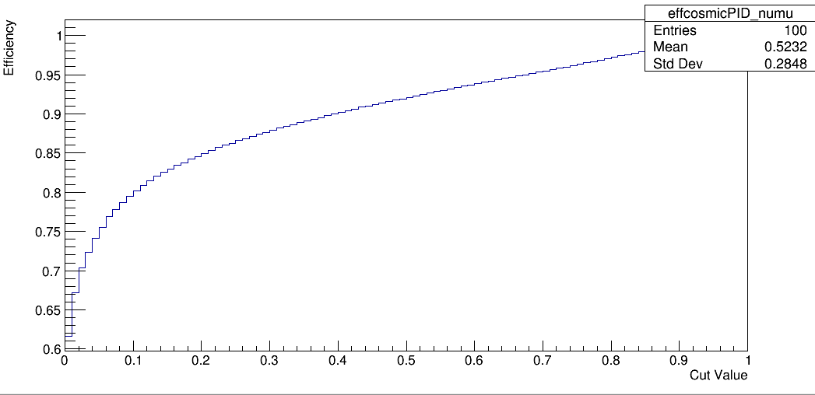
Efficiency vs. Cut (v_{μ})
32
8/9/18
Twymun K. Safford | SIST\GEM Presentation

Slide 33
Efficiency vs. Cut (v_{μ})
33
8/9/18
Twymun K. Safford | SIST\GEM Presentation

Slide 34
Conclusions and Future Work
Cosmic rejection network has potential for implementation
Continue to tune/train the networks
Utilize multi-access DBs
Move to Keras/TensorFlow
34
8/9/18
Twymun K. Safford | SIST\GEM Presentation

Slide 35
References
R., H., M., P., S., V. (2016, August 12). A Convolutional Neural Network Neutrino Event Classifier. Retrieved from https://arxiv.org/abs/1604.01444
A Convolutional Neural Network Neutrino Event Classifier. (2016, August 12). Retrieved from https://arxiv.org/pdf/1604.01444.pdf
R., H., M., P., S., V. (2016, August 12).
A Convolutional Neural Network Neutrino Event Classifier. Retrieved from $https://arxiv.org/abs/1604.01444v3?utm_campaign=Revue newsletterutm_medium=Newsletterutm_source=revue$
A., A., R., W., N., Y., . . . Dell'Acqua. (2002, August 22). GEANT4: A Simulation toolkit. Retrieved from http://inspirehep.net/record/593382?ln=en
Hammer, B. (2001). Neural Smithing – Supervised Learning in Feedforward Artificial Neural Networks. Pattern Analysis and amp; Applications, 4(1), 73-74. doi:10.1007/s100440170029
Hubel, D. H., and Wiesel, T. N. (1968). Receptive fields and functional architecture of monkey striate cortex. The Journal of Physiology, 195(1), 215-243. doi:10.1113/jphysiol.1968.sp008455
R., O., D., J., H., K., . . . L. (2015, January 30). ImageNet Large Scale Visual Recognition Challenge. Retrieved from https://arxiv.org/abs/1409.0575
Lecun, Y., Boser, B., Denker, J. S., Henderson, D., Howard, R. E., Hubbard, W., and Jackel, L. D. (1989). Backpropagation Applied to Handwritten Zip Code Recognition. Neural Computation, 1(4), 541-551. doi:10.1162/neco.1989.1.4.541
Neutrino 2014: The 24th Interactional Conference on Neutrino Physics and Astrophysics. (2014, June). Retrieved from http://neutrino2014.bu.edu/program/
M., G., W., R., R., B., . . . Valencia. (2016, July 05). Neutrino Flux Predictions for the NuMI Beam. Retrieved from http://inspirehep.net/record/1473668
35
8/9/18
Twymun K. Safford | SIST\GEM Presentation

Slide 36
Acknowledgements
Fermi National Accelerator Laboratory for offering this research opportunity through funding and opportunities made possible by the National GEM Consortium.
Dr. Alex Himmel, Dr. Evan Niner, Adam Moren, and Ryan Murphy for their continued support, guidance, and tutelage that made this project possible,
I would also like to thank the U.S. Department of Energy for its continued support and funding of STEM-based pursuits.
The SIST Committee for their guidance, support, and direction
36
8/9/18
Twymun K. Safford | SIST\GEM Presentation

