Slide 1
Simulation of Conduction Cooled SRF Cavity
Jessica Thompson, University of Alabama
SIST Final Presentation
6 August 2018

Slide 2
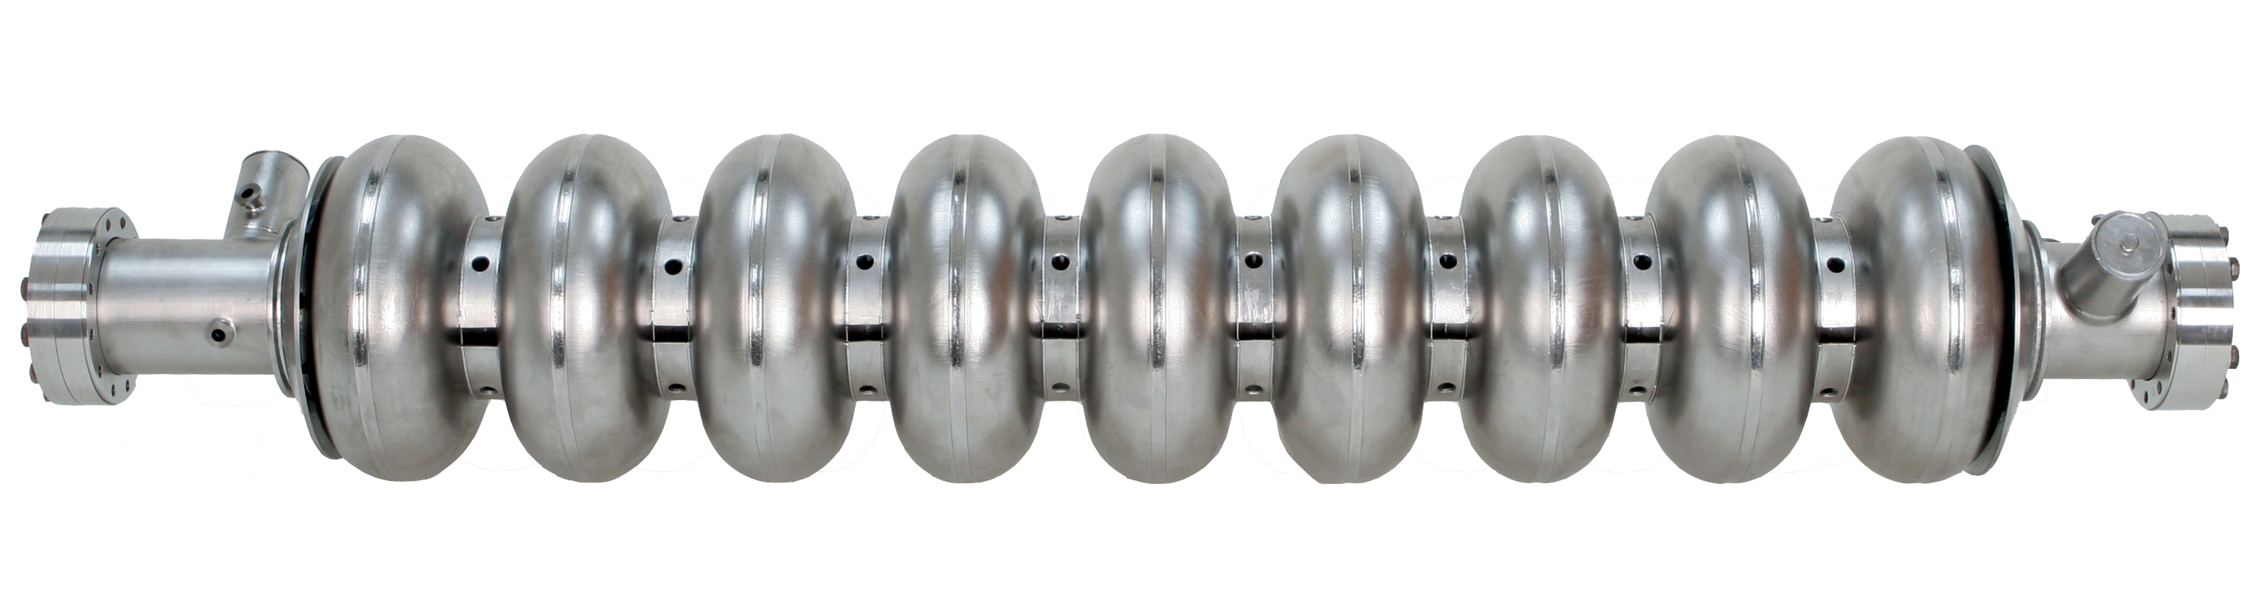
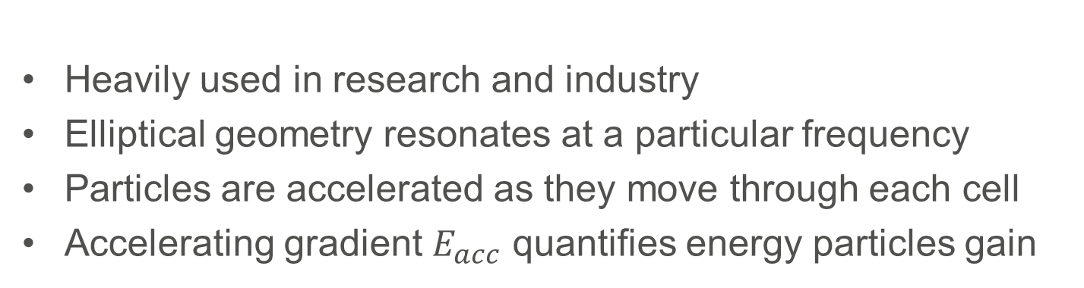
Radio Frequency (RF) Cavities
Heavily used in research and industry
Elliptical geometry resonates at a particular frequency
Particles are accelerated as they move through each cell
Accelerating gradient $E_{acc}$ quantifies energy particles gain

Slide 3
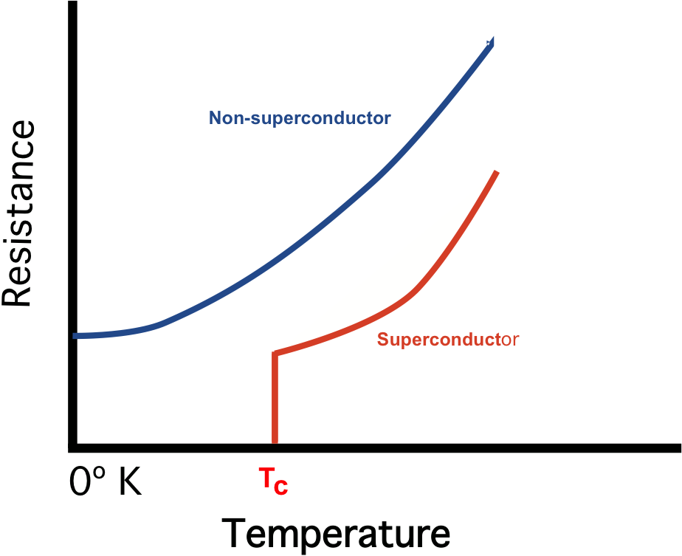
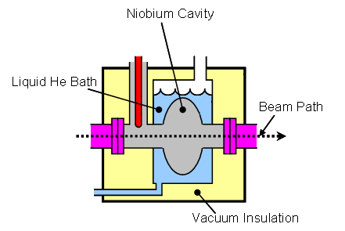
Superconducting RF (SRF) Cavities
Superconductors have very low energy losses
Cavity must be kept below critical temperature (9.25 K for niobium)
Liquid helium coolant is a major complexity

Slide 4
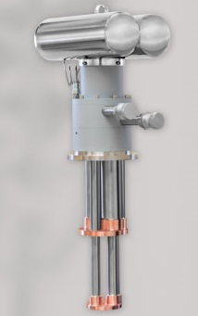
Conduction Cooling with a Cryocooler
Replace liquid helium with a cryocooler
Conduction cooling is a possibility due to technological advancements
  Cryocoolers are commercially available and can cool to 4 K or below
  Nb₃Sn coating reduces cavity heat dissipation
stage 1
stage 2
Cryomech PT420 Pulse Tube Refrigerator

Slide 5
Cryocooler Measurements
Measured the temperature of stage 2 as a function of heat input to stage 1 (H1) and to stage 2 (H2)
Measured amplitude of cryocooler temperature oscillations
Frequency of oscillation is about 1 Hz

Slide 6
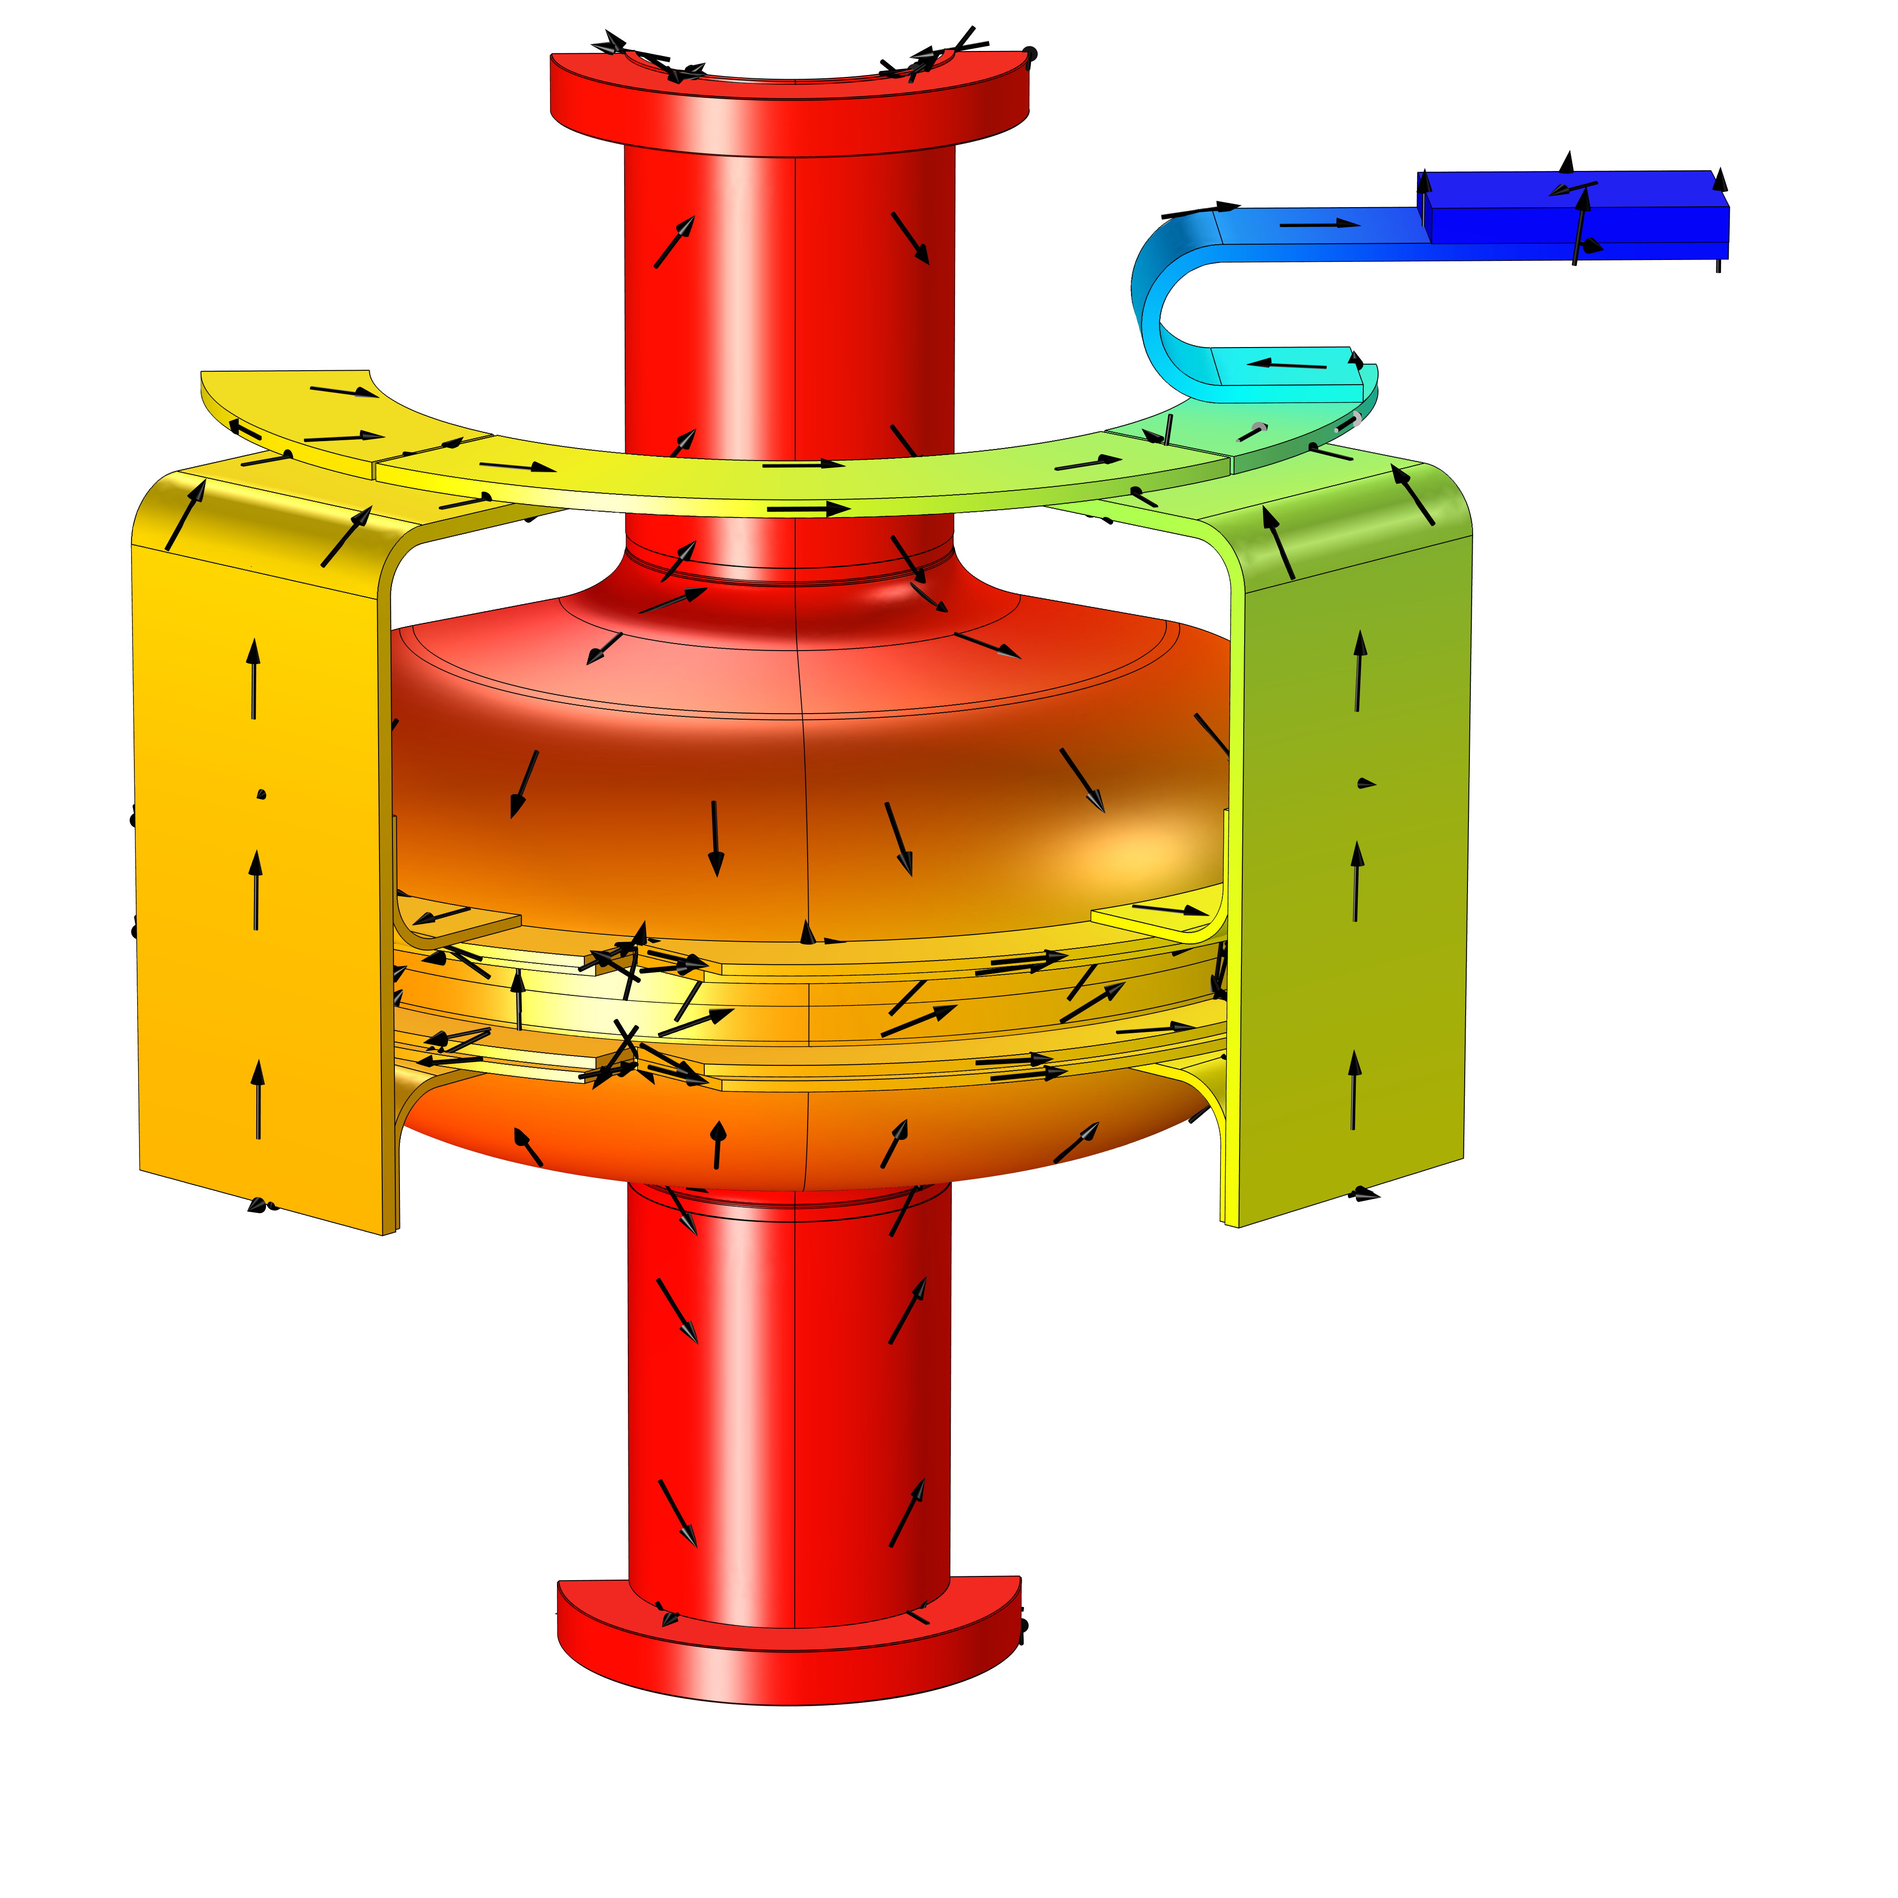
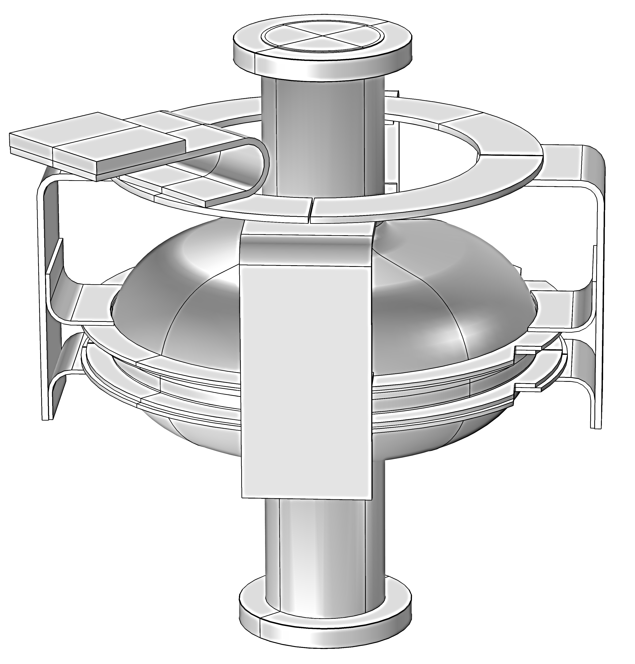
Simulated Geometry
cryocooler plate
thermal link
Thermal link connects cavity to cryocooler
Must have good thermal contact with cavity
Must conduct heat well at low temperatures in vacuum
Must be flexible to isolate mechanical vibrations of cryocooler
single cell cavity
welded rings
Expected Heat Flow

Slide 7
Simulation Procedure
Find the temperature difference between the cryocooler and the welded rings
Geometry
Material Properties
Cryocooler Measurements
Find the dissipated power of the cavity
Heat Transfer Across Thermal Link
RF Fields Inside Cavity
Find the temperature of the full system
Heat Transfer Across Cavity
Cryocooler Oscillations
Find the spatial temperature distribution of the cavity
Find the amplitude of cavity temperature oscillation
Heat Transfer Across Full Geometry

Slide 8
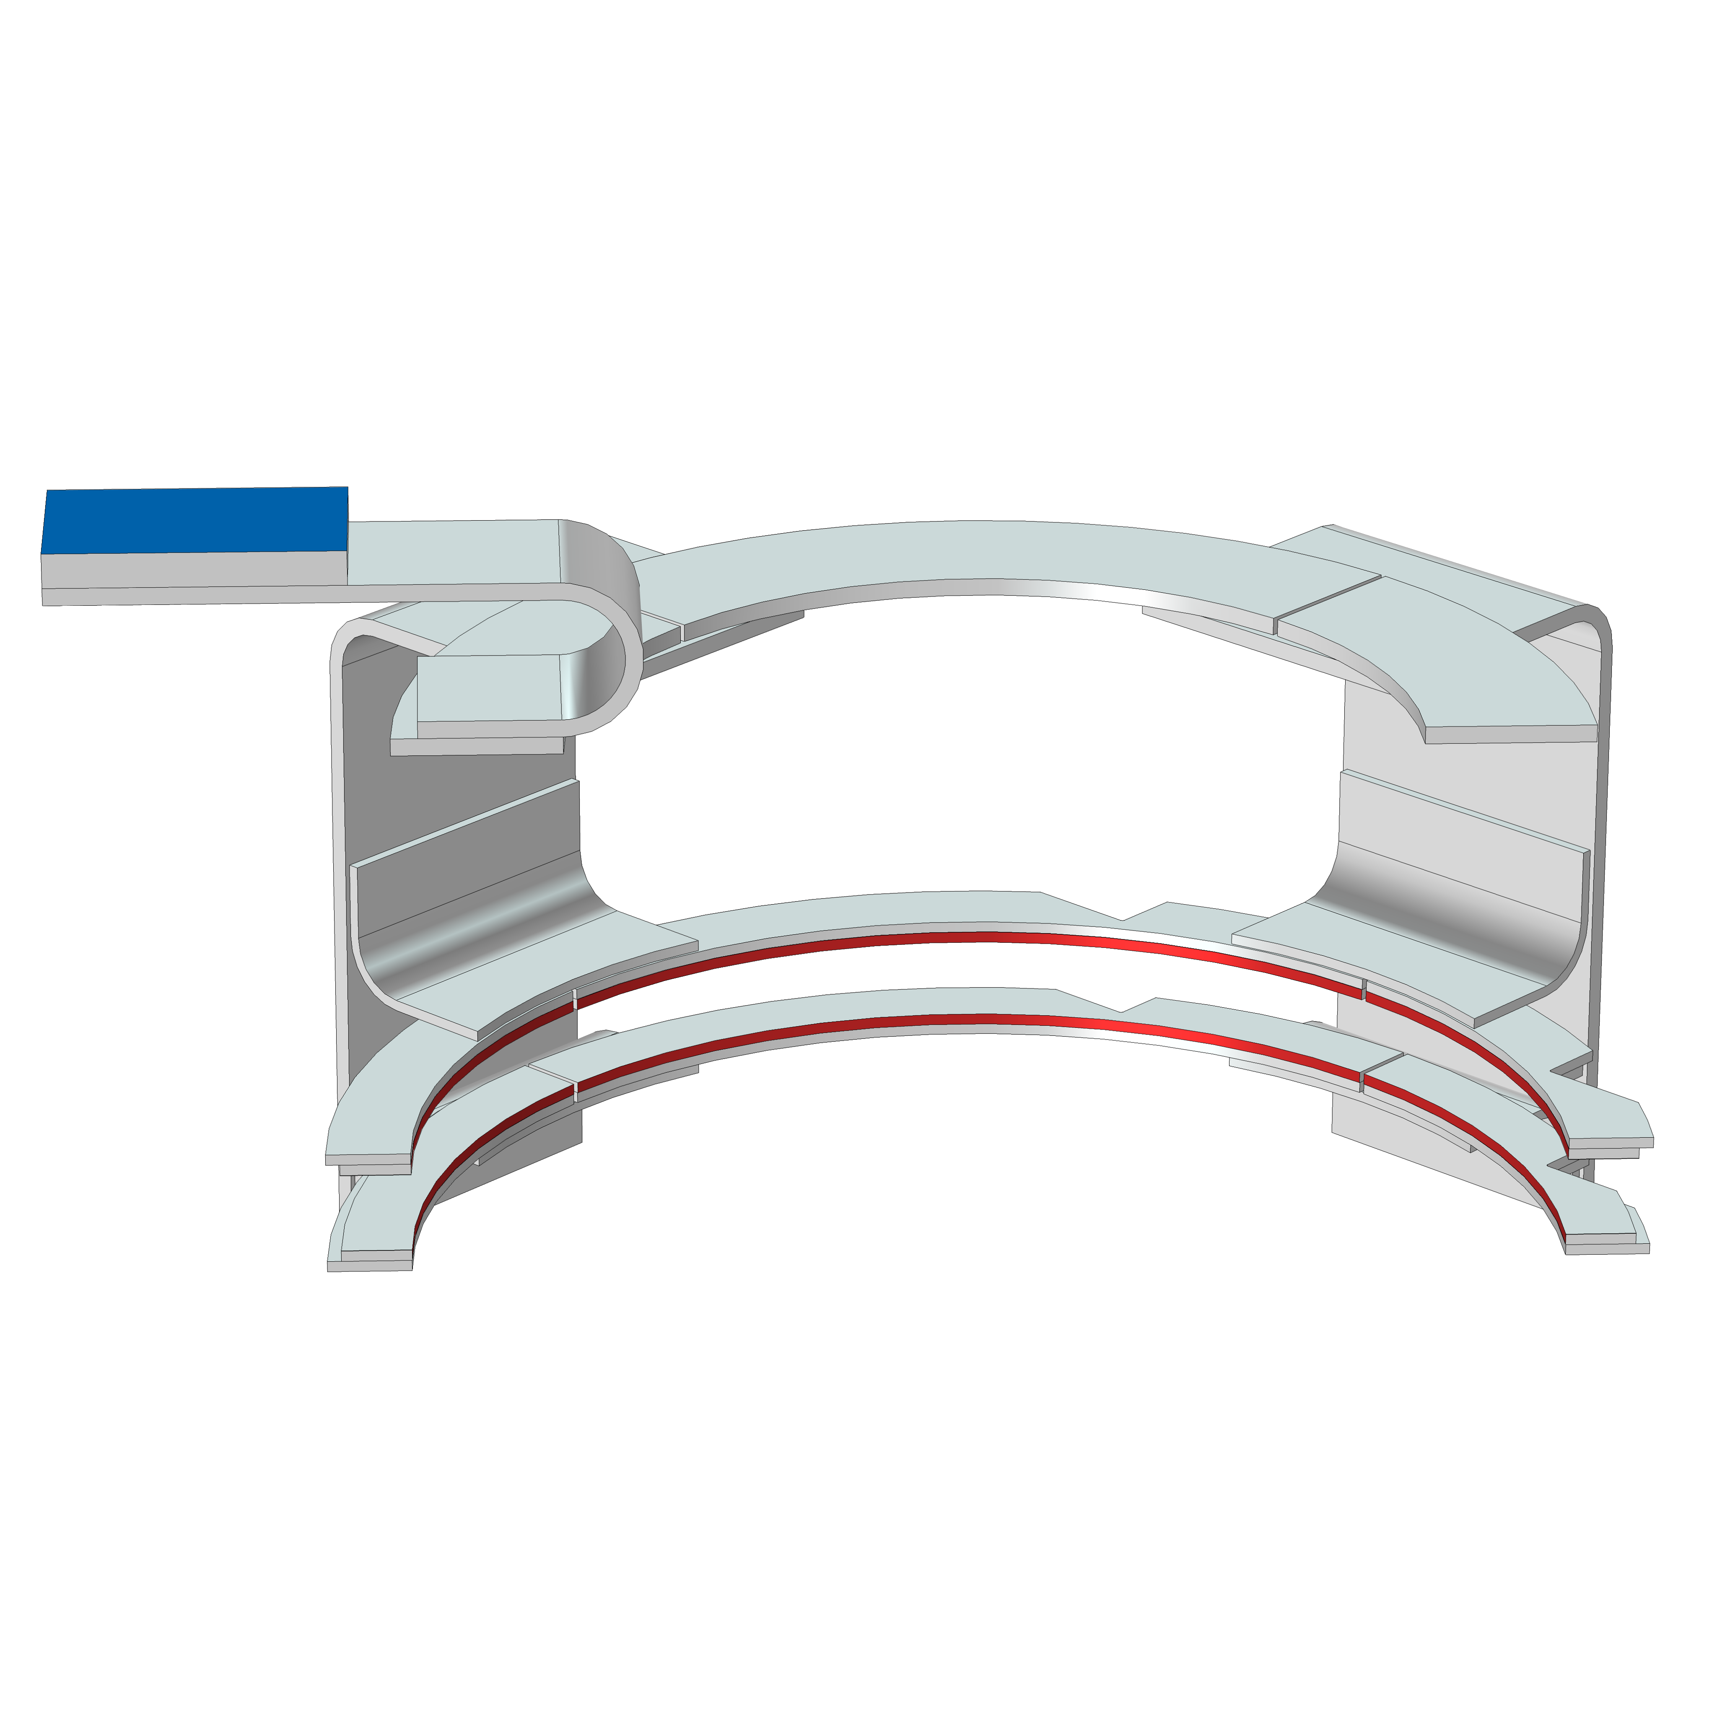
Heat Transfer Across Thermal Link
Heat flux is applied at weld faces of rings
Constant temperature is applied at cryocooler plate
  Used cryocooler measurements to determine this temperature
Temperature at weld faces is measured
Cryocooler
Dissipated heat

Slide 9
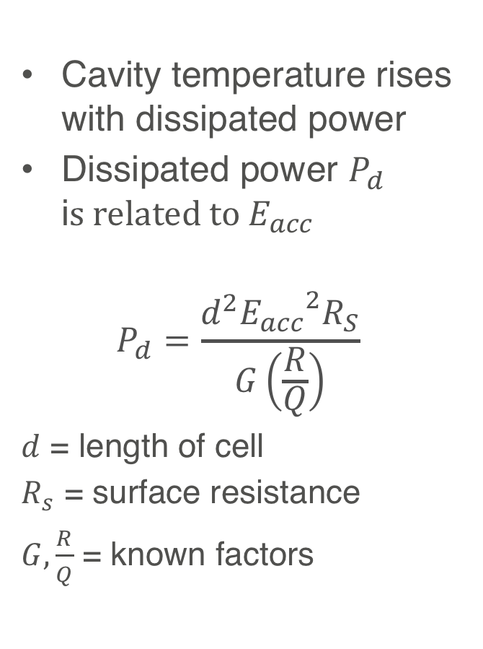
Heat Transfer Across Thermal Link
Cavity temperature rises with dissipated power
Dissipated power $P_{d}$ i$s related to E_{acc}$
$$P_{d}=\frac{ⅆ^{2}{E_{acc}}^{2}R_{S}}{G\left(\frac{R}{Q}\right)}$$
$d$ = length of cell
$R_{s}$ = surface resistance
$G, \frac{R}{Q}$ = known factors

Slide 10
Cryocooler Oscillations
Apply heat flux at weld faces
Apply time-varying cryocooler temperature
Measure time-varying temperature at weld faces
Oscillations dampen before reaching cavity

Slide 11
RF Fields Inside Cavity
Electric field
Magnetic field

Slide 12
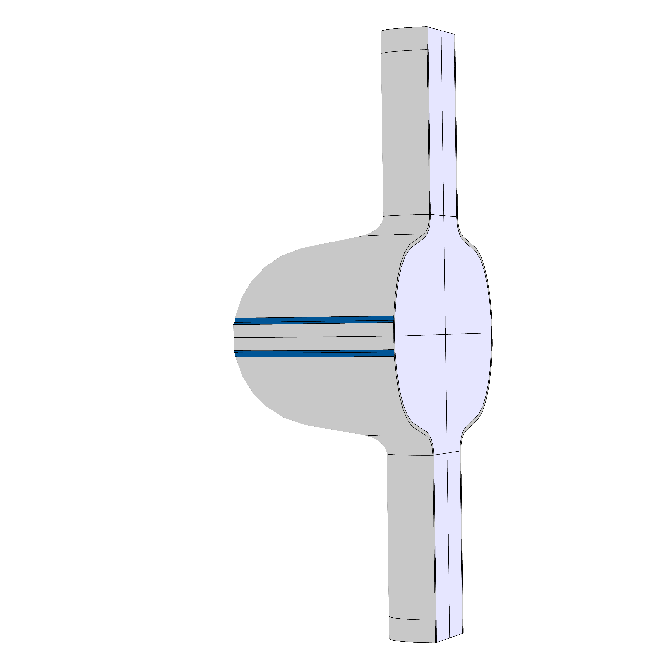
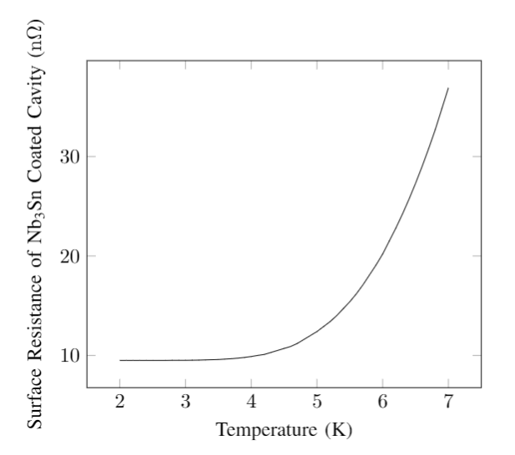
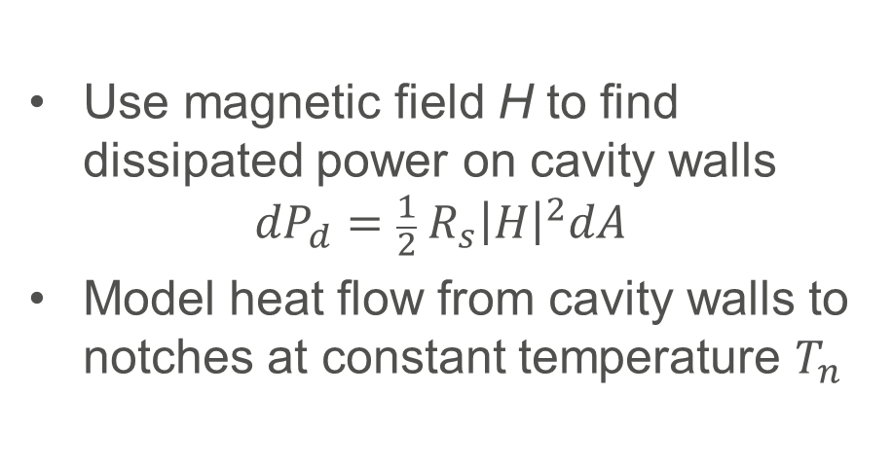
Heat Transfer Across Cavity
Use magnetic field H to find dissipated power on cavity walls
$${dP}_{d}={{\frac{1}{2} R}_{s}\left|H\right|}^{2}dA$$
Model heat flow from cavity walls to notches at constant temperature $T_{n}$
notches
cavity walls
vacuum
Data courtesy of Sam Posen

Slide 13
Heat Transfer Across Cavity
Spatial temperature variations across cavity are small compared to across cooling link
Average temperature of cavity and maximum temperature of cavity are close to equal
Temperature

Slide 14
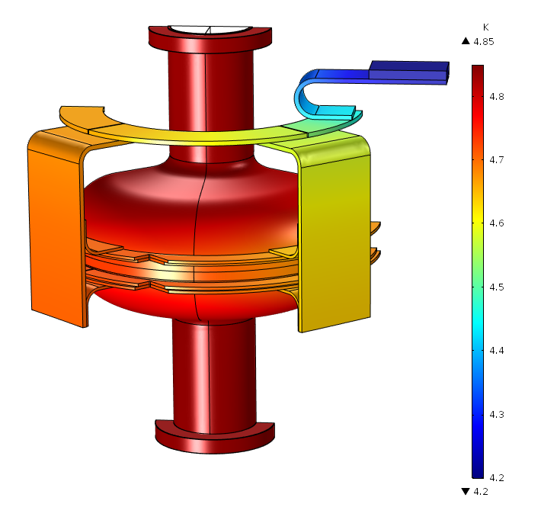
Heat Transfer Across Full Geometry
Model heat flow from cavity walls to cryocooler plate
Temperature difference is sum of difference from previous simulations

Slide 15
Conclusions
At an accelerating gradient of 12 MV/m or less, the cavity temperature is less than 7 K
The temperature across the cavity is nearly spatially uniform
Temperature oscillations in cryocooler dampen before reaching the cavity
Conduction cooling this geometry with a cryocooler is viable

Slide 16
Acknowledgements
Thanks to Ram Dhuley, Mike Geelhoed, Charles Thangaraj, Oleg Prokofiev, Ivan Gonin, Andrei Lunin, Aaron Sauers, Sandra Charles, Judy Nunez, Laura Fields, and the SIST Committee

