Slide 1
Machine Learning for Medical Diagnostics
Daralyn K. Fulton
Dillard University
Advisors Dr. Pushpalatha Bhat and Daniel Faia
SIST 2018

Slide 2
Outline
About Me
Motivation
Introduction
Machine Learning
Artificial Neural Network
Prior Research
Particle Physics
Medical Diagnostics
Technology
Results
Future Work
What I’ve Learned
Acknowledgements
References

Slide 3
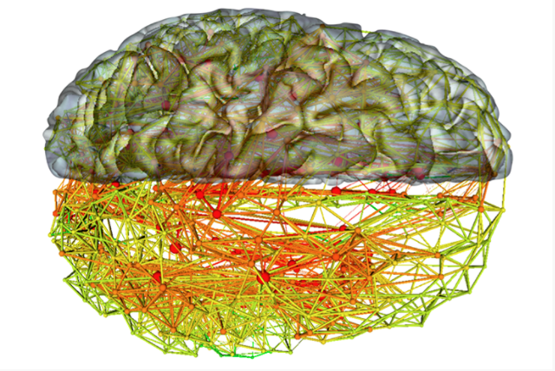
Motivation

Slide 4
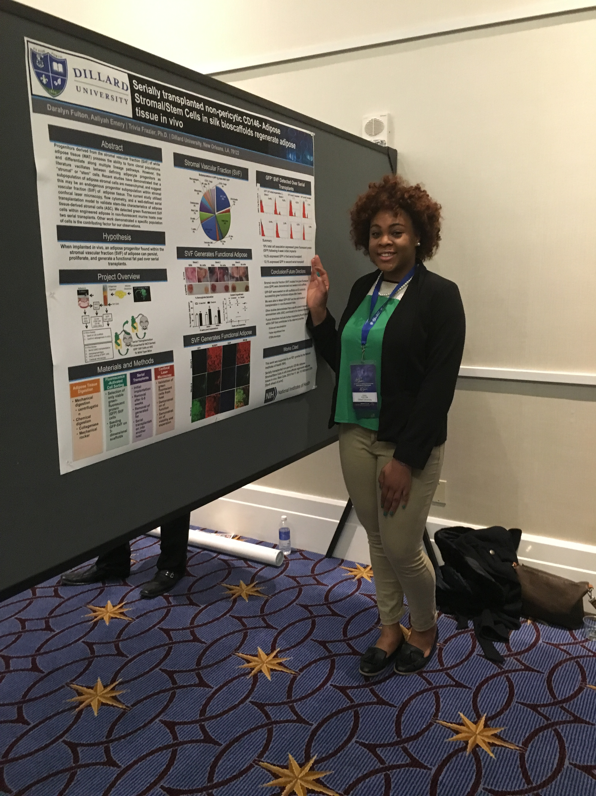
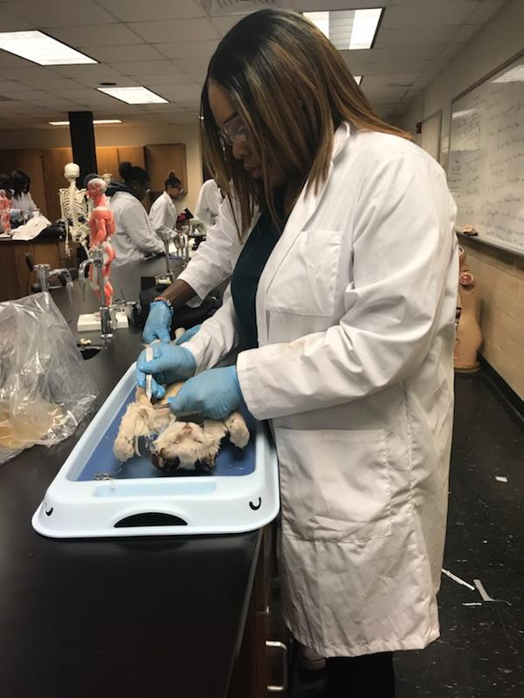
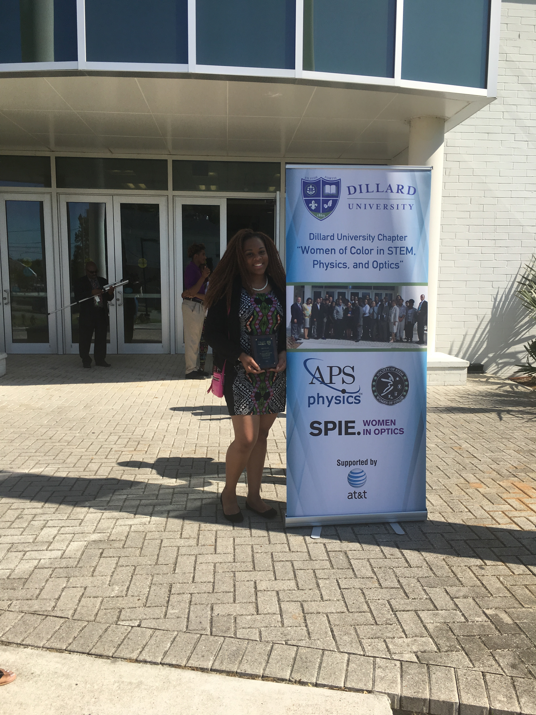
About Me
Daralyn K. Fulton
Rising Senior Physics Major
Medical Physics Concentration
Hometown: Baton Rouge, La
College: Dillard University
New Orleans,La
LS -AMP Scholar
Tom Joyner Foundation Scholar
APS Member/ Woman in Physics
Cook Honors Scholar

Slide 5
Machine Learning
Machine learning
an area of study in computer science; automated learning from data.
applies algorithms on a set of data samples to discover patterns of interest.
Supervised Learning
Learning using known patterns and associated outputs(labeled data); discovers known patterns in new data
Unsupervised Learning
used if someone wants to discover unknown patterns in data.)

Slide 6
Artificial Neural Networks
Supervised and Unsupervised Algorithms
commonly known type is the feed-forward neural network
a network of neurons, that is trained using the backpropagation algorithm( gradient descent); weights tuned using the chain rule
the artificial neurons generally are implemented as a non-linear function over a linear combination of the input features. Mathematically speaking: f(Wx)= y, where W is a matrix, x is the vector of input features and f is a non linear function, like tanh or sigmoid

Slide 7
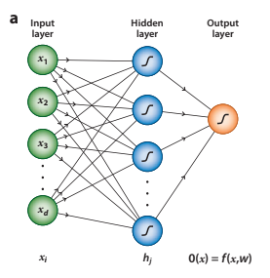
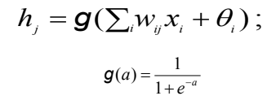
Artificial Neural Network
Backpropagation(Gradient Descent)
Where,
(Sigmoid)

Slide 8
Prior Research of MLP in Particle Physics, Technology, and Medical Diagnostics
Particle Physics : use Machine Learning to analyze data through:
Classification
Separating signal events (e.g.,Top Quark and Higgs Boson Events) from background
Functional Fitting
measurement of parameters
Pattern Recognition
recognizing images, and reconstructing tracks and events.
Netflix, Google Search Engine, Siri use ML/AI

Slide 9
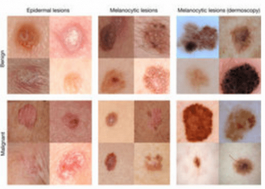
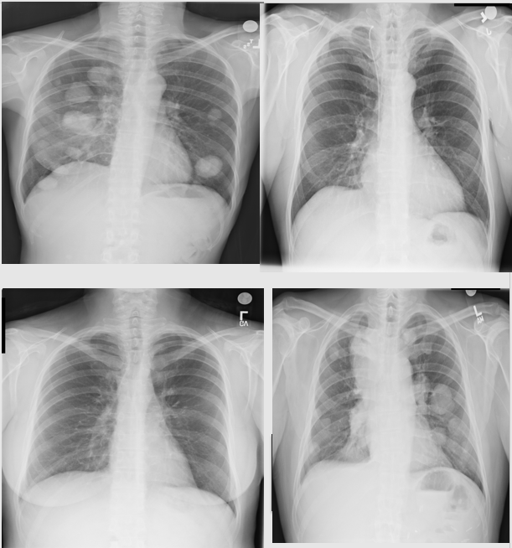
Medical Diagnosis
Oncology :Researchers are using deep learning to train algorithms to recognize cancerous tissue at a level comparable to trained physicians
Summer research at Fermilab: consisted of Machine Learning and Medical Diagnostics

Slide 10
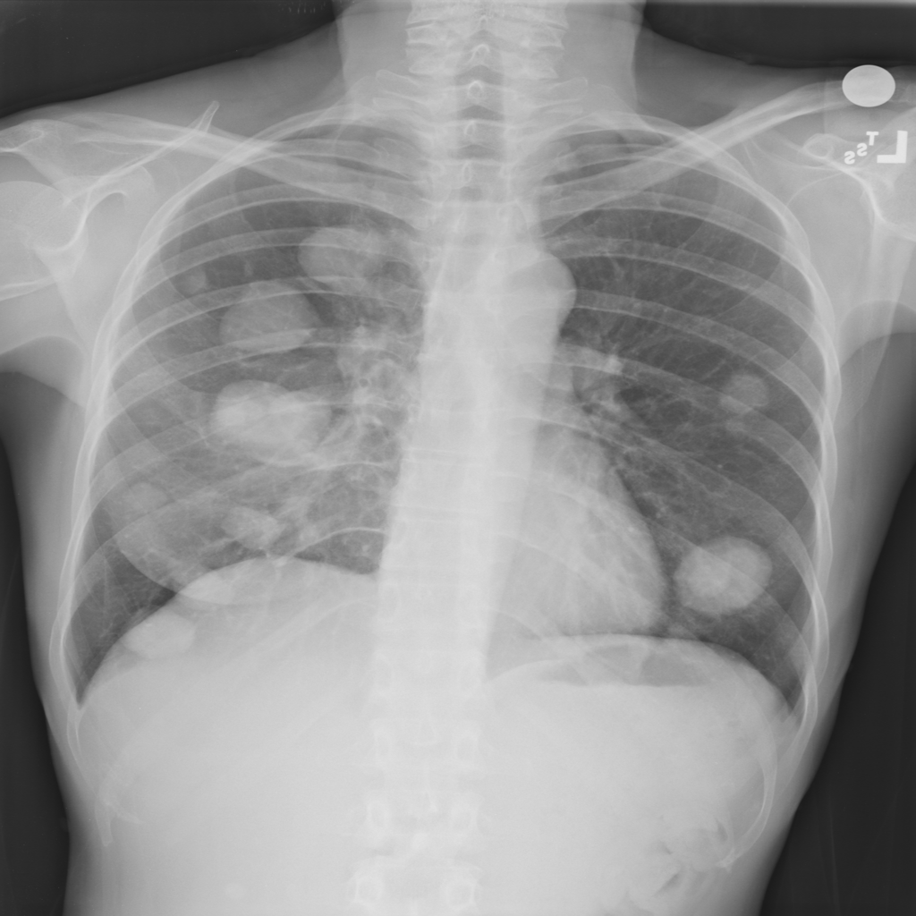
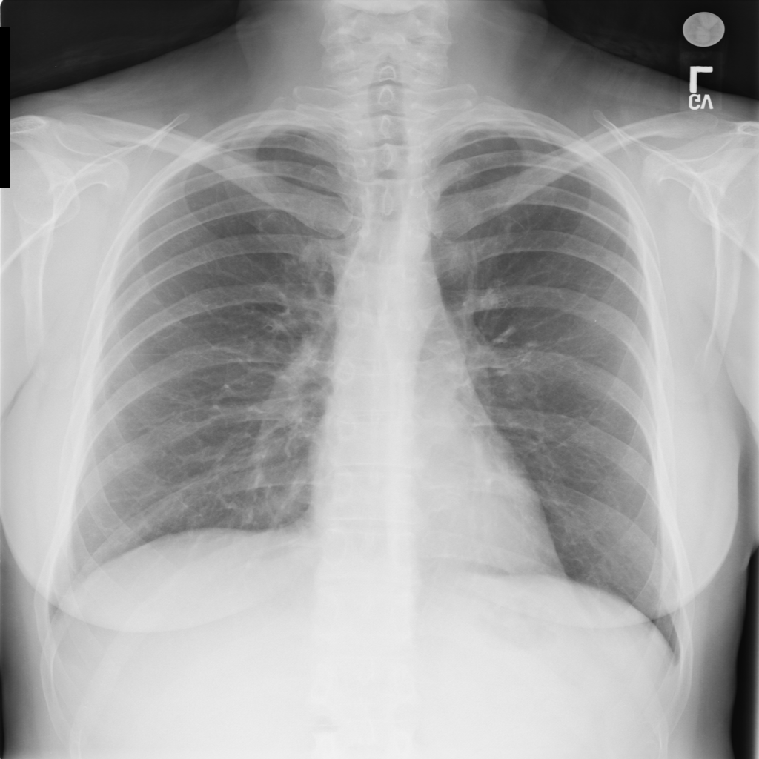
Chest X-ray Images
Trained an algorithm with 1,000 images to differentiate between images that have abnormalities and images that do not.
500 abnormal chest X-rays
500 normal chest X-rays.
Images from NIH Database

Slide 11
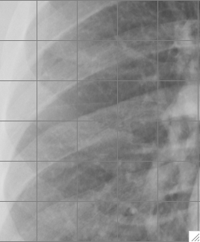
Extraction Bins from 5x6 Grid (Abnormal)
1
2
3
4
5
Values of Pixel 1
149,145,139,96,61,
46,153,152,119,88,
54,38,162,143,52,62,43,37……………………….etc.
6
7
8
9
10
11
12
13
14
15
16
17
18
19
20
21
22
23
24
25
26
27
28
29
30
5x6 Grid
Values are extracted using the grayscale ranging from 0 to 255, with 0 being black and 255 being white.
The value table represents the extraction of values from the first region of the 5x6 grid.
.

Slide 12
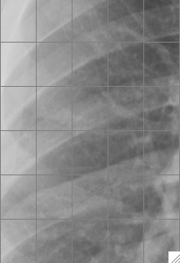
Extraction of Bins from 5x6 Grid (Normal)
1
2
3
4
5
Values of Pixel 1
140,98,65,50,42,42,
121,79,56,44,41,43,95
69,53,44,41,49,77,58, 47,43,48,58………………..etc.
Input Variables
140,98,65,50,42,42,
121,79,56,44,41,43,95
69,53,44,41,49,77,58, 47,43,48,58………………..
6
7
8
9
10
11
12
13
14
15
16
17
18
19
20
21
22
23
24
25
26
27
28
29
30
Values are extracted using the grayscale ranging from 0 to 255, with 0 being black and 255 being white.
The value table represents the extraction of values from the first region of the 5x6 Normal Grid

Slide 13
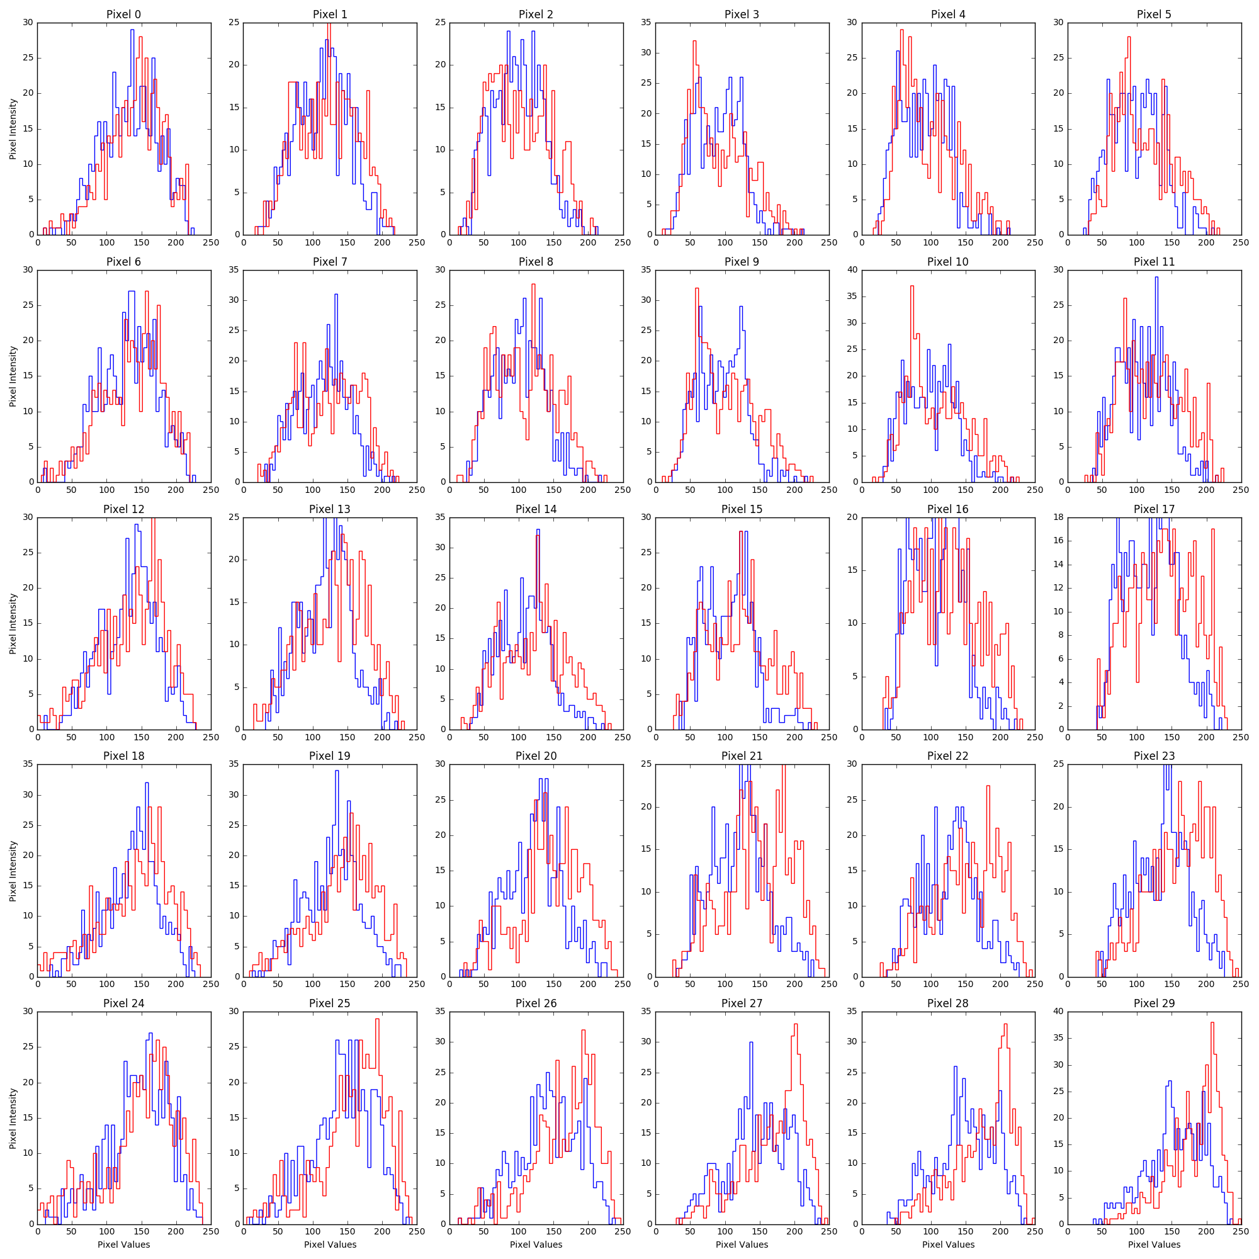
Histograms of Abnormal and Normal

Slide 14
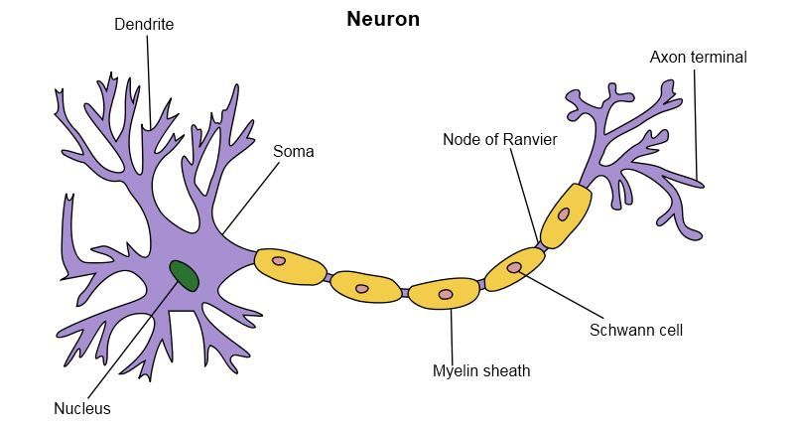
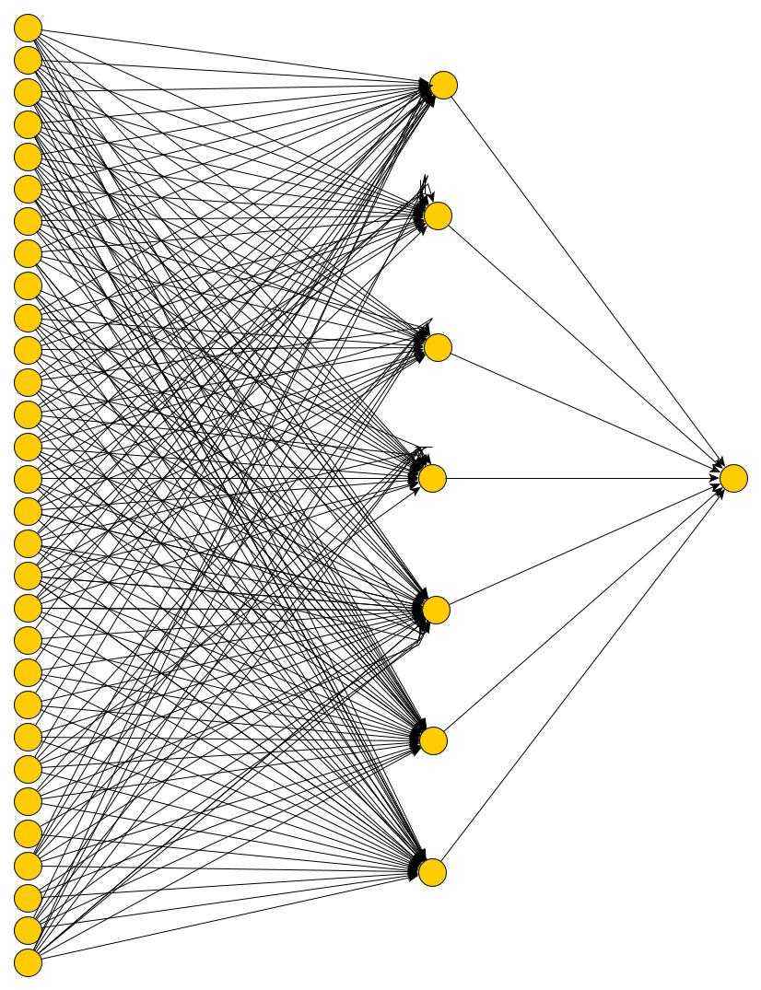
Feed Forward Neural Network
Input Layer
The 30 pixels are represented in the target input variable.
Biological: The dendritic tree receives the input into the nucleus from other neurons
Hidden Layer
Synaptic Weight
Biological: Synapses
Output Layer
Estimation of prediction of the target input variable
Biological: synapse propagates down the axon to dendrites of other neurons.
Input Layer
Hidden Layer
Output layer

Slide 15
Machine Learning Results: software packages used to analyze data
ROOT
software tool
deals with big data processing
statistical analysis
visualization and storage
used in particle physics
TMVA –
The Toolkit for Multivariate Data Analysis with ROOT
Used for machine learning
multivariate classification techniques.
ROC Curves(Receiver Operations Characteristic)
A method of evaluating the performance of the true positive rate (Sensitivity) is plotted in function of the false positive rate (1-Specificity).

Slide 16
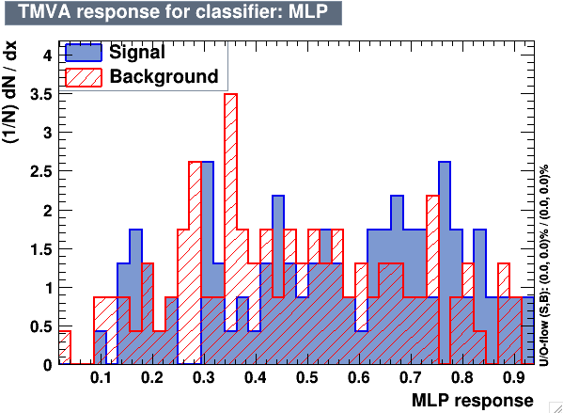
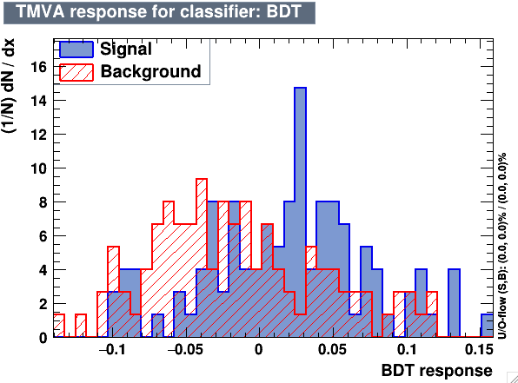
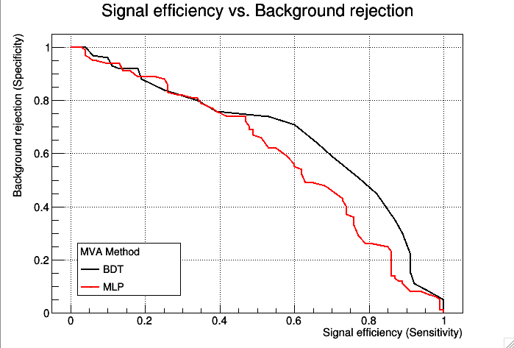
Machine Learning Results: Sigmoid
BDT: (Boosted Decision Tree)
Another Machine Learning Algorithm which uses trees of sequential cuts.
specificity
sensitivity

Slide 17
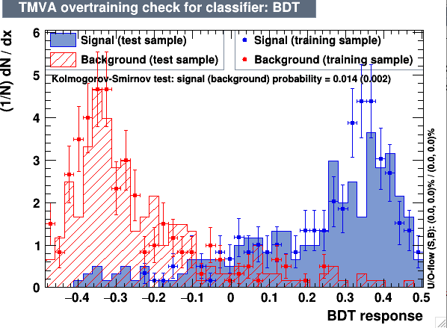
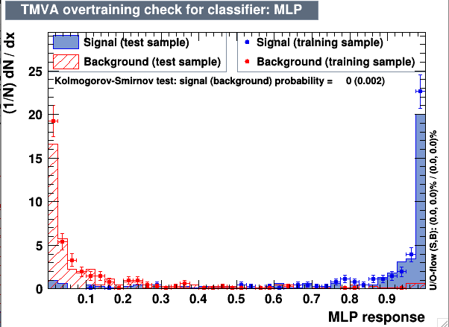
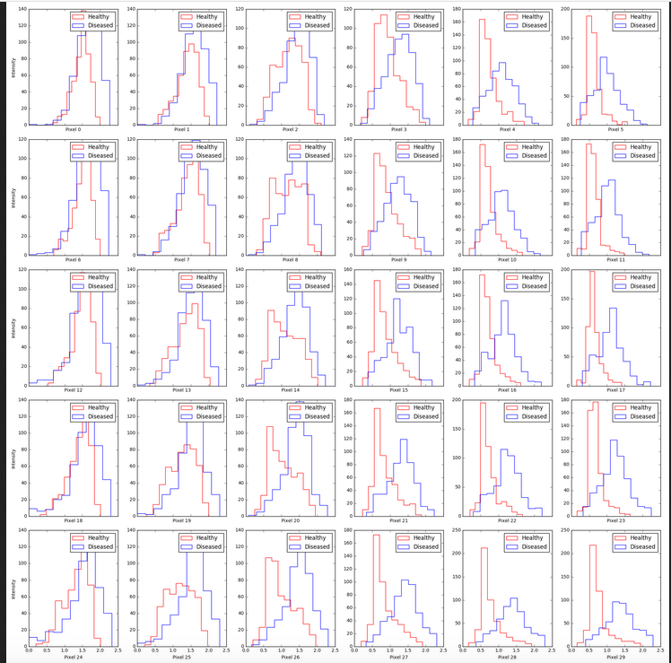
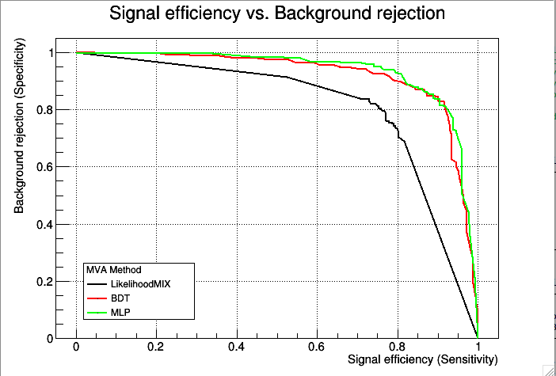
Problems encountered
Images came from two different databases(large dataset).
Some healthy images were mixed in with disease images.
Photo qualities, dimensions were inconsistent.
4. Therefore crop data not reliable.

Slide 18
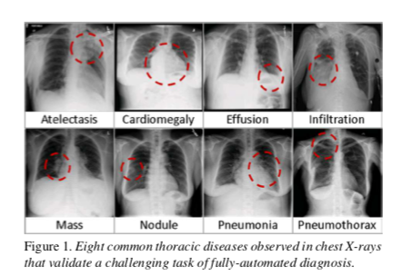
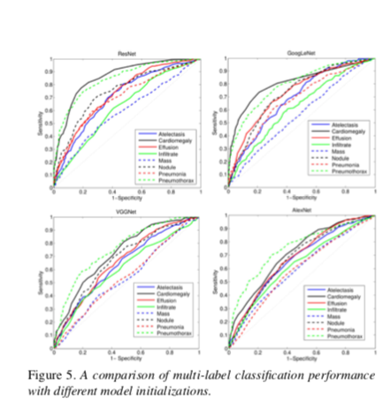
Previous Research using Convolutional Neural Networks
Wang X, Peng Y, Lu L, Lu Z, Bagheri M, Summers RM. ChestX-ray8: Hospital-scale Chest X-ray Database and Benchmarks on Weakly-Supervised Classification and Localization of Common Thorax Diseases. IEEE CVPR 2017, http://openaccess.thecvf.com/content_cvpr_2017/papers/Wang_ChestX-ray8_Hospital-Scale_Chest_CVPR_2017_paper.pdf(link is external)

Slide 19
Future Work
Collect more images from a medical facility to train the MLP
Train and test more images to improve accuracy rate.
Tune MLP
Use a CNN ( Convolutional Neural Network)

Slide 20
What I’ve Learned
Machine Learning
Neural Networks
Convolutional Neural Networks
Programming language Python
ROOT and ROOT Classifiers
Particle Physics Concepts

Slide 21
References
Sanjeevi, Madhu, and Mady. “Chapter 7 : Artificial Neural Networks with Math. – Deep Math Machine Learning.ai – Medium.” Medium, Augmenting Humanity, 11 Oct. 2017
“Activation Functions: Neural Networks – Towards Data Science.” Towards Data Science, Towards Data Science, 6 Sept. 2017, towardsdatascience.com/activation-functions-neural-networks-1cbd9f8d91d6.
“RARE Diseases: Facts and Statistics.” Global Genes, 29 Mar. 2017, globalgenes.org/rare-diseases-facts-statistics/.
Sennaar, Kumba. “Machine Learning for Medical Diagnostics - 4 Current Applications -.” TechEmergence, 12 Jan. 2018, www.techemergence.com/machine-learning-medical-diagnostics-4-current-applications/.
Quanta Magazine. “In Brain's 'Rich Club,' Meetings of the Mind.” Quanta Magazine, www.quantamagazine.org/in-brains-rich-club-meetings-of-the-mind-20131024/.
“Diagnostic Errors More Common, Costly And Harmful Than Treatment Mistakes - 04/23/2013.” Johns Hopkins Medicine Health Library, www.hopkinsmedicine.org/news/media/releases/diagnostic_errors_more_common_costly_and_harmful_than_treatment_mistakes.
“TMVA | ROOT a Data Analysis Framework.” User's Guide | ROOT a Data Analysis Framework, root.cern.ch/tmva.

Slide 22
Special Thanks
Dr. Pushpa Bhat and Daniel Faia

Slide 23
Acknowledgments
Ms. Sandra Charles and Ms. Judy
The SIST Committee
Mentors
Dillard Fam
SIST Interns

