Slide 1
Tritium Transport in Fermilab Water Systems
JoRee LaFrance
GEM Fellow
6 August 2018

Slide 2
Overview with objectives
Introduction
  Develop graphics for Fermilab water systems
Methods
  Understand sampling locations and frequency
  Update Tritium Load Tracking Matrix
Results
  Provide recommendations
8/6/18
JoRee LaFrance | Tritium Transport in Fermilab Water Systems

Slide 3
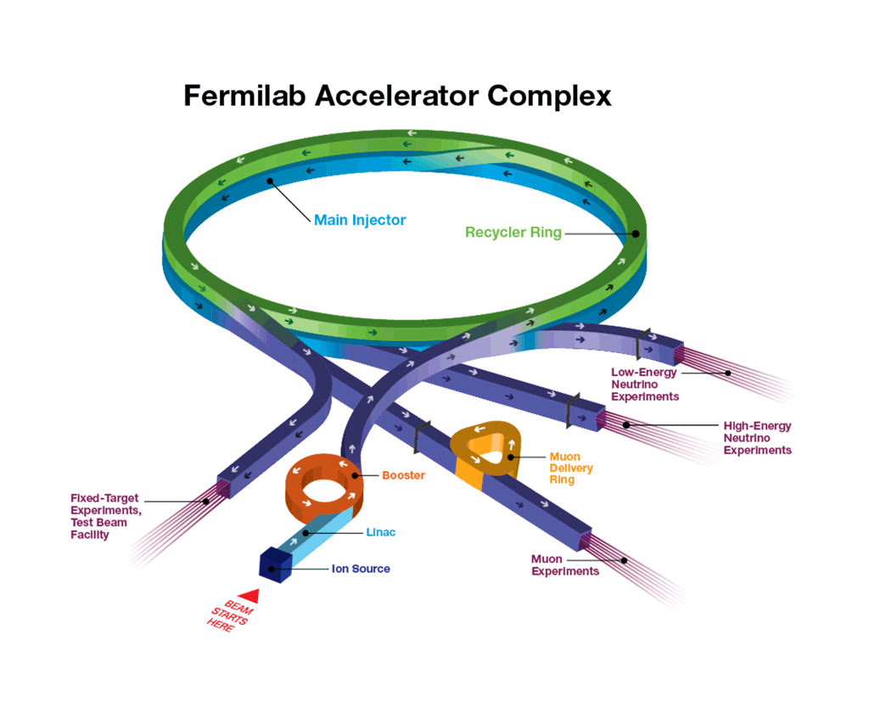
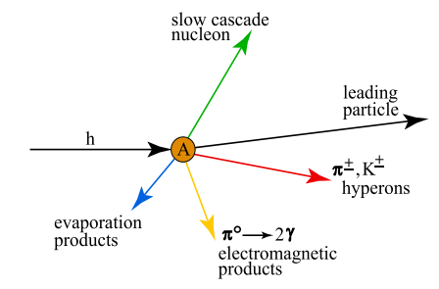
Tritium
Activated form of hydrogen (³H)
Occurs naturally when cosmic rays hit the earth
Byproduct of particle accelerator targets
When combined with oxygen it produces Tritiated Water (HTO)
  Half life of HTO is about 12.3 years
Source: ESH&Q Tritium Management Lecture
8/6/18
JoRee LaFrance | Tritium Transport in Fermilab Water Systems
Notes:
-Where is the hydrogen coming from for it become radioactive in the first place?

Slide 4
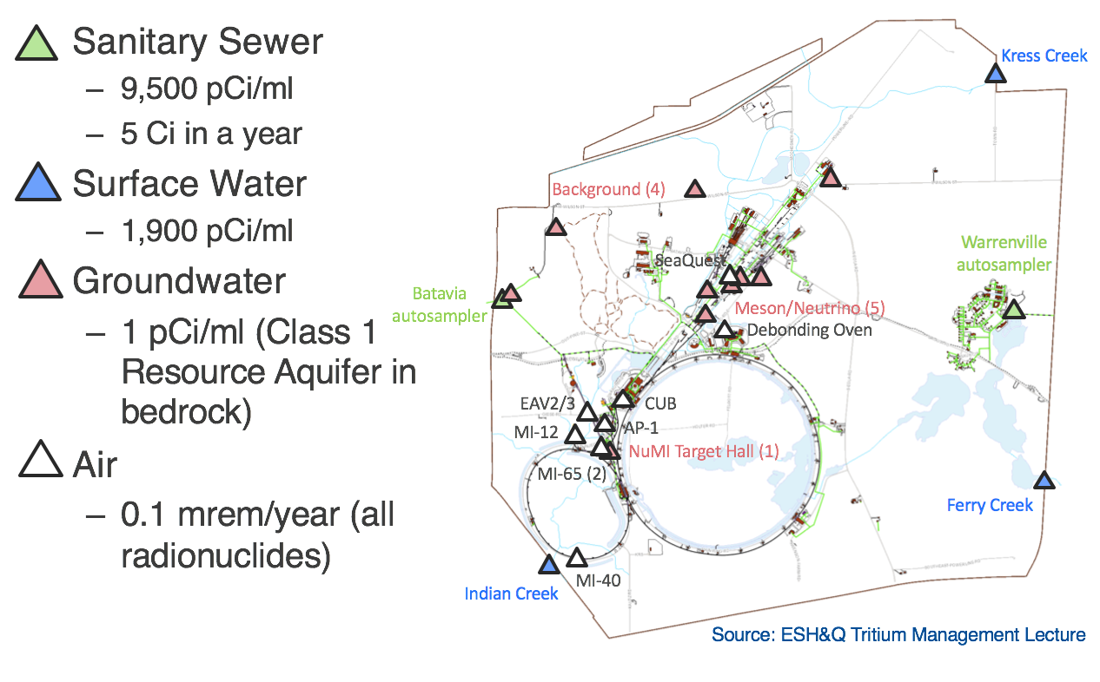
Why do we track tritium?
Released into water and air from sources
Eventually leaves Fermilab campus into public systems at discharge points
  Remaining well below federal and state regulatory limits
  Public Perception
Notes:
-Can this be moved after the sampling slide? Mentioning the percentages does not go with the flow of the presentation.

Slide 5
Fermilab Water and Air Systems
Surface Water
  Kress Creek
  Indian Creek
  Ferry Creek
Sanitary Sewer Systems
  Batavia Autosampler (Warrenville Autosampler <1 pCi/mL)
Industrial Cooling Water (ICW) System
Air Discharges
  MI-65 Building from NuMI
  Central Utility Building (CUB) from ICW
Notes:
-Talk about the 3 main water systems
-complexity of this system

Slide 6
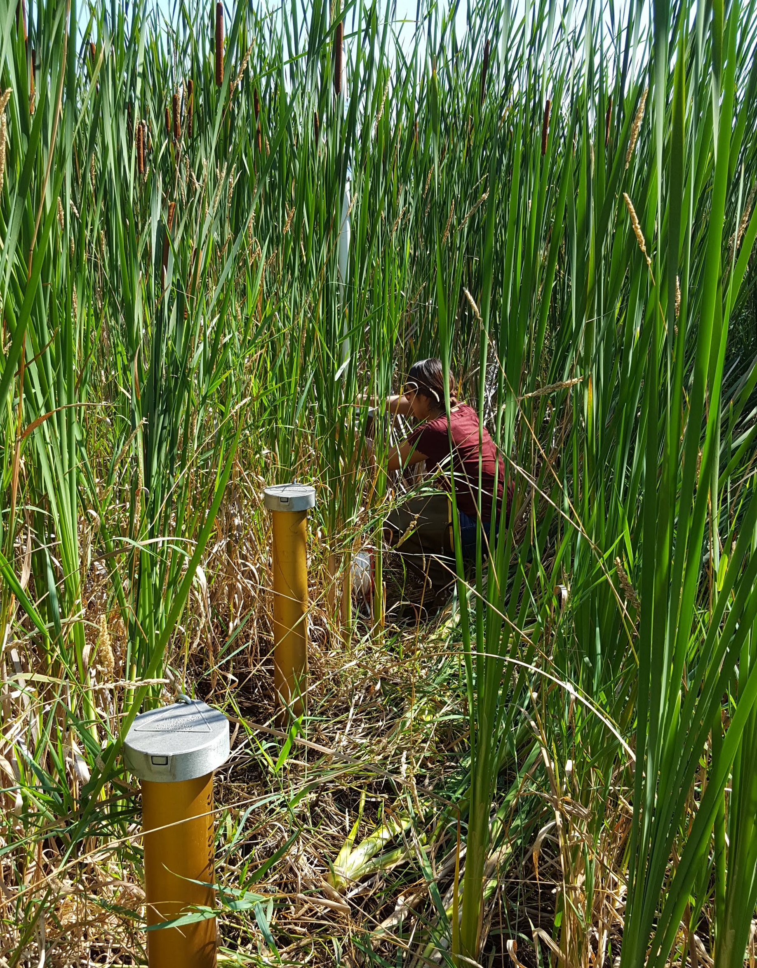
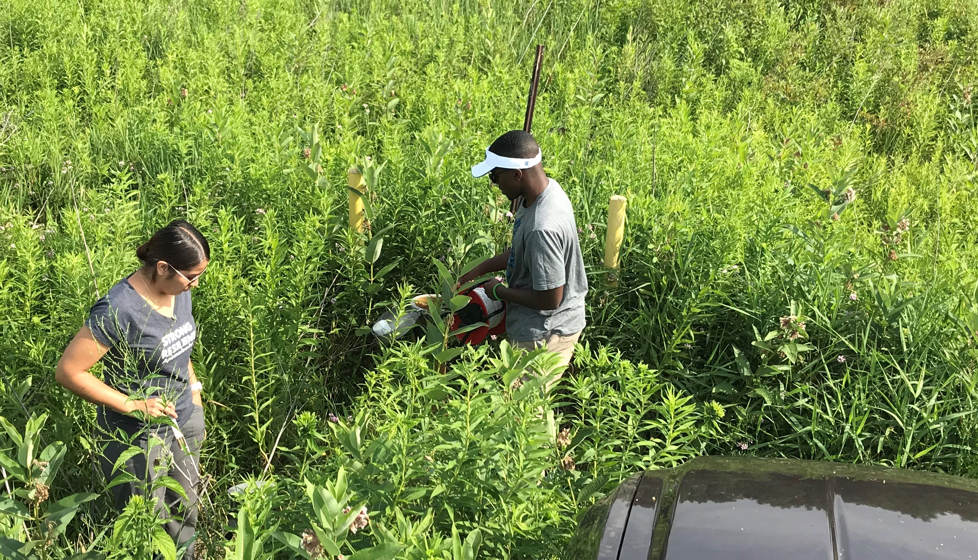
Sampling
Tritium sampling
Locations:
  Sanitary Sewer
  ICW
  Surface Water
  Groundwater
Well inspections in the main ring. JoRee (left) and Quaran (right, TARGET intern).
Well inspections in cattails.

Slide 7
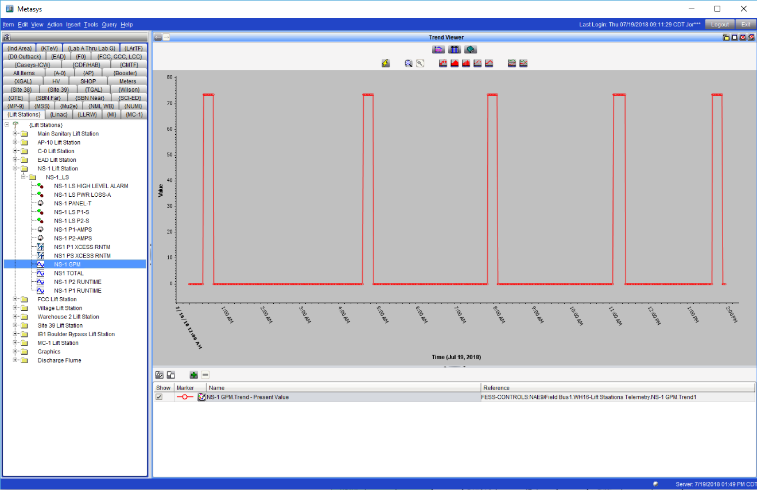
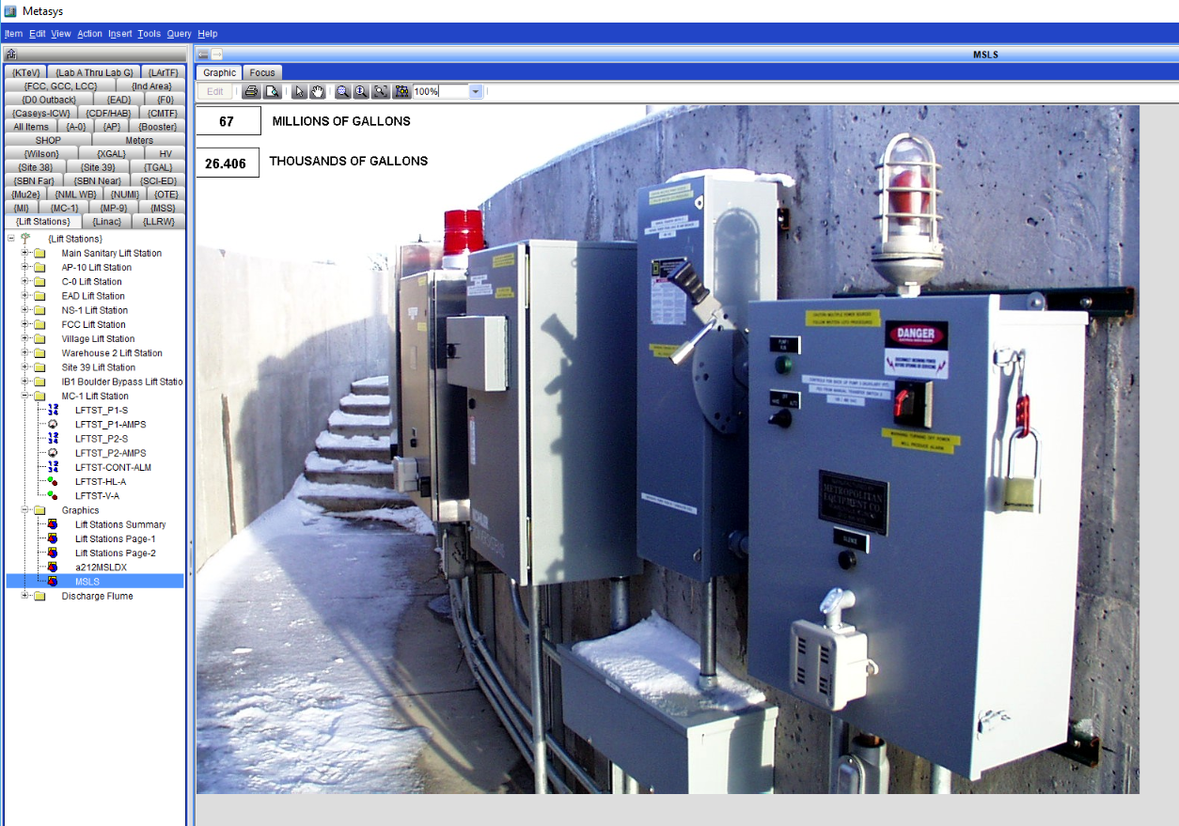
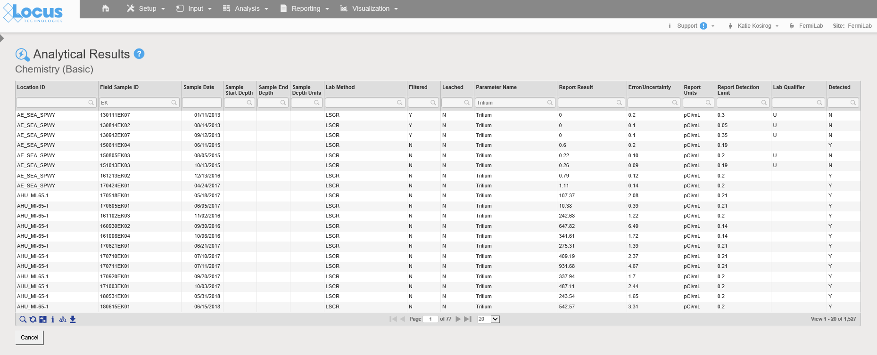
Sanitary Sewer Data Sources
Locus:
  Tritium analytical results
Lift Station Readings:
  FESS: Al Wywialowski
  Metasys
  Lift Station Pump Ratings
    GIS Identify Tool

Slide 8
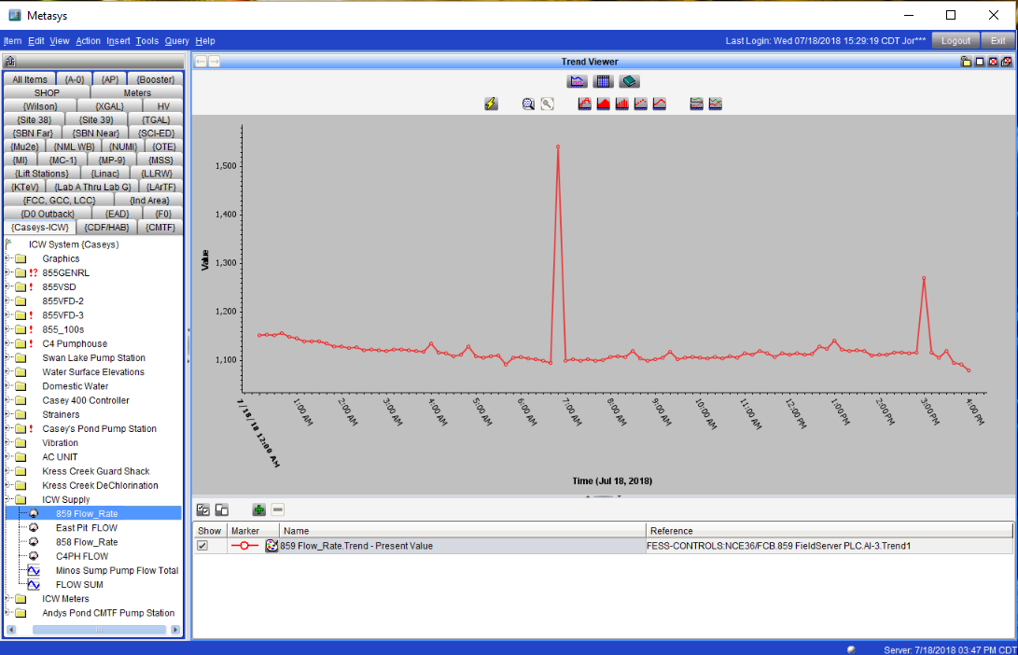
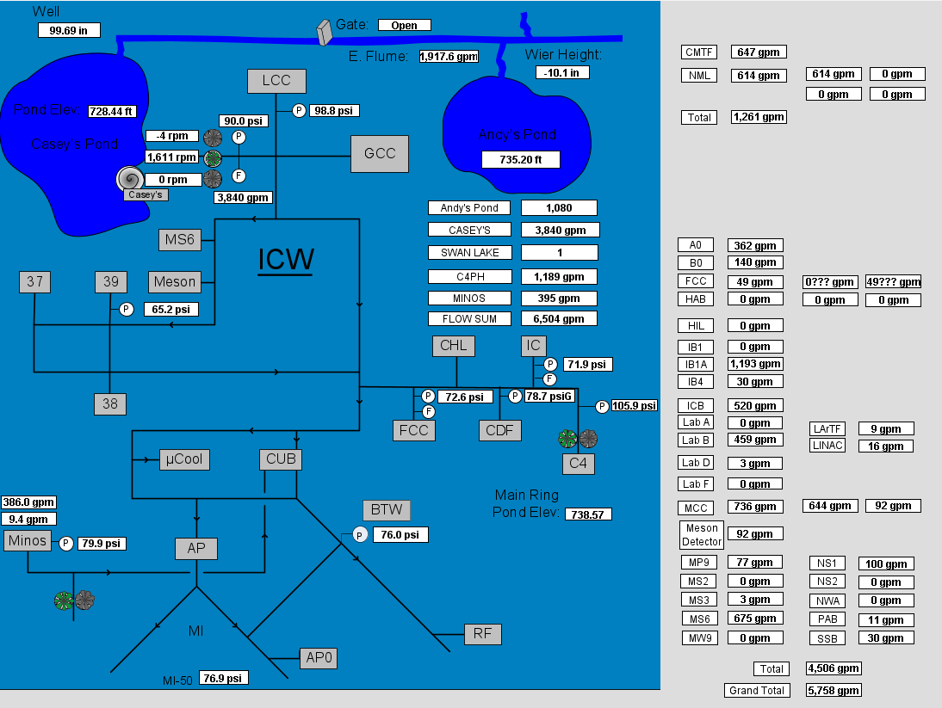
Industrial Cooling Water Data Sources
Locus:
  Tritium analytical results
Metasys:
  Industrial Cooling Water System
    Graphics
    Supply
    Meter

Slide 9
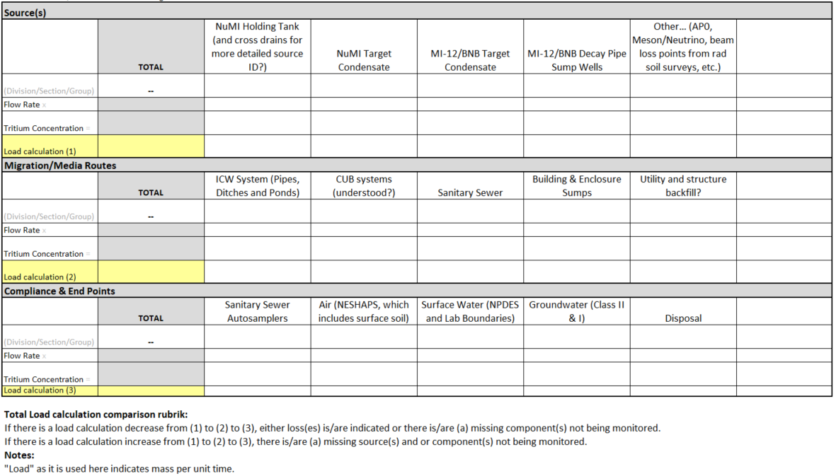
Tritium Load Tracking Matrix
Tritium Task Force Comprehensive Management Plan
Notes:
Comprehensive plan on how they are managing tritium with the immediate and future risks as well as mitigation efforts.
-sources, migration routes, discharges

Slide 10
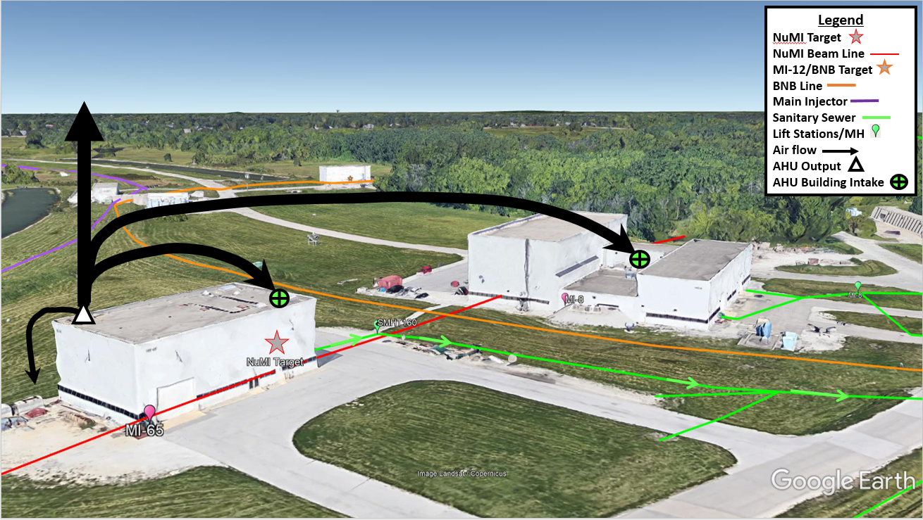
Cross-Connections
Central Utility Building (CUB)
NuMI/MINOS Holding Tank
NuMI Target Hall Condensate
  MI-65 and MI-8 Air Handling Units
  Migration into sanitary sewer and soil

Slide 11
Tritium Load Tracking Matrix
2017 Annual Tritium Load
2018-to-date Tritium Load
Sources | NuMI Holding Tank (and cross drains for more detailed source ID?) | NuMI Target Condensate | MI-12/BNB Target Condensate | MI-12/BNB Decay Pipe Sump Wells | Other… (AP0, Meson/Neutrino, beam loss points from rad soil surveys, etc.)
2016 | 13.70 | 71.9 | - | - | -
2017 | 9.17 | 104.04 | 0.60 | 1.03 | -
2018 | - | - | 0.33 | - | -
2017 Total
114.84
Discharge Points | Sanitary Sewer Autosamplers | Air (NESHAPS, which includes surface soil) | Surface Water (NPDES and Lab Boundaries) | Groundwater (Class II & I) | Disposal
2016 | 0.52 | 85.75 | - | <1 pCi/year | 0.30
2017 | 0.55 | 116.62 | - | <1 pCi/year | 0.24
2018 | 0.20 | - | - | - | -
2017 Total
117.41
*Units = Ci in a year
*2016 and 2017: January – December
*2018: January – May

Slide 12
2017 Tritium Results and Regulatory Limits
0.1%
10%
0.25%
Non-detect
3% (Tritium)
Notes:
-Can this be moved after the sampling slide? Mentioning the percentages does not go with the flow of the presentation.

Slide 13
TTF Management Recommendations
Sanitary Sewer:
  Target sampling locations:
    MC-1
    Main Sanitary Lift Station (MSLS)
  Understanding cross-connections:
    Air Handling Units
    CUB
Industrial Cooling Water:
  Target sampling locations:
    Casey’s Pond
    MINOS Holding Tank
    TeV Pond @ A0
  Understanding cross-connections:
    CUB
    NuMI/MINOS Holding Tank
Future work:
  Adjust sampling frequency to better represent time periods for flow volume measurements
Notes:
-Sampling Frequency
-ICW Flow data for NuMI/MINOS Holding Tank

Slide 14

Objectives (achieved)
Developed graphics for Fermilab water systems
Understanding sampling locations and frequency
  Sanitary Sewer
  Industrial Cooling Water System
  Surface Water
Updated Tritium Load Tracking Matrix
Recommendations
  Tritium Task Force (TTF)
  Environmental Monitoring
8/6/18
JoRee LaFrance | Tritium Transport in Fermilab Water Systems

Slide 15

Acknowledgements/Collaborations/Partnerships
Environmental Protection Group (EPG)
  Chris Greer, Eric Korzeniowski, Katie Swanson, Bridget Iverson, Dave Hockin
Tritium Task Force
  Kamran Vaziri, Joel Fulgham, James Hylen
FESS
  Paul Ranieri, Andy Martens, Al Wywialowski, Chip Kee, Thomas Kraus
Fermilab Diversity & Inclusion
  Sandra Charles, Judy Nunez, Mario Lucero
Program Mentors
  Raul Campos, Carrie McGivern, Kate Sienkiewicz
The National GEM Fellowship

