Slide 1
Qubit Defect Analysis
Mentor: Alexander Romanenko
Group: Technical Division-Quantum Computing
Presenter: Andrew Lambert
06 August 2018

Slide 2
Introduction
Quantum Computing is meant to solve problems that are intractable to classical computers- e.g. molecular modeling etc
Utilizes quantum mechanical phenomena such as quantum superposition-classical computer scales 2n, Quantum Computer scales 2^n
One of the biggest challenges facing quantum computing is coherence.
My work aims to investigate sources of decoherence

Slide 3
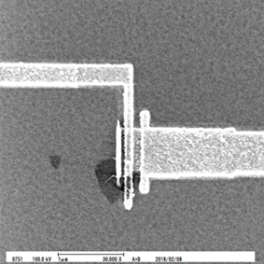
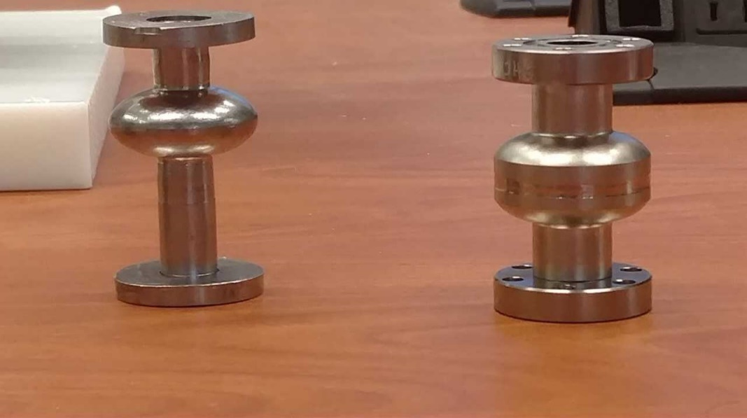
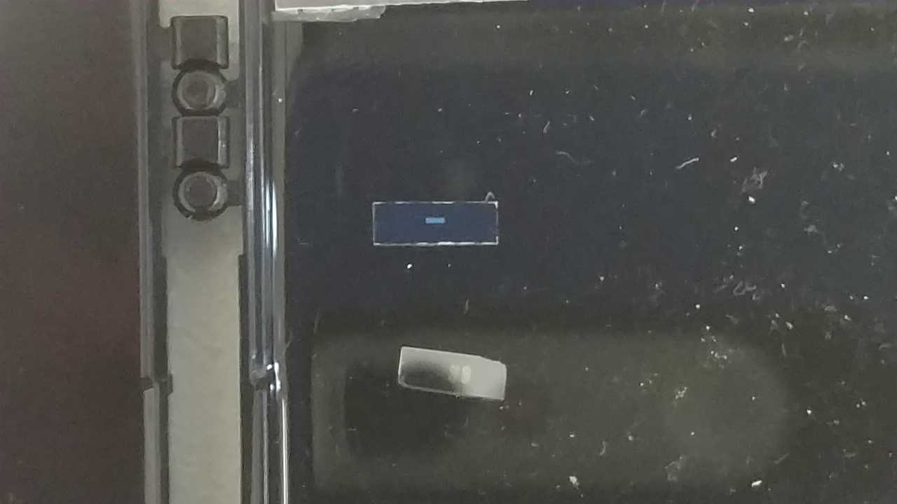
Our Qubit
Figure 2. a) (left) SEM image of qubit, b) (middle) superconducting resonator, c) (right) superconducting qubit.

Slide 4
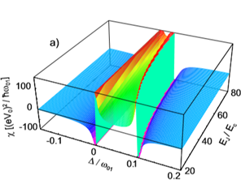
Experiment Overview
Qubit did not work
LSCM
SEM
AFM
Figure 1. Dispersive Shift

Slide 5
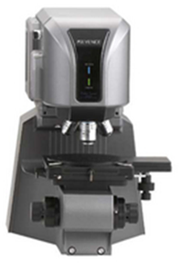
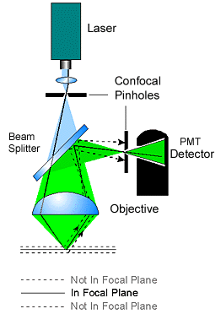
Laser Scanning Confocal Microscope
Figure 3. LCM
Used for profilometry, surface roughness, and imaging
Image constructed pixel by pixel

Slide 6
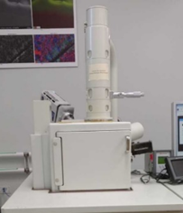
Scanning Electron Microscopy
Used for elemental analysis, imaging, and crystallographic structure
Energy Dispersive Spectroscopy utilizes secondary electrons and back scattered electrons
Electron Backscattered Diffraction is for analyzing chrystollography
Figure 4. SEM

Slide 7
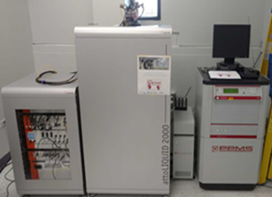
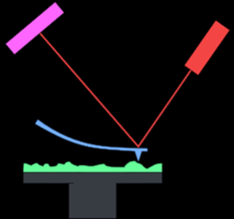
Atomic Force Microscopy
Used for imaging and surface topology
Uses force difference between sample and tip to generate surface topology.
Figure 5. AFM

Slide 8
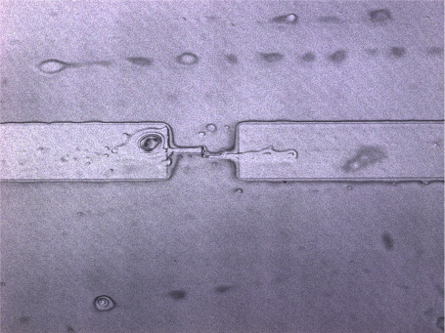
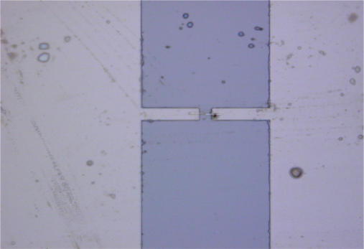
LSCM
Possible Defect
Figure 6. a) (left) 150x magnification, b) (middle) 50x magnification, c) (right) measurement comparison between 50x and 150x.

Slide 9
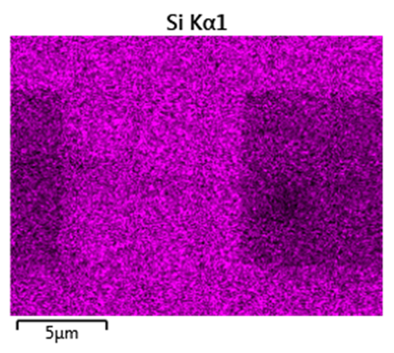
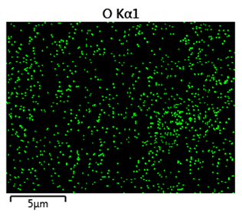
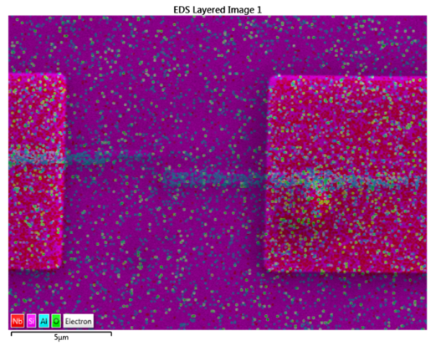
SEM Analysis
Figure 7. EDS analysis done at 15 kV a) (left) Layered image, b) (middle) silicon, c) (right) oxygen.

Slide 10
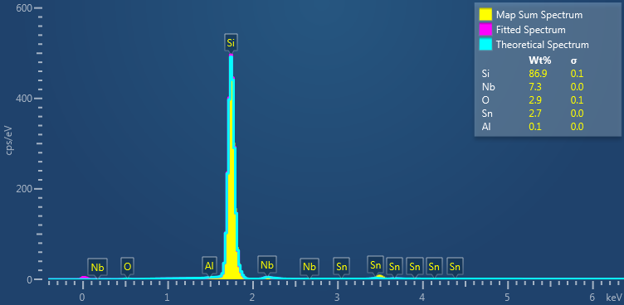
SEM Analysis Continued
Figure 8. SEM Analysis done at 27 kV

Slide 11
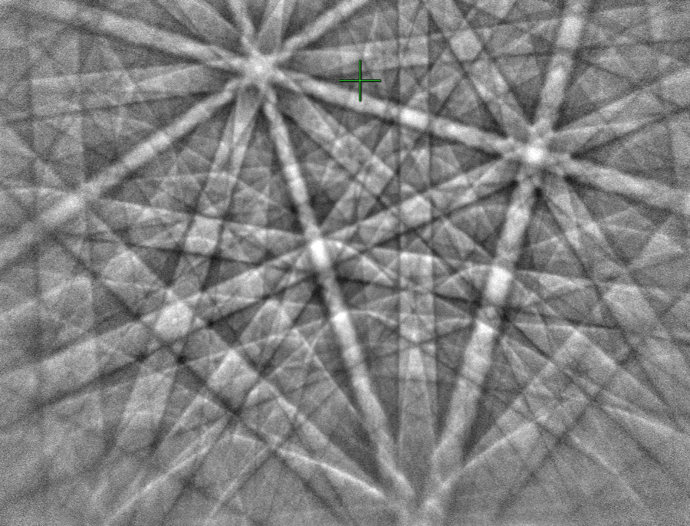
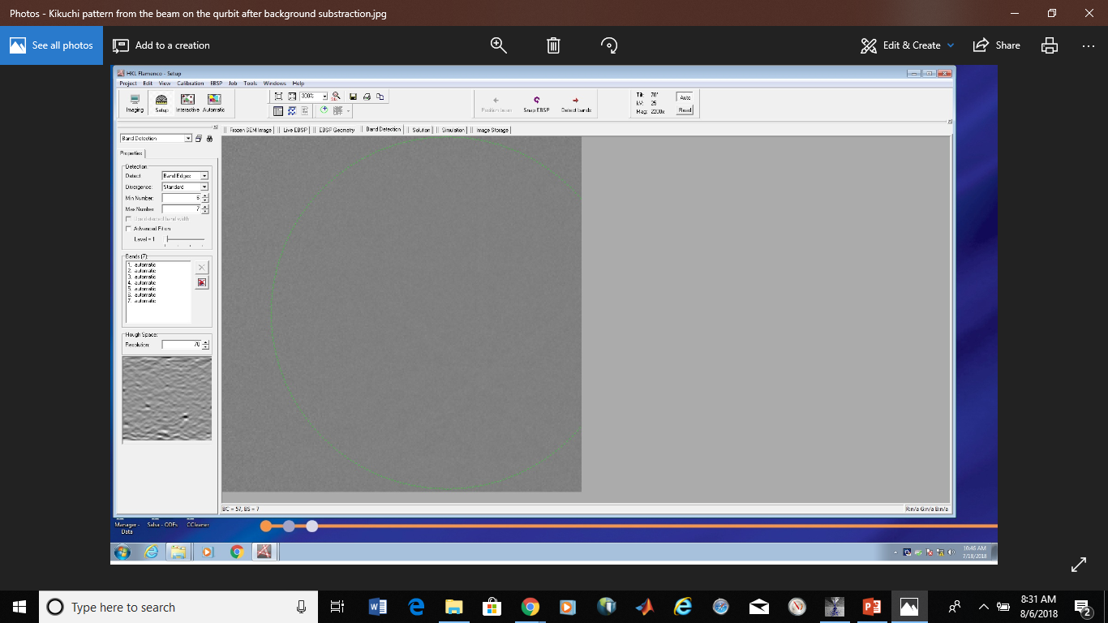
EBSD Analysis
Figure. (left) arrangement of crystal planes clearly seen. (right) noisy image

Slide 12
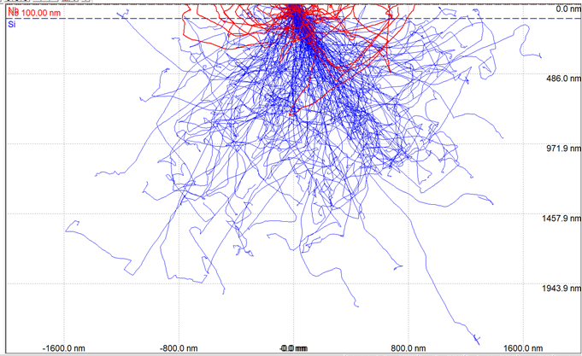
EBSD Analysis
Figure 9. Monte Carlo Simulation of electron penetration depth at 15 kV

Slide 13
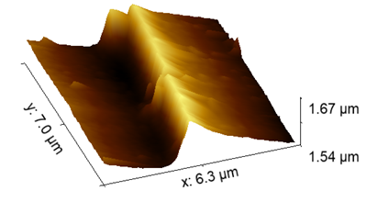
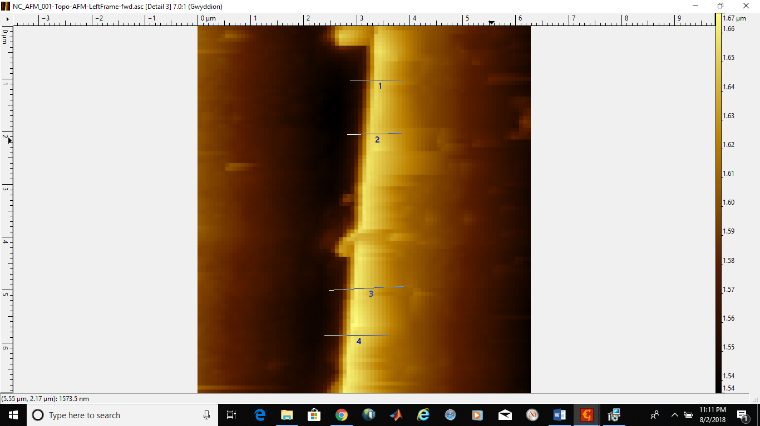
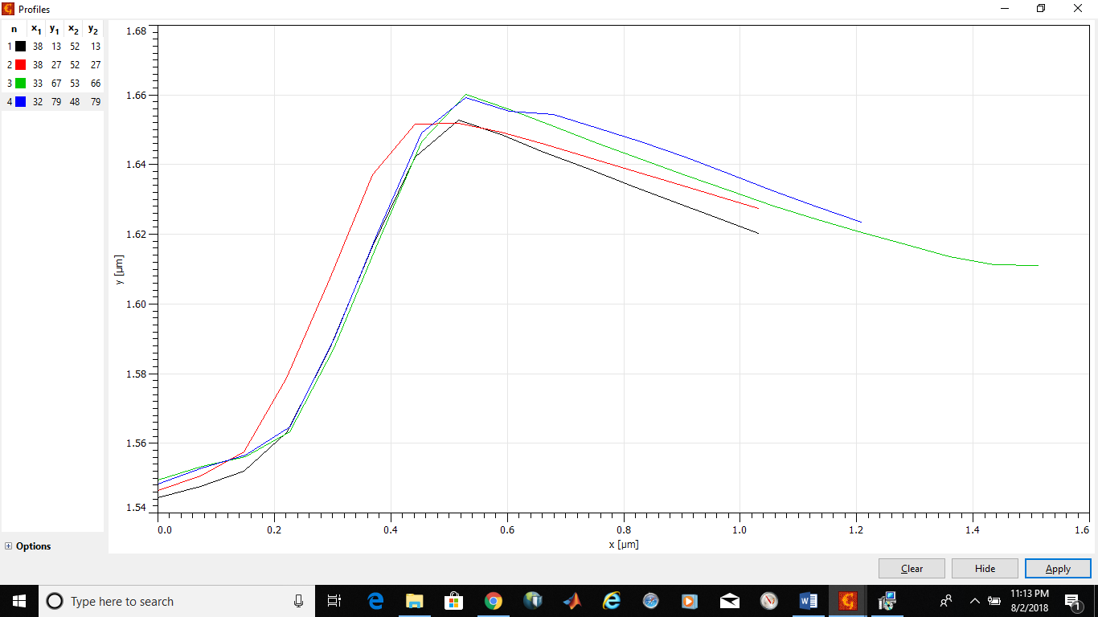
AFM
Figure 10. (top left and right) AFM image of niobium step height.

Slide 14
AFM Continued
 | Niobium Step Height (nm)
Measurement | Area 1 | Area 2 | Area 3
1 | 100 | 100 | 130
2 | 110 | 110 | 150
3 | 110 | 120 | 160
4 | 110 | 110 | 150
Figure 11. AFM measurements

Slide 15
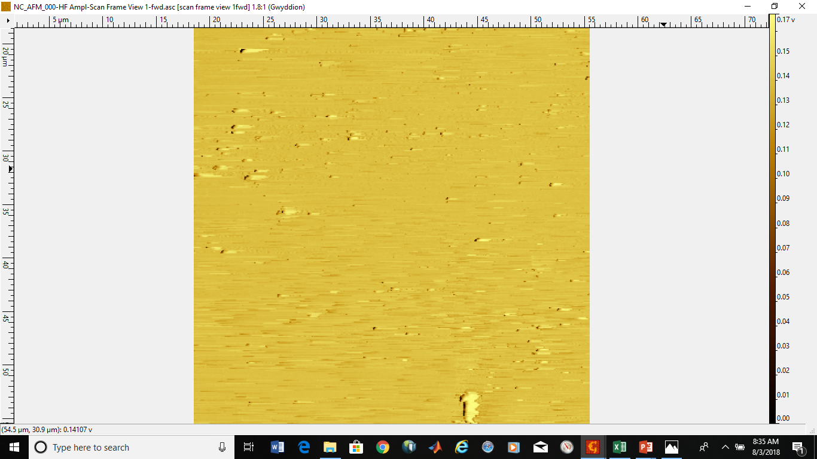

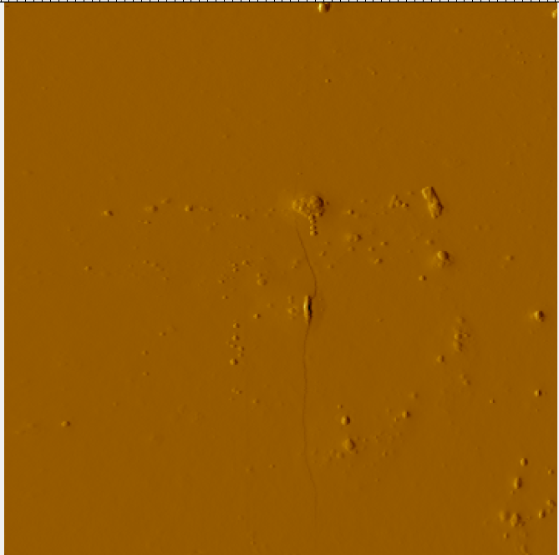
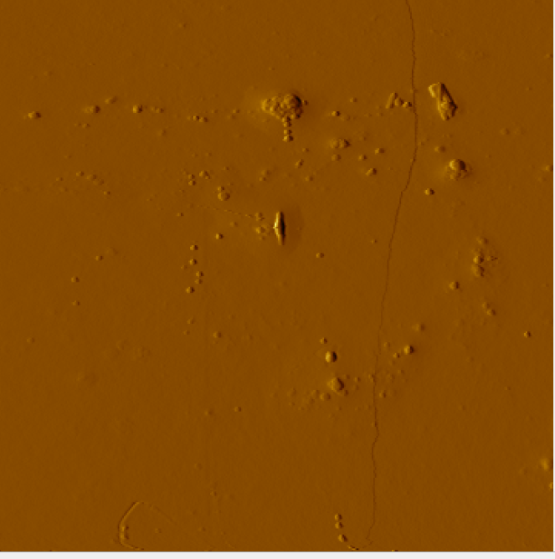
AFM Continued
Figure 12. AFM images.
300 K
200 K
50 K
10 K

Slide 16
Conclusion
Nb film deposition process is uneven
Possible foreign material that may affect superconductivity
Next Steps
Better sample prep
Cross sectional analysis
Qubit device modeling
Analise multiple working and non-work qubits for comparison

