Slide 1
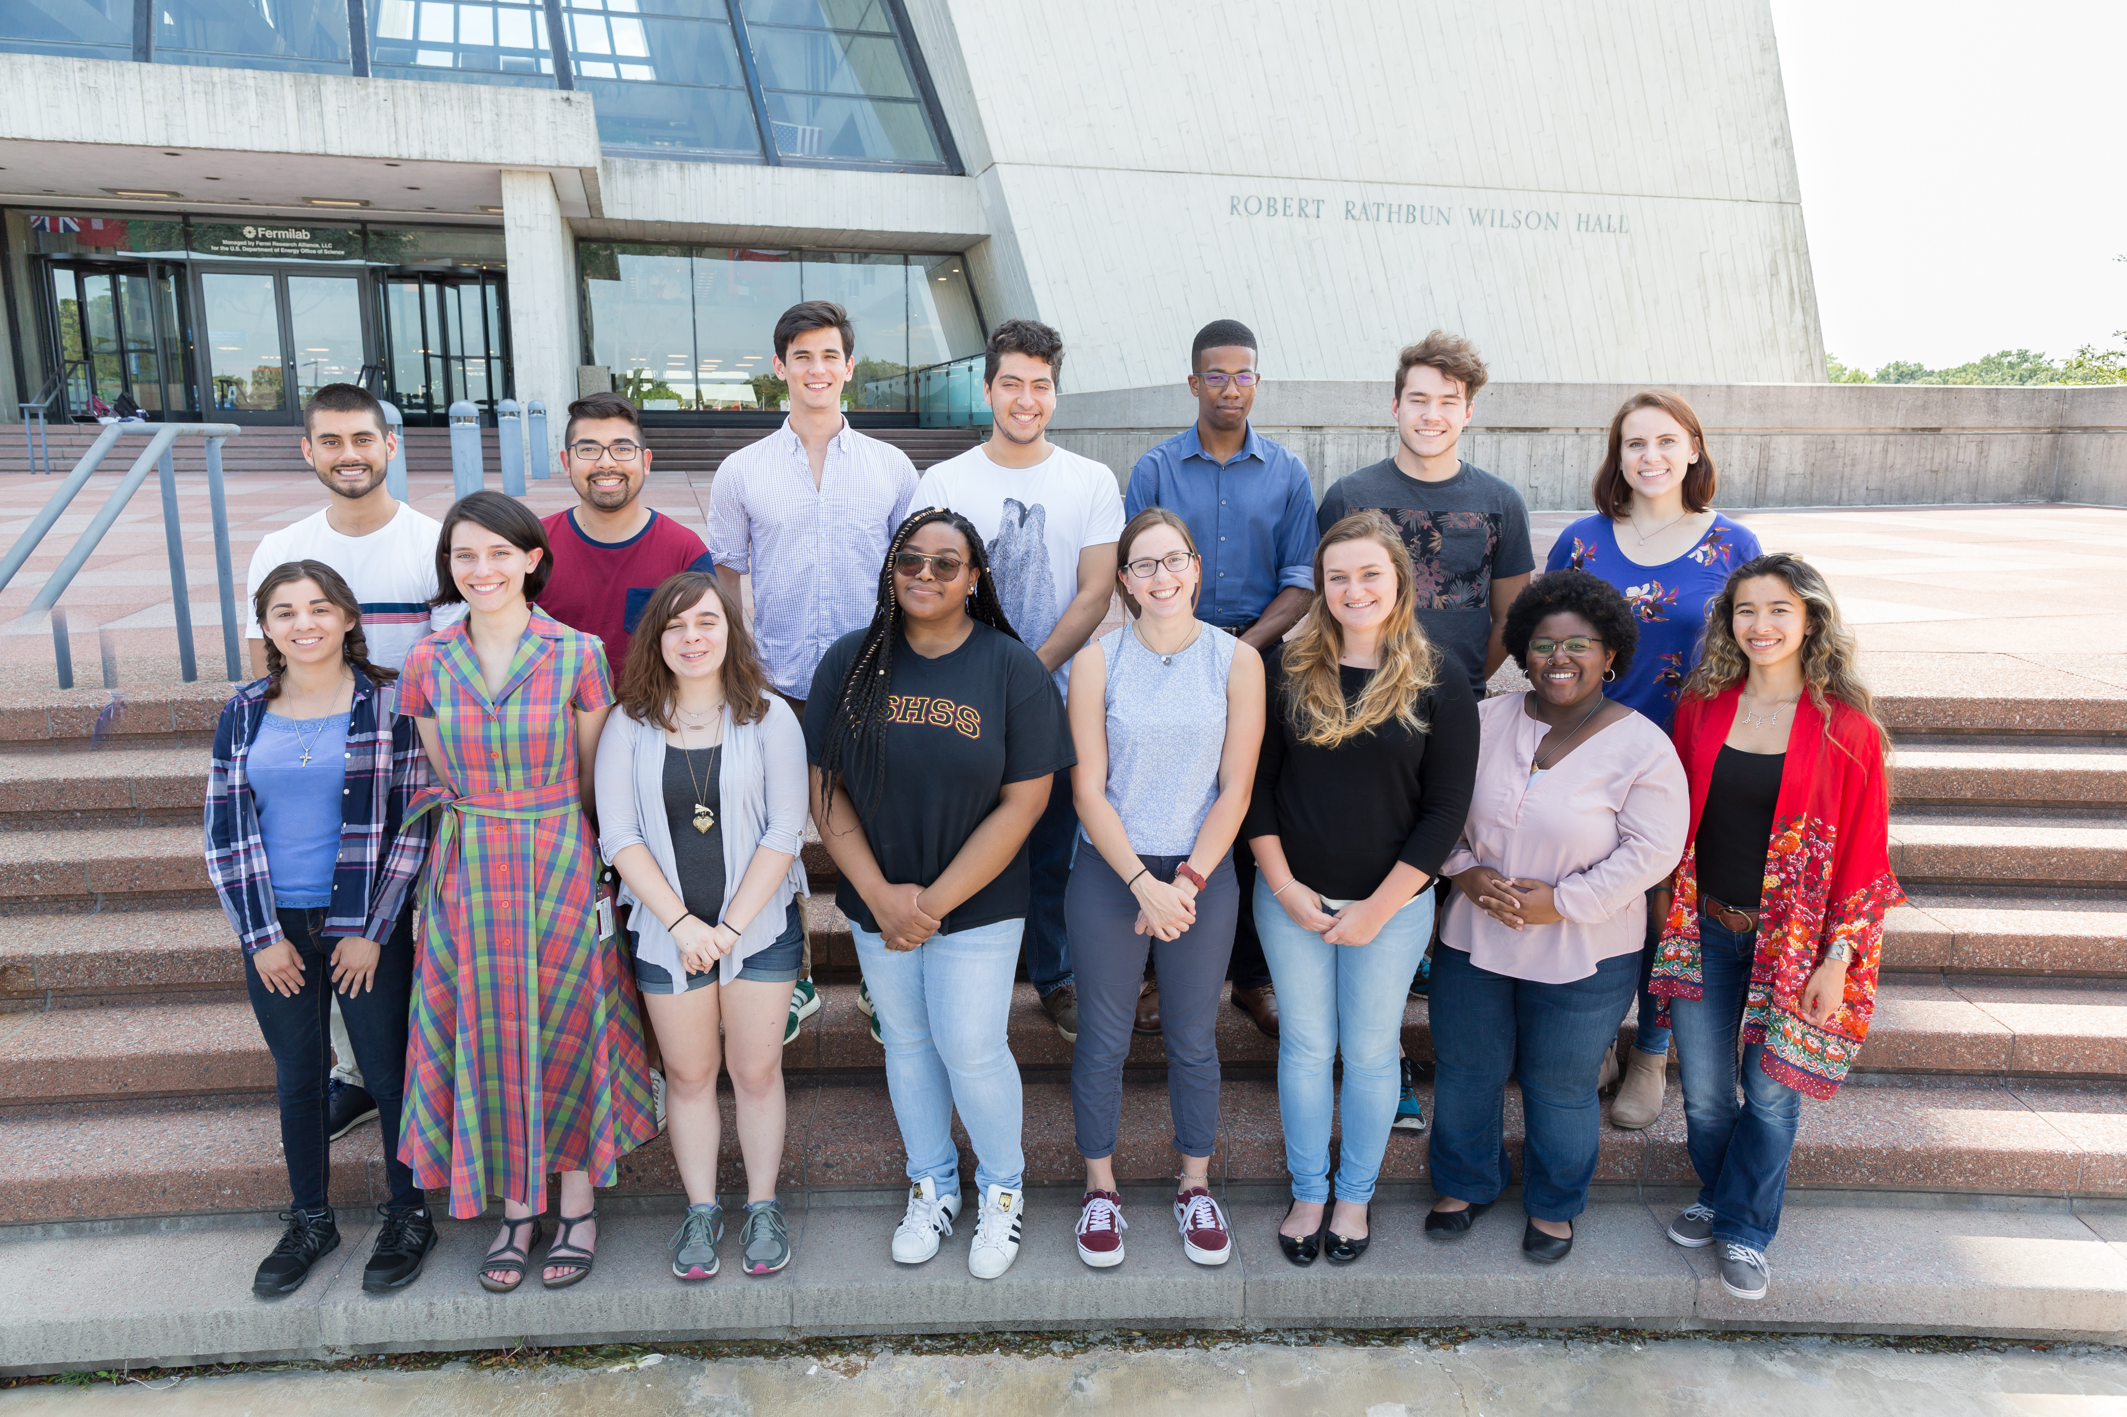
Construction and Commission of NOvA Test Beam Detector
Marilyn Wells
9 August 2018

Slide 2
Outline
Overview of NOvA and Neutrino Physics
Test Beam Project Overview
Power Distribution System
Timing System
Time of Flight Calibration
Summary and Future Work

Slide 3
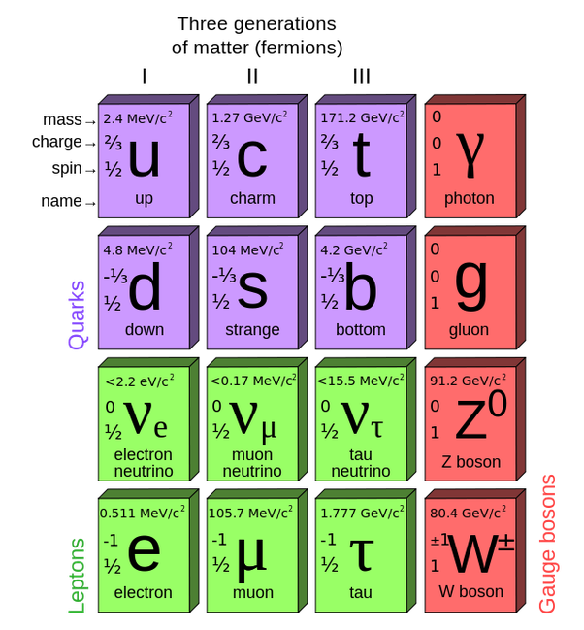
What is a Neutrino?
Tiny fermions with neutral charge: “little neutral one”
Three flavors named after their associated lepton: electron, muon, tau
Mass so small it was long thought to be zero

Slide 4
Neutrino Physics
We know that neutrinos have “flavor” (𝜈_{e} 𝜈_{𝜇} 𝜈_{𝜏}), which are superpositions of mass eigenstates (𝜈₁ 𝜈₂ 𝜈₃)
A 3x3 rotation matrix describes relationship between flavor and mass states
Can be written in terms of 3 angles and a phase

Slide 5
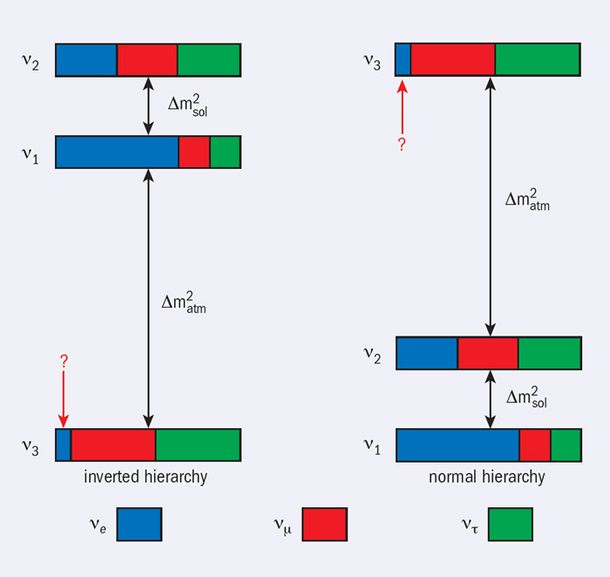
Neutrino Physics
Which mass state is heaviest and which is lightest?
Data favors normal hierarchy
This is a BIG question for physics and early universe cosmology

Slide 6
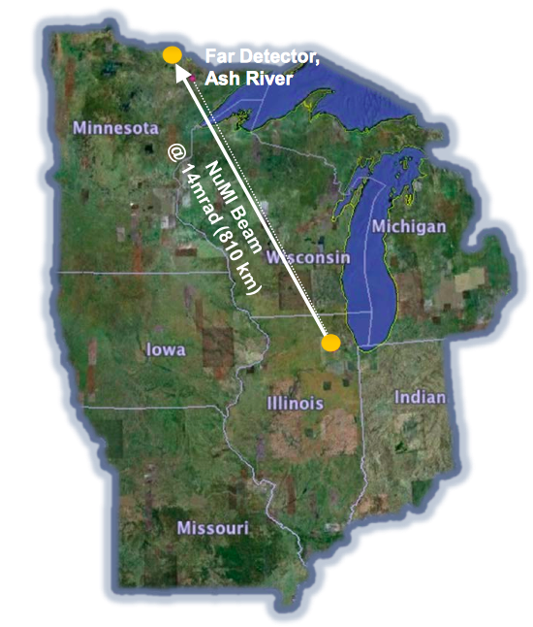
What is NOvA?
The NuMI Off-Axis Neutrino Appearance is a two-detector, long-baseline neutrino oscillation experiment
Near Detector on-site at Fermilab, Far Detector in northern Minnesota
14.6 mrad off-axis, ~2 GeV energy spectrum associated with mu → e
PVC cells filled with liquid scintillator (mineral oil) and optical fibers yield images of neutrino interactions
Main physics goals:
Measure mixing parameters θ13, θ23
Establish mass hierarchy
Constrain charge-parity violation phase, δ

Slide 7
Test Beam Detector
These measurements are difficult; it is essential to understand detector responses for better results.
Miniature version of Near Detector designed to:
test and calibrate detector responses
accumulate data library for algorithm training

Slide 8
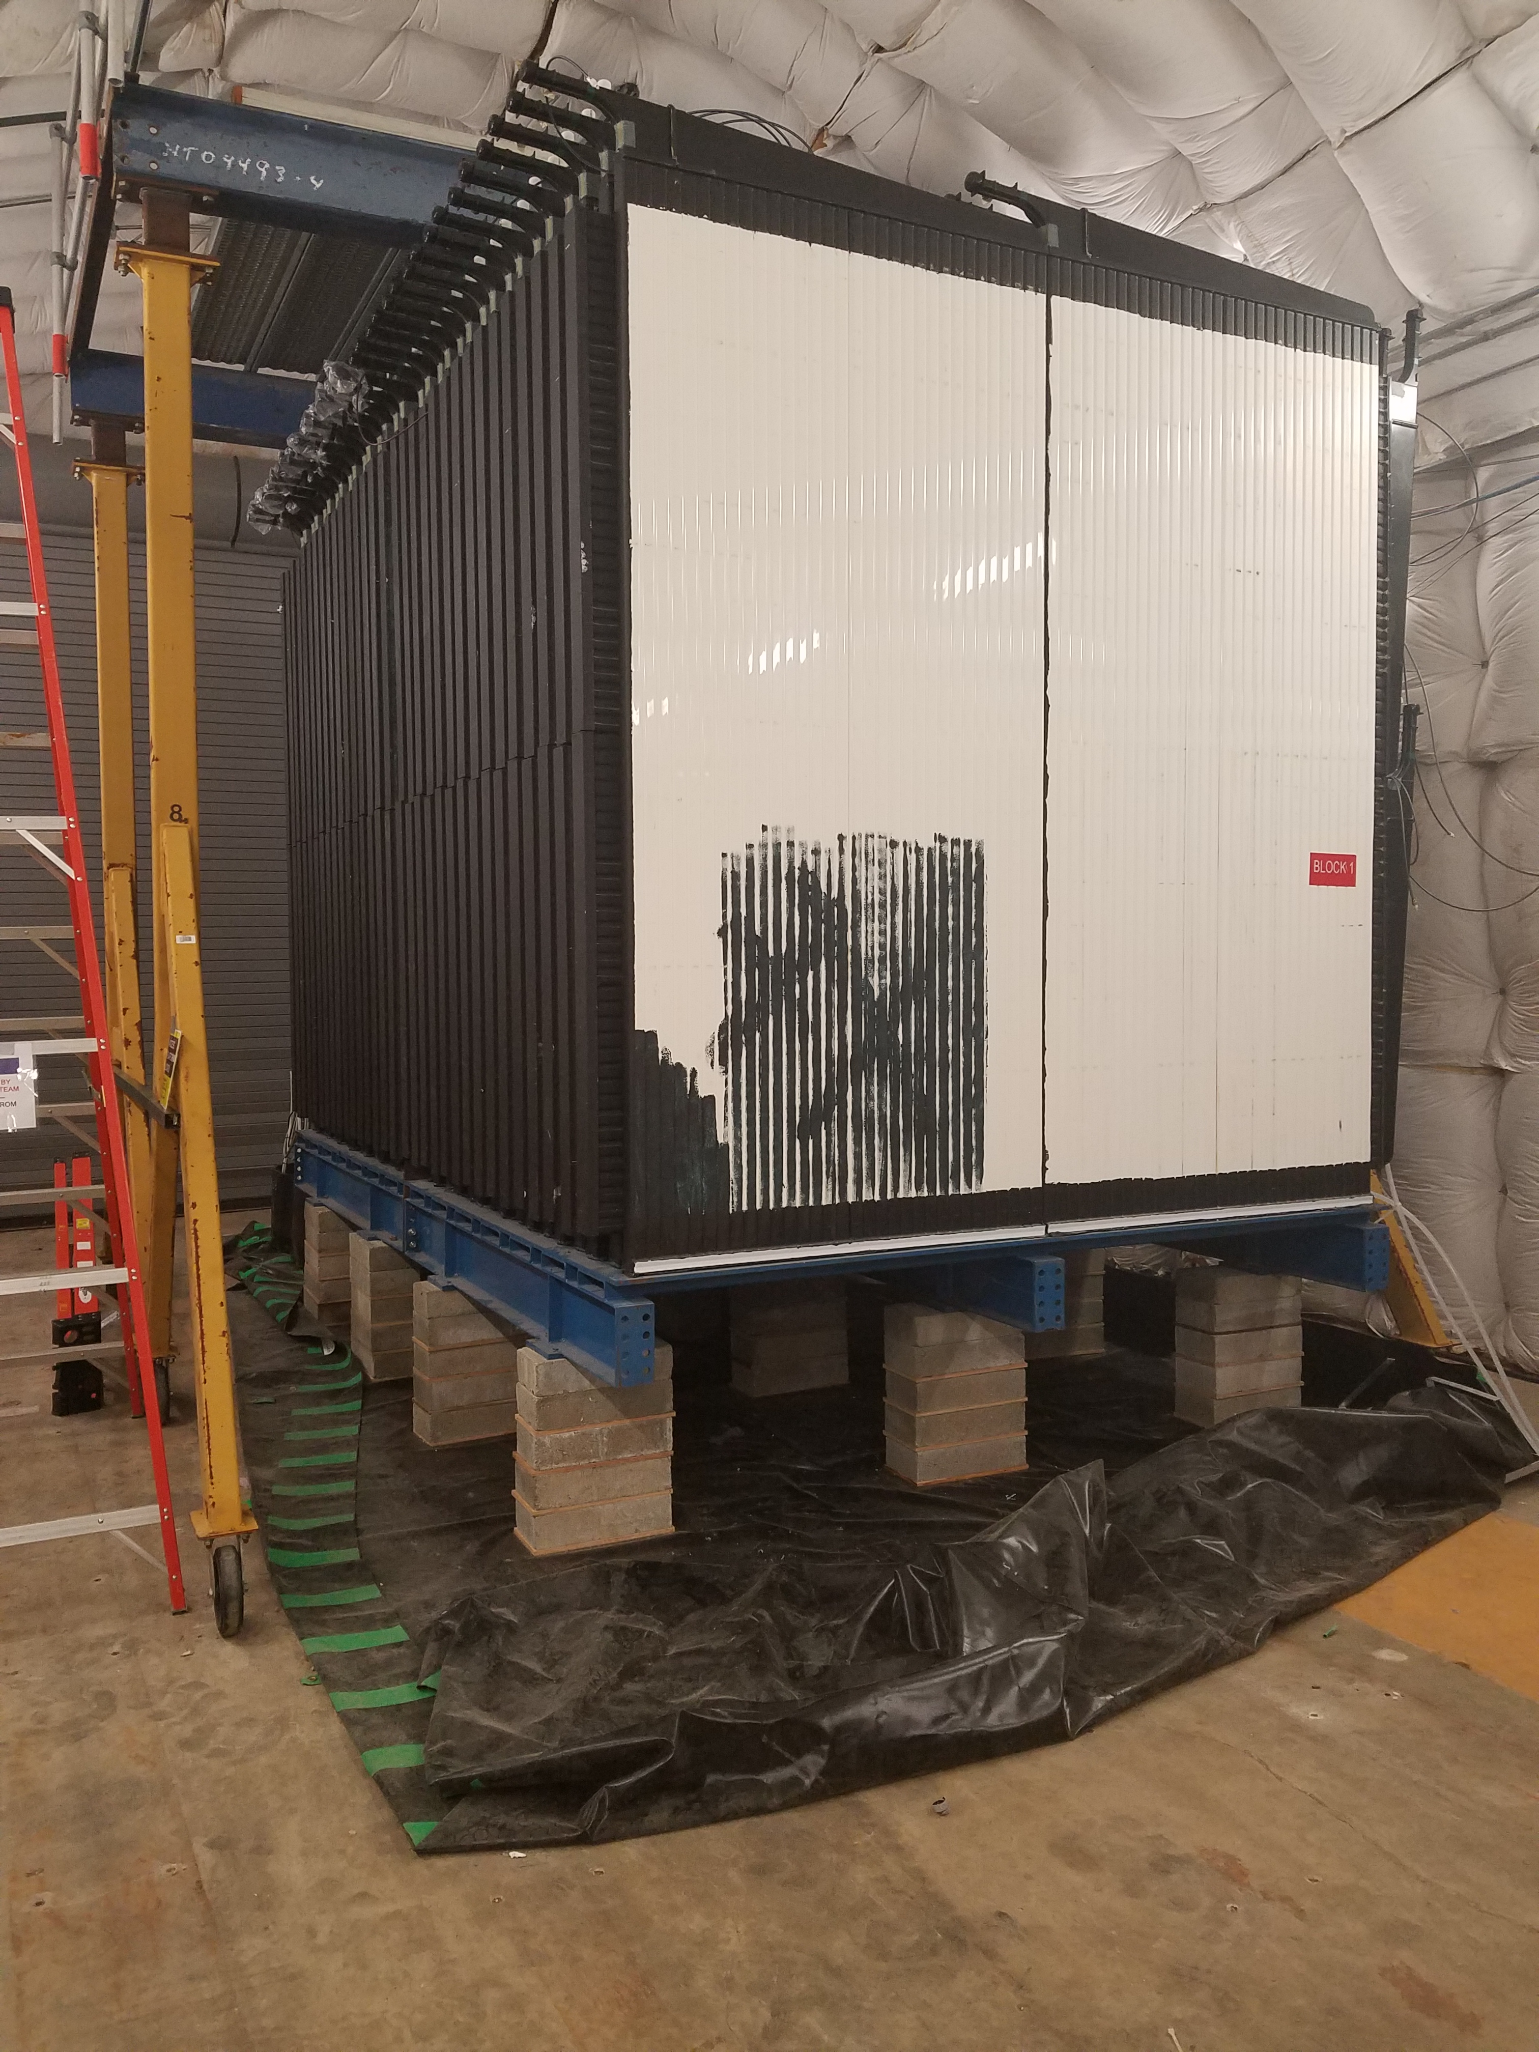
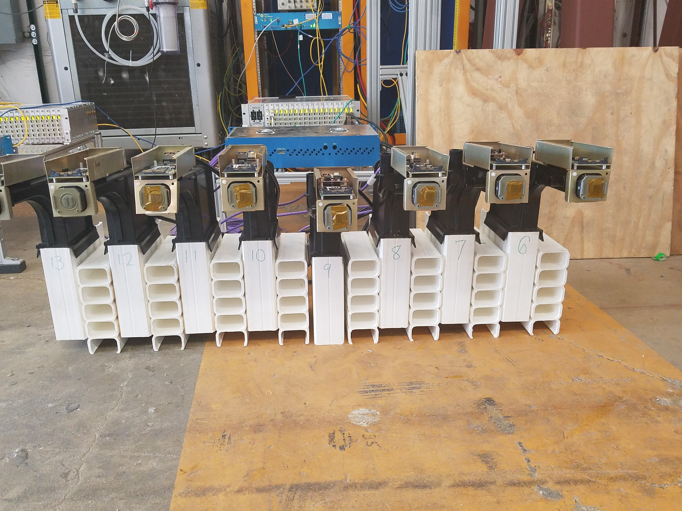
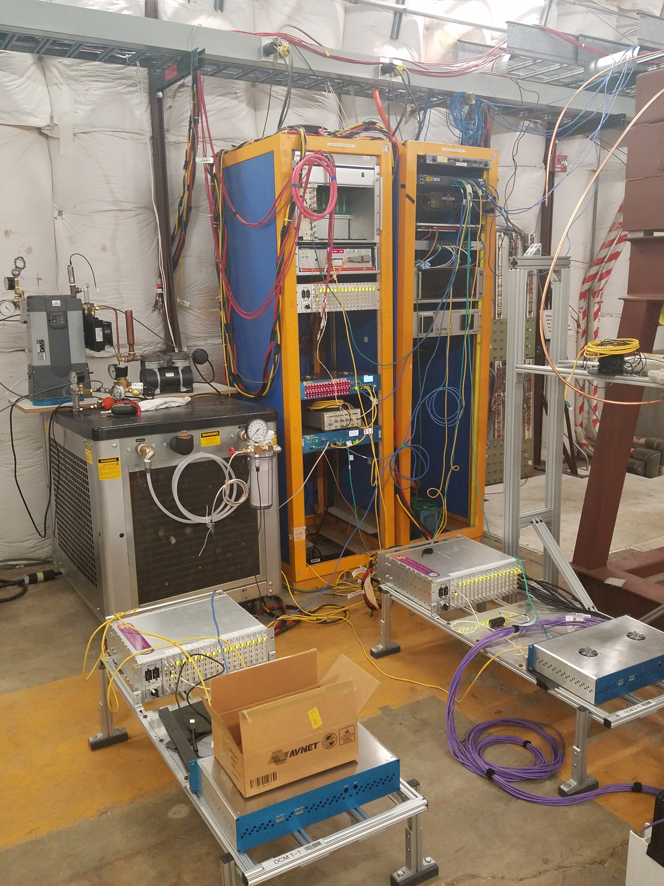
System Overview
Detector built with horizontal and vertical blocks of PVC cells
Front-end boards read out data and send to data concentrator modules
Components on the detector and on racks in enclosure need power system

Slide 9
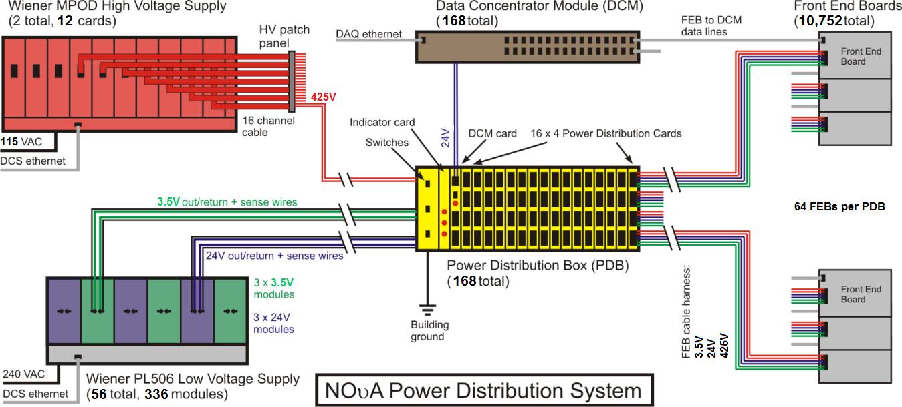
Power Distribution System
High Voltage → PDB → APDs
Low Voltage → PDB → FEBs, DCMs

Slide 10
Grounding Plan
Power Distribution Boxes serve as reference ground
2 grounding buses installed in MC7

Slide 11
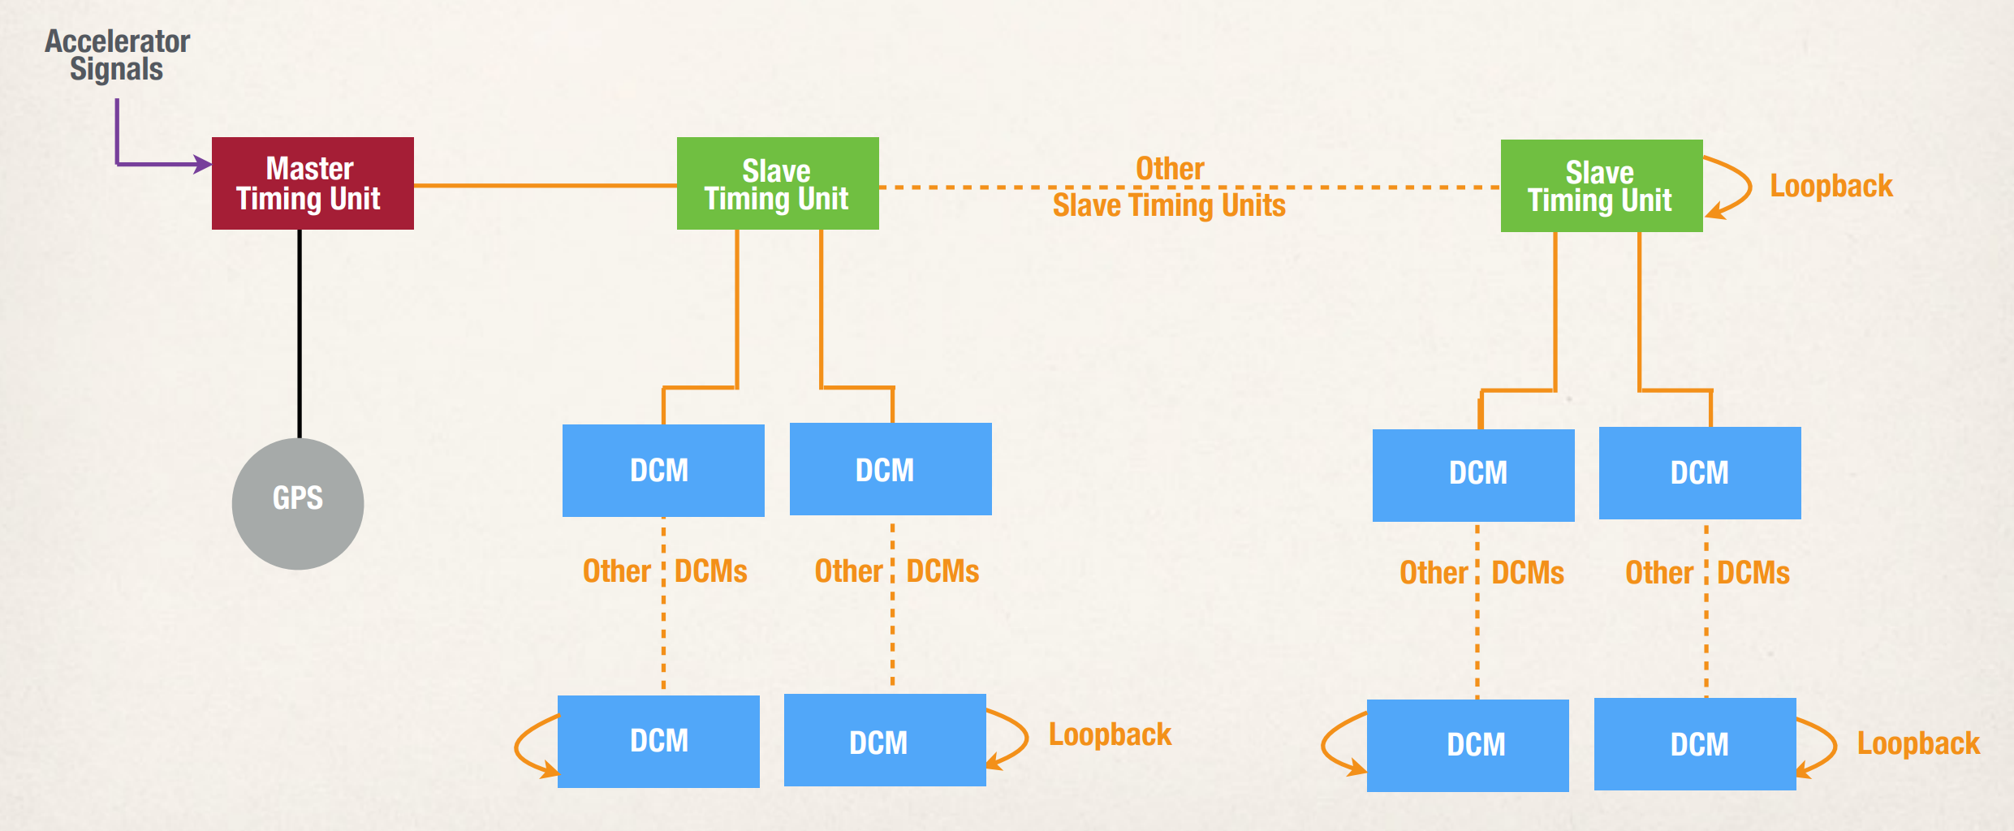
NOvA Timing System
Precise timing measurements allow for accurate reconstruction of neutrino events
NOvA uses a timing chain to synchronize its components to one another
The NOvA timing chain allows us to recreate neutrino events. A master TDU sends a timing signal along the chain and all components begin their clocks simultaneously

Slide 12
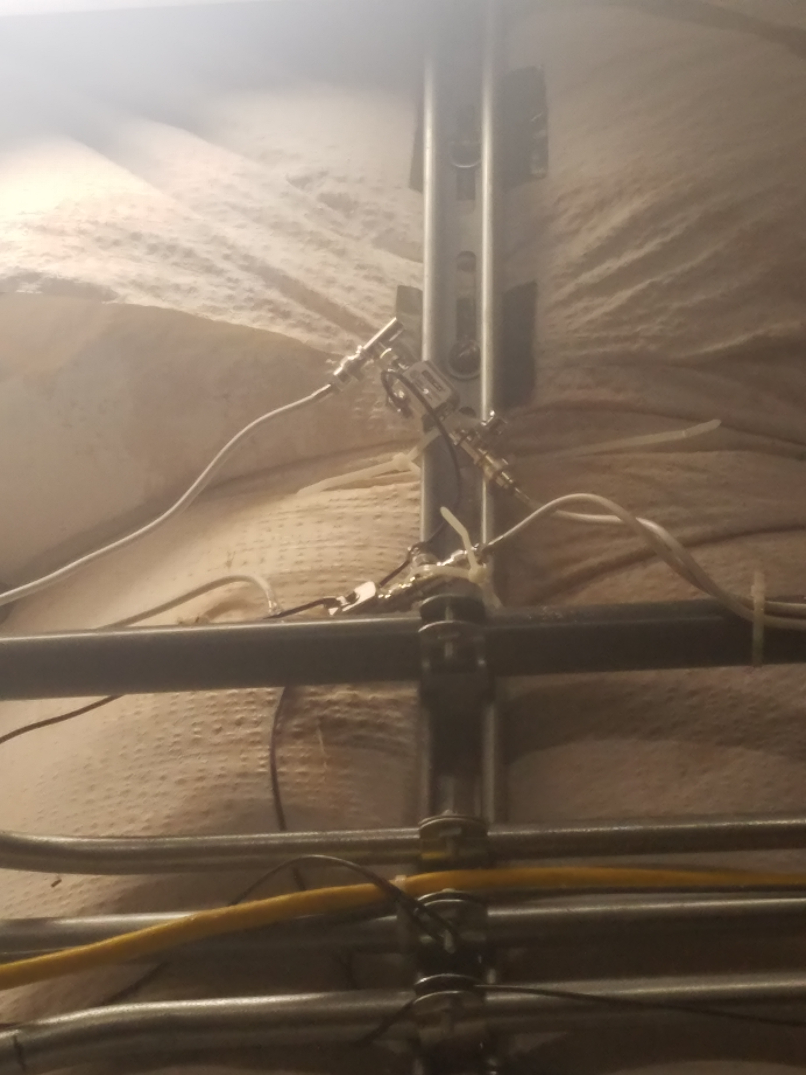
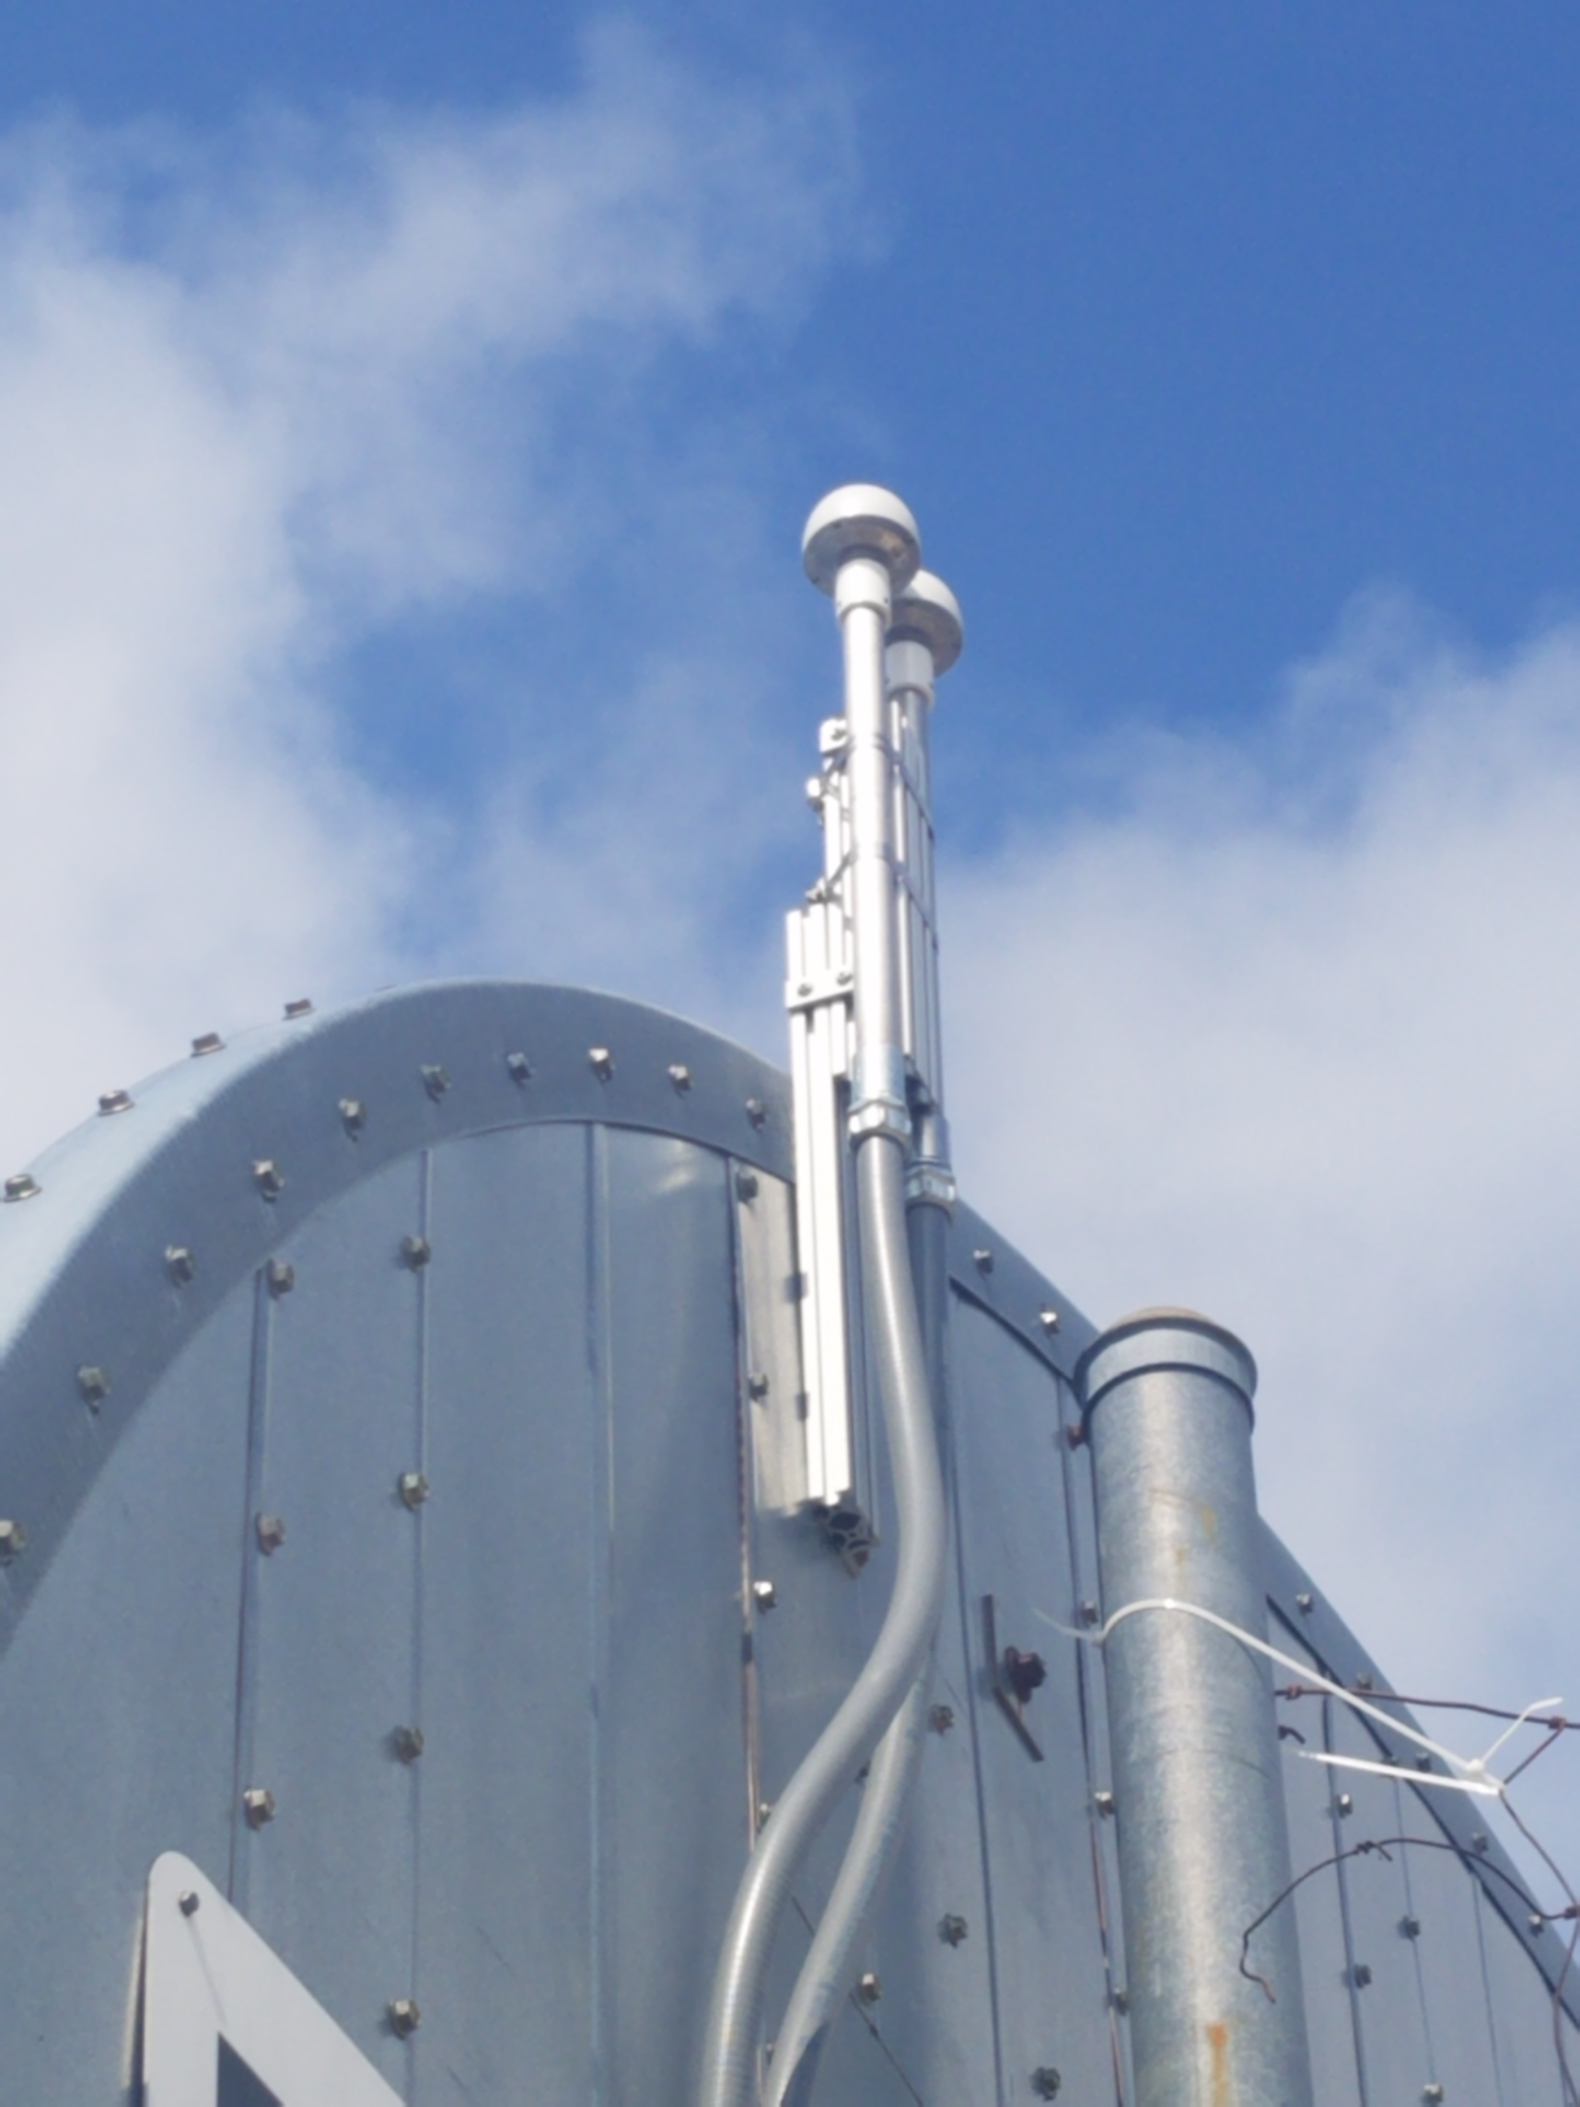
GPS
A commercial GPS installed outside of MC7 is crucial to maintaining timing precision.
Lightning arresters are installed within 3 feet of where the GPS cables enter the building to prevent lightning surges from damaging electronics

Slide 13
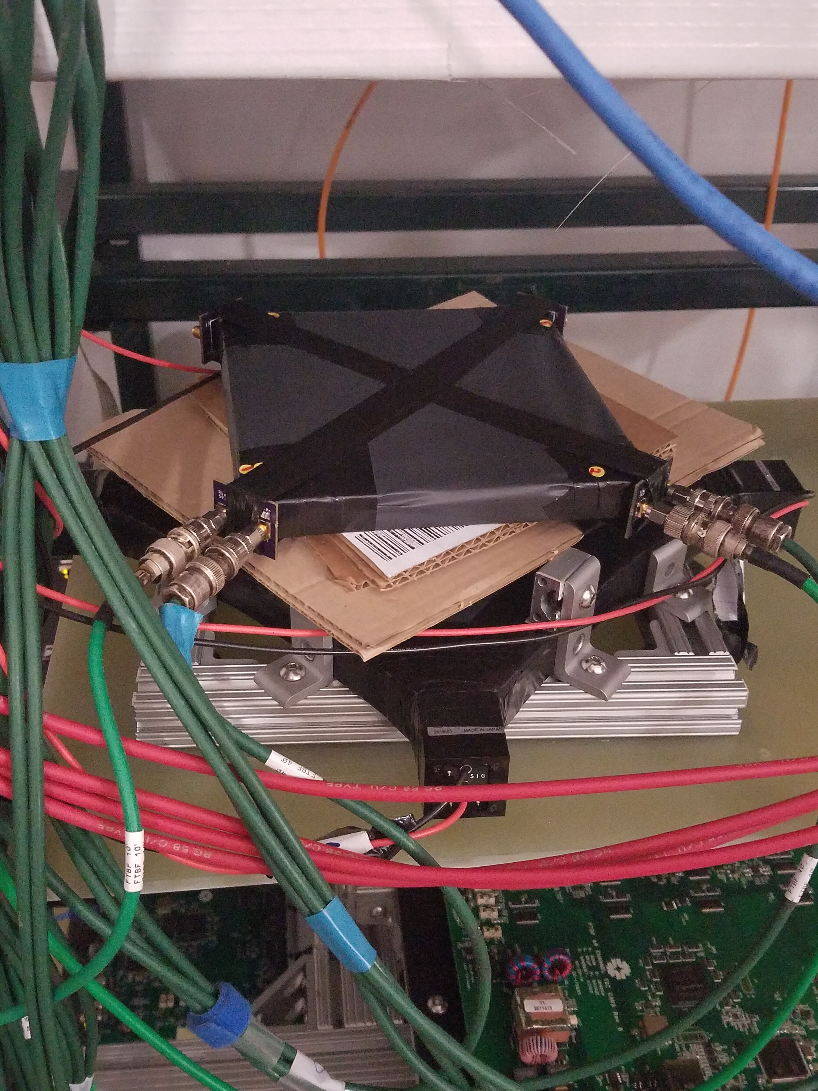
Time of Flight System
Time of flight system is integral to particle identification
Measures travel time and momentum
University of Dallas constructed 3 prototypes:
2 using Silicon photomultipliers
1 using photomultiplier tubes
Best 2 of 3 will be used for test beam

Slide 14
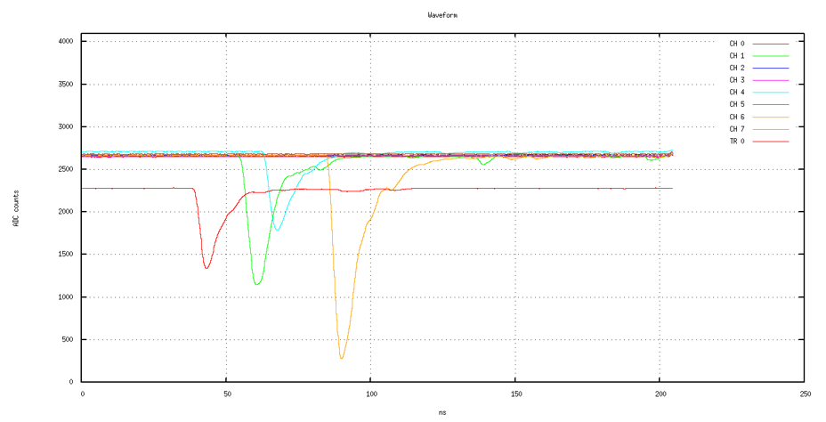
Time of Flight Time Resolution
Time of flight system identifies particles by their momentum
Signal cables of different lengths cause delays in data
A CAEN 1742 digitizer is used to read out data and plot pulses from cosmic muons

Slide 15
Current Status
Power distribution system and timing system are installed, time of flight system being tested for resolution.
Next steps: fill detector with liquid scintillator, install front-end boards and avalanche photodiodes, monitor environment for temperature and humidity.
Data taking is expected to begin in early 2019.

Slide 16
Summary
This summer has seen substantial progress for the Test Beam Project.
Results will serve as a template for interactions seen at the near and far detectors, and will help to calibrate detectors and refine data for the NOvA experiment.

Slide 17
Acknowledgements
Special thank you to Andrew Norman for his supervision!
Thank you to Alex Sousa, Will Flanagan, Mike Wallbank, Anna Heggestuen, and the rest of the Test Beam Team
Thanks to Sandra Charles, Laura Fields, Judy Nunez, and the SIST Committee

Slide 19
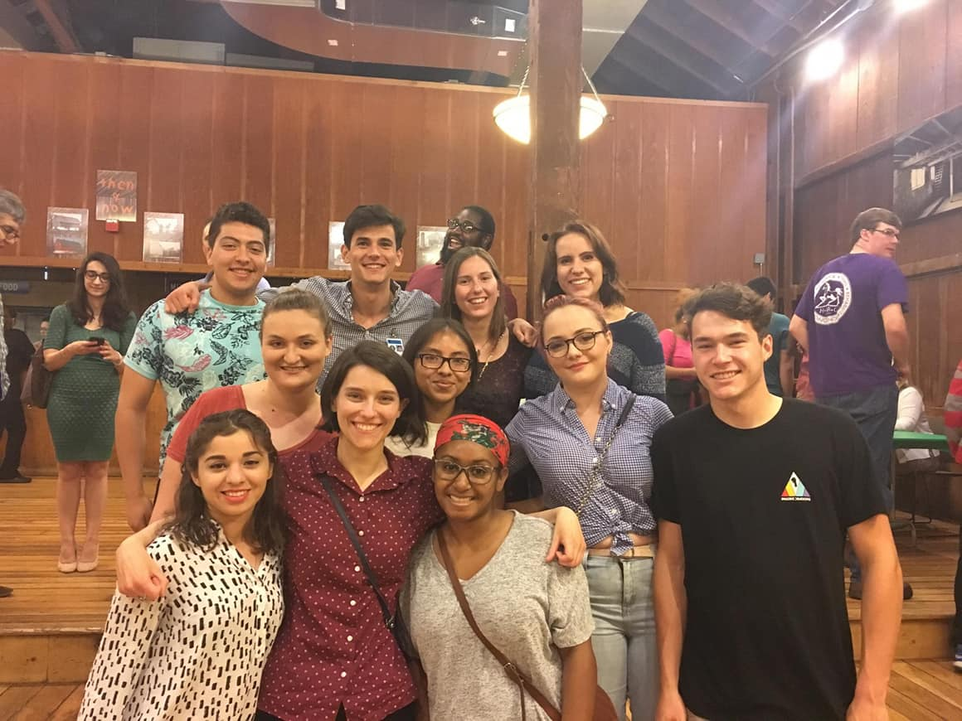
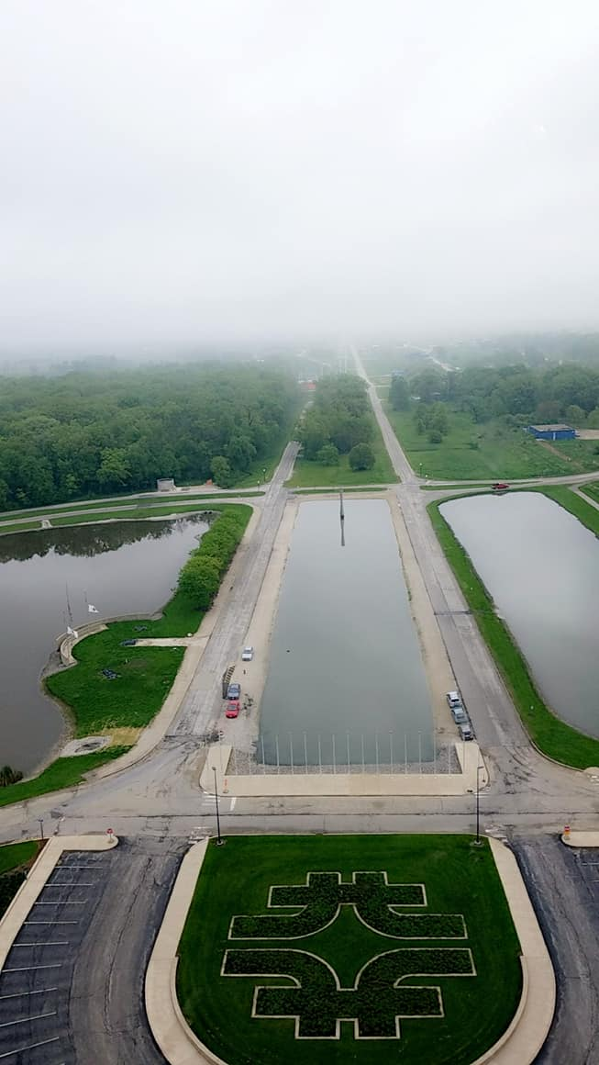
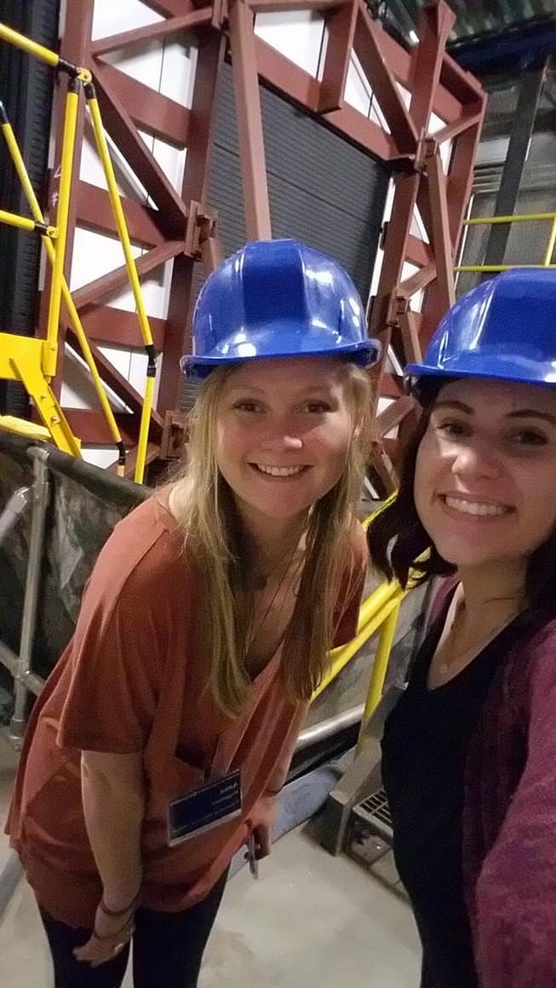
Thank you!

