Slide 1
SBND Electronics Data Analysis
Adrian Orea, FNAL SIST Intern
Supervisor: Minerba Betancourt
UIUC Mechanical Engineering
3 August 2018

Slide 2
Outline
Objective
Background
LArTPC and test beam
Purity
Purity Calculation
Multi-Channel FFT and Waveform plotting framework
Noise RMS Analysis
Raw Digit Event Display
Future work
Conclusion

Slide 3
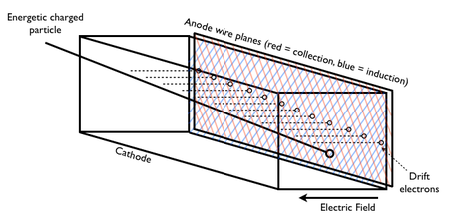
LArTPC
Time Projection Chamber (TPC)
Filled with Liquid Argon
Two Planes
Collection and Induction
High electric field
Used at several detectors
SBND, MicroBooNE, Icarus, and DUNE
1

Slide 4
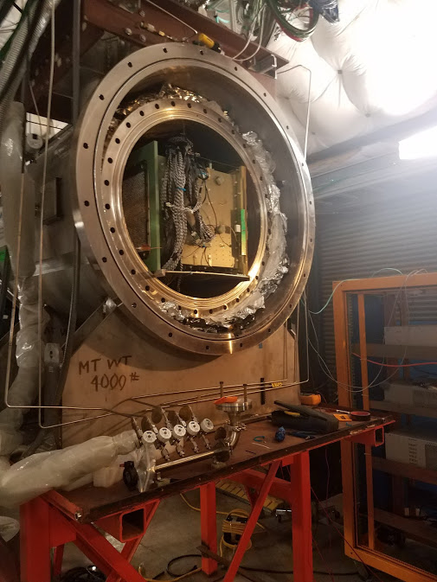
TPC at Fermilab Test Beam Facility (FTBF)
FTBF used to test detectors with a beam of protons
Beam for this project was a mixture of protons, pions, and kaons
Beam is pulsed
SBND TPC placed in Cryostat
Boards and wiring secured
Data was collected for several days at a time
Cosmic muon data could also collected

Slide 6
Purity Calculation
Free electrons can easily travel through liquid Argon
Some get recaptured by Argon Ions
Although a tank of pure Argon is ideal, it’s not
Potential contamination during various filling and boiling phases
Innate contamination from source
Electronegative contaminants capture free electrons
Oxygen, water, etc
Ar⁺
Ar
Ar
Ar
Ar
Ar
Ar
Ar⁺
Ar⁺
Ar⁺
Ar⁺
Ar⁺
Ar
Ar
Ar
Ar
Ar
Ar
Ar
Ar⁺
Ar⁺

Slide 7
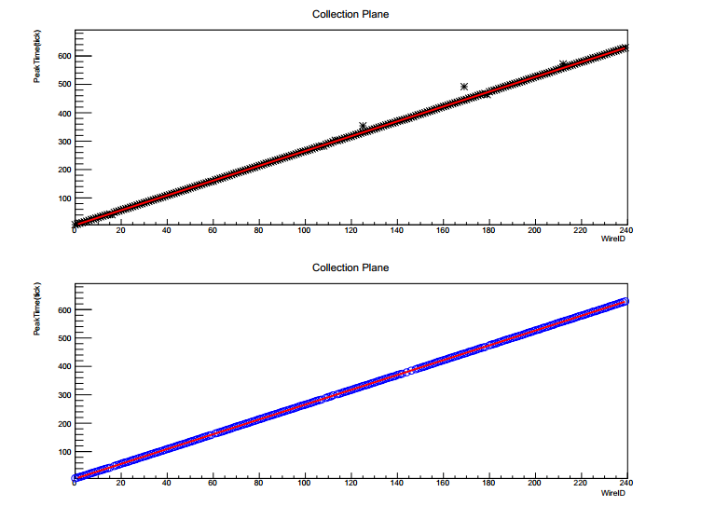
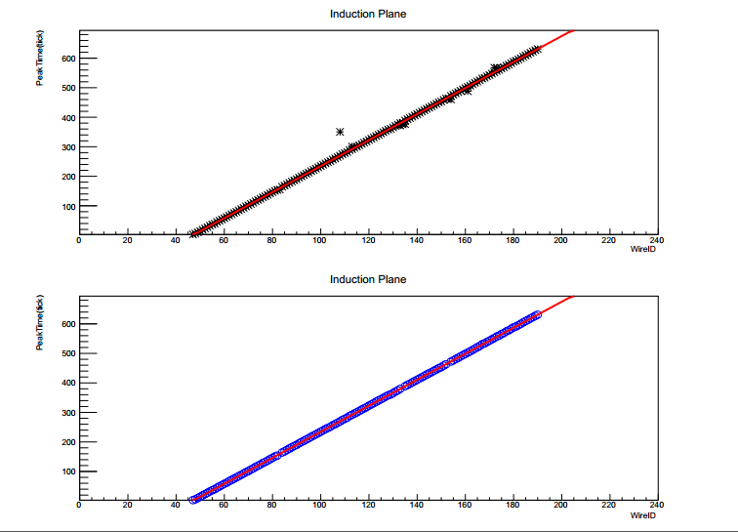
Purity Calculation
Apply first cut on number of hits and unique wire numbers
Plot Peaktime vs wire number, acts as a track reconstruction
Induction and collection planes
Remove points farther than 2 ticks from fit line
Collection Plane
Induction Plane
Notes:
$\frac{dσ}{dΩ}$, for a solid angle
$\frac{d^{2}σ}{dp_{t}{dp}_{||}}$, for the transversal and z-direction momentum

Slide 8
Purity Calculation cont.
Plot integral (charge) vs peak time
Fit with exponential, normalized based on geometry

Slide 9
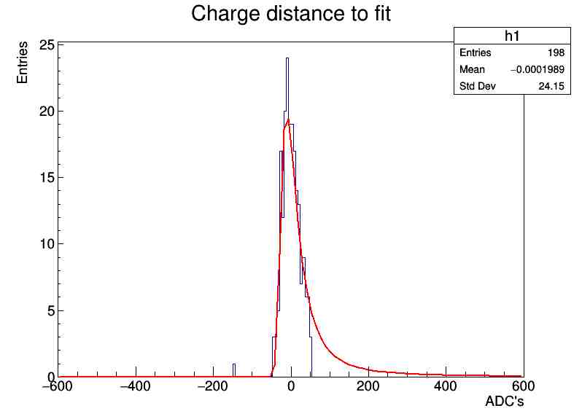
Purity Calculation cont.
Create histogram of difference between fit and data
Fit with Landau function to get sigma

Slide 10
Purity Calculation cont.
Refit with sigma cuts
Keep values and store into file that is used as input for a minimizer of a maximum likelihood estimator (MLE)
Lifetime is extracted
Notes:
Include the lifetime on here ☺

Slide 11
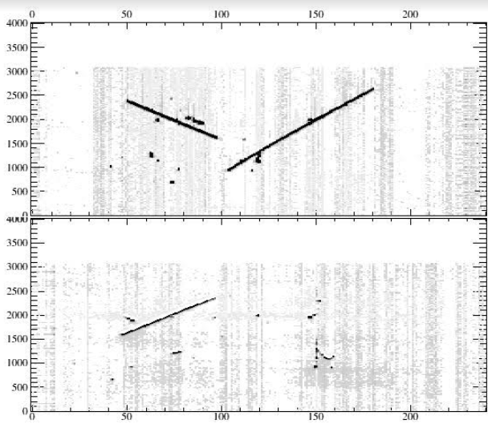
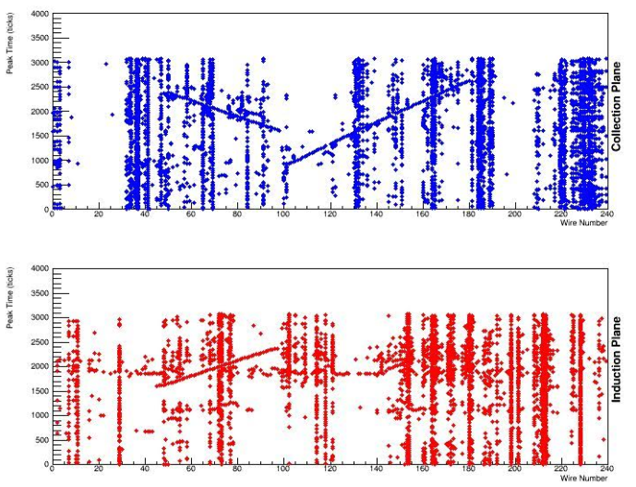
Event Display
Current event display works great
However, is loaded with features
Using for small checkups such as thresholds is slow
For changing Collection and Induction planes separately
Created a fast Event display that uses the output of Purity.cc
“Lite version”
Fast and reliable

Slide 12
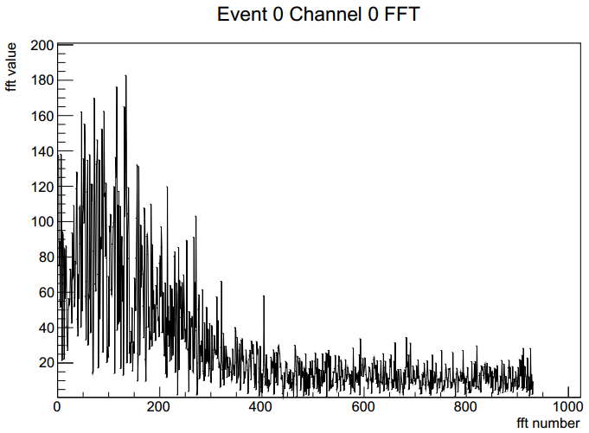
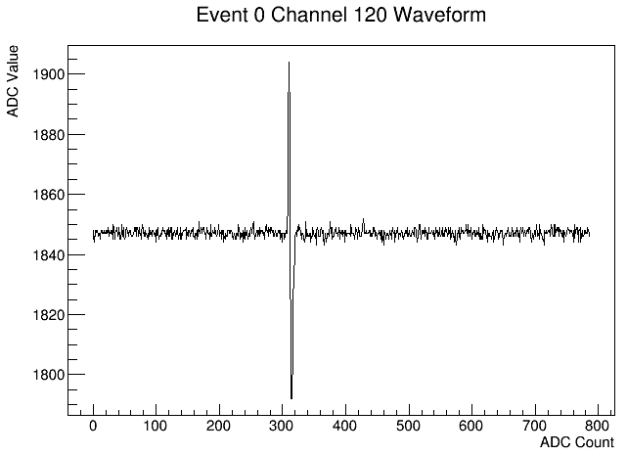
Multi-Channel Analysis
Current Plotting scripts analysis works
However, per event and per channel basis
Need a script to gather all of the channel data to analyze on an event basis
FFT and waveform plotting
Notes:
Change to simulation

Slide 13
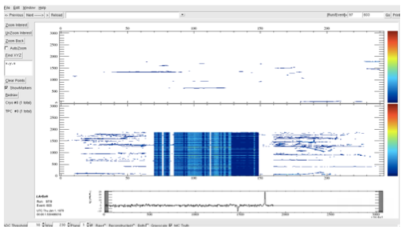
Data
Data was not correct
Malfunction in wires
Collection had inverted peaks
Induction had noisy wires and a broken motherboard

Slide 14
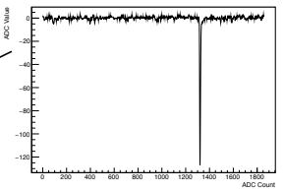
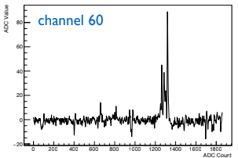
Data cont.
Collection Plane
Induction Plane
Ignored because of high noise
Notes:
Include picture of event display that I sent to Minerba. She will email me those slides

Slide 15
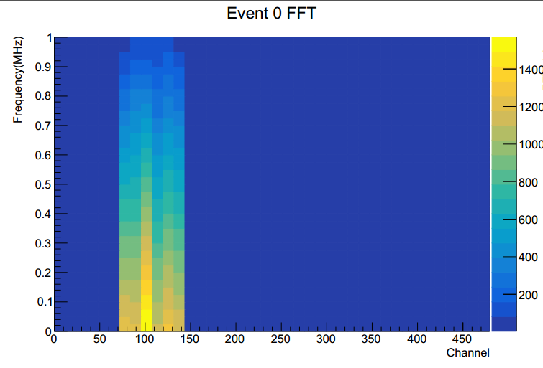
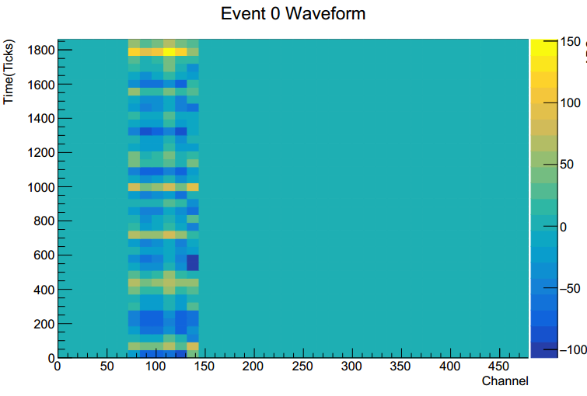
Multi-Channel Analysis cont.

Slide 16
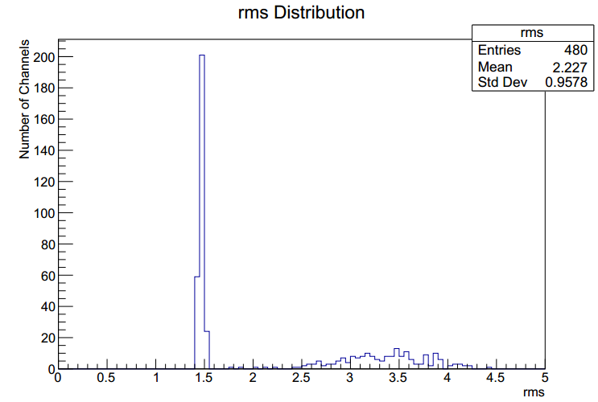
Noise RMS
From the purity calculation, values away from the linear fit are used to calculate the RMS of the noise
Currently exits on an event basis
Now averages over the entire set of events in a file
Induction and Collection plane are separate

Slide 17
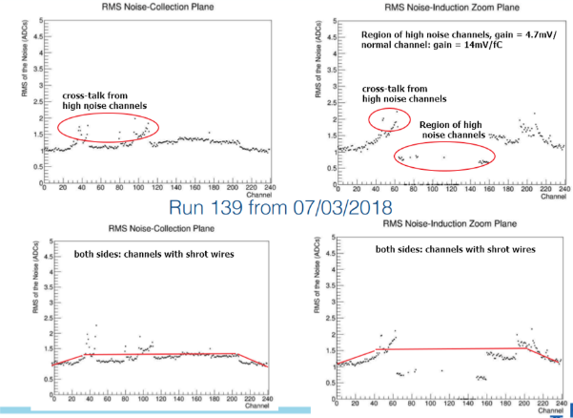
RMS Plots

Slide 18
Results
Purity is added to framework
Part of VST git repository
Noise RMS is finished
Useful for analyzing the channels
Pinpointing bad channels
FFT & Waveform vs Channel is finished
Part of VSTAnalysis git repository
Event display is done
Operates as long as Purity.cc operates

Slide 19
Future Work
Tune the Purity.cc code for data from simulation
Modifying “sigma” cuts
RMS used to set threshold based on the event
To eliminate general settings
Finalize a script for analyzing the general trend of lifetimes
Notes:
Next part is to tune all of the model parameters

Slide 20
Acknowledgments
I would like to thank the following people for their patience and help as they were always available to answer my many questions.
Minerba, Gray, Thomas, Dominic
Thank you to my Fermilab mentors for helping me with general work at Fermi and with my education path
Donovan, Javier, and Elliot
Finally, I would also like to thank Fermilab and the SIST committee, for such an amazing summer experience
Sandra, Judy, Laura

Slide 21
Distance from linear fit

Slide 22
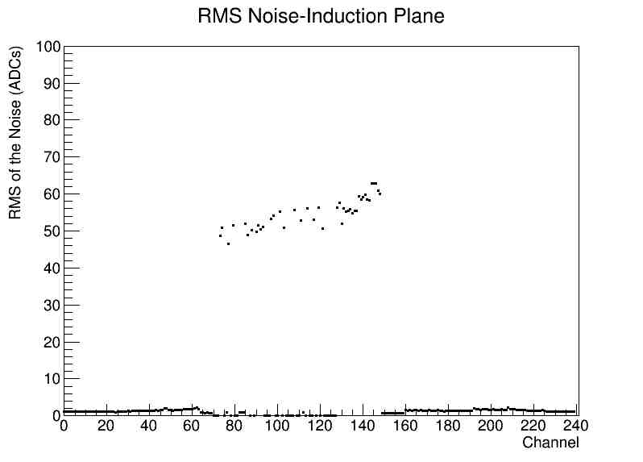
Data Induction Plane Noise

Slide 23
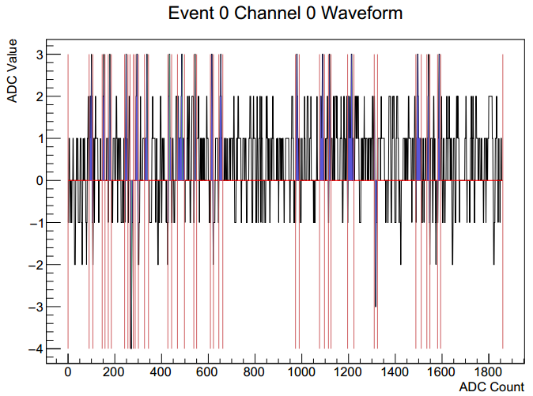
Data analysis
Notes:
Change to simulation

Slide 24
Beam Composition

