Slide 1
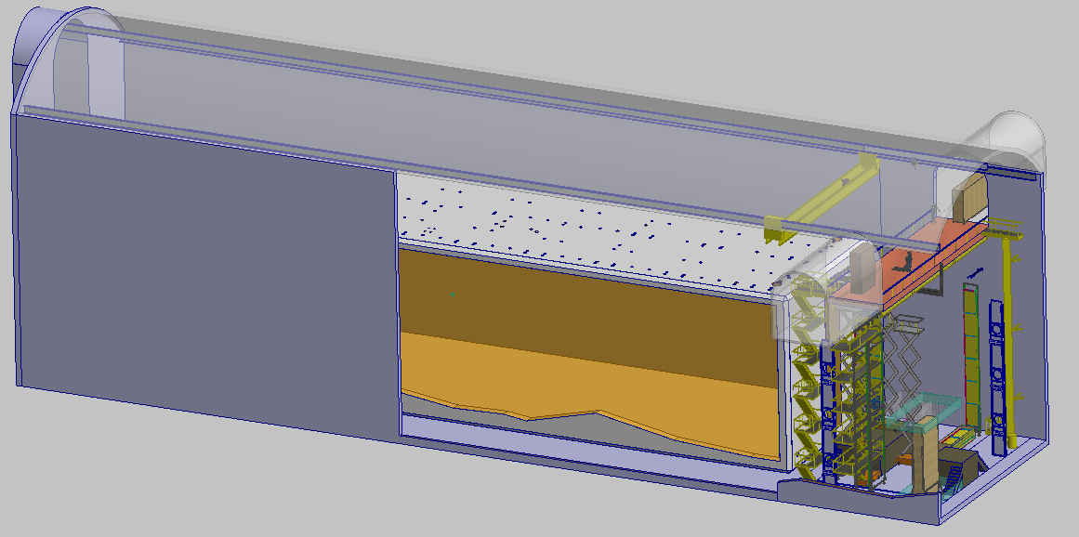


DUNE Far Detector
DSS Design Description
V. Guarino & R. Kmak
August 20, 2018

Slide 2
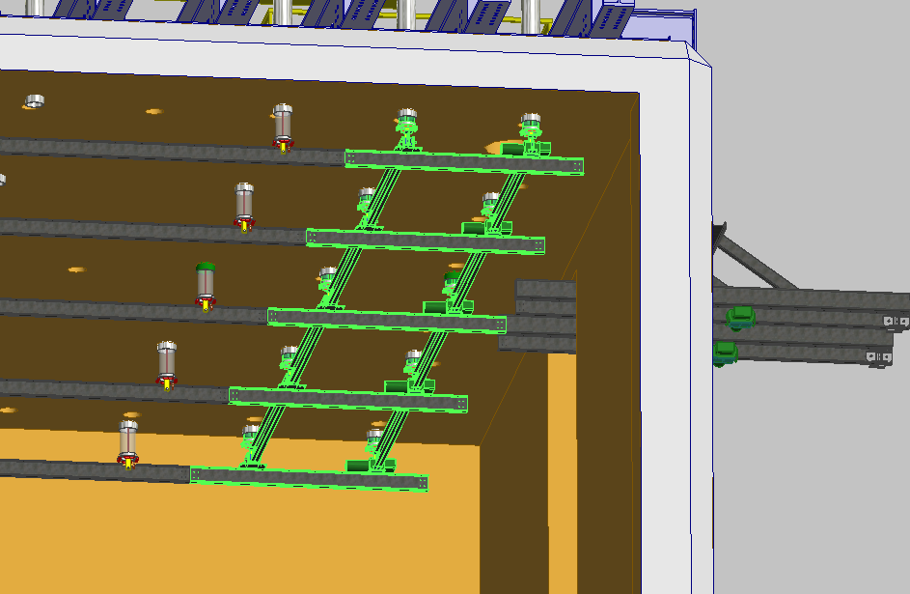

DUNE Far Detector
Component Identification – Inside Cryostat (Installed)
TCO Beams
DSS Area
Shuttle Area

Slide 3
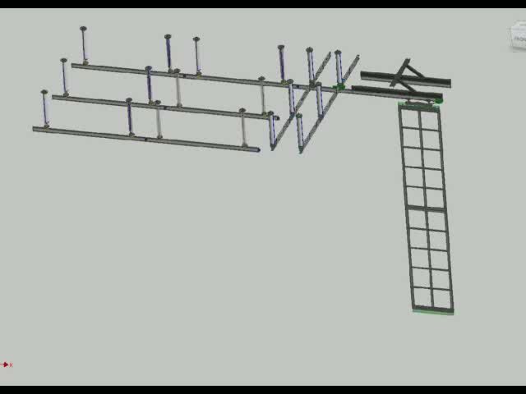
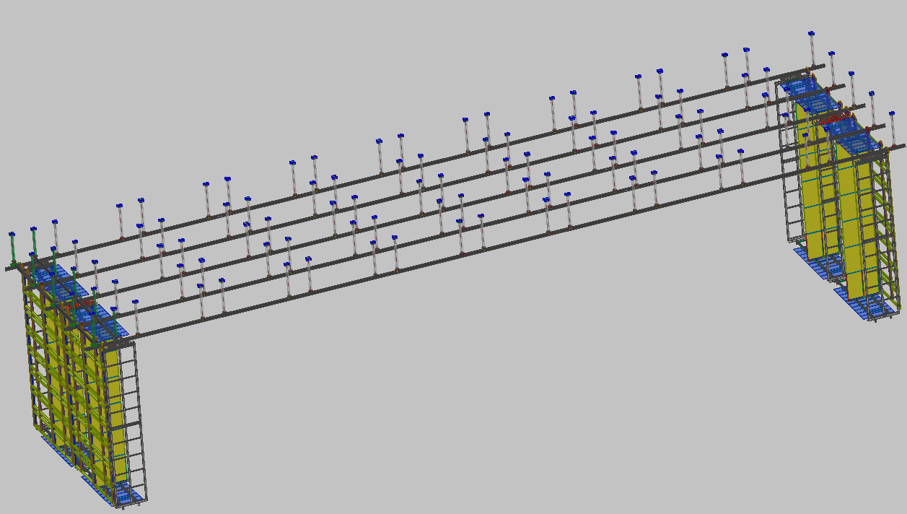
Far Detector DSS vs P-Dune
APA/CPA installed and mounted similar to P-Dune
APA/CPA inserted through TCO onto a shuttle (bridge) beam similar to P-Dune.
Shuttle (Bridge) beam transports APA/CPA to the fixed rows of DSS beams.
DSS beams supported by 100 feedthroughs which are mounted Cryostat crossing tubes similar to 9 feedthroughs for P-Dune
P-Dune had continuous beams, FD has a series of connected beams
Shuttle beam and TCO beams
100 DSS feed-thru’s supporting 50 independent I beams

Slide 4
Motivation for DSS Current Design
Preliminary design had all beams connected and shrink to center
  Results in 80mm movement of detector at ends
  Larger feedthrough tubes are needed
Current design:
  minimizes movement of detector elements
  is easier to predict final cold detector locations
  Is easier to perform structural analysis
  Minimizes lateral force

Slide 5
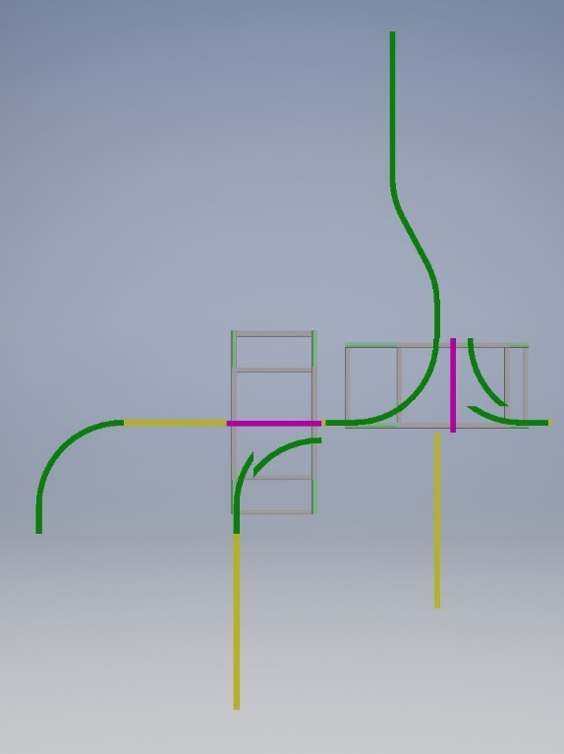
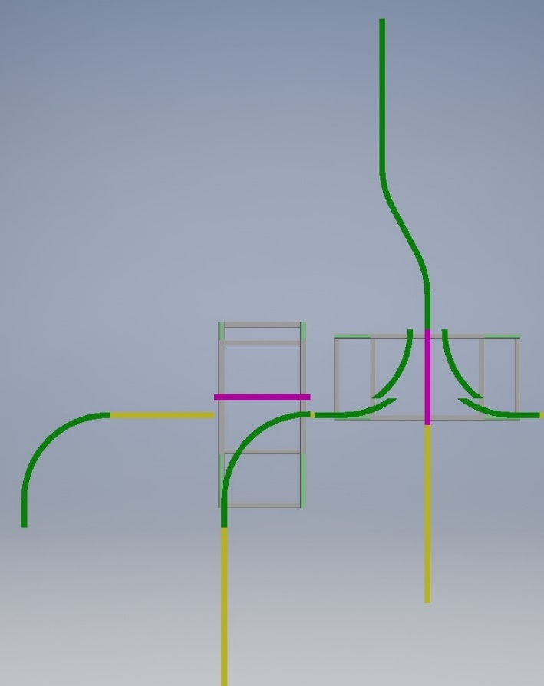
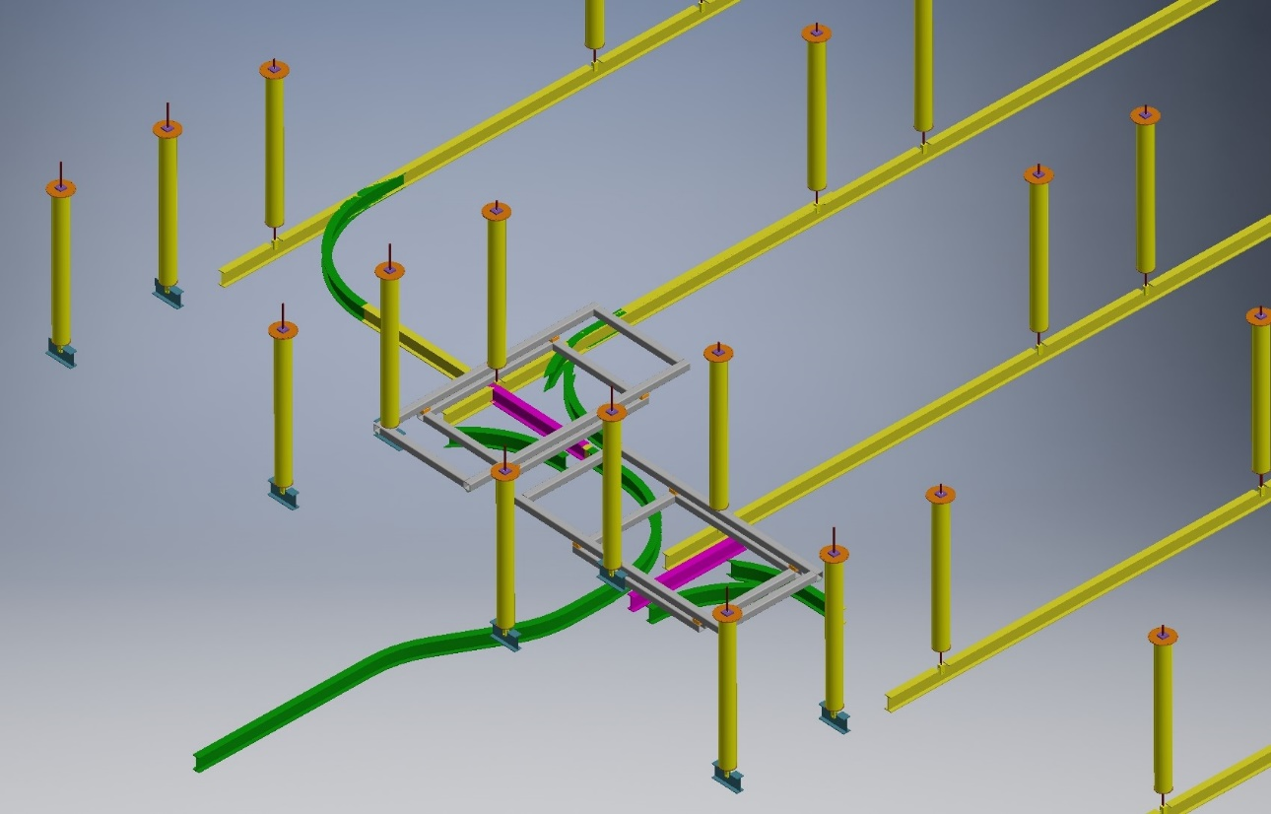
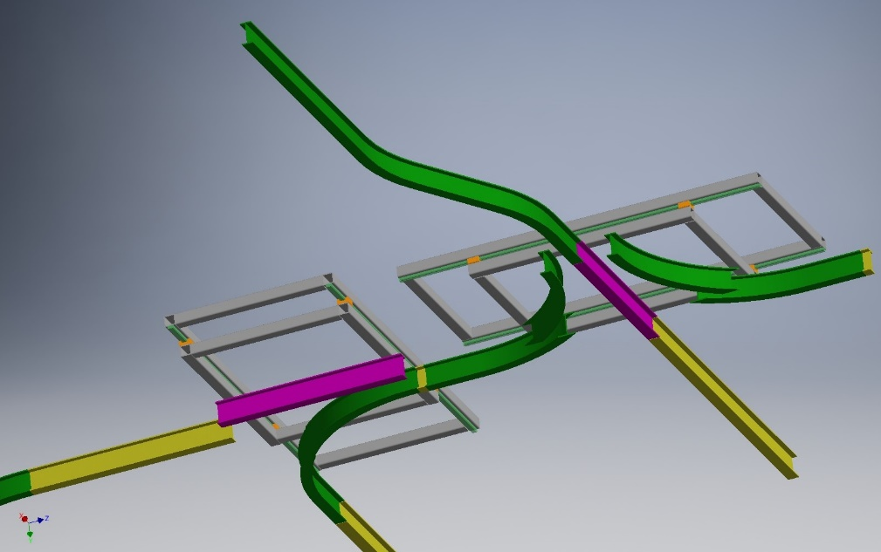
Alternative Switchyards considered
Utilize the rail switch concept that has been used in the proto-Dune cleanroom
Requires “switches” to be supported off of additional feedthroughs
Insertion through TCO more difficult
No clear concept for installing the last CPA/APA
A lot of equipment needs to be removed

Slide 6
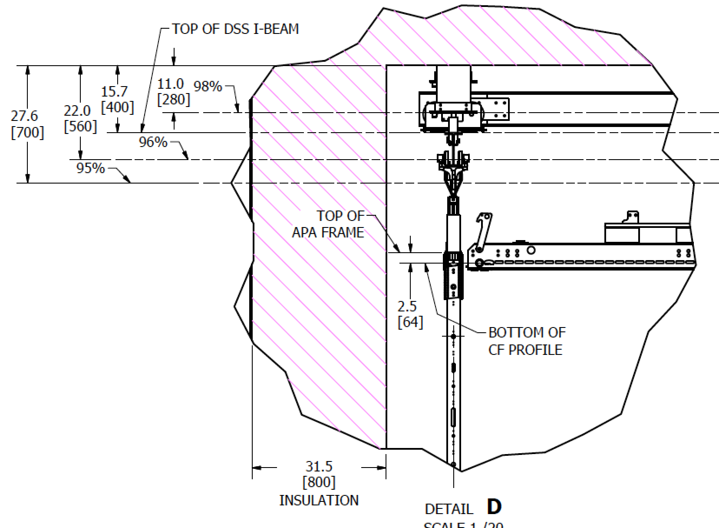
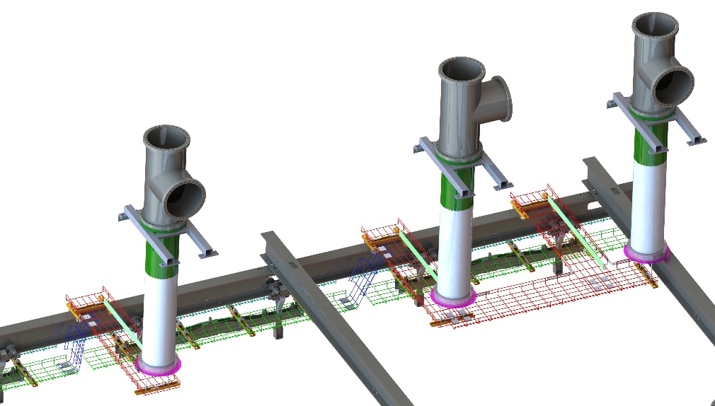
DSS Integration
Integration model created of cryostat/DSS/Detector
Vertical position of DSS determined by expected height of detector, detector clearance to floor and TCO opening, and desire to keep beams in ullage
Cable trays for CE/PE cables that run to the Cable Feed-thru’s will be supported by the DSS similar to ProtoDUNE shown below
5% Ullage line
Cable Feed-thru’s for ProtoDUNE
Cable Support trays

Slide 7
DSS Design
Beams are 6.4m long
Feedthrough supports are spaced at 4.8m (limited to 1.6m multiples for feedthrough spacing)
Beams are independent of each other to minimize detector movement during cool down.

Slide 8
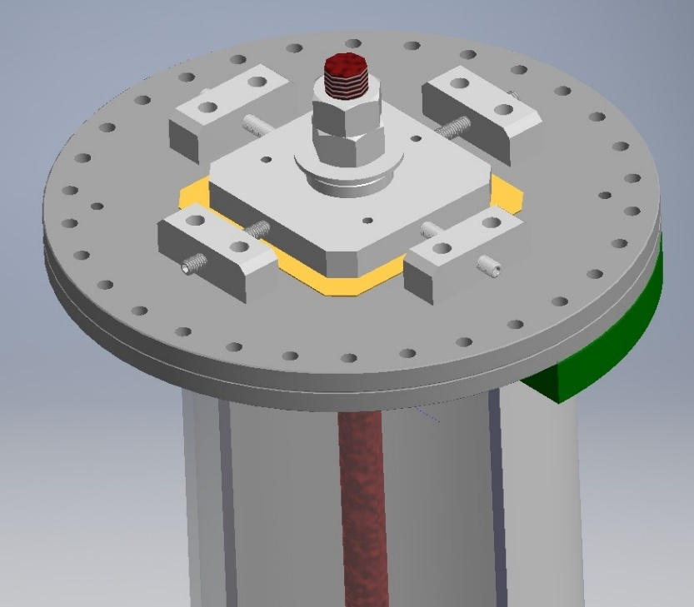
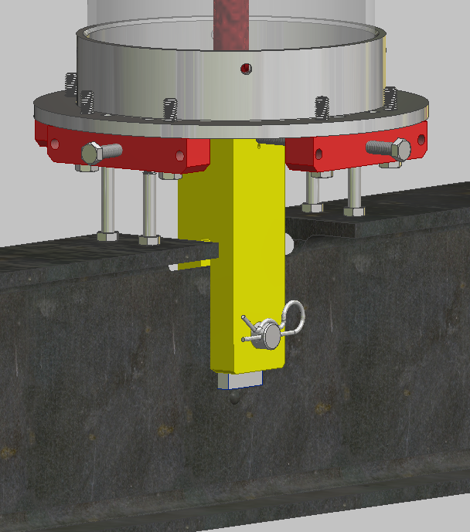
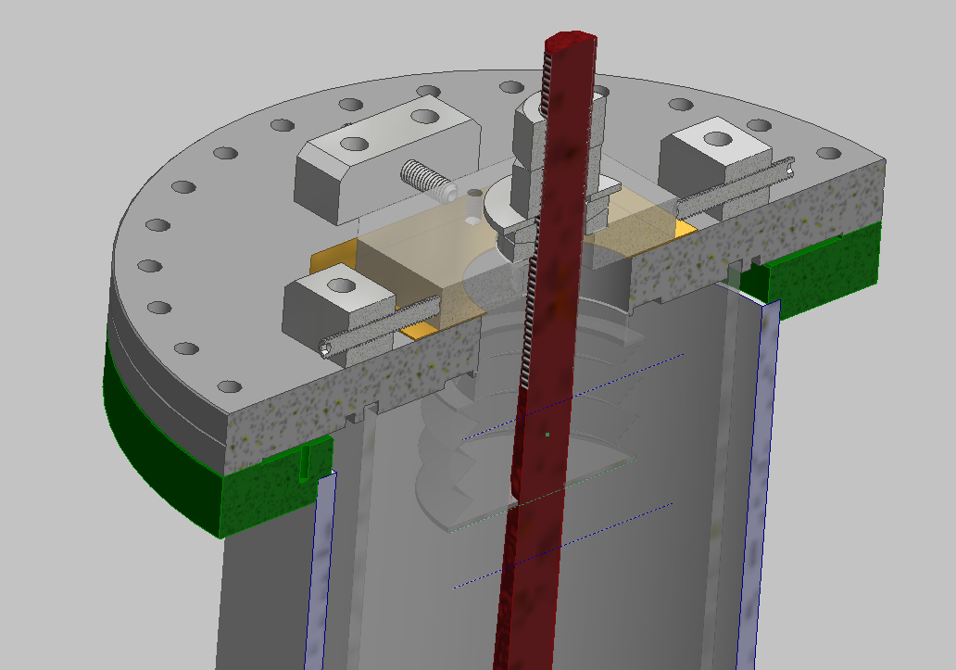
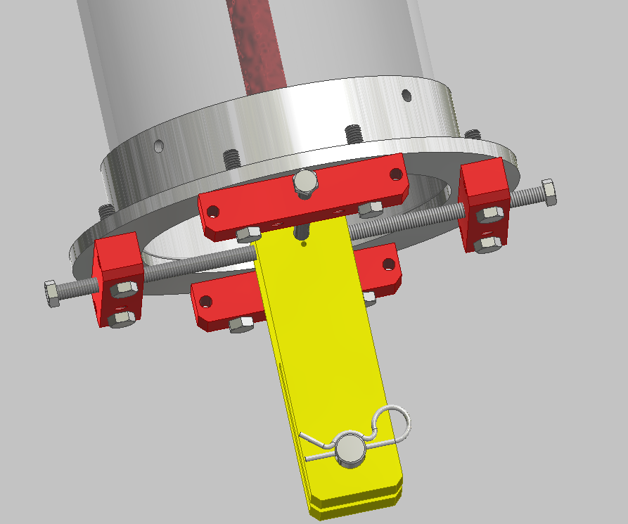
Feedthroughs
Conflat flange welded to 8” HSS tube
8” Tube provides lateral support
1” rod is supported on a pivot at the flange.
+/-1” vertical/horizontal adjustment of the rod position
Clevis at end of rod supports the DSS beam
Clevis is locked in position during installation
Bellows welded to conflat and rod for seal

Slide 9
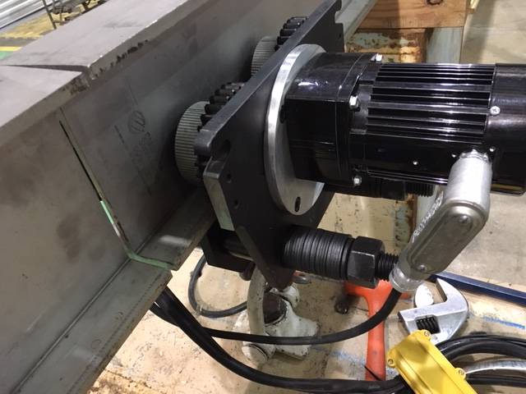
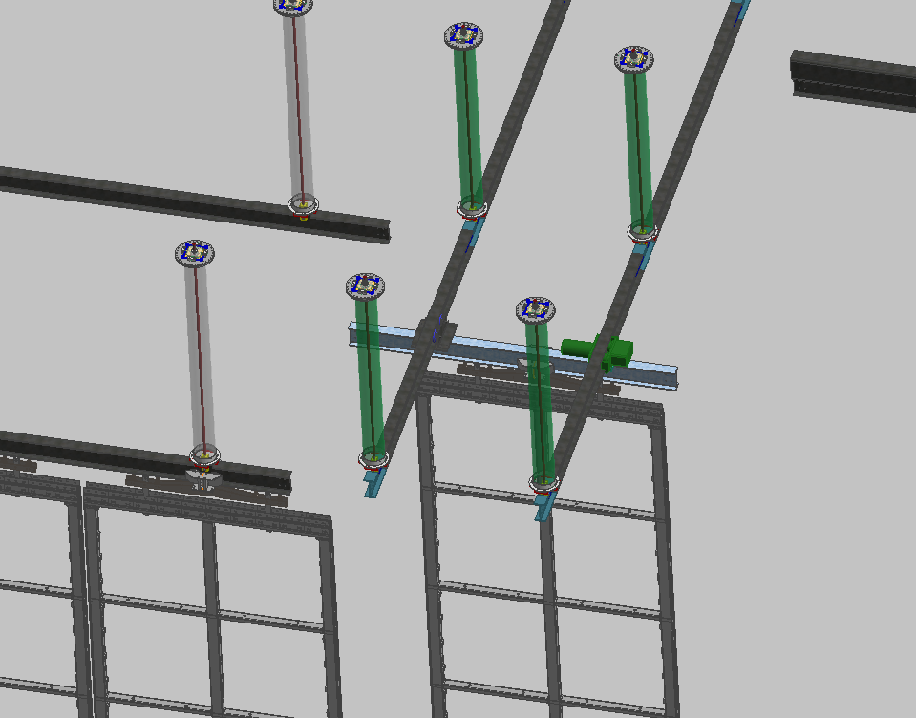
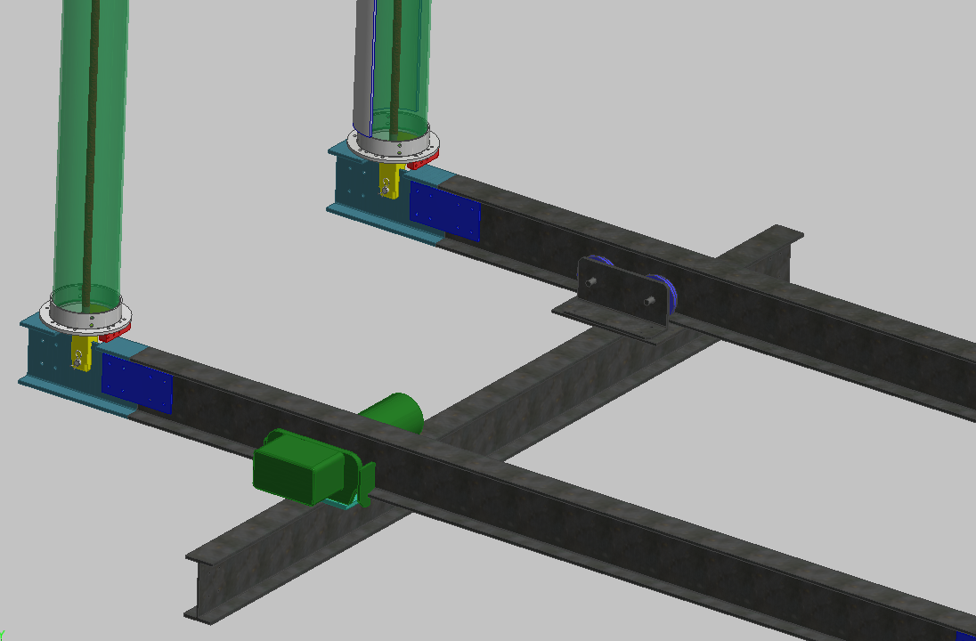
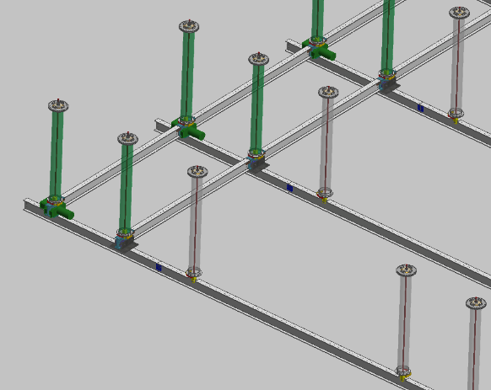
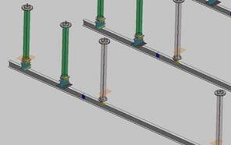
Shuttle Beam
Is similar to P-Dune Bridge Beams except used for transport
Method of driving beam needs to be finalized.
  A commercial driven trolley has been modified and tested
Requires a shorter feedthrough that supports temporary N-S beams.
Current design uses P-Dune bridge beam trolley and a modified driven trolley
Shuttle beam secured to feedthrough using the same method bridge beams were secured to runway beams

Slide 10


Removal of Shuttle Beams
Runway Beams
The last drift volume requires us to place final APA/CPA into position under the Shuttle Feed-thru and bolt beam section in place.
Trolleys and drives are removed
Each section of north/south shuttle beam is then removed
End wall is constructed as last step after drift volume is deployed
Remove Beams

Slide 11
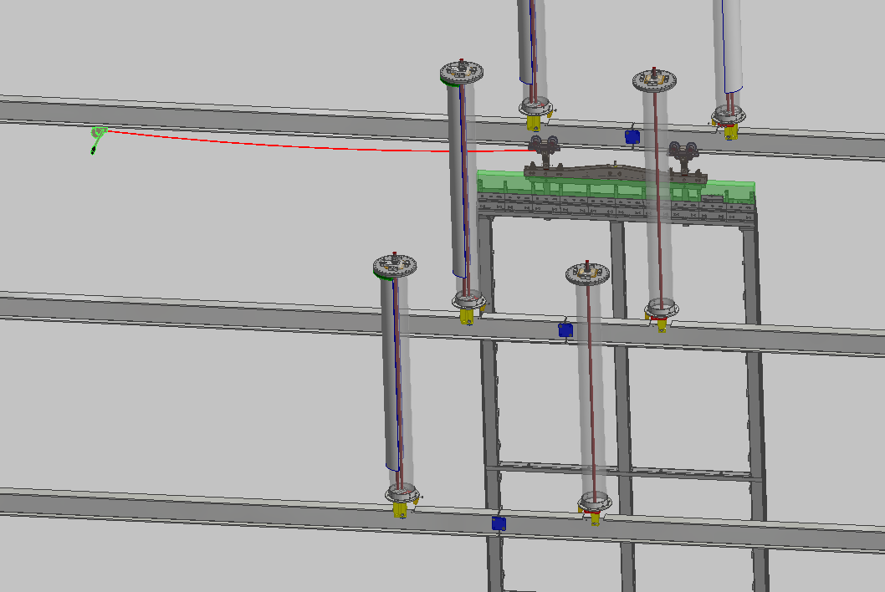
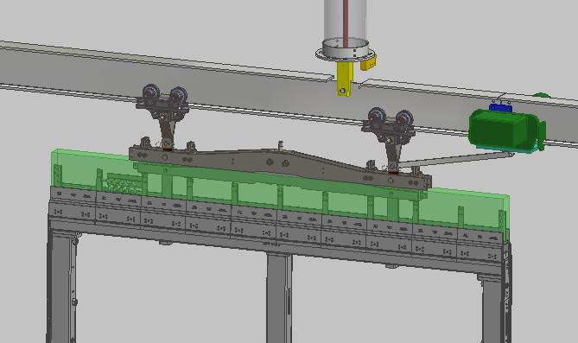
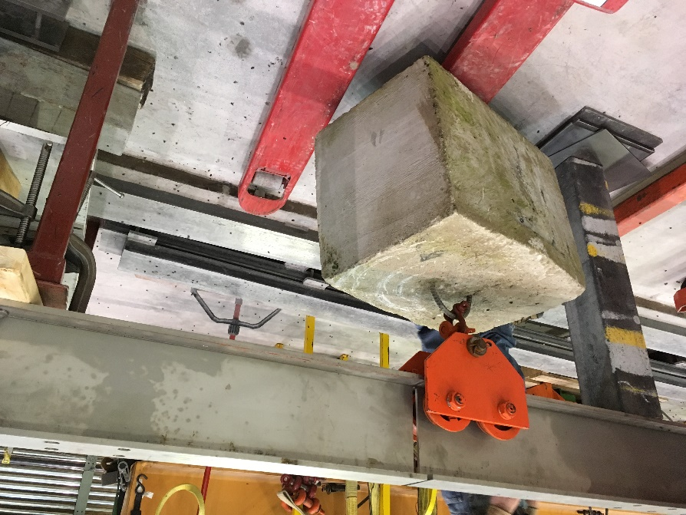
Moving APA/CPA
In P-Dune APA/CPAs were moved by hand by techs pushing from scissors lift --- not practical for FD
Investigating several options: Crawler trolleys, winches and gear rack
Tests have been done to determine how well DSS beams need to be aligned and lateral forces
  ¼” gaps are not a problem
  Steps greater than 1/8” are a problem to climb
  Beam alignment will determine allowable tolerances
SS I-Beams sections may be bolted together during installation

Slide 12
DSS Design Review Schedule: Before TDR
60% Review-~Jan 2019 Project schedule
  Design choice identified
  Complete integration with APA/CPA/CE/PD consortia requirements
  Integration with cryostat specifications for roof deflections and tolerances
  Complete engineering analyses and documentation
  Incorporation of ProtoDUNE lessons learned
  Plans for production and evaluation of prototypes
  Draft manufacturing, quality assurance, testing and procurement plans
  Installation plans including mechanical tests, special tools and fixtures
  Value engineering exercise
  Resolution of 30% review recommendations

Slide 13
DSS Design Details for 60%
Survey Design Details
  Work with FNAL survey experts to design compatible survey features
  Survey of DSS Hanger rod to allow adjustment of DSS elevations after cooling
Crossing Tube height incompatibility with feedthrough length has to be resolved.
Detailed prototype study of shuttle beam area
QA plans, documentation and integration into inventory/database system

Slide 14
DSS Design Risks
Roof Deformations have not been defined yet
Variation in the feed thru locations and variation in the flange angle due to installation tolerances
Effects from cooldown are not predicted properly.
  Is the DSS design adjustment enough compensate for this displacement
Need to dismount flange support assembly after TPC installation due to mechanical issue or leak.
  Leak test before installation at production site and after delivery to CERN.
  Increase purge rate to feed thru
  Pot volume of bellows if leak occurs
Unable to obtain required access during installation
  Full scale tests at Ash River will help, but not planned until 2020-2021
Changes in the TPC design affect loads or motions of the DSS
  This includes potential design change of Field Cage Ground Plan
  Cable tray support
  Top Field cage deployment

Slide 15
Conclusion
P-Dune was basis of design
Shuttle beams are similar to the P-Dune Bridge beams
  Similar trolleys and mounting method are used.
Feedthrough support concept similar to P-Dune
Method for driving shuttle beam and APA/CPA have been tested.
Full scale testing at AR is needed.

