Slide 1
Detector Support System Requirements
Jim Stewart
DSS Conceptual Design Review
August 20 2018

Slide 2
Outline - Summary of Requirements
The scientific design specifications are:
The CPA to APA centerline distance and tolerance envelope must be maintained 3574mm +/-35 mm when warm. (Drift uniformity <1%)
Minimize the gaps that develop between APAs during cool down less than 20mm
Define the position of the detector components when warm relative to each other within 3mm
The DSS is electrically connected to the cryostat ground
The APA/CPA/FC/Endwall are electrically isolated from the DSS
The DSS penetrations must be purged with GAr to maintain a positive pressure in order to prevent contaminates from diffusing to the liquid
All materials must be compatible for operation in ultrapure LAr
The DSS will insure that detector components shall not be less than 400mm from the membrane flat surface
The DSS beam will be fully in the 5% ullage at the top of the cryostat.
The mechanical design specifications are:
Support the weight, both dry and wet, of the TPC-Time Projection Chamber (Endwall, top/bottom FC, APA, CPA) ~135 metric tons
Be able to accommodate the roof movement – THE ROOF DEFORMATIONS NEED TO BE DEFINED
Accommodate the variation in the feed thru locations and variation in the flange angle due to installation tolerances and the loading on the warm structure.
Accommodate the shrinkage of the detector and DSS from ambient temperatures to LAr temperatures.
Install through the TCO
The instrumentation cabling must not interfere with the DSS.
The DSS beam will be fully in the 5% ullage at the top of the cryostat.

Slide 3
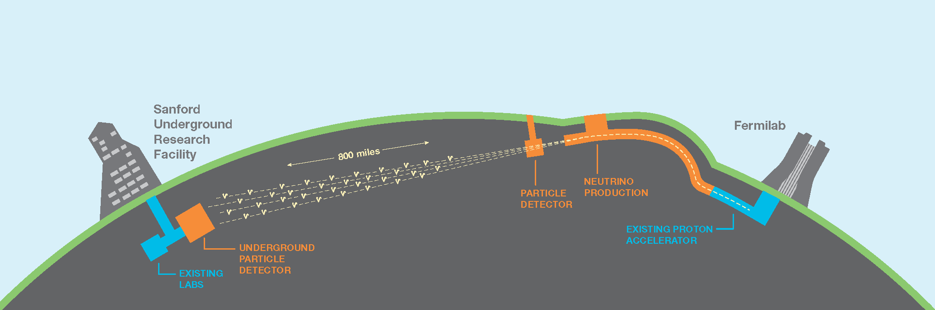
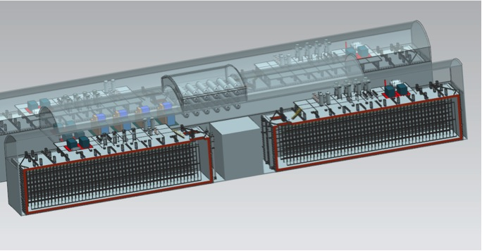
Detector Location Tolerance
1300 km
ν
FD
ND
No absolute position accuracy required!
  At 1300km the flux varies <1% over 1km
  Requirements on the detector location are driven by engineering considerations, detector performance considerations, and the cryostat interface.

Slide 4
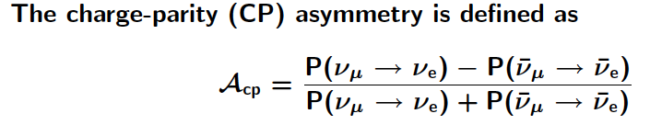
Detector Volume Requirement
Detector fiducial volume needs to be known better than the 1% level.
  DUNE will measure asymmetries so the volume is needed to normalize the data sets.
  Detector motion under cooldown needs to be understood to insure the 1% precision in defining the fiducial volume.
The CPA to APA centerline distance and tolerance envelope must be maintained 3574mm +/-35 mm when warm. (Drift uniformity <1%)
Cold?
FDmod-gen-004 | A DUNE far detector module shall provide a well-defined fiducial volume for the detector lifetime. | fiducial volume tolerance | 1%
FDmod-gen-005 | A DUNE far detector module shall provide a stable fiducial volume for the detector lifetime. | fiducial volume tolerance | 1%
LBNF-DUNE requirements DOCDB 112

Slide 5
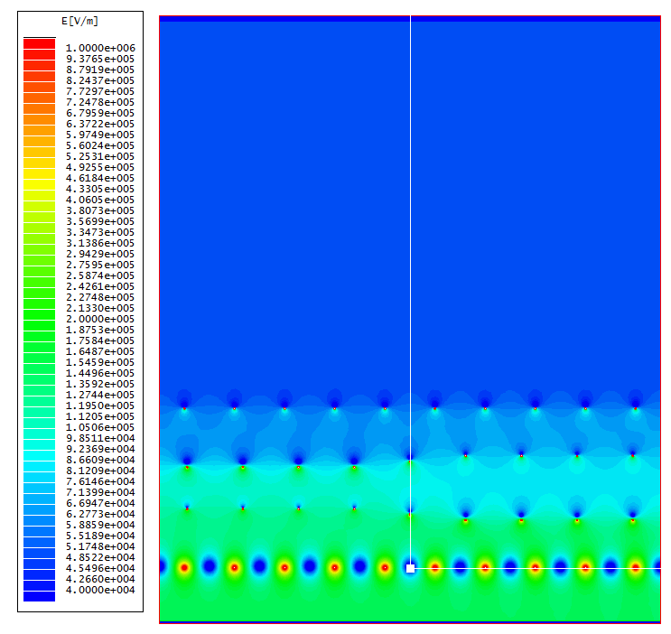
APA plane mechanical distortions
LBNE DOCDB 7370
The induction planes must fulfill the transparency condition at > 99%.
  Needed for both calorimetry and tracking.
This defines the APA flatness specification.
Field calculations show 0.5 mm wire displacement OK.
APA distortion studies show that this corresponds to a +/-5mm tolerance on flatness.
  APA flatness tolerance
Possible APA distortions will reduce the allowable tolerance of the DSS +/- 5 mm.
Nominal wire plane spacing: 3/16”
G & X wire pitch: 4.5mm
U & V wire pitch: 5mm
G and X planes remain at nominal position
U & V each moves 0.5mm closer at the left (U-V gap reduced by 1mm), 0.5mm farther at the right (U-V gap increase by 1mm).
Bo Yu

Slide 6
Design Goal for DSS position tolerance
The CPA to APA centerline distance and tolerance envelope must be maintained 3574mm +/-30 mm when cold. (Drift uniformity <1%)
A substantial margin should be maintained on this tolerance so that even when cold the distortion are significantly less than the requirement.
Engineering the DSS to substantially better than +/-30 mm was the design goal.
  Given that a 60m stainless steel beam will contract 150mm designing a system where the thermal motion was well understood was a priority during the design phase.
  Detector placement precision after cooling was an important factor in selecting the I-Beam support concept and thermal contraction plan.
  The present design is expected to be accurate to the 6-9mm level cold.
  Details will be given in the structural talk.

Slide 7
Impact on dE/dx from mechanical distortions
3.6 m
2.3 m
Suppose the drift volume becomes a trapezoid instead of a rectangle due to distortion and the drift distance on one side is 1 cm longer than on the other side, the electric field is different by 0.3% between the two sides.
For a track near the cathode that is parallel to the wire planes, the reconstructed track would appear to have a smaller angle w.r.t the wire planes. The maximum change to dE/dx would be .01/2.3 = 0.4% due to this distortion. This is negligible for particle ID.
20.08.2018
J Stewart | DSS Requirements

Slide 8
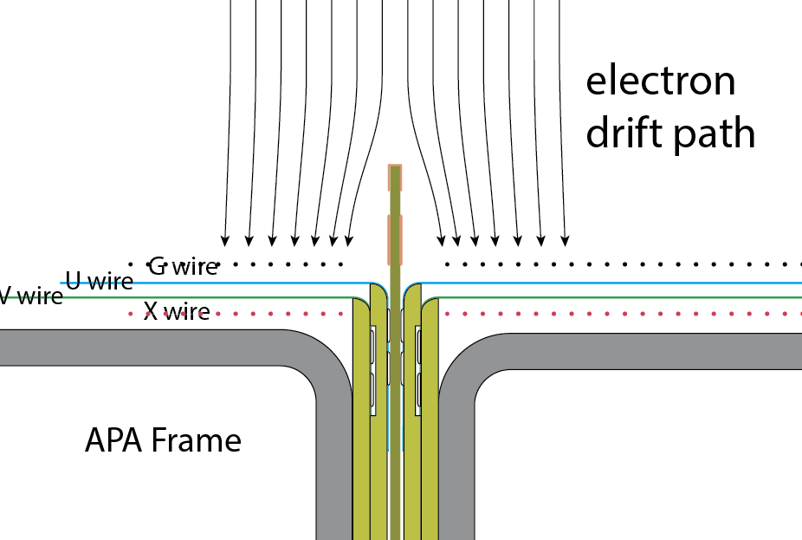
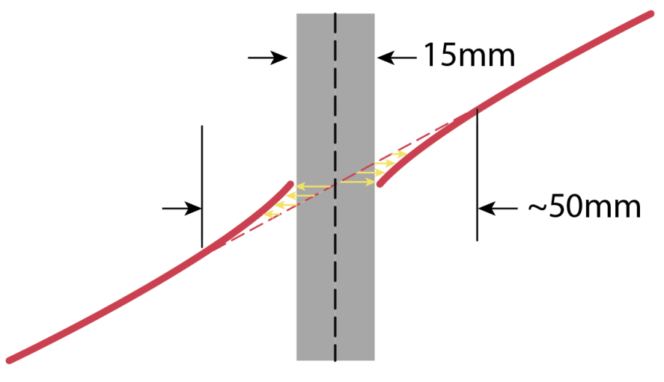
Gaps between APAs
Situation: 20 mm gap between APAs
  Natural consequence of modular design
  Between 3rd and 4th APA, an additional 17 mm gap
Physics considerations for ν_{μ}→ν_{e} oscillation
  Energy reconstruction :
    Gap leads to loss of ionization electrons
    Its value can be estimated by multiple methods: for track, rely on the track length, for shower or non-stopping track, can use the adjacent energy to fill in the gap
    Expect no impact on the energy resolution, which is dominated by neutrons in the final state
  Event ID:
    Vertex has to be away from the gap,
    Loss in fiducial volume is expected, but a natural consequence caused by cool down
Mitigation method: electron diverter
  Ensure all charge will be collected, better estimation of the energy in gap
  Stable distortions in the reconstructed event topology can be calibrated

Slide 9
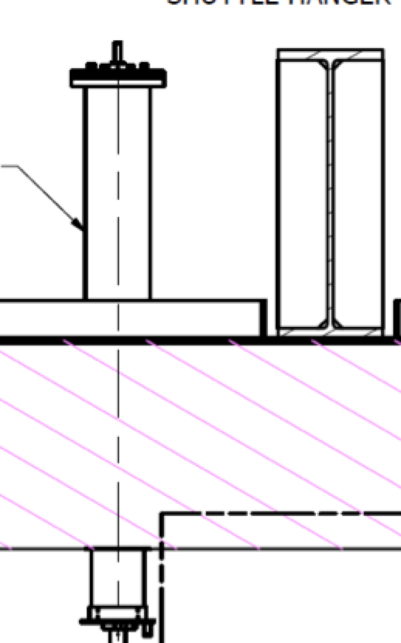
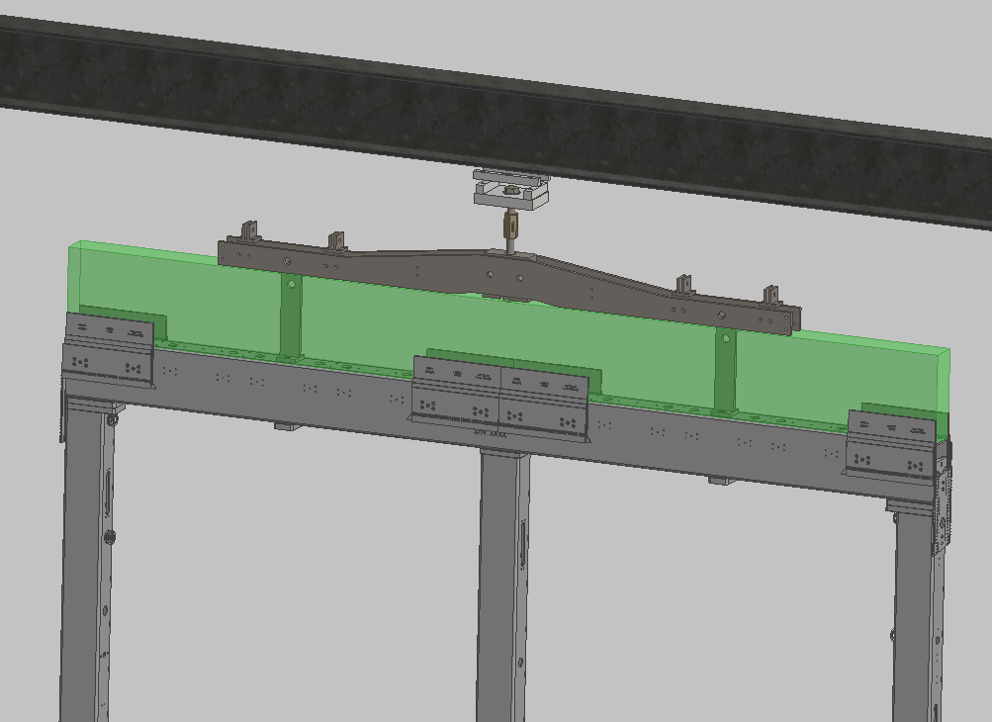
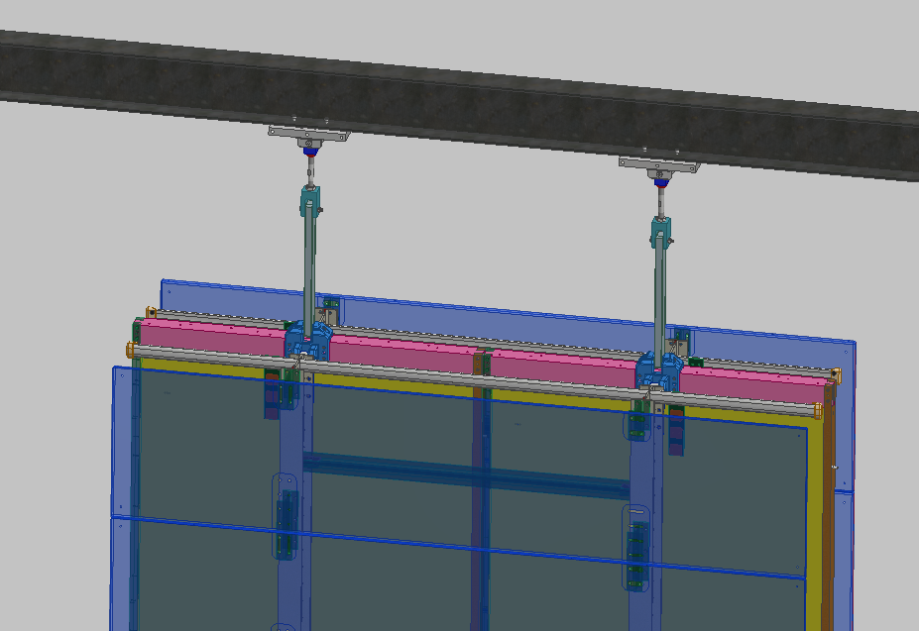
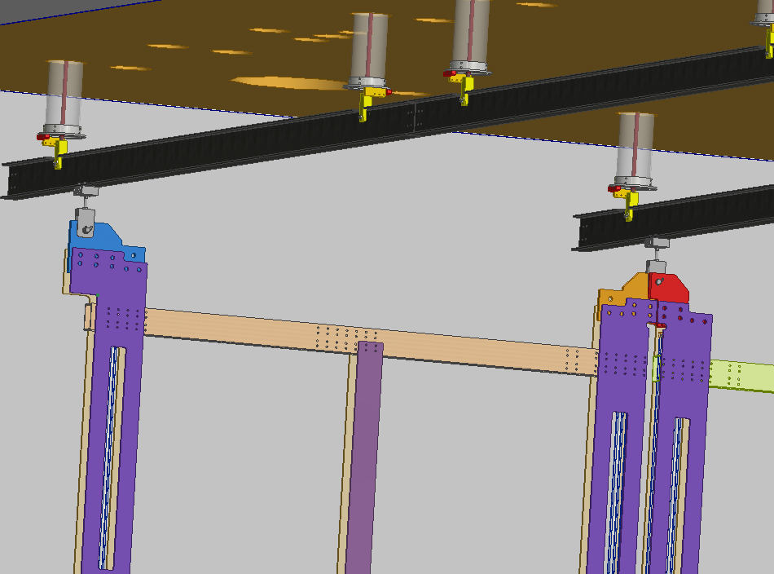
Grounding and Shielding
Cryostat Ground
All detector systems must conform to the DUNE grounding and shielding plan.
  Same requirement as ProtoDUNE-SP
The DSS is electrically connected to the cryostat ground
  The DSS shall be electrically isolated from all detector components.
The APA/CPA/FC/Endwall are electrically isolated from the DSS
Isolator
Isolators
Isolator
APA
CPA
FDmod-gen-017 | A DUNE far detector module shall be constructed to comply with all requirements set by the DUNE grounding and shielding committee. | DUNE Doc 285

Slide 10
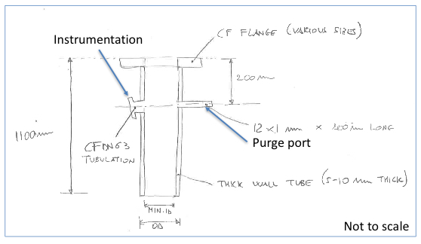
Scientific DSS requirements
The DSS penetrations must be purged with GAr to maintain a positive pressure in order to prevent contaminates from diffusing to the liquid
All materials must be compatible for operation in ultrapure LAr
All Metal DSS construction ensures material compatibility

Slide 11
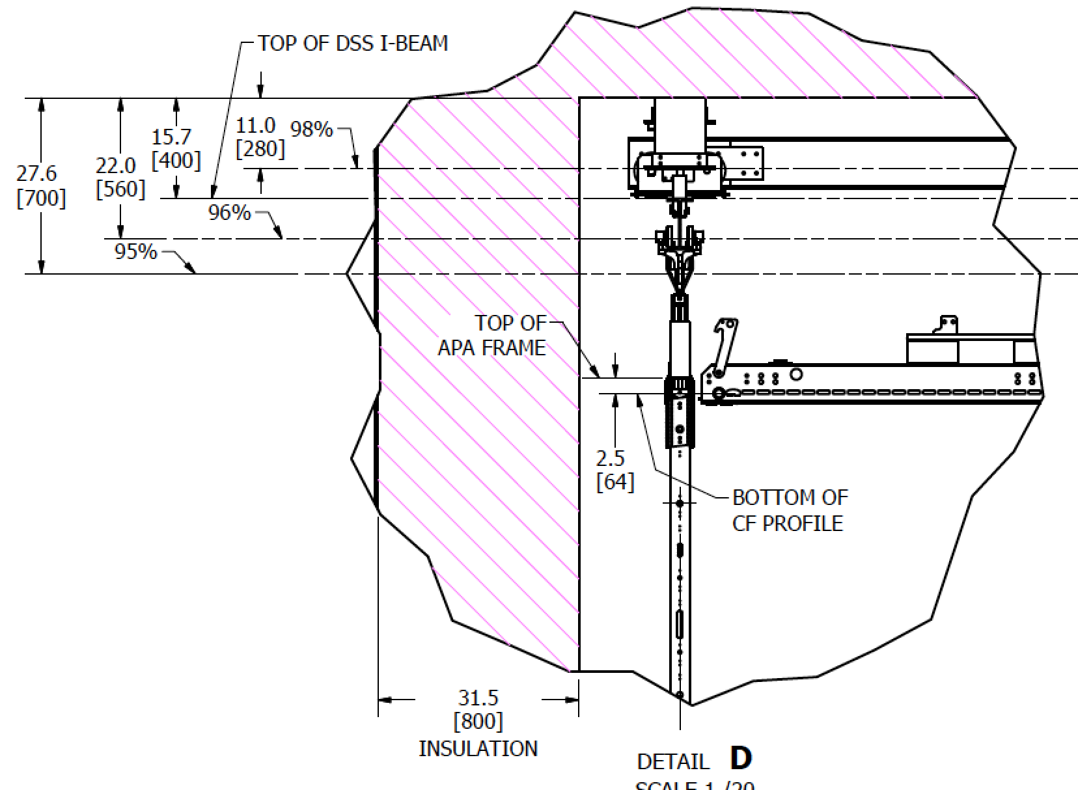
I-Beam height requirement
The DSS beam will be fully in the 5% ullage at the top of the cryostat.
The beam should be either fully submerged in liquid or fully in gas. If the beam is partially covered then thermal induced distortions may distort the detector.

Slide 12
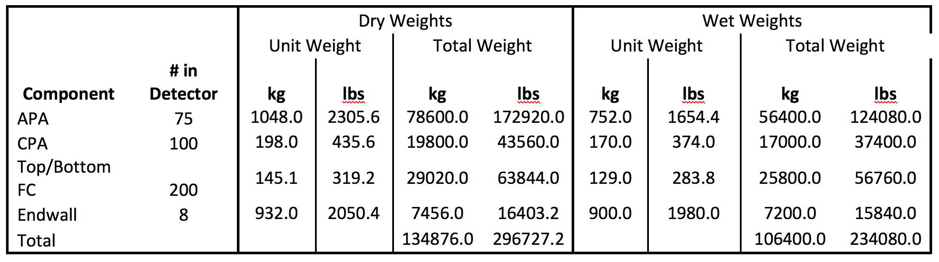
Mechanical Design Specifications
Support the weight, both dry and wet, of the TPC-Time Projection Chamber (Endwall, top/bottom FC, APA, CPA) ~135 metric tons
No agreements on the maximum loads of the components are available.
Component designs are still changing so the final loads are not yet determined.
Loads were computed based on information from ProtoDUNE.
Substantial margin exists in the present design.

Slide 13
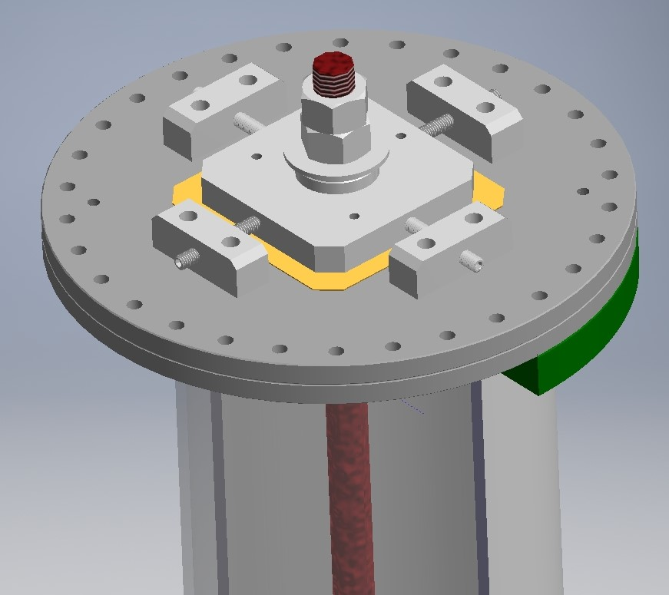
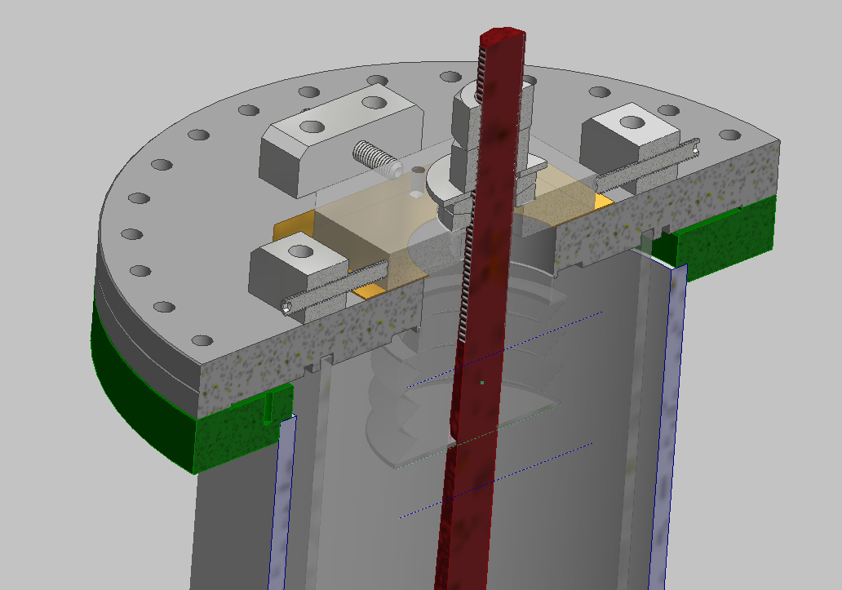
Roof Deflections
Be able to accommodate the roof movement
  THE ROOF DEFORMATIONS NEED TO BE DEFINED
Accommodate the variation in the feed thru locations and variation in the flange angle due to installation tolerances and the loading on the warm structure.
Clear requirements from the cryostat group were not available so reasonable assumptions were made.
Pivot
X-Y
The axis of the cryostat crossing tube must lie within a 36mm diameter cylinder positioned along the nominal axis.
The outer alignment tube has 25 mm clearance to the membrane crossing tube.

Slide 14
Mechanical Design
Accommodate the shrinkage of the detector and DSS from ambient temperatures to LAr temperatures.
Install through the TCO
The shrinkage and the installation through the TCO will be covered in the structural and installation talks.

Slide 15
Instrumentation Cabling
The instrumentation cabling must not interfere with the DSS.
The cryogenic instrumentation group has requested that electrical feedthrus be made available in the crossing tubes.
The space between the crossing tube and the support rod alignment tube is available for the cabling.
Details of this interface have not yet been developed.

Slide 16
Outline - Summary of Requirements
The scientific design specifications are:
The CPA to APA centerline distance and tolerance envelope must be maintained 3574mm +/-35 mm when warm. (Drift uniformity <1%)
Minimize the gaps that develop between APAs during cool down less than 20mm
Define the position of the detector components when warm relative to each other within 3mm
The DSS is electrically connected to the cryostat ground
The APA/CPA/FC/Endwall are electrically isolated from the DSS
The DSS penetrations must be purged with GAr to maintain a positive pressure in order to prevent contaminates from diffusing to the liquid
All materials must be compatible for operation in ultrapure LAr
The DSS will insure that detector components shall not be less than 400mm from the membrane flat surface
The DSS beam will be fully in the 5% ullage at the top of the cryostat.
The mechanical design specifications are:
Support the weight, both dry and wet, of the TPC-Time Projection Chamber (Endwall, top/bottom FC, APA, CPA) ~135 metric tons
Be able to accommodate the roof movement – THE ROOF DEFORMATIONS NEED TO BE DEFINED
Accommodate the variation in the feed thru locations and variation in the flange angle due to installation tolerances and the loading on the warm structure.
Accommodate the shrinkage of the detector and DSS from ambient temperatures to LAr temperatures.
Install through the TCO
The instrumentation cabling must not interfere with the DSS.
The DSS beam will be fully in the 5% ullage at the top of the cryostat.

