Slide 1
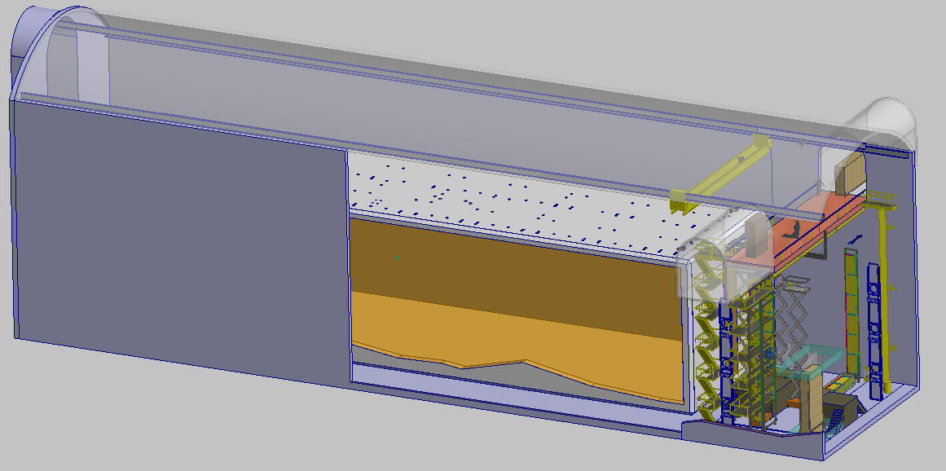
DUNE Far Detector DSS Analysis
V. Guarino & R. Kmak August 20, 2018

Slide 2
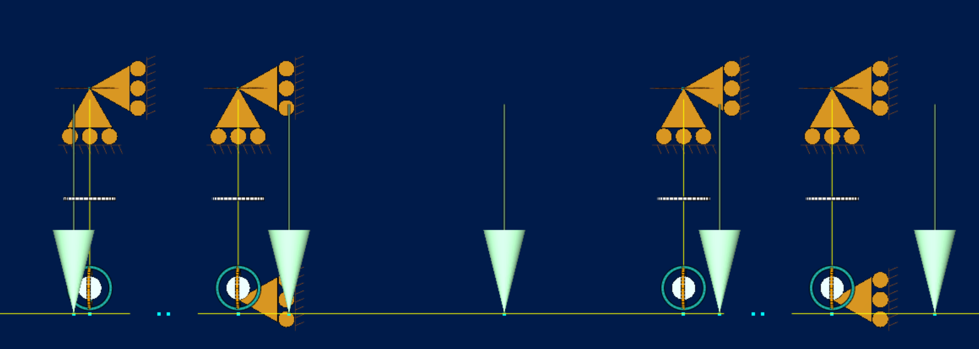
DSS Analysis
Hand calculations were done for all structural components, see Appendix 1
Beam Element FEA model was created of CPA beams and center row of APA
Thermal deformations were examined
All components have acceptable loads
Design/Analysis follows the American Institute of Steel Construction (AISC) Specification 13th Edition
Examined two worst case loading:
Load Case 1 --- Assembled Detector Dry
Load Case 2 --- Loads during assembly

Slide 3
Weights
Weights were determined from an extrapolation of P-Dune detector weights
 |  | Dry Weights |  |  |  | Wet Weights
 |  | Unit Weight |  | Total Weight |  | Unit Weight |  | Total Weight
Component | # in Detector | kg | lbs | kg | lbs | kg | lbs | kg | lbs
APA | 75 | 1048.0 | 2305.6 | 78600.0 | 172920.0 | 752.0 | 1654.4 | 56400.0 | 124080.0
CPA | 100 | 198.0 | 435.6 | 19800.0 | 43560.0 | 170.0 | 374.0 | 17000.0 | 37400.0
Top/Bottom FC | 200 | 145.1 | 319.2 | 29020.0 | 63844.0 | 129.0 | 283.8 | 25800.0 | 56760.0
Endwall | 8 | 932.0 | 2050.4 | 7456.0 | 16403.2 | 900.0 | 1980.0 | 7200.0 | 15840.0
Total |  |  |  | 134876.0 | 296727.2 |  |  | 106400.0 | 234080.0

Slide 4
Lateral Loads
Seismic load of 0.08g was calculated based on ASCE 7-10 methodology and ground parameters provided by SURF. Email correspondence with SURF indicate that seismic loading is not needed.
Lateral loads are induced along the length of DSS beams due to installation. Feedthroughs can resist 2640 lbs lateral loads. Tests of the force needed to span gaps/steps between beams indicate that the max lateral load is ~100 lbs.

Slide 5
Load Case 1
S8 x 18.4 beam has a max allowable moment of 28.1 kip-ft
All beams and rods meet AISC requirements
Max factored moment is 24 kip-ft in western most beam of center APA row. Max deflections also occur in this beam.
This beam is loaded by EW
Deflections of APA are higher than CPA because APA is heavier and center loaded. APA deflections as large as 10mm; CPA ~4mm
Deflections can be compensated for by adjusting the height of the APA/CPA during installation.
Strength of all connections and detector supports were calculated
Hand calculations matched FEA model

Slide 6
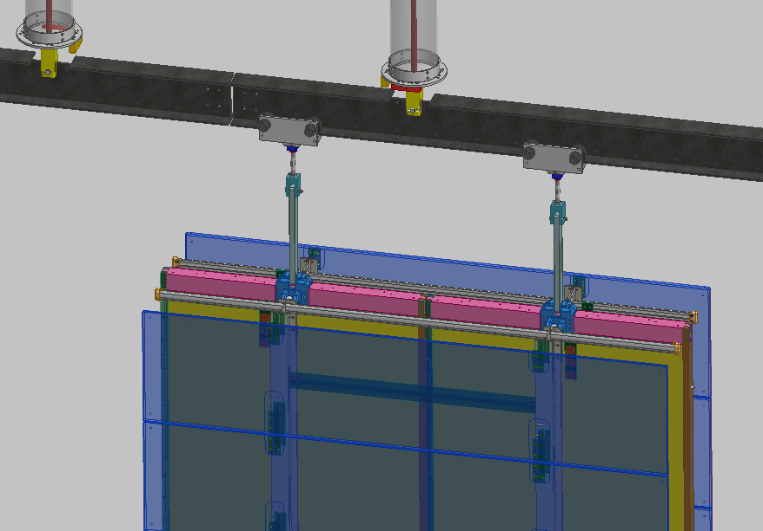
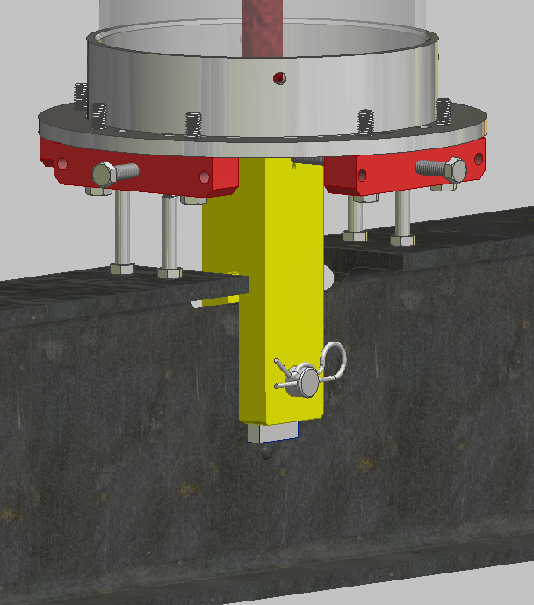
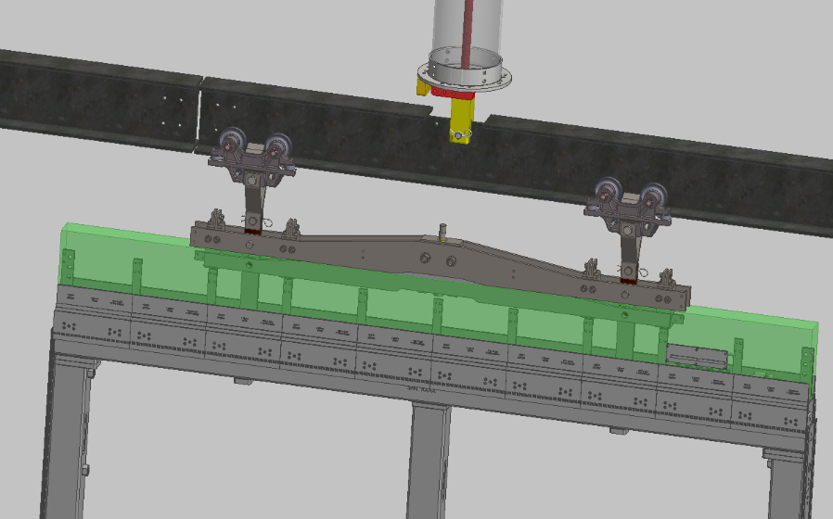
Load Case 2
During installation single APA/CPAs are inserted along beam and load the cantilever end of the beam
Max upward force of 168 lbs resisted by the feedthrough
Max moment is 5.7 kip-ft

Slide 7
Cool Down Analysis
APA and CPA drift distance shrinks by 7.5mm
DSS beams are in the ullage. Worst case a 16K temperature gradient results in a 2.9mm deflection at the center of the beam
Hanging rod will shrink by 2.8mm
Heat loss at feedthrough is 8.7W
Detector assembly needs to be designed to accommodate shrinkage

Slide 8
APA Gaps During Cool Down
Shrinkage can be accommodated in two ways:
The DSS beam can be continuous from the center of the detector to the end of the detector; the beam would shrink toward the center and no gaps develop.
Requires DSS supports to accommodate 80mm of movement at the ends, the entire detector shrinks/moves
The DSS beams can be segmented. Gaps open up between APA.
There is less movement of detector and DSS supports accommodate a small shrinkage
A proposed design uses beams that are 6.4m long, which support typically 3 APAs.
Option 1: Restrain beam at one feedthrough which results in a zero gap developing between the three APA’s on the same beam but a 17mm gap opening up between adjacent APA’s that are on separate beam. Roughly there will be a 17mm gap between every 3rd and 4th APA.
Option 2: No Restraint and gaps open up between all APAs. Zero gap between APAs on the same beam and 11mm to 18mm gaps between adjacent APAs that are on separate beams

Slide 9
Conclusion
Estimated loads of detector components were used for analysis – need to updated weights
Every component of the DSS and connections has been examined under worst case loading.
FEA beam element model and hand calculations have been done and match each other
All components meet AISC requirements.
Need to update analysis for final weights and create full beam element model of DSS and detector.
HA documents, load tests, procedure documents and analysis documents will be produced for Production Readiness Review

