Slide 1
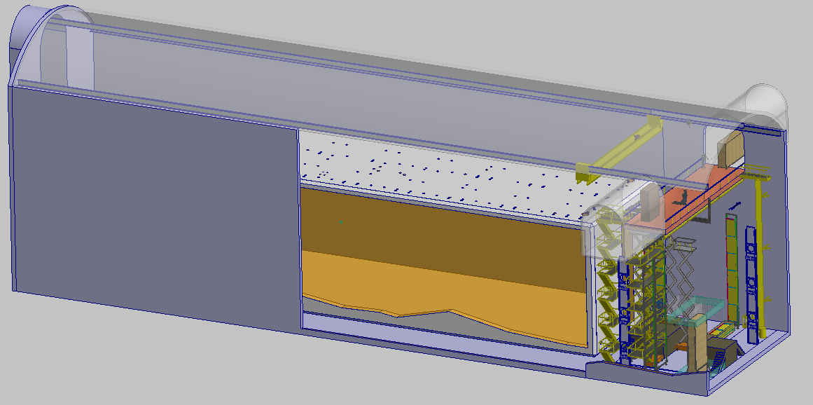


DUNE Far Detector
DSS Interfaces
V. Guarino & R. Kmak
August 20, 2018

Slide 2

DSS Interfaces
Integration Process
Interfaces to the Cryostat
Interfaces to the detector
Conclusion

Slide 3
Integration Process
No official 3D model exists so we assembled a model to be able to design the DSS and identify interfaces and plan for installation
The cryostat model was from EDMS https://edms.cern.ch/document/1834561/1
The APA model is based on P-DUNE and sketches from PSL
HV model is maintained by ANL
Created drawings and views of critical interfaces – see DocDb 6311 Appendix 3 Integration Drawings
DocDb 6260 was created a year ago and contains 2d drawings and full STP file and regularly is updated.

Slide 4
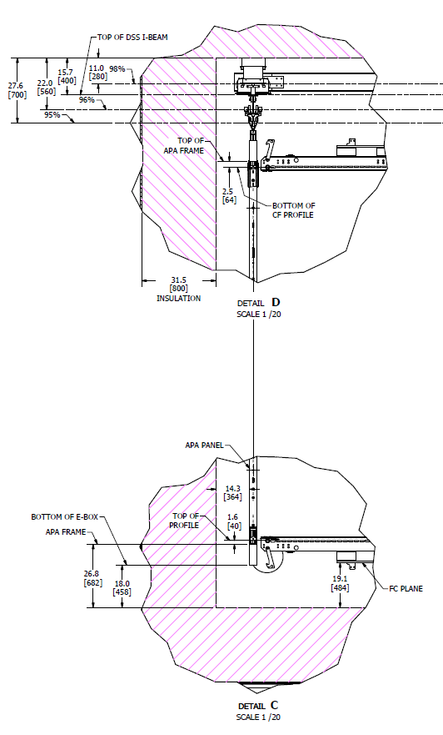
Integration Model

Slide 5
Integration Process – next steps
Need to incorporate APA cable trays and cable loops at bottom
Need official APA model
Need to update cryostat model with crossing tube flanges at corrected height for installation under mezzanine.
Need review with HV of current design and changes to Ground Plate
Need to incorporate connections between APA/EW/FC
Need to incorporate false floor and cryo piping in cryostat
Will create additional views for detector

Slide 6
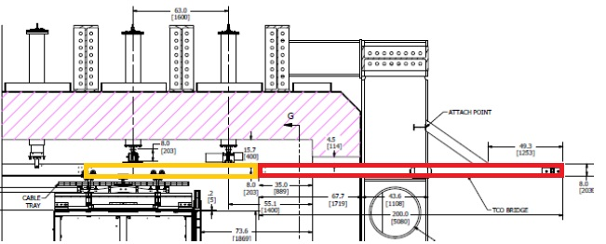
Cryostat
TCO Beam and support (shown in red) must be designed.

Slide 7
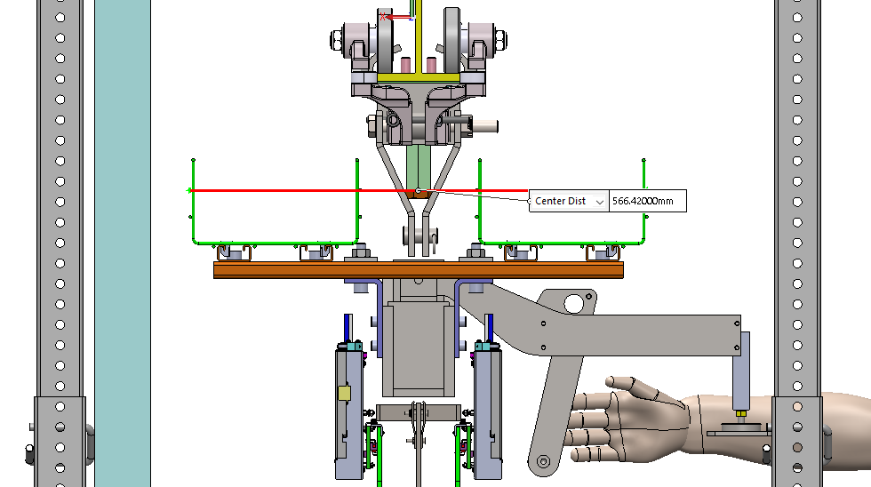
Cryostat -- TCO
~4” of clearance for CE cables between cable tray and DSS
6.8” clearance between bottom of CE boxes and TCO opening
4.5” clearance between top of DSS beam and TCO
Cable trays fit through TCO

Slide 8
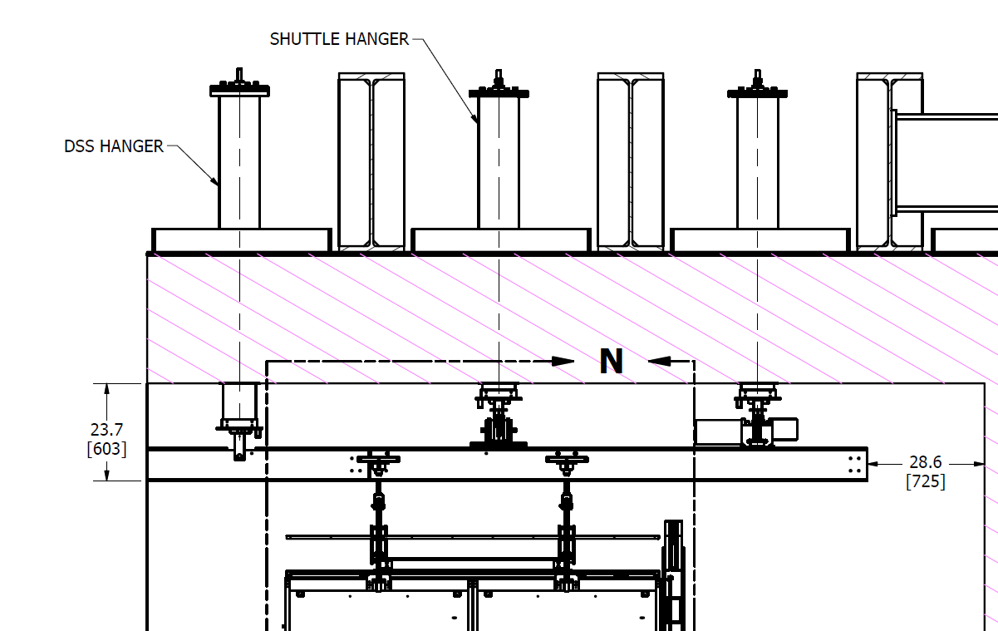
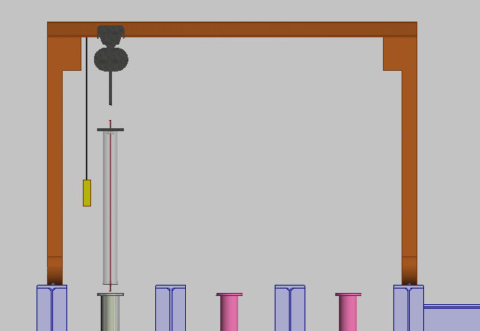
Crossing Tube Flange Height
Crossing tubes:
  Must resist 8480 lbs vertical load and 2640 lbs lateral load
  How are they mounted?
  Height of flange must be determined
  Must be located to true position of 18mm
Flange height is currently to high to install false floor and install feedthroughs under mezzanine
Conflicts exist with cryo piping under mezzanine
Feedthroughs must be installed before detector cable trays and racks

Slide 9
Cryostat
DSS beam is in ullage if less than 96%. Cables are submerged if ullage greater than 95%. Final target ullage needs to be determined.
DSS height cannot be increased
  TCO beam 4.5” from top of TCO
  Shuttle beam feedthrough 4” from ceiling
Is there enough room at bottom to clear cryo pipes and false floor?

Slide 10
Detector Interfaces
Detector Interfaces are:
  APA
  CPA
  Cabling
  Grounding
DSS is on cryostat ground

Slide 11
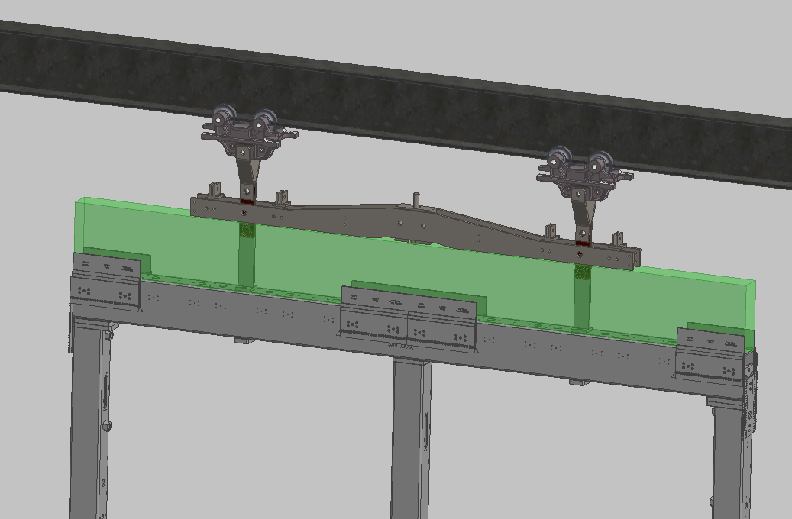
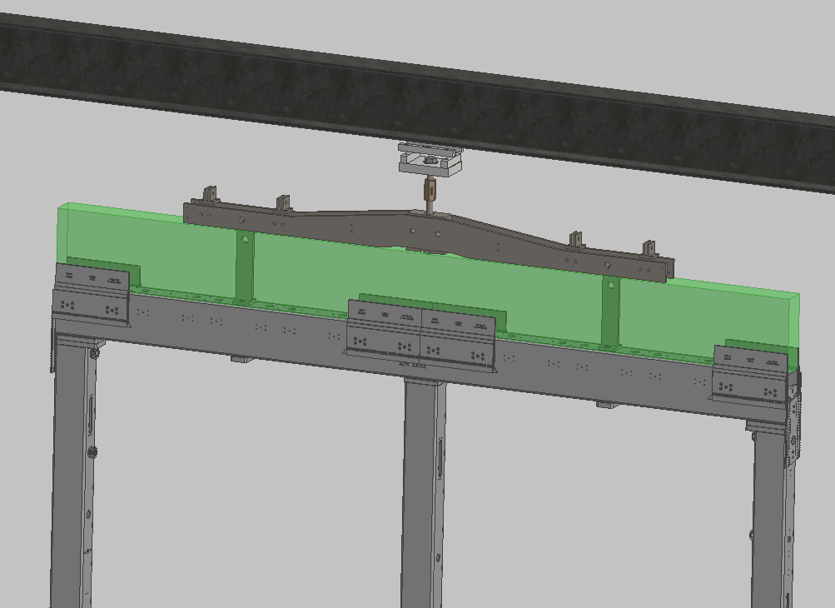
APA
APA will be supported the same way as in P-Dune – 2.30m spacing
The same trolleys will be used – need to evaluate removal with cable trays
During installation the APA will be supported at 2 points
In Final location the APA will be supported at the center using a similar connection as at P-Dune
DSS responsibility is trolley during installation and threaded rod at final position
See Appendix 1, Section 17 for strength Calculations
Need to incorporate Cable Trays/Cables into APA model to evaluate if it hangs straight, interferences, and access to trolleys and mounting

Slide 12
APA
Trolley
Threaded Rod

Slide 13
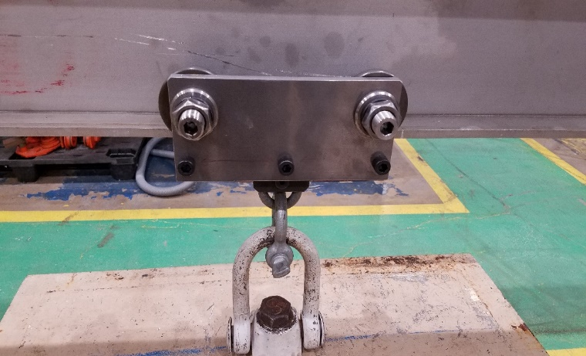
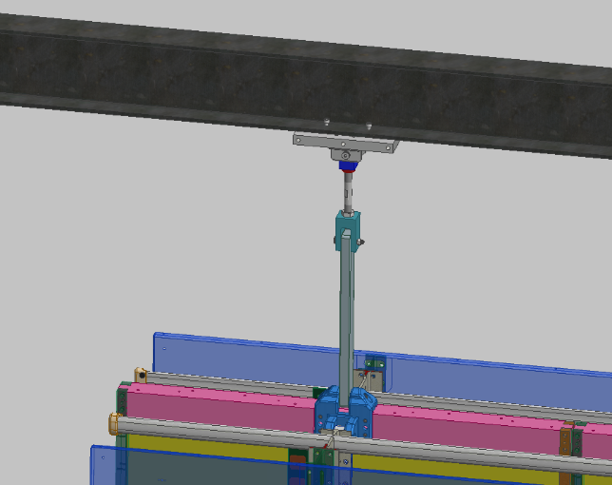
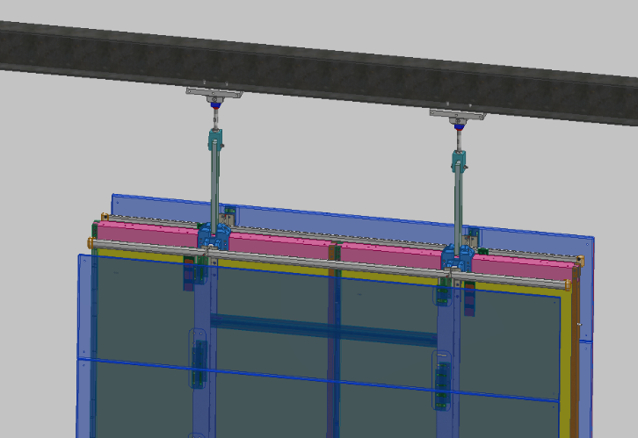
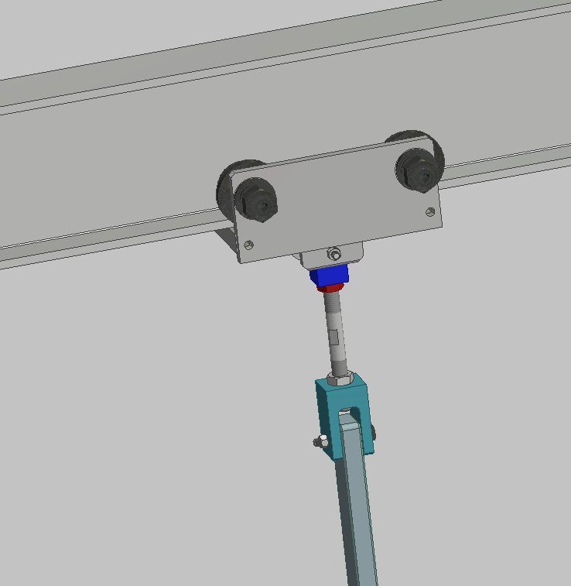
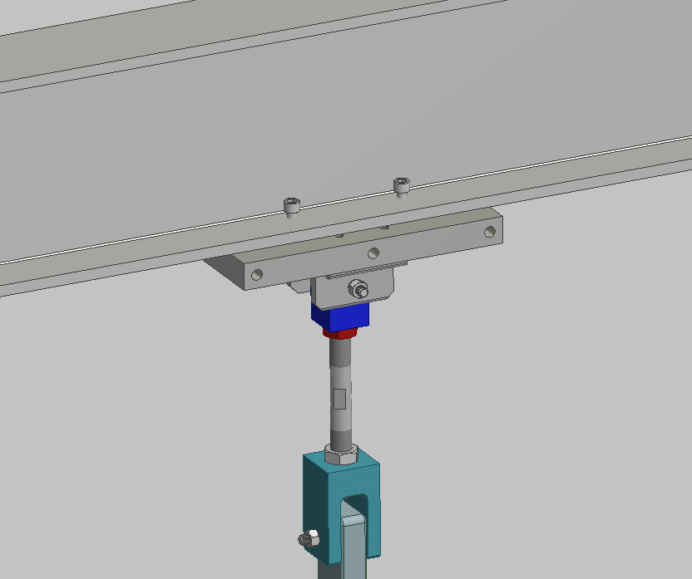
CPA
CPA panel supported at 1 point on a 1.15m pitchsimilar to P-Dune
Trolley used to install CPA and then wheels removed and trolley base bolted to DSS flange similar to P-Dune
DSS responsibility is the hardware above the FR4 strap
See Appendix 1, Section 14 for strength calculations
Prototype trolley has been fabricated and load tested
HV is evaluating GP increase

Slide 14
CPA
FR4 Strap

Slide 15
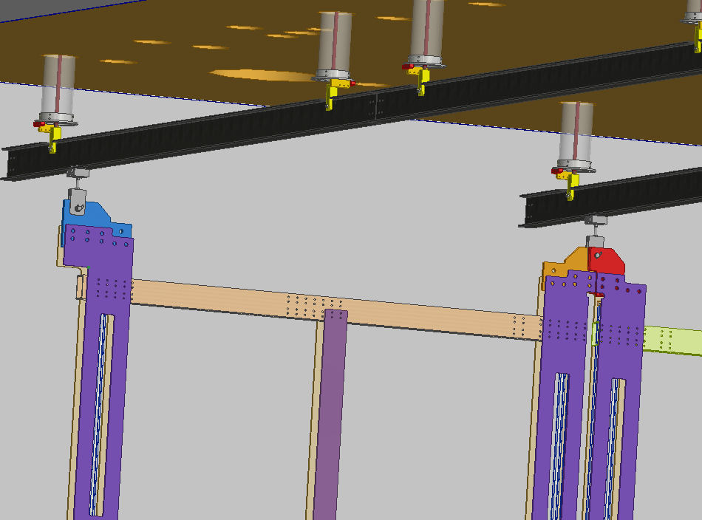
EndWall
EW supported similar to P-Dune
DSS responsibility is the hardware above the FR4 Plate on EW
EW will be installed in place using DSS as a support to raise EW – need to work out details
Pin is interface
EW installation is evolving

Slide 16
Next Steps
Need updated weights from detectors
Need to determine positional tolerance buildup for detectors
Need official APA model with electronic boxes/cable loops/cable trays
Need confirmation that height of detector is ok (clears TCO/cryo pipes/false floor)
Need to finalize crossing tube flange height and support
Need to design TCO beam supports
Interface to mezzanine needs to be clarified
Synergies between DSS installation and cryostat membrane installation need to be investigated

Slide 17
Conclusion
The interface to the APA/CPA/EW are defined and based on P-Dune
An integration model of the detector/DSS/Cryostat has been created to define interfaces.
Crossing tubes need to be designed
TCO beam support needs to be designed.

