Slide 1
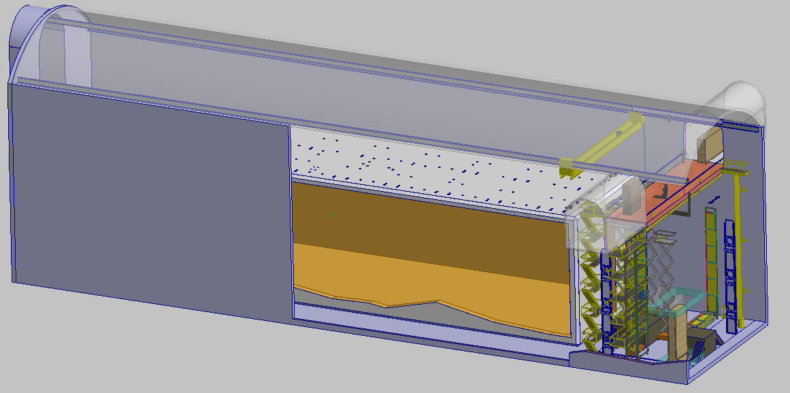
DUNE Far Detector DSS Procurement and QA
V. Guarino & R. Kmak August 20, 2018

Slide 2
Outline
Quality Assurance and Quality Control
Prototyping
Engineering Practices
Inspection and testing
Procurement

Slide 3
DSS Prototyping
A staged approach to the prototyping is planed for the DSS with the goal of having all the components fully tested and trials of all motions prior to construction.
Initial testing will be done with single components.
After component testing is complete a a full scale model of one small section of the DSS will be built and tested near ground level.
The DSS model will then be moved to Ash River and integrated with the installation model so full scale tests can be performed.
Tests at Ash River were critical to debugging the equipment prior to the start of the installation at CERN.

Slide 4
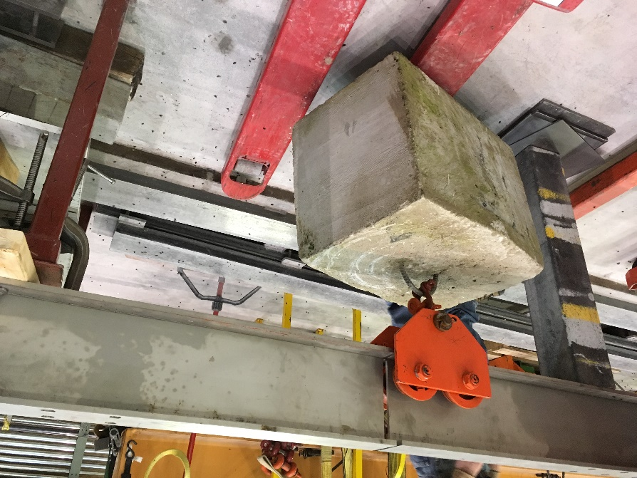
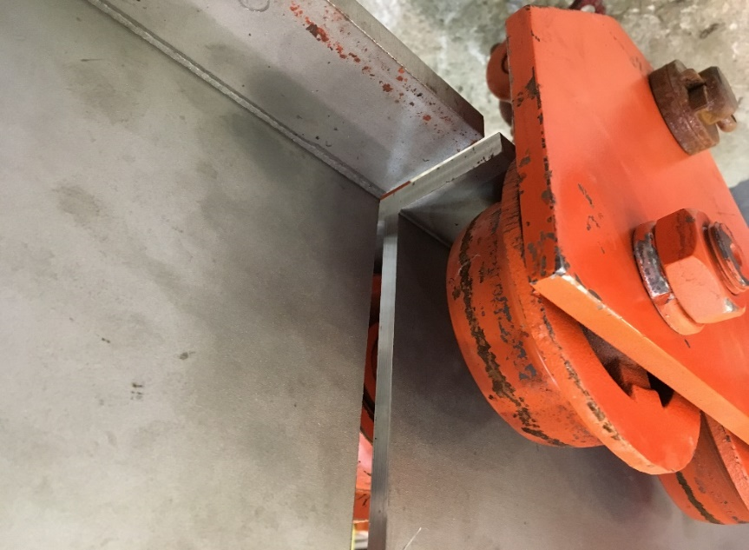
Small Scale Prototyping
Small scale prototyping is was performed at ANL to test the impact gaps between the I-Beams under simulated APA loads.
The force needed to pull the trolley under load was measured
No gap, 1/2” and 1” -> 8, 39, 69 pounds.
A 0.1” step required 70 pounds
Spice plates are being considered to align beams during installation.

Slide 5
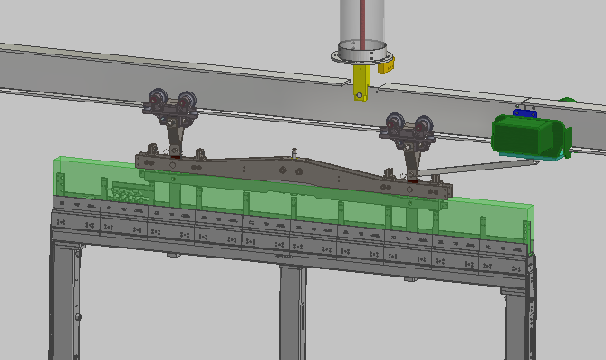
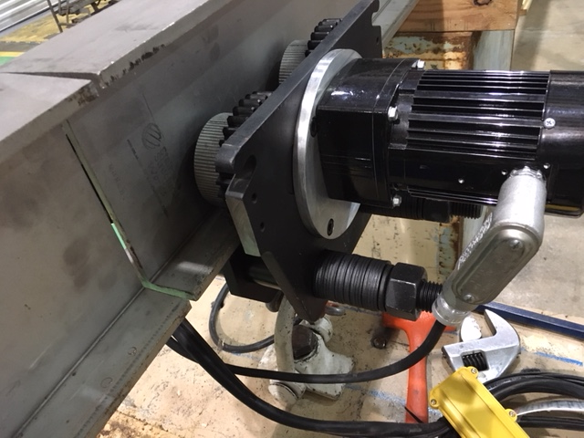
Small Scale Prototyping
Beam crawler
A commercial motorized trolley was purchased and tested at ANL on a short section of beam.
Initial tests indicated that the travel was faster then desired.
The drive to the trolley was modified to use a DC gear motor for better control
Concept
Test Trolley with DC motor Drive

Slide 6
Section Mockup – Near Ground
A ground level mockup of the switchyard and a DSS beam section will be built and tested at ANL.
3 sections for DSS I-Beam will be used and corresponding switches.
Will allow testing switchyard motion and trolley movement.
Allows debugging switchyard system.
Allows early evaluation of all safety related aspects of the design.
Mockup DSS rails
Switchyard

Slide 7
DSS prototyping and Ash River Test
The DSS prototype is then moved to Ash River and integrated in to the installation test setup.
The Ash River setup allows working with full scale APA and CPA units.
The work at height will be used to optimize the design.
DSS installation procedures will be evaluated.
The time for the motions can be benchmarked.
Ash River setup

Slide 8
DSS Engineering Model
To design the DSS it was necessary to develop an integrated model of the cryostat and detector. This integration model was also used to define the DSS interfaces to the cryostat and all the detector components.
The DSS design work is being done in Autodesk Inventor importing .stp files from the different interfaces.
No official repository of approved models exists so files were obtained from various sources.
The DSS design uses cryostat model from EDMS
https://edms.cern.ch/document/1834560/1 02.10.17
Models from the cavern were obtained from Jack Fowler
The HV models were already at ANL.
A 3-D model of the APA was not available
Several attempts were made to get a model but only a PPT with dimensions was made available. An APA model was generated from the pdf file.
This integrated model was then used to place the detector in the cryostat and fix the DSS dimensions.

Slide 9
DSS Drawings
For DUNE we do not have a process to officially approve, store and eventually revise drawings.
For ProtoDUNE this was a problem particularly to the smaller items like sensors, cameras not being included.
The ProtoDUNE floor design did not take into account the elevation of the Field Cage mounts so they could not be installed until after the floor was removed.
A drawing archive was generated at ANL and all drawings were then copied to DocDB .
No official drawing numbering scheme and title block is available so the ANL number was used.
Drawings will be updated and both paper and electronic versions available during procurement, QA at the ITF and for installation at DUNE.
Guidance on the drawing approval process would be helpful.

Slide 10
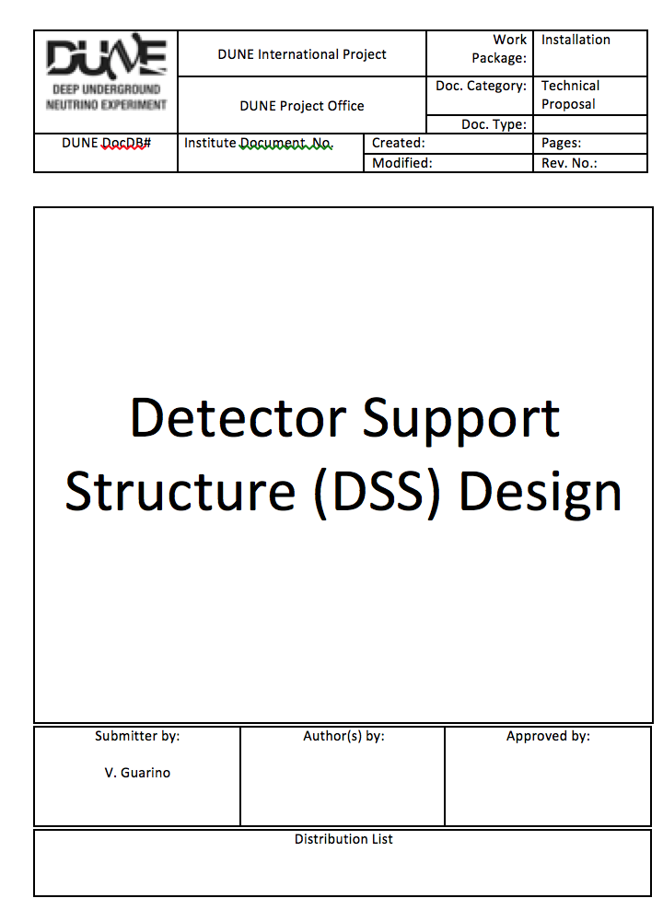
Engineering Document Control and Approval
No official mechanism is in place to review and approve engineering analysis notes.
This review plays a role but it is unclear if this body signs off on the analysis.
Guidance for official approval of the analysis is sought.
A template suitable for document management and approval was drafted with the engineering note.
An official template will be adopted when it is available.

Slide 11
Lessons Learned
Category | Issue Name | Problem/Success | Impact | Recommendation
DSS | Bridge beams | Sharp edges of the bridge beams inside the cryostat | You can cut your fingers or cut/damage cables | All the sharp edges were people are working or where cable work is done should be grinded
DSS | Installation | No procedure for moving runway beams into place | This was done by shear manpower with the scaffolding in place | A better mechanical means needs to be developed
DSS | Bridge beams trolleys | Very heavy and difficult to remove with a single person | Potentially hazardous to the TPC components if something dropped | -
DSS | Bridge beams trolleys | The bridge beam trolleys rolled extremely well | - | -
DSS | Packaging | PSL did a good job of cleaning and packaging all of it's components | Saved time searching for parts. Could have supplied more spare parts | -
DSS | Vibration isolation | This is an optional feature in the protoDUNE design | Adds complexity and cost to DSS | Remove this option if not needed
DSS | Survey during operation | Survey points of support rods is covered up with decking on cryostat roof | Probably not an issue for protoDUNE due to minimal roof deflections, but more of an issue for DUNE | Small floor opening for access for a survey extension tool
DSS | Bellows | Bellows can not be replaced after the detector is filled. It is somewhat vulnerable to stress when adjusting the support rod | Leak would allow argon to escape and impurities to get in | Consider a design that eliminates the bellows
DSS | Leak checking | Sealing the volume around the installed DSS was very difficult | Leaking around the temporary seal caused lots of false readings | Better method for sealing for leak checking is needed
DSS | Runway beam positioning | Beams were installed from scaffolding. Scaffolding posts prevented the rotation of the beams into position | Some beams were lifted over the scaffolding posts manually by a team of people | Ensure that beams can be placed on low profile carts and wheeled into position on the scaffolding without obstacles
DSS | Runway beam lifting | The plan was to lift the beams on the ends with a tripod. Install the center DSS support with a crane and connect at the center. Then repeat at the ends. This required too much coordination with the crane | All the DSS supports were installed. The beam was lifted with a tripod through available feedthroughs and was strapped 20cm below its final position. One end was lifted manually and connected and then the other | Use a tool that could lift and position the beam the last 20cm from the scaffolding or through available feed throughs
Lessons learned from ProtoDUNE-SP are documented and have been addressed.

Slide 12
Specifications- DSS beams & feedthroughs
The requirements and specifications on the DSS beams and feedthroughs will be approved prior to procurement.
During procurement the lead engineer will do site visits to verify the material certification, certificate of conformance, weld specification and qualification record to insure the quality of the product.
Specifications on the cleaning process and wrapping, shipping and packaging for deliver to the Integration and Testing Facility (ITF) will include site visits to the companies.
Guidance related to the approval process is requested.
A complete set of load tests will be completed and documented on the feed-through system

Slide 13
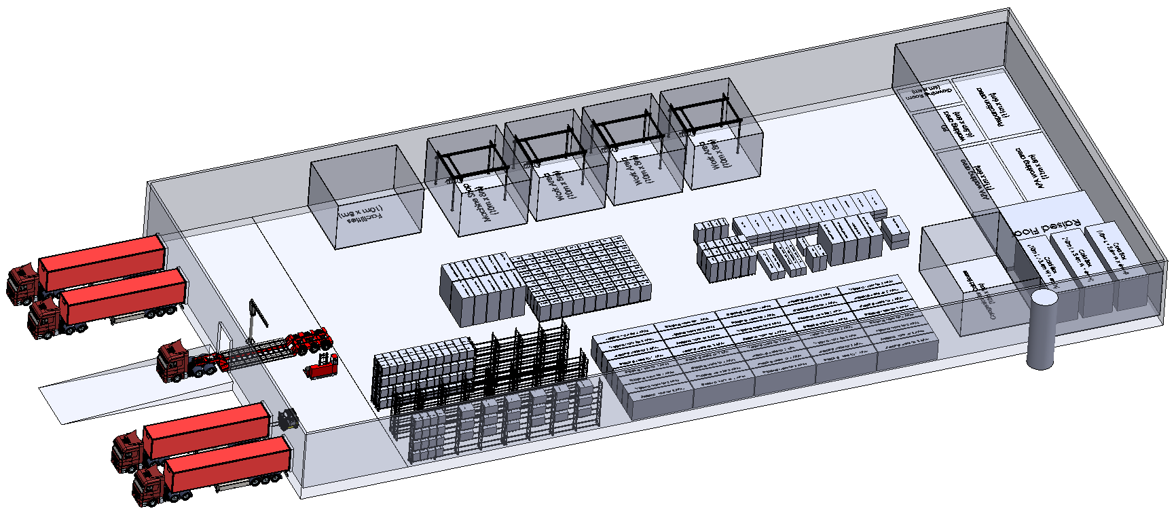
QC and Assembly at ITF
DSS cleanroom
A cleanroom with workstation crane is available at the ITF for DSS assembly and QC.
Class 100k or ISO-9
Pre-assembly of the feed-thru components is done at the ITF.
Checking dimensional tolerances.
Cleaning
Assembly
Leak testing
A special frame for transport underground is planned
The SS I-Beams are inspected and checked that they meet specifications for flatness, size and hole location this information for each beam is saved in the hardware database
All inspection and test data is stored in a data base.
Work has not yet started on drafting assembly testing procedures.

Slide 14
Inventory and QA Hardware Database
The University of Minnesota is working with the DUNE consortia and Technical Coordination to set up a universal Inventory and QA hardware database. This would be used to track the DSS components during the QA process and where the different parts end up in the completed detector. Planned features of this system include:
Ability to scan information using barcode/RF/engraved # (work in progress) so that the QA documentation can be viewed during the installation process.
The inventory system can be used to keep track of all the smaller misc. bolts, brackets, flange seals, etc. required for the installation

Slide 15
Procurement
We have started discussions with I-Beam vendors.
Quotes are in hand from two vendors.
Tolerance discussions
It is planned to approach vendors for the feedthus after this review.
Will approach vendors PSL used and others.
Will get cost information and also details on fabrication and QA
Will need to have detailed specifications and testing procedures prior to procurement but this will be developed in final design.

Slide 16
Backup

Slide 17
DSS QA Overview
A complete set of drawings for every part/assembly process will be made.
Detailed specifications for the DSS beams, feedthroughs that specify:
Material certification & Certificate of conformance
Weld specification and qualification record
Cleaning process, wrapping shipping and packaging
Inventory and QA records will be keep in the DUNE Hardware Database
On-site inspection by engineer during procurement
Assembly and QA on all components will be preformed at the Integration and Testing Facility, repackaged and shipped underground
Approved procedures for installation

