Slide 1
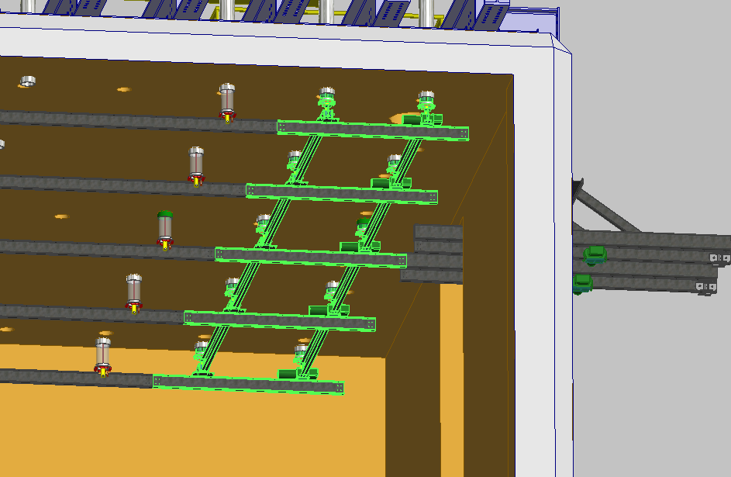

DUNE Far Detector
DSS Installation
V. Guarino & R. Kmak
August 20, 2018

Slide 2
DUNE Far Detector
Installation Sequence Overview
Pallet with 6 feedthroughs delivered to top of bridge
Assume top of cryostat is floored over so that pallet jack can deliver feedthroughs to each crossing tube
Gantry or tripod used to place feedthroughs
Clevis ends are surveyed and adjusted to rough position
Beams are delivered to bridge in crates of 4 and lowered to 4910.
Single beams are inserted through TCO. Assume false floor is in place and cart can be used to wheel beam to correct location.
Beams are raised using winch and cable through feedthrough and attached to clevis
Beams are surveyed and adjusted as needed

Slide 3
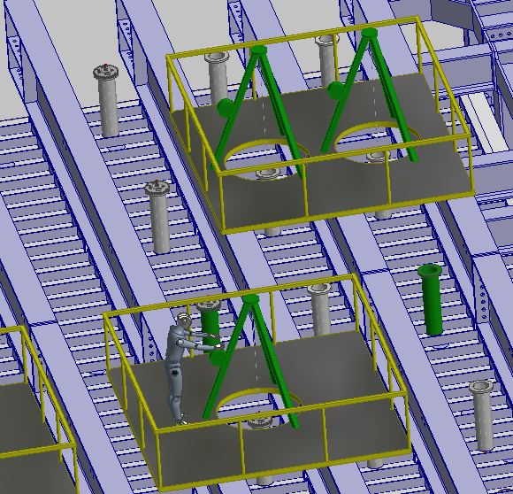
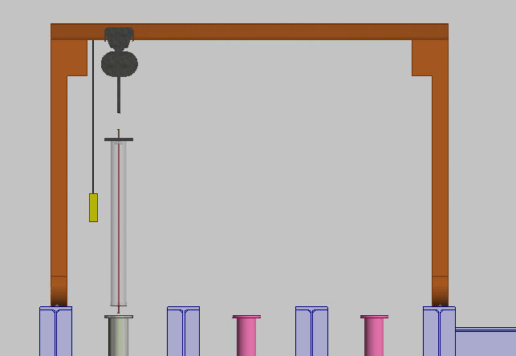
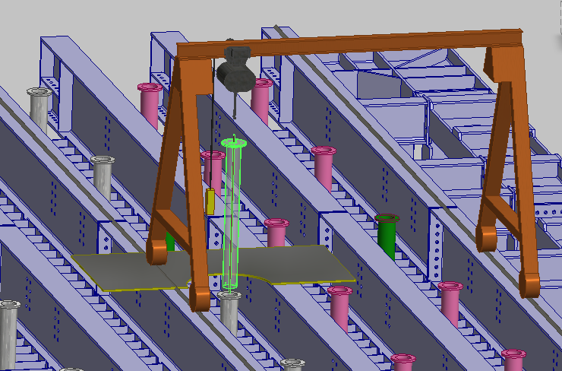

DUNE Far Detector
Installing Feedthroughs
A working surface is assumed.
Feedthroughs delivered by pallet jacks to crossing tubes
Gantry used to raise and install feedthroughs
Current crossing tube height is to high to install under mezzanine.

Slide 4
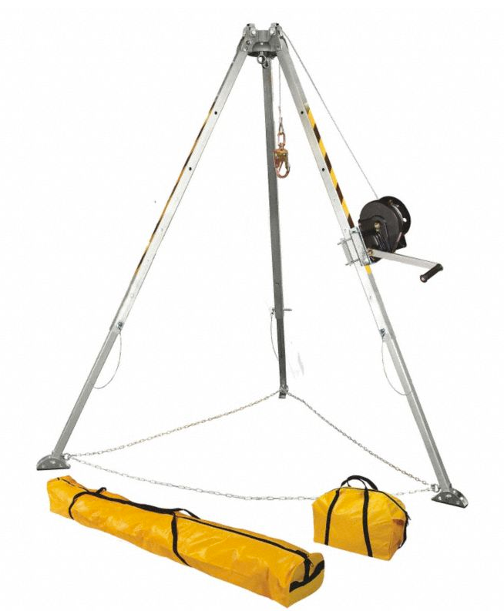
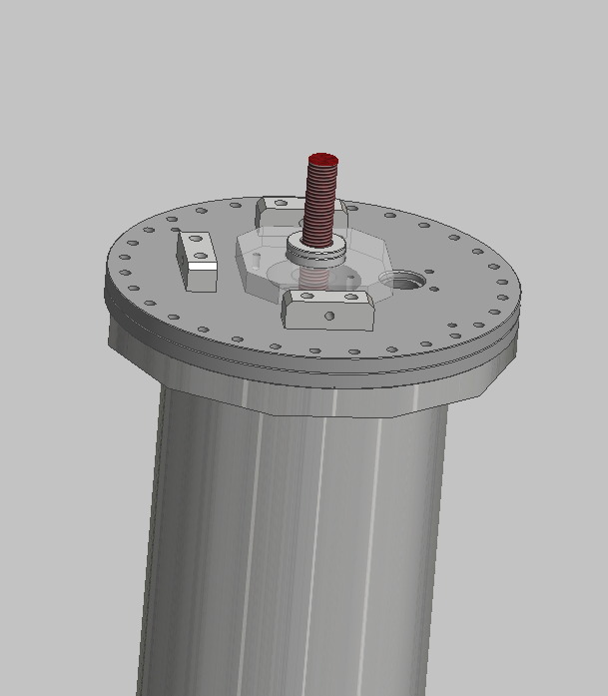
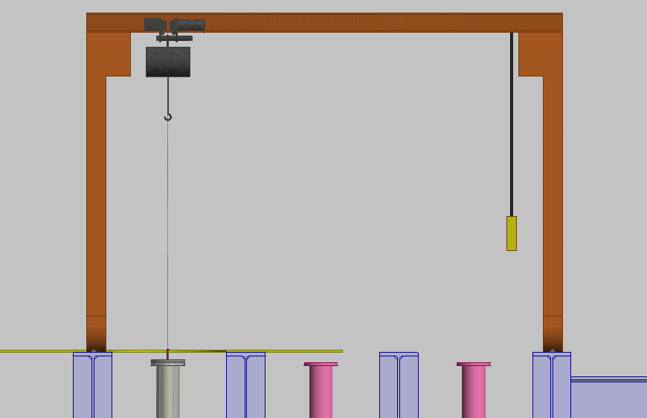
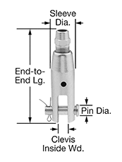
DUNE Far Detector
Raising Beam
Hanger Rod
DSS Hanger
Cable
Access Hole
Cryostat Crossing Tube
Motorized winch on a tripod system or gantry will be used to install feedthrough
Wire Rope Lift Fitting
McMaster-Carr #3473T211
Ø1/4” Rope
1,300 lb capacity

Slide 5
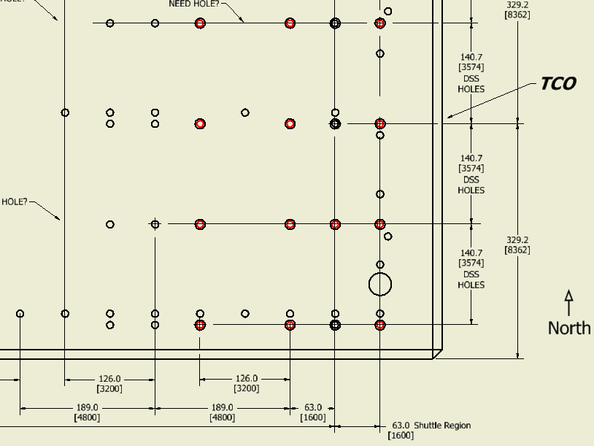
DUNE Far Detector
Feedthru Location – Upper Cryostat

Slide 6
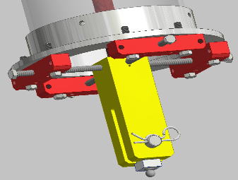
Survey and Leak Testing
After installation the clevis ends will be surveyed and adjusted as needed
A “cup” with O-ring seal will be placed over feedthrough end for leak testing

Slide 7
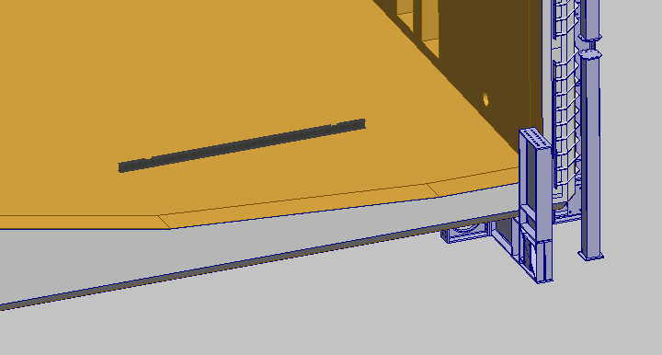
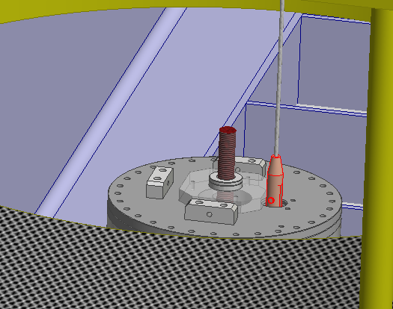
DUNE Far Detector
DSS Beam Lifting Procedure
DSS Beam (est 370 lb)
placed on floor of Cryostat
Assume a false floor that allows the beam to be moved around on a cart.
Beam will be shipped clean and wrapped. Wrapping removed in cleanroom before installation in cryostat.
Wire rope fitting is fed down thru the DSS Hanger Flange.
Hanger rod is in place, not under load.

Slide 8
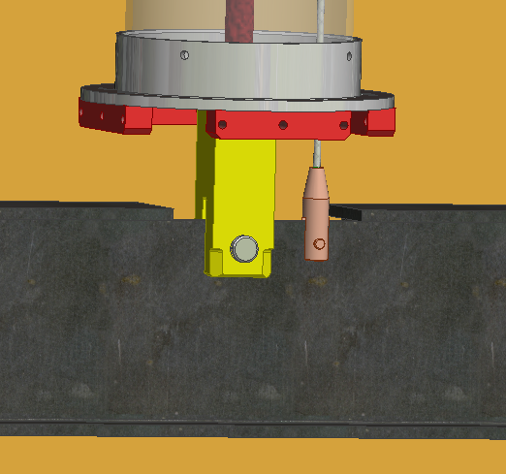
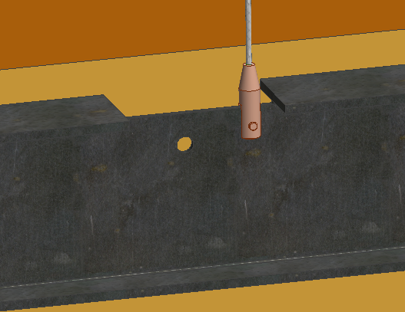
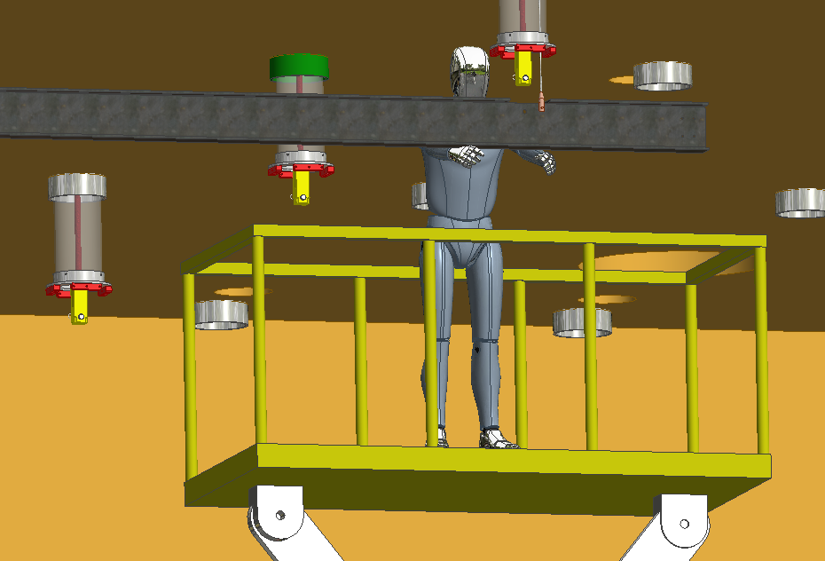
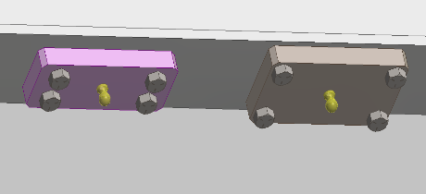
DUNE Far Detector
DSS Beam Lifting Procedure
Wire Rope Fitting
attached to I-Beam
(Cryostat floor)
Beam hoisted into position…
…and secured to
DSS Hanger Clevis
After mounting beam surveyed and position adjusted

Slide 9
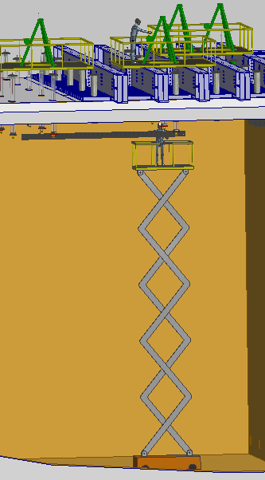
DUNE Far Detector

Slide 10
Conclusion
The DSS design has incorporated features to facilitate installation.
A feasible installation concept has been developed

