Slide 1
Detector Support System Cost estimate at Conceptual Design
Jim Stewart
DUNE CDR: DSS Review
August 20 2018
INDICO Agenda
https://indico.fnal.gov/event/17719/other-view?view=standard

Slide 2
Content
Methodology for the Cost Estimate
Overview of the Scope
Estimate Details
  Support Feedthrus
  I-Beam supports
  Switchyard
  Production Costs
  Installation Costs

Slide 3
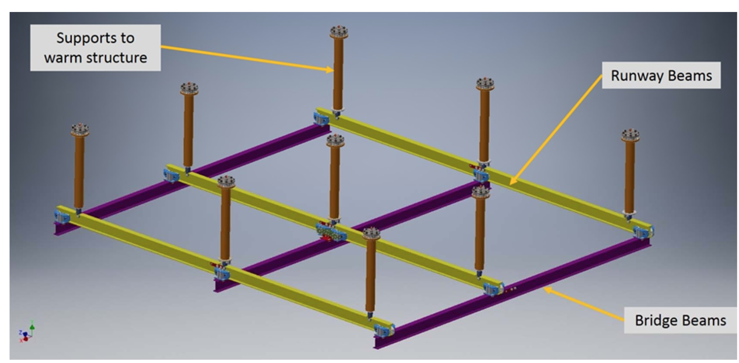
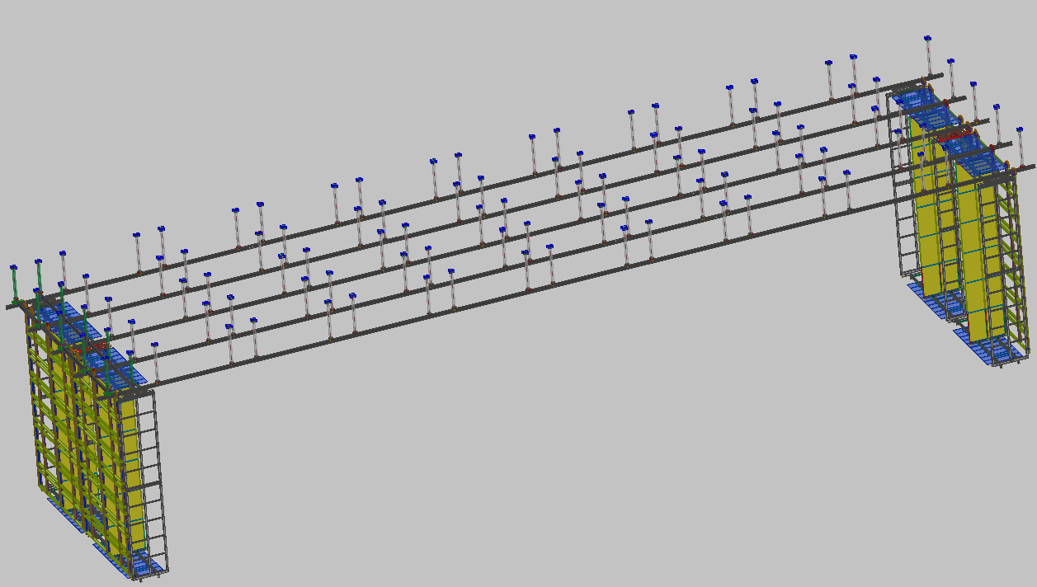
ProtoDUNE-SP and DUNE-SP
The ProtoDUNE-SP DSS has many features in common with the DUNE-SP DSS but also many differences.
  Common: Same type I-Beam, similar load requirements, cryostat roof interface, cleanliness requirements, alignment tolerance.
  Differences: DUNE has a switchyard, detector height is different, thermal expansion mitigation is different, ProtoDUNE had bridge and runway beams DUNE has only bridge beams, DUNE is bigger.

Slide 4
Methodology used for cost estimating
A cost estimate was generated prior to this conceptual design review based, where possible, on actual cost numbers from ProtoDUNE-SP. I felt that the actual purchase cost of the ProtoDUNE-SP components was more reliable than estimates of components where the design is still evolving.
  The purchase costs for the ProtoDUNE-SP components were collected.
  The costs were then scaled by the number of feedthrus or the number of pounds of fabricated I-Beams.
Activities and equipment where there was not equivalent at ProtoDUNE were estimated based on engineer evaluation.
  Examples: Installation, assembly QA, I-Beam crawler

Slide 5
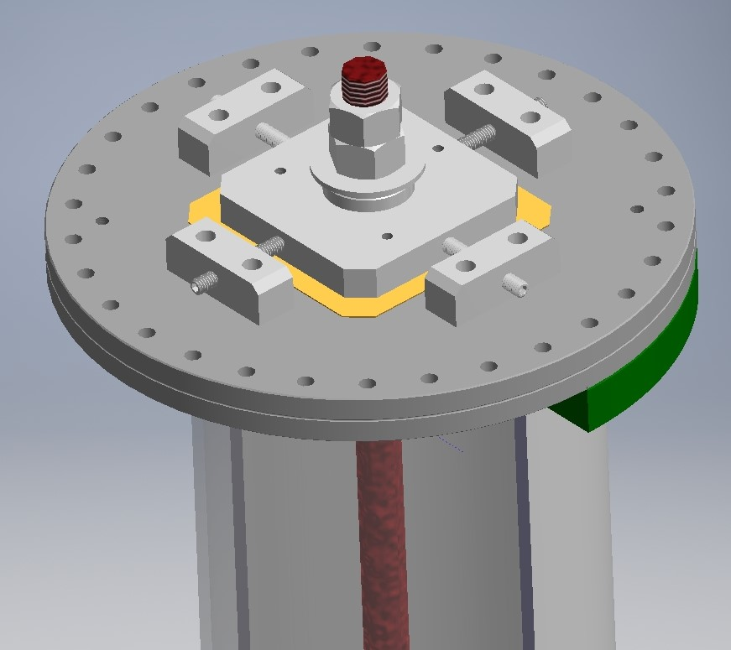
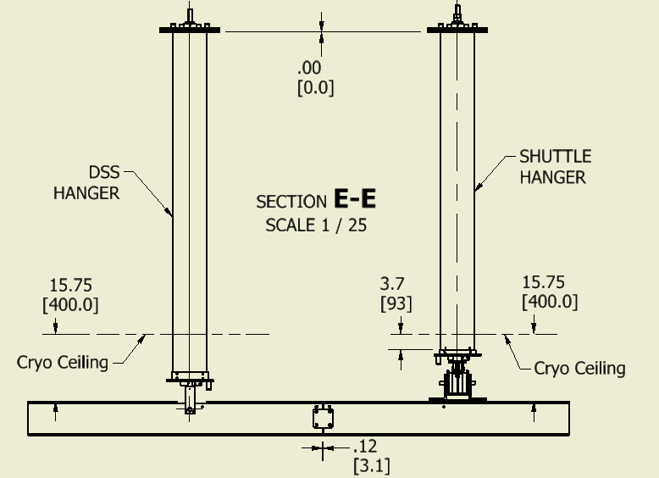
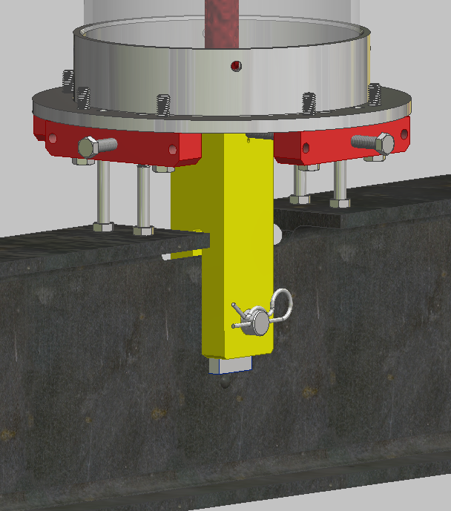
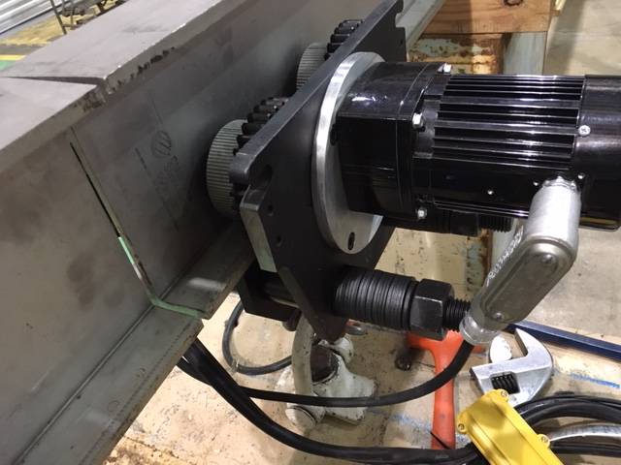
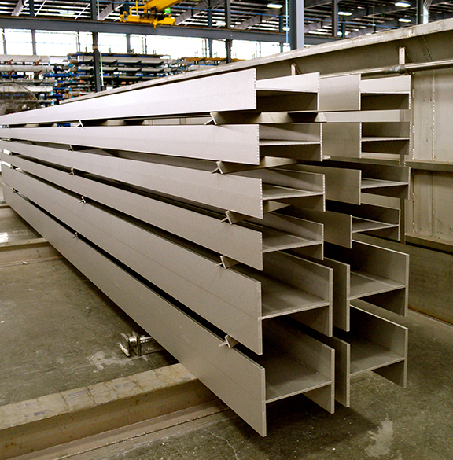
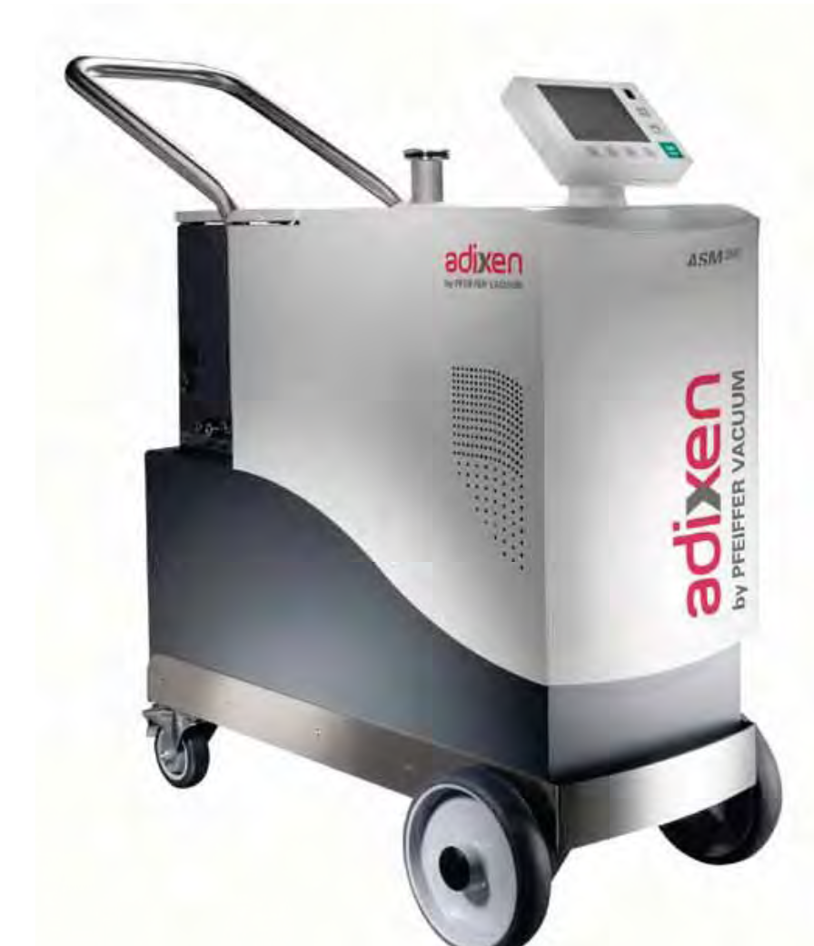
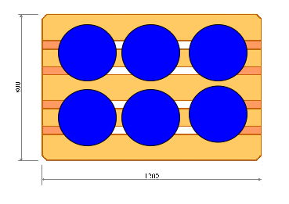
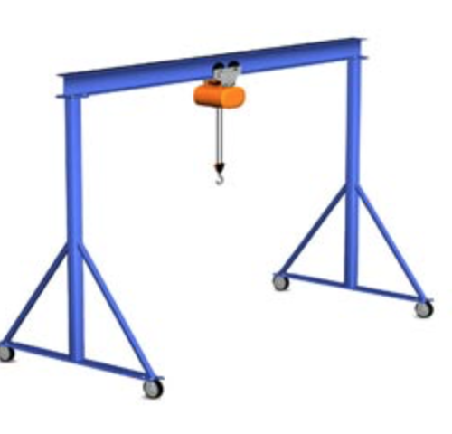
DSS Scope
100+5 DSS Supports
Machined S8x18.4 laser fused I-Beams
  45 detector support beams
  25 switchyard beams
Miscellaneous components
  Trollies, crawlers, I-Beam couplers, switch hardware, end-wall support blocks
Installation tools underground
Assembly and testing equipment with shipping crates.

Slide 6
Assumptions used to estimate
It is assumed that some progress will be made before April but that the preparations for the TDR and various reviews till take a majority of the time. This implies significant engineering and design needs to be done after next April.
It is assumed that the assembly and testing can be done at the ITF in parallel to other work. No cost is included for the cleanroom for the assembly or the cleanroom outfitting as this is included in the ITF cost.
  Includes all QA for I-Beams, DSS supports, switchyard components etc.
It is assumed that an efficiency factor of 0.7 is applied for underground work.
Work at SURF will be done in 10hr shifts to reduce the impact of non-productive time (getting underground, cleanroom gowning, safety meeting)
With the present labor estimate the installation can probably be done in 1 shift.

Slide 7
Top Level Schedule
April 2019 to Jan 2022 is available for Post-TDR design effort.
One year is assumed to purchase all the components assemble and test them.
DSS will be installed in ~2 months early 2023
  DSS is critical path so we will want to be working in more than one location

Slide 8
Cost Estimate
The cost estimate was generated so the data can be easily used for the DUNE Neutrino Cost committee review. This meant that the design costs were estimated in a separate spreadsheet from the production and installation spreadsheet.
Only the costs after the TDR submittal in April were estimated.
Materials costs were estimated as direct costs so no overheads or escalation are applies.
Labor hours by skill set are estimated but no cost is derived from this.
Contingency was computed, but it is unclear if it will be used.
The cost estimate is stored in DocDB 9453
  BOE 2.1.3 Design xlsx
  BOE 2.1.4.1 DSS Production xlsx

Slide 9
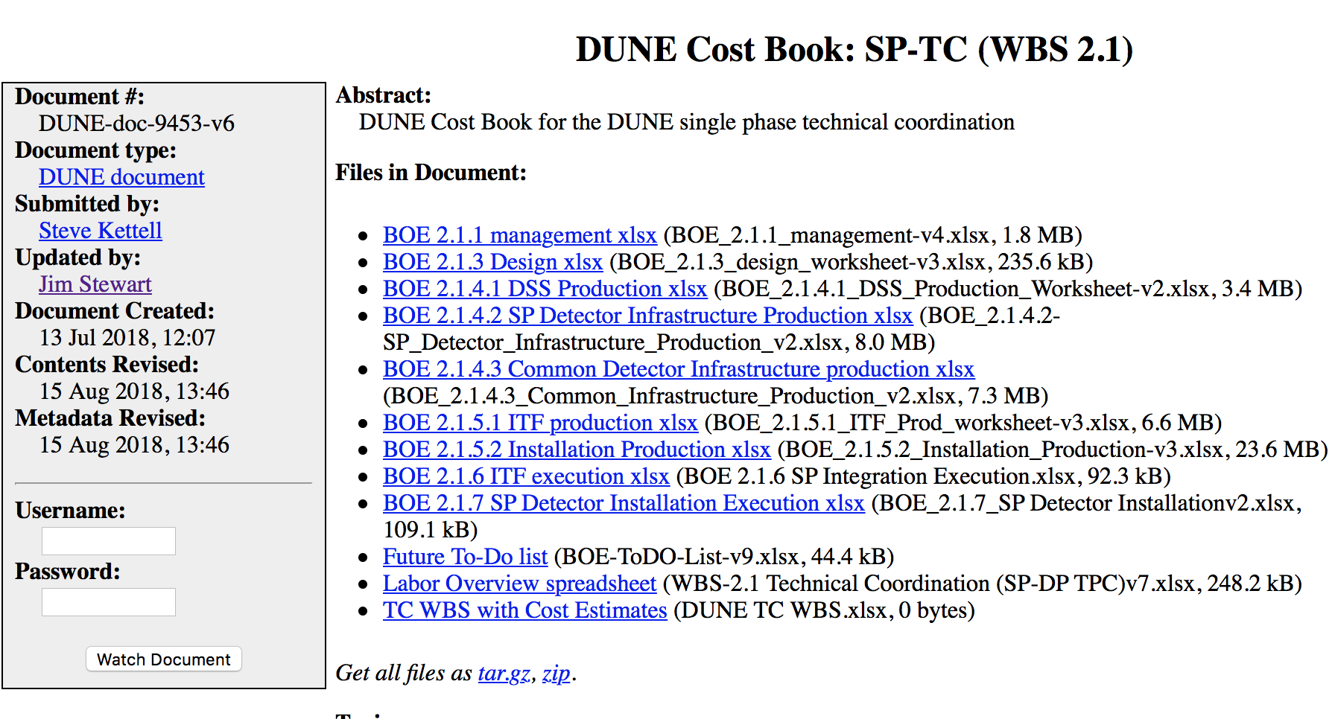
Cost files on DocDB

Slide 10
Design Cost Estimate
Design spreadsheet has only one line for DSS design cost
Roughly 6 mo of Engineer and designer with a small amount of technician time have been needed to bring the design to the present status.
Extrapolating from this 12 months of engineer and designer will be needed to finish the design.
Final design will include: 3-D model, all approved 2-D drawings with tolerances, QA plan and testing procedures, bid packages for all high value items, detailed installation plan with procedures.
Description of the prototype ($50k + 3mo tech) is on the next slide.

Slide 11
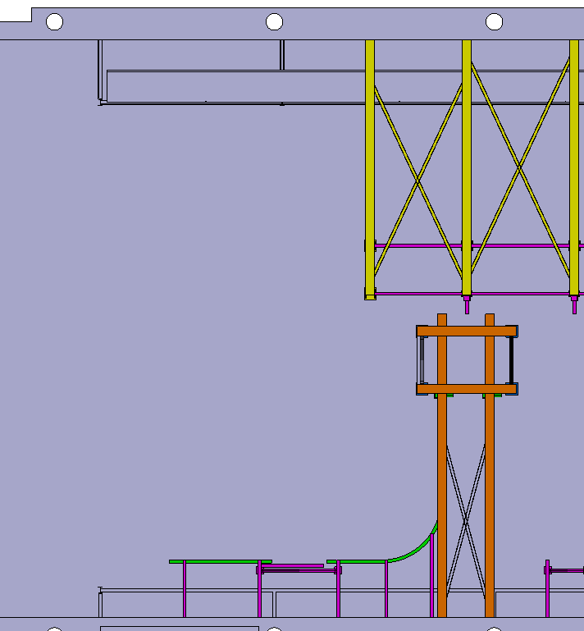
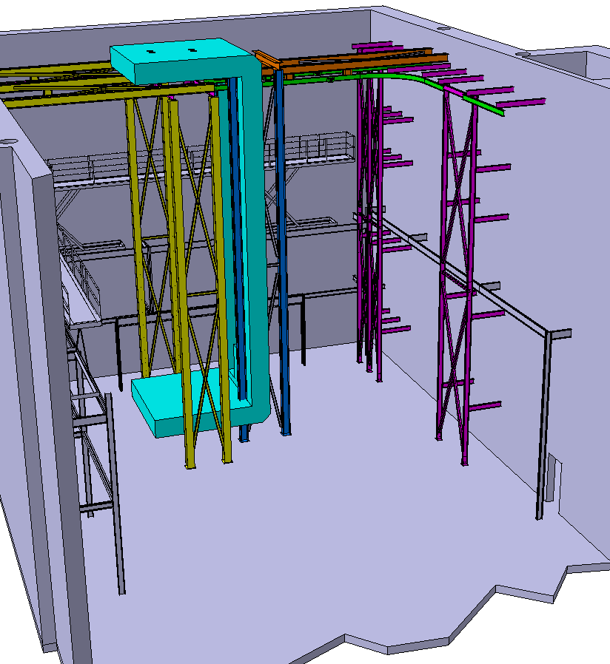
DSS prototyping and Ash River Test
A small prototype of the switchyard and rails will be constructed at ANL to de-bug the switches and insure the safety aspects are understood. This will be build close to the ground and all motions with full loads will be tested.
When successful this will be transported to ash river where it will form part of a larger installation test.
Mockup DSS rails
Mockup Switchyard
TCO Beams
Ash River setup

Slide 12
DSS Production Cost
The basis of estimate workbook is divided into a summary tab and 5 sub categories.
  Summary
  DSS Production
  Support M&S
  I-Beam M&S
  Misc. M&S
  DSS Installation
The estimates for the support feedthrus, the I-Beams, and the miscellaneous equipment are for M&S only.
DSS Production covers the labor estimate to produce the DSS and all the equipment related to the production and testing.
DSS installation covers the labor for the DSS installation

Slide 13
Summary of M&S direct cost
Material costs | M&S Direct Cost | AVG Contingency | Cost with Contingency
DSS Production | $92,226 | 26% | $116,585
Support M&S | $1,002,566 | 20% | $1,203,080
I-Beam M&S | $127,187 | 20% | $152,625
Misc. M&S | $284,832 | 25% | $357,167
DSS Installation
Total M&S | $1,414,586 | 21% | $1,712,872
The materials cost is dominated by the 105 support feedthrus

Slide 14
Support Feedthru Cost
The cost is computed by calculating the unit cost of the ProtoDUNE-SP feedthru and then scaling to the 105 DUNE-SP feedthru
The BOM for the used and the cost for each significant part was documented based on the actual purchase
I had to estimate the cost of one support plate -> 2k
The cost per feedthru was $9548
Scaling with the total number of feedthrus of 105 gives the total cost.
Total = $1,002,566

Slide 15
I-Beam Cost
The quote PSL had for the I-Beams gave a cost per pound for the fabricated S-8 x 18.4 laser fused I-Beams
  Cost per pound = $6.40
  The beams weigh 18 lb per ft
The cost per beam is then calculated from the length of beams from the model.
Part Description | Beam length m | Beam length ft. | Beam weight lb./ft. | Unit Cost $/lb. | Number of Beams | Cost per I-Beam | Cost per detector
APA/CPA support beams S8x18.4 | 6.4 | 20.9984 | 18 | 6.4 | 45 | $2,419 | $108,856
Switchyard Shuttle beams S8x18.4 | 2.3 | 7.5463 | 18 | 6.4 | 5 | $869 | $4,347
Switchyard runway beams | 3.5 | 11.4835 | 18 | 6.4 | 10 | $1,323 | $13,229
Switchyard shuttle support stubs | 0.2 | 0.6562 | 18 | 6.4 | 10 | $76 | $756
 |  |  |  | I-Beam Total Cost |  |  | $127,187
More recent quotes confirm these estimates.

Slide 16
Cost of miscellaneous items
Part Description | Unit Cost | Quantity | Cost per detector | Contingency | Contingency Cost
TCO transfer rail |  |  | $8,500 | 30% | $11,050
Trollies | $885 | 8 | $7,080 | 25% | $8,850
Beam Crawlers | $3,700 | 8 | $29,600 | 25% | $37,000
Switchyard locks and controls |  |  | $15,000 | 25% | $18,750
Rail to CPA coupler | $335 | 100 | $50,000 | 25% | $62,500
Rail to APA coupler | $335 | 75 | $50,000 | 25% | $62,500
Tools to install the feedthrus |  |  | $3,500 | 30% | $4,550
Tools to install the DSS Beams |  |  | $8,500 | 30% | $11,050
Endwall support blocks | $2,500 | 16 | $40,000 | 40% | $56,000
Survey targets |  |  | $800 | 10% | $880
DSS installation tool | $50,000 | 1 | $50,000 | 20% | $60,000
Gantry Crane - assembly | $1,911 | 2 | $3,822 | 10% | $4,204
Curtained cleanroom | $9,015 | 2 | $18,030 | 10% | $19,833
 |  | Total | $284,832 | 25% | $357,167
Estimates are a mix of experience from ProtoDUNE, Engineering estimate, and Quotes

Slide 17
Production equipment
Component | Manufacturer | Part Number | quantity | unit cost | cost
leak detector | Pfeiffer | ASM 380 | 1 | $50,000 | $50,000
Tooling for acceptance testing |  |  |  |  | $10,000
Vacuum Vessel to test support feedthrus |  |  | 1 | $5,000 | $5,000
Shipping/storage rigs for the feedthrus |  |  | 17 | $500 | $8,500
Al Pallets | Uline | H-4062 | 20 | $309 | $6,180
Shipping crates for the I-Beams |  |  | 12 | $1,000 | $12,000
Company Site visits |  |  | 0 | $2,000 | $0
Work Benches | McMaster Carr |  | 3 | $182 | $546
Ultrasonic cleaner |  |  | 1 |  | $24,000
Shrink-wrap and dispenser | Amazon |  | 1 | $300 | $300
 |  |  |  | Total | $92,226
Evacuate 1 m^3 in few minutes
Quote
Quote
Web search -will be custom
Material needed to assemble test and ship the feedthrus underground

Slide 18
Labor Estimate Production
1760hr = 1FTE yr
During the year where all the parts are ordered assembled, tested, and prepared for shipment underground ½ FTE of engineering is budgeted.
Technician activities are:
Component | Action | hours | Number of units | Productive hours
DSS I-Beams | Acceptance Testing | 1 | 70 | 70
DSS Support Feedthrus | Component acceptance testing | 1 | 105 | 105
DSS Support Feedthrus | Cleaning, Assembly and testing, bagging | 12 | 105 | 1260
Assemble Support storage shipping racks | Assembly | 2 | 18 | 36
Crate I-Beams for transport | Crate Assembly | 8 | 12 | 96
Assemble gantry crane and assembly area for support feed thru assembly | Crane Assembly | 20 | 1 | 20
DSS support installation tool | Construct and test | 100 | 1 | 100
Acceptance testing of Misc. Parts | Acceptance Testing | 100 | 1 | 100
 |  |  | Total | 1787
1 FTE of technician

Slide 19
Installation Labor
Efficiency factor accounts for time getting underground, gowning, breaks, lunch …
 |  | Hours per Unit |  | Total Productive Hours |  |  | Total Hours
Task | Unit | Eng. Hours | Tech Hours | Eng. Hours | Tech Hours | Efficiency Factor | Eng. Hours | Tech Hours
Locate feedthroughs on cryostat | 100 | 0.5 | 2 | 50 | 200 | 0.7 | 71 | 286
Bolt feedthrough flange/align | 100 |  | 1 | 0 | 100 | 0.7 | 0 | 143
Leak Testing | 100 |  | 1 |  | 100 | 0.7 | 0 | 143
Move I-beams into cryostat | 50 | 0.5 | 2.5 | 25 | 125 | 0.7 | 36 | 179
Setup tripod/gantry and beam lifting cable | 50 | 0.5 | 5 | 25 | 250 | 0.7 | 36 | 357
Lift beam and attach to clevis | 50 | 0.5 | 8 | 25 | 400 | 0.7 | 36 | 571
Align and Fix Beam | 50 | 1 | 8 | 50 | 400 | 0.7 | 71 | 571
Survey and Adjust position |  |  |  |  |  | 0.7
Move N-S Shuttle support beams into cryostat | 10 |  | 2 | 0 | 20 | 0.7 | 0 | 29
Setup tripod and lifting cable for shuttle beam | 10 | 0.5 | 5 | 5 | 50 | 0.7 | 7 | 71
Lift and mount shuttle support beams | 10 | 0.5 | 8 | 5 | 80 | 0.7 | 7 | 114
Align Shuttle support beams | 10 | 0.5 | 4 | 5 | 40 | 0.7 | 7 | 57
Mount shuttle beams | 5 | 1 | 8 | 5 | 40 | 0.7 | 7 | 57
Mount shuttle beam electric and controls | 1 | 10 | 120 | 10 | 120 | 0.7 | 14 | 171
Total |  |  |  | 205 | 1925 |  | 293 | 2750
9 technicians working 2 months for the installation of 100 support feedthru and 70 I-Beam sections.
One full time engineer overseeing the work
Not shown but also 6 surveyors working one shift during this period.

Slide 20
Summary of M&S direct cost
Material costs | M&S Direct Cost | AVG Contingency | Cost with Contingency
DSS Production | $92,226 | 26% | $116,585
Support M&S | $1,002,566 | 20% | $1,203,080
I-Beam M&S | $127,187 | 20% | $152,625
Misc. M&S | $284,832 | 25% | $357,167
DSS Installation
Total M&S | $1,414,586 | 21% | $1,712,872
The materials cost is dominated by the 105 support feedthrus

Slide 21
Next steps
When the drawings are sufficiently advanced we will seek quotes based on the DUNE drawings.
  Quotes will be at the part level.
Assembly, testing, and installation procedures need developed in detail.
  When the procedures are in draft form the labor estimate needs to be revised.
Design work on tooling is needed to refine these costs.
Need to understand the cryostat installation plan to see if we can optimize the joint installation.
  Will the cryostat have scaffolding in place that would simplify the DSS installation?
  Can we install the support feedthru before the cryostat installation is finished?

Slide 22
Summary
The material costs are reasonably well understood for this stage of the design thanks to the detailed information from ProtoDUNE-SP.
A first pass over the labor estimate is complete.
  Input from this committee is greatly appreciated.
It is planned to revise the cost estimate based on DUNE-SP drawings after this review is complete.

