Slide 1
TrajCluster Restructuring
Tingjun Yang and Bruce Baller
LArSoft Coordination Meeting
Jul 31, 2018

Slide 2
Introduction
Bruce and I have been working to change the way TrajCluster reconstructs events.
By default, TrajCluster loops over all hits in each event to reconstruct 2D clusters, which are then matched to create PFParticles. It also produces 2D and 3D vertices.
3D matching step can be slow for busy events (cosmic events, big showers, etc.)
In the new approach, we slice event based on proximity of the 3D spacepoints and then run TrajCluster on each slice.
Each slice can be a cosmic ray muon, a neutrino interaction or a beam particle interaction
Take advantage of 3D (spacepoints) information to slice event and examine details using 2D (hits) information

Slide 3
3D Slicing
Run SpacePointSolver to reconstruct 3D spacepoints using hits as input.
Run a new 3D DB (density-based) scan algorithm to cluster 3D spacepoints.
Create a new data product recob::Slice to save the hits in each 3D cluster.
Similar algorithms exist in Pandora, WireCell, Cluster3D.

Slide 4
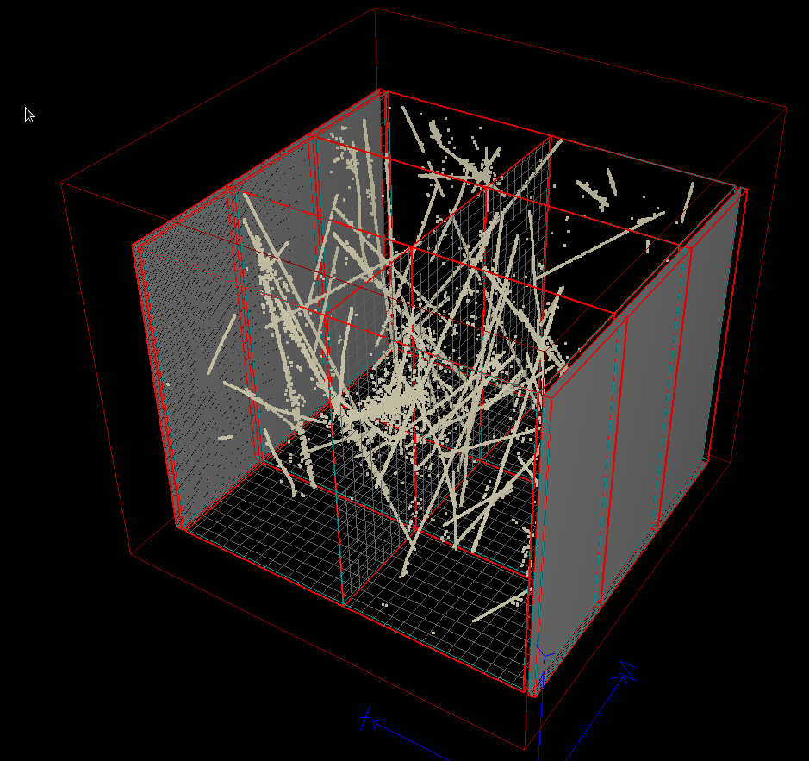
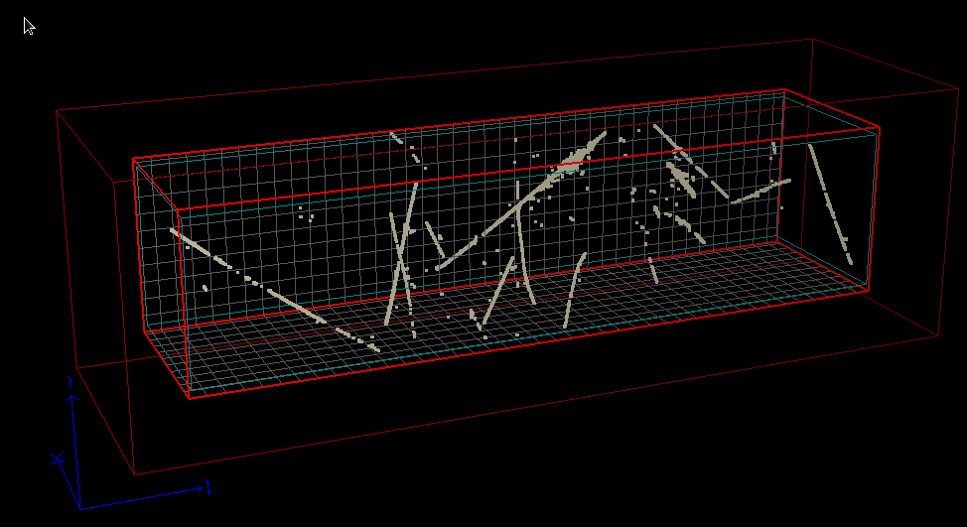
SpacePointSolver
Algorithm created by Chris Backhouse
https://indico.fnal.gov/event/15173/contribution/2/material/slides/1.pdf
Create spacepoints from hits. Use regularization to reduce fake spacepoints.
MicroBooNE
ProtoDUNE

Slide 5
DBCluster3D
larreco/RecoAlg/DBScan3DAlg.h(.cxx)
Copyright 2015 Gagarine Yaikhom (MIT License)
https://github.com/gyaikhom/dbscan
Two FHiCL parameters:
float epsilon; // distance to neighbors
unsigned int minpts; // the minimum number of points required to form a dense region
larreco/ClusterFinder/DBCluster3D_module.cc
A module to use spacepoints as input and run DBScan3DAlg to form 3D clusters
Output: recob::Slice

Slide 6
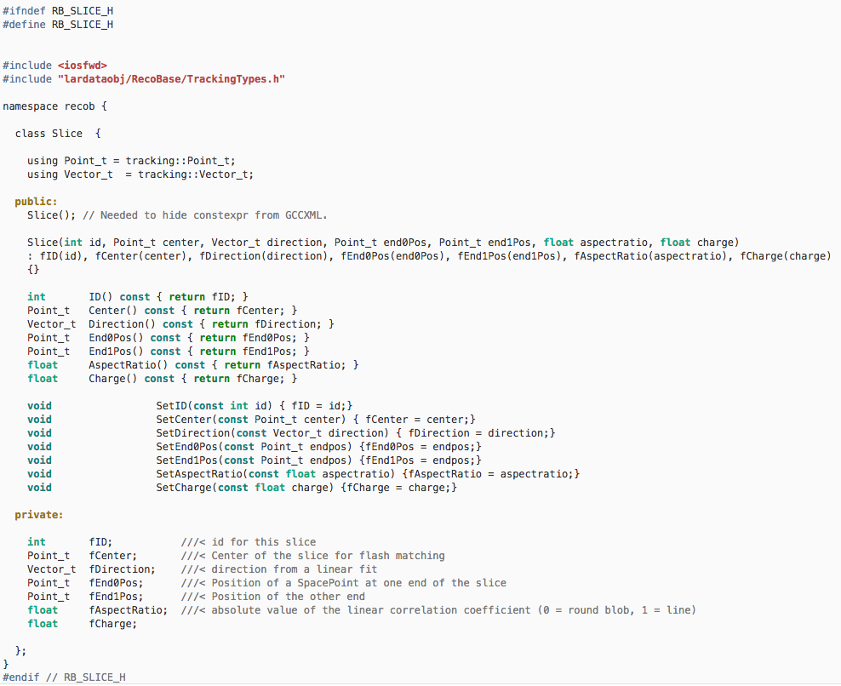
New data product: recob::Slice
Also associations between recob::Slice and recob::Hit

Slide 7
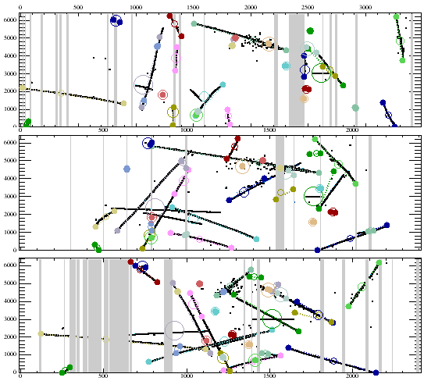
Display slices
Bruce updated lareventdisplay to support recob::Slice
slice
DrawSlices: 2
DrawSlices: 3
Each color represents one slice in 3 views

Slide 8
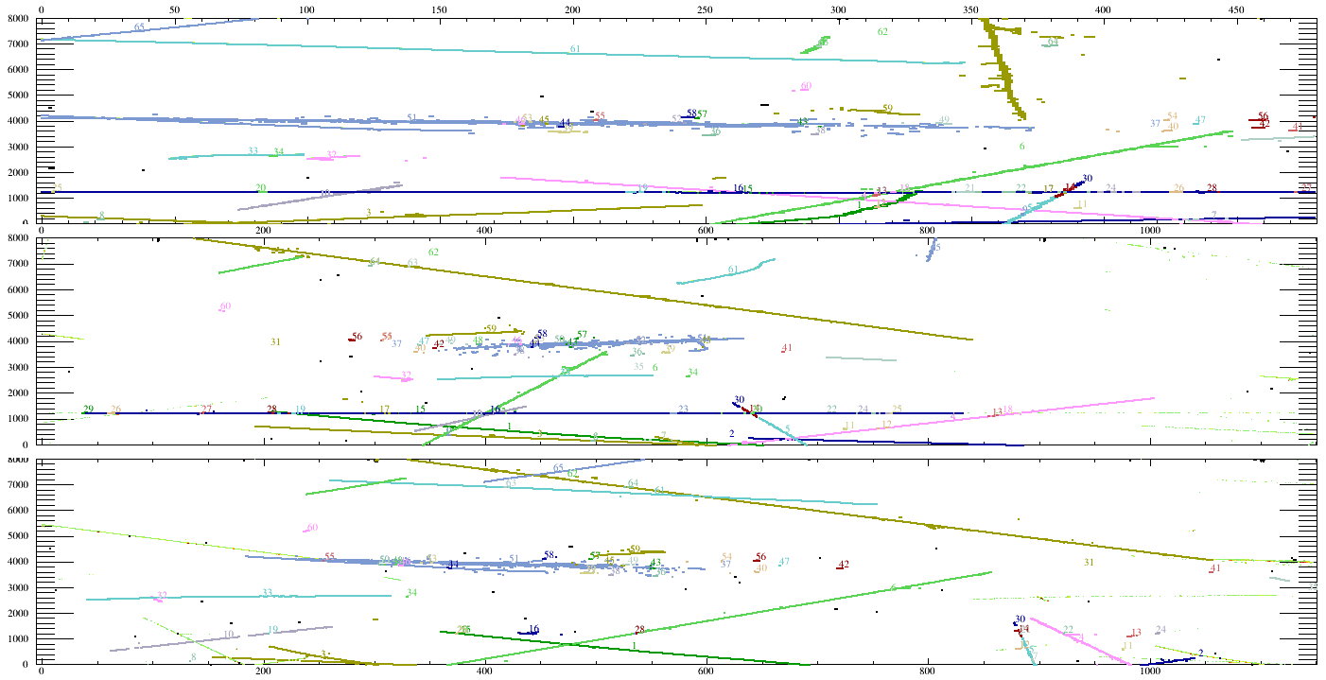
On ProtoDUNE
Beam e

Slide 9
TrajCluster Restructuring
Bruce modified TrajCluster to use slice as input optionally.
larreco/ClusterFinder/TrajCluster_module.cc

Slide 10
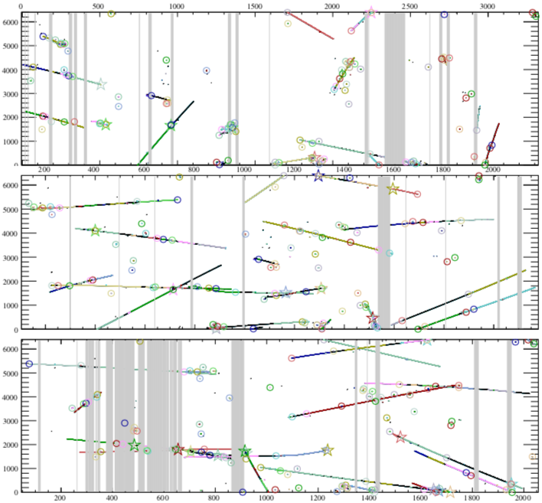
Reconstruction comparison
No slicing
455 sec
Test on Mac using debug build
Slicing first
44 sec (sps3d) + 20 sec (dbcluster3d) + 20 sec (trajcluster) – first results, no fcl optimization

Slide 11
Conclusions
We have developed a 3D slicing algorithm and restructured TrajCluster to use slices as input optionally.
Chris Backhouse is improving the handling of dead wires in SpacePointSolver.
Bruce is updating the TrajCluster users manual.
We thank Paul Russo for the useful discussion and guidance in coding.
Merging requests
larreco: feature/bb_restruct
lardataobj: feature/bb_recobslice
lareventdisplay: feature/bb_clsIDs
Bruce also added support for SpaceChargeService in lareventdisplay. Each experiment needs to add the following to their evdservices_(experiment).fcl: SpaceChargeService: @local::standard_spacecharge
I have done this for DUNE, MicroBooNE, LArIAT, ArgoNeuT, not for SBND and ICARUS.

