Slide 1
Shipping System Design and Improvements Status
Yuriy Orlov, Joshua Kaluzny (Fermilab)
LCLS-II Cryomodule Transportation Review
June 12, 2018

Slide 2
Outline
DESY Feed & End caps in 1.3 CM Transportation
LCLS-II Feed & End caps in F1.3-06 Transportation
Modification for DESY Feed & End caps for LCLS-II 1.3 CM Transportation
Modification for LCLS-II Feed & End caps
Improvements for LCLS-II 1.3 CM Transportation
Drawings status for reworking DESY & LCLS-II caps for LCLS-II 1.3 CM

Slide 3
LCLS-II 1.3 CM Transport System
Feed Cap
Transportation Frame
1.3 CM
End Cap
Beam

Slide 4
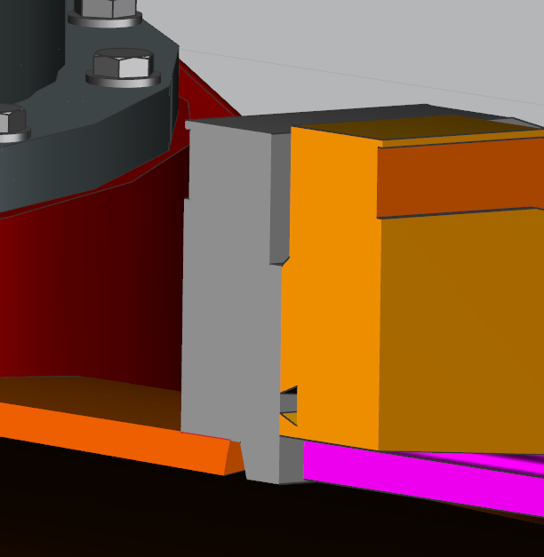
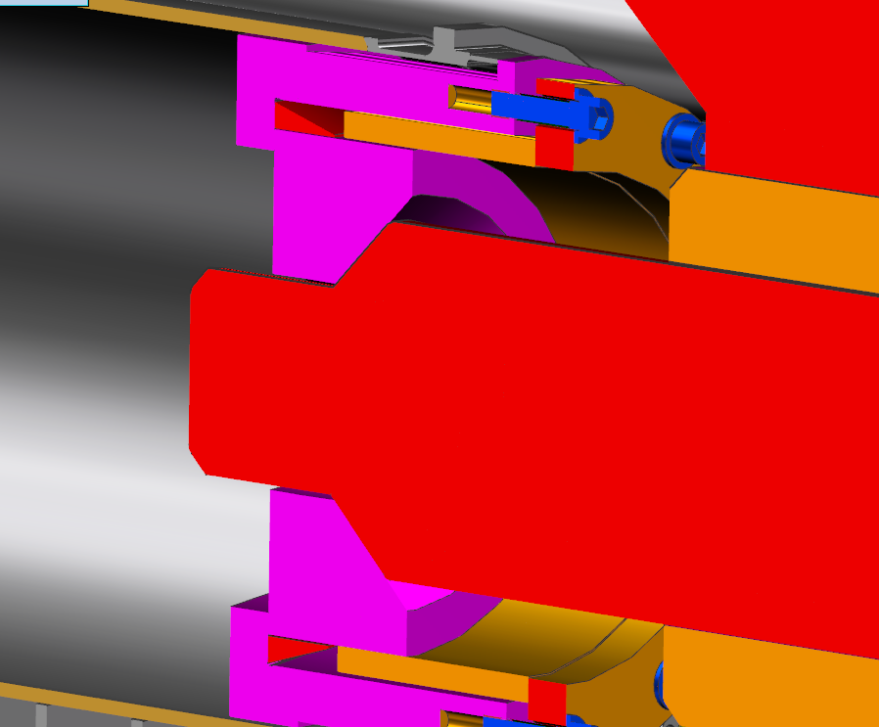
DESY End Cap, D0000000908933
76mm
(Regular Clamps)
O-ring
~20mm
~35mm
40mm
Clamp connection between End Cap
and Vacuum Vessel

Slide 5
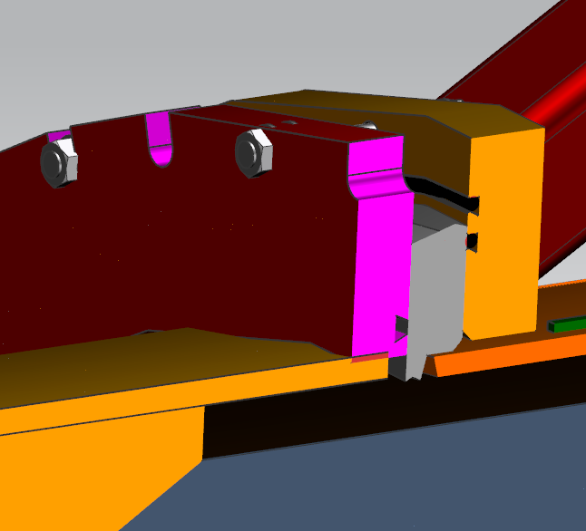
DESY Feed Cap, D00000008953
~20mm
O-ring
Slot-18mm wide
(flanges connected with
M16 screws)

Slide 6
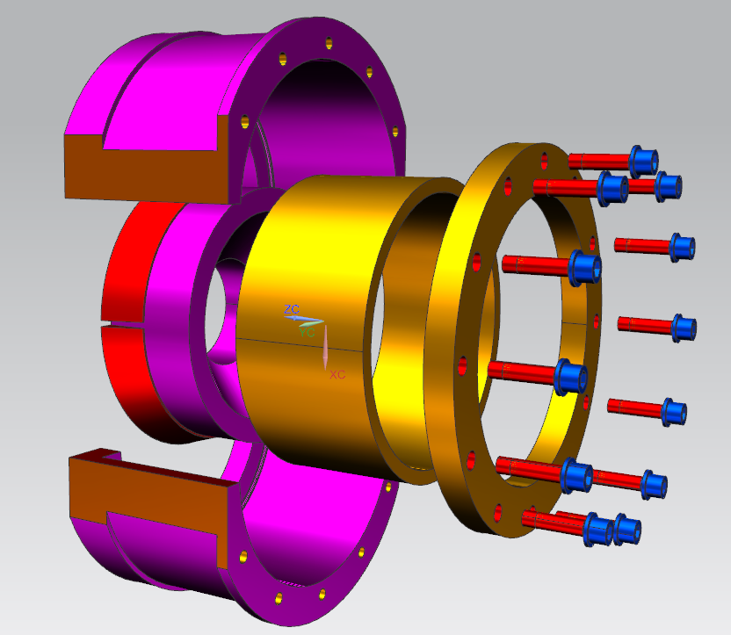
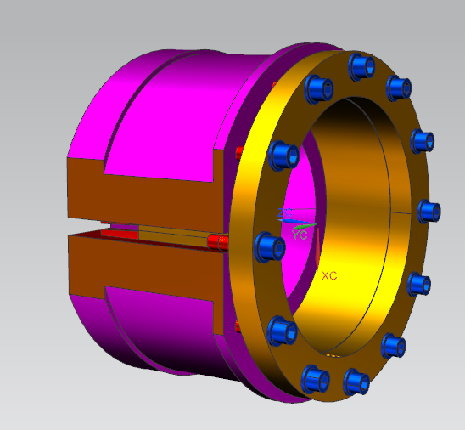
DESY 300mm Insert, D0000000908943
R149
40mm
15mm
150mm
2 Conical Rings
~ 22mm

Slide 7
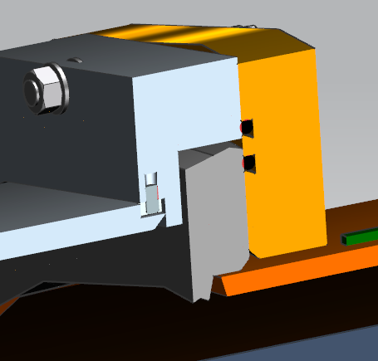
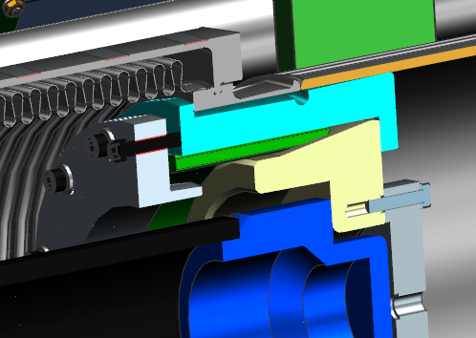
LCLS-II Feed Cap at F1.3-06 CM Transportation
1. Not enough compliance
for alignment End Cap.
2. Friction-between spindle
and 300mm Insert,
Rotation moment-73.8 ft-lbf
(pushing force~700lbf)
60mm

Slide 8
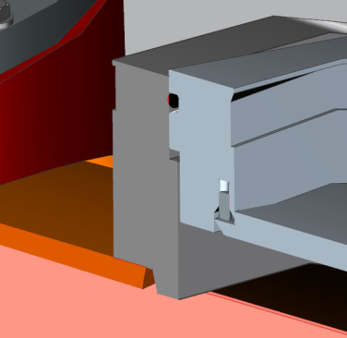
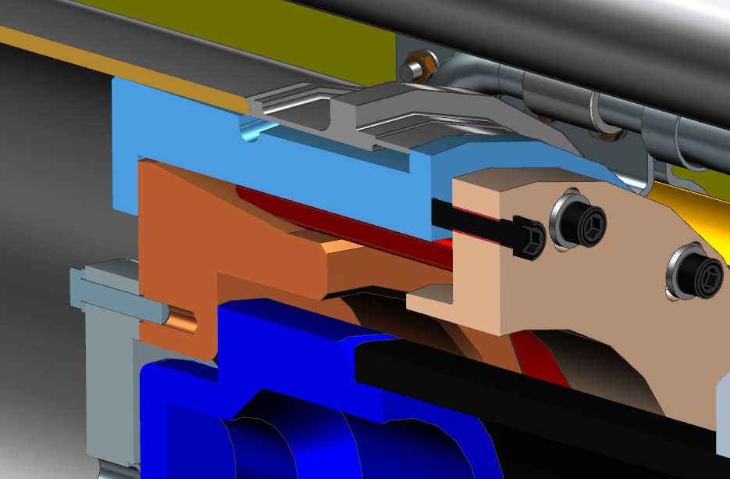
LCLS-II End Cap at F1.3-06 CM Transportation
1. Not enough compliance
for alignment End Cap.
2. Friction-between spindle
and 300mm Insert,
Rotation moment-73.8 ft-lbf
(pushing force ~700lbf)

Slide 9
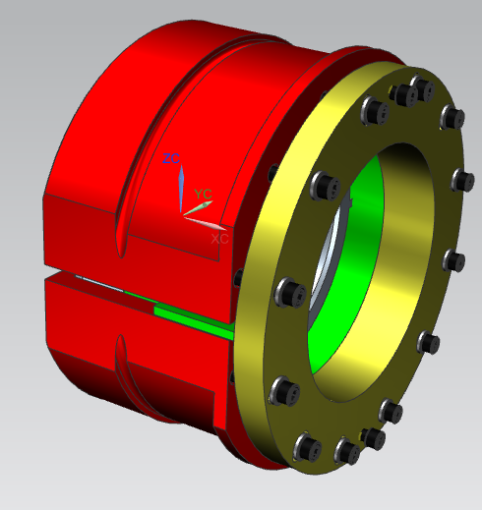
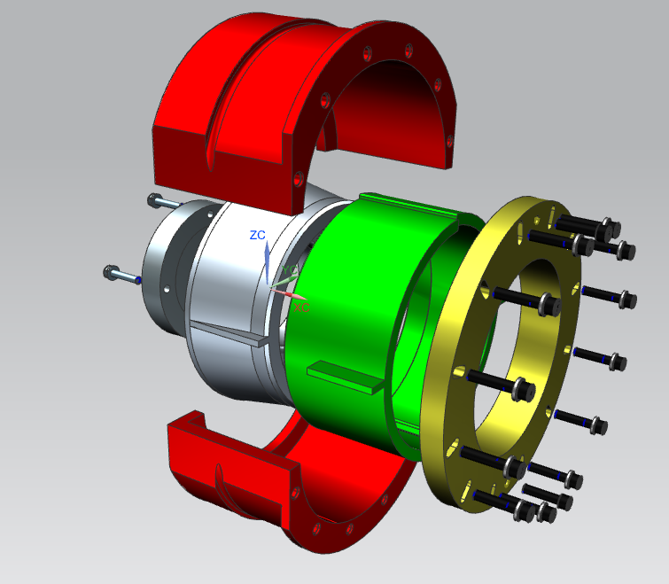
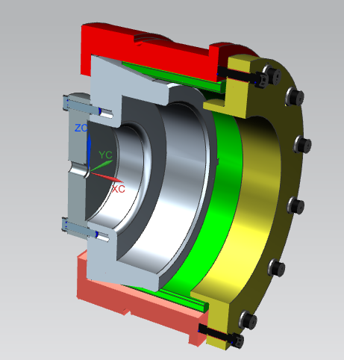
LCLS-II 300mm Insert, F10041555-A (F1.3-06CM)
~11mm
60mm
140mm
12mm

Slide 10
DESY Feed Cap Modification for LCLS II – modify ribs/base
US GV with support

Slide 11
DESY End Cap modification for LCLS-II – modify ribs/base
DS Manifold

Slide 12
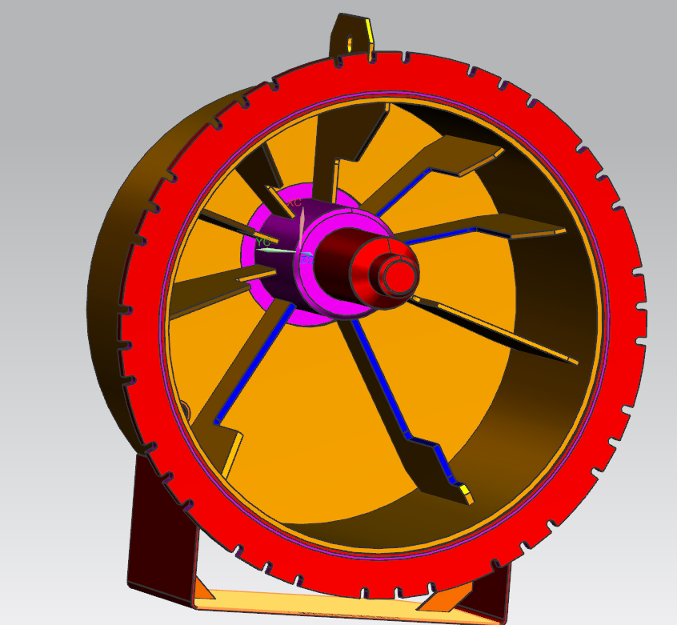
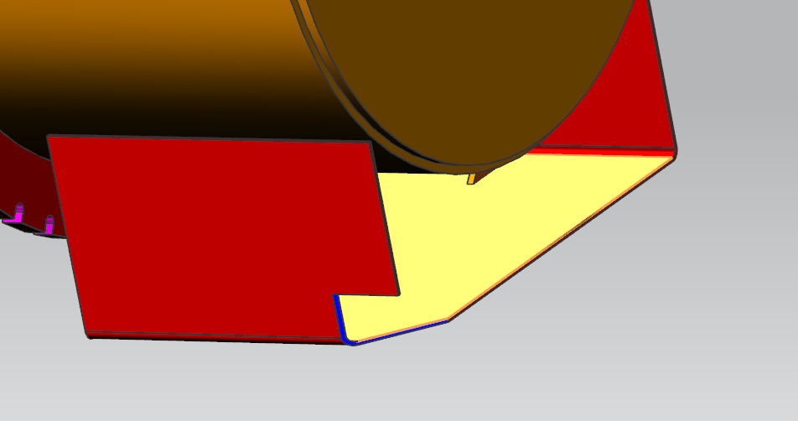
DESY Feed Cap modification for LCLS-II
1
2
5
Stiffeners # | Length, IN
1 | 6.846
2 | 8.346
3 | 12.283, 7.931, 3.5
4 | 12.283
5 | 4.0x4.0x3.0
3
4

Slide 13
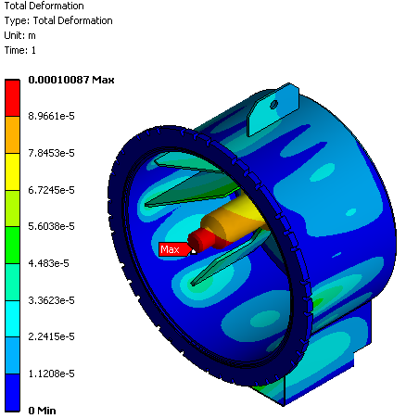
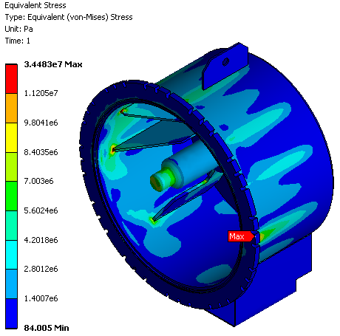
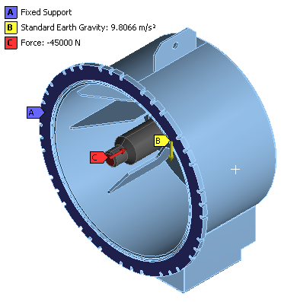
DESY Feed Cap modification for LCLS-II. FEA
m~3000kg; F=m*1.5g~45e3N
Allowable stress for welded 6061-T6 Aluminum 55 MPa (B31-3)
(by Sergey Cheban)

Slide 14
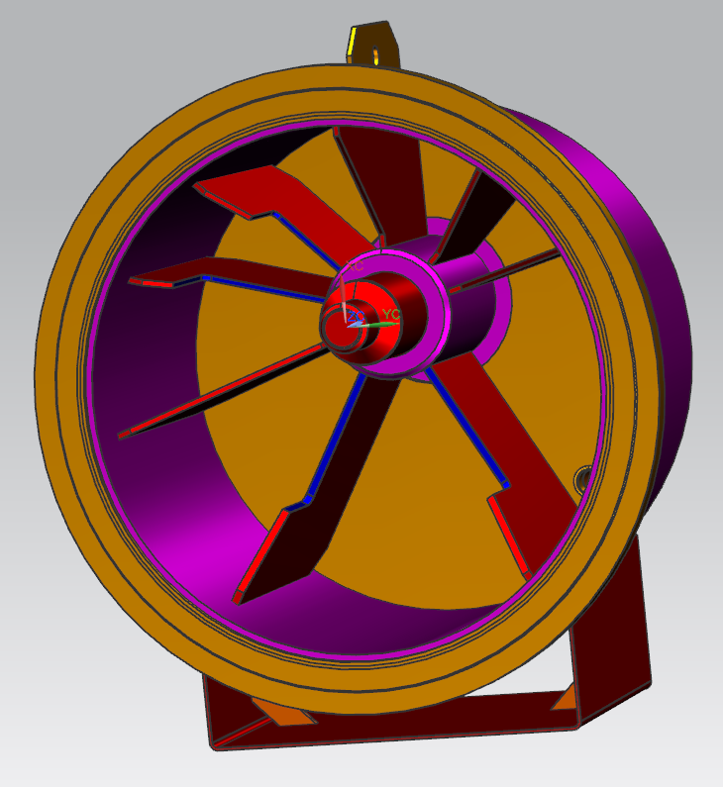
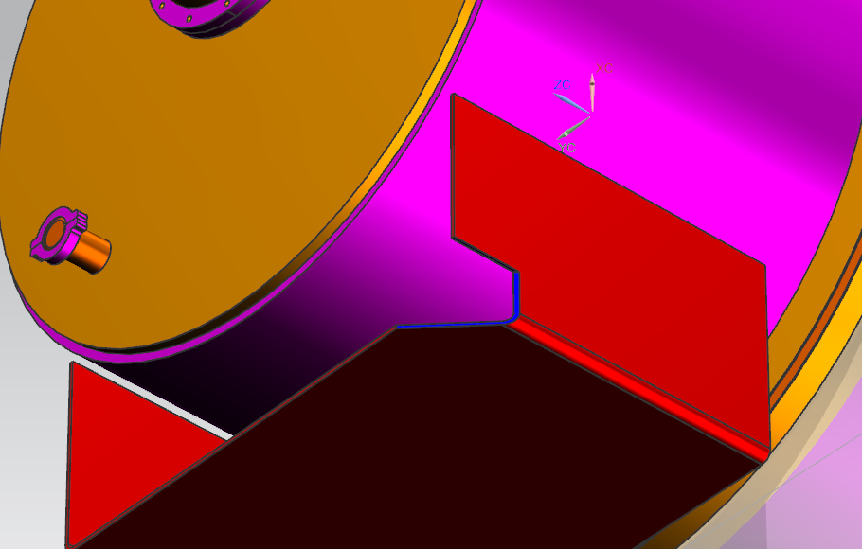
DESY End Cap modification for LCLS-II
1
2
5
RIB # | LENGTH, IN
1 | 6.483
2 | 9.484
3 | 10.483
4 | 10.483
5 | 4.0x4.0x3.0
3
4

Slide 15
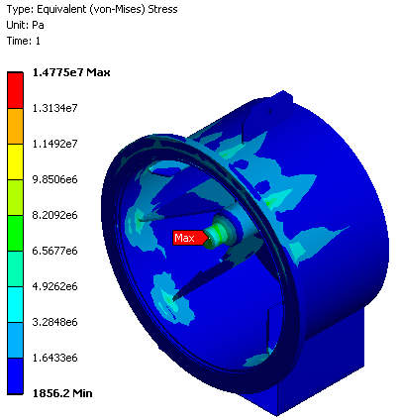
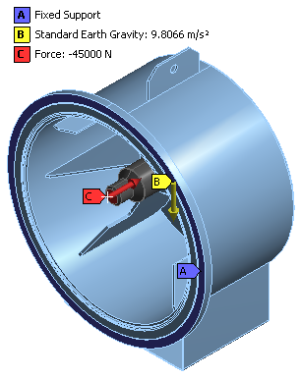
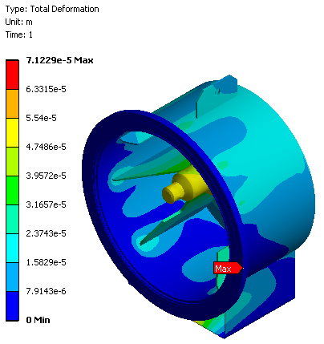
DESY End Cap modification for LCLS-II. FEA
m~3000kg; F=m*1.5g~45e3N
Allowable stress for welded 6061-T6 Aluminum 55 MPa (B31-3)
(by Sergey Cheban)

Slide 16
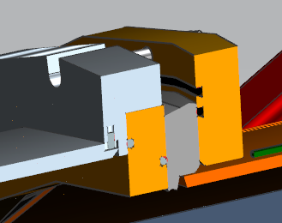
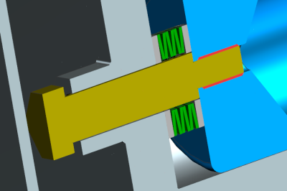
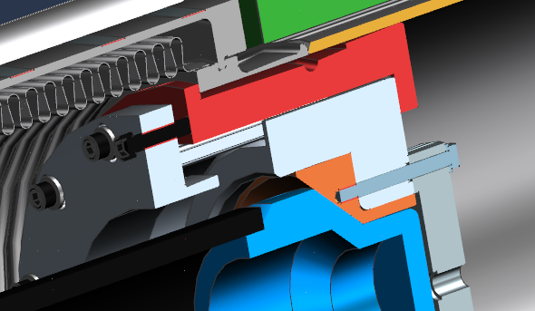
LCLS-II Feed Cap Modification (conical connection)
~20mm
35mm
40mm
Need small cutout
25mm
1. Double O-Ring Insert (35mm thick)
2. Need longer M16 screws
3. Cutout at lower stiffener
4. Optional thermal compensator with Belleville
washers

Slide 17
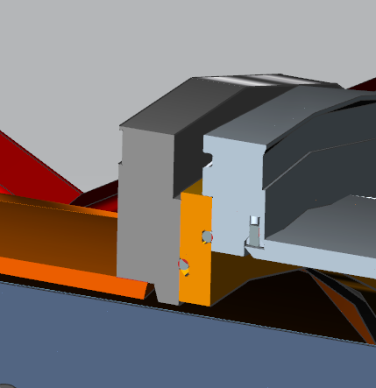
Modified LCLS-II End Cap
~20mm
1. Double O-Ring Insert
(20mm thick)
2. Need longer range clamp
3. Optional thermal
compensator with Belleville
washers

Slide 18
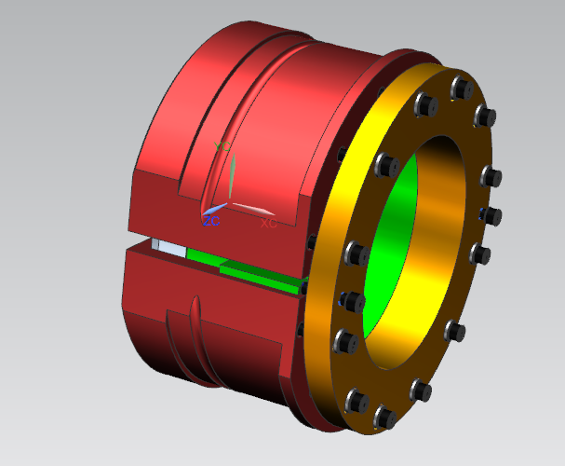
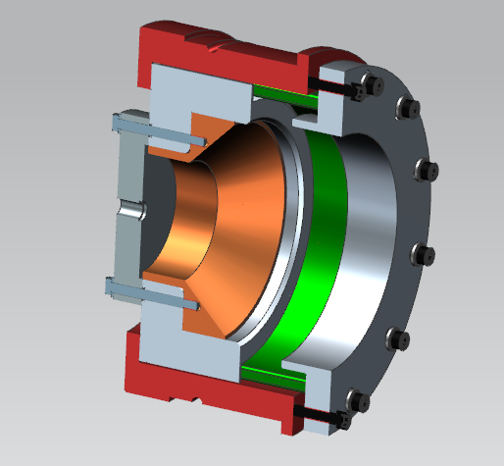
Modified LCLS-II 300mm Insert, F10041555-B (proposal)
40mm
15mm
R149mm
140mm
New Part
Extraction Plate

Slide 19
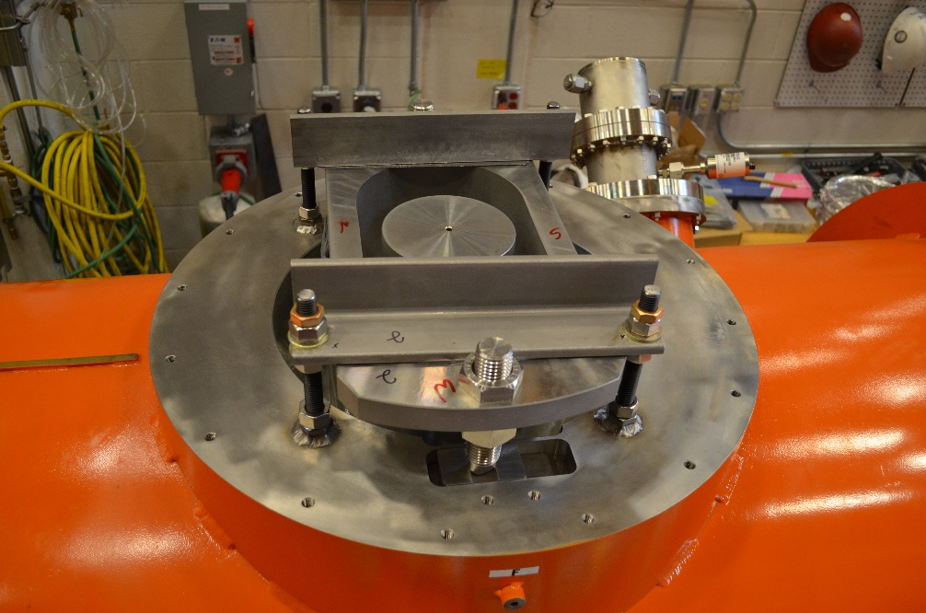
Cold Mass Supports Restrain (3.9 CM, J-Lab)
Center Fix Cold Mass Support
DS & US Sliding Cold Mass Support

Slide 20
Transportation without warm coupler (optional)
FPC cold with “Berry bolts”
Stress analysis completed – good
Stiffness of Berry bolts – good

Slide 21
Drawings status for LCLS-II CM transportation
Part name or Drawing number | Status
DESY End Cap modification for LCLS-II (sketch) | done
DESY Feed Cap modification for LCLS-II (sketch) | done
DESY 300mm Insert (modification) | in process
LCLS-II Feed Cap with Spindle, F10054678-B | done
LCLS-II End Cap with Spindle, F10054679-B | done
LCLS-II 300 mm Insert, F10041555-B | in process
LCLS-II cold mass (Fix and Sliding) supports restrain | done

Slide 22
BACK UP

Slide 23
Transport System. DESY Feed Cap Sectional View

Slide 24
Transport System. DESY End Cap Sectional View

