Slide 1
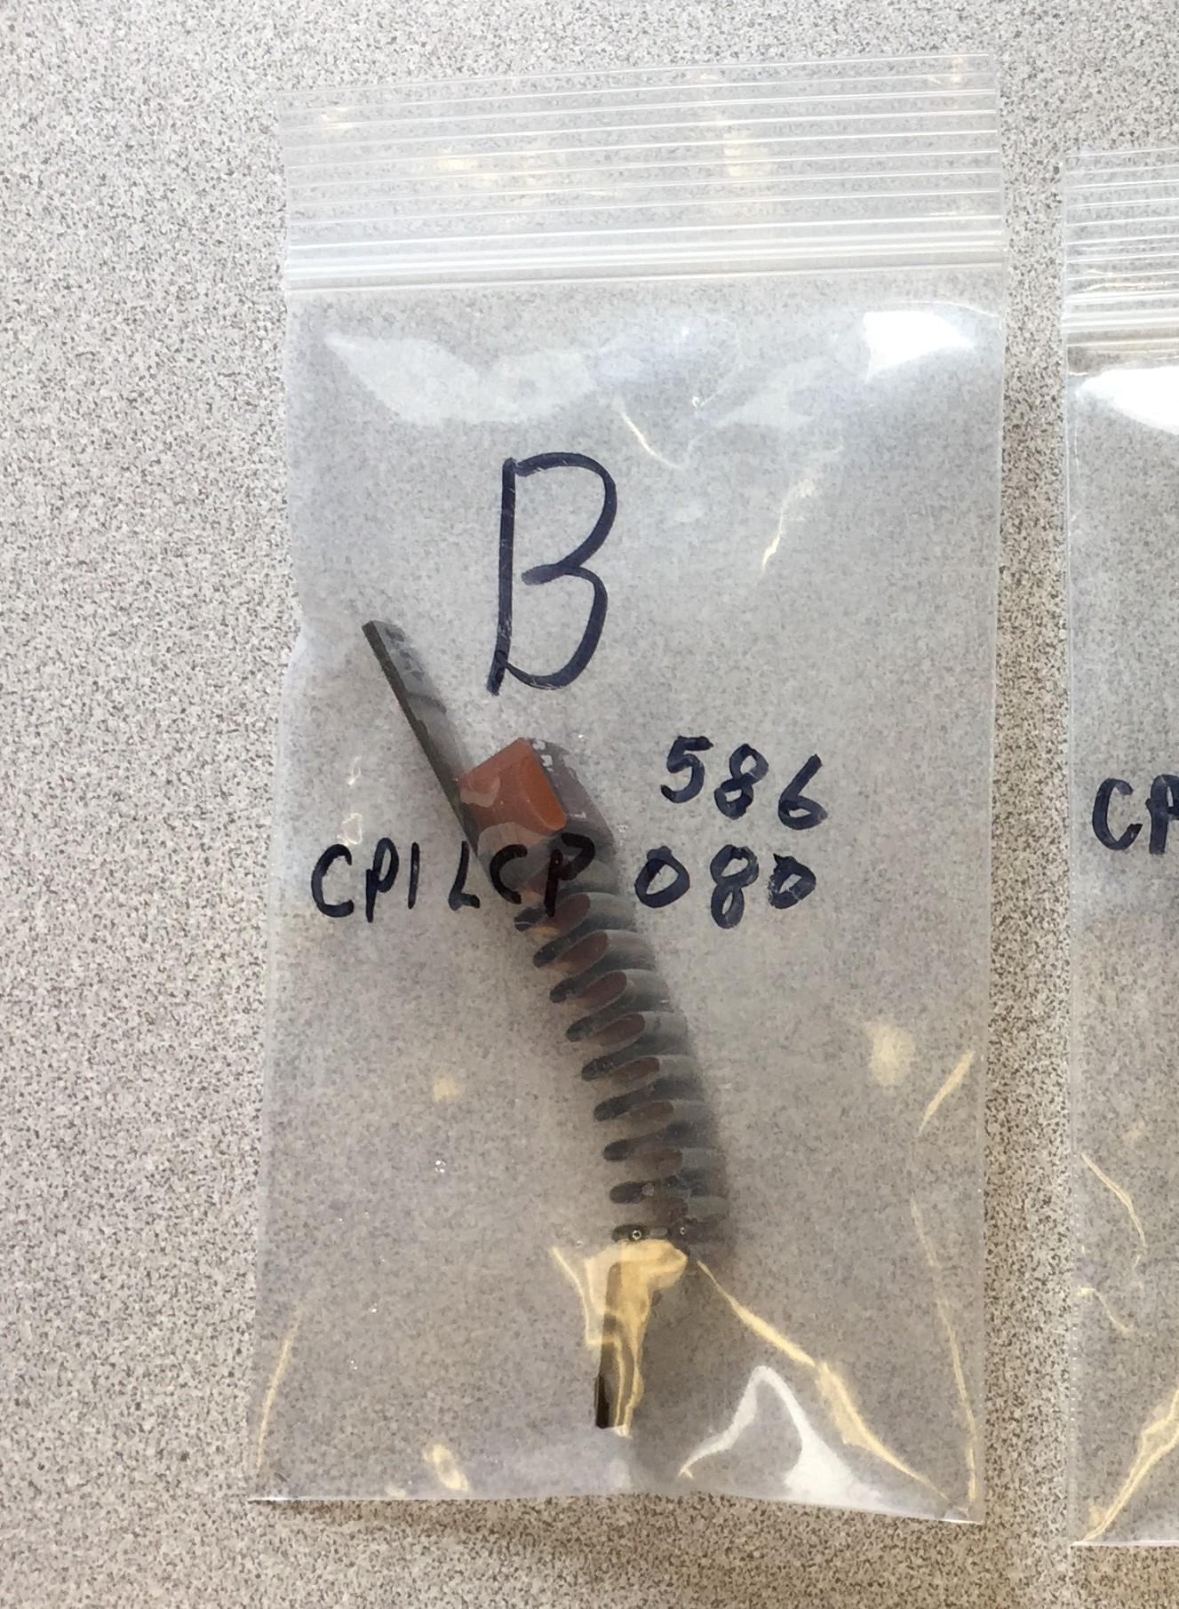
LCLS II –Cryomodule Bellows Failure SEM and EDS Results Chris Pearson 5/23/18
REF:
Bellows sample submitted by Marc Ross for SEM and EDS examination 6/1/2018.
Sample had been EDM sliced from coupler #4.
The sample contained a portion of the crack, including one terminus.
The EDM surface opposite the crack was “polished” to create a sharper cross section.
70 SEM images and 8 EDS line-scan spectra were generated and saved.
The complete set of data can be found at: U:\p\pearson\Drop Box\ChrisA20180601Bellows
The following is a short summary of the data along with some conclusions and comments.
(Note: There was an SEM failure, and I was not able to complete all of SEM/EDS work that I wanted to do.)

Slide 2
LCLS II –Cryomodule Bellows Failure SEM and EDS Results
Conclusions
The copper plating looks OK. Thickness runs from 5 to 8 microns. Thicker at the bellows ID (convex area as viewed from bellows ID), and (as is typical) thinner as you proceed to the bottom of the convolution (concave area as seem from the bellows ID). No signs of other problems such as delamination or porosity. (I did not get to looking for blisters on the surface). The plating was abrasively polished, leaving a few embedded abrasives. This mechanical polishing could cause local thin spots, especially at the ID.
The material thickness is 8 mils down to 5+ mills. (nowhere is it as thin as 100 microns). In the bellows neck areas it is exactly 8 mils. This represents the starting material thickness. The thinnest areas are at the top and bottom of the convolutions, where there is maximum stretching from the forming process. (I think this thinning may be typical, and I will try to check some data on other bellows that I have looked at in the past). The fracture location corresponds with the thinnest location. The thinning is likely axi-symmetrical and more or less similar for all convolutions.
The fracture appears brittle and does not exhibit signs of plastic deformation.
The fracture does not show conclusive beach mark surface areas as in low stress high cycle textbook fatigue. (Although there are some areas where the fracture topography seems indicate local crack initiation on the vac side that radiates inward toward the air side.)
There are numerous micron sized cracks adjacent to and extending out from the termination of the fracture.

Slide 3
LCLS II –Cryomodule Bellows Failure SEM and EDS Results
Conclusions
The following two conclusions are part opinion based on my SEM observations coupled with very limited information regarding the circumstances surrounding this failure.
This is an example of high stress low cycle fatigue. That is, the material at the fracture location experienced multiple bending stress cycles at or above the yield strength, work hardening locally and eventually failing in a brittle manner. The fact that there numerous micron sized cracks in the immediate vicinity of the fracture, supports this conclusion.
Initial cracking developed in a large number of locations along the line of maximum stress, more or less simultaneously. The failure is not the result of a single large shock. Such a failure would exhibit extensive signs of plastic deformation, almost certainly including significant macro buckling of the bellows itself.
Caveat 1: I do not have enough information to exclude the possibility of some material problem (such as stringer inclusions, carbide precipitation, etc. as a contributing cause of the fracture.) (Carbide precipitation is unlikely to be a factor based on the .02 reported carbon content)
Caveat 2: I did not complete all the SEM/EDS work that I wanted (due to a SEM failure).

Slide 4
LCLS II –Cryomodule Bellows Failure SEM and EDS Results
Recommendations
Some additional analysis would be helpful:
Examine bellows cross-section at 180° from fracture to determine if thinning is symmetrical.
Examine other bellows to see if the observed thinning is typical of all formed bellows.
Do metallographic analysis of cross-sections to determine microstructure (look for inclusion content in SST, porosity of Cu, etc).
Do chemical analysis to determine actual carbon content of this particular bellows material.
I would like to do EDS on the fracture surface.
More detailed high res SEM imaging of the fracture surface at likely crack initiation points and look for inclusions or other defects.
Closer SEM examination of Cu plating surface. (determine degree of particulate contamination.

Slide 5
LCLS II –Cryomodule Bellows Failure SEM and EDS Results
Thickness Measurement
Polished cross-section of bellows near crack.
Copper plating appears to be about 7 microns in this area. Note: The material contrast between copper and sst is very slight and is not easily discerned in this image.
Sst appears to be about 180 microns (7.1mils) thick in this area.

Slide 6
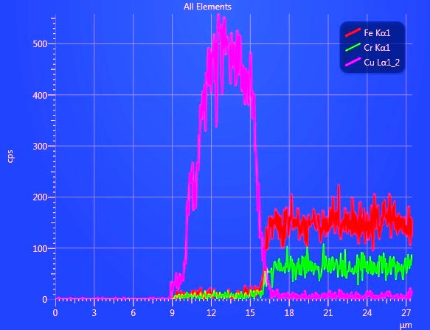
LCLS II –Cryomodule Bellows Failure SEM and EDS Results
Thickness Measurement
EDS line-scan indicates a plating thickness of about 6 microns. (Same area as previous slide.)
This location is close to the tangent point of the same convolution as the crack location.

Slide 7
LCLS II –Cryomodule Bellows Failure SEM and EDS Results
Thickness Measurement
Polished cross-section of bellows on different convolution adjacent to the cracked convolution.
Copper plating appears to be about 9 microns in this area. (Note: The material contrast between copper and sst is very slight and is not easily discerned in this image.)
Sst appears to be about 160 microns (6.3mils) thick in this area. (Sst gets thinner at top and bottom of convolutions).

Slide 8
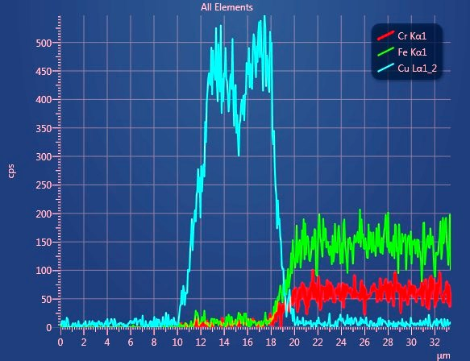
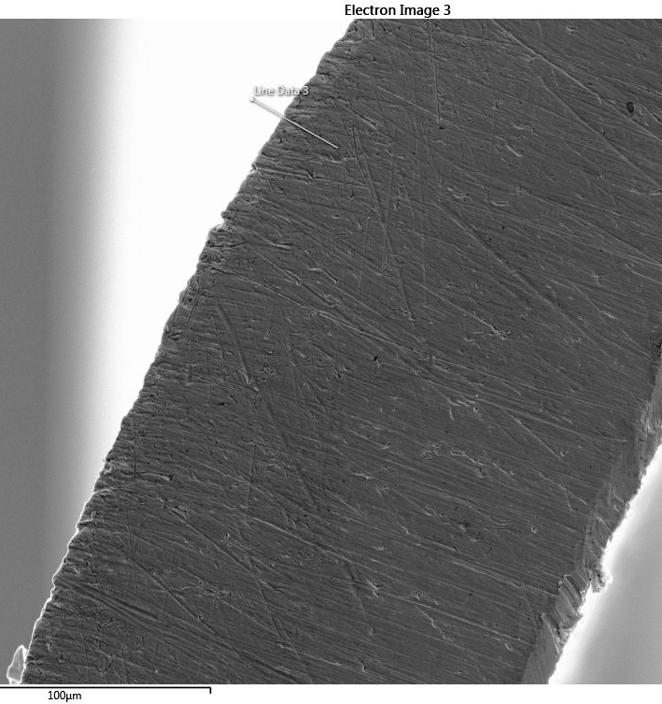
LCLS II –Cryomodule Bellows Failure SEM and EDS Results
Thickness Measurement
EDS line-scan indicates a plating thickness of about 8 microns. (Same area as previous slide.)

Slide 9
LCLS II –Cryomodule Bellows Failure SEM and EDS Results
Thickness Measurement
Polished cross-section of bellows on different convolution (concave area as viewed from ID) adjacent to the cracked convolution.
Copper plating appears to be about 6 microns in this area. (Note: material contrast between copper and sst is very slight and is not easily discerned in this image.)
Sst appears to be about 140 microns (5.5mils) thick in this area. (Sst gets thinner at top and bottom of convolutions).

Slide 10
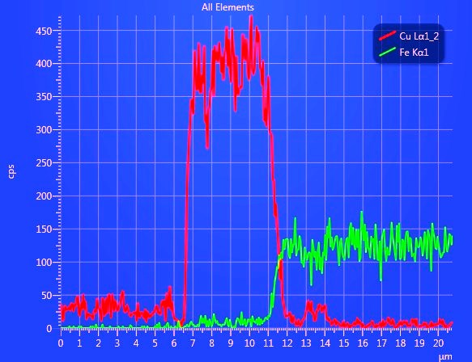
LCLS II –Cryomodule Bellows Failure SEM and EDS Results
Thickness Measurement
EDS line-scan indicates a plating thickness of about 5 microns. Same area as previous slide.

Slide 11
LCLS II –Cryomodule Bellows Failure SEM and EDS Results
Thickness Measurement
This image shows a cross-section of the convolution in which the fracture occurred. The crack terminus is a few degrees distant from this section.
The thickness varies here from about 6.5 mils down to about 5 mils in the areas indicated by the arrows.
Green arrow indicates the crack
relative position

Slide 12
LCLS II –Cryomodule Bellows Failure SEM and EDS Results
Thickness Measurement
Zoom-out of previous slide showing position of crack relative the curvature of the convolution.

Slide 13
LCLS II –Cryomodule Bellows Failure SEM and EDS Results
Thickness Measurement
Image showing section of bellow to ring braze.
Thickness of bellows in this area (neck area) is 8 mils as expected.

Slide 14
LCLS II –Cryomodule Bellows Failure SEM and EDS Results
Thickness Measurement
Image showing section of bellows braze at opposite end.
Likewise, thickness of bellows in this area (neck area) is 8 mils as expected.

Slide 15
LCLS II –Cryomodule Bellows Failure SEM and EDS Results
Fracture Analysis
Image of fracture terminus, as viewed from Bellows OD. (air side)
Fracture terminus.
Fracture surface.
Unplated SST.
(ref: looking through opening to SEM stage adhesive.)
(ref: this lateral fissure occurred during sample preparation –manually pulling open the fracture.)

Slide 16
LCLS II –Cryomodule Bellows Failure SEM and EDS Results
Fracture Analysis
There are many micron scale cracks extending azimuthally outward from the fracture terminus.

Slide 17
LCLS II –Cryomodule Bellows Failure SEM and EDS Results
Fracture Analysis
These cracks continue to be present some distance from the fracture terminus.

Slide 18
LCLS II –Cryomodule Bellows Failure SEM and EDS Results
Fracture Analysis
Many cracks are also apparent lining the areas immediately adjacent to the fracture.
SST
Cu Plating

Slide 19
LCLS II –Cryomodule Bellows Failure SEM and EDS Results
Fracture Analysis
Image of fracture terminus, as viewed from Bellows ID. (vacuum side)
Fracture terminus.
Cu plated SST.
One convolution

Slide 20
LCLS II –Cryomodule Bellows Failure SEM and EDS Results
Fracture Analysis
As with the air side, these cracks continue to be present some distance from the fracture terminus. (but are much less numerous –vacuum side)

Slide 21
LCLS II –Cryomodule Bellows Failure SEM and EDS Results
Fracture Analysis
Typical appearance of fracture surface.
Cu plating
SST 5 mills approx.

Slide 22
LCLS II –Cryomodule Bellows Failure SEM and EDS Results
Fracture Analysis
Note apparent contrasting topographies above and below blue line. This might appear as if the SST material has two layers of materials with different properties.
However, this appearance is very probably due to the cracks initiating on the vacuum side (concave side), progressing far into the material, before cracks initiate on the air side, and ultimately meet at the blue line.

Slide 23
LCLS II –Cryomodule Bellows Failure SEM and EDS Results
Fracture Analysis
Another image showing typical fracture topography.

Slide 24
LCLS II –Cryomodule Bellows Failure SEM and EDS Results
Fracture Analysis
Another image showing typical fracture topography.
Topography in some areas seem to indicate progression of cracks from vac side surface toward air side. (reminiscent of high cycle fatigue marks)

Slide 25
LCLS II –Cryomodule Bellows Failure SEM and EDS Results
Surfaces
The air side surface (unplated sst) has a somewhat unusual “hammered” appearance and was likely bead blasted. It is rather dirty.

Slide 26
LCLS II –Cryomodule Bellows Failure SEM and EDS Results
Surfaces
The vacuum side surface (Cu plated sst) has been abrasively polished. The polishing is heaviest on the ID and extends part way into the convolutions. It has some embedded abrasive particles.
Note: This mechanical abrasive polishing introduces some uncertainty into the actual plating thickness.

Slide 27
LCLS II –Cryomodule Bellows Failure SEM and EDS Results
Conclusions
The copper plating looks OK. Thickness runs from 5 to 8 microns. Thicker at the bellows ID (convex area as viewed from bellows ID), and (as is typical) thinner as you proceed to the bottom of the convolution (concave area as seem from the bellows ID). No signs of other problems such as delamination or porosity. (I did not get to looking for blisters on the surface). The plating was abrasively polished, leaving a few embedded abrasives. This mechanical polishing could cause local thin spots, especially at the ID.
The material thickness is 8 mils down to 5+ mills. (nowhere is it as thin as 100 microns). In the bellows neck areas it is exactly 8 mils. This represents the starting material thickness. The thinnest areas are at the top and bottom of the convolutions, where there is maximum stretching from the forming process. (I think this thinning may be typical, and I will try to check some data on other bellows that I have looked at in the past). The fracture location corresponds with the thinnest location. The thinning is likely axi-symmetrical and more or less similar for all convolutions.
The fracture appears brittle and does not exhibit signs of plastic deformation.
The fracture does not show conclusive beach mark surface areas as in low stress high cycle textbook fatigue. (Although there are some areas where the fracture topography seems indicate local crack initiation on the vac side that radiates inward toward the air side.)
There are numerous micron sized cracks adjacent to and extending out from the termination of the fracture.

Slide 28
LCLS II –Cryomodule Bellows Failure SEM and EDS Results
Conclusions
The following three conclusion are part opinion based on my SEM observations coupled with very limited information regarding the circumstances surrounding this failure.
This is an example of high stress low cycle fatigue. That is, the material at the fracture location experienced multiple bending stress cycles at or above the yield strength, work hardening locally and eventually failing in a brittle manner. The fact that there numerous micron sized cracks in the immediate vicinity of the fracture, supports this conclusion.
Initial cracking developed in a large number of locations along the line of maximum stress, more or less simultaneously. The failure is not the result of a single large shock. Such a failure would exhibit extensive signs of plastic deformation, almost certainly including significant macro buckling of the bellows itself.
Caveat 1: I cannot exclude the possibility of some material problem (such as stringer inclusions, carbide precipitation, etc. as a contributing cause of the fracture.) (Carbide precipitation is unlikely to be a factor based on the .02 reported carbon content)
Caveat 2: I did not complete all the SEM/EDS work that I wanted (due to a SEM failure).

Slide 29
LCLS II –Cryomodule Bellows Failure SEM and EDS Results
Recommendations
Some additional analysis would be helpful:
Examine bellows cross-section at 180° from fracture to determine if thinning is symmetrical.
Examine other bellows to see if the observed thinning is typical of all formed bellows.
Do metallographic analysis of cross-sections to determine microstructure (look for inclusion content).
Do chemical anaylsis to determine actual carbon content of this particular bellows material.
I would like to do EDS on the fracture surface.
More detailed high res SEM imaging of the fracture surface at likely crack initiation points and look for inclusions or other defects.

