Slide 1
Cryo-Module Analysis
Vishy Ravindranath
Dt: 05/24/2018

Slide 2
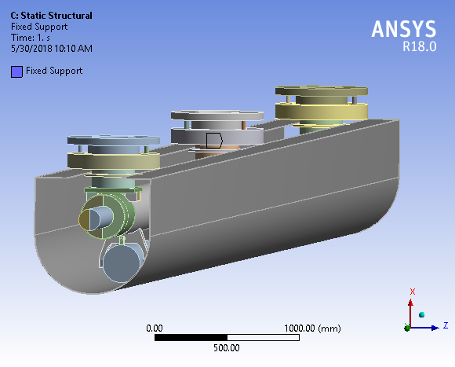
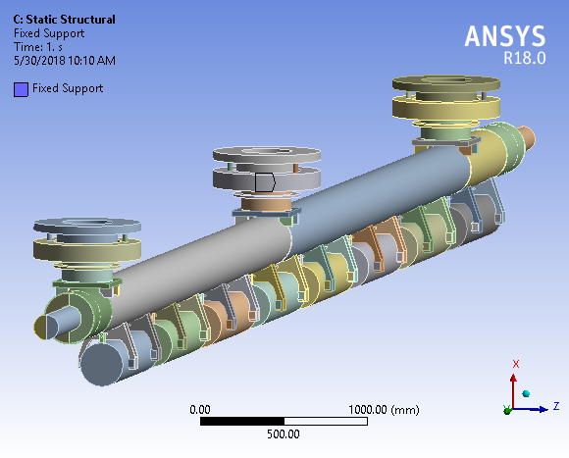
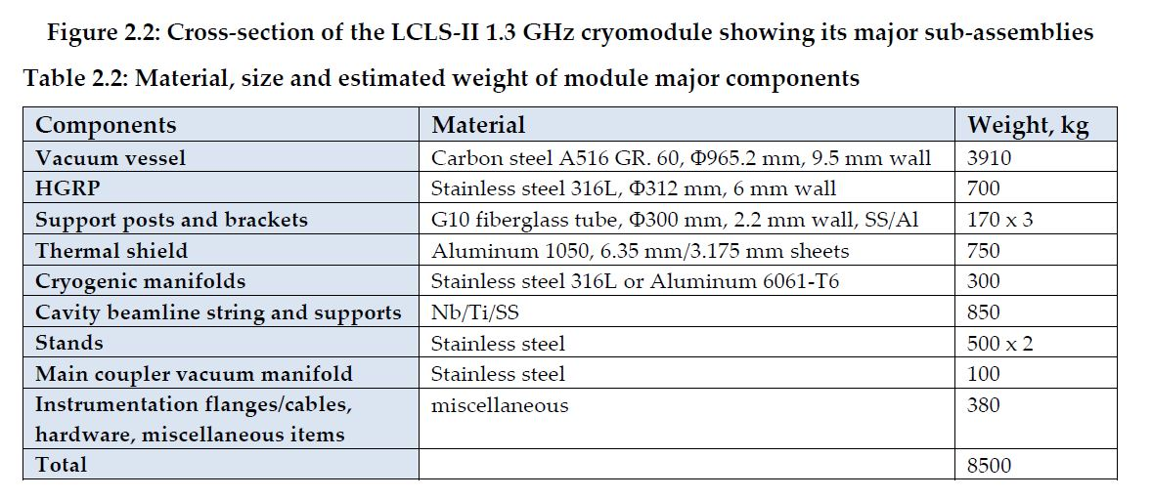
BOUNDARY CONDITIONS-WEIGHTS
Weights Assumed for FEA
G-10 | 180 kg x 3 [1]
HGRP | 700 kg
CAVITY | 850 kg
SHIELD | 1000 kg
[1] Wt includes G-10+SS Post + Bracket

Slide 3
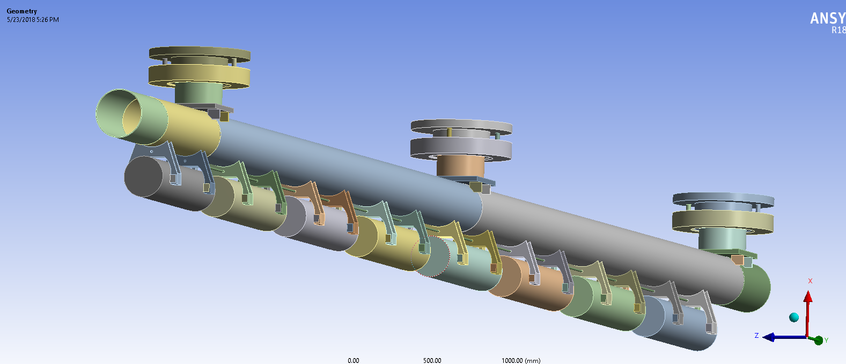
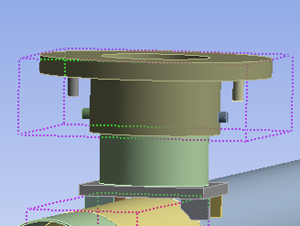
BOUNDARY CONDITIONS-GENERIC (COMMON TO ALL CASES CONSIDERED)
G-10 Post
HGRP
CAVITY
References for G-10 Modulus Assumption:
LCLSII-4.5-EN-0430-R0, “Stress Analysis of LCLS-II Cryomodule for Seismic Load
http://materialdatabase.magnet.fsu.edu/G10.htm
 | Modulus
Young’s Modulus for G-10 | 20 GPa

Slide 4
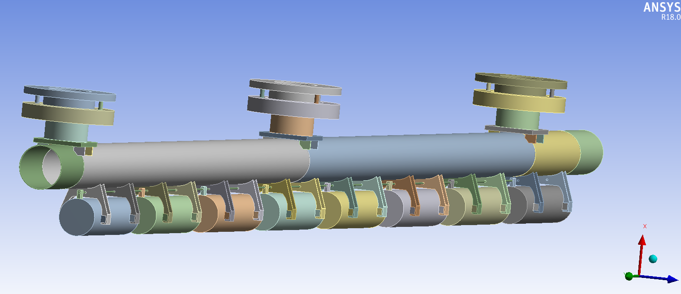
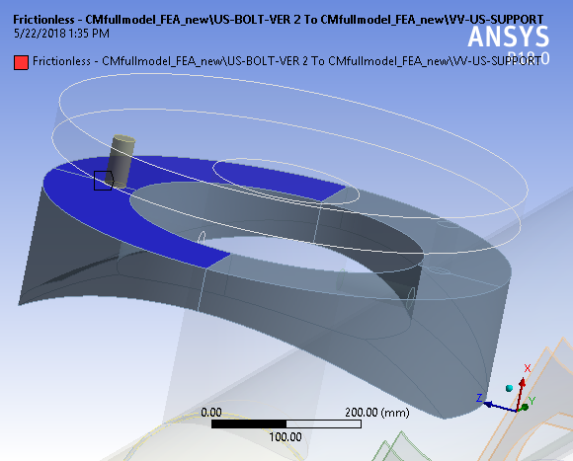
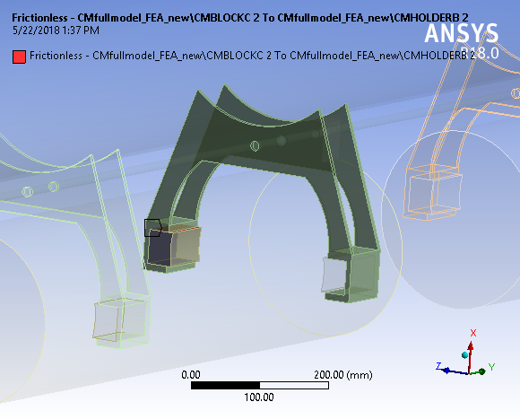
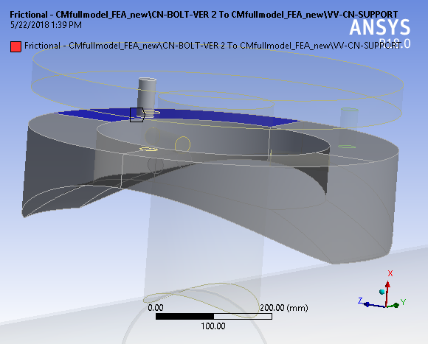
BOUNDARY CONDITIONS-GENERIC (COMMON TO ALL CASES CONSIDERED)
Boundary Conditions
 | Frictionless Contact Bolts and End Vacuum Vessel Flanges Cavity Holder and the Welded Blocks
 | Frictional Contact Bolts and the Center Vacuum Vessel Flange.
Fixed Vac Flange
Fixed Vacuum Vessel Flanges

Slide 5
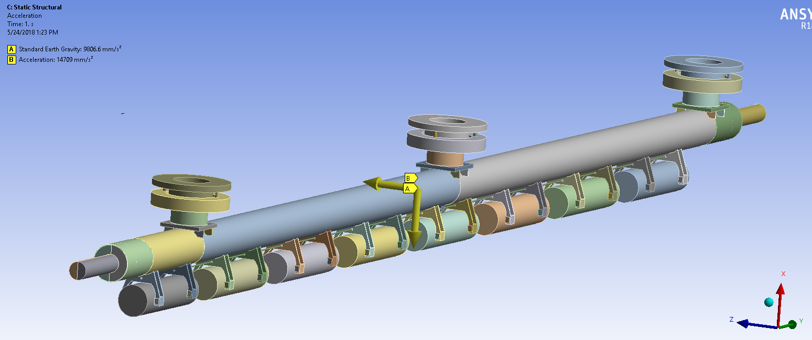
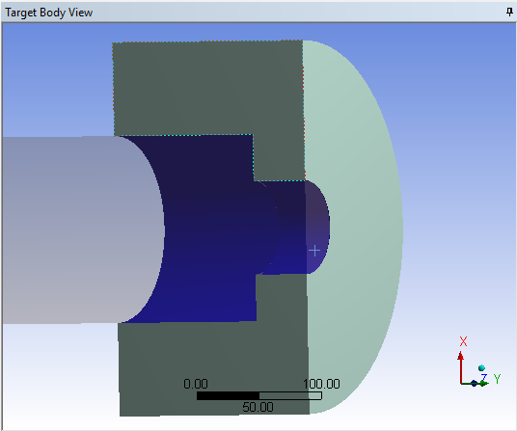
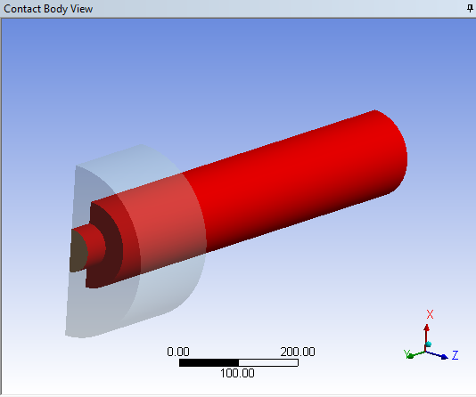
BOUNDARY CONDITIONS: CASES
FIXED END
FIXED END
 | A. HGRP END CLAMP | B. HGRP TOP POSTS
CASE1 | FRICTIONLESS | FREE
CASE2 | FRICTIONLESS | CLAMPED
CASE3 | BONDED | FREE
CASE4 | BONDED | CLAMPED

Slide 6
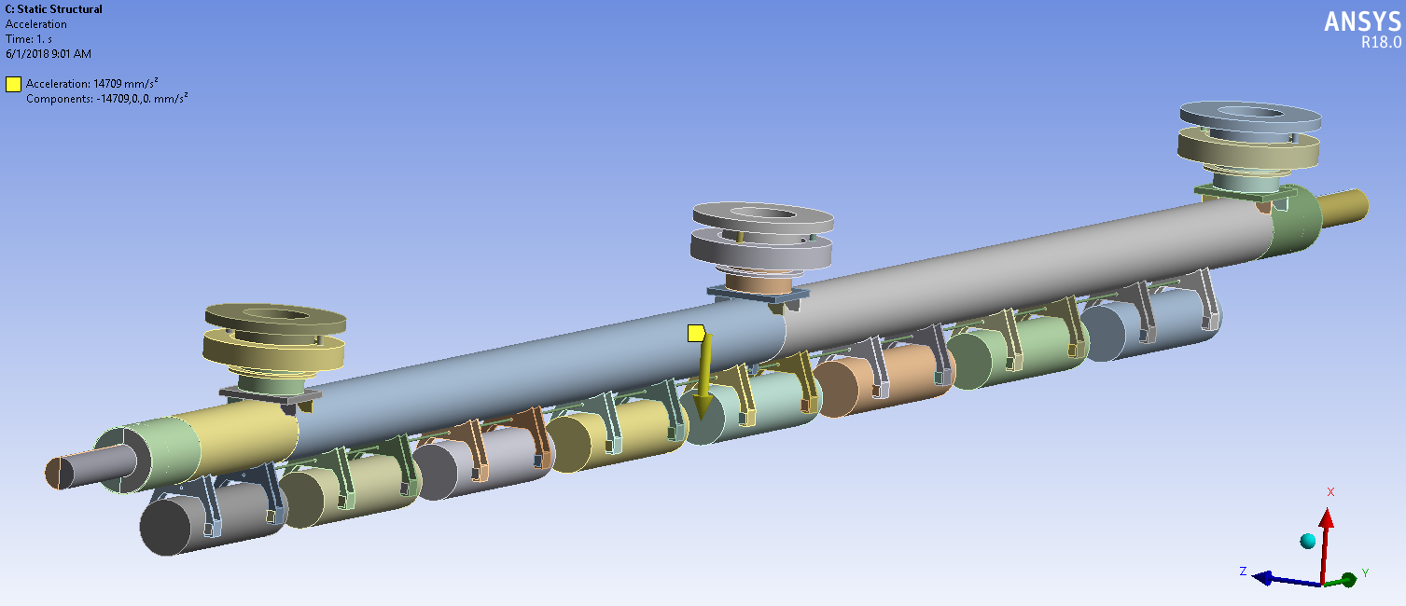
PART I: STATIC ANALYSIS (Vertical Acc = 1.5xG)
1.5 x G
FIXED END
FIXED END
Self Weight
Loads assumed for the analysis:
Vertical Load of 1.5 x G
Self-Weight

Slide 7
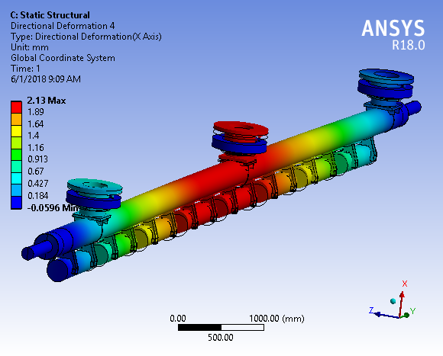
Case 1: (a) HGRP END CLAMP. = FRICTIONLESS (b) HGRP POSTS = FREE
Max Vertical Displacement = 2 mm
NOTE: The location of the maximum displacement coincides with the failed bellow location (cavity 4 & 5)

Slide 8
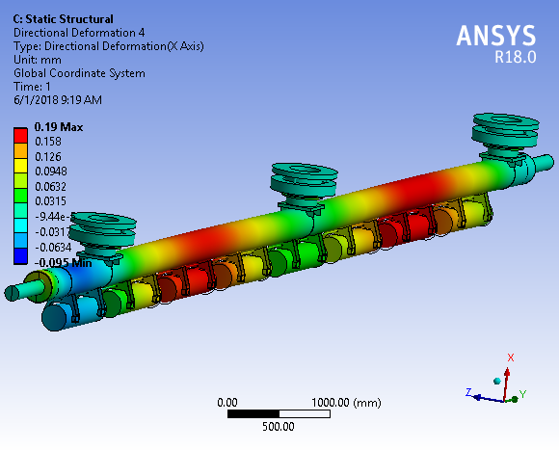
Case 2: (a) HGRP END CLAMP = FRICTIONLESS (b) HGRP POSTS = CLAMPED
Max Vertical Displacement = 0.2 mm

Slide 9
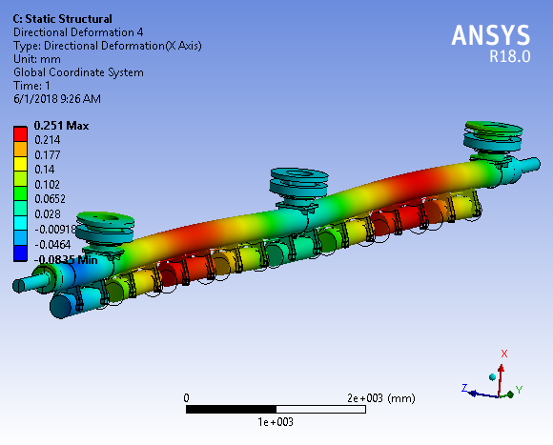
Case 2(a): (a) HGRP END CLAMP = FRICTIONLESS (b) ONLY CENTER HGRP POST = CLAMPED
Max Vertical Displacement = 0.2 mm

Slide 10
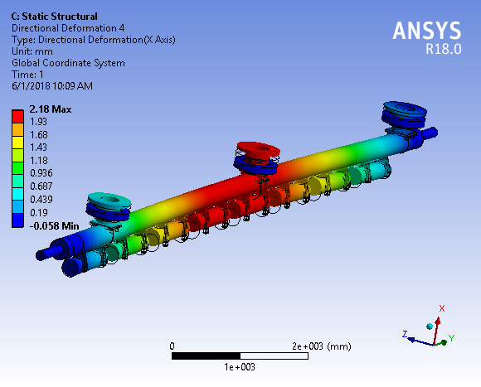
Case 3: (a) HGRP END CLAMP = BONDED
(b) HGRP POSTS = FREE
Max Vertical Displacement = 2 mm

Slide 11
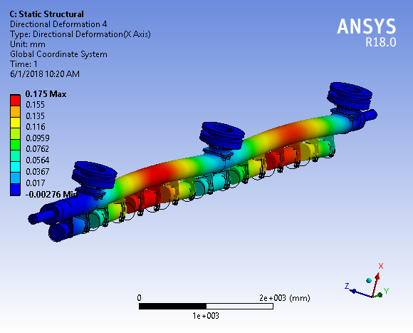
Case 4: (a) HGRP END CLAMP = BONDED (b) HGRP POSTS = CLAMPED
Max Transverse Displacement = 0.2 mm

Slide 12
SUMMARY
PART-I: STATIC ANALYSIS (1.5 X G VERTICAL ACC.)
 | A. HGRP END CLAMP | B. HGRP TOP POSTS | DISPLACEMENT
CASE1 | FRICTIONLESS | FREE | 2
CASE2(a) | FRICTIONLESS | All POSTS CLAMPED | 0.2
CASE2(b) | FRICTIONLESS | CENTER POST CLAMPED | 0.2
CASE3 | BONDED | FREE | 2
CASE4 | BONDED | CLAMPED | 0.2
Clamping the top plate eliminates the vertical CM displacement (lateral motion for the coupler bellows)

Slide 13
PART II: STATIC ANALYSIS (Vertical Acc = 2xG)
2 x G
FIXED END
FIXED END
Self Weight
Loads assumed for the analysis:
Vertical Load of 2 x G
Self-Weight

Slide 14
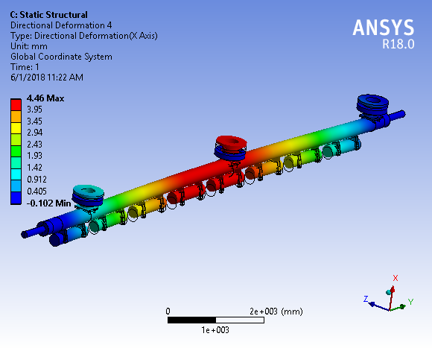
Case 1: (a) HGRP END CLAMP. = FRICTIONLESS (b) HGRP POSTS = FREE
Max Vertical Displacement = 4 mm
NOTE: The location of the maximum displacement coincides with the failed bellow location (cavity 4 & 5)

Slide 15
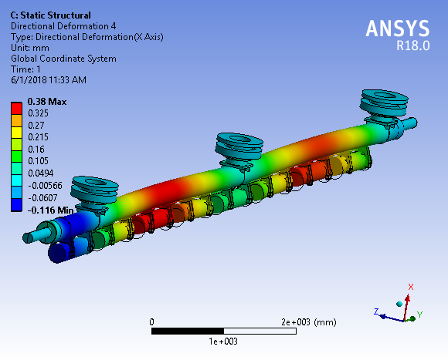
Case 2(a): (a) HGRP END CLAMP = FRICTIONLESS (b) HGRP POSTs = CLAMPED
Max Vertical Displacement = 0.4 mm

Slide 16
SUMMARY
PART-I: STATIC ANALYSIS (1.5 X G VERTICAL ACC.)
 | A. HGRP END CLAMP | B. HGRP TOP POSTS | DISPLACEMENT
CASE1 | FRICTIONLESS | FREE | 4
CASE2(b) | FRICTIONLESS | CENTER POST CLAMPED | 0.2
Clamping the top center HGRP plate eliminates the vertical CM displacement (lateral motion for the coupler bellows)

Slide 17
PART III: STATIC ANALYSIS (Transverse Acc = 1.5xG)
1.5 x G
FIXED END
FIXED END
Self Weight
Loads assumed for the analysis:
Transverse Load of 1.5 x G
Self-Weight

Slide 18
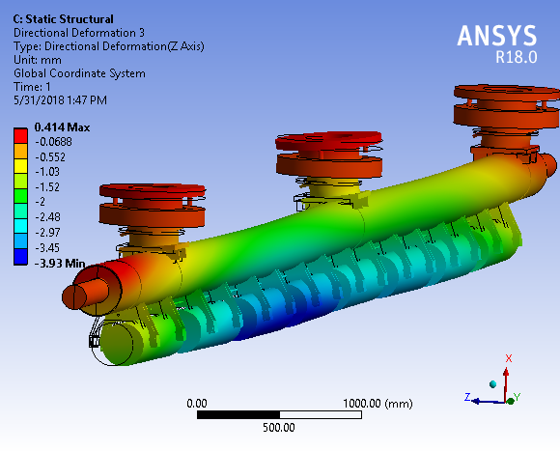
Case 1: (a) HGRP END CLAMP. = FRICTIONLESS (b) HGRP POSTS = FREE
(a) Max Transverse Displacement with thermal shield free to rotate = 4 mm
(b) Max Transverse Displacement with thermal shield fixed = 3.3

Slide 19
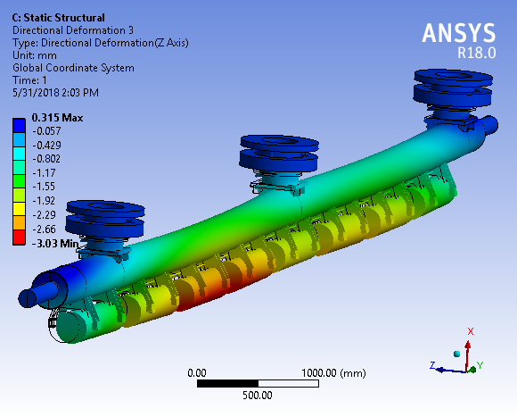
Case 2: (a) HGRP END CLAMP = FRICTIONLESS (b) HGRP POSTS = CLAMPED
Max Transverse Displacement = 3 mm

Slide 20
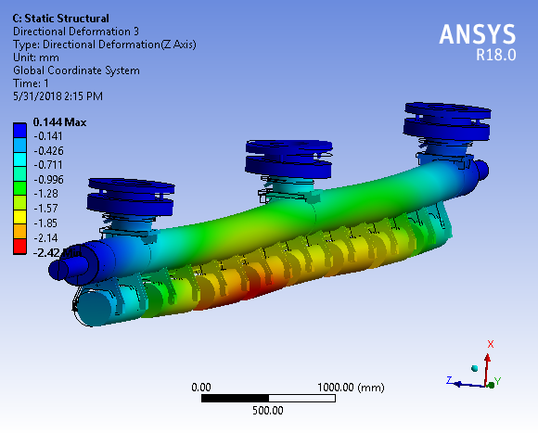
Case 3: (a) HGRP END CLAMP = BONDED
(b) HGRP POSTS = FREE
Max Transverse Displacement with thermal shield free to rotate = 2.4 mm
Max Transverse Displacement with thermal shield fixed = 2.1

Slide 21
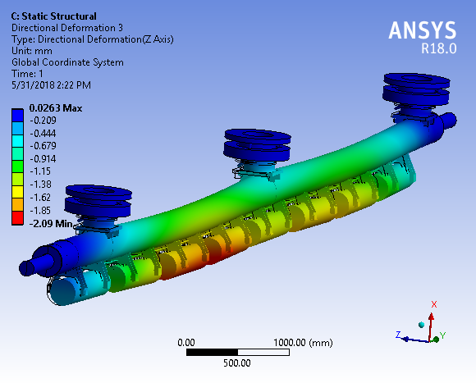
Case 4: (a) HGRP END CLAMP = BONDED (b) HGRP POSTS = CLAMPED
Max Transverse Displacement = 2 mm

Slide 22
SUMMARY
PART-II: STATIC ANALYSIS (1.5 X G TRANSVERSE ACC.)
 | A. HGRP END CLAMP | B. HGRP TOP POSTS | DISPLACEMENT
CASE1 | FRICTIONLESS | FREE | 4 mm (with Shield free to rock) 3.3 mm (with Shield fixed)
CASE2 | FRICTIONLESS | CLAMPED | 3
CASE3 | BONDED | FREE | 2.4
CASE4 | BONDED | CLAMPED | 2.1
Clamping the top plate helps reduces the transverse CM displacement (axial bellow motion) = 25%
Fixing the rotation of the thermal shield reduces the CM displacement (axial bellow motion) = 18%

Slide 23
PART-III: MODAL ANALYSIS

Slide 24
Case 1: (a) HGRP END CLAMP. = FRICTIONLESS (b) HGRP POSTS = FREE
MODE 1 = 8 Hz
MODE 2 = 15 Hz
MODE 3 (FOR COLD MASS) = 19 Hz
MODE 4 (FOR COLD MASS) = 24 Hz

Slide 25
Case 2: (a) HGRP END CLAMP = FRICTIONLESS (b) HGRP POSTS = CLAMPED
MODE 1 = 8 Hz
MODE 2 = 15 Hz
MODE 3 (FOR COLD MASS) = 19 Hz
MODE 4 (FOR COLD MASS) = 24 Hz

Slide 26
Case 3: (a) HGRP END CLAMP = BONDED
(b) HGRP POSTS = FREE
MODE 1 = 8 Hz
MODE 2 = 17 Hz
MODE 3 (FOR COLD MASS) = 20 Hz
MODE 4 (FOR COLD MASS) = 24 Hz

Slide 27
Case 4: (a) HGRP END CLAMP = BONDED (b) HGRP POSTS = CLAMPED
MODE 1 = 8 Hz
MODE 2 = 17 Hz
MODE 3 (FOR COLD MASS) = 20 Hz
MODE 4 (FOR COLD MASS) = 24 Hz

Slide 28
MODAL ANALYSIS SUMMARY
CASES |  | MODE-1 | MODE-2 | MODE-3 | MODE-4
CASE-1 | HGRP END: FRICTIONLESS HGRP POSTS: FREE | 8 Hz | 15 Hz | 19 Hz | 24 Hz
CASE-2 | HGRP END: FRICTIONLESS HGRP POSTS: CLAMPED | 8 Hz | 15 Hz | 19 Hz | 24 Hz
CASE-3 | HGRP END: BONDED HGRP POSTS: FREE | 8 Hz | 17 Hz | 20 Hz | 24 Hz
CASE-4 | HGRP END: BONDED HGRP POSTS: CLAMPED | 8 Hz | 17 Hz | 20 Hz | 24 Hz

Slide 29
BACK-UP

Slide 30
PART III: STATIC ANALYSIS (Transverse Acc = 1.5xG)
1.5 x G
FIXED END
FIXED END
Self Weight
Loads assumed for the analysis:
Transverse Load of 1.5 x G
Self-Weight

Slide 31
Case 2: (a) HGRP END CLAMP = FRICTIONLESS (b) ALL THREE HGRP POSTS = CLAMPED
Max Transverse Displacement = 3 mm

Slide 32
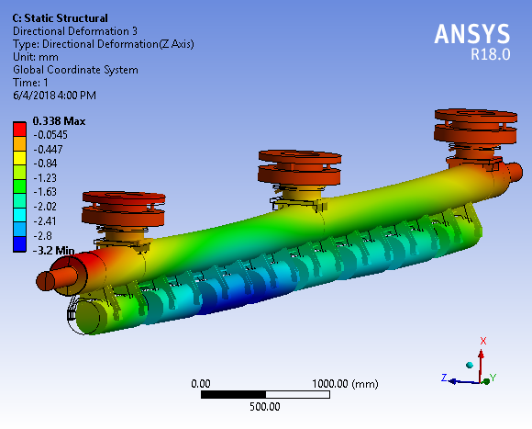
Case 2: (a) HGRP END CLAMP = FRICTIONLESS (b) ALL THREE HGRP POSTS = CLAMPED
Max Transverse Displacement = 3.2 mm

